Slide 1
The spoken word is excellent for
conveying emotions and stories,
but is a poor medium for
helping people retain large amounts of facts.
Visual projections on a screen are wonderful for conveying images that stick in a viewer’s mind and make abstract concepts more concrete and understandable,
but slides are a poor and inefficient method for getting people to retain large amounts of facts.

Slide 2
The printed page is great for conveying large amounts of data.
It is the most accessible and flexible of all media because your audience can underline interesting points, reread sections, file it away, and pull it out three months later.
However, print does not convey the emotion or passion a speaker may have for a subject.

Slide 3
„There is actually no such thing as a „PowerPoint Presentation“. There are some people who give presentations and use PowerPoint slides to make a better and more memorable impression on an audience, although this is an extremely rare phenomenon. Then, there are people who use PowerPoint slides to make a bad or unmemorable impression on their audiences. Is this you?“
Source: TJ Walker, Jess Todtfeld: Presentation Training A-Z, Media Training Worldwide, 2008

Slide 4
I hate to tell you, but chances are your PowerPoint slides are lousy. But don’t také my word for it, let’s do a little test. Show your slides to someone who does not speak your language. Now, you are saying ‘What’s he talking about? Of course, they can’t read them.’ Ahah! If you’re expecting your audience to read your PowerPoint, you are already in big trouble.
PowerPoint is a visual medium. Whether it is a chart, a graph, a picture or a cartoon, your audience should be able to understand your message just by looking at the images.
Source: TJ Walker, Jess Todtfeld: Presentation Training A-Z, Media Training Worldwide, 2008

Slide 5
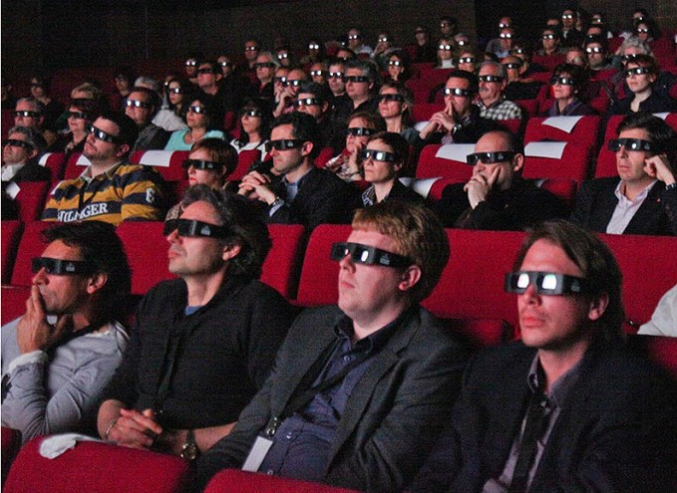
200 million

Slide 6
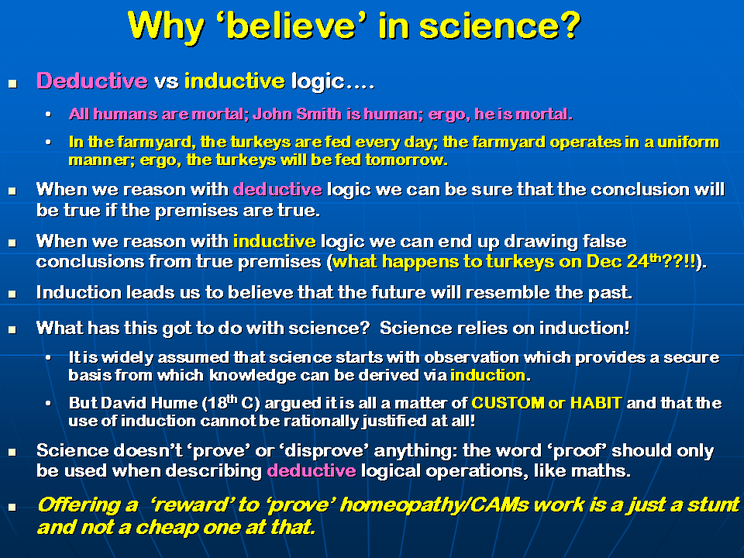

Slide 7
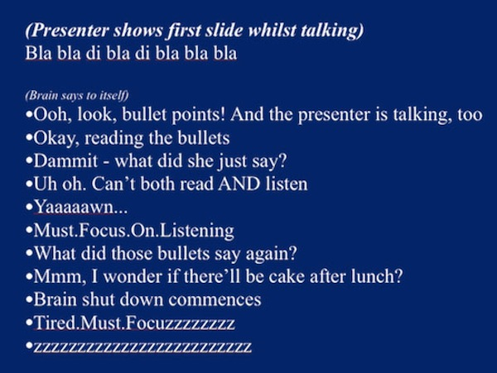

Slide 8
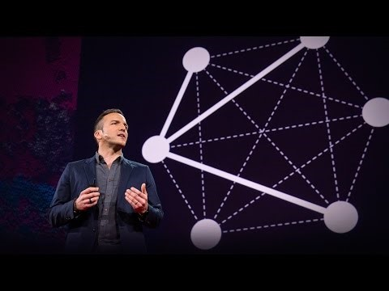
Manuel Lima: A visual history of human knowledge

Slide 9
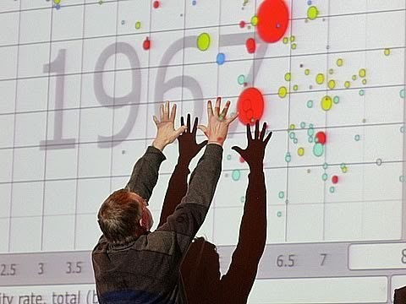
Hans Rosling: The best stats you have ever seen

Slide 10
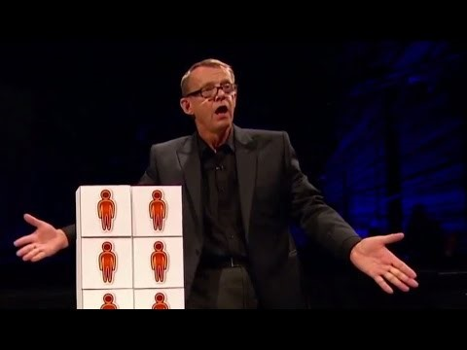
Hans Rosling: Don’t panic

Slide 11
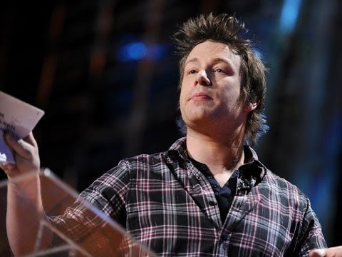
Jamie Oliver: Teach every child about food

Slide 12
No more than six words on a slide – ever!
Seth Godin, marketing guru

Slide 13
The 666 Rule and 10-20-30 Rule refer to the bullet points, font sizes and number of slides you should use in your presentation. What do you think these rules might be?

Slide 14
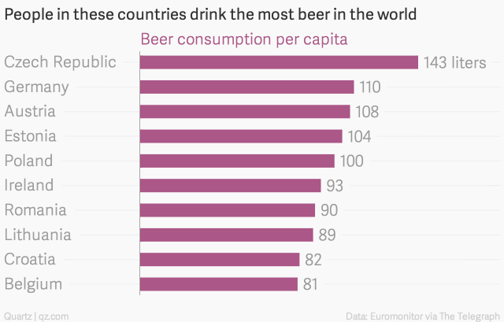

Slide 15
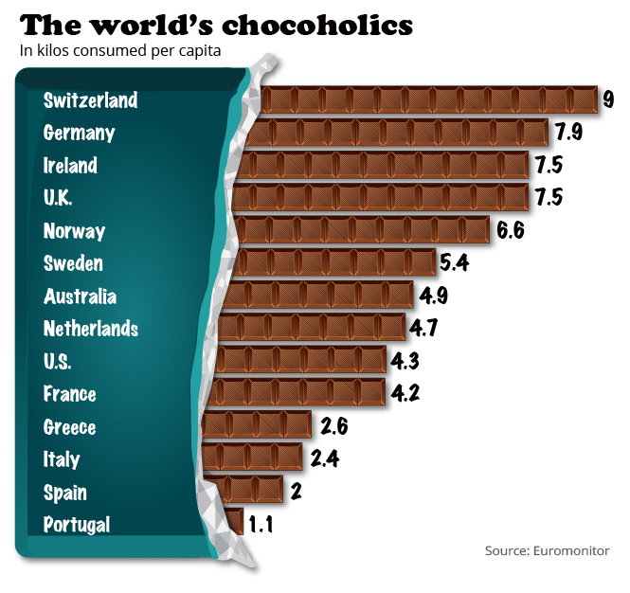

Slide 16
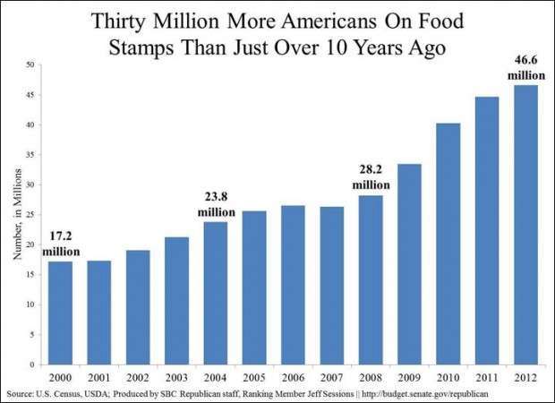

Slide 17
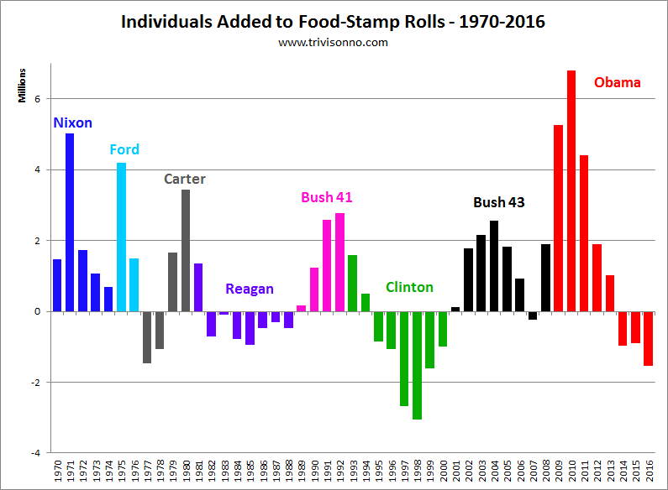

Slide 18


Slide 19


Slide 20
17 interesting graphs that define the life of an introvert
http://www.lifehack.org/325085/17-interesting-graphs-that-define-the-life-introvert

