Slide 1
PREFEKT & CEITEC PhD school
Preparing International Grant Applications I.
Zlatuše Novotná, Veronika Mikitová, Renata Padrtová, Ladislav Čoček, Zdenka Žampachová, Daria Kucharova
Grant Office CEITEC MU
Brno, 15th April 2016

Slide 2
Content
Project Management – Introduction
Proposal structure and evaluation criteria
1 – Excellence
  Aim and objectives
  Background and significance
  Preliminary studies
  Research design
2 – Impact
3 – Implementation
  Work plan
  Project management
  Budget
Running the Project on Day-to-Day Basis
Notes:
ZNo:
short intro to H2020 – myths about international projects bureaucracy – comparison to MEYS – NF, SF, changes confirmed by e-mail, justifying scientific results and excellence, not every 2CZK in expenses, technological and scientific challenges, not bureaucratic ones / 1 slide

Slide 3
Scientific Career Path
Collaboration
PhD student
PostDoc I
PostDoc II
Senior
Group Leader
Junior
Group
Leader
Start-up grant
Mobility
Mobility
Institutional brand
GAČR Standard
OP VVV
H2020 collaborations
ERC Advanced grants
CEITEC PhD School
Excellent research & leadership skills
Long-term projects
Installation grants – EMBO
ERC Starting grant, GAČR Junior
Flexible and preparing independent career
Fluctuation supports internationalization
Individual grants – MSCA / SoMoPro / OP VVV
H2020 / GAČR team member
Absorbing experience and knowledge
Short-time projects
Incoming/outgoing mobility: MSCA / SoMoPro / OP VVV
H2020 / GAČR team member
International recruitment
Prevention of inbreeding
H2020 / GAČR team member
16

Slide 4
Project management – Introduction
Notes:
Jakub

Slide 5
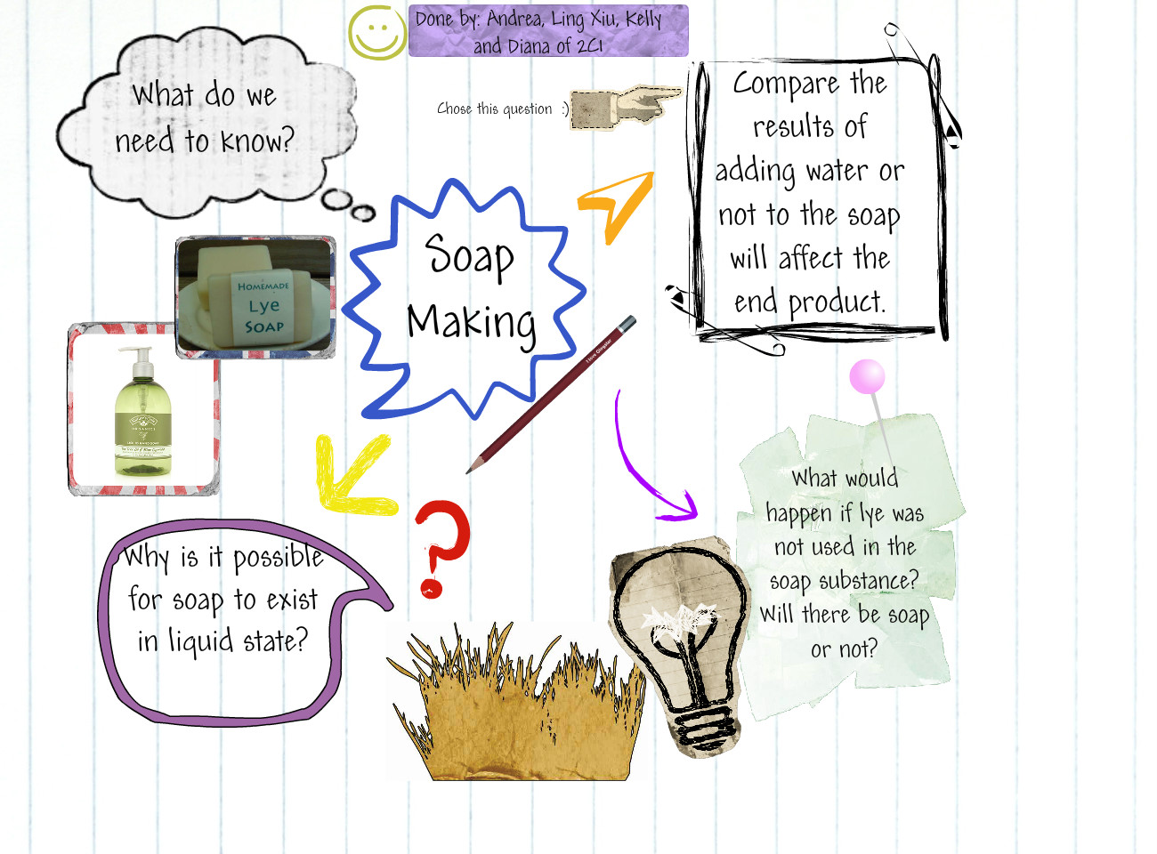
What is a Project?
Notes:
ZNo

Slide 6
Project is…
…a temporary endeavour undertaken to create a unique product, service or result.
  Temporary = it has a defined beginning and end in time, and therefore defined scope and resources.
  Unique = a planned piece of work that has a specific purpose (such as to find information or to make something new)
Project vs. Operations

Slide 7
Project Management is…
… the application of knowledge, skills and techniques to execute projects effectively and efficiently.
  Projects must be expertly managed to deliver on-time, on-budget results
Notes:
ZNo
Project definition
A project is temporary in that it has a defined beginning and end in time, and therefore defined scope and resources.
And a project is unique in that it is not a routine operation, but a specific set of operations designed to accomplish a singular goal. So a project team often includes people who don’t usually work together – sometimes from different organizations and across multiple geographies.
The development of software for an improved business process, the construction of a building or bridge, the relief effort after a natural disaster, the expansion of sales into a new geographic market — all are projects.
And all must be expertly managed to deliver the on-time, on-budget results, learning and integration that organizations need.
Project management, then, is the application of knowledge, skills and techniques to execute projects effectively and efficiently. It’s a strategic competency for organizations, enabling them to tie project results to business goals — and thus, better compete in their markets.
Answering the question using strategies of: the institution, the Research Programme and the Research Group, your career development plan
having an idea: why, what, when, for how much …; 5 key questions; strategy of centre, group; relation to European strategy / 1 slide; JZe

Slide 8
Project Manager is…
… the person assigned by the performing organization to lead the team that is responsible for achieving project objectives
Knowledge
Performance
Personal approach

Slide 9
Reasons to start a project
Market demand
Strategic opportunity /business need
Social need
Environmental considerations
Customer request
Technological advantage
Legal requirement
… What about in academia and R&D?
Notes:
ZNo
Project definition
A project is temporary in that it has a defined beginning and end in time, and therefore defined scope and resources.
And a project is unique in that it is not a routine operation, but a specific set of operations designed to accomplish a singular goal. So a project team often includes people who don’t usually work together – sometimes from different organizations and across multiple geographies.
The development of software for an improved business process, the construction of a building or bridge, the relief effort after a natural disaster, the expansion of sales into a new geographic market — all are projects.
And all must be expertly managed to deliver the on-time, on-budget results, learning and integration that organizations need.
Project management, then, is the application of knowledge, skills and techniques to execute projects effectively and efficiently. It’s a strategic competency for organizations, enabling them to tie project results to business goals — and thus, better compete in their markets.
Answering the question using strategies of: the institution, the Research Programme and the Research Group, your career development plan
having an idea: why, what, when, for how much …; 5 key questions; strategy of centre, group; relation to European strategy / 1 slide; JZe

Slide 10

7 Project constraints
Budget
Scope
Schedule
Quality
Resources
Risk
Customer satisfaction (?)

Slide 11
Triple constraint
Priorities?
TIME (schedule)
SCOPE (work plan)
Add time
Limit scope
Put more money
COST (budget)

Slide 12

Time management
Understand the importance of basic project planning
Develop scheduling skills
Learn how to use several basic tools:
  WBS (Work breakdown
  structure)
  Resource allocation
  Gantt charts

Slide 13
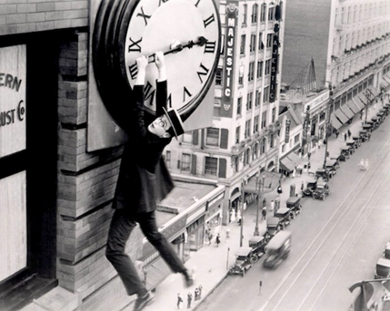
Time management principles
„Time is terrible resource to waste. And it is the most valuable resource in a project.“
Projects have finite duration.
Managing a project requires
awareness of 2 time frames:
The amount of effort a task will take (in time), e.g.,
3 hours to write a report or 2 hours to cook lunch
The time span over which the activity will occur, e.g., the report will be done within a week, dinner will be ready at 6 o´clock

Slide 14
Project team
Project management team
Dedicated
Part-time
Project team
  Project sponsor
  Project management team
  Project manager
  User or customer representatives
  Subcontractors and suppliers
  Partners
Project team
Stakeholders
Project Manager

Slide 15
Project Stakeholders
… are people/organizations influenced or involved in the project.
Key points
  Who they are?
  What interests they have?
  How shall we deal with this?
Stakeholders

Slide 16
Sponsor role
… is customer (= grant provider) or member of senior management
Provides financial resources for the project
Appoints Project Manager
Gathers support for the project, protects project
Determines priorities
Approves changes
Accepts deliverables

Slide 17
Project Manager role
Leads the team and is responsible for achieving project objectives
  Helps write the project / the grant proposal
  Influences project team and atmosphere
  Manages interactions with key stakeholders
  Leads planning the project
  Manages project team
  Monitors project work and proposes changes
  Performs closing activities
Is proactive, has authority and accountability

Slide 18
Project team role
Project team completes the work of the project
  Helps identify requirements, constraints and assumptions
  Participates in activity planning and provides estimates
  Does the work according to plan
  Participates in meetings
  Raises change request

Slide 19
Proposal Structure and Evaluation Criteria
Notes:
Jakub

Slide 20
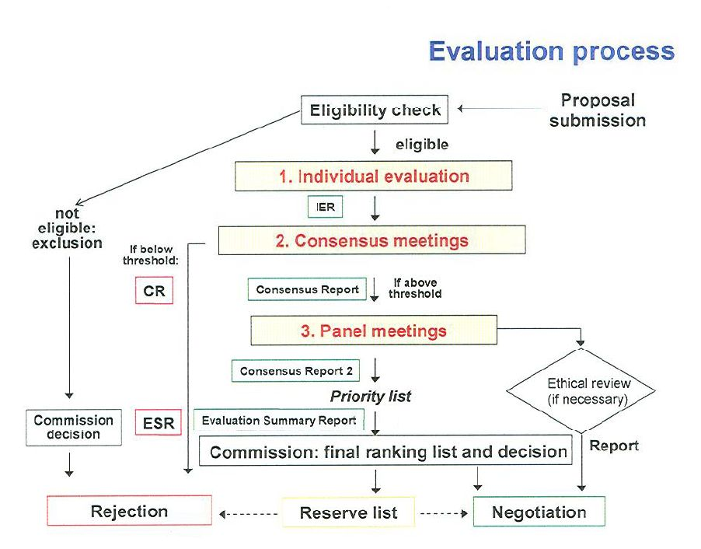
Horizon 2020

Slide 21
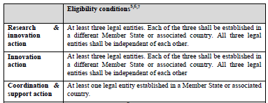
Eligibility check
To be considered admissible, a proposal must be:
  submitted in the Electronic Submission System before the deadline given in the call conditions;
  readable, accessible and printable.
Incomplete proposals may be considered inadmissible. This includes the requested administrative data, the proposal description, and any supporting documents specified in the call.

Slide 22
Evaluation – Process
Forms of evaluation – remote or in-situ (in Brussels). In situ usually takes a week without the opportunity to contact the applicants, this usually covers both individual evaluation and consensus meeting; remote evaluation is usually individual, with consensus meeting later on in Brussels; sometimes, a hearing/interview is part of the evaluation (typically ERC)
Evaluation process – starts with a briefing from EC (call objectives, work programme, call text, interpretation of evaluation criteria; „calibrating“ evaluators to minimize the risk of inconsistent evaluation)
Individual part – at least 3 evaluator individually reviewing the same project, completing Individual Assessment Report (IAR), verbal and numerical scoring for each criterion
Consensus meeting – all the 3 evaluators meet together and discuss the project jointly (ca. 0,5-1 h); the goal is to find consensus on verbal and numerical scoring of the project (not average, but consensus); in the end, one of the evaluators writes common position – Evaluation Summary Report (ESR)
Moderator = EC representative – takes care of administration (appointing projects, gathering IAR), moderation of consensus meeting, control of evaluation quality (corelation between numerical scores and verbal comments), aims for consistency of „calibration“ of the three evaluators

Slide 23
Evaluation – Criteria
Excellence (50%) The following aspects will be taken into account, to the extent that the proposed work corresponds to the topic description in the work programme. | Impact (30%) The extent to which the outputs of the project should contribute at the European and/or International level to: | Quality and efficiency of the implementation (20%) The following aspects will be taken into account:
Clarity and pertinence of the objectives; Credibility of the proposed approach; Soundness of the concept, including trans-disciplinary considerations, where relevant; Extent that proposed work is ambitious, has innovation potential, and is beyond the state of the art (e.g. groundbreaking objectives, novel concepts and approaches). | The expected impacts listed in the work programme under the relevant topic; Enhancing innovation capacity and integration of new knowledge; Strengthening the competitiveness and growth of companies by developing innovations meeting the needs of European and global markets; and, where relevant, by delivering such innovations to the markets; Any other environmental and socially important impacts (not already covered above); Effectiveness of the proposed measures to exploit and disseminate the project results (including management of IPR), to communicate the project, and to manage research data where relevant. | Coherence and effectiveness of the work plan, including appropriateness of the allocation of tasks and resources; Complementarity of the participants within the consortium (when relevant); Appropriateness of the management structures and procedures, including risk and innovation management.
Criteria may slightly vary according to type of action.

Slide 24
Evaluation – Criteria
Criteria are general, interpretation may vary according to call (it is, however, possible, to deduce the interpretation from the call text – e.g. what impact is desirable)
There are usually thresholds for the criteria (proposals not passing the threshold may not be financed) – usually 3 out of 5 for individual criteria and 10 out of 15 for the sum of scores; the criteria often have differing weights (excellence or impact the highest, according to focus on innovation)
Marie Skłodowska-Curie Actions and ERC have slightly different evaluation procedure
For each criterion, your proposal will be given scores of 0 to 5 (half marks are possible), as follows:
0 | The proposal fails to address the criterion or cannot be assessed due to missing or incomplete information (unless the result of an ‘obvious clerical error’)
1 — Poor | The criterion is inadequately addressed or there are serious inherent weaknesses
2 — Fair | The proposal addresses the criterion well but with a number of shortcomings
3 — Good | The proposal addresses the criterion well but with a number of shortcomings
4 — Very good | The proposal addresses the criterion very well but with a small number of shortcomings
5 — Excellent | The proposal successfully addresses all relevant aspects of the criterion; any shortcomings are minor

Slide 25
Evaluation – interpretation of criteria
Proper interpretation of evaluation criteria is the key to success!
Excellence
  Originality of the idea, progress in state-of-the-art, ambition of the defined goals, work plan and its quality (logic behind the work packages)
Impact
  Dissemination of results, use of results (expected impact is always specified in the text of call/work programme), impact beyond the project participants (involvement of industry/users, extension towards other countries, …)
Implementation
  Management – governing structure of the project, quality of project participants and team as a whole (complementary expertise), budget (reasonably – no need to be over-modest, the key is reasoning, explanation)

Slide 26
Proposal Structure
1 – Excellence (Scientific part)
  Aim and objectives
  Background and significance
  Preliminary studies
  Research design
2 – Impact
3 – Implementation
  Work plan
  Project management
  Budget

Slide 27
1 – Excellence (Scientific Part)
Notes:
Zlata/Verča

Slide 28
Scientific Part – Tips
Make it short and simple = transmitting your message to others.
How does it fit into the existing knowledge base?
Write on target.
Don´t make your hypothesis radical (cure of cancer…). Your hypothesis is a step up. Knowledge tends to be incremental!
Address why it is a good question.
What need does it fill for the granting agency?

Slide 29
a. Aim and objectives
  Specific and concrete
  Realistic and supported with your expertise
  Clearly and briefly described
  Justified
  Quantified
  Well timed and in line with defined project outcomes – linkage of objective with Project Plan (work packages)
  In line with the call, i.e. with what the funding agency expects
First 1-2 pages must attract evaluator´s interest!
29

Slide 30
b. Background and significance
Sketch the background leading to the proposed grant, get straight to the point
Focus and evaluate the current knowledge leading to the hypothesis
Identify the gaps in current knowledge that your hypothesis is intended to fill
State the „impact“ relevance of the proposed work
Relate this section to the aim
Include your work here showing your expertise and credibility
  Key point where your experience and credibility
  should be shown.
30

Slide 31
c. Preliminary studies
Important is to have some studies performed that support your hypothesis. Not studies that have nothing to do with the hypothesis!
Crucial point to establish experience and credibility.
References can be noted here if they are DIRECTLY relevant to the hypothesis.
Think about your potential Intellectual Property (IP).
Can you turn your research into a revenue stream???
Without asking yourself the question about IP you
can lose a lot.
31

Slide 32
d. Research design 1/2
Must correspond with the Aim and Objectives section – nothing more, nothing more complicated.
Describe the research and procedures you will use
How the data will be collected, analysed and interpreted?
If introducing new methodology describe how it will be better than the „old“ methods
Discuss potential difficulties and risks/obstacles /limitations and how they will be overcome.
(Contingency plan is often completely missing!)
32

Slide 33
d. Research design 2/2
Give a sequence and timetable for the work
Describe work packages, outcomes, milestones …
Work Plan
Hazard/ dangers for personnel and how they will be overcome
Statistics that will be used
Do you need collaborators, subcontractors,…? If so document their expertise and describe their function and relation to the aim.
Ethical issues: animal and human experiments,
supporting documentation accompanying the proposal.
The golden rule is KISS – keep it simple and stupid ☺!
33

Slide 34
Example of general project design
34

Slide 35

Background study on existing projects
Cordis webpages, web databases, e.g. http://www.healthcompetence.eu

Slide 36
Consultation with the grant provider
Is your topic the right one?
What is expected from the grant provider?
Does your proposal correspond to the call description?
Do you understand the call correctly?
Information days and seminars, e-mail, phone calls, meeting in Brussels, …
Consultation with the grant provider idealy before call official opening => smaller competition!
36

Slide 37
2 – Impact
Notes:
Jakub

Slide 38
Impact – what is it?
The key is answering the following questions:
The scientific/societal impacts of the results
  What will be the results of the project?
  What / Who are the results for – target group?
  What differences they can bring about / why are the results needed?

Slide 39
Impact throughout the project proposal
Knowing and understanding the state-of-the-art
Seeing the gaps of knowledge
Well-defined project aims
Good implementation plan (good PM knowledge)
Scientific knowledge, methodology, infrastructure, etc…
Finding knowledge, i.e. closing the gaps
Achieving IMPACT
(through re-definition of the state-of-the-.art)
Notes:
JZe:
We have mentioned the impact earlier as an important aspect of the project proposal and of your efforts in general….
Tady zatím nový náčrtek, komentář k tomu ještě doplním, grafiku upravím. Podstatné je předat to, že vše začíná už jejich znalostí vědy. Pokud dokážou najím mezery a způsob, jak je zacelit, tak mají o čem psát v impaktu, nemusí nic poracně vymýšlet. Zárˇoveň budou mít dobře definované cíle

Slide 40
Impact in H2020 – evaluation
IMPACT is one of 3 (up to 6) evaluation criteria
The role of IMPACT has increased in H2020
„Writing“ the IMPACT must be more elaborate than it used to be in FP7
The weight of the criteria in the collaborative H2020 projects:
  SCIENCE (50%, 3/5)
  IMPACT(30%, 3/5)
  IMPLEMENTATION (20%, 3/5)
Notes:
JZe:
We have mentioned the impact earlier as an important aspect of the project proposal and of your efforts in general. The impact is actualy one of the three criteria your proposal will be assessed against. It used to be the least important criterion, with the smallest weight. However, from now on, with our entering the H2020, the Impact has become the second most important criterion its weight being 30%!. There are diffeent weights in MCSA and FET. Where the impact counts%, while the science is 25-30% and 60% , respectively.
/ table from ncRNApain; contexts of impact / JZe will prepare slides
new focus in the world of funded research: the significance of research
impact – What is the project good for, what it brings in long term? (first row of logical framework matrix)
always refer to expected impact in topic description
use the EU terminology (quote from the Work Programme and other EU documents)
impact should be included in abstract
the more the scientist writes, the better

Slide 41
Impact in example of H2020 call
  SC1-PM-04–2016: Networking and optimising the use of population and patient cohorts at EU level
  Specific Challenge: Population cohorts are invaluable resources to obtain detailed description of individual biological variations in connection with a variety of environmental, pathogenic, occupational, societal, and lifestyle determinants that influence the onset and evolution of diseases. Europe currently has some of the most valuable population and patient cohorts, including well annotated clinical trial cohorts. However, the lack of integration of these cohorts hampers the optimal exploitation of these resources, essential to underpin and facilitate the development of stratified and personalised medicine9.
  Scope: Proposals should aim at maximizing the exploitation of cohorts by bringing together national and/or European cohorts with common scientific interests (e.g. across diseases, children, mothers, elderly, birth, gender, etc.), and by taking advantage of new technologies (e.g. ICT, social platforms, etc.) and new type of data (e.g. geographical, genetic, eHealth records, etc.). Based on those cohorts using a comprehensive integration strategy to facilitate hypothesis-driven research, data sharing, harmonisation and analysis, proposals should provide expanded resources and knowledge on health and disease determinants, onset and course of diseases (including aspects of co-morbidity and/or co-infections), clinical, public health and socio-economic research. Synergies with relevant existing European infrastructures and additional collaborations with relevant international initiatives are encouraged. Proposals should also engage with relevant international/national/regional authorities to ensure that findings are implemented and translated into health policy.
  The Commission considers that proposals requesting a contribution from the EU of between EUR 8 and 10 million would allow this specific challenge to be addressed appropriately. Nonetheless, this does not preclude submission and selection of proposals requesting other amounts.
  Expected Impact: Expected impacts include one of or a combination of the following point(s):
  Make major conceptual, methodological and analytical contributions towards integrative cohorts and their efficient exploitation.
  Contribute to providing novel information on health maintenance, onset and course of diseases, or population stratification, with a view to tailor diagnosis or to optimise prevention and treatment.
  Provide the evidence base for the development of policy strategies for prevention, early diagnosis, therapies, health economics as well as addressing health inequalities. Wherever relevant, evidence for economic evaluation of interventions should also be included.
  Optimise the use of population cohorts in defining/improving clinical practice and public health policy.
Notes:
JZe:
We have mentioned the impact earlier as an important aspect of the project proposal and of your efforts in general. The impact is actualy one of the three criteria your proposal will be assessed against. It used to be the least important criterion, with the smallest weight. However, from now on, with our entering the H2020, the Impact has become the second most important criterion its weight being 30%!. There are diffeent weights in MCSA and FET. Where the impact counts%, while the science is 25-30% and 60% , respectively.
/ table from ncRNApain; contexts of impact / JZe will prepare slides
new focus in the world of funded research: the significance of research
impact – What is the project good for, what it brings in long term? (first row of logical framework matrix)
always refer to expected impact in topic description
use the EU terminology (quote from the Work Programme and other EU documents)
impact should be included in abstract
the more the scientist writes, the better

Slide 42
Impact in H2020 – how to approach it
Consider Impact at the very beginning
Consults relevant EU and H2020 policies and documents (GO CEITEC MU) – Work Programmes, Europe2020…
Consider different dimensions of Impact
Identify and exercise your influence on the Impact
Notes:
JZe:
/ table from ncRNApain; contexts of impact / JZe will prepare slides
new focus in the world of funded research: the significance of research
impact – What is the project good for, what it brings in long term? (first row of logical framework matrix)
always refer to expected impact in topic description
use the EU terminology (quote from the Work Programme and other EU documents)
impact should be included in abstract
the more the scientist writes, the better

Slide 43
Basic dimensions of IMPACT
Stakeholders
  (your) scientific community (all levels of it)
  Society you (might) live in and its institutions
  Your funder, i.e. the aims of the grant scheme/programme
Time – immediate or short-term or long-term impact
Control / Influence
Notes:
JZe:

Slide 44
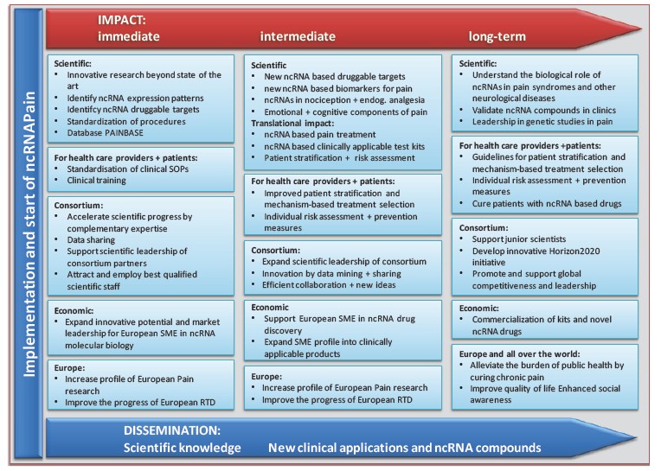
Examples – Impact
Notes:
JZe:
/ table from ncRNApain; contexts of impact / JZe will prepare slides
new focus in the world of funded research: the significance of research
impact – What is the project good for, what it brings in long term? (first row of logical framework matrix)
always refer to expected impact in topic description
use the EU terminology (quote from the Work Programme and other EU documents)
impact should be included in abstract
the more the scientist writes, the better

Slide 45
Impact – measures to maximize it
Good dissemination and exploitation plan
Open Access – mandatory in H2020
Open Data – voluntary, but we should join!
  Insitituional repositories
  ZENODO repository – supported by the EU, own webspace, both paper (including „ferey“ literature“ and connected data (http://zenodo.org/)

Slide 46
Example: Dissemination – communication target groups
Notes:
JZe:
/ table from ncRNApain; contexts of impact / JZe will prepare slides
new focus in the world of funded research: the significance of research
impact – What is the project good for, what it brings in long term? (first row of logical framework matrix)
always refer to expected impact in topic description
use the EU terminology (quote from the Work Programme and other EU documents)
impact should be included in abstract
the more the scientist writes, the better

Slide 47
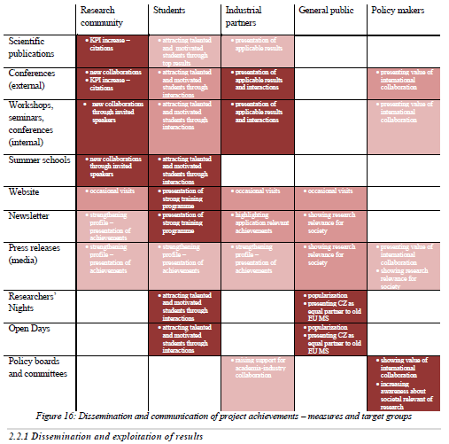
Example of impact scheme

Slide 48
3 – Implementation
Notes:
Laďa

Slide 49
Project Planning Techniques and Tools
Initiation
Planning & design
Scope of the project
Logical Framework
Quality management plan
Work Breakdown Structure (WBS)
Project Charter (acceptance criteria)
Optimization of plans + definition of reserves
List of activities
Dependency between activities
Estimates of activity duration
Gantt, network analyses, critical path
Timing
Basic Timeframe
Financing
Top-down budget estimate
Estimates of costs, incl. human resources
Budgeting (BOTTOM-UP)
Cash-flow plan
Organization Breakdown Structure (OBS)
Responsibility matrix (RACI)
Estimates of resources
(H)R balancing bar chart
Environment,
human resources
Appointment of management
Stakeholder Analysis
Communication strategy
Communication plan, document. matrice
Risks and
opportunities
First assessment
Risk analysis (RIPRAN)
Risk monitoring
Notes:
Ukázka toho, jak složitě to lze dělat.

Slide 50
Work Plan
Notes:
Verča

Slide 51
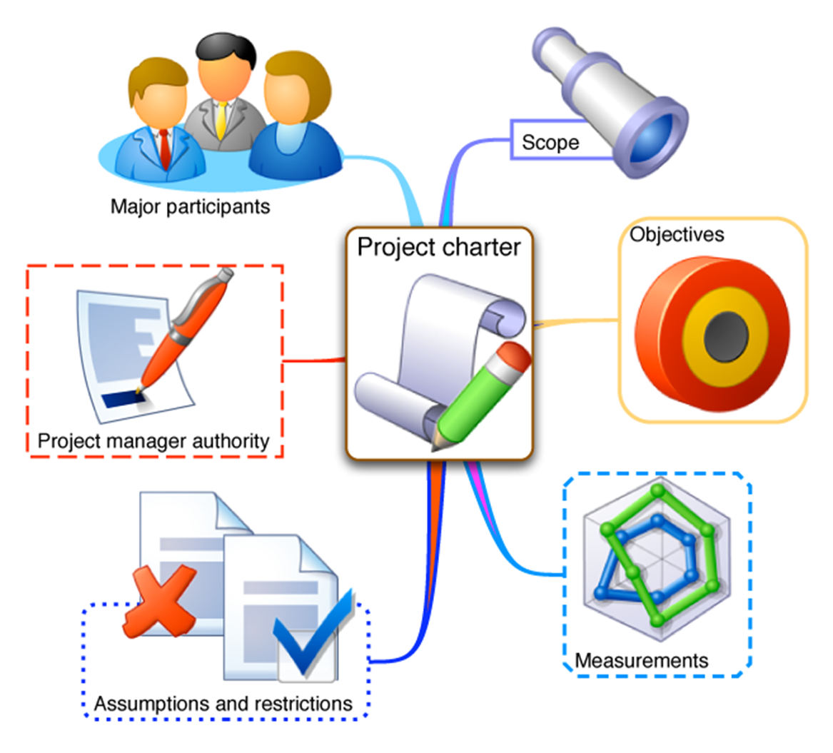

Project Charter
Project team and stakeholders
Background and motivation
Notes:
Output of the INITIATION process: Project Charter = document issued by the Project Initiator (or Project Sponsor) that formally authorizes the existence of the Project. It contains description of objectives and high-level requirements and risks. Project charter can be used to describe the project intention to potential partners (ideally after having signed the NDA) or consult the Project with the grant provider, i.e. the European Commission.

Slide 52
Work Breakdown Structure (WBS)
WBS is a hierarchical decomposition of the total work scope on the project
Developed in planning stage (based on logical framework)
No pre-defined number of levels (usually 3-4)
Responsibility for each box can be allocated to a single person
The lowest level – Work Package
Work Package is an output, not an activity
Notes:
LČO
The optimal tool to prepare a Work Plan well suited for EU project is the Work Breakdown Structure (WBS) diagram. The top usually based on LFM – the Aim of the project and the Work Packages below – in this stage, you need to include all the work (outputs) needed to successfully deliver the Aim. So, this is the phase where you will be adding Management and Dissemination, the support work packages.
WBS is a brainstorming exercise, the core project team should gather to discuss how to breakdown the work packages into tasks, eventually go into even lower levels. The point is to be able to monitor the project progress and delivery based on the unit in WBS, therefore, it is advisable to only list activities if they can be monitored using a specific outcome – deliverable. Also, a specific person should be responsible for each of the WBS units.
work Package (WP) – set of activities needed to reach a specific objective
task – a specific activity for which a specific individual (partner) is responsible
risks generation – what can happen with each WP

Slide 53
Work Breakdown Structure (WBS)
Dinner implemented
1. Resources purchased
2. Soup cooked
3. Main course cooked
4. Desert delivered
5. Dinner served
3.1 Meat roasted
3.2 Sauce prepared
3.3 Side dish cooked

Slide 54
Work Breakdown Structure (WBS)
PhD conference organized
1. Venue booked
2. Speakers invited
3. Marketing organized
4. Registration open
5. Dinner organized
3.1 Flyers designed
3.2 Flyers printed
3.3 Flyers distributed

Slide 55
Work packages
Work package is a set of activities required to produce a major project output (i.e. a tangible result, deliverable). It is characterized by effort and time and may cover a single task or several related tasks.
effort
time
Work package No | Work package title | Type of activity | Lead participant No | Lead participant short name | Person-months | Start month | End month
WP1 | Setting and activating the scene | SUPP | 1 | JIC | 9.50 | 1 | 6
WP2 | State-of-Play directory and analysis | SUPP | 5 | CBM | 36.50 | 1 | 12
WP3 | Mentoring and mutual learning | SUPP | 4 | AREA | 39.75 | 6 | 24
WP4 | Joint Action Plan towards integration | SUPP | 2 | MU | 40.00 | 21 | 36
WP5 | Dissemination & Information management | SUPP | 4 | AREA | 22.25 | 1 | 36
WP6 | Project coordination and assessment | MGT | 1 | JIC | 13.50 | 1 | 36
 |  | TOTAL |  |  | 161.50
Notes:
A workpackage is a set of activities required to produce a major project output. It is characterized by time and effort and a single person/partner is responsible for its delivery on time, with the expected costs, and in sufficient quality.

Slide 56
Work package collaborative H2020 project
Workpackage number | 1 | Start date or starting event |  |  | Month
Workpackage title
Participant number
Short name of participant
Person/months per participant
Start month |  |  | End month
Objectives
Description of work Task 1.1: Task 1.2
Deliverables: D1.1 D1.2
Milestones:
M1.1
M1.2

Slide 57
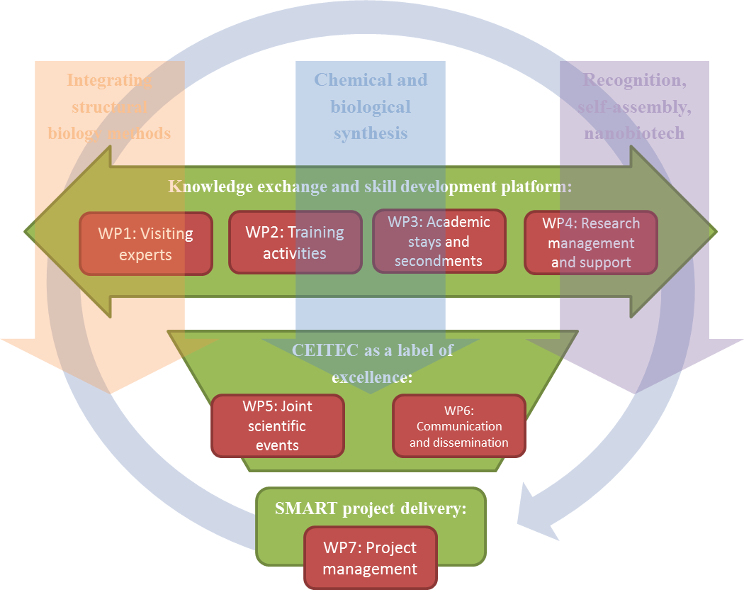
Work packages - Example
Notes:
Randomness has established itself as a vital building block of information processing and represents an integral ingredient for practically any aspect in the field of information processing and technology. The principal objective of this project is to establish and evaluate the role played by randomness in quantum information processing.
address the main difficulties that arise through the use of randomness, in particular the following:
the use of randomness as a theoretical tool to prove existence and properties of information processing applications;
the design of novel quantum information processing applications that exploit randomness;
the design and analysis of applications that work with real-world (that is, non-uniform) randomness;
the construction of design techniques that produce high-quality randomness, both from a computational and adversarial perspective; and, finally,
the use of randomness to analyze and improve the physical processes necessary for the design quantum communication and computation devices.
The consortium (composed of 8 research teams) aims to unite the forces of EU expertise in computer science, physics and mathematics to undertake a comprehensive study of randomness and quantum information within their research portfolio.

Slide 58
Work package - Example
Research training
Network-wide activities
WP1
RNA dynamics
WP4
Training events
WP5
Dissemination & Exploitation
WP2
Protein-RNA interactions
WP3
Novel tools
WP6 Management

Slide 59
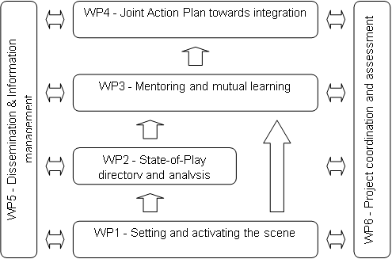
PERT chart
Pert chart is a network diagrame which represents interdependencies between and among work packages
Notes:
LČo: PERT Chart depicts relations and interdependencies between work packages. Make a nice picture.

Slide 60
Another example of a PERT chart

Slide 61
Deliverable
Deliverable is a tangible or intangible result of the project to be delivered and accepted by the customer / grant provider
Deliverable differs from milestone: milestone is a measurement of progress towards an output whereas the deliverable is the result of the process
Examples: report, document, server upgrade, functional design, prototype, web portal, knowledge base, publication, business plan,
kick-off meeting minutes…
Notes:
všichni navrhnou příklady , LČo přednáší

Slide 62
Example:
List of Deliverables
Deliverable (number) | Deliverable name | Work package number | Short name of lead participant | Type | Dissemination level | Delivery date
D1.1 | Mid-term report on expert visits | 1 | CEITEC | R | PU | M18
D1.2 | Final report on expert visits | 1 | CEITEC | R | PU | M36
D2.1 | Training plan | 2 | UJF | R | PU | M6
D2.2 | Career development plans of jointly supervised PhD students | 2 | UJF | R | CO | M9
D2.3 | Mid-term training report | 2 | UJF | R | PU | M18
D2.4 | Final training report | 2 | UJF | R | PU | M36
D3.1 | Secondment plan | 3 | UEA | R | PU | M6
D3.2 | Mid-term secondment report | 3 | UEA | R | PU | M18
D3.3 | Final secondment report | 3 | UEA | R | PU | M36
D4.1 | Management knowledge transfer report | 4 | CEITEC | R | PU | M21
D5.1 | Annual report on strategic events Year 1 | 5 | CEITEC | R | PU | M12
D5.2 | Annual report on strategic events Year 2 | 5 | CEITEC | R | PU | M24
D5.3 | Annual report on strategic events Year 3 | 5 | CEITEC | R | PU | M36
D6.1 | Communication, dissemination, and exploitation plan | 6 | UNIVIE | R | PU | M6
D6.2 | Mid-term communication, dissemination, and exploitation report | 6 | UNIVIE | R | PU | M18
D6.3 | Final communication, dissemination, and exploitation report | 6 | UNIVIE | R | PU | M36
D7.1 | List of CEITEC MU publications for the last 3 years | 7 | CEITEC | R | PU | M3
D7.2 | Periodic report | 7 | CEITEC | R | PU | M18
D7.3 | Final report | 7 | CEITEC | R | PU | M36
^{[1]} R: Document, report; DEC: Websites, patents filing, market studies, press & media actions, videos, etc.; OTHER: Software, technical diagram, etc. PU = Public, fully open, e.g. web; CO = Confidential, restricted under conditions set out in Model Grant Agreement; CI = Classified, information as referred to in Commission Decision 2001/844/EC.

Slide 63
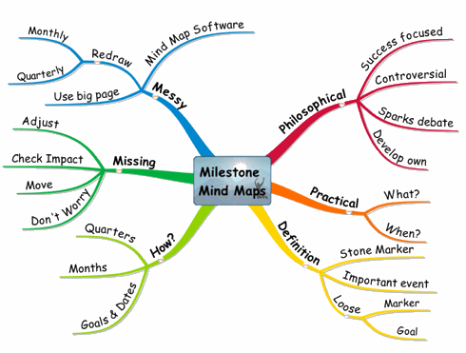
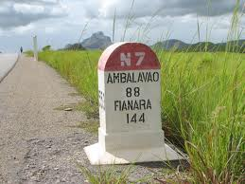
Milestone
Milestone is a measurement of progress towards an output. It is a decision point and control gate within the work plan
Milestones are decisions influencing further progress of the project
Notes:
key outcomes of the projects (needed for success/continuation) or decision points (result that enables us to determine what to focus on afterwards)
e.g. we characterized 3 nanomaterial structures in an analytical work package, the next work package focuses on production scale-up of the one with most desirable qualities – this is a milestone, because the next work package cannot proceed without the decision being taken

Slide 64
List of Milestones

Slide 65
Template and example:
List of Milestones

Slide 66
Milestones - example

Slide 67
GANTT Chart – tasks and milestones
Gantt chart is a graphical presentation of Project schedule. It describes timing of tasks and milestones.
Months | 1 | 2 | 3 | 4 | 5 | 6 | 7 | 8 | 9 | 10 | 11 | 12 | 13 | 14 | 15 | 16 | 17 | 18 | 19 | 20 | 21 | 22 | 23 | 24 | 25 | 26 | 27 | 28 | 29 | 30 | 31 | 32 | 33 | 34 | 35 | 36 | 37 | 38 | 39 | 40 | 41 | 42 | 43 | 44 | 45 | 46 | 47 | 48
WP1 Simulations
T1.1 |  |  |  |  |  | D
T1.2 |  |  |  |  |  |  |  |  |  |  |  | D
T1.3 |  |  |  |  |  |  |  |  |  |  |  | D
WP2
T2.1 |  |  |  |  |  |  |  |  |  | D
T2.2. |  |  |  |  |  |  |  |  |  |  |  |  |  |  | D
T2.3 |  |  |  |  |  |  |  |  |  |  |  |  |  |  |  |  |  |  |  |  |  | D
T2.4 |  |  |  |  |  |  |  |  |  |  |  |  |  |  |  |  |  |  |  |  |  |  |  | D
WP3
T3.1 |  |  |  |  |  |  |  |  |  |  |  |  |  |  | D
T3.2 |  |  |  |  |  |  |  |  |  |  |  |  |  |  |  |  |  |  |  | D
T3.3 |  |  |  |  |  |  |  |  |  |  |  |  |  |  |  |  |  |  |  |  |  |  |  | D
WP4
T4.1 |  |  |  |  |  |  |  |  |  |  |  |  |  |  |  |  |  |  |  |  |  |  |  |  |  |  |  |  |  | D
T4.2 |  |  |  |  |  |  |  |  |  |  |  |  |  |  |  |  |  |  |  |  |  |  |  |  |  |  |  |  |  | D
T4.3 |  |  |  |  |  |  |  |  |  |  |  |  |  |  |  |  |  |  |  |  |  |  |  |  |  |  |  |  |  |  |  |  |  |  |  |  |  |  |  | D
T4.4 |  |  |  |  |  |  |  |  |  |  |  |  |  |  |  |  |  |  |  |  |  |  |  |  |  |  |  |  |  |  |  |  |  |  |  |  |  |  |  | D
T4.5 |  |  |  |  |  |  |  |  |  |  |  |  |  |  |  |  |  |  |  |  |  |  |  |  |  |  |  |  |  |  |  |  |  |  |  |  |  |  |  |  |  | D
WP5
T5.1 |  |  |  |  |  |  |  |  |  |  |  |  |  |  |  |  |  |  |  |  |  |  |  |  |  |  |  |  |  |  |  |  |  |  |  |  |  |  |  |  |  |  |  |  | D
T5.2 |  |  |  |  |  |  |  |  |  |  |  |  |  |  |  |  |  |  |  |  |  |  |  |  |  |  |  |  |  |  |  |  |  |  |  |  |  |  |  |  |  |  |  |  |  |  |  | D
WP6
T6.1 |  |  |  |  |  | D
T6.2 |  |  |  |  |  |  |  |  |  |  |  |  |  |  |  |  |  |  |  |  |  |  |  |  |  |  |  |  |  |  |  |  |  |  |  |  |  |  |  |  |  |  |  |  |  |  |  | D
T6.3 |  |  |  |  |  |  |  |  |  |  |  | S |  |  |  |  |  | W |  |  |  |  |  |  |  |  |  |  |  |  |  |  |  |  |  | W |  |  |  |  |  |  |  |  |  |  |  | S
WP7
T7.1 |  |  |  |  |  |  |  |  |  |  |  |  |  |  |  |  |  | D |  |  |  |  |  |  |  |  |  |  |  |  |  |  |  |  |  | D |  |  |  |  |  |  |  |  |  |  |  | D
T7.2 |  |  |  |  |  | C |  |  |  |  |  | C |  |  |  |  |  | C |  |  |  |  |  | C |  |  |  |  |  | C |  |  |  |  |  | C |  |  |  |  |  | C |  |  |  |  |  | C
M1
M2
M3
M4
M5

Slide 68
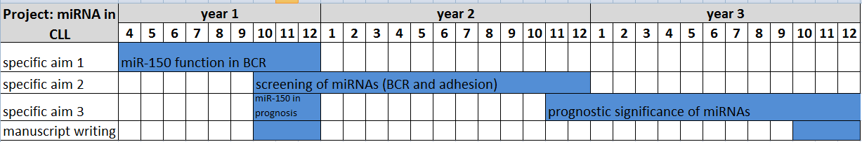
Gantt chart

Slide 69
GANTT Chart - examples

Slide 70
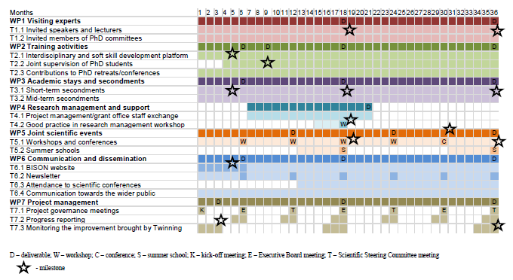
Gantt Chart Example

Slide 71
Project management
Notes:
Verča

Slide 72

Time management principles
How we think projects evolves…
What the reality demonstrates
goal
goal
action
action
start
start
time
time
Q: Is time like a sail boat or a motor boat?
A: It´s more like a sail boat shifting in the wind

Slide 73

Scheduling
What do you manage?
You DO NOT manage time
You DO manage your commitments
How to manage your commitments?
Have list of tasks / activities
Have list of deliverables
Have list of milestones
Have risks analysed
Sequence activities considering logical relationships among them
Estimate activities duration and add risk reserves

Slide 74
Planning – HR Management Plan
Roles and responsibilities
  Role
  Authority
  Responsibility
  Competency
Human Resource Plan
  Project organization chart
  RACI matrix
PM
WP Leader
WP Leader
…
Task Leader
TL
TL
…
Work package | Brno team | Prague team | Vienna team
Sample preparation | A | R | R
Sample analyses | A | R | C
Conference organization | I | I | A,R
R – responsible
A – accountable
C – consulted
I – informed

Slide 75
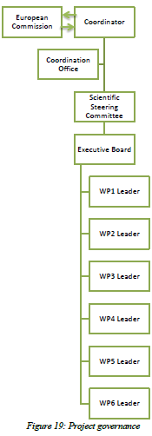
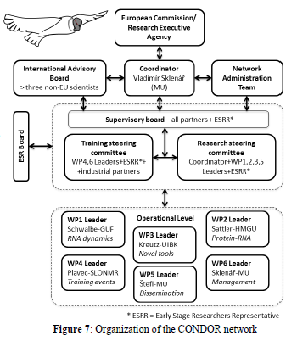
Example

Slide 76
Responsibility Matrix (RACI)
 | Mom | Dad | Son | Daughter
Dinner implemented | A | R | R | R
1. Resources purchased | A | R | - | I
2. Soup cooked | A | R | I | R
3. Main course cooked | A | - | I | R
3.1 Meat roasted | R | A | C | R
3.2 Sauce prepared | R | A | C | R
3.3 Side dish cooked | R | A | - | -
4. Desert delivered | C | R | I | A
5. Dinner served | A | - | R | R
R – Responsible A – Accountable (also approver or final approving authority) C – Consulted (sometimes counsel) I – Informed

Slide 77
Acquiring & Developing Project Team
Pre-assignment
Negotiation with
  Key project team members,
  other project teams,
  external subjects, partners, contractors, suppliers,…
based on multiple criteria like
  availability, cost, experience, ability, knowledge, skills, attitude, international factors,…
Considering virtual teams

Slide 78
Budget
Notes:
Verča

Slide 79
Preliminary issues to be considered
ELIGIBILITY
Are you eligible? Make sure your research can be funded by the funder in the extent you expect
Funder can be supporting only:
  Certain kinds of research (basic, applied, …)
  …or fields of sciences
  …or defined target groups (experienced researchers, woman, (new) EU-member countries researchers, …)
  Specified types of organizations (SMEs, NGOs, …)
  APPROPRIATENESS
  Is your research in line with funder’s intention?
  Are the expected impacts of your research of any interest to the funder?
Notes:
Jze
Make sure your research CAN be funded by the funder at all
The point one referes to the seemingly obvious things – identification of approapriate grant scheme. The funder may not be funding particular filed of scientific research, or supports only specific kinds of research (basic, applied, translational .- clinical studies, development, etc.), specified types of organisations, or researchers of certain gender, age, or nationality, located in specific „geopolitical“ areas, etc.

Slide 80
Practical issues to be considered
RESEARCH COSTS (RC) – the costs you need to implement your project
Are your estimated research costs (RC) within what the funder can provide?
What is the structure of your RC?
Are all of the RC categories eligible fundable/eligible for funding?
Do you need to budget indirect costs (overheads) and if so, are these eligible costs?
Are there any other limitations regarding eligibility of the RC?
Notes:
Jze
Make sure your research CAN be funded by the funder at all
The point one referes to the seemingly obvious things – identification of approapriate grant scheme. The funder may not be funding particular filed of scientific research, or supports only specific kinds of research (basic, applied, translational .- clinical studies, development, etc.), specified types of organisations, or researchers of certain gender, age, or nationality, located in specific „geopolitical“ areas, etc.

Slide 81

Planning the budget
Direct x Indirect costs
Direct costs are specific costs directly linked to the performance of the project and which can therefore be directly booked to it (= accountancy)
Any cost declared by a beneficiary as a direct cost of the action must be justified by supporting evidence (showing the link to the action)
CONFUSED?
Just remember the direct costs are the money
you need to budget to cover your research activities.

Slide 82
Planning the budget
Indirect costs are costs not identifiable as specific costs directly linked to the performance of the project
In practice, they are costs whose attribution to the specific project / action cannot be or has not been measured directly, but only by means of cost drivers or a proxy, which apportion the total indirect costs (overheads) among the different activities
CONFUSED?
Just remember the indirect costs are the costs related to „utility bills“ of your institution are a percentage of the direct cost

Slide 83
Planning the budget
COMMON BUDGET CATEGORIES
  Personnel costs – often a major part of the budget
  Non-personnel cost
    Equipment, facilities
    Services
    Travelling costs
    Other direct cost
    Materials, consumables
    Special categories such as inflation allowance or contingency reserve

Slide 84
Planning the budget
PERSONNEL COSTS
  Personnel costs = costs of the work on the projects
  You must figure out WHO you need to achieve your research objectives - composition of your team
  You must make a good estimate of how much effort you need to complete research activities (and defined tasks and work packages)
  You should calculate the effort as FTEs (full-time equivalents) or person-months

Slide 85
Planning the budget
PERSONNEL COSTS
  AN EXAMPLE:
  Working on a project ALL the time means working full-time = 1 FTE = 12 PMs/year
  Then you need to match the effort with the team positions

Slide 86
Planning the budget
PERSONNEL COSTS
  Different pay rates for different positions
  The ranges of pay rates usually defined and there is a salary cap
  Multiply the number of PMs for individual positions with the pay rates for the positions and make a sum of it = personnel budget
CONFUSED?
  Consults your CEITEC dedicated project manager and Personal Deparment

Slide 87
Budget – tips
Make it realistic (this helps your credibility)
Justify the personnel and their time incl. experts and subcontracting to be paid (services)
Justify your time, justify everything. Be not too modest, count with reserves (EUR/CZ exchange rates...
Consider risks, such as changes in prices in time
Don´t be afraid of giving details – the budget is indicative. It cannot be increased, but costs can be shifted during negotiation.
Big budget is nothing wrong if properly justified.
87

Slide 88
Budget – another example
A Slovakian researcher from Masaryk university applies for a collaborative project with US laboratory for 2 years. His project team consists of himself (FTE 0.2) and 2 PhD students (FTE 0.5 each). One student will visit US laboratory during 1st year and the other one in 2nd year, each for 3 weeks. They plan to use MRI Core Facility for 150hours of imaging (1h/74EUR). They do not need major investments into equipment, apart from two computers (2 x 1481 EUR) and one SW licence (2222 EUR). Costs of US partner are eligible and both institutions will sign an grant agreement with provider. They will disseminate results in 2 joint publications and on 2 international conferences and a one-day workshop at the MU (attendance expected: 50 persons). Project allows 20% indirect costs.

Slide 89
Running the Project on Day-to-Day Basis – Monitoring, reporting and control, Project closing
Notes:
Verča

Slide 90
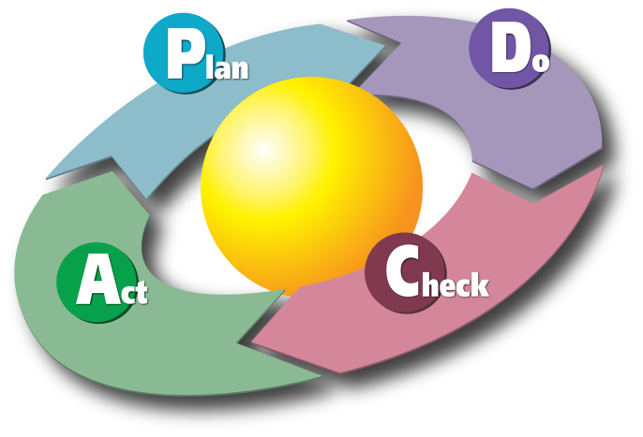
Day-to-day project management
Implementing
Monitoring and controlling the progress
Reporting
Change management
Communication

Slide 91
Implementing
During project implementation refer to:
  Scope – Work plan
  Time schedule – Gantt chart
  Resources
  Budget
  Intermediate outcomes – Deliverables, Milestones
  Risks
  Team (roles and responsibilities)

Slide 92

Monitoring
Regular collection and analyses of relevant information about the project implementation
Comparison actual vs. planned performance
Well structured projects are easier to monitor
Key questions for monitoring:
Do I have enough and appropriate
resources?
Am I running in time on schedule?
  Start and end dates for each activity
  Dates when milestones are reached
Scope – quality of achieved progress

Slide 93

Reporting
Effective analysis of the project (Progress Report or Final Report) which usually includes:
    Financial and scientific part
    Objectives that have been achieved, work completed during the period, evaluation of progress, changes requested and approved
    Future plan, key steps and dates
Include illustrations, charts and tables
Hand your report on time

Slide 94
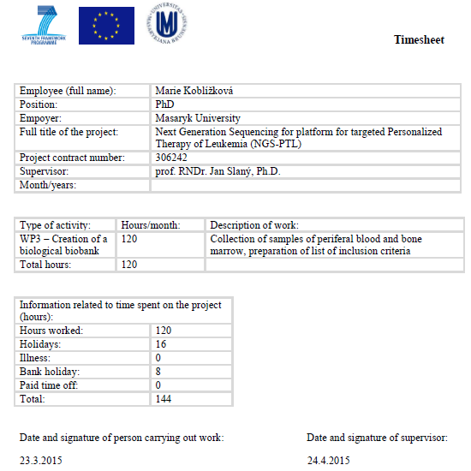
Timesheets
Record of the amount of a researcher's time spent on the project

Slide 95

Change management
Change is possible if:
you justify the reasons – outline benefits
it is well communicated – good communication is important in overcoming resistance to change
you ask for it in time – do not imply the change until the funder approves it. Plan ahead, change approval may take even weeks.
Minor change – e.g. duration of one activity, minor financial changes
Major change – e.g. project aim, duration of project, big shifts in cost categories etc.

Slide 96
Communication
  Good communication is essential to wellbeing of any project
  Personal communication
  E-mails
  Publications
  Website
  Presentations
  Project meetings
  Communication plan – clearly assign key roles, responsibilities, their importance and preferred way of communication

Slide 97

Communication – common failings
  Unwillingness to communicate bad news
  Not asking for help when it's needed
  Poor communication channels
  Lack of honest communication

Slide 98
Closing a project
A process of finalizing all activities across the project and to formally complete the project or phase.
  Review all information (especially deliverables) to make sure that work is completed and objectives have been met
  Actions to transfer project outcomes to next phase
  Collect records, audit of success or failures, gather lessons learned and archive project information
  Give recognition and reward to the team

Slide 99
Sources of information
Jan Doležal, Pavel Máchal, Branislav Lacko a kol. - Projektový management podle IPMA, 2. aktualizované a doplněné vydání
Roland Gareis: Happy Projects
Orr Alan: Advanced project management,
Rita Mulcahy, PMP, et al. – PMP® Exam Preparation, 8th edition
Patzak G&Rattay G (2004): Projektmanagement - 4. Auflage Linde Verlag Wien
Verzuh Eric (1999): The fast forward MBA in project management – John Wiley&Sons Inc.
Young Trevor (2004): The handbook of project management
Terri Morrison, Wayne Barker Stephen, Cole Rob (2009): Projektový management pro praxi; Co nejlepší projektoví manažeři vědí, říkají a dělají

Slide 100
Thank you for your attention

