Slide 1
The Hitchhiker’s Guide to the Career in Science
Zuzana Holubcová

Slide 2




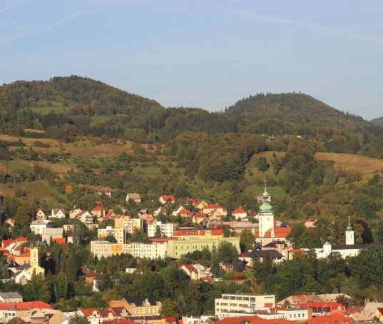

My Career Path
Cambridge
Brno
Vsetín
Brno

Slide 3

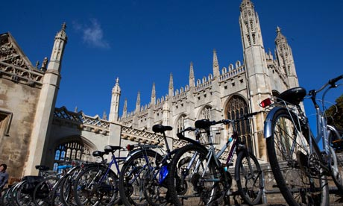
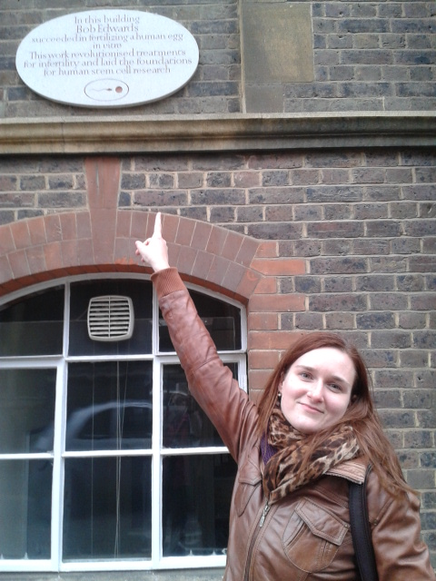
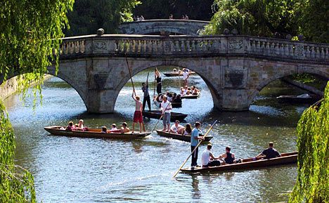

Slide 4
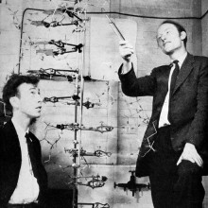
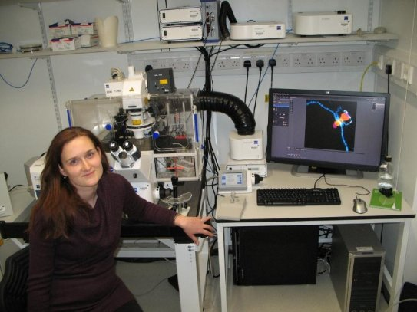

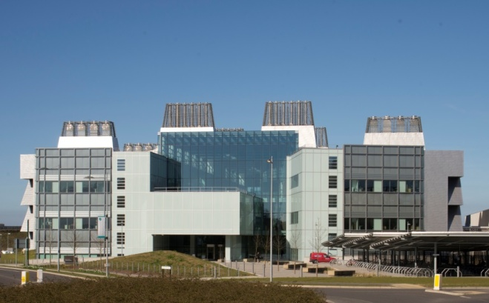


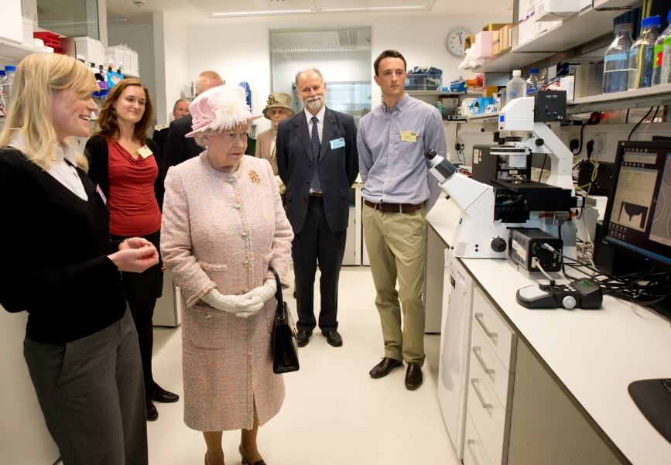
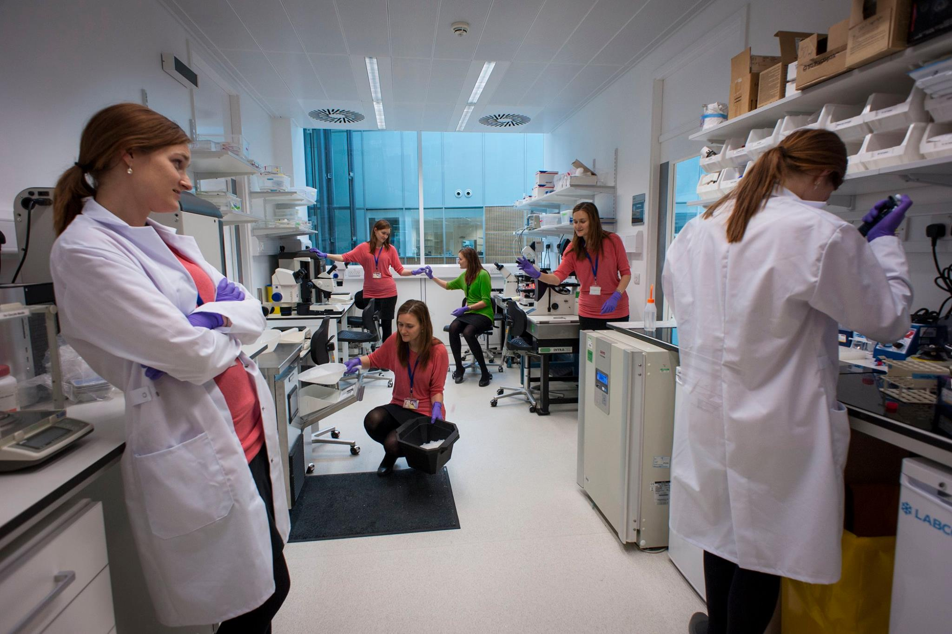

Slide 5
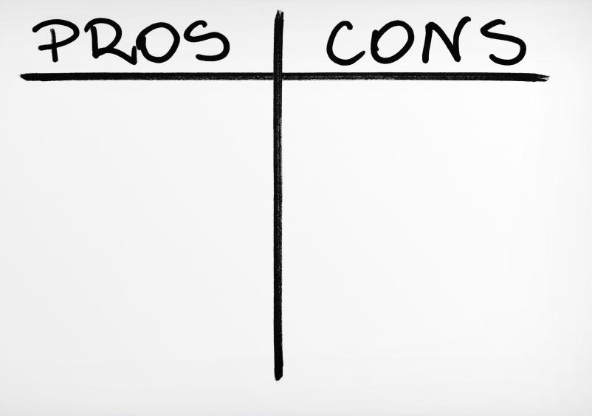
Career in Academia
challenges
• The SCIENCE
• It’s not boring
• The flexibility
• The community
• Travel
• The international
friendships
• The work / life balance
• Loneliness
• The pressure
to “be successful”
• Getting grants
• Lack of support
• Financial insecurity

Slide 6
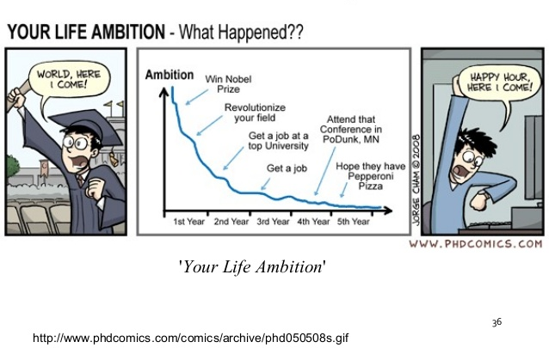

Slide 7
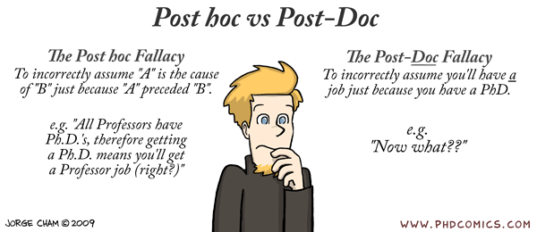

Slide 8
Career Strategy
Know WHY (Developing an understanding of your motivations and reasons for pursuing a particular career)
Know HOW (Acquiring the professional and academic capabilities that are necessary to do the required work)
Know WHOM (Building networks, relationships and sponsors; identifying helpful people)
Know WHAT (Monitoring opportunities, threats and risks, requirements for the role)
Know WHERE (Sourcing opportunities to enter the field, develop your capabilities and progress your career)
Know WHEN (Judging the best timing for decisions
and actions)

Slide 9
Career Service
Career advisors, CV and Cover Letters Guides, Take Away Materials, Prospects Career Planner
Career events, Courses/Workshops
  Personal Development
  CV/Cover letter writting
  Job search tools
  Career Stories
  Presentation of Recruiters, Headhunter, Entrepreneurs, Investors
  Proposal writting
One to one appointments, Interview Preparation,
Mock Interviews
CV/cover letter review/proof reading
Database of alumni, vacancies and opportunities (incl. Fellowships, Internships and Regionaly Based R&D Companies)

Slide 10

How to Approach Your Career Path
Self-knowledge
Opportunities
Matching
Applying

Slide 11
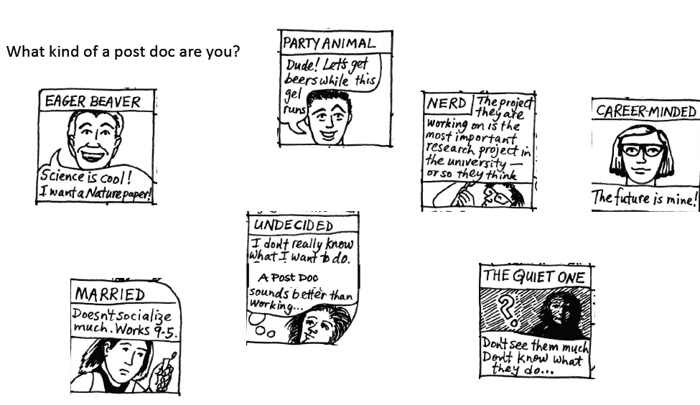
What Kind of PhD Student/Postdoc Are You?

Slide 12

The importance of
Self-knowledge
What are your interested in?
What motivates you?
What are your skills & attributes?
What are your priorities?

Slide 13
Self-Analysis
Work-Life Balance
Team Work
Independence
Personal Possessions
Leadership
Personal Grown
Risk
Security
Creativity
Competition
Appreciation
Stability
Expertise
Wealth
Responsibility
Respect
Leisure Time
Work-life balance
Challenge
Income
Travel
Communication
Excitement
Flexibility
Fun
Predictible Working Hours
Friendship
Sense of Achievement
Networking
Contribution to Society
Engagement
Promotion Opportunity

Slide 14
Self-Analysis
Do you prefer to work alone, with little input / interference from anyone including your supervisor?
Do you work best as a member of a team?
Are you self-motivated or do you need a structure to help keep you on track?!
Do you want feedback on how you are doing on a regular basis?
Are you self-centred (even selfish ??) or do you happily contribute to the smooth running of the lab?
Do you find it impossible to ‘say no”? Do you do too much outside your own research?
How well do you know all your own strengths and weaknesses?!
How well do these match to your career aspirations?
Do you face up to your own weaknesses and address them or do bury them!

Slide 15
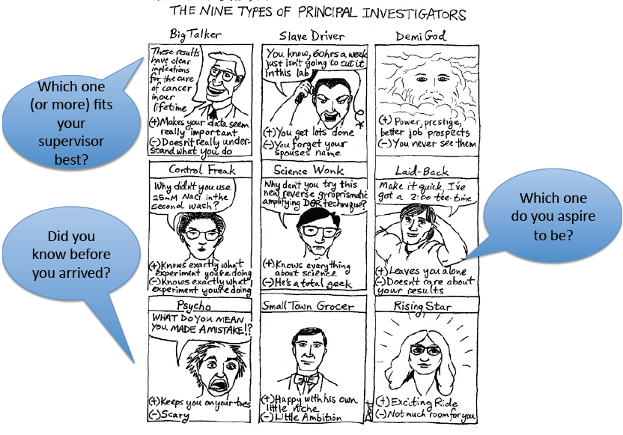
You and your PI (Supervisor)

Slide 16
What are the kinds of problems that can arise?
Poor communication - Lack of attention, lack of time with your supervisor!
You are not performing up to his / her standards but you don’t know how to improve.
You think that he/she is not showing enough interest in your work.
Poor relationships within the lab –you think that poor behaviour goes unpunished / even rewarded, you feel excluded
You are actively discouraged from taking training courses
You are afraid to bring up problems because you think it will be “held against you”
Life – work balance: You and your supervisor don’t agree on what is reasonable!

Slide 17
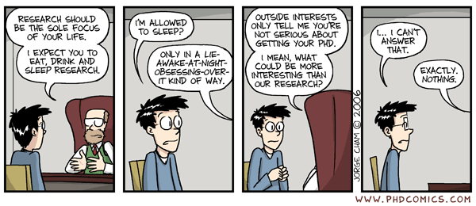
Work-Life balance

Slide 18
If things start to go wrong….
You have to take the initiative to improve things
before difficulties escalate
If you don’t speak up, then how is he/she expected to know you are unhappy? He / she is very busy, so help by making things explicit , clear, and suggest remedies yourself..!
Develop strategies to make things work better & discuss them with him / her
Show your self to be hardworking, dedicated and that you play your part
Talk things over early on! No supervisor wants to have an unhappy team.

Slide 19
Building your academic profile
Research
Engagement
Teaching

Slide 20
Building your academic profile
TEACHING
RESEARCH
ENGAGEMENT
Effective teacher
Knowledgeable about teaching and
learning theory and principles
lyblis |.r abo gt.telchin g inn gyati o
Leatt -ns birava*i:y roti;, in€duee@di, '.
innovation or enhancement
Discipline expert who guides new
educational paths
Quality publications and sufficient quantity and regularity
Collaborations
Grant funding
Track record of quality conference presentations
Industry connections
Supervising research students
Patents, commercialised research
Gaining research impact and recognition

Slide 21
Building your academic profile
TEACHING
RESEARCH
ENGAGEMENT
Effective teacher
Knowledgeable about teaching and
learning theory and principles
lyblis |.r abo gt.telchin g inn gyati o
Leatt -ns birava*i:y roti;, in€duee@di, '.
innovation or enhancement
Discipline expert who guides new
educational paths
Effective teacher
Knowledgeable about teaching and learning theory and principles
Publish about teaching innovations
Lead or play a key role in educational innovation and enhancement
Discipline expert who guides new educational paths

Slide 22
Building Your Academic Profile
TEACHING
RESEARCH
ENGAGEMENT
Participate in university committees
Provide workshops / seminars on area of expertise
Conference /Eventsupport / Coordination
Manage projects, programs, initiatives
Participate in projects of team activities
Contribute as a reviewer for academic journals
Adviser to government / industry; Board membership
Public speaker /Commentator/ Active social media presence
Effective teacher
Knowledgeable about teaching and
learning theory and principles
lyblis |.r abo gt.telchin g inn gyati o
Leatt -ns birava*i:y roti;, in€duee@di, '.
innovation or enhancement
Discipline expert who guides new
educational paths

Slide 23
Career „T“
BREADTH
DEPTH
Breadth
Have you applied your skills and knowledge? How many roles have you filled? Are these roles varied and diverse? What are the key achievements ? Am I focused on the right thing? Are they visible to the others? Am I balanced? Am I well positioned to support my future aspirations?
Depth
What skills/expertise/ knowledge do you possess? Am I future proofed?
Can I step into different academic role?
Do I have sufficient depth and confidence to do so?
Am I not under-utilising my skills? Do others know about my skills?
What new challenges must I set?
Notes:
(What)

Slide 24
Outside Academia?
Using Your
Science
Background
Something
Completely
Different
Academic
Career
Industry
Research
Specialised,
familiar
but insecure
Options are
little wider
but still
research based
Using knowledge
and understanding
of science but not
hands on research
skills
Using transferable
skills rather
than specific
knowledge
Increasing search effort and likelihood of refraining
BUT increasing number of opportunities

Slide 25
Careers Outside Academia
Industry R&D – Pharma, Biotech, Physical Sciences Firms, CRO (Contract Research Organisation), Spin-offs
Supportive R&D – Clinical Trial, Sales and Technical Support, Bioinformatics, Statistics and Commputation Biology services
Healthcare Science, Public Health, Government Labs
Science Communication – Jounalism, Publishing, Public Relations, Science Outreach,, Education
Consultancy, Patent, Tech Transfer, Start-ups
Finance, Modelling, Data analysis, Software Development
Research Funding and Management – grant management, funding bodies
Scientific Admin, Science Policy, Training and Support Roles
EU and International Organisations, Local Government

Slide 26

Time Management
Use planner
Make „to do list“
Get organised
Identify effective work time of the day
Create rituals/habits
Programme/social networks blockers
Define your day priorities and tasks

Slide 27
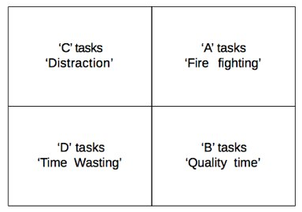
4D Time Management Matrix
IMPORTANCE
HIGH
LOW
DO
DEFER
HIGH
URGENCY
LOW
DELEGATE
DUMP

Slide 28
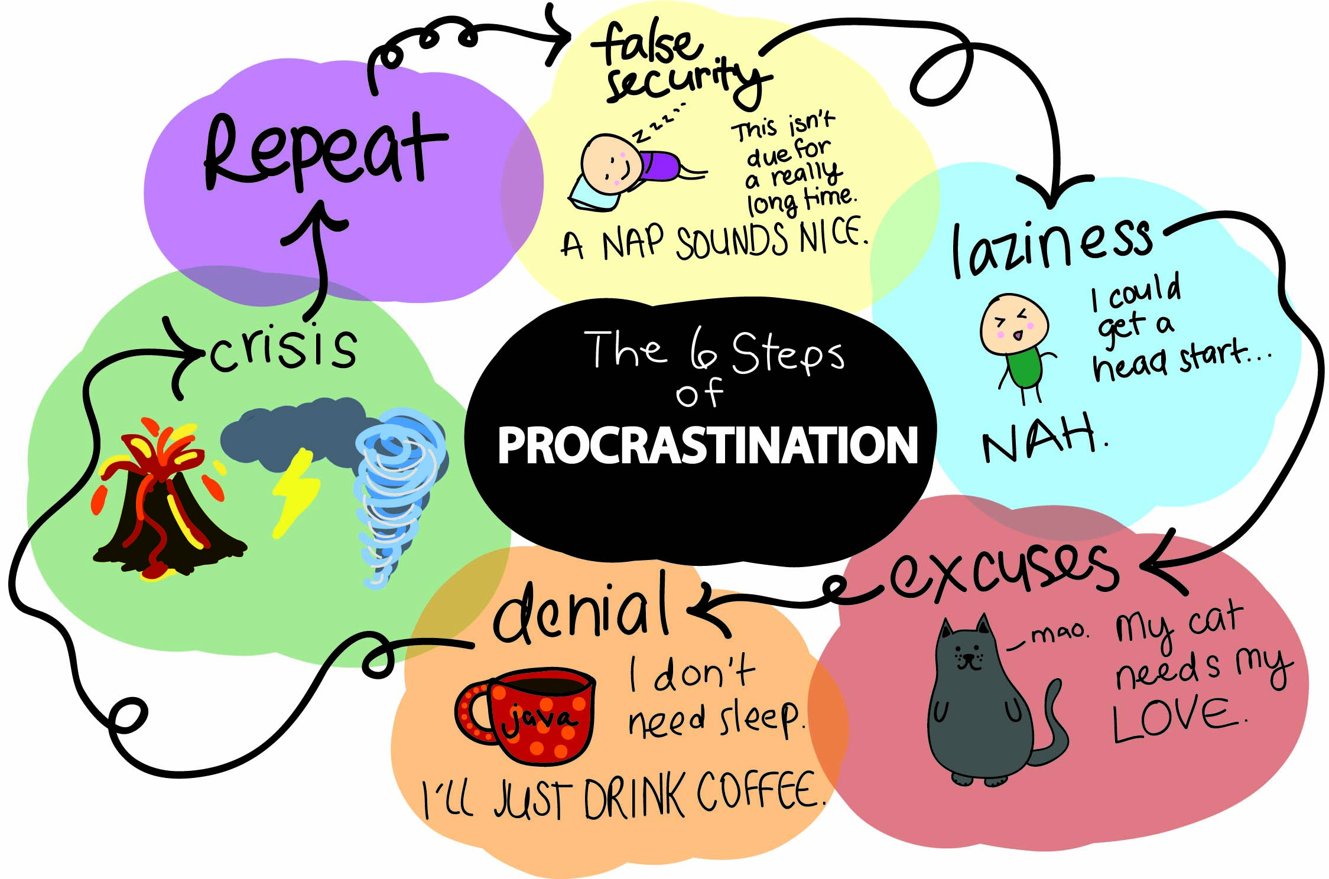
Procrastination

Slide 29
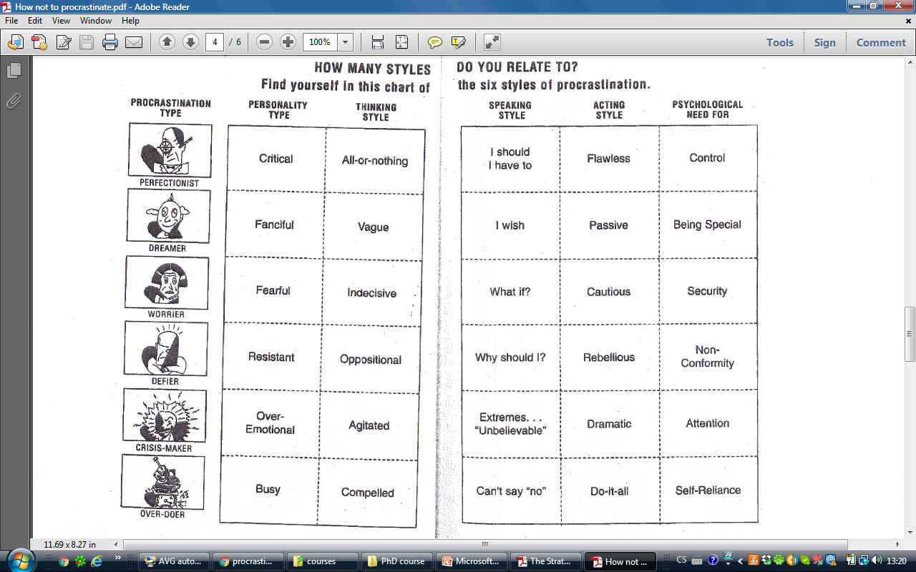

Slide 30
How to MANAGE Procrastination
Set a realistic goal
Be realistic (rather than wishful) about time
Break your goal down into small specific minigoals
Just get started
Reward your progress along the way
Protect your time
Use next 15 minutes
Work in focus bursts
Expect obstacles and standbacks

Slide 31

Networking
Notes:
whome

Slide 32
Networking
Collaborations
Student Conferences, Seminars, Summer Schools, Public Talks
Be ready for the unanticipated „elevator talk“
  „career pathways are filled with unxpected kindness of strangers“
Social networks
  Research Gate
  LinkedIn
  (Facebook)
Membership in Societies, Student communities, Academic boards,..
Volunteering

Slide 33

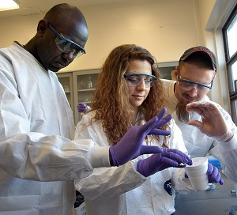
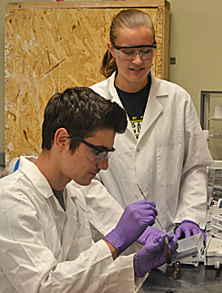
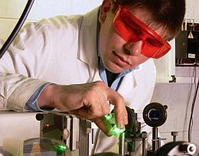
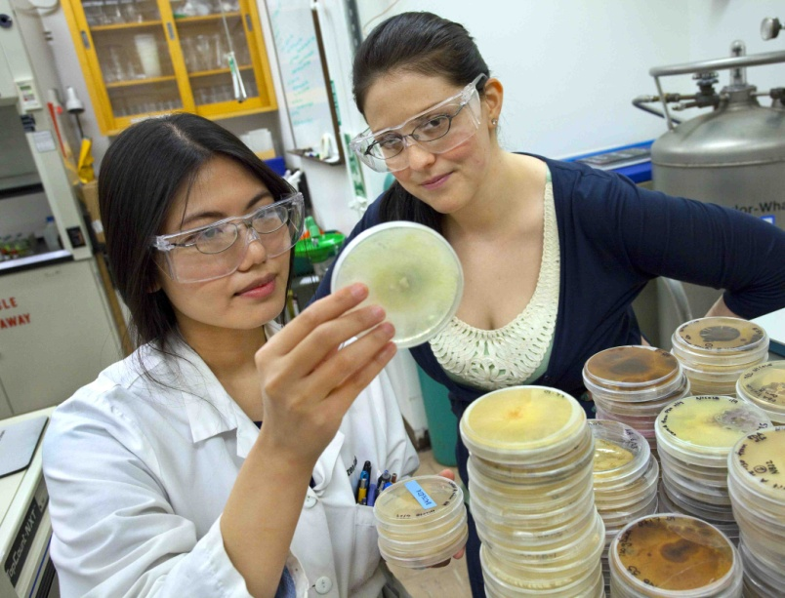
Internships
Notes:
(Where) How

Slide 34







Fellowship Applications and Student Contests
Opportunity
  for a career review
  to develop/improve writting and presentation skills
  to shape your ideas
  to gain finantial credit/funding
  to build networks and increase your visibility in the field
  to improve your CV and job opportunities

Slide 35
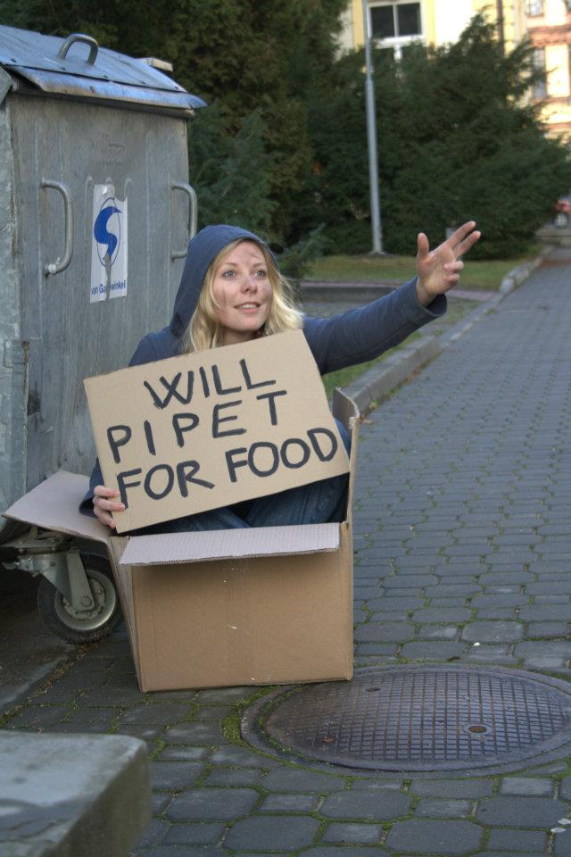
Know Your Value

Slide 36

„Do Not Go For Comfort, Go For Challenge“

Slide 37
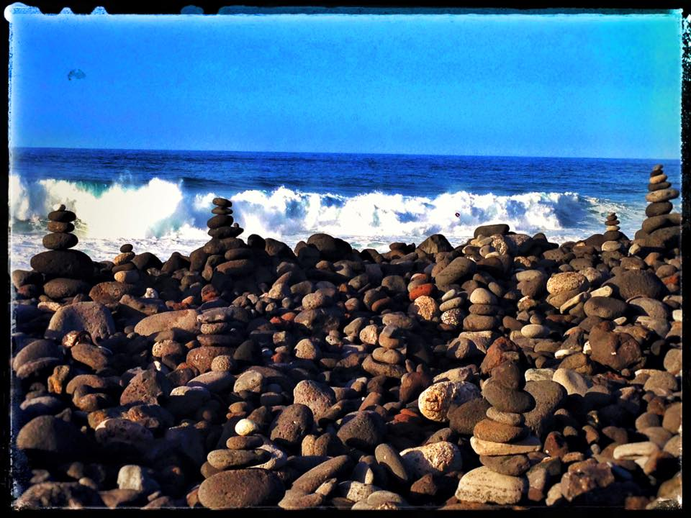
Life’s too short to waste time doing something you don’t love doing!

