Slide 1
National Funding Opportunities
Roman Badik
Head of Research Office
April 28, 2017

Slide 2
Content
MU research income
National funding oppotunities
Internal Funding Opportunities
Research support at MU

Slide 3
MU Research Funding
State budget – 33 %
Projects through grant competition – 66%
Absolutely:
  2 billion CZK

Slide 4


Different funding streams supporting research
1.
National providers
GA ČR (Czech Science Foundation)
TA ČR (Technology Agency of CR)
Ministries
Regional: SoMoPro
2.
International sources
Horizon 2020
EMB/EMBO
EEA grants
International Visegrad Fund
US funding schemes
Foundations
etc.
3.
EU Structural and Investment Funds
OP RDE Operational Program Research, Development and Education
OP EIC Operational Program Entrepreneurship, Innovation and Competitiveness

Slide 5
Institutional support
27% of all research income at MU
  Based on research evaluation results
  Current methodology
    Pillar I – publication results evaluation
    Pillar II – quality of selected research results
    Pillar III – patents and applied research results

Slide 6
Reseach funding sources at MU – non-investments

Slide 7
Reseach funding sources at MU – investments

Slide 8
National Funding Opportunities

Slide 9
National grants providers – non-investments

Slide 10
Different approaches
Programmes in basic research = open scope, researchers choose the topic of research
  Czech Science Foundation (GAČR)
Programmes in applied research = more targeted approach, topic of research must correspond to the programme
  Technology agency, other programmes of applied research

Slide 11
Technology readiness level
TRL 0: Idea. Unproven concept, no testing has been performed.
TRL 1: Basic research. Principles postulated and observed but no experimental proof available.
TRL 2: Technology formulation. Concept and application have been formulated.
TRL 3: Applied research. First laboratory tests completed; proof of concept.
TRL 4: Small scale prototype built in a laboratory environment ("ugly" prototype).
TRL 5: Large scale prototype tested in intended environment.
TRL 6: Prototype system tested in intended environment close to expected performance.
TRL 7: Demonstration system operating in operational environment at pre-commercial scale.
TRL 8: First of a kind commercial system. Manufacturing issues solved.
TRL 9: Full commercial application, technology available for consumers.

Slide 12
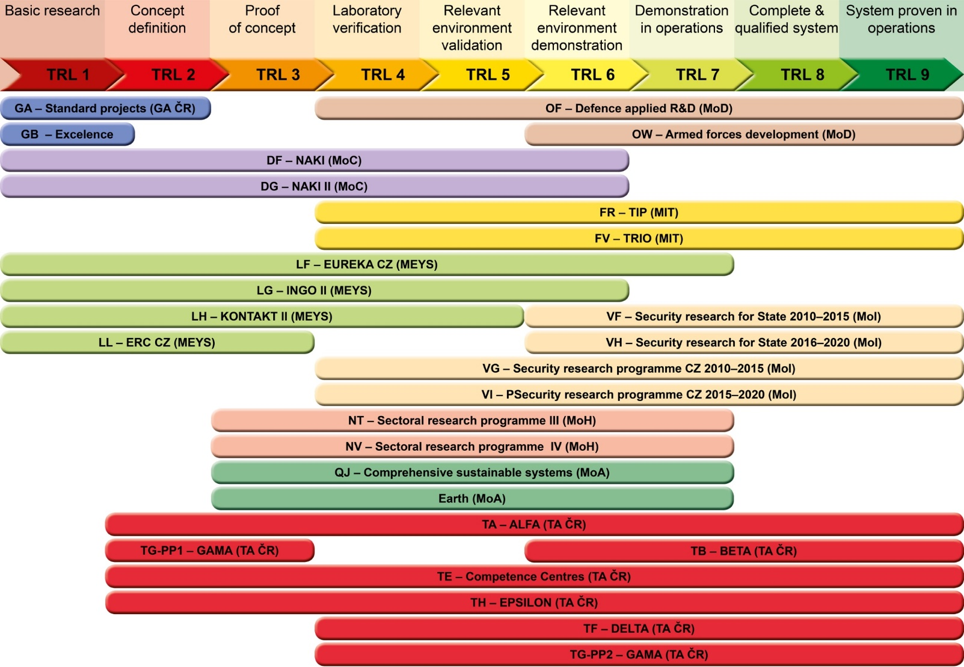
Technology readiness level on national level

Slide 13
Czech Science Foundation (GAČR) - features
Basic research
All disciplines
Individual research teams
Bottom–up principle
evaluation based solely on excellence (of the PI and the project)
peer review system of evaluation

Slide 14
Czech Science Foundation (GAČR) - programmes
STANDARD PROJECTS – excellence in basic research
JUNIOR PROJECTS – young excellent researchers
BILATERAL PROJECTS – international cooperation in basic research (Germany, South Korea, Taiwan)
LA GRANTS - Czech-Austrian Joint Research Projects with the The Austrian Science Fund (FWF)

Slide 15
Czech Science Foundation (GAČR) - statistics
Standard grants starting in 2017
Number of proposals: 2129
Number of supported projects: 698
Success: ≥ 33 %
Junior grants starting in 2017
Number of proposals: 283
Number of supported projects: 97
Success: ≥ 36 %

Slide 16
Technology Agency
BETA
DELTA
EPSILON
ÉTA
THÉTA
ZÉTA
Public tenders following state administration requirements.
l
Market lounge for new technologies, materials, products and services in energetic engeneering, environment and transport
Supporting research, experimental development and innovation of applied social sciences and humanities.
Projects aim at updated National Energy Policy of the Czech Republic.
International cooperation in the applied research focusing on specific countries in every call.
Cooperation between the academia and companies through students and young researchers.

Slide 17
Sectoral ministries of the Czech Republic
TRIO
NAKI II
KUS
Security research
Medical research

Slide 18
Sectoral ministries of the Czech Republic - MEYS
Inter-Action
KONTAKT – support of international cooperation
COST CZ – support of multi-lateral cooperation through European platform of COST Actions
INGO – support of membership in non-governmental research organizations (e.g. CERN)
EUREKA – support of SMEs
GESHER-MOST – Czech-Israeli cooperation in applied research
MOBILITIES – support of researchers‘ mobility
Czech-Norwegian research programme
Large Infrastructures for R&D – support of infrastructures on the Roadmap
Inter-Excellence

Slide 19
SoMoPro as a regional instrument
Regional fellowship programme inspired by Marie Skłodowska-Curie Fellowships
Incoming grants to attract researchers from abroad to undertake research and training in the South Moravian region
Research experience + mobility conditions
Next call hopefully coming soon

Slide 20
Summary

Slide 21
Internal Funding Opportunities and Research support at MU

Slide 22
Research support at MU – financial incentives
Grant Agency of Masaryk University:
  For students:
    Specific research – projects for PhD students
  For PIs:
    Interdisciplinary research projects
    High-risk high-gain projects
    Excellent results
  Support of international research grants preparation

Slide 23
Research support at MU – non-financial
Information spreading
  Research Office newsletter
  Research Office website
  Information seminars, workshops, trainings
    GRANTSWEEK 2017 - autumn
Individual support provided
  Individual consultancy with Research Office staff
  Help with proposal development

Slide 24
Thank you for your attention

