Slide 1
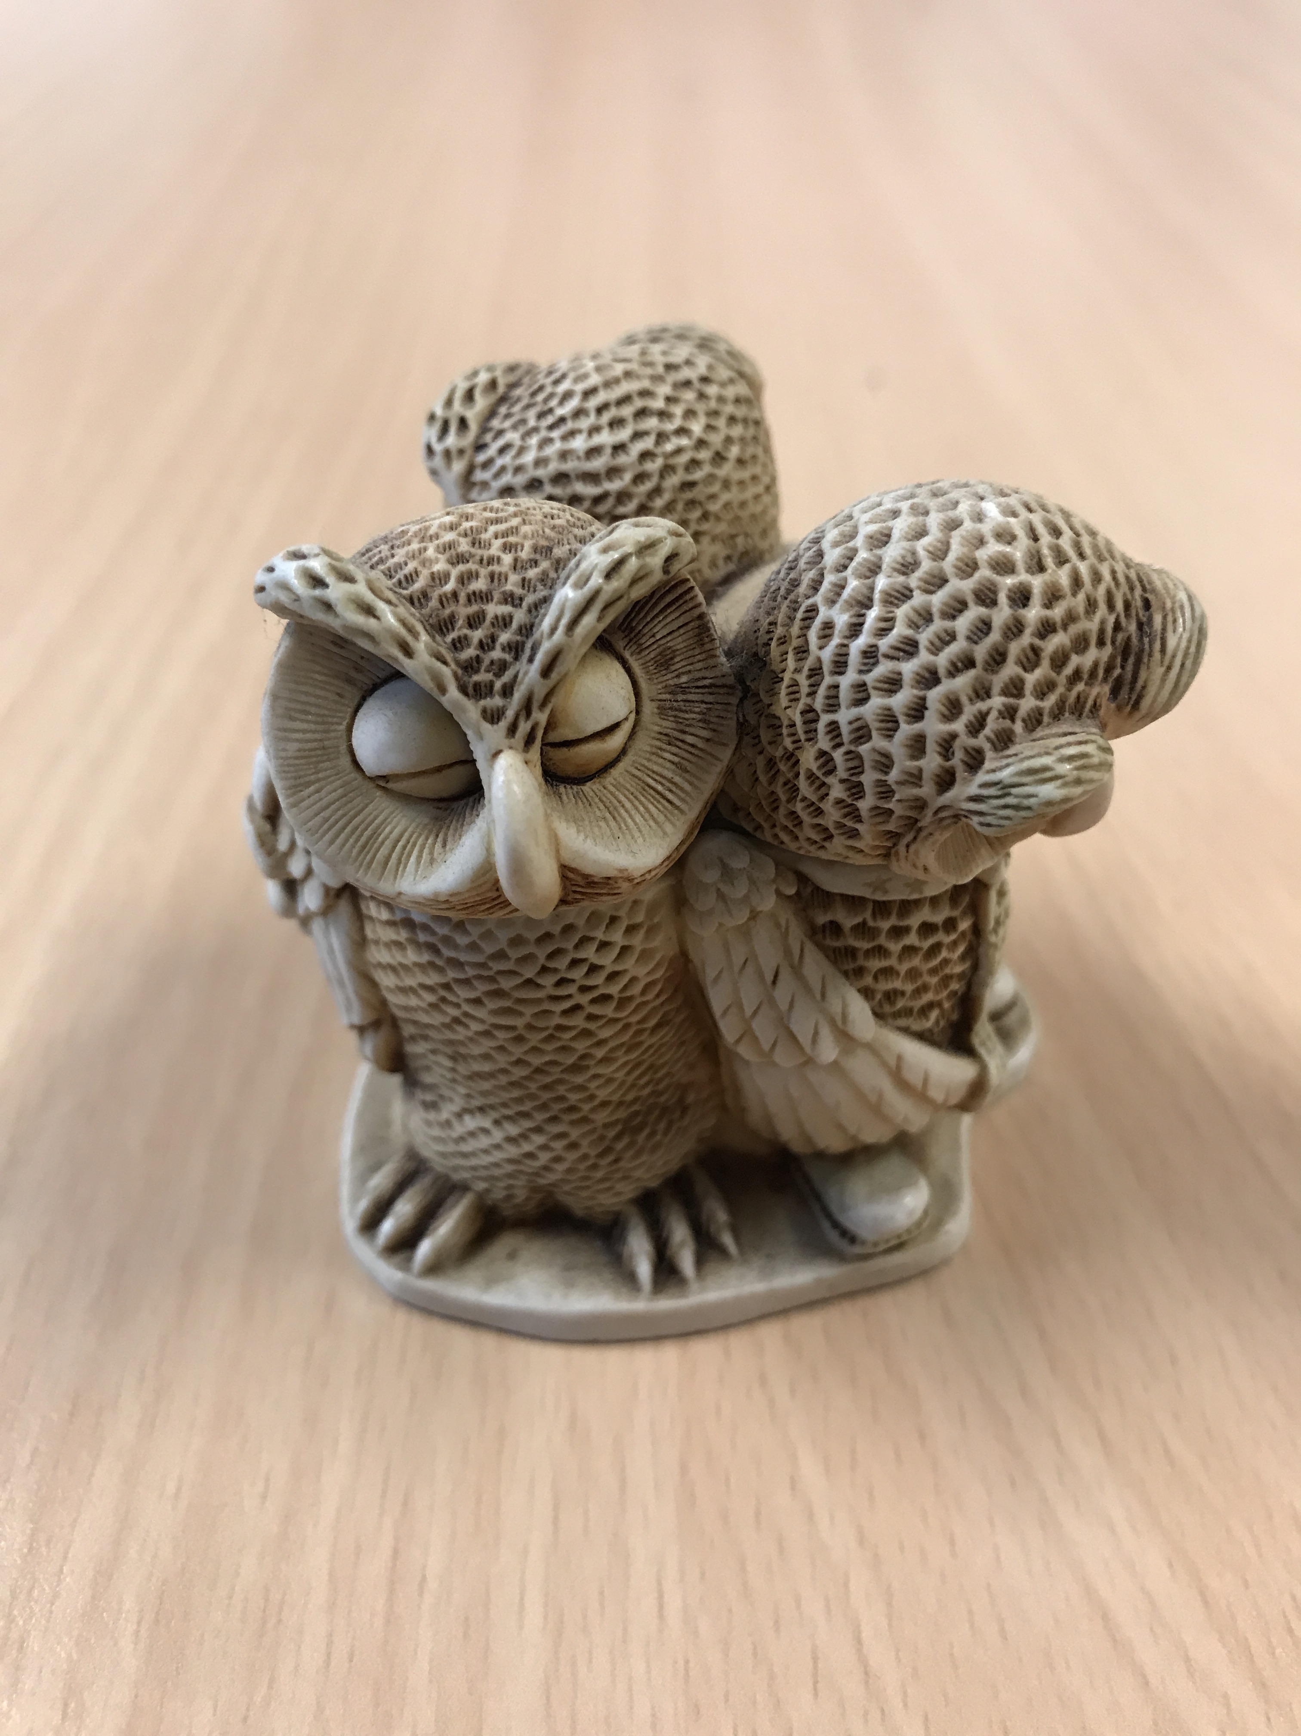

English Language Focus Summer School
Masaryk July 2019
Essential Language Skills
& Areas Of Focus

Slide 2
IN THIS WORKSHOP
Essential Skills & Areas of Focus
F.L.I. And Dunglish
Czechlish (?)
Check your own skills
Academic focus

Slide 3
A Second Language Speaker Issue
Essential Skills & Areas of Focus
F.L.I. (?)
First Language Interference
A fact for all 2nd language speakers
Dunglish
Spanglish
Franglais
Chinglish
”Czechish”?
  Each “ish” has it’s own problems
  …… a problem for “lingua franca” communication

Slide 4
Dunglish 1
Essential Skills & Areas of Focus
I am the first woman state secretary for the inside and I’m having my first period
I am the first female Minister of the Interior and this is my first term of office.
He had it not standing in his diarrhoea
It wasn’t written in his diary

Slide 5
Dunglish 2
Essential Skills & Areas of Focus
She worked hardly (Ze heeft hard gewerkt)
She worked hard
I am there earlier been (Ik ben dar eerder geweest)
I have been there before
The monkey’s coming out of your sleeve (idiom)
Now I see what you mean

Slide 6
……. And Spanglish
Essential Skills & Areas of Focus
He doesn’t have two fingers of forehead
He’s not very intelligent
Idioms, colloquialisms and jokes don’t always translate from one language to another
The culture of language: direct / conditional?
The “you” problem

Slide 7
Over to you (1)
Essential Skills & Areas of Focus
Does “Czechlish” exist?
  What problems do Czech speakers find when transferring to English?
Small groups (2 or 3). Think about
  Vocabulary
  Grammar
  Idioms
  Other
Be prepared to report back

Slide 8
Over to You (2)
Essential Skills & Areas of Focus
Test your own skills

Slide 9
Academic Focus
Essential Skills & Areas of Focus
DISCUSSION FOCUS
What do you expect from yourself when you teach in English?
What do you expect from your students?

