Slide 1
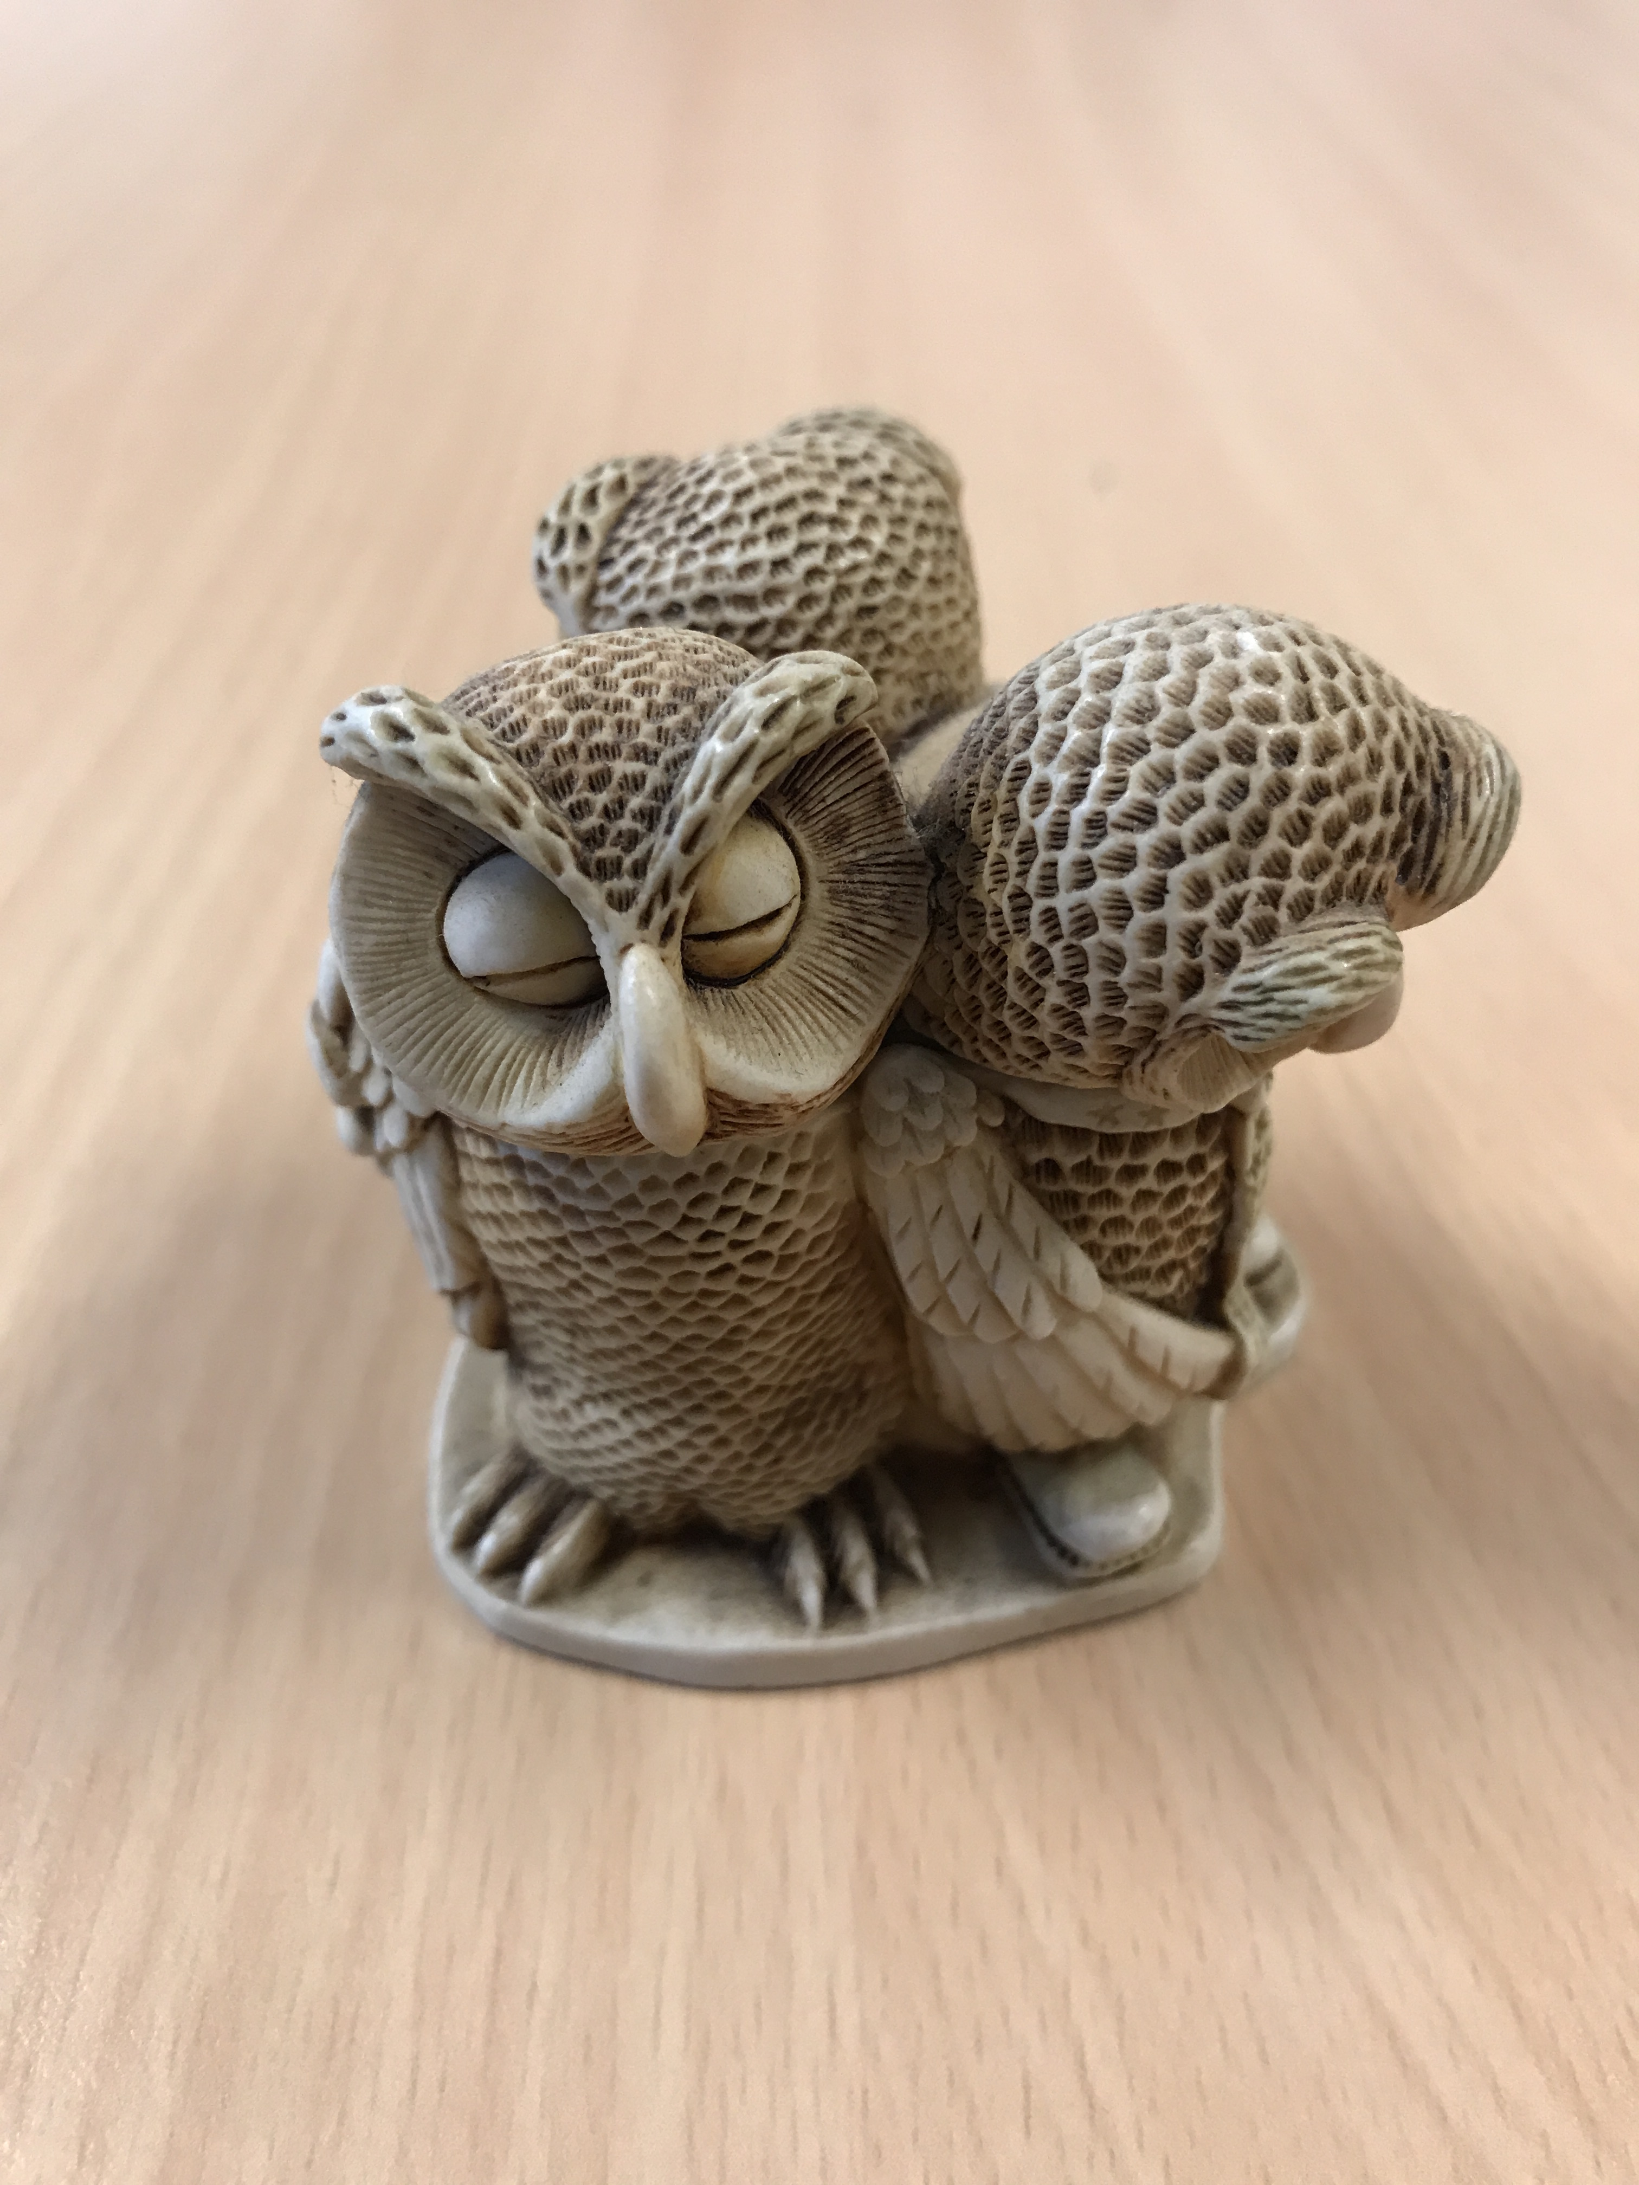
English Language Focus Summer School Masaryk July 2019
Introduction
Marcus Grollman

Slide 2
Dagal!
Introduction
Mog nimen Marcus Grollman
Nimen yoog?

Slide 3
Dagal 2
Introduction
How did you feel?
Confused?
Irritated / annoyed?
Worried?
Interested?
English as friend of foe?

Slide 4
This Workshop
Introduction
Dagal!
Introductions (personal, professional, role of English)
The State of Play

Slide 5
The State Of Play
Introduction
English as a “lingua franca”
English as THE academic language?
Movement of students (Erasmus, etc.)
Increasing number of English-medium courses (Bachelor, Master, PhD)
First language English-speaking students
The situation in Groningen (meetings, Student Services, HR, etc.)
Language training for students
Language training for teachers

Slide 6
Over To You
Introduction
Groups of 2 or 3 (preferably same institution / department)
Think about the situation in your workplace
What about your own personal issues?
Be positive as well as critical
Be prepared to report back to the whole group

Slide 7
A brief discussion
Introduction
Global English: A friend or an enemy?
What impact will the advance of Global (Academic) English have on you, your working practices and your future career?

