Slide 1
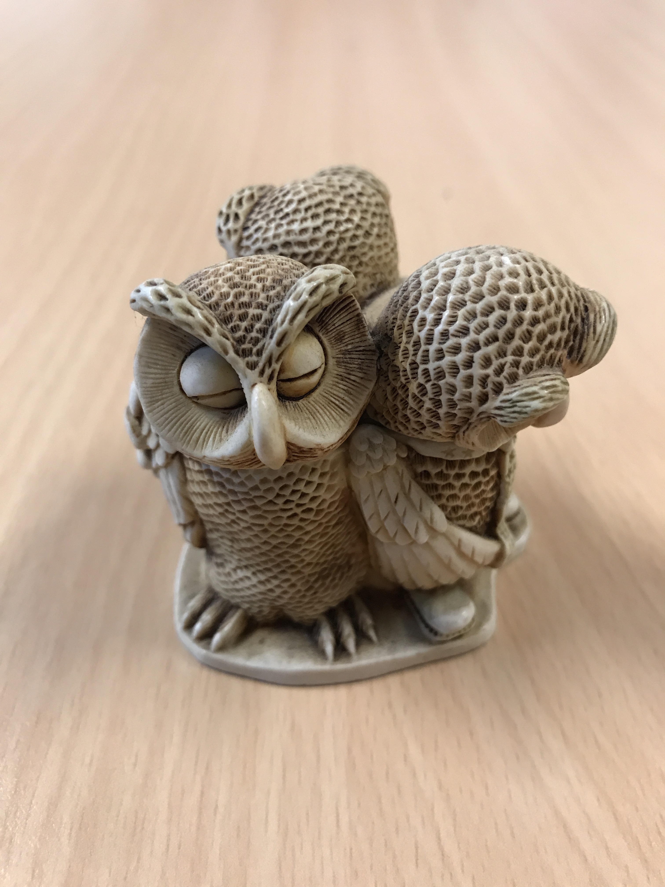

English Language Focus Summer School
Masaryk July 2019
Reading Skills

Slide 2
In ThIs workshop
Reading Skills
Discussion of techniques
Some reading exercises
A group reading activity

Slide 3
Discussion of techniques (1)
Make a list of all the texts you have read in English during the months of May and June (include everything …….. even film subtitles)
Discuss your list with a partner.

Slide 4
Discussion of techniques (2)
How do you approach a text (any text) which is written in English?
What do you do differently from when you read a text that is written in Czech
Discuss this in small groups?

Slide 5
Discussion of techniques (3)
What are the questions that need to be answered?
What information do you want to find?
What are you expecting from the text?
Skimming and scanning.
Reading in “chunks”
Get the main points.
Key words (underline)

Slide 6
Some focused Reading Activities
Please read these 2 texts on your own
Text 1: answer the questions
Text 2: try to produce a sentence that summarizes the content of each paragraph
You have 15 minutes on your own, then five minutes to discuss your answers with a partner.
Then you will get the answers!!

Slide 7
A group Reading Activity
Read the text on your own (15 minutes)
Make a note of what you consider the key words (or phrases)
Any vocabulary issues?
With a partner (or in a group of 3), produce a summary of the text (no more than 200 words) which will be presented to the whole group (20 mins)

Slide 8
What can you take away from this workshop?

