Slide 1
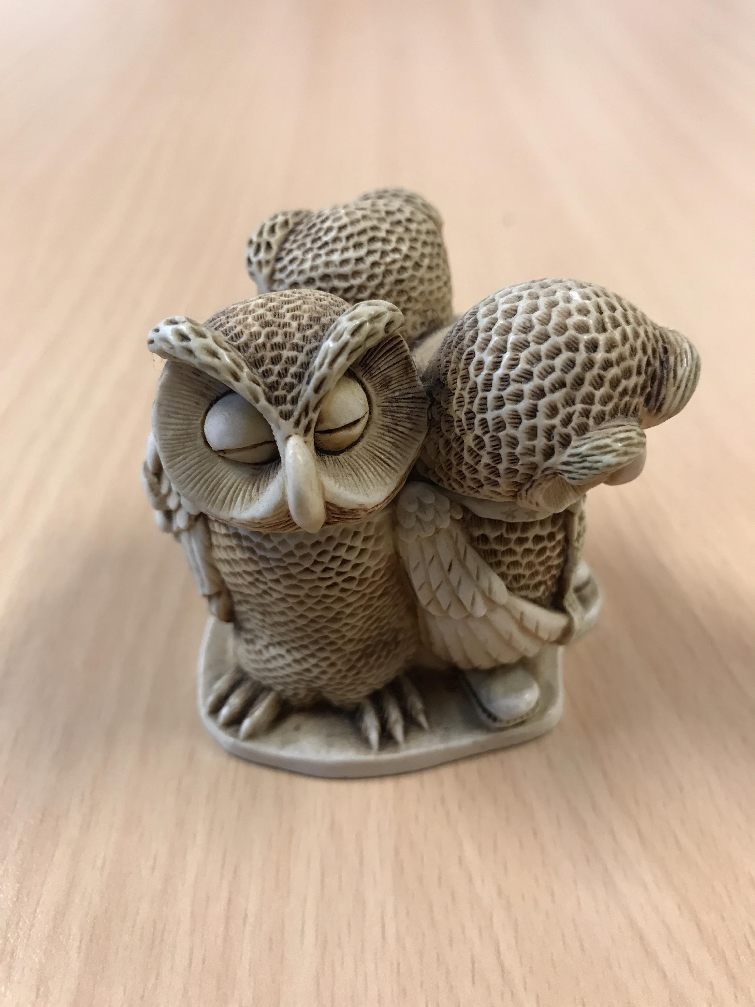

ENGLISH LANGUAGE FOCUS SUMMER SCHOOL
MASARYK JULY 2019
Speaking Skills:
know your audience

Slide 2
ACTIVITY 1
Speaking Skills
One-word story
Record: 12 minutes

Slide 3
IN THESE WORKSHOPS
Speaking Skills
What do we mean by English Speaking Skills?
The audience
Formal language, appropriate language
Let’s put it into practice.
Presentations
What can you take from these sessions?

Slide 4
WHAT DO WE MEAN BY ENGLISH SPEAKING SKILLS (1)
Speaking Skills
Communication
Accuracy?
Vocabulary and style
Grammar
Fluency and coherence
Who is your audience?
Appropriate to the (academic / non-academic setting) setting

Slide 5
ACTIVITY 2
Speaking Skills
What’s In The Box
A group of 5 year old children
A police briefing
A TV news report
A student seminar

Slide 6
WHAT DO WE MEAN BY ENGLISH SPEAKING SKILLS (2)
Speaking Skills
Issues for second-language speakers
The fear factor
Accuracy, grammar, fluency, coherence, style
Lack of “out of the box” vocabulary
FLI
Experience of Global (Academic) English

Slide 7
WHAT DO WE MEAN BY ENGLISH SPEAKING SKILLS (3)
Speaking Skills
Issues for native speakers of English (the “native-speaker problem”)
Complacency
Unawareness of an appropriate style
Unawareness of others
Poor grasp of the local FLI (can’t understand other’s English)
Experience of Global (Academic) English

Slide 8
ACTIVITY 4
Speaking Skills
Masarykia Amnesty

Slide 9
SMALL GROUPS
Speaking Skills
Use your discussion phrases
You are advocates for particular prisoners
What case can you make for each of your “candidates”
Make notes
Prepare an opening statement for the plenary
Remember your audience

Slide 10
ACTIVITY 3
Speaking Skills
FOR THE NEXT SPEAKING SKILLS WORKSHOP
3 minute presentations
(or mini-lessons)
Key issue:
Who’s the audience?
(you’re going to get some peer feedback)

Slide 11
PRESENTATIONS: HOW WE LOVE THEM!
Audio Visual Aids
As you watch these two examples, think about what is good or bad with these presentations.
https://www.youtube.com/watch?v=Y1qDNTG9lg0&t=8s
https://www.youtube.com/watch?v=sCTI5tcnEok
So, over to you ……..

Slide 12
USEFUL RESOURCES
Audio Visual Aids
http://www.speakingaboutpresenting.com/delivery/presentation-handouts/
http://totalcommunicator.com/vol4_1/handouts.html
http://learnenglish.britishcouncil.org/en

Slide 13
WHAT ROLE HAS GLOBAL ENGLISH IN ACADEMIC SPEAKING?
Speaking Skills
A form of English open to all
Clear
Appropriate
Suitable for the required task
Not British or American ………. GLOBAL
A learnt (and taught) skill
Allows the user to practise and develop what they already have

Slide 14
EVALUATION
Speaking Skills
What can you take from these sessions?

