Slide 1
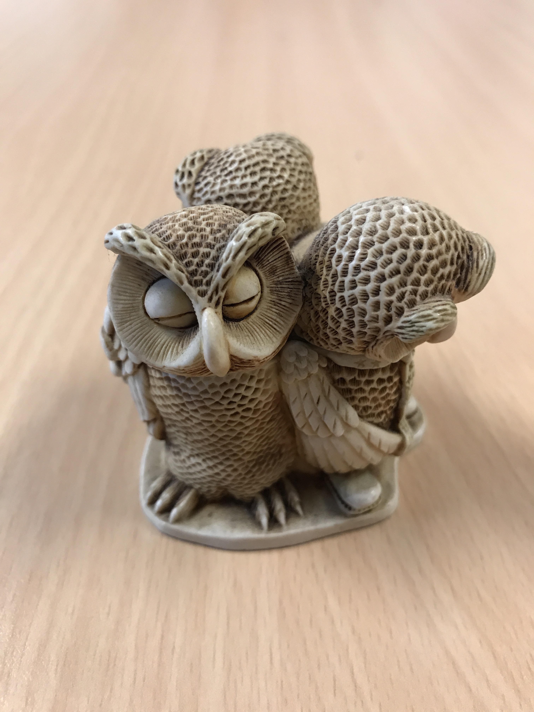

English Language Focus Summer School
Masaryk July 2019
Vocabulary Skills

Slide 2
In These workshops
Vocabulary Skills
Some useful resources
Formal versus informal
Transition phrases
Discussion phrases
Activity 1 Paired discussion
Formality in writing
Activity 2: Redrafting a text
What can you take from these sessions?

Slide 3
Some useful resources
Vocabulary Skills
BBC Learning English
http://www.bbc.co.uk/guides/z8gp2nb
University of Roehampton, London
https://pathway.roehampton.ac.uk/blog/best-apps-improve-academic-vocabulary/
English Page.com
https://www.englishpage.com/index.html
Pinterest
https://nl.pinterest.com/cathemccoy/academic-vocabulary/

Slide 4
Formal versus informal (1)
Vocabulary Skills
The effect of the media (TV, Internet, Film, Social media)
The SMS / WhatsApp generation
English invading first language
Cultural sensitivities
Factors affecting formality
lack of experience
Fear
Gap-fillers / redundant language
poor planning or language research

Slide 5
Formal versus informal (2)
Vocabulary Skills
WhatsApp versus Academic English
Thanks for coming to my presentation
I would like to welcome you to this presentation
I want to start with …..
I would like to begin by ……..
I’m gonna end with ………
I would like to conclude by ………
Yeah, well I think you’re wrong.
I wish to take issue with you on that point.
Lots of people think that ………
It is widely believed that ……….

Slide 6
THree Extra Resources
Vocabulary Skills
Informal & Formal Phrases
Transition Phrases
Discussion Phrases

Slide 7
Activity one
Vocabulary Skills
A Quick
Discussion

Slide 8
Discussion topic
Vocabulary Skills
In pairs, choose a topic. One partner speaks for and one against
15 minutes in small groups, followed by a plenary discussion, with a topic chosen by the instructor

Slide 9
Activity two (Second Workshop)
Vocabulary Skills
Redrafting a Text

Slide 10
Evaluation
Vocabulary Skills
What can you take away from these workshops?

