Slide 1

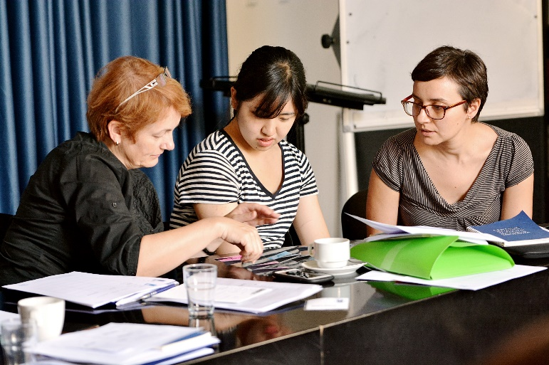
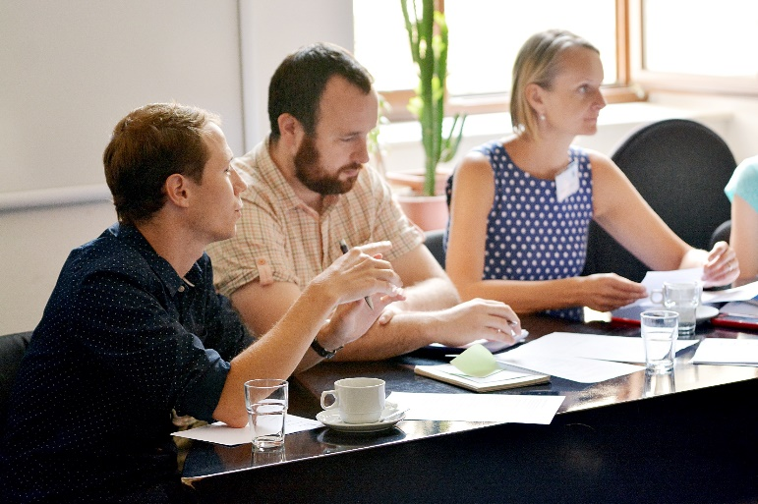
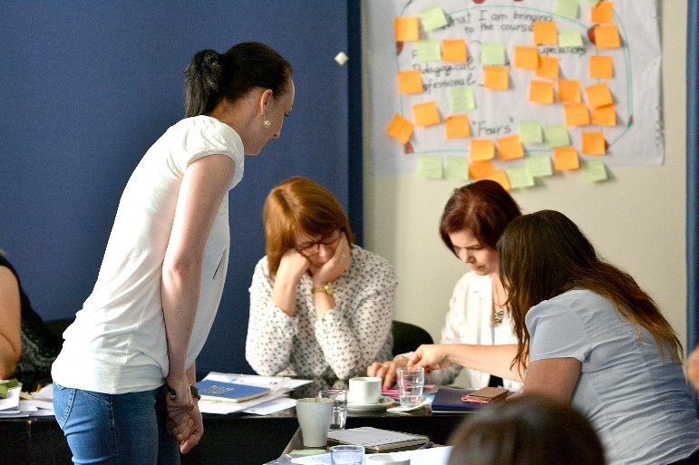

Seminar Styles
Alex Floyd - alex.floyd@cjv.muni.cz
Notes:
1

Slide 2
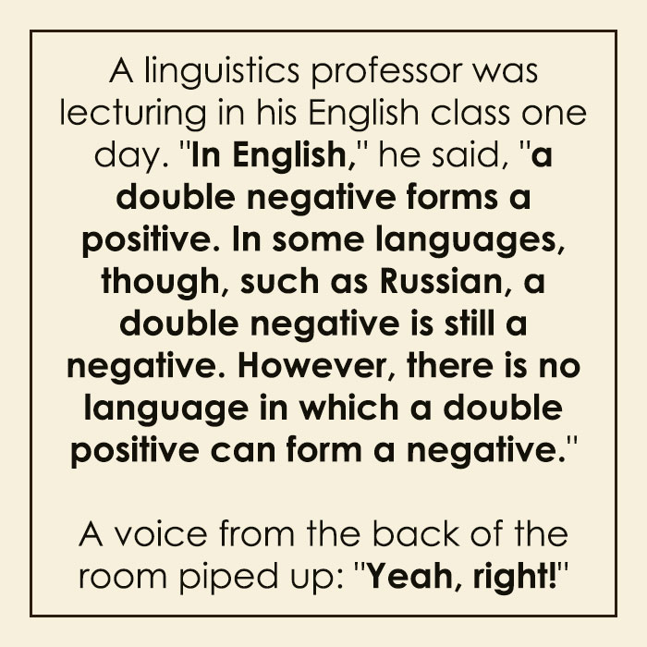
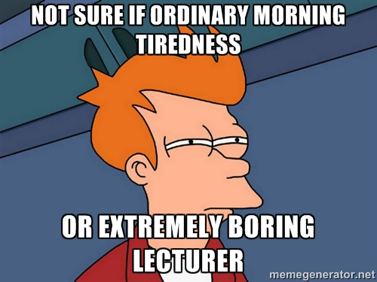
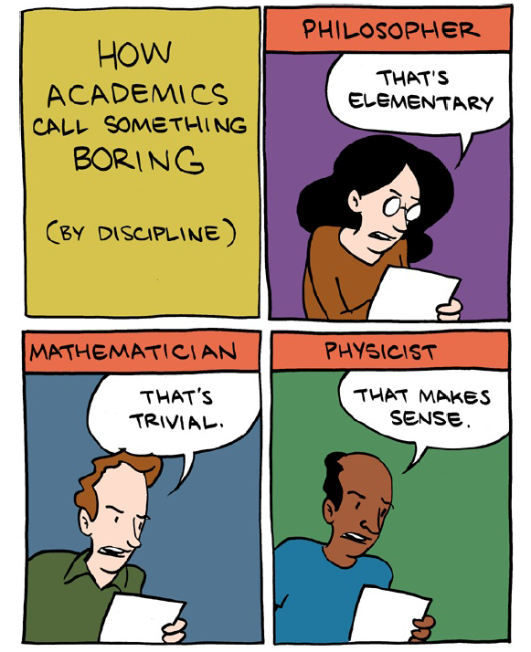

Slide 3
^{What we will discuss today…..}
What is a seminar?
Different styles of seminar
We will practice some seminar techniques
Speaking skills for academics
Functional language you can use when presenting

Slide 4


^{What is a seminar?}
Is a seminar different to a lecture?
If so, how?

Slide 5
Lecture: much larger groups, often whole year, less interactive, teacher led
Tutorial: 1:1 or small group meeting, usually with teacher, small group learning
Seminar: like a larger scale tutorial, up to 30 students with a lecturer/ teacher.
(Source: http://www.english-lecturer.com/what-is-the-difference-between-tutorials-seminars-and-lectures/)

Slide 6
^{Aim:}
To explore some different types and styles of seminar
To gain some experience practicing some different seminar styles…
Can you think of any seminar types / activities you have used in your teaching?

Slide 7
Teacher-led Seminar
Features: more traditional approach, teacher leads the group explicitly or implicitly towards certain learning outcomes.
Why: good for covering broader and key areas in the curriculum, students get to learn, absorb and practice essential areas of knowledge and skills (speaking, writing, vocabulary)
Challenges: need to keep students focused and on-track with learning outcomes, ensure participation from all students, volume of information covered can be challenging.

Slide 8
Teacher-led Seminar
These can be led, but need not be dominated by the teacher.
Choose a variety of activities that also involve the students to actively engage, speak, participate, answer questions, read, etc.
The later in the day….the more student activity and participation there needs to be. Also after lunch…

Slide 9
Role Play and Simulation
Features: rehearsal/preparation time needed, group or pair participation and co-operation required, more effective if goal based, pre-teach essential vocabulary
Why: Students become familiar with essential learning/outcomes in their subject area, valuable for practical skills including speaking, improvising.
Challenges: students may focus more on the role they take on – need to encourage swapping of roles where possible, can be harder for teacher to intervene to control or facilitate learning.

Slide 10
Role Play and Simulation (3-5 mins then swap roles)
Visiting your GP: In groups of 3, choose a patient, a Doctor and a receptionist.
Practice: The patient enters, informs receptionist of attendance for an appointment. Receptionist informs the Dr. The GP runs through some basic questions about the presenting problem (choose a common complaint) – when it started, symptoms, progression or the problem, treatment or medication so far, general health, then recommends some medication and advice. The patient then leaves and books a follow up appointment for the next week as they exit.
Pre-taught vocabulary/skills: to practice making appointments and discussing weekly diary, practice discussing basic health symptoms (eg cough, fever, aches and pains, feeling unwell, runny nose, sneezing etc), practice taking a medical history and prescribing basic medication and advice in English.

Slide 11
Role Play – your experience?
Was this a useful exercise for your own learning? Why / why not?
What would help this exercise be more useful / successful?
How could you apply a role play in your own field?
What would you do/not do when conducting a role-play exercise with your own class?

Slide 12
Debates
Features: rehearsal/preparation time needed, group participation and co-operation required, learning may come after the activity, pre-teach as needed.
Why: Interactive, excellent opportunity for high-level speaking / reasoning, students gain important points / arguments / language in their subject area, great at reinforcing important vocabulary.
Challenges: encourages students to take a position rather than just develop their own, may encourage strong opinions that aren’t necessary or accurate, can be harder for teacher to intervene to control or facilitate learning.

Slide 13
Debates – Practice Scenario (1 min per participant)
Question: Should facemasks have been compulsory during the recent Covid-19 lockdown period in Czech Republic?
For / yes group: You are arguing that the use of facemasks during the period SHOULD have been compulsory and that the government was right to do this. Compile your main reasons for this, each person be prepared to argue one main point for up to one minute.
Against / no group: You are arguing that the use of facemasks during this period SHOULD NOT have been compulsory. Come up with the main reasons why you think this is the case, each person be prepared to argue one main point for up to one minute.
Extras: Listen to the arguments and debate, rank each argument out of 10 in terms of the logic used, and the English (grammar, vocabulary etc).

Slide 14
Debate – your experience?
Was this a useful exercise for your own learning? Why / why not?
What would help this exercise be more useful / successful?
How could you apply a debate in your own field?
What would you do / not do when conducting a debate with your own class?

Slide 15
Fishbowl
Features: Students observe a discussion performed by their peers and take notes for feedback, or to join in later. Layout: often an outer and inner circle of chairs for those active in the discussion.
Why: Interactive, excellent opportunity for high-level speaking / reasoning, students gain important points / arguments / language in their subject area, students can practice both speaking and active listening / feedback skills. Students may have time to think of arguments then can participate later.
Challenges: can be lively and difficult to control, allowing everyone to participate at a level they would like to can be difficult though often manageable.

Slide 16
Fishbowl – Practice Scenario (5 mins then swap circles – or tap)
Question 1: Discuss some of the biggest environmental challenges facing the planet and it’s population today. Why have these problems come from and how have they become so significant? What do scientists predict for the future if the human population doesn’t address these issues?
Question 2: Now focus on some of the solutions to these environmental problems. What environmentally friendly solutions have become more common in recent decades? Is the human population improving it’s use of ‘green living’? What technology could help us combat these issues in the future?
Pre-taught Vocabulary: climate change, global warming, plastic pollution, deforestation, greenhouse gases, fossil fuels, rising sea-levels, emissions, recycling, renewable energy (solar, wind etc), electric cars and e-mobility, carbon capture, reducing plastic usage, energy efficiency etc.

Slide 17
Fishbowl – your experience?
Was this a useful exercise for your own learning? Why / why not?
What would help this exercise be more useful / successful?
How could you apply a fishbowl activity in your own field?
What would you do / not do when conducting this exercise with your own class?
*Variation: Wingmen – helpers advising (whispering / notes) the inner circle.

Slide 18
Mediated Feedback
Features: Students rehearse and practice a small aspect of a seminar / discussion feature. They can get feedback from their peers or record themselves for discussion / review.
Why: Interactive, excellent opportunity for high-level speaking / reasoning, students gain important points / arguments / language in their subject area, students can practice both speaking and active listening / feedback skills. Excellent source of feedback regarding your own performance / skill level, eg presentations. More to do with form and performance than content
Challenges: Covers less content, focuses more on skills, more time consuming.

Slide 19
Mediated feedback – Practice Scenario (2 mins then swap)
Mini-Presentation: In small groups of 3-4, each person to present for 2 minutes (informally) on one topic that they have presented in the past in English to students or colleagues. Spend 2-3 minutes preparing some points to speak about first. Swap so each person in the group has a chance to present.
Feedback: Practice listening to the content of the talk, but also to the language and observe the delivery of the presentation. Think about the tone / expression, pronunciation, vocabulary. Offer some useful feedback suggestions for any of the above.

Slide 20
Mediated Feedback – your experience?
Was this a useful exercise for your own learning? Why / why not?
What would help this exercise be more useful / successful?
How could you apply a mediated feedback activity in your own field?
What would you do / not do when conducting this exercise with your own class?

Slide 21
Academic Communication
Speaking Skills
Alex Floyd - alex.floyd@cjv.muni.cz
Notes:
21

Slide 22
Why are we here today?
Personal
-to practise my English
-to get to know new people
-to become more confident in my speaking skills
-to talk to a native speaker
Professional
-to learn some new/useful phrases
-to meet people who work in the same area
-to get the know-how about how to be an academic speaker
-to speak about specialised problems
-to listen to other colleagues
Pedagogical
-to find some tips for teaching speaking
-get ideas on how to make students speak in class
-to learn how to handle a discussion
-to compare what I have picked up about speaking in EAP with the session
-to make more motivating lessons
-to share ideas on various aspects of speaking

Slide 23
How do we need to communicate in the
^{academic arena?}
Different scenarios require different styles of communication and language……you need to develop a range of styles.
Lectures….seminars…..tutorials……
Other academics / institutions, students
Informal / semi-formal situations….eg. conferences, networking, lunch / drinks.

Slide 24
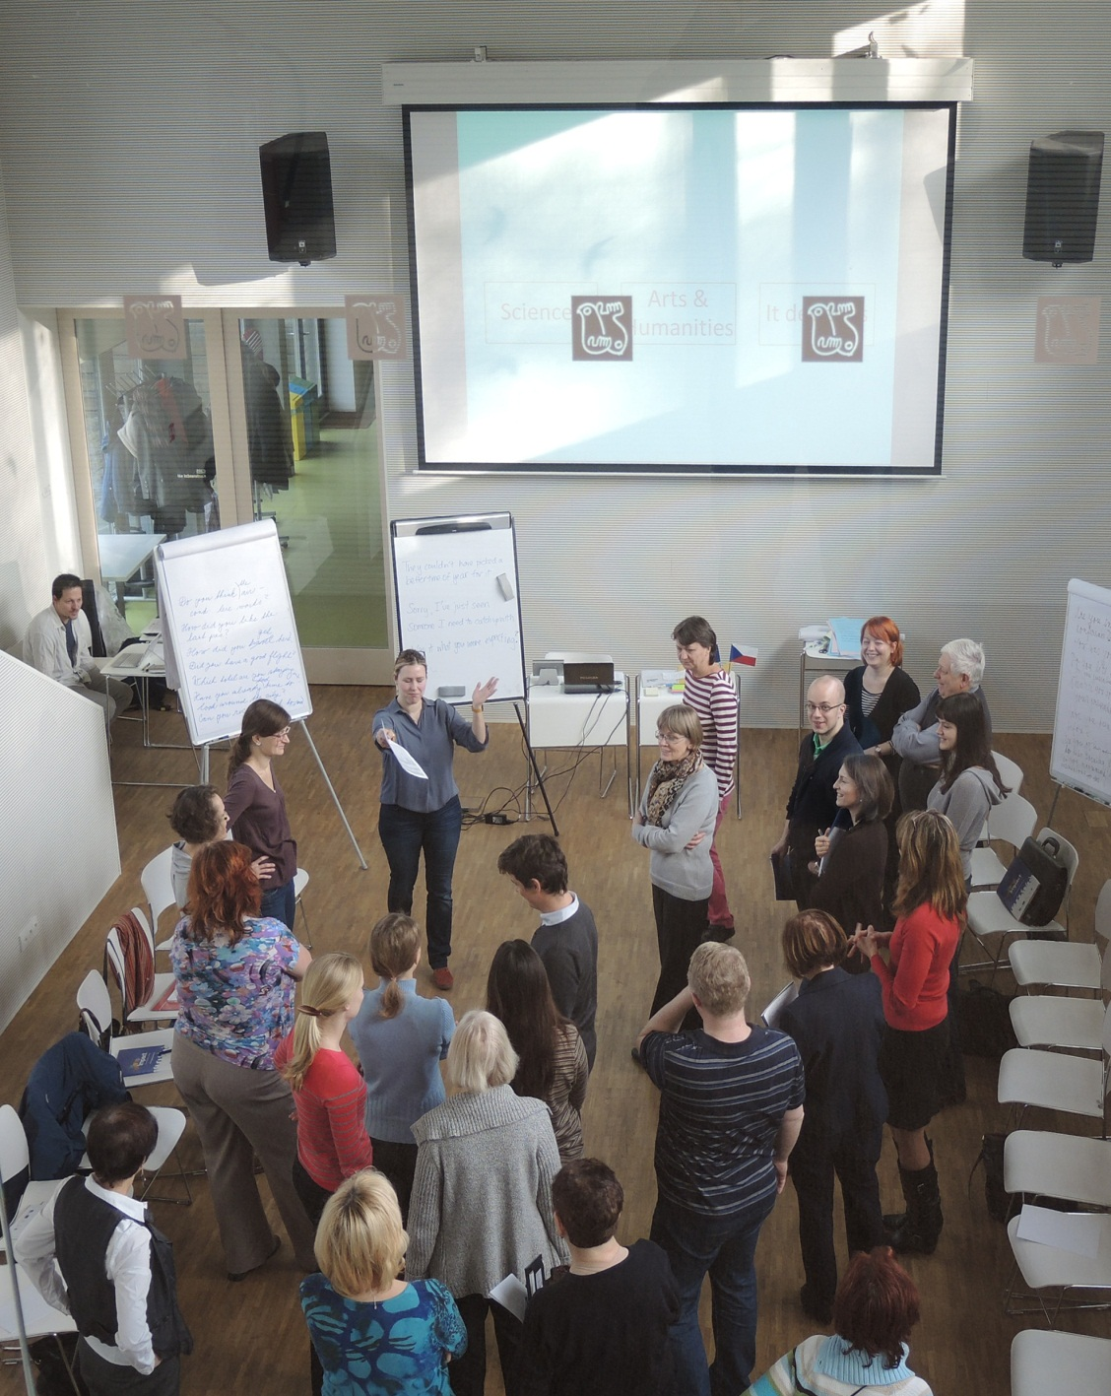
A semi-formal speaking situation… networking at a conference
Think of some examples of language that might be useful here….

Slide 25
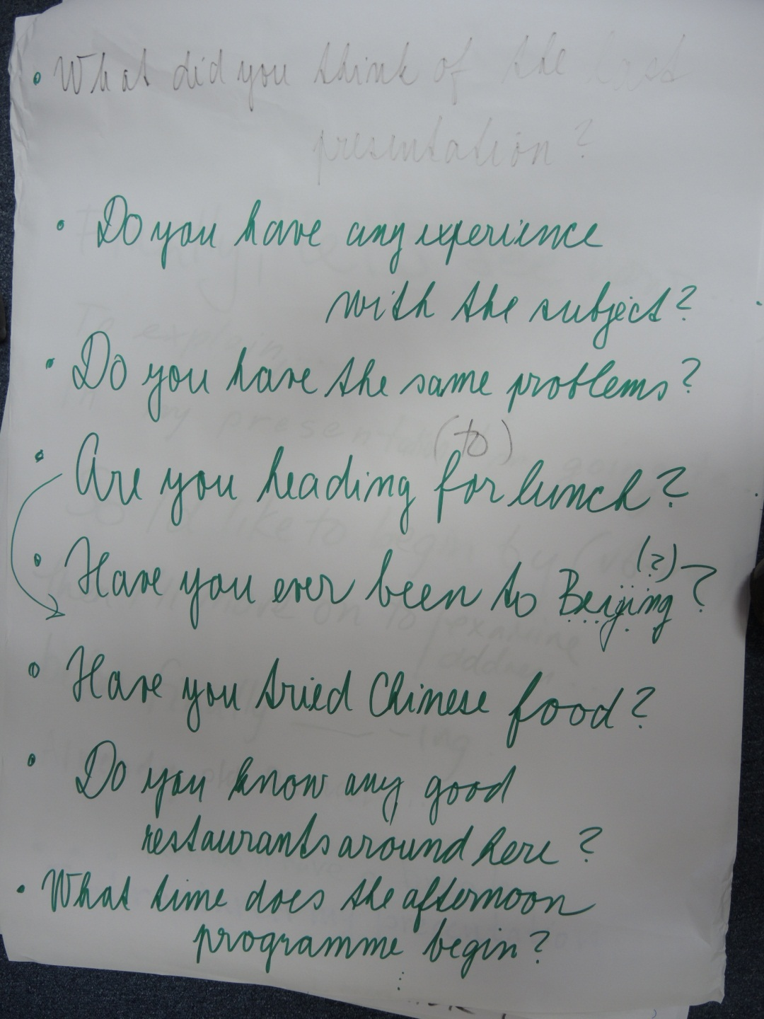
At a conference in Beijing in the summer just before lunch
#1

Slide 26
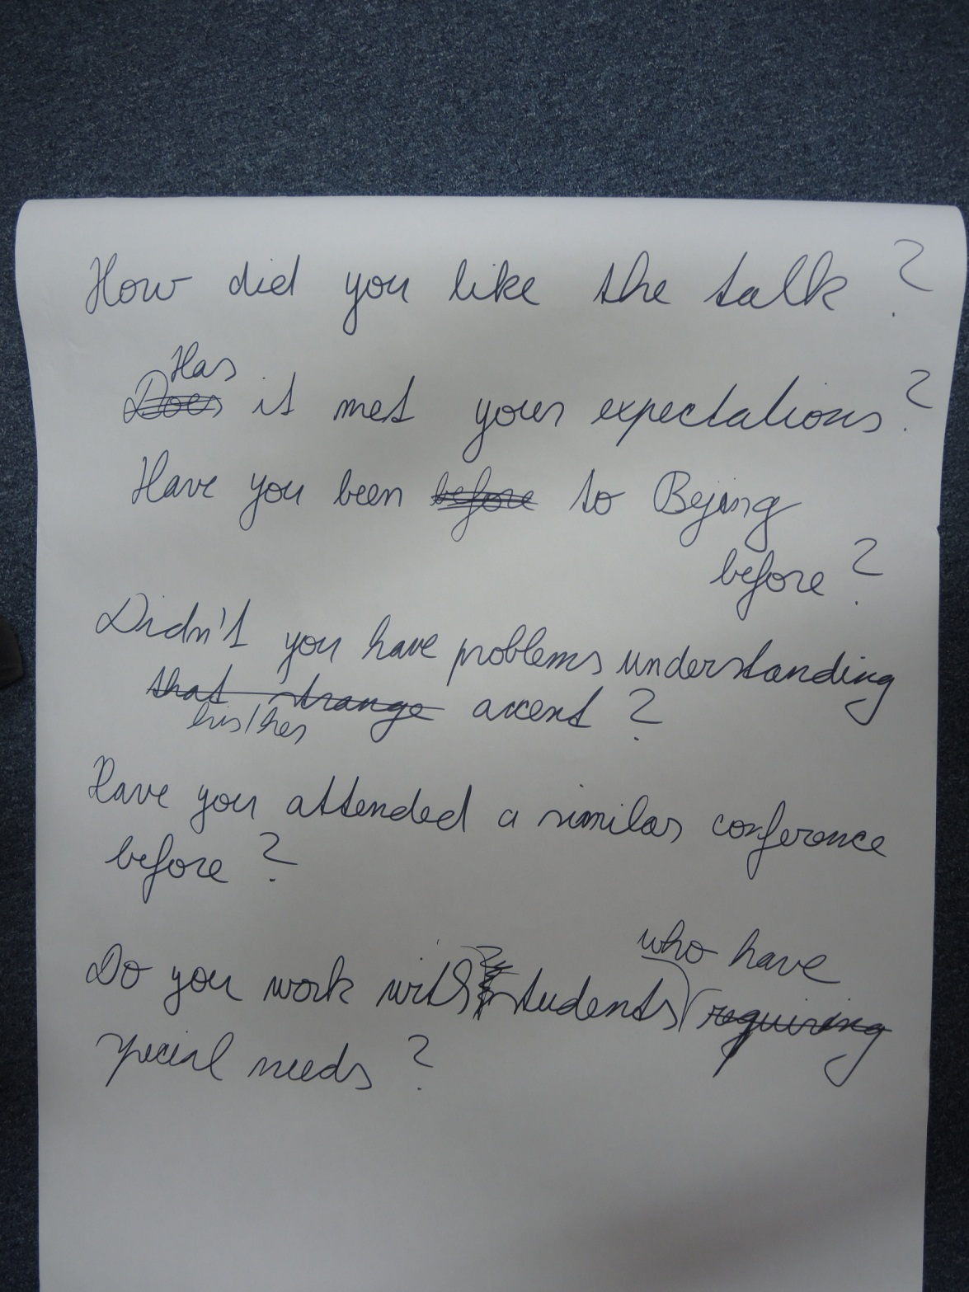
At a conference in Beijing in the summer just before lunch
#2

Slide 27
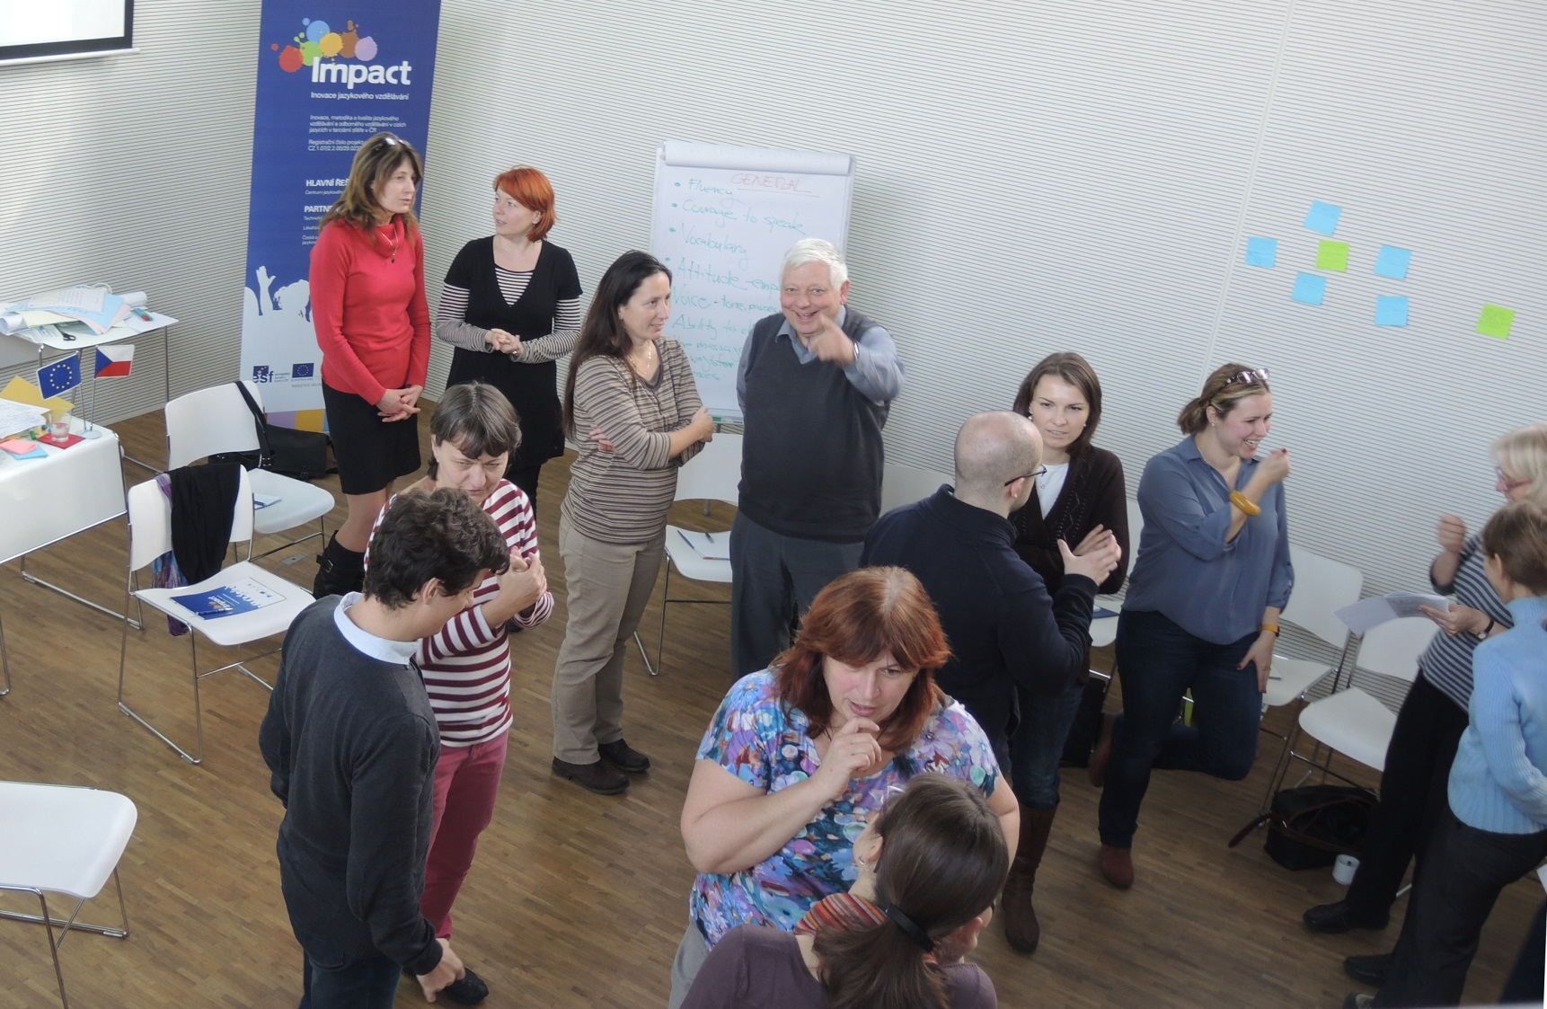
What do speaking skills involve?

Slide 28
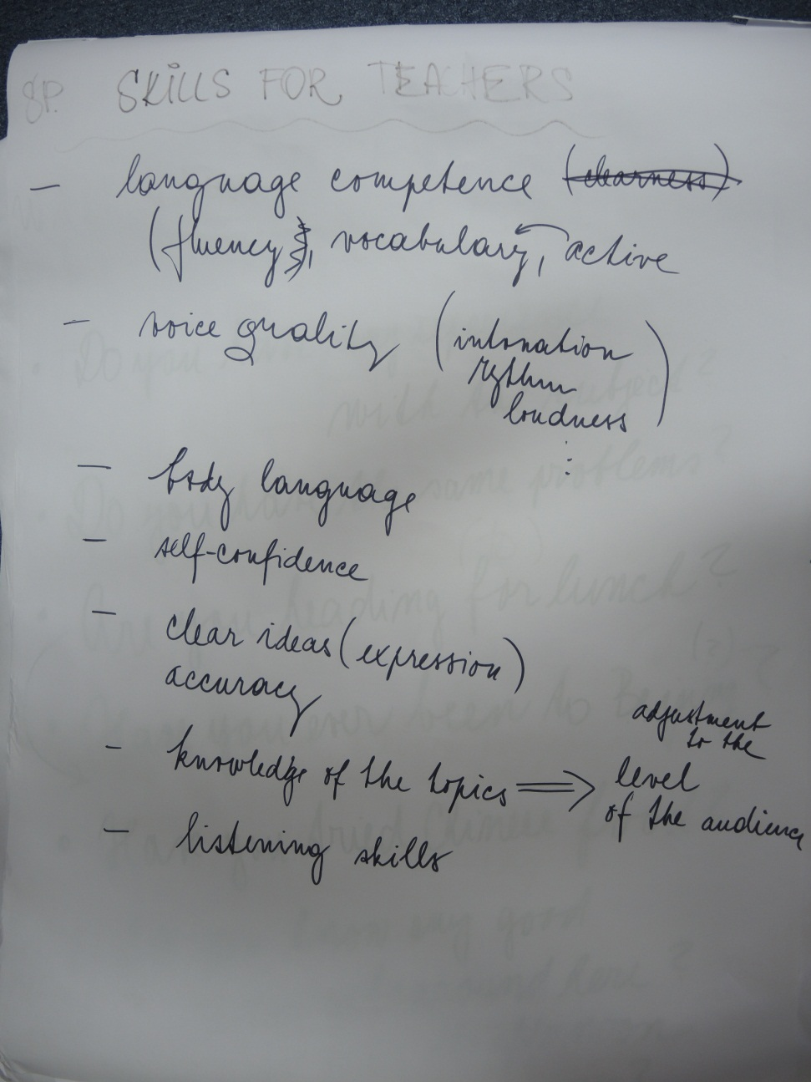
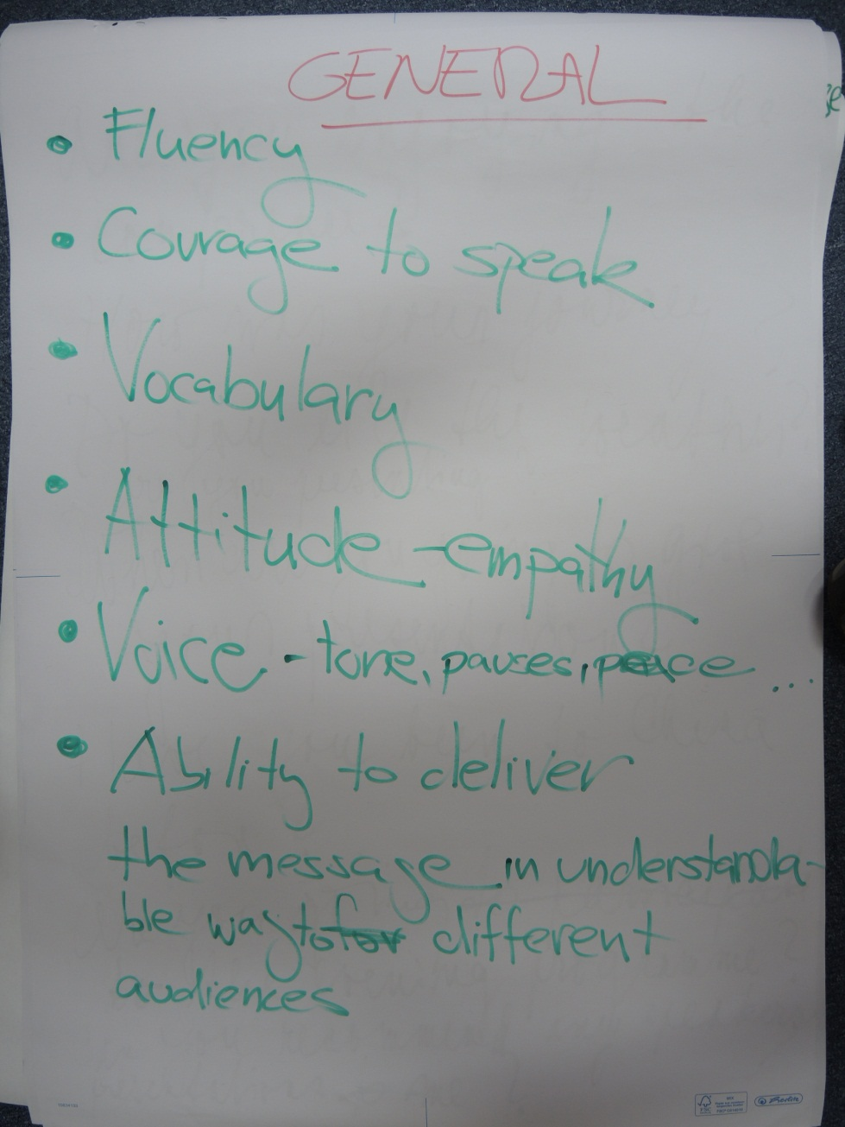
What do speaking skills involve?

Slide 29
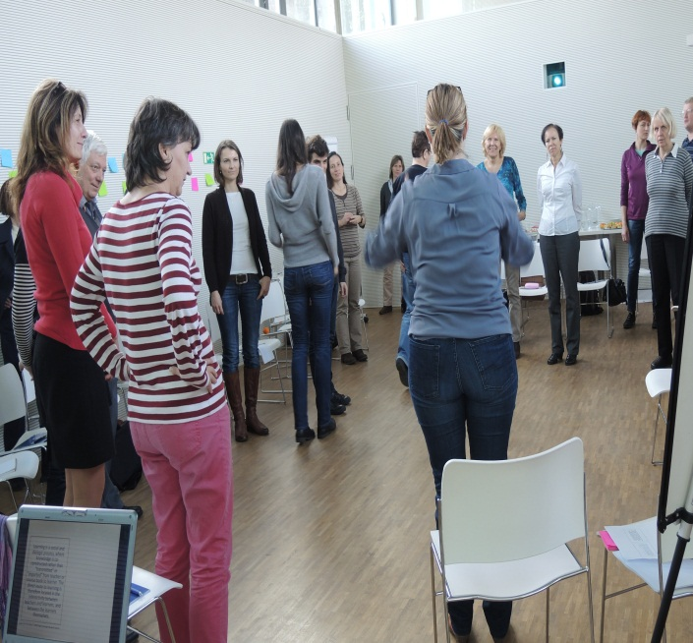
Learning is a social and dialogic process, where knowledge is co-constructed rather than "transmitted" or "imported" from teacher or course book to learner. The direct route to learning is therefore located in the interactivity between teachers and learners, and between the learners themselves.
Adapted from Thornbury, S. (2005) Dogme, Dancing in the dark? Folio 9/2
walking word stress
diaLOgic
inteRACtivity
Note this can also be done by tapping the table, raising arms, humming, dum-di-dah-dah

Slide 30
Speaking skills for presentations and lectures can be improved by:
focussing on sentence stress and which words carry stress for emphasis to communicate the main thrust of an argument.
chunking phrases and adding in pauses (/=short pause //=long pause) help the speaker maintain interest/ emphasis and provide the listener with pauses to digest information (especially in academically ‘dense’ texts).
using the rising and falling tones to signal continuing and finishing information respectively.
Learning/ is a social and dialogic process,/ where knowledge is co-constructed /rather than "transmitted" or "imported" from teacher or course book to learner.// The direct route to learning/ is therefore located in the interactivity / between teachers and learners, /and between the learners themselves.
Adapted from Thornbury, S. (2005) Dogme, Dancing in the dark? Folio 9/2

Slide 31
^{Functional Language:}
What would you say / what language would you use in the following scenarios? – discuss and present some examples:
To open a topic or presentation
To give an example of something
To refer to a graph, table, picture etc
To refer back to something that you’ve already said
To move on to a new point / topic
To explain something in a different way
To interrupt someone in order to make a comment
To summarise and or to conclude your talk

Slide 32
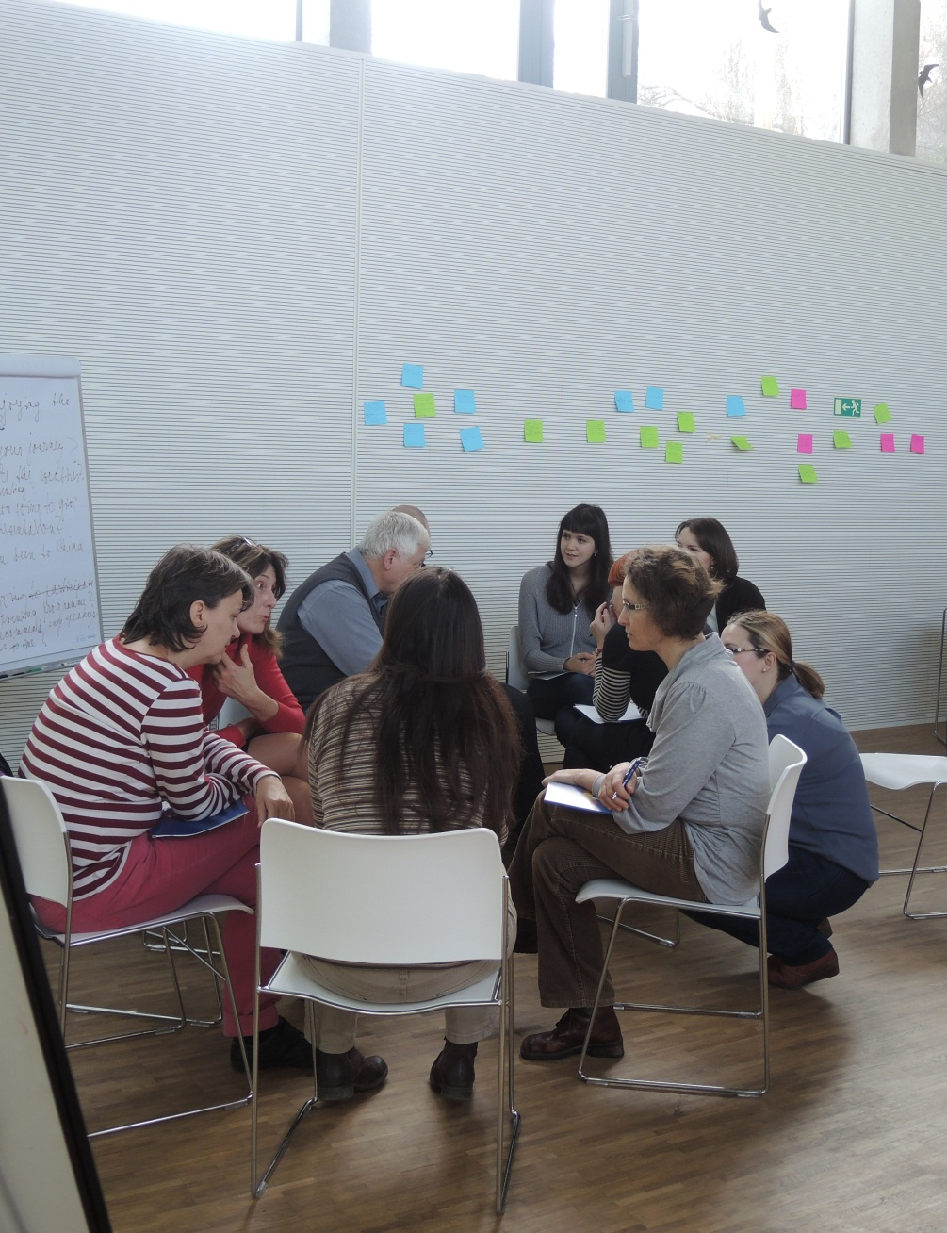
Seminars: management and participation strategies
Opening
So what I’d like to start with is...
So, who wants to get things going?
What I’d like us to discuss today is…
So, let’s get the ball rolling!
Interrupting to comment
If I could just come in here.
Sorry to butt in, but ....
Can I just add....
That’s a really interesting point but it’s worth remembering that…
That’s great but have you thought about…
Clarifying Questions
That's not really what I was asking. My question is about ...
Perhaps I didn't make my question clear. What I asked/meant was..
I think you've answered a slightly different question. What I would like to know is ...
I understand that but what I actually had in mind was ....
I think you’ve got the wrong end of the stick there, what I meant was…

Slide 33
Lectures & Presentations: functional language
Putting it in other words
In other words, ....
That is to say, ....
To put it another way, ....
The point I'm making is ....
What I'm suggesting is ....
Let me put it another way.
Giving examples
An example of this is ....
For instance, ....
And as proof of that, ....
Remember ....
You only have to think of ....
Using visuals
On this graph, ...
Take a look at this.
Let's have a look at this.
I'd like you to look at this.
I'd like to draw your attention to ...
Here we can see ....
As you can see, ....
If you look closely, you'll see ....
Referring back to what you have said
As I said at the beginning, ....
In the first part of my talk, I said ....
As I mentioned earlier, ....
I told you a few minutes ago that ....
Moving on
I'd like now to move on to ....
Turning now to ...
Moving on now to ....
Having looked at ..., I'd now like to consider ....
Now, let's turn to ....
I now want to turn to ....
The next point is ....
Another interesting point is ....
The next aspect I'd like to consider is ....
I'd now like to turn to ....
Concluding
So ....
We've seen that ....
First we looked at ... and we saw that ....
Then we considered...and I argued that...
So basically .....
we have looked at ....
To sum up ....
To finish up, I'd like to emphasise that..

Slide 34
Seminars: management and participation strategies
Encouraging participation
Does anyone have any comments or questions?
So is this the same as your experience?
Do you agree with what X has just said?
So, Y, what is your opinion of this?
Redirecting the discussion
... is important but it's too complex for us to deal with now.
I see where you’re going but really we need to keep to the topic.
I think the aim of this seminar is to focus on ... rather than ....
That's not something we have time to deal with today, but ....
Let’s come back to that [point] later.
Closing
So, let’s leave it there for today. That was a really [useful / interesting / productive] session.
So, let’s wrap up for today.
That’s all we’ve got time for today.There’s a lot to think about there.
Ok, let’s finish there. Some really interesting comments/contributions.
Lots of great ideas. Let’s pick this up next time.

Slide 35
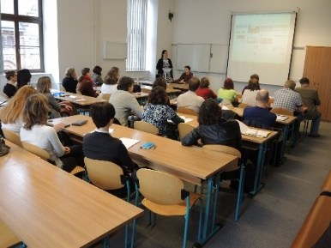
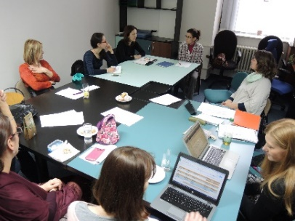
Summary
There are many different activities you can consider for your teaching and seminars.
Encourage interaction, participation and practice of core skills and language in the field.
Remember to provide adequate time for preparation and feedback for each activity.
A range of different language skills are required when working in the academic arena, you need to have the adaptability to choose the appropriate style for the occasion..
Speaking skills involve knowledge of the language and non-verbal skills.
Remember word and sentence stress to make your language clearer.

Slide 36
Enjoy the rest of
the summer school!
Notes:
36

