Slide 1
English Writing Skills
for Teaching
Alex Floyd - alex.floyd@cjv.muni.cz
Notes:
1

Slide 2
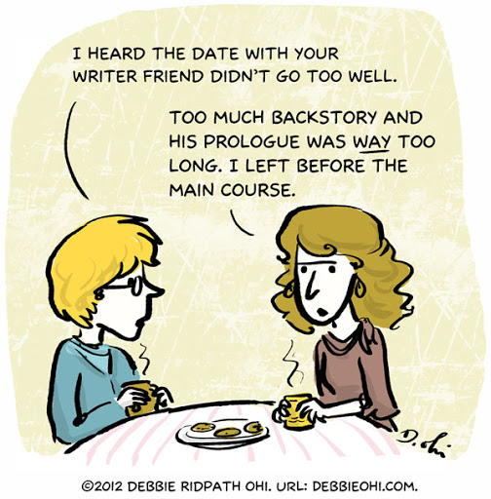
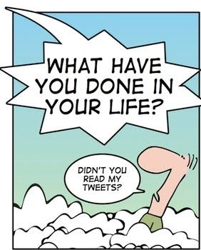
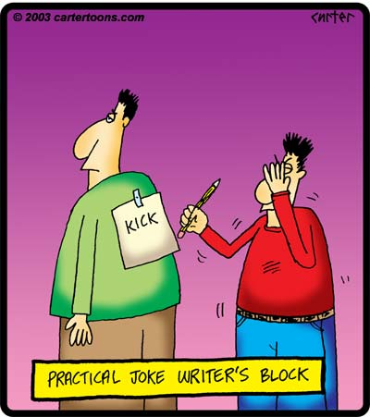

Slide 3
What we will discuss today…..Interactive
Types of writing teachers use
Writing emails
Preparing written learning material
Writing styles
Grading language
English articles in writing – common mistakes

Slide 4
What do teachers need to write?
Discuss all the types of writing you do as a teacher:

Slide 5
What do teachers need to write?
Emails / responses to emails
Lecture notes / seminar notes etc
Assignments / projects / tests / exams
Marking / comments / feedback
Other?

Slide 6
Reflective Questions ??? Where do problems come up in these tasks? What areas do you find challenging? Which areas are you less confident expressing yourself in English? What do you need to improve in your written English?

Slide 7
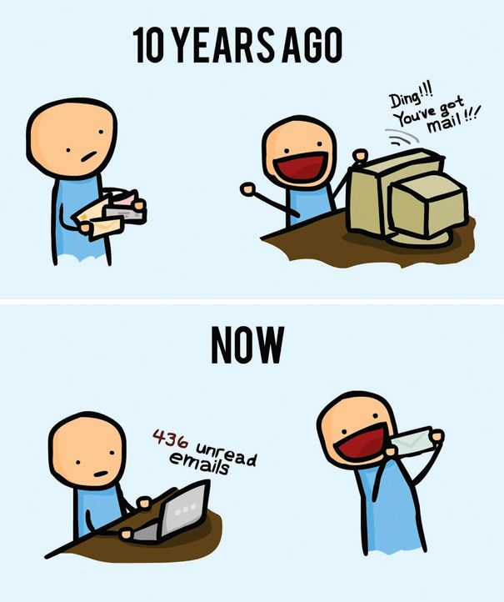
Writing Emails
How often do you write emails as a teacher / lecturer?
What problems / difficulties have you experienced?

Slide 8
What do you think of the email below?
Dear Peter,
many greetings from the research centre here and I hope that everything is OK with you. I am contacting you to clarify the situation regarding experiments done by our student during her stay in your lab (April 2018). Unfortunately, communication with her was a little difficult since last year and her study at our university has been cancelled this month. However, it would be a pity to throw away all the results. Would it be possible for you to send me all the results obtained during her stay in your lab?
Thank you and wish you a nice day!
Jirka

Slide 9
How would you classify it?
Dear Peter,
many greetings from the research centre here and I hope that everything is OK with you. I am contacting you to clarify the situation regarding experiments done by our student during her stay in your lab (April 2018). Unfortunately, communication with her was a little difficult since last year and her study at our university has been cancelled this month. However, it would be a pity to throw away all the results. Would it be possible for you to send me all the results obtained during her stay in your lab?
Thank you and wish you a nice day!
Jirka

Slide 10
What do you think of the email below?
Dear Professor Smith,
I would like to request a vacation from Monday March 9th until Friday March 13th.
My current projects and tasks are all progressing well, and I don‘t anticipate any problems with my overall workload as a result of the vacation. I have also ensured that several of my colleagues will be available to cover any problems that could arise during my absence.
Thank you for considering my request,
Yours sincerely,
Jack Hammersley

Slide 11
How would you classify it?
Dear Professor Smith,
I would like to request a vacation from Monday March 9th until Friday March 13th.
My current projects and tasks are all progressing well, and I don‘t anticipate any problems with my overall workload as a result of the vacation. I have also ensured that several of my colleagues will be available to cover any problems that could arise during my absence.
Thank you for considering my request,
Yours sincerely,
Jack Hammersley

Slide 12
How could the email below be better worded? How would you respond to it?
Dear Alex,
I‘m really sorry assignment hasn‘t been submitted yet, I know I‘m very late with it. But my work and study schedule are both crazy recently and so I simply have forgotten about the date to supply the work.
I‘m now sending you the assignment, please it is attached to this email. I know that it was meant to be in 3 weeks ago but at least it is here at last, I‘m happy about that. Can you tell me please if that means I have finished everything now for the course?
BR,
Pavel

Slide 13
How could the email below be better worded? How would you respond to it?
Dear Mr Floyd,
I would like to apologise for submitting my assignment late, I realise it is now some time past the due date. My work and study schedule have both been extremely busy recently and so I simply forgot to submit the work on time.
I‘m now sending you the assignment, please find it attached to this email. I know that it was due in 3 weeks ago but I hope it is not too late for it to be finally accepted. Please let me know if there is anything else you require at this stage in order for me to successfully complete the course.
Yours sincerely,
Pavel

Slide 14
Email etiquette – discuss:
What’s important to remember when writing emails? What should you do?
What should you try and avoid? X

Slide 15
Email etiquette:
Do:
- Open with a polite address eg. Dear Dr Smith, Dear John….
Pay attention to the recipient’s name and title (including spelling of the names). Check on the school/university website if need be.
Sign off with a polite address that is appropriate for the email, eg yours sincerely, Kind regards etc.
Don’t:
Don’t address someone by their first name unless you are on quite familiar terms with them. If someone uses both their names it’s usually an indication of formality.
Avoid opening emails with overly informal or unusual language..eg. Hiya John, Hello there….etc.
Avoid unnecessary spelling errors, especially in a professional context.
(University of Bristol)

Slide 16
Email wording
Formal Informal
Name Dear Mary, Dear Mrs Hat Hi Mary, Hello Mrs Hat
Previous Contact Apologies for my late reply, however.. Thanks for the email.....
Reason for email I‘m writing in connection with Just a quick email about...
Giving Information We regret to inform you that... Just a note to say....
Attachments Please find attached.... Here is the ....you wanted..

Slide 17
Pairs task – compose two short emails:
An email to a colleague who has complained to you about a misplaced item of value missing in the department. You need to address their concerns.
An email to a university professor at an English university department, requesting that one of your students be allowed to visit for a 3 month research placement.

Slide 18
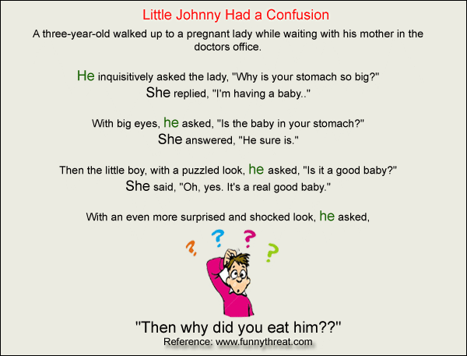
Written Material in English (lecture notes, seminars etc).
What should you consider?
Is it different preparing written material for students learning in a second language? Why?
How will you present your course information clearly, but completely in English?

Slide 19
Structuring Lecture Material:
Your lectures are likely to be more effective for international students (and all students) if you focus on:
Transparent structure
Essential content
Improved understandability
Effective note taking

Slide 20
Structure:
Try to be more explicit and transparent about how the lecture is organised:
Use an introduction and a summary and repeat key ideas eg. ‘This is an introduction/summary….’
State links to previous/future lectures and topics
Signal moves between sections as in ‘Now I am going to talk about how you apply this idea with an example….’. Try pointing to where you are: ‘On the outline, I am now here…’
State the importance of ideas: ‘This is a key point….’
Repeat. ‘In the last section, I talked about (a) and now in (b), I will cover….’
‘This building up and rehearsal of the content of a lecture as it develops can help us to link chains of ideas together, and can work well when the lecture is structured as a story, investigation, or other logical sequence’ (www.heacademy.ac.uk).

Slide 21
Content:
If you devote time to structure and making a lecture more understandable, you may cover less material. It has been reported that teachers may cover 10-15% less material when the audience is listening to English as a 2nd or 3rd language (www.heacademy.ac.uk).
To address this you might:
Provide additional readings, handouts or supplemental multimedia instruction
Explore and develop ideas rather than only introduce new knowledge
Use video / audio recordings for sessions that may contain a lot of content, so that students can review the material, more than once if necessary.

Slide 22
Understandability
International students may only understand 50% or less of lectures at the start of their studies (see http://www.llas.ac.uk/events/archive/2513). You will lighten the students’ ‘language load’ so they can attend to the content of the lecture if you try to:
Be aware of your own use of English. Using a slower pace and shorter, clearer content may help all your students.
Use plain English and straightforward sentence structure. Cut out wordy, introductory clauses in spoken and written work (‘So, whilst not wishing to underestimate the importance of.... ). Choose vocabulary that is in common use eg. ‘living in’ rather than ‘domiciled at’.
Provide pre-reading. Consider making a discipline-specific glossary, and offer lecture notes or Powerpoint slides in advance.
Encourage students to ask questions and clarify information. Students appreciate being able to ask individually after the lecture, via email etc.
Provide ways for students to record and replay lectures.

Slide 23
Effective Note Taking:
To improve students’ notes, you could:
Structure explicitly (see above) so the students are more likely to add headings and sections in their notes. Relate your lecture clearly to the written lecture notes and refer to it.
Record the lecture so that students can listen, translate and record at their own pace. One student from Vietnam described this as ‘Very boring but useful’ (Gosper et al, 2007).
Provide handouts with key information and any complex diagrams or data. Some lecturers provide gapped handouts where students can annotate or add new information as the lecture is delivered.
Provide pauses so students can review and reconstruct their notes during the lecture itself.

Slide 24
Top Tip – Pause for Effect:
‘The pause is one of the most critical tools of public speaking. It is an important device for gaining attention. Pauses can be used as punctuation - to mark a thought, sentence, or paragraph - and also for emphasis, before or after a key concept or idea. If you suddenly stop in midsentence, students will look up from their notes to see what happened. Planned pauses also give you and your audience a short rest. Some faculty take a sip of coffee or water after they say something they want students to stop and think about. Other faculty deliberately pause, announce, "This is the really important consideration," and pause again before proceeding.’
(Barbara Goss Davis, Tools for Teaching, University of Berkeley, http://teaching.berkeley.edu/bgd/delivering.html)

Slide 25
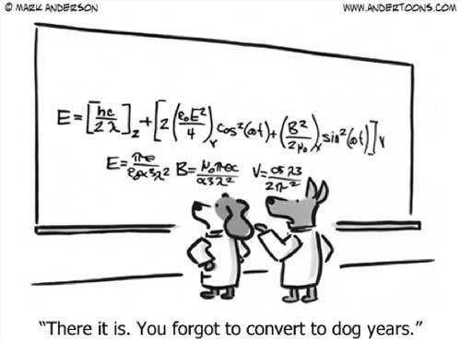
Writing Style
Written style can differ greatly
Different subject areas require different styles of writing
Look at the following examples:

Slide 26
Look at these three different styles of writing. What do you notice about the statements? What is the academic style?
Beaut weather mate!
2. What a splendiferous day.
3. Evidence from the Bureau of Meteorology indicates that a temperature of approximately 25 degrees is expected.
(Adapted from Alison Brown, 2007)

Slide 27
They are broadly saying the same thing…
using different language.
Beaut weather mate! - ocker (Australian slang…)
2. What a splendiferous day. - posh (British upper class…)
3. Evidence from the Bureau of Meteorology indicates that a temperature of approximately 25 degrees is expected. - academic, scientific
(Adapted from Alison Brown, 2007)

Slide 28
In the following examples, the same message is expressed in 6 different styles, from an extremely formal written style, to a very informal spoken one.
Work in small groups: Match the sentences with the styles, then discuss with the group.
Jargon, very formal.
Written, formal, clear.
Written style for the general public (scripted radio or TV news style).
Formal spoken style (seminar, talk).
Informal spoken style (discussion).
f) Very informal spoken style (chat).

Slide 29
1. As the value of Sterling increased compared to other currencies, the government was forced to take tax measures to head off a rapid increase in consumer spending spurred on by cheaper imports.
2. And you see, Sterling got more and more valuable, so as a result, the government had to go round putting up taxes, you see, to stop everyone going out and splashing out, spending all their money on cheap imports.
3. Consequent to the appreciation in the exchange value of Sterling against other currencies, necessary fiscal measures were introduced by the government in order to reduce the likelihood of an import-led consumer spending surge.

Slide 30
4. As Sterling went up in value, the government had to put up taxes to stop consumers splashing out on too many cheap imports.
5. As Sterling's international value went up, the government had to take tax measures to head off a consumer spending boom spurred on by cheaper imports.
6. After the international value of Sterling rose, the government was obliged to take fiscal measures to reduce the likelihood of a surge in consumer spending led by cheaper imports.

Slide 31
Answers:
a) Jargon, very formal. 3 Used in official reports, a style of written English, full of verbal nouns, technical words and passives.
b) Written, formal, clear. 6 This is clear, written English, as found in the press or in documents aimed at ordinary educated readers.
c) Written style for the general public (scripted radio or TV news style). 1 Written style for the general public, scripted radio or TV news style.
d) Formal spoken style (seminar, talk). 5 Formal spoken style - radio, seminar, talk.
e) Informal spoken style (discussion). 4 Relaxed, informal spoken style: discussion
f) Very informal spoken style (chat). 2 Relaxed, simplified, chat, very informal spoken style Note the addition of repetition and fillers.

Slide 32
What style is the below….?
Academic Vocabulary: What is the True Nature of Identity?
In my opinion, the very concept of identity, corresponds precisely to the perception and interpretation of it’s meaning by the individual themself. It’s not necessary for one to scour the research looking for irrelevant variables and obscure analysis, simply to go with one’s own gut-feeling.
The principle of identity is therefore an interpretation of what someone believes about themselves, rather than the acquisition of information, data or estimates from formal or scientific sources….I deduce that I am who I think I am, a function of my own innate creativity, emotions, imagination and cognitive processes. And it is my own opinion and estimate that is significant, not comments or thoughts from anyone else…. AF - Sept 2019

Slide 33
Style
There are many different styles of writing…
Which style would be most appropriate for your subject area?
Which is most appropriate for tertiary level education in English?

Slide 34
Grading Language
Why grade your language?
The content of the course will be more manageable if the language is understandable.
Keep the learning focus on new topics / vocabulary etc, not the language used in the delivery.
How do you grade your language?
Speak slower than usual, clearly intonate and highlight the stress on important words carefully.
Avoid use of idioms, higher level phrasal-verbs, slang and more complex language.
Aim to use more common, everyday language.

Slide 35
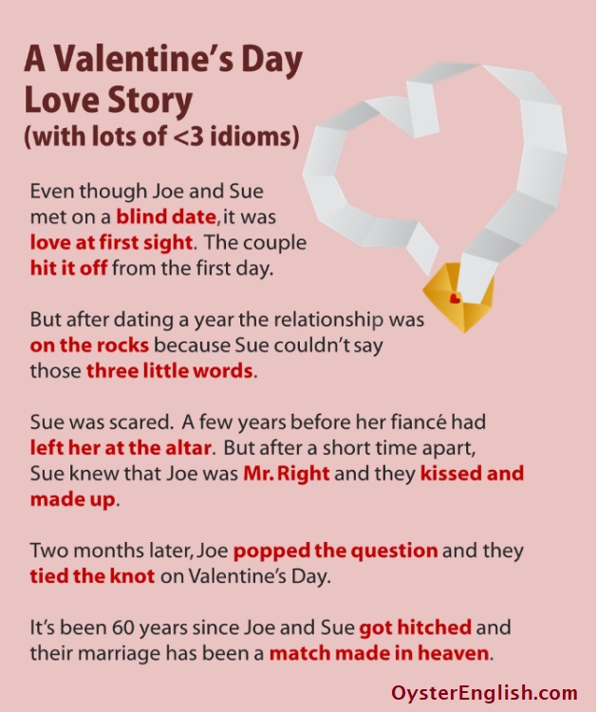
When I set off for work this morning, my car broke down, so I ended up taking the bus. As soon as I got off, I bumped into an old schoolmate, Mark. While we were talking, he brought up something I had already found out from some mutual friends- that he had come into some money and had set up his own business. He told me that there was a lot to sort out, and offered to take me on, but I turned him down straight away.
When I clocked in, my boss had a go at me, telling me off in front of everyone. When I got over the initial shock, I told her I’d make up for being late, but it turned out that she had blown up over a deal that had fallen through, after a client of mine had pulled out of a contract. She told me that I wouldn’t get away with it, that I’d let everybody down, and just went on and on….
Eventually, I ran out of patience and answered back– I said I was not going to put up with it anymore, and if she wanted to lay me off, she should go ahead. Anyway, to cut a long story short, I stormed out, phoned Mark’s secretary, who put me through to him. I told Mark I’d like to take him up on his offer. So, in the end, everything has worked out perfectly!

Slide 36
Grammar in the English Writing
What is aspect of English you find most challenging when you write?
Do you find using the English Grammar a difficult?
What would you like to improve in your writing?
Do you make the mistakes when youre writing email?
Do you get confused with the English articles?

Slide 37
Use of Articles in English – common mistakes
Use a/an with a singular, countable noun:
There’s been an accident…
There is a young boy over there who…
We want to do an experiment…
NOT – we want to do experiment, there’s been accident…..
You can’t usually use a/an with uncountable nouns:
I’m sorry, I don’t have time right now…
Ok let’s go, do you have any luggage?
Oh, you have really nice furniture in here…
NOT – I don’t have a time now, you have a really nice furniture!

Slide 38
Use of Articles in English – common mistakes
3. When a noun is first talked about, we often use a/an, when it’s already been mentioned we use the:
There’s been an accident……Oh really? What happened in the accident?
There is a young boy over there….Is that the young boy you were talking about?
We want to do an experiment….How did the experiment go yesterday?
4. We use the when referring to something specific (individual or group)
I’ve sent him the letter that we discussed.…
Where is the money that I put on the table?
He belongs to the band that I was telling you about…

Slide 39
Practice: Complete with a/an/the or zero article
Some of the methods of data collection in _____ Sports Science research include the following:
Questionnaires: are _____ very commonly used method in sport-related research. A questionnaire is simply ____ standardised set of questions used to gain information from ____ subject. They are often associated with quantitative research designs, when simple measurements are required from _____ large sample group. _____ questionnaires generally fall into one of three categories: postal, telephone or face to face questionnaires.
Research interviews: The principle of _____ research interview is simply _____ recording of data from subjects via ____ interview process by ____ researcher. The face to face interview is undoubtedly ____ most common method by which qualitative data is collected in _____ sport research. Research interviews are quite different from _____ very structured form that a questionnaire will usually take. Whereas ____ questionnaire collects data and is usually completed without ____ presence of _____ researcher, the researcher is ____ key element of _____ interview process, and the skills, attributes and interviewing technique of _____ researcher forms an integral part of the success of this method of obtaining _____ real qualitative data.

Slide 40
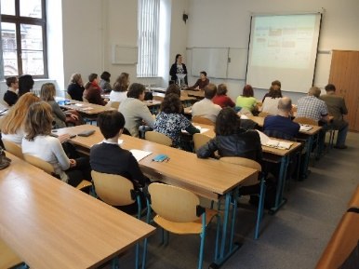
Summary
Teachers need to write……think about what and how you write for your EMI class.
Consider your audience…whether it’s an email, group seminar or individual communication.
Structure your lecture material clearly, don’t cover too much, guide and repeat important points.
Grade your language, make it understandable in both written and spoken form.
Consider the most appropriate style of writing for your group.
Keep working on your own English ability to teach more effectively!

Slide 41
Enjoy the rest of
the summer school!
Notes:
41

