Slide 1
Interaction in Larger Classes
Belinda Allan
ICT Coordinator and English Lecturer
MUNI Language Centre

Slide 2
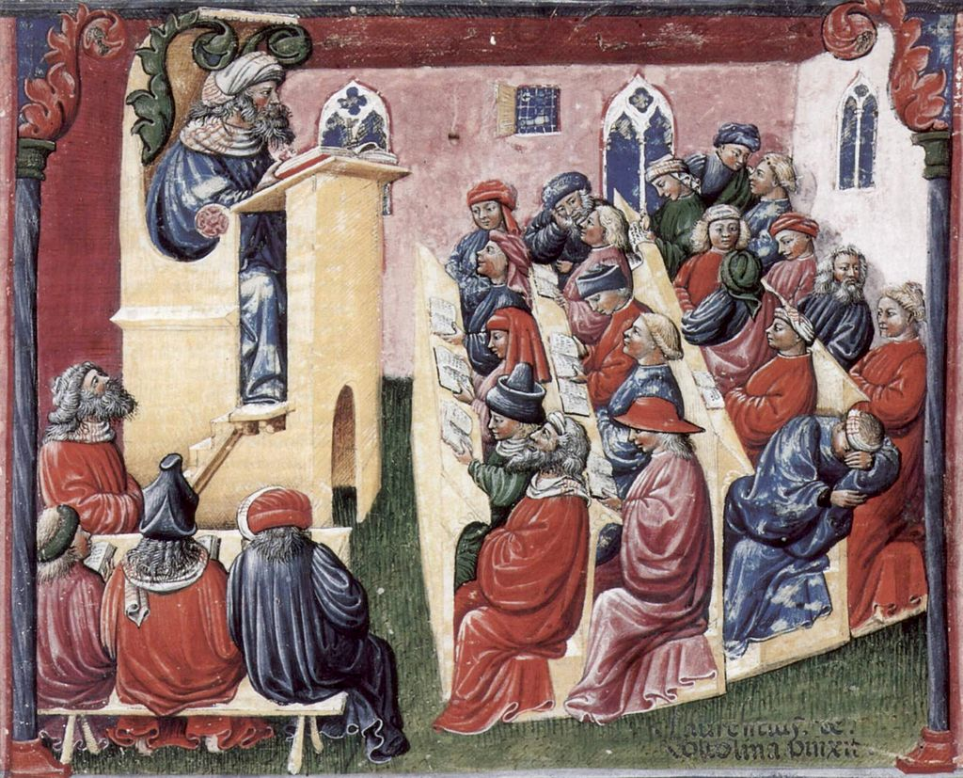
Notes:
What’s going on here?
Are students’ brains active? Are students active?
What interaction is there?
When was this?
Have larger classes changed since then?

Slide 3
What are the challenges?
Fear of speaking (such a large crowd)
Feedback lag
Please ask questions at the end.
Single-speaker paradigm
only one talking at a time
(similar problem for a Zoom meeting)
How can we deal with it?
What opportunities are there?
Notes:
Simple ideas:
nearpod lessons
polling / questioning the audience (Socrative / Mentimeter / Slido / DirectPoll / VoxVote / PollEverywhere)
With questions results:
Create a WordCloud

Slide 4
Sooooo many options!!
Socrative / Mentimeter / Slido / DirectPoll / VoxVote / PollEverywhere / AhaSlides / Second Street / VeVox / Conference i/o / …

Slide 5
Notes:
Ponder = what do we want?
free,
can have large audience of …,
can create X polls,
WordCloud?
graph?

Slide 6
Google can be your friend
Google loves to help!
For example, search “free live poll”
or “free live wordcloud”

Slide 7
Try a page that lists many options (and reviews them)
https://www.educatorstechnology.com/2018/02/17-of-best-surveys-and-polls-creation.html
https://www.freetech4teachers.com/2015/12/15-good-tools-for-quickly-gathering.html#.WpcEdRPwai4
https://www.educatorstechnology.com/2016/06/12-great-formative-assessment-tools-for.html
https://oedb.org/ilibrarian/polling-classroom-4-free-polling-tools-keep-students-engaged/

Slide 8
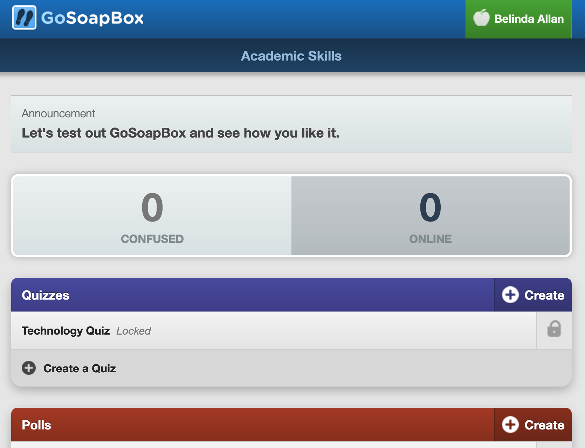
“Let’s Try Something” Time
Go to app.goSoapBox.com
Code: 872 658 627

Slide 9
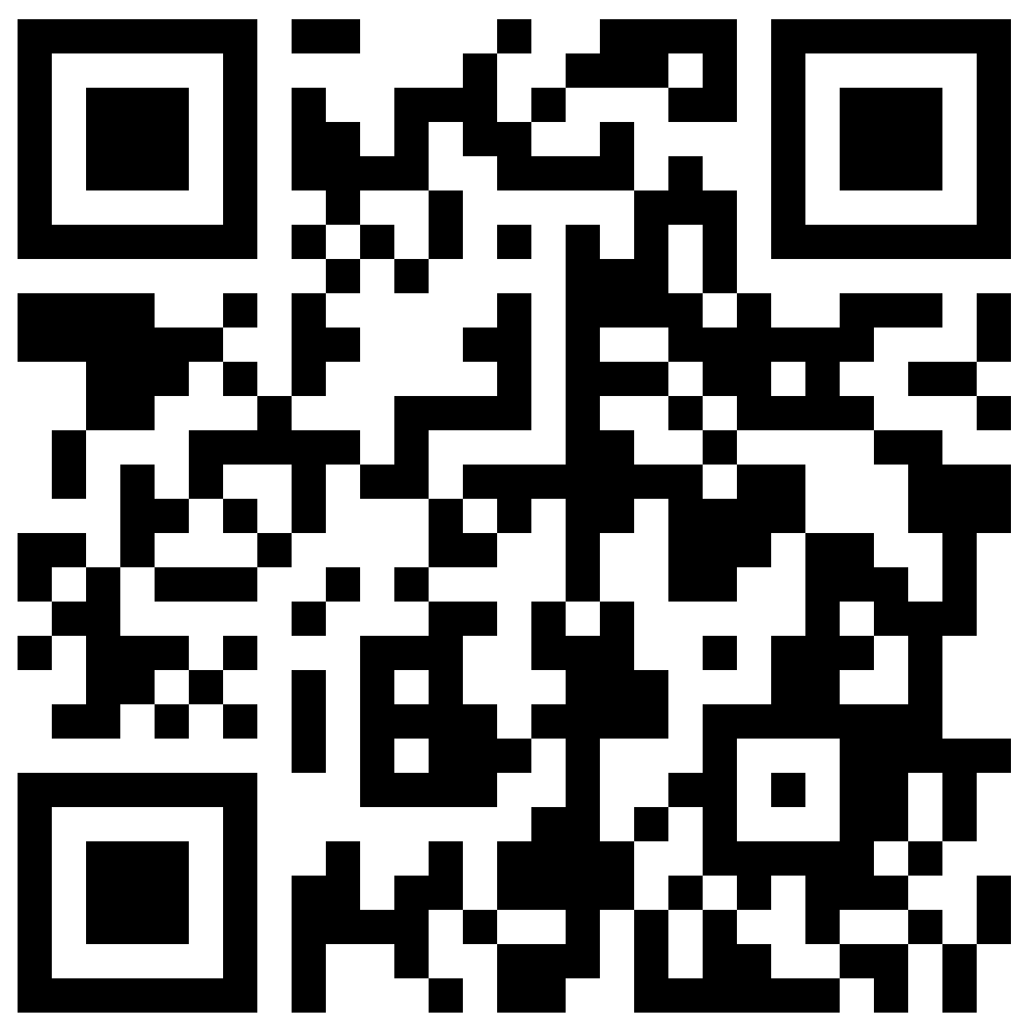
Software Research Project
https://padlet.com/2425592/interaction

Slide 10
