Slide 1
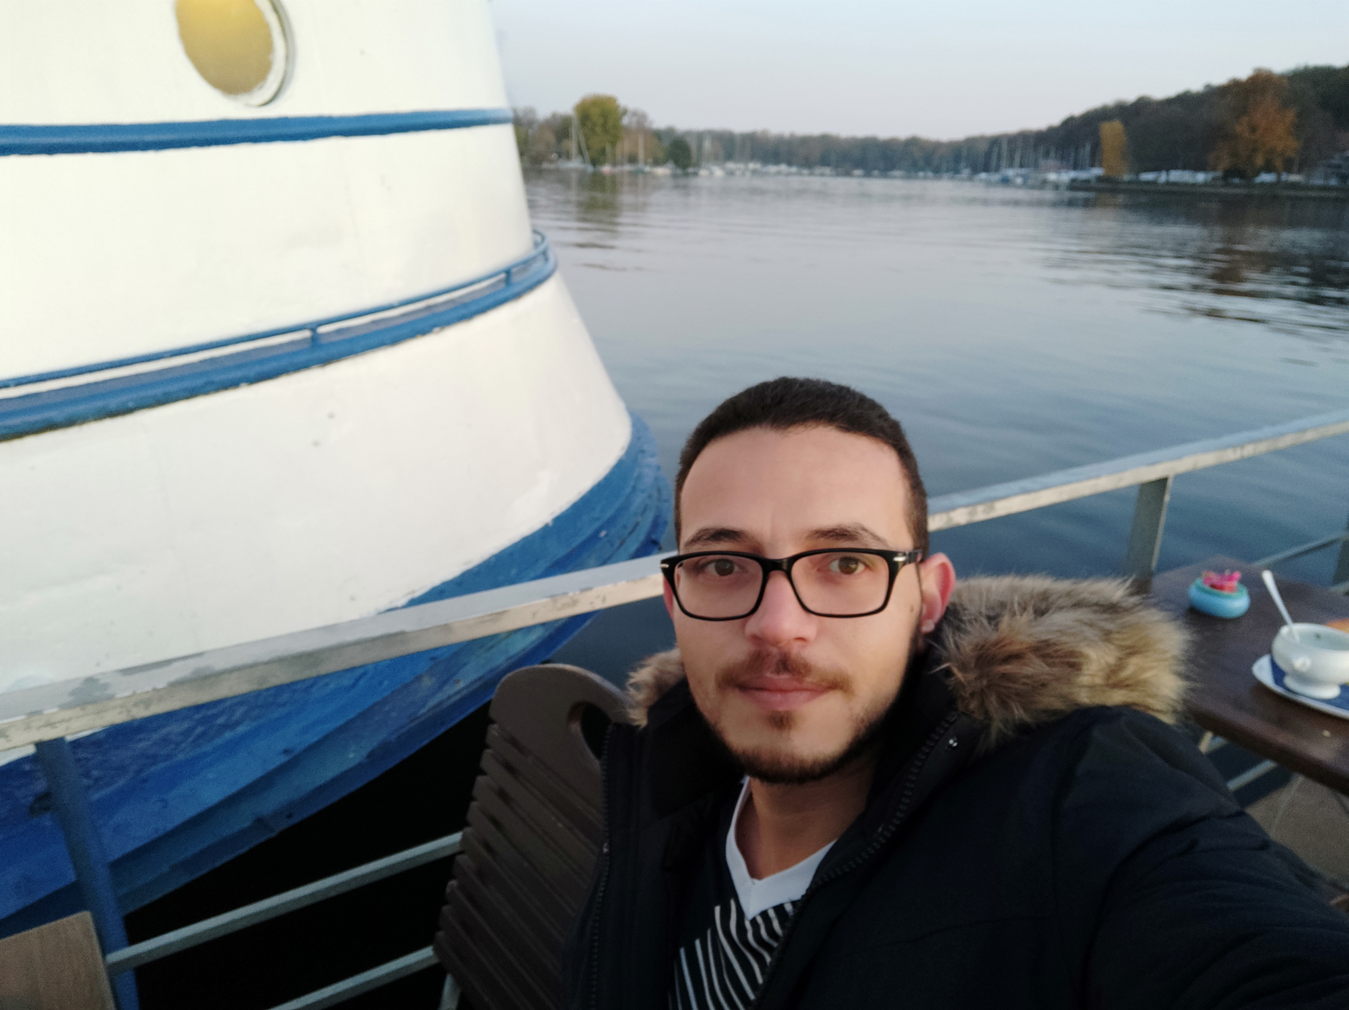
Who am I?
I am a 36 years old English instructor with wide experience in different fields, Education is unexpectedly my favorite.

Slide 2



Life
An English Teacher father, and 3 brothers. Didn’t know the importance of education till later in my life
B.A of Art, Major is English Language & Literature
Major influence is my Mom. Then my mistakes. I’ve learnt a lot from challenging my father
Didn’t speak proper English till the age of 18. Never thought of being a teacher. Finished my education late. Started the professional career in education since 2015.

Slide 3
Work
Starting education as profession
Moving back to Jordan to teach, joining World Associates
Promoted to head of English and Humanities Dept.
1
2
3
Started teaching as a profession in 2015 at Dawha International School in Sharjah.

Slide 4
Influence
First impact
First year teaching
Didn’t notice the impact till parents meeting. Parents came just to see the English teacher and thank him.
AUSME lead to World Associates
Parents meeting, an American student told his parents about me. Lead joining an NGO they’re working at
3rd impact
Changing lives
Teachers have similar effect as parents if not more important. Roaa - writer, Hussam - Drama, Mohammad - NGO.
2nd Impact
Deleted the awards slide for my biggest award is the influence and the fingerprint left.

