Slide 1

International Communication Strategies
(CJV_ICSDM) for Social and Digital Media in Academic Setting
Spring Term 2025

Slide 2
International Communication Strategies
course instructor
course administration
course introduction

Slide 3
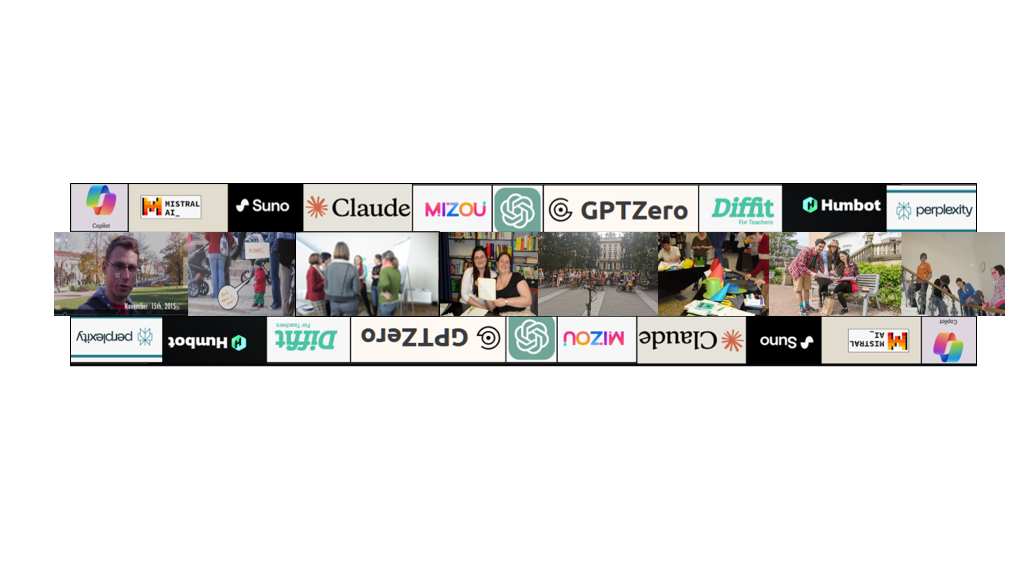
LIBOR ŠTĚPÁNEK (libor.stepanek@cjv.muni.cz)
Masaryk University Language Centre (CJV MU) Komenského nám 2
Background:
  MA in English/History; PhD in Political Science
Specialization and Research:
  Academic Skills in English
  Academic Public Speaking
  Academic Writing
  Creativity in language learning

Slide 4
course objectives
After completing this course you will be able to:
be a successful participant of an international team;
communicate a message clearly and engagingly across different languages and cultures;
understand and apply principles of effective writing/speaking and text design;
plan and design texts with a clear hierarchy of contents;
use images in communication to maximise impact of their messages;
plan and execute a simple communication campaign;
adjust communication to different tasks.

Slide 5
course organisation
weekly sessions
Wednesdays 12:00-13:40
theoretical input combined with diverse practical activities based on individual needs

Slide 6
course organisation
online sessions with Cagliari
Wednesdays:
5 March (intro; group formation, organisation and tasks)
26 March (reflection of the tasks)
23 April (reflection on the project work)
14 May (presentation of outcomes)

Slide 7
course organisation
work in groups (individual setting)

Slide 8
materials
IS study materials
Moodle materials
synchronous classes
discussion fora
  individual activities
  collaborative activities

Slide 9
requirements
Active participation in the course:
  synchronous discussions in class
  online asynchronous discussions
  project work

Slide 10
introduction

Slide 11
introduction
peer2peer → class

