Slide 1
Music in the Czech lands II
Four oldest czech songs

Slide 2
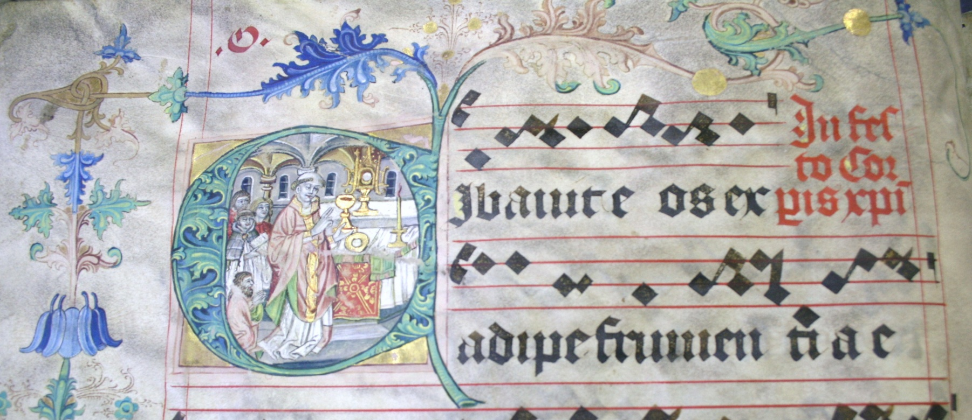
„The four songs“
For sacred songs were permitted to be sung in the church by the prague synod in 1408: Hospodine, pomiluj ny; Buoh všemohúcí, Svatý Václave a Jezu Kriste, ščedrý kněže.

Slide 3
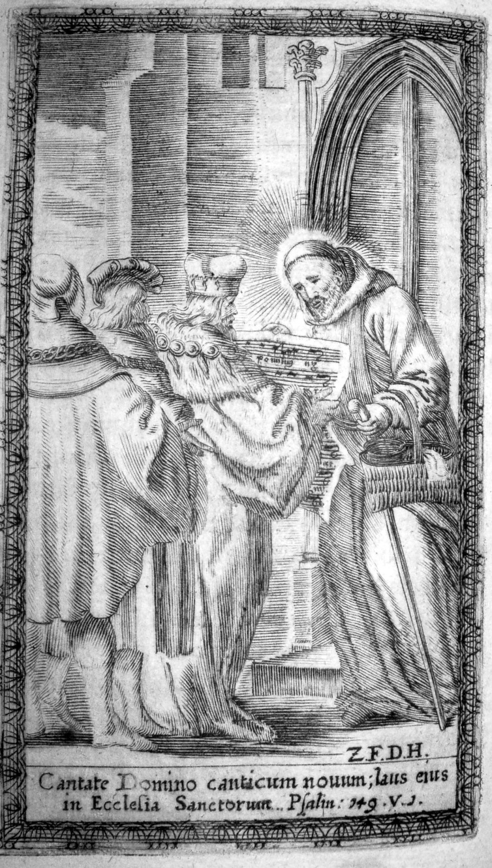
Hospodine, pomiluj ny (Lord, have mercy)
The earliest major relic
of musical culture in Czech
lands, originated in
the second half of the 10th
century. As early as in
the 11th century became
carmen patrium
(national and state anthem).
Earliest notation dating 1397.
Example: bishop Vojtěch
presents the song invented
by himself to the duke
of Bohemia
(baroque engraving).
http://www.antologiehudby.cz/autori.php?jazyk=EN

Slide 4
Buoh všemohúcí (God almighty is risen from the dead awaited)
Easter song, originated in the 12th century (Christ ist erstanden), sung at the end of an Easter play,
The melody is derived from easter sequence Victimae paschali laudes
In the 14th century it was sung paralelly in latin, czech and german.
Later version (15th or 16th century)
http://www.youtube.com/watch?v=2crSmi7PF7k&feature=related (scores)
http://www.youtube.com/watch?v=8o_gmO1M-1o (with instruments)
See renaissance motet with the melody in tenor line (cantus firmus)

Slide 5
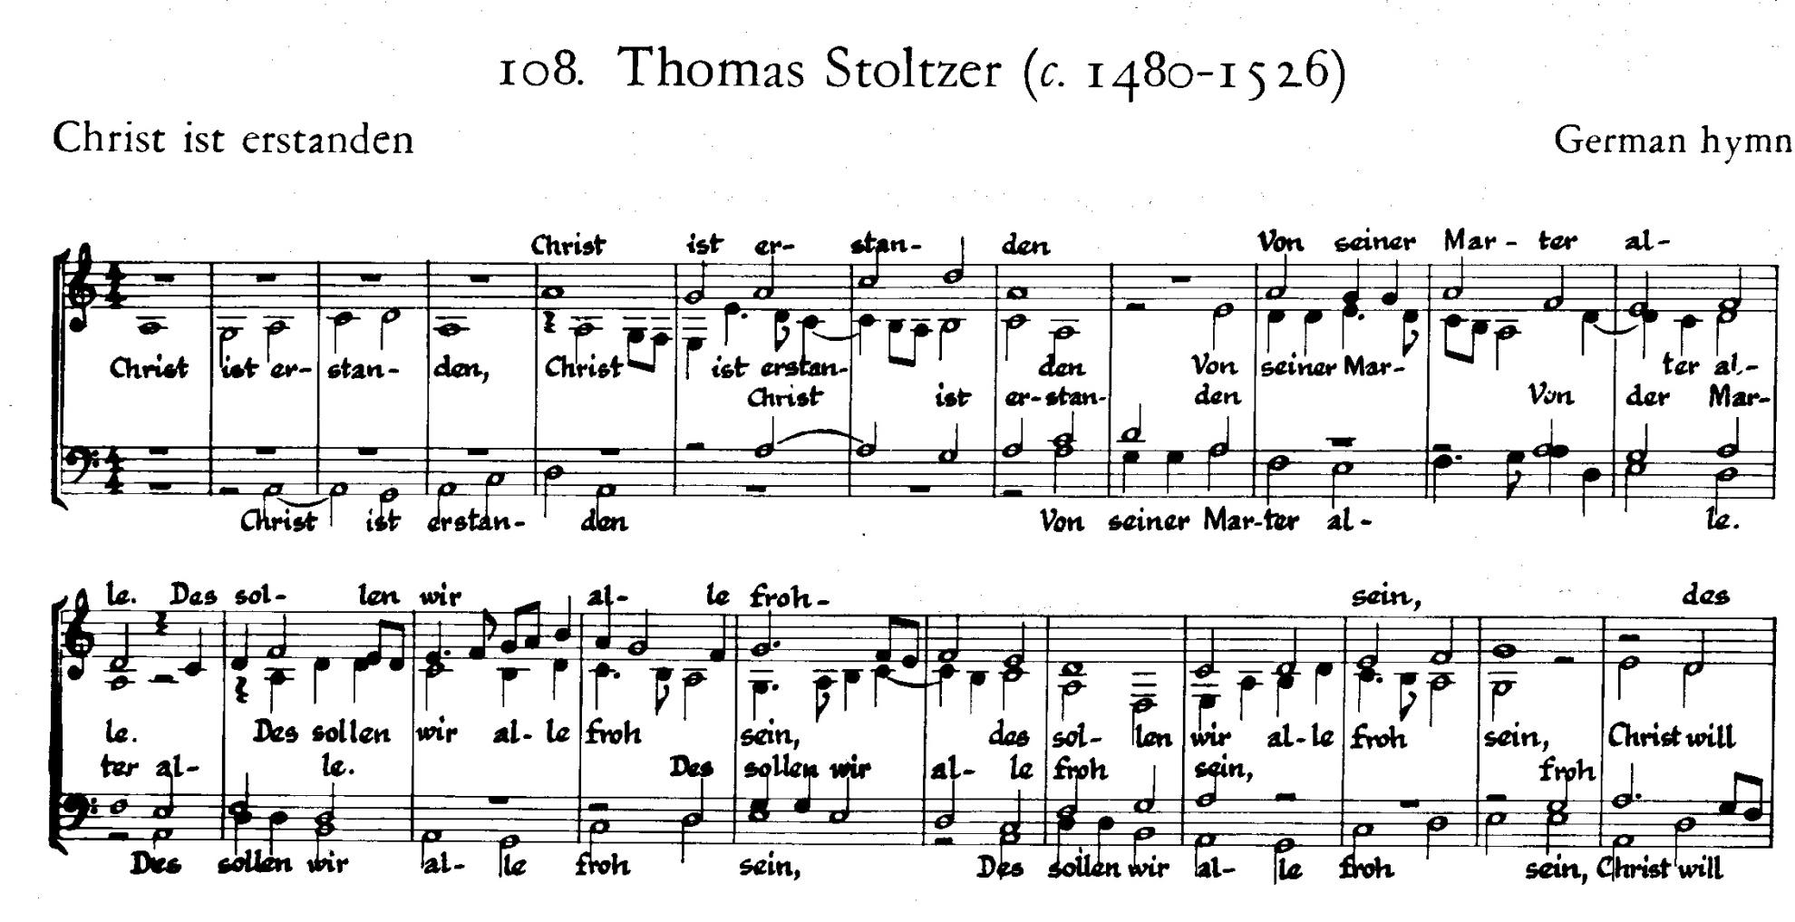

Slide 6
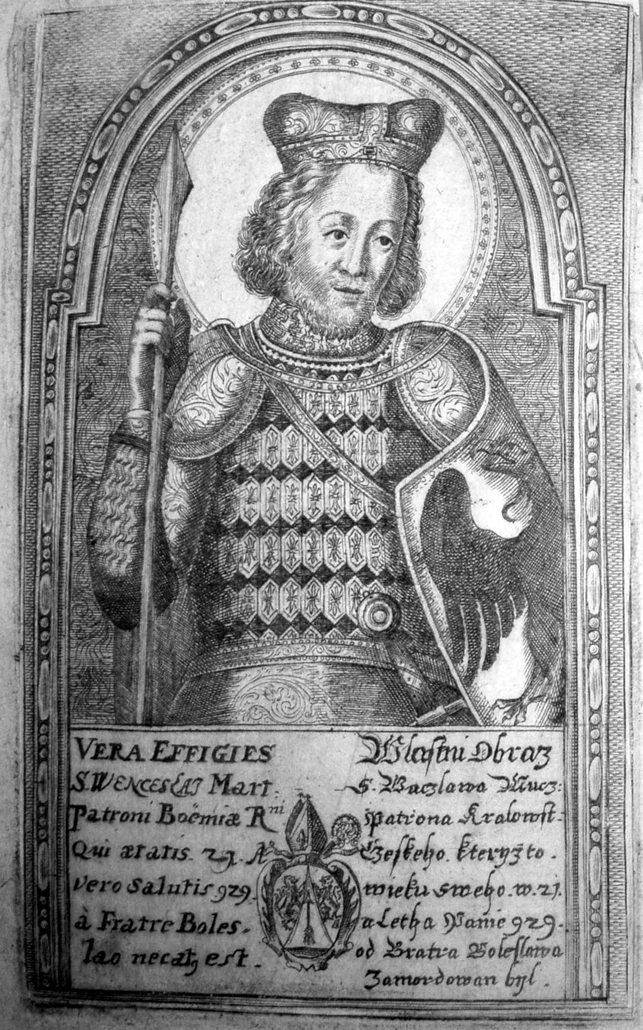
Svatý Václave
(Saint Wenceslas)
„the oldest preserved piece of evidence documenting the use of the Czech language as a poetic vehicle, dates from the 1280s or rather earlier… The song eulogizes St. Wenceslas as the eternal sovereign leader of the Bohemians.“

Slide 7
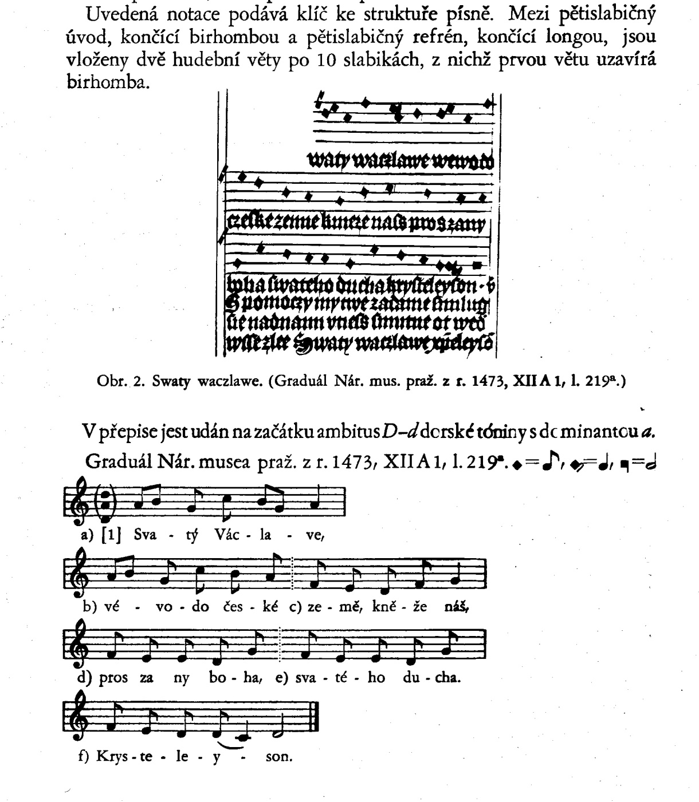
Earliest notated version (1473)

Slide 8
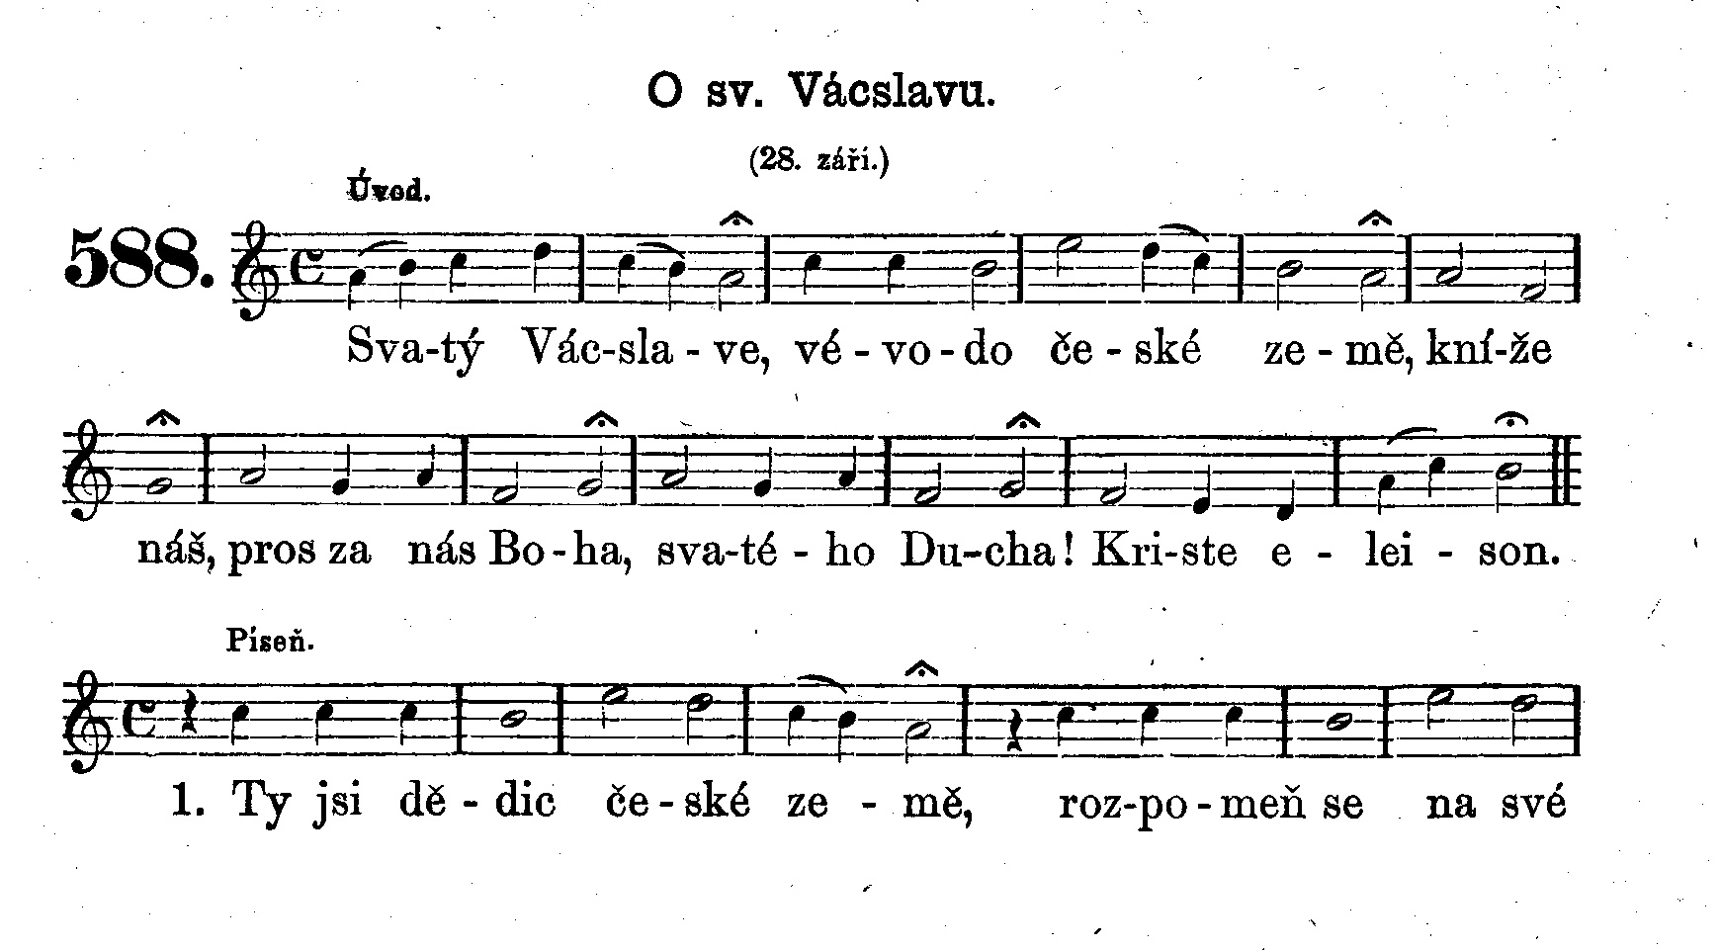
Later and nowadays more vivid version (melody) of the hymn, first documented by the hymnal book from 1864.
The church feast of St. Wenceslas the martyrer (28th of september) is also a state feast.

Slide 9
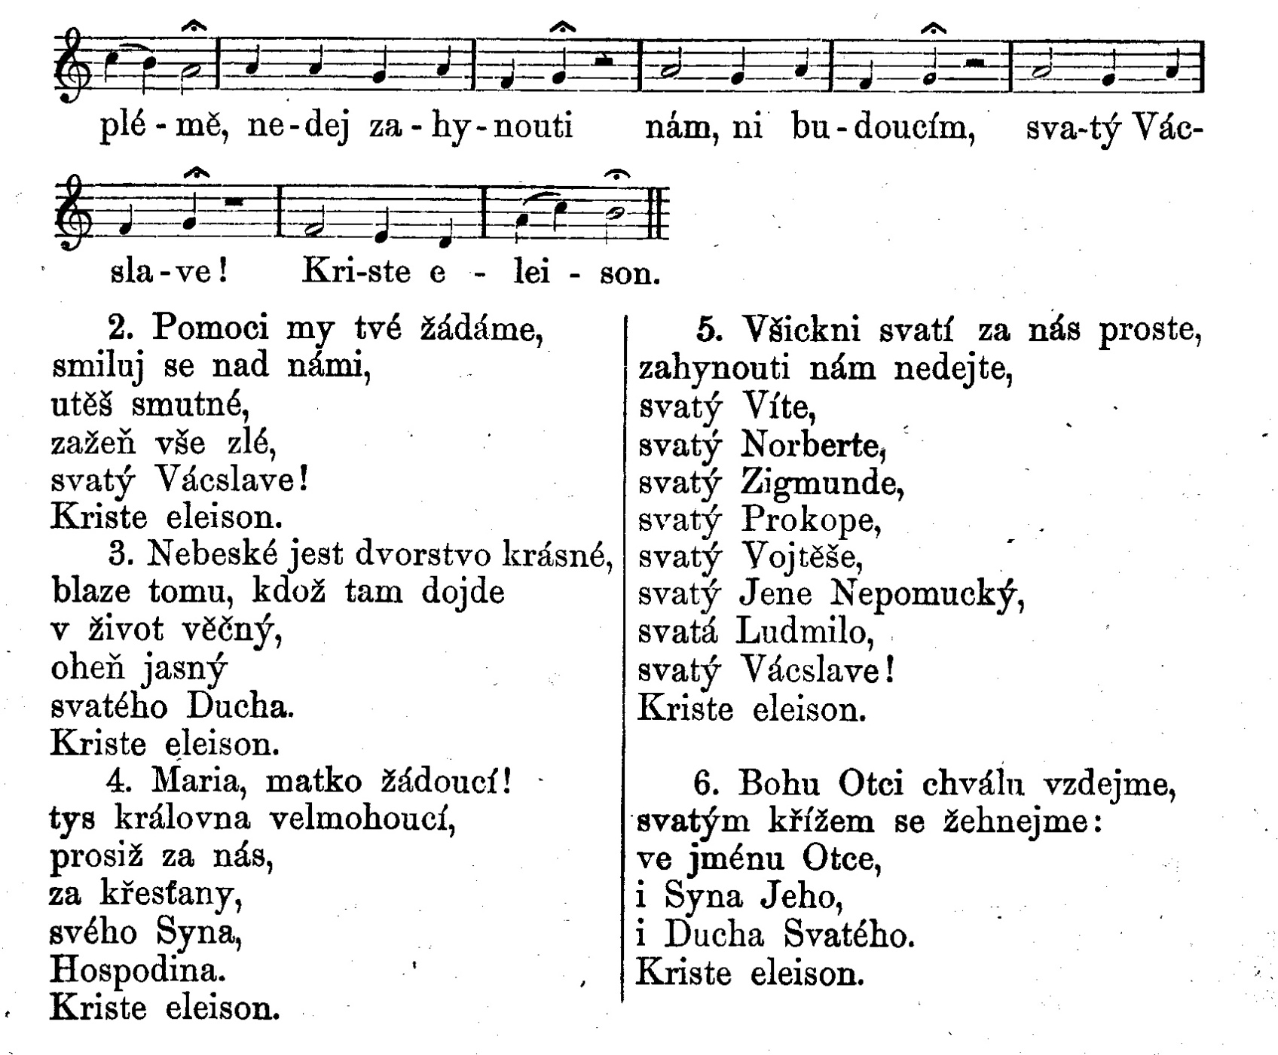

Slide 10
Verse nr. 6 lists the saint patrons of Czech lands , among them also St. Vojtěch (Adalbertus), prague bishop, to whom the St. Wenceslas hymn was traditionally attributed(see the engraving above).

Slide 11
Josef Suk: Meditation on the St. Wenceslas hymn
http://www.youtube.com/watch?v=1DbS3qAxv6g
A song – tributing St. Wenceslas, created in the late 80s of 20th century during the reign of communist party in Czech lands by Petr Skoumal
(somehow similar to the music of Peter Gabriel)
http://www.youtube.com/watch?v=gIZQ4JQV9A4&feature=related

