Slide 1
Music in the Czech lands III
ca1420-1620

Slide 2
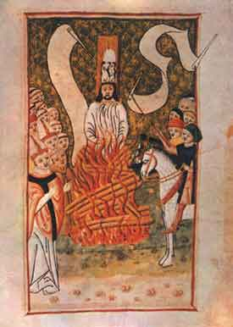
Music in the Czech lands ca1400-1620
(including foreign musicians active here)
+1415 priest and preacher John Huss (Jan Hus) burned at the stake in Constance
during the council (1414-1418)
Hussite movement in Czech lands – recession of the latin chant, secular song and polyphonic compositions
use of vernacular, preference of songs for the community

Slide 3
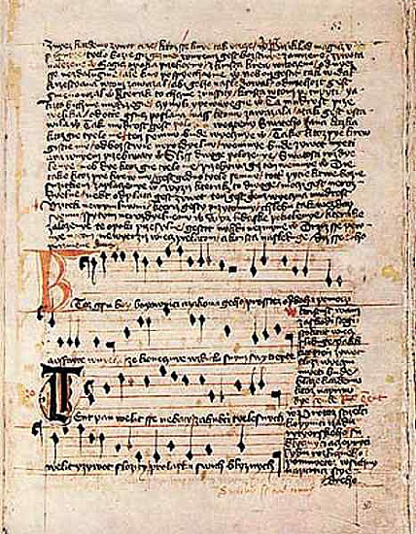
Jistebnický kancionál, ca 1420-30
First attempt to translate
liturgy into vernacular
That means, that this
manuscript – collection of
sacred songs, contains also
repertory for the mass as
a plainchant, but not in
latin, in czech!
Example: battle song
„Ktož jsú Boží bojovníci“
(You who are God´s
soldiers…)

Slide 4
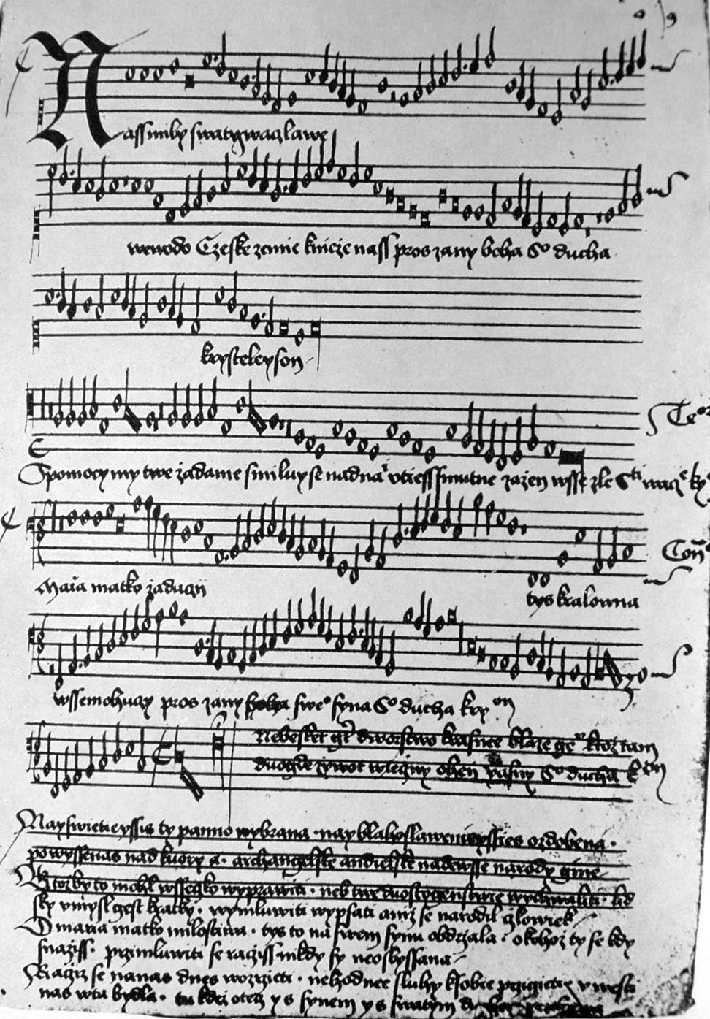
Codex Speciálník, manuscript ca1500,
See ECM: Codex Specialnik (Hilliard Ensemble)
Contains various repertory
plainchant, earlier
compositions in black
mensural notation, up to date
compositions for 3-4 voices
mostly in white mens. not.
(among them works by
important europ. authors)
Example: 3voice motet Náš
milý svatý Václave (Saint
Wenceslas…) in white mens.
notation

Slide 5
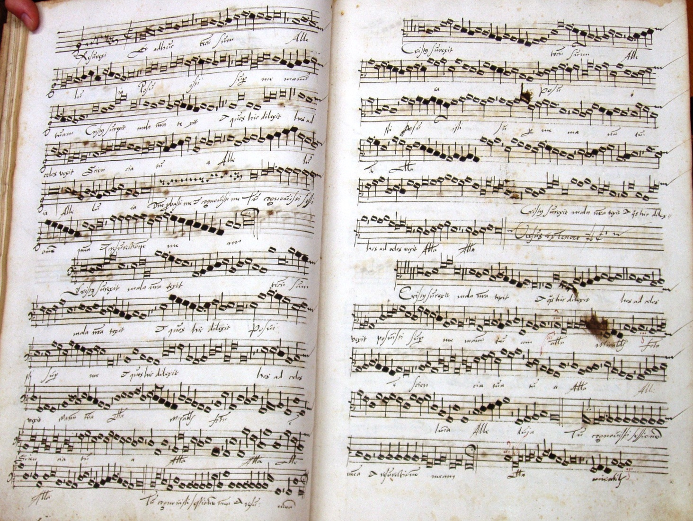
Franko-Flemish polyphony in the Czech lands
Names as Josquin, de la Rue, Isaac and others
See polyphonic manuscripts from Brno from ca1500:
http://www.youtube.com/watch?v=5gCZrPuag74

Slide 6
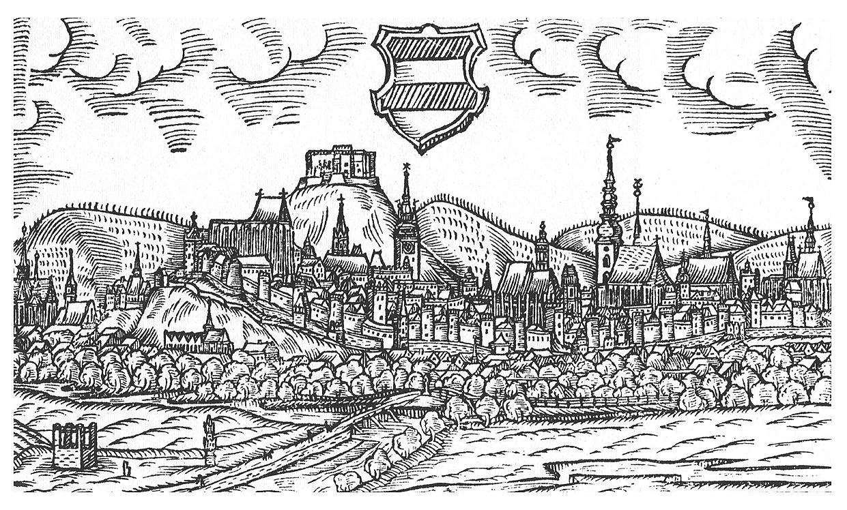
Emperor Maxmilian II in Brno 1567
His master of music chapell Jacobus Vaet died here
see the lament for his deceased master Clemens non Papa http://www.youtube.com/watch?v=PDIhRmwuYw4
Missa for 40 voices from Alessandro Striggio presented as a gift from Medici family here in Brnohttp://www.youtube.com/watch?v=CDUDWvB31lU
http://www.youtube.com/watch?v=6OppWKYl_Ak
Brno in 1593

Slide 7
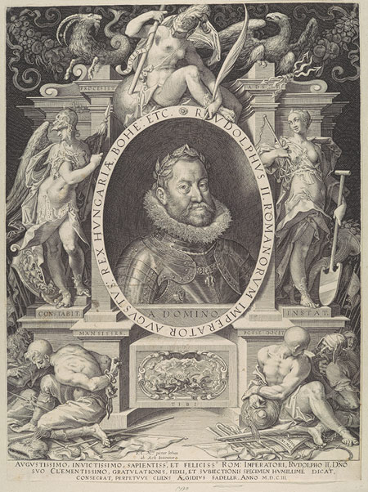
Emperor Rudolf II in Prague (ca1583-1612)
Emperor´s music ensemble
Philipp de Monte (musicae praefectus)
http://www.youtube.com/watch?v=hzmUty-MtVQ
Charles Luython (emperor´s organist)
http://www.youtube.com/watch?v=qzu8h_NRb2k
others: Jacobus Regnart, de Sayve family, Franz Sale
Prague organist and composer Jacobus Gallus
Handl (ca1550-1591), former
chapelmaster of the bishop of
Olomouc, moved to Prague 1585
to publish his large work
listen to his christmass
motet Mirabile mysterium
http://www.youtube.com/watch?v=pB0uI2h0FGs&feature=related
http://www.youtube.com/watch?v=Y1xht7I2hSA&feature=related
See Itinerary of
Fynes Moryson
http://en.wikipedia.org/wiki/Fynes_Moryson

