Slide 1
The brief outline of the history of the Czech Lands in the Middle Ages
Jana Musilova and Jana Hrabcova

Slide 2
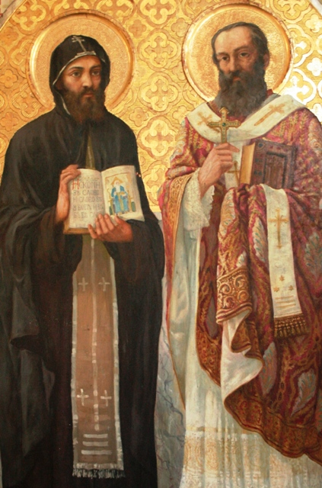
The Great Moravia in the 9th century
the Slavic state in the 9th century situated mostly in Moravia
cultural development resulted from the mission of Saints Cyril and Methodius

Slide 3
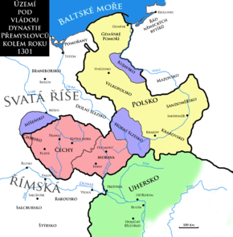
the House of Přemyslids – from 9th century till 1306
the centre of the duchy in Bohemia
Prague the capital city
the Kingdom of Bohemia since the end of 12th century

Slide 4
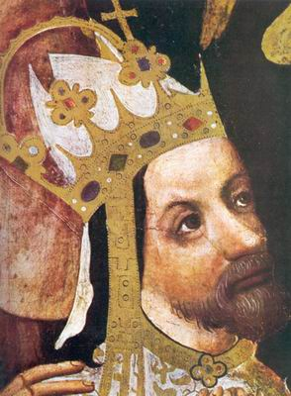
the House of Luxembourgs
From 1310 till 1437
Charles IV
the king of Bohemia (1346–1378) and Holy Roman Emperor (1355–1378)
the most important and the best known Bohemian king
1356 - The Golden Bull – the basic law of the Holy Roman Empire
Prague became his capital, and he rebuilt the city on the model of Paris, establishing the New Town of Prague (Nové Město), Charles Bridge, and Charles Square, Karlštejn Castle etc.
1348 – he founded the University of Prague, later named after him, the first university in Central Europe

Slide 5
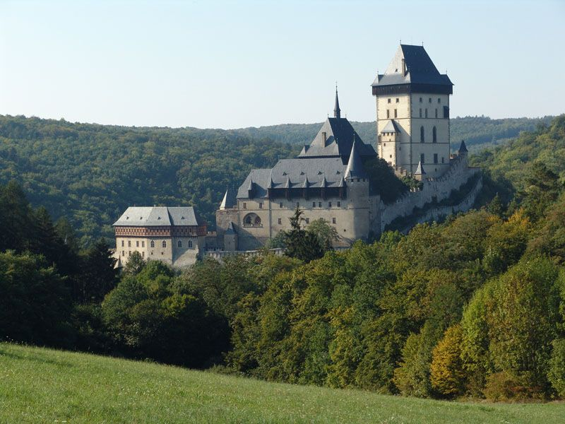
Charles IV
Readings:
Charles IV (autobiography), edited by Balázs Nagy, Frank Schaer (2001): Autobiography of Emperor Charles IV; And, His Legend of St. Wenceslas: Karoli IV Imperatoris Romanorum Vita Ab Eo Ipso Conscripta; Et, Hystoria Nova de Sancto Wenceslao Martyre, Published by Central European University Press.

Slide 6
The Hussite Revolution (1419 - 1436)
religious struggles
Master Jan Hus – became one of the forerunners of the Protestant Reformation
clergyman, preacher and Professor of Prague University
wanted to reform the Catholic Church
he was protesting against clerical abuses, especially the sale of indulgences (paying for forgivness of the sins during the confession)
he also declared that the clergy should live according to the Bible, in poverty, without property and a secular power
the mortal sins should be prohibited and punished
he also proclaimed that the believers should understand the Holy Writ so it should be proclaimed in the national languages

Slide 7
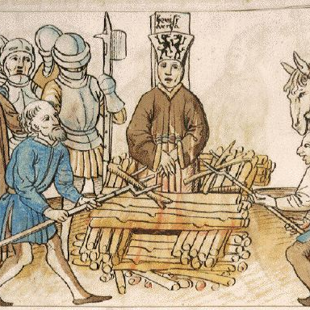
Master Jan Hus
Master Jan Hus was sentenced to death was burnt to death in 1415 at the Council of Constance

Slide 8
The Hussites
the Bohemian people blamed Emperor Sigismund for Hus´ death so they did not want him to become the king of Bohemia atlthough the was Charles IV´s son
Hus´s followers were called the Hussites; (Men of the Chalice - the symbol of Hussites movement)
Sigismund organized five crusade campains against Hussites but all the campains were unsuccesfull
almost 15 years of religious struggles and wars – the country was destroyed and plundered
the moderate Hussites wanted to finish the warfare so they united with Catholics and destroyed the radical Hussites at the battle of Lipany in May 1434
after that both the religions – the Catholic and the Hussite became legal in Bohemia and two churches were formed
1436 – Sigismund was accepted as the King of Bohemia, but he died only one year after that

Slide 9
The Hussites
after Sigismund´s death, a Bohemian nobleman and the leader of Hussites George of Kunštát and Poděbrady (1458–1471) was elected a king
he suggested something what could be considered as a proposal of latter European Union
he tried to prevent isolation of hussite Bohemia in catholic Europe, so he proposed a treaty among all Christian powers, the member states should pledge to settle all differences by exclusively peaceful means and fight altogether against Osman Turks who were threatening Central Europe
Readings:
Doležalová, Eva – Pánek, Jaroslav (2011): Confession and nation in the era of reformations: Central Europe in comparative Perspective). Prague.

Slide 10
the House of Habsburgs
1526 – 1918
Ferdinand I (1526–1564)
The key events during his reign were:
the contest with the Ottoman Empire, whose great advance into Central Europe began in the 1520s
the contest with the protestant Reformation, which resulted in several wars of religion
The Habsburg rule brought the re-introduction of the Roman Catholic faith, centralization and the construction of a multi-national empire. The Habsburgs included the Crownlands of Bohemia in their monarchy, and they remained a part of the Habsburg empire until 1918

Slide 11
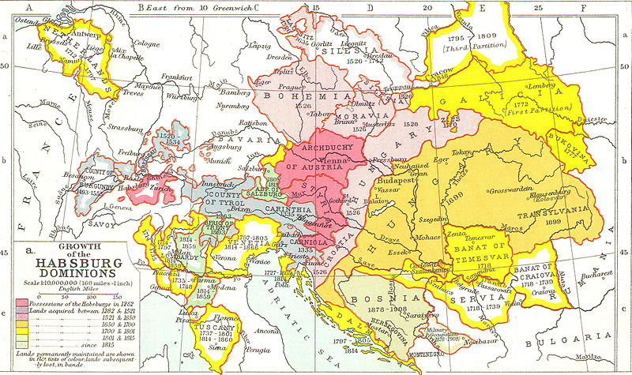
The habsburg monarchy

Slide 12
Rudolph II (1576-1611)
left Vienna for Prague, Bohemian capital grew into an important center of European culture
The Czech Estates forced Rudolph II to issue a decree - so called "Maiestatus" - proclaiming freedom of religious confession
due to many artist and scientist and the development of culture and natural sciences it was called „the Golden Prague“
Rudolph also supported natural philosofers such as the the astronomers Tycho Brahe and Johannes Kepler, also Giordanno Bruno spent some time in Prague when he was on the run from the inquisition
Rudolph also patronated occult sciences, many alchymists stayed in Prague during his reign
Interesting web site: http://english.habsburger.net/

Slide 13
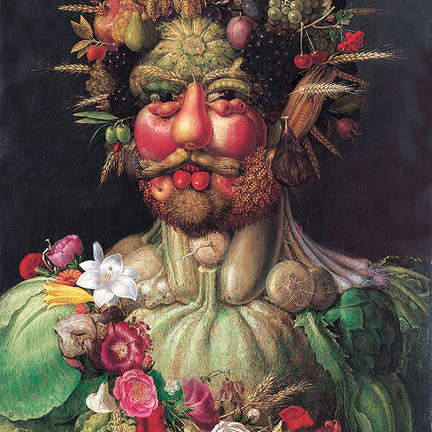
Rudoplh Ii
Rudolph loved collecting paintings and was also patron of many contemporary artists – e.g. Giuseppe Arcimboldo, Bartolomeus Spranger, Hans von Aachen, Adrian de Vries and many others

Slide 14
The Thirty Years' War (1618–1648)
The EmperorFerdinand II tried to limit the freedom of religious confession and his efforts sparked a civil war between the Estates and the Catholic Emperor which later spread into Europe under the name of the Thirty Years' War
1618 – The so-called Defenestration of Prague – the unpopular king´s representatives in Bohemia (the governors) were thrown out of a window of the Prague Castle
The Czechs elected an independent king Frederick V.
The Estates were defeated in 1620 at the Battle of the White Mountain and the Kingdom of Bohemia lost its independence for the following almost 300 years
the Catholic faith was declared to be the only permitted creed in the country

Slide 15
The Thirty Years' War (1618–1648)
The period of the Thirty Years' War brought political disorder and economic devastation to Bohemia which had far-reaching consequences on the future development of the country.
The throne of Bohemia was made hereditary in the Habsburg dynasty and the most important offices were transferred permanently to Vienna
Ferdinand II issued an edict, which ordered all non-Catholic noblemen to convert or to emigrate – so the large wave of emmigration succeeded
the hussite or protestant inhabitansts were often violently forced to convert
tightening of serfdom
German soon became the first language of the country

Slide 16
The Thirty Years' War (1618–1648)
all European states participated on the Thirty Years´ War – directly or indirectly
the Peace of Westphalia finished The Thurty Years´War – series of peace treaties signed between May and October of 1648
Readings: Grafton, Anthony(2001): Thirty Years War. New York Review of Books.
Duchhardt, Heinz : Münster/Osnabrück as a Short-Lived Peace System. In: Goudoever, Albert P. van (ed.) (1993): Great Peace Congresses in History 1648–1990. Utrecht. Pp 13–19.

