Slide 1
Central europe in the second half of 19th century
Jana Hrabcova

Slide 2
Habsburg Monarchy
after the defeat of revolution movement in Habsburg monarchy conservative absolutism again
the ruler – Emperor
Franz Joseph I of Austria (1848–1916)
1851 – the constitution was cancelled –neoabsolutism was introduced
the main personality – the Prime Minister Alexander Bach → Bach´s absolutism
police regime, centralism, control of public life, strict censorship
political rights cancelled
kept – eqality before the law, freedom of religion and cancellation of the serfdom
economic reforms

Slide 3
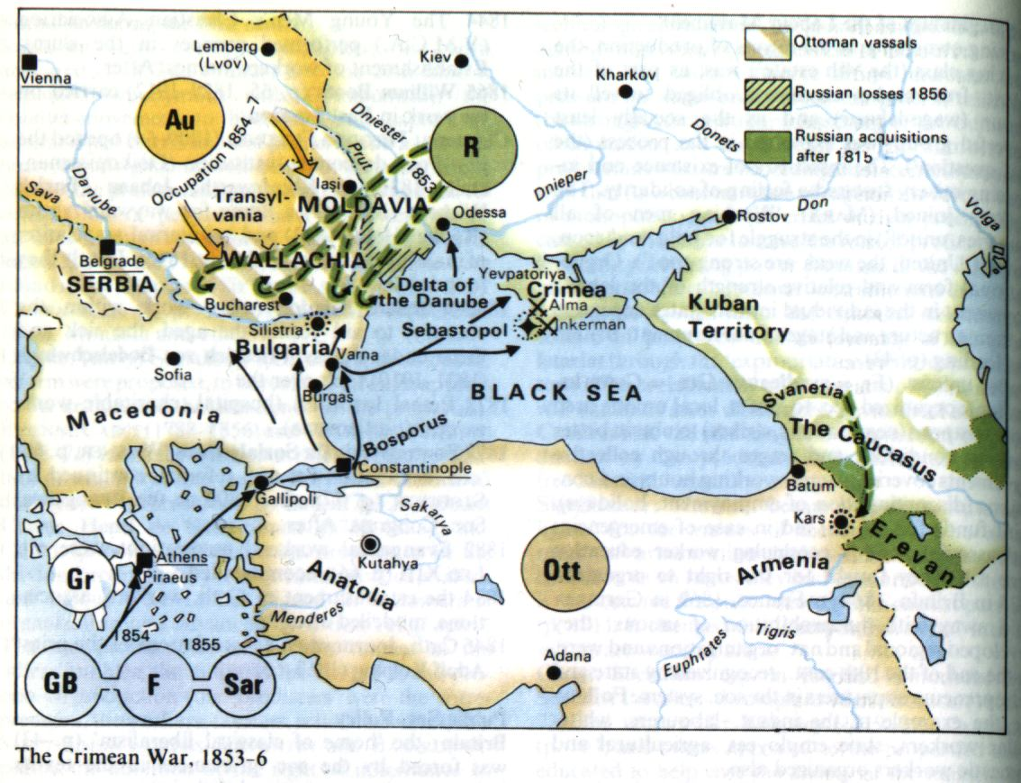
Habsburg Monarchy
foreign policy – unsuccesful
neutrality in Crimean War 1853–1856 - Austrian Emperor agreed the intervention but did not support it, declared neutrality what caused international isolation of Habsburg Monarchy

Slide 4
Habsburg Monarchy
1859 – the war with Italy – Habsburgs were defeated and lost Lombardy
this war caused deep financial crisis in Habsburg Monarchy
this crisis and dissatisfaction with absolutist policy led to its end
its main representatives headed by Alexander Bach were withdrawn
1860 – the October Diploma – the new imperial code – was proclaimed
1861 – February - new the constitution was instroduced, it was the beginning of parliamentary monarchy in the Habsburg Empire

Slide 5
Habsburg Monarchy
1866 – Austrian-prussian war
Austria was defeated
Austria lost its influence in Italy and in Germany
internal weakness of Habsurg Monarchy was shown
it was used by Hungarians – their representative count Julius Andrássy (1823–1890)
they refused centralism but also federalism which proposed the Czech political representation
so called Compromise with Hungary in 1867
the empire was devided into two parts: the border the river Leithan between Austria and Hungary – the dual monarchy was established
Cisleithania (Austrian lands, Bohemia, Moravia, Galicia and Bukovina, Adriatic lands – Dalmacia, Istia, Terst, Gorica) – domination of German nation
Translaithania (Hungary, Upper Hungary – Slovakia, Transylvania, Croatia, Slavonia, Rijeka) – domination of Hungarian nation

Slide 6
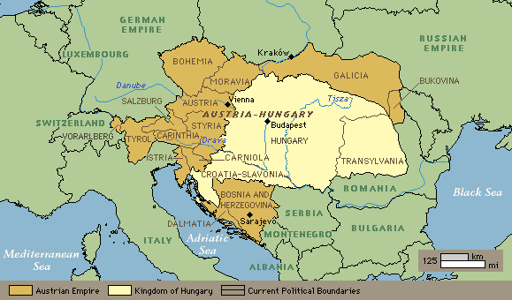
Austria-hungary

Slide 7
Austria-hungary
Austria-Hungary became an union of two states with different constitutions a political systém
they had common ruler – the Emperor Franz Joseph I., common Ministry of War, Ministry of Finance, Ministry of Foreign Affairs
they were connected also economicaly – common currency, customs union
common legislative organ for common issues
Austria – 1867 – liberal constitution, parliament monarchy – the power of the ruler was limited by parliament, the ministrers were responsible to the parliament which was approving the legislation and the taxes
the ruler was not responsible to parliament (the rest of absolutism)
Hungary – no liberalization but centralisation, the only Hungarian nation, the official language was hungarian, the other nations without any rights, high schools only in Hungarian language

Slide 8
Austria-hungary
the Czech political representation was dissatisfied with the situation – the political rights of Hungarians were accepted but of Czechs were not
they tried to change this situations many times but their politics were unsuccesful
they started so called passive politics – they were boycotting the parliament sitting and the council meetings till 1878
Readings:
Okey, Robin: The Habsburg Monarchy c. 1765-1918: From Enlightenment to Eclipse. New York: St. Martin´s Press, s.d.

Slide 9
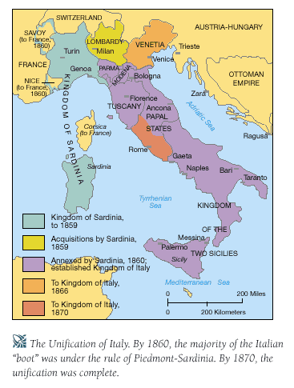
unification of Italy
there were 8 smaller states in Italy - rulers - the Habsburgs, the Bourbons, the Pope
in the north-western part the most economicaly developed Kingdom of Sardinia and Piemont was situated, the home dynasty was ruling there – the House of Savoy – king Victor Emanuel II

Slide 10
unification of Italy
1859 - the war with Habsburg Monarchy,
at the same time, the revolution in smaller states in the middle Italy broke out and the local pro-Habsburg rulers were everted
after the plebiscit these states were connected with Victor Emanuel´s state
the uprising led by legendary hero Giuseppe Garibaldi (1807–1882) – he led one thousand of men in red shirts to Palermo, occupied it, in September they entered the city of Naples and defeated the army of king Francis
then Garibaldi gave his power to Victor Emanuel II and southern parts of Italy were unified with the nothern parts

Slide 11
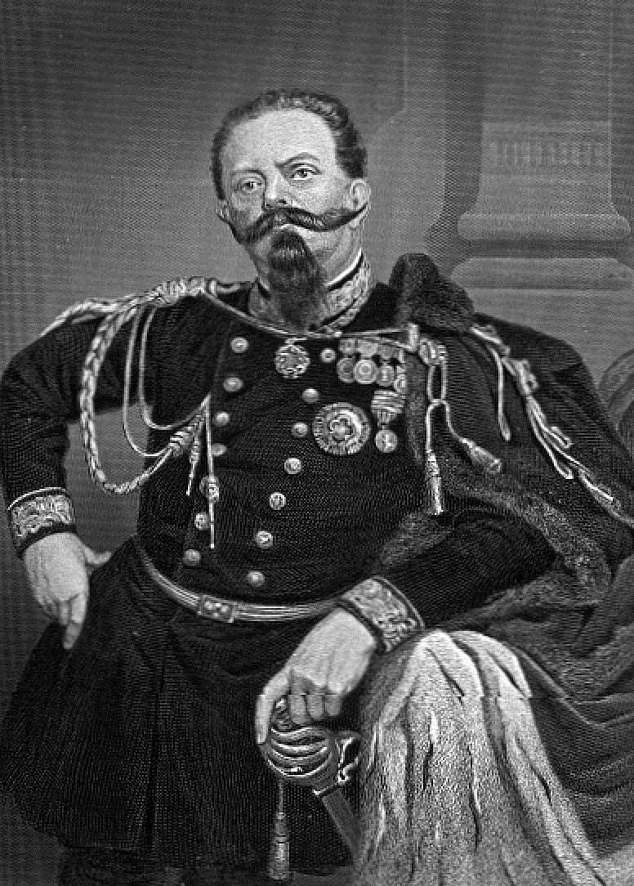
unification of Italy
March 1861 –the Kingdom of Italy was proclaimed in Torino
1866 – after Austrian-prussian war Veneto was connected with the Kingdom of Italy
1870 – the Papal state with Rome was annexed by the Kingdom of Italy
1871 – Rome became the capital city of Italy
Victor Emanuel II ruled till 1878

Slide 12
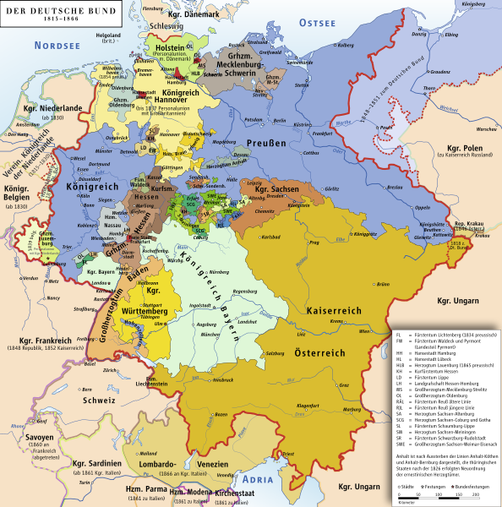
unification of Germany
between 1849–1866 – struggle between Austria and Prussia for domination in German states (German Confederation)
in Prussia king William I (1861–1888, since 1871 the first German Emperor)
since 1862 – the Prime Minister Otto von Bismarck – his target was to unify Germany „by blood and iron“ that means by army and military power and make Germany the strongest Empire in Europe

Slide 13
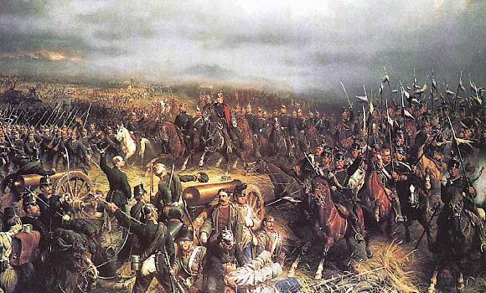
unification of Germany
1866 – the war with Austria
July 3rd 1866 the battle of Sadowa near Königgratz (Hradec Králové), 2nd biggest battle in Europe since the Battle of Leipzig in 1813 (8 000 – Austria was defeated and lost some areas in Germany and Veneto in Italy

Slide 14
unification of Germany
the German Confederation existing since 1815 was dissolved
instead of that the North German Confederation was constituted – 21 states – customs union, common currency and common foreign policy – the first step to unification
prussian king became the President of this Commonwealth and the commander-in-chef of the army
Prussia provoked France to declare war on Prussia in 1870
France was defeated at the battle of Sedan in September 1870 – French king Napoleon III was captured what caused the fall of the French Empire
Paris was besieged since September 1870 till January 1871
in January 1871 – The German Empire was proclaimed

Slide 15
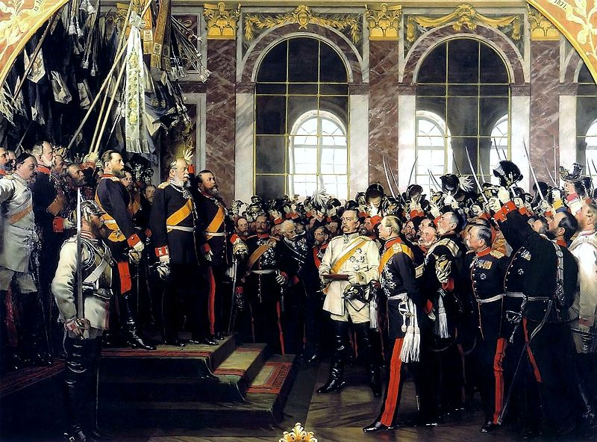
unification of Germany

Slide 16
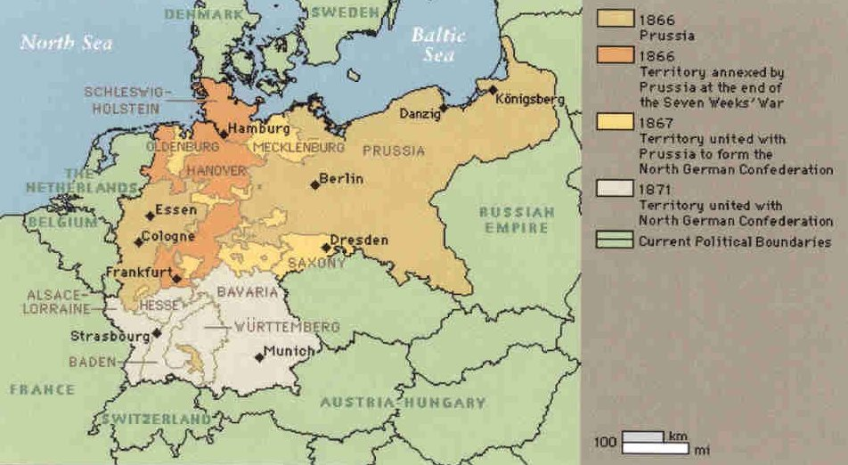
unification of Germany

Slide 17
unification of Germany
Germany annexed Alsace and Loraine what were the richest French provinces
Germany became federation of 25 states (22 states + 3 cities) with its own representatives
each state nominated its represesentative to the Senate (Bundesrat), the memers of the assembly (Bundestag) were voted – the suffrage was universal for all the men since 25 years
Germany became European and world power with strong army and imperial politics
William II (1888–1918) – the last prussian king and German Emperor
Readings:
Breuilly,John (ed.): Nineteenth-Century Germany: Politics, Culture and Society 1780-1918.New York: Oxford University Press, 1997 and 2001.

Slide 18
International Relationships before the WW1
Great powers at the end of the 19th century:
USA - the strongest
Germany (2nd world industrial area), the most powerful state in Europe, strong army, developed economy and culture
France – the bank of the world, 2nd strongest European state, succesful colonial politicis – colonies in Africa and in Asia
Great Britain – the greatest colonial power – its domain included the geatest colony – India, also colonies in
in Asia Japan – constitutional monarchy, development of industry, expansive politics
Austria-Hungary –cooperation with Germany, its foreign politics focused on the Balkan Peninsula
Russia – economicaly and politicaly the weakest state among the great powers, military-political system, absolute power of the Tsar, no political rights for citizens, social movement, expansion to Asia – conflicts with Japan and Great Britain

Slide 19
Formation of two enemy blocks in Europe at the end of 19th century
1879 – the secret agreement was concluded between Germany and Austria-Hungary – against France and Russia
1882 – Italy joined this pact → Tripple Alliance (later the Central Powers)
1893 – Russia and France made an agreement – they both were isolated and were affraid of strong and aggresive Germany
1904 – so called Entente Cordial concluded between France and Great Britain (affraid of strong Germany)
1907 – Russia + Britain → Tripple Entente

Slide 20
Balkan Wars
the first conflict in Europe after 40 years
the Balkan nations were fighting against Turkey which was occupiing them
1912–1913 - 1st Balkan War – so called Balkan League (Bulgaria, Serbia, Greece and Montenegro) X Turkey – Turkey was defeated and its European areas were liberated
but then the former allies started to fight with each other because of deviding of the liberated areas, Bulgaria had greatest war casualties and invested the most but the deliberated areas (Macedonia, Thrakia) got especially Greece and Serbia → Bulgaria was dissatisfied and declared war on Greece and Serbia → 2nd Balkan War – 1913
Turkey and Rumania joined Greece and Serbia and they were fighting against Bulgaria which was defeated and lost also the areas which obtained after the 1st Balkan War
but also Serbia was dissatisfied with the results of the wars (Serbia was expecting enlargement of its territory and wanted to raise Adriatic coast but instead of that Albania was formed)
Serbia started to prepair for the new war – wanted tu unify all the southern Slavs – who were living in Austria-Hungary

Slide 21
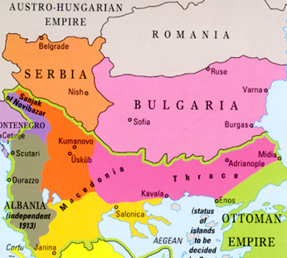
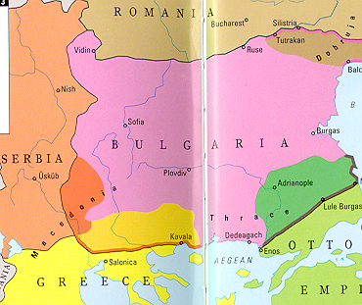
Balkan Wars
1st Balkan War
2nd Balkan War

