Slide 1
Enlightenment and reforms.
Central Europe during 18th century
Jana Hrabcova

Slide 2
Habsburg monarchy after 30 Years’ war
The wars with Ottoman Empire – ruling over the whole Balkan Peninsula and a part og Hungary
1683 – Vienna besieged by the Ottomans
Polish king Jan (John) III Sobieski (1674–1696) helped Vienna and the Turks were defeated
1697 – The Ottomans were defeated at the Battle of Zenta
1699 - Peace Treaty of Karlowitz (Sremski Karlovci) – Hungary,Croatia and Slavonia incorporated into the Habsburg Monarchy again
1701–1714 – the Wars of Spanish Succession – Habsburgs x Bourbons
Bourbons won and got Spanish throne
Habsburgs got territories in Italy (Naples, Sardinia, Milan) and Spanish Netherlands as compensation
Habsburg Monarchy became a great power at the beginning of 18th century and a leading power in Central Europe

Slide 3
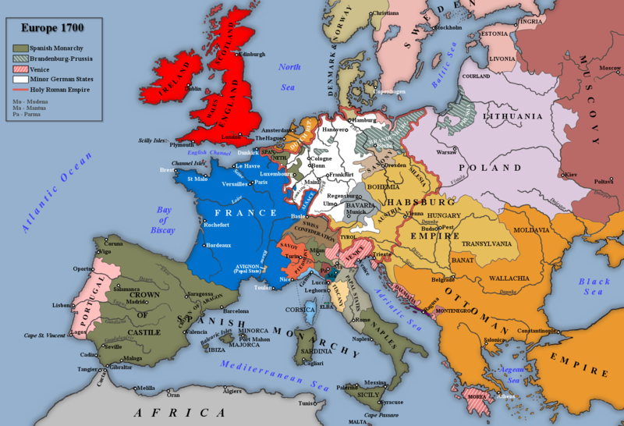
Europe around 1700

Slide 4
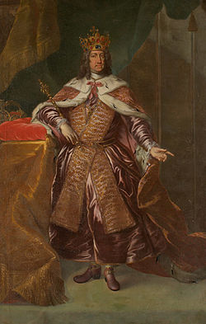
Habsburg Monarchy in 18th century
Joseph I (1705–1711)
Charles VI (1711–1740) – a dynastic crisis - no living male heirs
1713 –Pragmatic Sanction
a law which ensured the succession by female family members if there were no male heirs
ensuring the indivisibility of the Habsburg Empire (Austrian Lands, the Lands of Bohemian Crown and Hungary) - the Habsburg ruler ruled as a hereditary sovereign
Recognized by most European governments as an iternationally valid document
the re-Catholization pressure increased
1737–1739 – war with Ottoman Empire

Slide 5
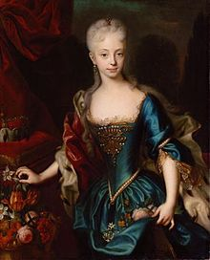
Maria theresa (1740 – 1780)
born in 1717
Her husband was Francis Stephen of Lorraine (Holy Roman Emperor since 1745)
They had 16 children, 13 of them survived
her right to rule was based on the Pragmatic Sanction from 1713, but after Charles´ death some rulers challenged its validity and presented their claims to Habsburg lands
the War of Austrian Succession in 1740–1748
she managed to defend almost her entire heritage but it was clear that it is necessary to put a big effort into perfecting the army and reforms of the state
Seven Years´ War (1756–1763) - Frederick II invaded Bohemia but in the end the Prussians were pushed from Bohemia

Slide 6
Enlightened reforms
since the mid-1760s Maria Theresa could finally focus on the consolidation and modernization of her lands – enlighted reforms
formation of new administration and the new institutions and beraucratic machinery
she decided to transform the complex multinational domonion into a compact state which was to be a state unified on legal, ideological and later also linguistic levels (germanisation)
it was to be politically and economically strong state, managed centrally and efficiently by qualified people (important – education, experiences and personal abilities, not the social status)
the administration was centralised (this concerned only Austria and Bohemia, not Hungary, which obtained many privileges for its help in the War od Austrian Succession, this ensured different development)

Slide 7
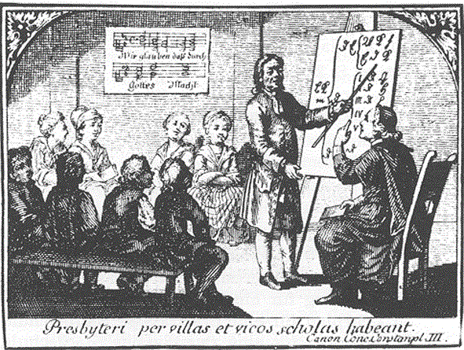
Enlightened reforms
Hygiene and medical services
better health care – hospitals, inoculation, urban sanitation measures→ population increase
education system reforms (obligatory school attendance for children from 6 to 12 years old)
schools under the state control, unified curriculum
universities also under the state control, new study programmes – economics, technical sciences

Slide 8
Enlightened reforms
legal reforms - equality before the law was declared, humanization of punishments, torture dissapeared from court procedures, capital punishment was temporarily abolished in 1780s
1769 – Maria Theresa´s Penal Code
1786 – General Civil Code
1787 – Joseph II´s Penal Code
tax reform - land register and tax and urbarial reforms, universal land tax, which was to be paid by all the population (earlier the aristocracy and the church had been exempted from the taxes)
uniformed units of size and weight, unification of currency, extensive road network, abolished customs barriers between the provincies – the trade became much easier

Slide 9
Enlightenment
in the Czech lands since mid- 18th century, the peak during Joseph II´s reign, sometimes also called josephinism
centres of enligtened life – noble salons and Masonic lodges – enlightened state clerks and army officers focused on charity
1784 – the Bohemian Society of Sciences – focused on natural and historical sciences
the Bohemian enlightment and science was linguistically mostly German

Slide 10
Joseph II (1780–1790)
The eldest son of Maria Theresa and Francis Stephen of Lorraine, born in 1741
Well educated, diligent
popular ruler – often traveled incognito (Duke of Falkenstein)
Patron of the arts
Holy Roman Emperor since 1764
1760 – married Princess Isabella of Parma (died in 1762), second wife – Maria Josepha od Bavaria
None of his children survived

Slide 11
Joseph II
censorhip was loosened, not completely freedom of speech, but citizens could comment on domestic political matters
He tried to reform highly conservative Catholic church
the church was put under state control, its property was taxed
education of the priests was controlled by the state
the priest were in charge of educational and administrative activities – administered population registires, executed medical supervision etc.
Joseph II dissolved those monasteries which were not engaged in activities beneficial to either state or citizen – education, healthcare or charity (so those which were begging were cancelled)
1781 – Joseph II´s Toleration Patent – granted freedom of religion to non-Catholic denominations: Orthodox, Calvinist and Lutheran
the era of state promoted re-Catholization was definitely over
later in 1780s the rights were also applied to the Jews, who also became the equal citizens

Slide 12
Joseph II
1781 – Serfdom Patent (abolished restricions and granted the peasants personal freedom, they became equal citizens)
1785–1789 – Josephine land register was elaborated, the taxation was based on real economic conditions – quality of the soil, types of plantation, other necessary expenses
the Enlightened state reforms, particularly the changes intorduced by Emperor Joseph II, did not meet with a universaly possitive response
especially the nobility refused to accept the loss of its political possition, privileges and power over the peasants, but many people had problem with state control of the church and of the life in general, they did not like interventions into folk customs and religious traditions
Some of his reforms were cancelled after his death – his brother Loepold II (1790–1792) who succeeded him was under the heavy pressure of the nobility and the church

Slide 13
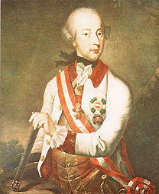
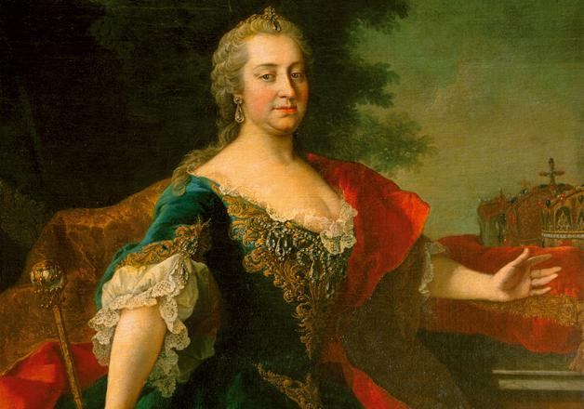
Maria Theresa (1717 – 1780)
Joseph II (1741 – 1790)

Slide 14
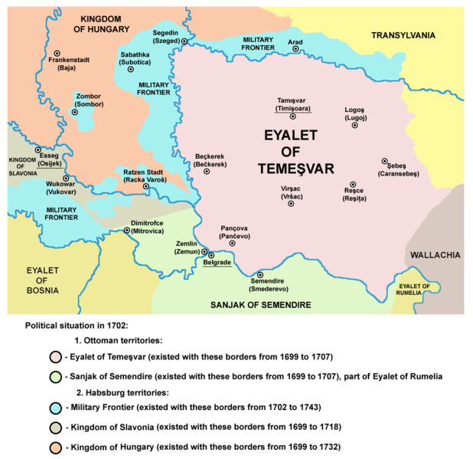
Hungary
in the second half of the 17th century – unstable region with several anti-Habsburg rebellions taking place
1699 – Peace Treaty of Karlowitz (Sremski Karlovci) with Otoman Empire – most of Hungarian areas liberated from Otomans
Personal union with Austria
Many nationalities – Hungarians only 40 % of inhabitants (Slovaks, Croats, Serbs, Romanians etc.)

Slide 15
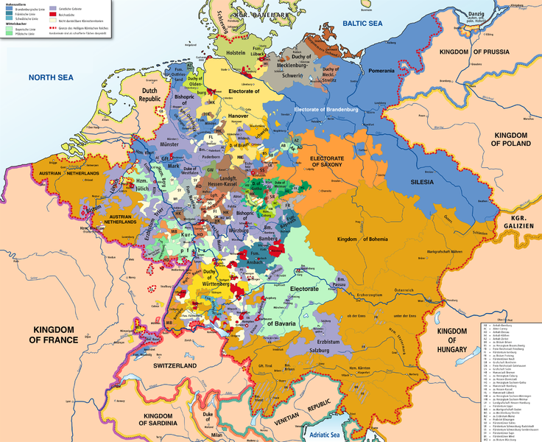
The Holy Roman Empire
after Thirty Years´ War the European power structure was rearranged
The Holy Roman Empire was fragmented into many territories (360 states) - de facto they were sovereign and had their own rulers - this limited the power of the Holy Roman,the power of the Emperor was very weak, the Empire Diet did not work in fact
the Holy Roman Empire had no army, no central autority

Slide 16
prussia
after the Thirty Years´ War the Kingdom of Prussia in the North- Eastern part of the Holy Roman Empire started to grow and politicaly strenghten, the rulers were coming from the House of Hohenzollern
Prince Elector Frederick William (1640–1688) – ecomonical reforms, strong power of the ruler
his son Frederick III (1688–1713) - he was crowned the King as Frederick I
the capical city was Berlin – rebuilt, administrative and cultural centre of the state
Frederick William I (1713–1740) – called the Soldier King, thrifty, practical, good ruler
creator of the Prussian bureaucracy and the professionalized standing army, which he developed into the best army in Europe

Slide 17
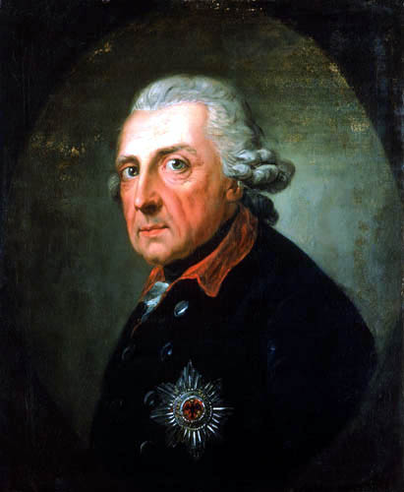
prussia
Frederick II (1740 – 1786) – the Great, the King of Prussia
he was succesful reformer
practised enlightened absolutism
he introduced a general civil code, abolished torture
he also promoted an advanced secondary education
supported science and arts – according to the French example he built the Chateau Sanssouci
he used the power of his army to conquer Silesia, which was the richest province of Habsburg Monarchy
In 1740, Prussian troops crossed over the undefended border of Silesia and the so called Silesian Wars began (1740–1763)
these wars have been groped with the War of Austrian Succession (1740–1748)

Slide 18
Partitions of poland
the third largest state in Europe till 1770s, Polish-Lithuanian Commonwealth – it was very difficult to govern such a large country
many nations and many confessions living in Poland
a great influence of Russia in 18th century – the Russian tsars installed Polish kings in fact – firstly the Saxony dynasty and later the Russian Empress Catherine the Great installed the last Commonwealth King Stanisław August Poniatowski (1764–1795)
the general decline of Poland was used by its neighbouring states – Prussia, Russia and Habsburg Monarchy and resulted in the Partition of Poland in the second half of the 18th century
1st partition – 1772
Poland lost 1/3 of land and 1/3 of inhabitants
the reform magnates wanted to save Poland by introducing some reforms and the constitution
the Polish Constitution was the first written constitution in Europe but the pro-Russian conservative Polish magnates, the Confederation of Targowica, fought against Polish forces supporting the constitution which were defeated

Slide 19
Partitions of poland
2nd partition – 1793
Prussia named its newly gained province South Prussia
the last attempt to save at least the rest of Poland was the Kościuszko Uprising in 1794 – the leader Tadeusz Kościuszko
the uprising was organized by nobility and burghers, the peasants did not allied
the Russians allied with Prussia and the uprising was totaly defeated
3rd partition – 1795 – the rest of Poland divided between Russia and Prussia
Results of the Partition of Poland:
To Russia: Latvia, Lithuania, Belarus, great part of the Ukraine
To Habsburg Monarchy: Lesser Poland, the Kingdom of Galicia, city of Cracow, City of Lwow
To Prussia: Greater Poland with the City of Poznan, Mazuria with Warsaw

Slide 20
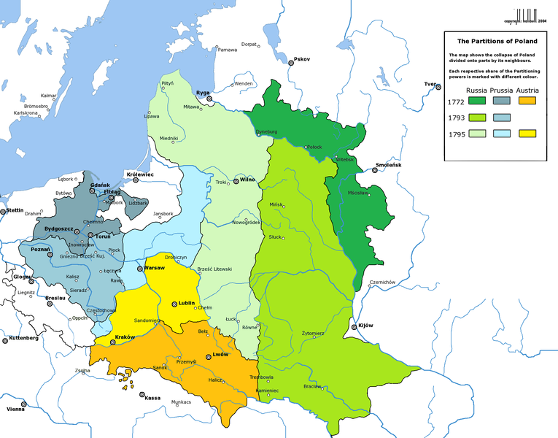
Partitions of poland

Slide 21
Readings
Tapié, Victor Lucien. The rise and fall of the Habsburg monarchy. London: Pall Mall Press, 1971.
HUBATSCH, Walther. Frederick the great of Prussia: absolutism and administration. London: Thames and Hudson, 1975.
MAC DONOGH, Giles. Frederick the Great: A Life in Deed and Letters. New York: St. Martin's Griffin, 2001.

