Slide 1
World War I and international relations in the central europe after WW I
Jana Hrabcova

Slide 2
Central europe before WWI
two blocks of powers at the beginning of the war:
Entente (Allied Powers): Great Britain + France + Russia
Central Powers: Germany + Austria-Hungary + (later) Bulgaria + Turkey
Italy – firstly neutral, in May 1915 joined the Entente (the London Treaty in April 1915 promised territorial gains to Italy)
neutral countries: Sweden, Norway, Denmark, Netherlands, Spain, Switzerland, Albania
USA – neutral at the beginning of the war, entered the war in April 1917
the pretext for starting the war was the assassination of Archduke Franz Ferdinand of Austria in Sarajevo on June 28, 1914
July 28, 1918 – Austria-Hungary declared the war on Serbia

Slide 3
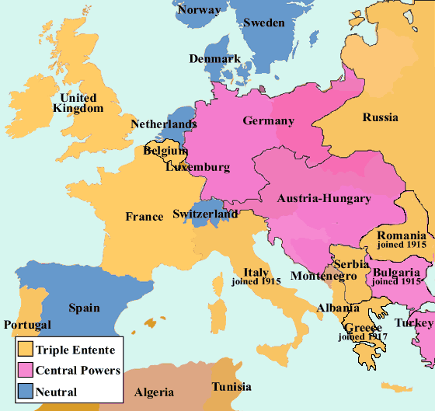
europe during WW i
The blocs of Powers

Slide 4
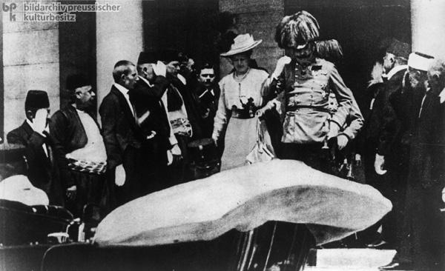
Central Europe and WW I
Archduke Franz Ferdinad and his wife Sofia in Sarajevo.

Slide 5
The targets
Germany – the most agresive, wanted new colonies and wanted to expand to the Middle East (Berlin-Baghdad), also wanted to rule in the Central, Eastern and South-East Europe (with the help of Austria-Hungary), Germany also wanted some areas in France and Belgium
Austria-Hungary – wanted to expand into the Balkan Peninsula and defeat the Kingdom of Serbia, which was independent, Serbia was enemy for A-H also becauce of Bosnia and Herzegovina
France – wanted to get back Alsace and Loraine from Germany + keep its colonial domains
Russia – wanted Galicia (which was Austro-Hungarian in those times), Silesia, and some parts of Balkan Peninsula, especially around the straits between Asia and Europe - Bosphorus and Dardanelles
Serbia – wanted to keep its independence and to form the Balkan federation – with Croats, Slovenes and Serbs living in Austria and Hungary
Great Britain – wanted to keep its colonies and exclude Germany from world trade, stop its expansion to the Middle East
USA – wanted to defend democracy in the world and the principle of self-determination of the nations (Woodrow Wilson)

Slide 6
Four phases of the war:
August – December 1914 – offensive operations
1915–1916 – trench warfare
1917–1918 – the era of total exhaustion
March 191 –November 1918 – supremacy of Allied Powers (USA entered the war in April 1917)

Slide 7
Four main fronts
Balkan front (Balkan Peninsula, firstly in Serbia, then in Greece)
Western front (against France)
Eastern front (against Russia)
Italian front
also naval war (in the Pacific Ocean – Japan + Great Britain against Germany, in the Nothern Sea – Great Britain against Germany)
warfare in the colonies

Slide 8
Western Front
the Germans attacked France according to the so called Schlieffen Plan - designed to attack France quickly through neutral Belgium
the German troops were stopped at the First Battle of Marne in September 1914 – the offensive war changed into trench warfare
March 1915 – the second Battle of Ypres – the Germans used chlorine gas – 15 thousands of men were poisoned
from February till September 1916 – bloody battle of Verdun – 600 thousands of casualties,
from July till November 1916 the great battle of the Somme - totally 1 million casualties during the whole battle, the new British invention was used – the tanks

Slide 9
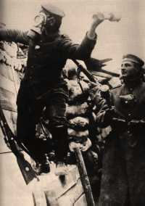
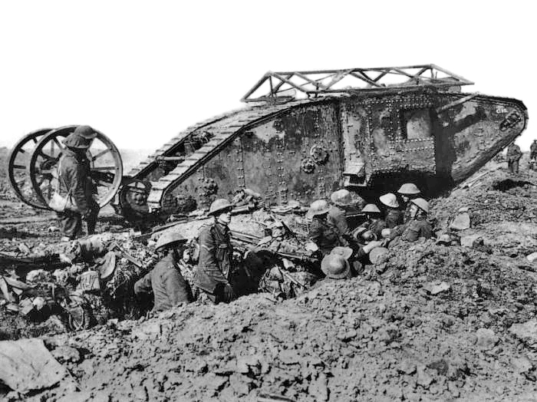
Western Front
The Second Battle of Ypres
The Battle of the Somme

Slide 10
Balkan Front
Austrian army was not succesful in Serbia
September 1915 – Bulgaria entered the war
during October and November 1915 German-Austrian and Bulgarian troops occupied Serbia
in spring 1915 – the Allied Powers prepared the operation in Gallipoli under the command of Winston Churchill, but the operation was not succesful
then in 1916 the Macedonian Front in Greece was opened
the Bulgarians were defeated in September 1918

Slide 11
Eastern Front
In the east, Russia attacked East Prussia but was defeated by German army at the series of battles colectively known as the Battle of Tannenberg in August 1914
Already in 1914 – the Czech Company in Russian Army – Legions
summer 1916 – so called Brusilov offensive
1917 – the Czechoslovak Corps in Russia – from 38,000 to 70,000 of men
the Russians were more succesful against Austria-Hungary in Galicia
Russia occupied parts of Galicia and Bukovina
July 1917 – so called Kerensky offensive – the Battle of Zborov (Galicia) – Czechoslovak Legions, the offensive was unsuccesfull for Russians
After the Russian Revolutions tle Czechoslovak Legions were fighting against bolsheviks

Slide 12
Italian Front
Italy entered the war in April 1915 – the Allied Powers promised to Italy Istria with Trieste, Dalmacia and Trentino, so Italy declared war on Austria-Hungary and later also on Germany
but the Italians were not very succesful, their offensives along the Isonzo River were repelled by the Austro-Hungarians
1917 – the Battle of Caporetto – Italian troops were defeated by Austro-Hungarian army and the front line was broken through, use of poison gas
during 1916 the front stabilized at the Piave River till 1918 – June 1918 – the Battle of the Piave River – participation of Czechoslovak Legions
the Austro-Hungarians were defeated in October – the Battle of Vittorio Veneto – participation of Czechoslovak Legions again

Slide 13
The Final Period of the War
after the Russian revolutions in 1917 Russia concluded separate peace with Germany in Brest Litevski in March 1918
April 1917 – USA declared war on Germany – originally USA persued the politics of non-interventions, but German submarines several times attacked merchant ships and civil ships with American passengers
The United States were never formally a member of the Allies but became a self-styled "Associated Power"
American troops came to Europe and after the great offensive of Allied Powers in summer 1918 the Central Powers collapsed very quickly
On November 3, 1918 Austria–Hungary sent a flag of truce to ask for an Armistice and the armistice with Austira was signed in Vila Giusti near Padua
on November 11, 1918– an armistice with Germany signed in railroad carriage near Compiègne
at 11 a.m. on November 11, 1918 a ceasefire came into effect

Slide 14
Results of the War
dissolution of four monarchies (Russia, Austria-Hungary, German Empire and Otoman Empire)
after dissolution of Austria-Hungary: constitution of 5 new states (Austrian Republic, Czechoslovakia, Hungary, Poland, Kingdom of Serbs, Croats and Slovenes)
the map of Europe changed: Latvia, Lithuania and Estonia was established, independent and unified Poland was renewed

Slide 15
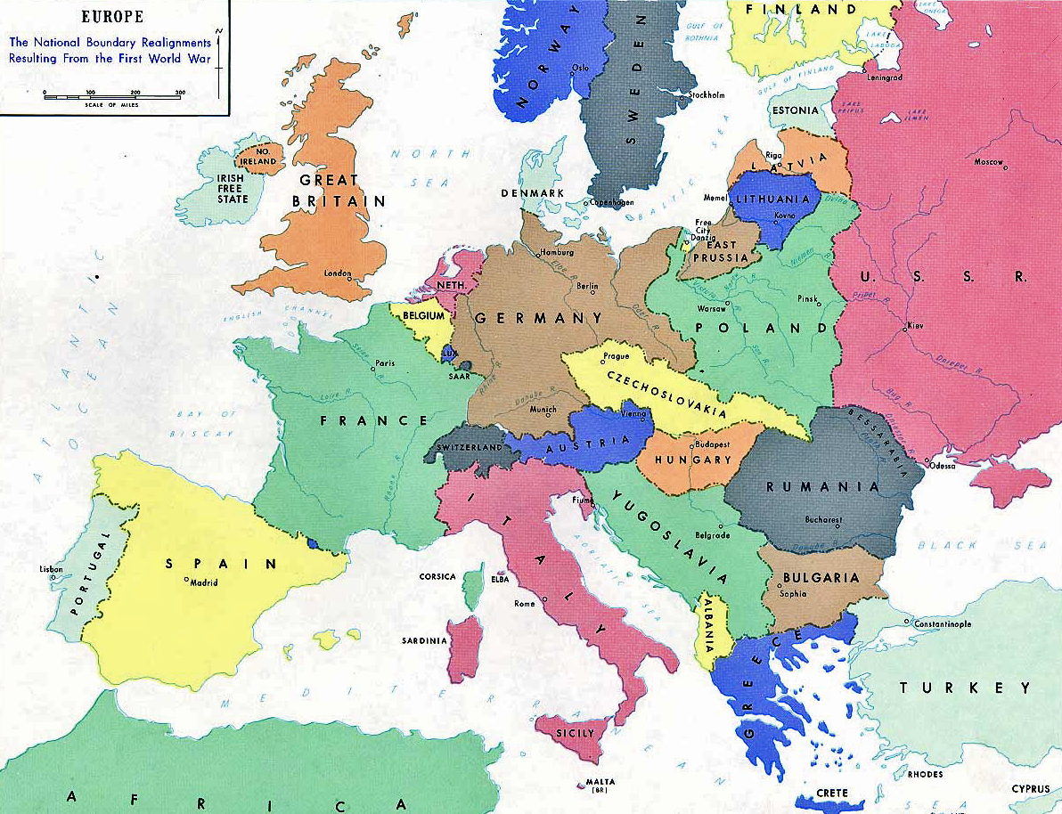
Results of the war
Europe after WW I

Slide 16
Paris Peace Conference
the meeting of the Allied victors following the end of World War I – the aim was to set the peace terms for the defeated Central Powers following the armistices of 1918
It took place in Paris in 1919 and involved diplomats from more than 32 countries and nationalities. They met, discussed various options and developed a series of treaties ("Paris Peace Treaties") for the post-war world
the winning powers – France, Great Britain, USA, Italy, Japan
other figthing states – Belgium, British domoniums, Poland, Kingdom of Serbs, Croats and Slovenes, Czechoslovakia, Rumania, Greece, Portugal and other non-european states
defeated states – Germany, Austria, Hungary, Turkey
Russia was not invited to the Paris Peace Conference (bolshevik revolution and civil war in Russia)

Slide 17
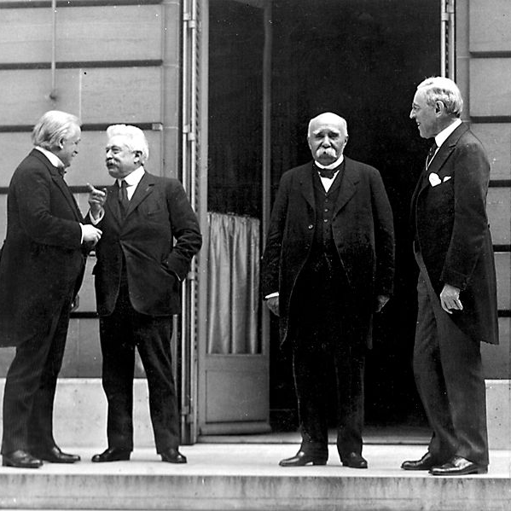
Paris Peace Conference
The Big Four –
David Lloyd Geroge (GB), Vittorio Orlando (It), George Clemencau (Fr), Woodrow Wilson (US)

Slide 18
Peace Treaties
The following treaties were prepared at the Paris Peace Conference:
the Treaty of Versailles, 1919, 28 June 1919, (with the German Empire in Weimar Republic form)
the Treaty of Saint-Germain, 10 September 1919, (with Austria)
the Treaty of Neuilly, 27 November 1919, (with Bulgaria)
the Treaty of Trianon, 4 June 1920, (with Hungary)
the Treaty of Sèvres, 10 August 1920; subsequently revised by the Treaty of Lausanne, 24 June 1923, (withTurkey)

Slide 19
Versailles system
The so-called "Paris Peace Treaties", together with the accords of the Washington Naval Conference of 1921-1922, laid the foundations for the so-called Versailles-Washington system of international relations
the United States never ratified the Treaty of Versailles, never joined the League of Nations, and signed separate peace treaties with the three countries it had declared war against
1920 – the League of the Nations was established – the all over the world organization which goal was to save peace in the World, USA did not join this organization

Slide 20
Central Europe after WWI
Economy
1921–1922 – economic depression as a consequence of the war
1924–1929 – economic boom, liberal economic reforms, technical development, intensification and growth of production
1929, October 24 – the Black Tuesday, New York Stock Market Crash (Wall Street) → The Great Depression – the longest, most widespread, and deepest depression of the 20th century, drop of industrial production, high unemployment, social unrests, crisis of democracy
since 1933 – economic development again, but slow

Slide 21
International relations in the central europe after WWI
unstable peace, effort to avoid conflicts, era of democratism a pacifism
April – May 1922 – Conference in Genova, Italy about economy after WWI
also Russia and Germany invited
the conference was about German reparations - Germany was not able to pay it but France insisted on it → no agreement
the result of the conference: meeting of German and Soviet diplomats – they concluded an Agreement in Rappalo –Germany was the first state which recognized the Soviet Union de iure
1924 – the Dawes Plan – the plan of stabilization of German economy and economical recovery (stabilization of mark, budget, sequential paying of reparations)
The Dawes Plan relied on money given to Germany by the US – high loans

Slide 22
International relations in the Central Europe after WWI
Locarno Conference, Switzerland – October 1925
4 great powers (Great Britain, France, Italy, Germany) – an attempt to overcome the differences between the winners and losers
The principal treaty concluded at Locarno was the "Rhineland Pact" between Germany, France, Belgium, the United Kingdom, and Italy. The first three signatories undertook not to attack each other, with the latter two acting as guarantors
the western borders of Germany were guaranted but the eastern were not – there could come up to some changes
Germany's admission to the League of Nations, the international organization established under the Versailles treaty to promote world peace and co-operation, and in the subsequent withdrawal (completed in June 1930) of Allied troops from Germany's western Rhineland

Slide 23
International relations in the Central Europe after WWI
Briand-Kellog Pact - also called the General Treaty for the Renunciation of War or the World Peace Act) was signed on August 27, 1928 57 states
prohibited the use of war as "an instrument of national policy" and as an instrument of settlement of disputes between states
the problem was that there were not defined any sanctions in case of breaching the Pact
no program of disarmement
The Young Plan was a program for settlement of German reparations debts after World War I written in 1929 and formally adopted in 1930
Germany was not able to pay the huge annual payments, so the amount of the reparation payments was reduced again – to 112 billion Gold Marks, Germany should pay them in next 59 years, 2 bilion marks every year

Slide 24
Readings
WWI:
http://www.firstworldwar.com
Treaty of Locarno
http://treaties.un.org/Pages/showDetails.aspx?objid=08000002801683d0
Henig, Ruth B. (1995). Versailles and after, 1919-1933. 2nd ed. London: Routledge.

