Slide 1
Central europe during the interwar period
Jana Hrabcova

Slide 2
Czech lands during WW I
The Czech lands were constituent part of Habsburg monarchy – no effort to destroy the monarchy till 1917/1918
Only a small conspiracy group – The Maffia – cooperation with South Slavs
Emigrants – Tomáš Garrigue Masaryk, Edvard Beneš and Milan Rastislav Štefánik – 1915 – founded The Czechoslovak National Council in Paris
army in abroad – Legions (France, Italy, Russia) – during 1918 de facto recognized as the allied army
Masaryk travelled around Europe (Geneve, Paris, London), to Russia (summer 1917) and to the USA – looking for the support for the idea of independent Czechoslovak state
January 1918 – The Fourteen Points of the US President Woodrow Wilson – the self-determination of the nations
10th Point: The peoples of Austria-Hungary, whose place among the nations we wish to see safeguarded and assured, should be accorded the freest opportunity to autonomous development.
http://wwi.lib.byu.edu/index.php/President_Wilson%27s_Fourteen_Points
January 1918 – Czech politians in A-H – demand of independence
July 1918 – The Czechoslovak National Comitee in Prague – Karel Kramář
October 1918 – the Emperor Charles I (1916–1918) offered the federalisation of Habsburg Monarchy but its nations refused it

Slide 3
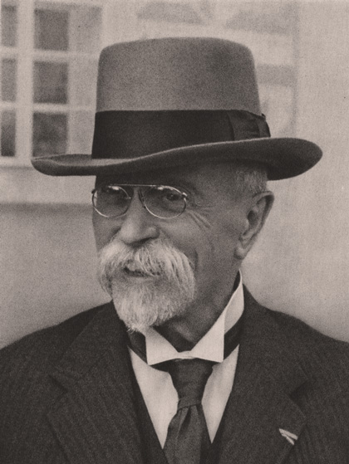
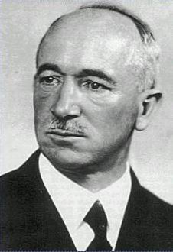
czechoslovakia
Tomaš Garrigue Masaryk
Edvard Beneš

Slide 4
czechoslovakia
the First Czechoslovak republic was proclaimed on October 28, 1918 in Prague
consisted of: Bohemia, Moravia, Silesia, Slovakia and Carpathian Ruthenia
The first Prime Minister – Karel Kramář
1920 – the constitution - plural parliament democracy
in 1920 – Tomas Garrigue Masaryk (1850–1937) was elected the first President (reelected in 1925 and 1929, served till 1935), he was a philosopher and politician, very influential personality, his wife was American – Charlotte Garrigue, their son Jan Masaryk served later as Czechoslovak Foreign Minister
most important and most influential political party - Republican Party of Agricultural and Smallholder People - Peasant party, they ussually had a Prime Minister – Antonín Švehla in 1920s, Jan Malypetr and Milan Hodža in 1930s

Slide 5
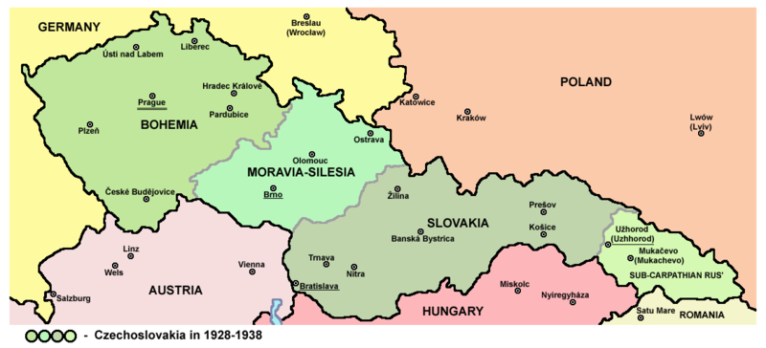
czechoslovakia
The first Czechoslovak republic consisted of: Bohemia, Moravia, Silesia, Slovakia and Carpathian Ruthenia (Sub-Carpathian Rus)

Slide 6
czechoslovakia
foreign policy – led by Minister Edvard Beneš from 1918 to 1935 – one of the most important European diplomats during the interwar period, in 1936 he was elected second President of Czechoslovakia
1921 – the Little Entente was formed – an alliance of Czechoslovakia, Kingdom of Serbs, Croats and Slovenes and Romania – against Hungary and its revanchism and against restoration of Habsburgs, Little Entente was supported by France (1924 – Czechoslovak-French Agreement)
the Little Entente was an idea of Czechoslovak Foreign Minister Edvard Beneš
since 1925 – economic growth, cultural development
the great depression since 1930
since 1933 – Czechoslovakia was threatened by Nazi Germany
Border fortification

Slide 7
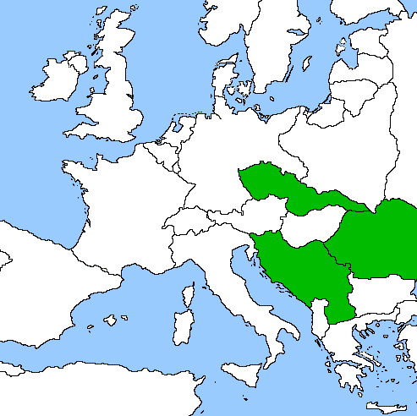
Little entente
Czechoslovakia + Yugoslavia + Rumania

Slide 8
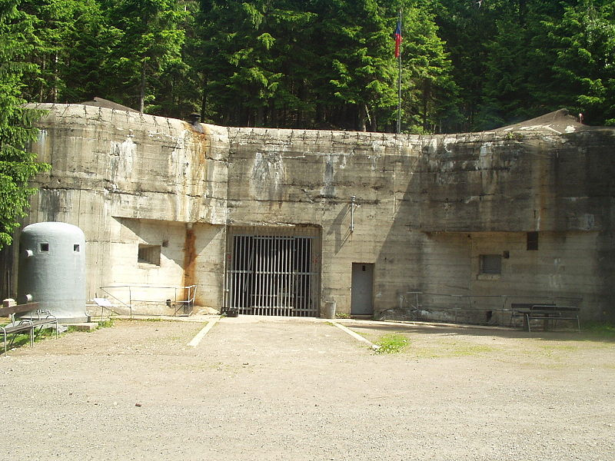
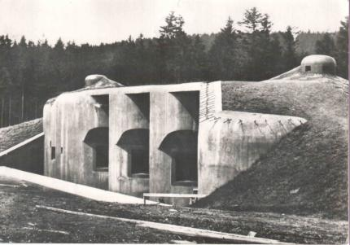
czechoslovakia
Czechoslovak fortification – Hanička
http://www.hanicka.cz/
Czechoslovak fortification – Bouda
http://www.boudamuseum.com/

Slide 9
czechoslovakia
national minorities – more than 3 million of ethnic Germans were living in Bohemian lands, they were called Sudeten Germans
The German minority living in Sudetenland demanded autonomy from the Czech government, claiming they were suppressed and repressed by the Czech government
In the 1935 Parliamentary elections, the newly founded Sudeten German Party under leadership of Konrad Henlein, financed with Nazi money, won an upset victory, securing over 2/3 of the Sudeten German vote, which worsened the diplomatic relations between the Germans and the Czechs
since 1937 – isolation of Czechoslovakia in internatioanl polititics
policy of appeasement – the Great powers did not want to risk world peace for Czachoslovakia
1938 - this policy resulted in Munich Agreement

Slide 10
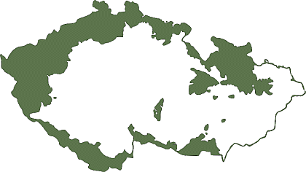
czechoslovakia
Sudetenland – the areas inhabited by Germans in Bohemia, Moravia and Silesia

Slide 11
czechoslovakia
Readings:
TUMA, Oldrich – JINDRA, Jiri (eds.): Czechoslovakia and Romania in the Versailles System. Prague 2006.
LUKES, Igor: Czechoslovakia Between Stalin and Hitler: The Diplomacy of Edvard Beneš in the 1930s. New York1996.
LUKES, Igor – GOLSTEIN, Erich (eds.): The Munich Crisis, 1938: Prelude to WWII. London 1999.

Slide 12
Germany
strong revolutionary wave
in Bavaria – Bavarian Soviet Republic was proclaimed in October, defeated in April 1919
1919 – the first elections
1919 – 1933 – Weimar Republic, parliamentary republic, federation of 16 states
the first President – Friedrich Ebert (Social Democratic Party)
serious problems – economical crisis, reparations, restrictions of the area, lost of the colonies, restrictions of army, navy and air force
March 1920 – right-wing monarchistic Kapp Putsch
1923 – the new government – Prime Minister (Chancellor) Gustav Stresemann – stabilization of Golden mark, succesful foreign policy
1923 – suppression of Hitler-Ludendorff Putsch in Munich, Hitler was arrested and wrote his programme book Mein Kampf, his political party NSDAP was banned
1925 – the second President became Paul von Hindenburg

Slide 13
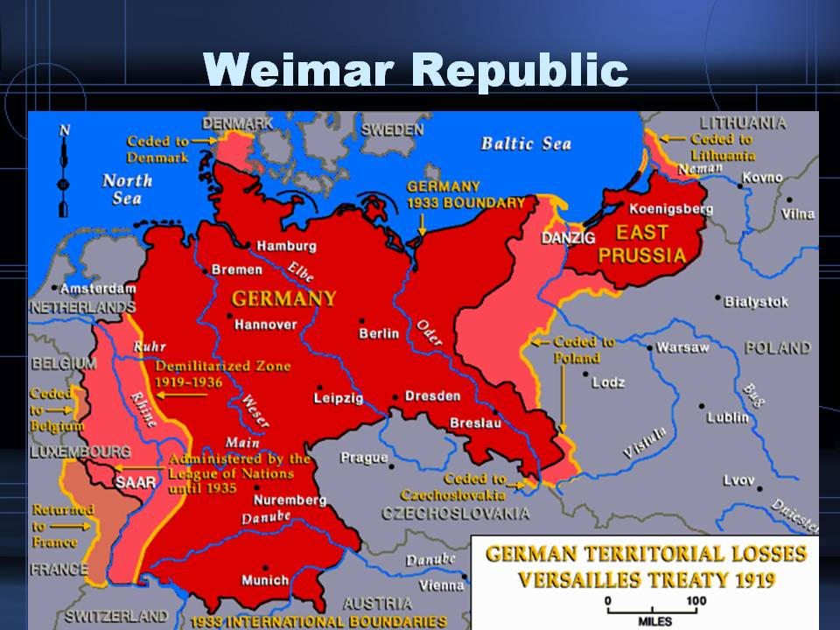
Germany

Slide 14
Germany
since 1929 – Great Depression – in Germany very serious effects (1932 – unemployment was 44,5 %), the growth of extreme nationalism and revanchism
1932 – NSDAP won the elections, 1933 – Adolf Hitler became a Chancellor
1934 – Hitler became a Führer – the head of the state
1935 – Nüremberg laws – anti-Semitism, the Jews excluded from political, economical and public life, had to wear a yellow star
1935 – Germany introduced general military service
1936 – Germany occupied de-militarized zone in Rheinland
both were breaching of Versailles Peace Treaty and of Rhineland Pact but only formal prostest of great powers
1936 – pact with Italy – Berlin-Rome Axis
1936 – Anti-Comimmntern Pact – with Japan
1938, November 9–10 – Crystal Night – great pogrom against Jews

Slide 15
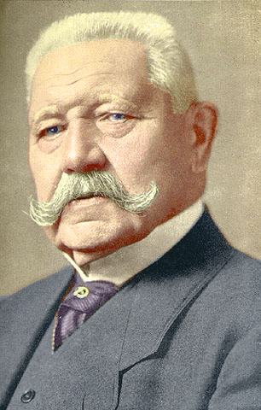
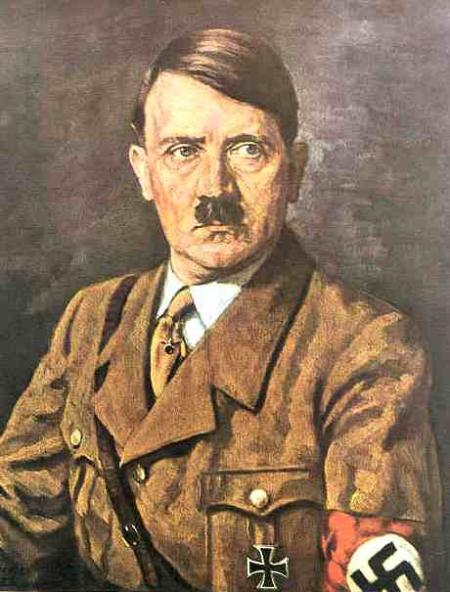
Germany
Paul von Hindenburg
Adolf Hitler

Slide 16
Germany
Readings:
Kaes, Anton – Jay, Martin – Dimendberg, Edward, (eds.): The Weimar Republic sourcebook. Berkeley: University of California Press, 1994.
http://books.google.cz/books?id=J4A1gt4-VCsC&printsec=frontcover&hl=cs&source=gbs_ViewAPI&redir_esc=y#v=onepage&q&f=false

Slide 17
Austria
1919–1934 – the Republic of Austria, first Chacellor Ignaz Siepel, Austria's government was dominated by the Christian Social Party
the country was unstable, severe economical consequences of the war
many paramilitary forces had been formed during the early 1920s - the clash between right-wing and left-wing paramilitary forces is known as July Revolt of 1927
1932 – authoritarian regime of Chancellor Engelbert Dollfuss, austrofascism, Dollfuss was assassinated by Nazi agent who attempted coup d'état in 1934 – July Putch
New Chancellor – Kurt Schuschnigg – an effort to keep Austria´s independence
1938 – Anschluss – March 11 – German troops crossed Austrian frontiers and Austria was occupied by Germany

Slide 18
hungary
The official proclamation of democratic republic on November 16, 1918, Mihály Károlyi was named as the republic's Prime Minister
the area of Hungary was of only one third of pre-war Hungary – dissatisfaction, attpemts to restore the Great Hungary
the rapid rise of power of Hungarian Communist Party, the Hungarian Soviet Republic was proclaimed on March 21, 1919 – an attpemt to restore the Great Hungary, the head of this republic was Béla Kun, Hungarian communists wanted to connect with Soviet Russia
Czechoslovakia and Rumania were threatened by Hungarian demands → their armies attacked Hungary and the Hungarian Soviet Republic was defeated
the new Government – fascist party of Admiral Miklós Horthy
1920 – monarchy was restored in Hungary – Horthy regent 1921–1931 – the Prime Minister was István Bethlen (till 1931)

Slide 19
Hungary
the former Austrian Emperor, Charles IV, unsuccessfully attempted to retake Hungary's throne in March 1921
Hungary's signing of the Treaty of Trianon on June 4, 1920, ratified the country's dismemberment, limited the size of its armed forces, and required reparations payments
1920s – the white terror - led to the imprisonment, torture, and execution without trial of communists, socialists, Jews, leftist intellectuals, sympathizers with the Károlyi and Kun regimes, and others who threatened the traditional Hungarian political order that the officers sought to reestablish
1932–1936 – the Prime Minister was Guyla Gömbös - the radical right's ascendancy in Hungarian politics
1939 – Arrow Cross Party (Hungarian Equivalent of Nazi Party) won the elections
1940 – Hungary joined the Tripartite Pact (Germany, Italy and Japan)

Slide 20
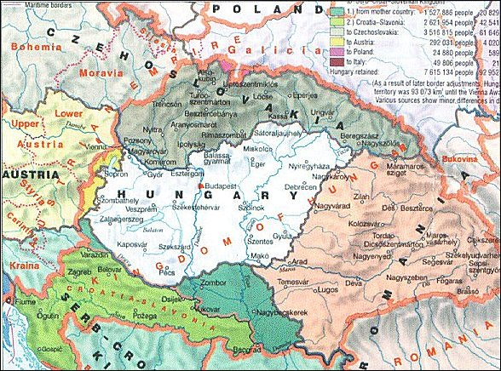
Hungary

Slide 21
poland
the Republic of Poland reestablished in 1918
several regional conflicts:
1918 – 1919 – Polish – Ukrainian War –
border conflicts with Czechoslovakia - Juanuary 1919 – Seven day war broke out
a new demarcation line – the western part of the disputed territory was given to Czechoslovakia while Poland received the eastern part
1919 – 1921 – Polish-Soviet War – Poles attacked Russia – they wanted to use Russian civil war to ensure their eastern borders, but later Soviet counteroffensive – they wanted to establish Soviet Republic in Poland
August 1920 – the battle of Warsaw - the Soviet troops were defeated
the Peace Treaty of Riga – Poland got parts of Belarus and Ukraine
1922 – annexation of Vilnius Region from Lithuania

Slide 22
Poland
1926 – the May Coup d´État – Marshall Jozef Piłsudski, he became most influential politician in Poland and became its de facto a dictator till his death in 1935
1932 – non-agression pact with Soviet Union
October 1938: annexation of Zaolzie, Górna Orawa, Jaworzyna from Czechoslovakia
March 31, 1939: military guarantees from United Kingdom and France
August 23, 1939: non-aggression pact between Soviet Union and Germany: Ribbentrop-Molotow Pact with a secret military alliance protocol targeting Poland
September 1 – October 6, 1939: Invasion of Poland

Slide 23
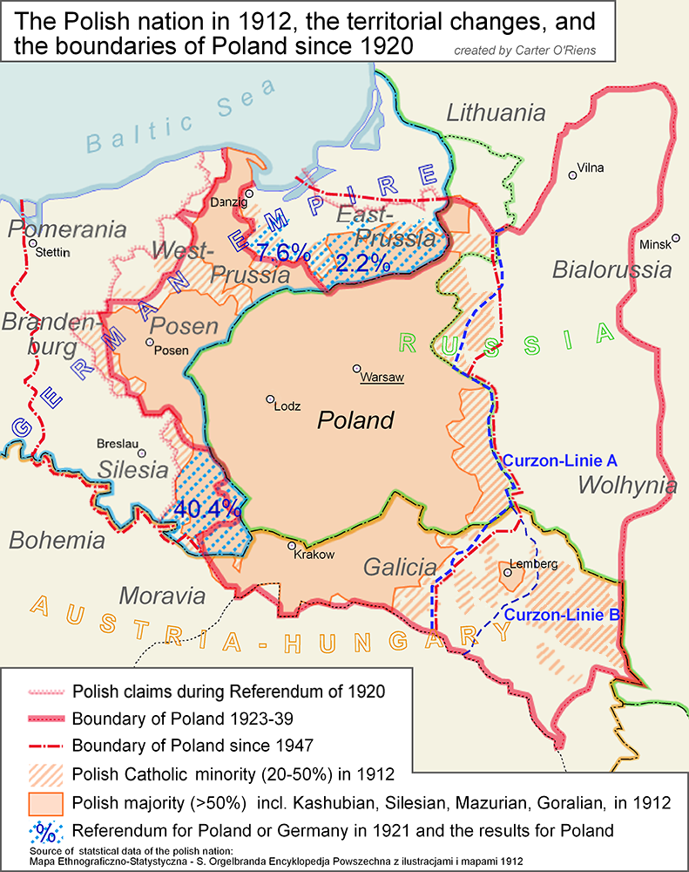
poland

