Slide 1
Postgraduate Academic Writing Course
Masaryk University
10th – 11th September 2013
Katie Mansfield
ksmansfield@hotmail.com

Slide 2
10th September – Agenda
Introduction to the AWL & how to make a discipline-specific vocabulary list
Understanding the differences between academic & non-academic writing (analysing texts)
Evaluating Sources
Writing introductions and conclusions

Slide 3
11th September – Agenda
Referencing (quoting and paraphrasing)
Paragraphing (ensuring cohesion)
Expectations of literature reviews
Improving & revising work

Slide 4
Introduction to the Academic Word List (AWL)
What is it?
Why is it important to know about it?

Slide 5
Academic Word List (AWL) (i)
Compiled from corpus of 3.5 million words of written academic texts
570 word families (10% of total words in academic texts)
Arranged into 10 sublists
Reflect word frequency & range
(Coxhead 2000)
Notes:
Texts used: journals, textbooks, coursebooks, lab manuals and course notes.
Sublists 1-9 each have 60 word families whereas 10 has 30 word families.

Slide 6
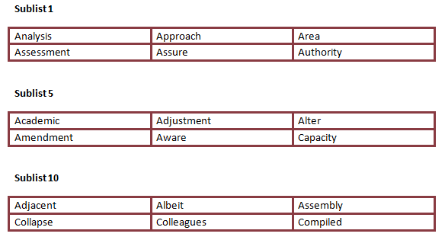
Academic Word List (AWL) (ii)
Sublists

Slide 7
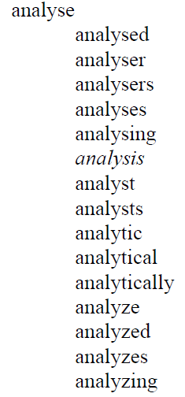
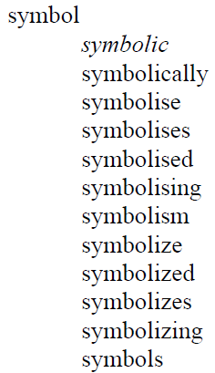
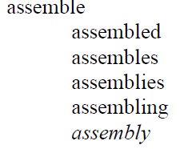
Academic Word List (AWL) (iii)
Word families
(Sublist 1) (Sublist 5) (Sublist 10)

Slide 8
AWL Exercises
B
Accumulate
Fluctuate
Radical
Offset
Contemporary
Tense
Bias
Infrastructure
Via
Deviate

Slide 9
Sublist 8 – Group 6
D
A
B
A
B
C
C
A
A

Slide 10
AWL – Advantages
Words students need in wide range of academic texts
Free online sources available (PC & Smartphone):
  Flashcard maker
  http://orangeorapple.com/Flashcards/Default.aspx
  Exercises
  http://www.englishvocabularyexercises.com/
  Test maker
  http://www.phonetain.com/Phonetain_Software/Products.htm
  AWL highlighter
  http://www.nottingham.ac.uk/alzsh3/acvocab/awlhighlighter.htm

Slide 11
AWL – Disadvantages
No focus on collocations (Durrant 2009)
Does not address discipline-specific vocabulary (Martinez et al 2009)

Slide 12
Practical suggestions (i)
Problem: Does not address discipline-specific vocabulary
How can we overcome this problem?
Discuss with your partner.
Solution: Create a discipline – specific wordlist.
What needed?
  Discipline-specific texts.
  Concordance software programme e.g. Antconc (free), Sketch engine, Wordsmith Tools.
  Time!

Slide 13
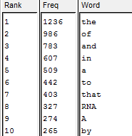
Practical suggestions (ii)
6 Steps
Save discipline-specific journal articles as .txt docs.
Open the txt docs in Antconc.
Click on create ‘Word List’.
From most frequent words, make a list of discipline-specific vocab.

Slide 14
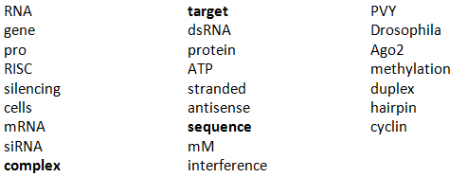
Practical suggestions (iii)
Run list through AWL Highlighter
http://www.nottingham.ac.uk/alzsh3/acvocab/awlhighlighter.htm

Slide 15
Practical suggestions (iv)
Once at home, you can:
Write definition of key words
See how words work by accessing online tools e.g.
  Word tree http://wordtree.coventry.ac.uk/?BAWE
  BNC http://corpus.byu.edu/bnc/

Slide 16
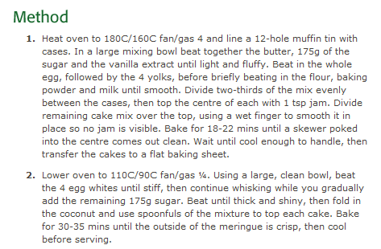
Understanding the different structures of academic writing

Slide 17
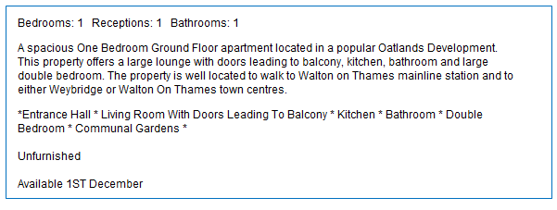
Understanding the different structures of academic writing
Text B

Slide 18
Understanding the different structures of academic writing
Text C
It is a subject of considerable debate as to whether women are naturally programmed to be mothers and homemakers while men are natural breadwinners and protectors of the family. Some consider these to be gender stereotypes which are invalid in modern society. For the purpose of this assignment, ‘natural’ and ‘naturally programmed’ will be taken to mean biologically or genetically determined. The topic in question has raised considerable amounts of attention, essentially from advocates of women’s rights because it implies a sexual segregation in the labour market. To date, in most western societies, the labour market exhibits a greater percentage of high status occupations being held by the male species. The reasons for these differences seem to be biological. That said, several statistics reveal an increase in the frequency of dual income families, which argues against the theory that biological differences lead to fixed gender roles. This essay will discuss if and to what extent differences in male and female behaviour and physical differences of the sexes lead to rigid ‘natural’ gender roles and whether these are essential for the functioning of families and societies. Firstly, we will examine the behaviour of men and women from a biological and cultural point of view. We will then consider the physical differences between men and women and examine the gender stereotypes that exist in today’s society.

Slide 19
Nevertheless, there are many authors who argue that there are biologically determined differences, for instance, physical differences, which unavoidably lead to gender stereotypes. Men are credited with physical strength, dexterity, rationality and objectivity while women are often associated with traits considered inferior, such as empathy and warmth. These differences are reflected in the stereotype whereby “women nurture and men go out to work” (Haralambos and Holborn 1995:326). The most common explanation for these labels seems to be linked to history. Years ago, men were hunters and women stayed at the base camp because of physical restrictions of pregnancy and because they had to raise the children. These ancient traits could still be imprinted in our genes. The anthropologist George Peter Murdock (1949) concludes that these ancient traditions lead to the sexual division of labour out of practicality (in Haralambos and Holborn 1995). Nonetheless, this view is opposed by some anthropologists and sociologists.

Slide 20
3. Evaluating Sources (i)
Discuss with a partner
Where do you typically find the sources for your academic written work?
What types of sources do you typically use?
Are you very selective when you choose a source?
What do you consider when deciding whether to use a source or not?

Slide 21
3. Evaluating Sources (ii)
How reliable do you think the following sources might be?
What do you need to be careful of?
An article in the Times newspaper from 2001
A blog called ‘Best and Worst of Business’
A supermarket website
CIA World Factbook
A Powerpoint of a talk given at a conference
An editorial from The Economist (British newspaper)
A newspaper article citing an academic report which found the UK to be the worst place to live in Europe.
A journal article from Google Scholar

Slide 22
3. Evaluating Sources
http://scholar.google.co.uk/

Slide 23
4 Writing introductions & conclusions
Introductions (i)
Discuss with a partner.
Do you find writing introductions difficult? If yes, why?
What is the purpose of an introduction?
What should you typically include in an introduction?
What percentage of an essay should the introduction be?
Why is an introduction one of the most important parts of an essay?

Slide 24
Introductions (ii)
Time to reflect
What do you notice about the high-scoring introductions?
Are there any key features that you have not used before?
Underline any phrases that you could use in your essays in the future?

Slide 25
Conclusions (i)
Discuss the following questions with a partner.
Do you find writing conclusions difficult? If yes, why?
What is the purpose of a conclusion?
What do you typically include in a conclusion
What percentage of an essay should the conclusion be?
When do you usually write your conclusion?
Why is the conclusion one of the most important parts of an essay?

Slide 26
Conclusions (ii)
Time to reflect
What do you notice about the high-scoring conclusions?
Are there any key features that you have not used before?
Underline any phrases that you could use in your essays in the future?

