Slide 1
Postgraduate Academic Writing Course
Masaryk University
10th – 11th September 2013
Katie Mansfield
ksmansfield@hotmail.com

Slide 2
11th September – Agenda
Referencing (quoting and paraphrasing)
Paragraphing (ensuring cohesion)
Expectations of literature reviews
Improving & revising work

Slide 3
5. Quoting (i)
Discuss the following questions.
What is a quotation?
What do you need to remember when including a short quotation in your written work?
What do you need to remember when including a long quotation?
What quoting method do you use in your country/discipline?

Slide 4
Quoting (ii)
Today we’re going to focus on the Harvard Referencing System which is commonly used throughout universities in the UK.
For more information about how to quote using the Harvard Referencing System, see:
http://libweb.anglia.ac.uk/referencing/harvard.htm
This will give you information about how to reference in-text and how to write a list of references.

Slide 5
Quoting (iii)
Before we begin…
What is the difference between a Bibliography and a List of References?

Slide 6
Text 1
Interesting research conducted within the field of applied linguistics has indicated that ‘L2 [second language] writers will plan for their writing more effectively, write better texts containing more content, and create more effective texts when they are able to plan in the language related to the acquisition of knowledge of the topic area’ (Friedlander 1990:112). This means that if students are required to write an essay on whether Japanese schools provide a more rounded education than British schools, Japanese learners might be more effective planning in Japanese when brainstorming the first half of the question, and in English when generating ideas for the second.

Slide 7
Text 2
Potential disadvantages to course planning include the fact that planning in advance and in minute detail may lead to an inflexible programme and discourage teachers from being spontaneous in response to individual student needs. Indeed, the necessity of balancing structure and systematicity on the one hand, and flexibility on the other, seems to be a recurring concern for theorists concerned with course design (Batstone 1988). Another criticism that can be levelled against course plans is that they may end up bearing little resemblance to what actually goes on in the classroom. It would thus be prudent to remember that ‘just as the lesson plan […] is not the lesson, the course plan is not the course’ (Graves 2000, p8).

Slide 8
Text 3
Classroom work on synonyms and antonyms is a useful way of expanding learners’ vocabulary. It helps learners discern and understand semantic boundaries (how meaning overlaps and where the limits lie) and also provides a way for learners to establish coherent meaning networks. The latter point is significant, for research indicates that organising lexical input is one of the keys to successful acquisition; as Gairns and Redman affirm:
Since vocabulary consists of a series of interrelating systems and is not just a random collection of items, there seems to be a clear case for presenting items to a student in a systematised manner which will both illustrate the organised nature of vocabulary, and at the same time enable him to internalise the items in a coherent way (1986: 69).
Most practising teachers and material writers would instinctively agree with the logic of this claim.

Slide 9
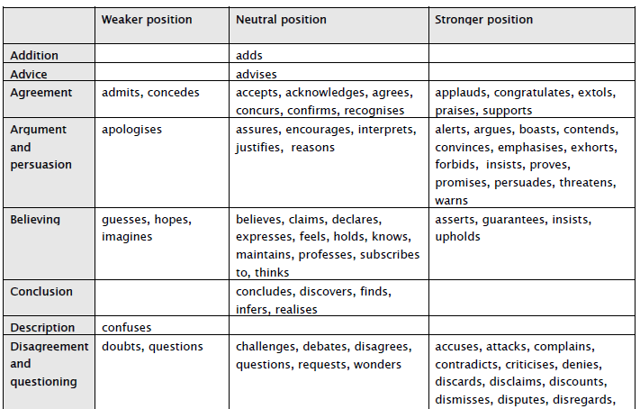

Slide 10
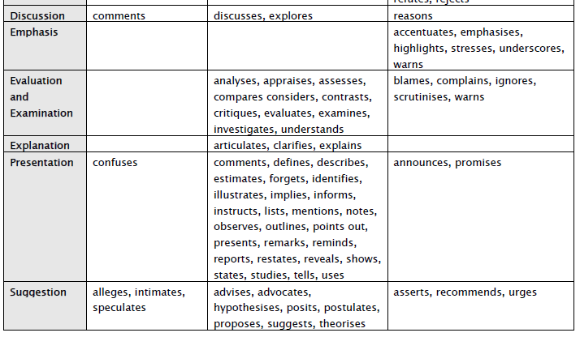

Slide 11
Text 4
Task-based learning (TBL) is ‘a form of teaching that treats language primarily as a tool for communicating rather than as an object for study or manipulation’ (Ellis 2003, ix). In TBL, rather than ‘learning to use English’, students ‘use English to learn it’ (Howatt 1984 in Larsen-Freeman 2000:37). While engaged in tasks, learners ‘mean what they say’ and use language to exchange information and opinions for a real purpose (Willis and Willis 1996). All tasks result in a definite outcome – what Crookes (1986) calls ‘a specified objective’ (in Ellis 2003:8). An outcome differs from an aim. The former refers to what learners arrive at when they have completed a task (e.g. a list of differences between two similar pictures); the latter to the pedagogic purpose of a task (e.g. to elicit meaning-focused language use) (ibid). The overriding objective of TBL is to develop in learners the various ‘competences’ – linguistic, sociolinguistic, discourse and strategic (Canale 1983 in Ellis 2003:19) – that will enable them to use an L2 easily and effectively in the real-world. In order to facilitate this, TBL theorists and practitioners believe that learners need to be placed in communicative situations that replicate or are analogous to those outside the classroom.

Slide 12
12 possible issues with quoting
Exercise 4
A reference given at the end but there are a large number of points made. Where should you put the first reference?
Wrong word to introduce 'quote' – could use ‘define’ instead. Also, no initial needed.
Misunderstood or misinterpreted the original - the replacement figure is 2.1 (what you need for a stable population and more even match between workers and elderly) not the average. The point is the average is much lower!
Not sufficiently paraphrased and no reference.

Slide 13
5. Paraphrasing
Discuss these questions with a partner.
What is paraphrasing?
Why is paraphrasing important in academic writing?

Slide 14
Look at the two passages. What’s the difference between them? Underline any changes.

Slide 15
Exercise 2- Answers:
Original Passage
Language is the main means of communication between people. But so many different languages have developed that language has often been a barrier rather than an aid to understanding among peoples. For many years, people have dreamed of setting up an international universal language which all people could speak and understand. The arguments in favour of a universal language are simple and obvious. If everyone spoke the same tongue, cultural and economic ties might be much closer, and good will might increase between countries (Kispert, 2004: 58).‘
Paraphrase
Kispert (2004:58 ) claims that humans generally communicate through language but as there are so many different languages, however, people around the world have a difficult time understanding one another. Some people have wished for a universal international language that speakers all over the world could understand. Their reasons are straightforward and clear. If one international language was spoken by everyone, it would build cultural and economic bonds. It would also create better feelings among countries

Slide 16
Paraphrasing Techniques 1
Changing the vocabulary
people > humans
language > tongue
dream of > wish for
Changing the word class:
communication (n) > communicate (v)

Slide 17
Paraphrasing Techniques 2
Changing the word order:
international universal language > universal international language
Active to passive
If everyone spoke the same language > If the same language was spoken by everyone

Slide 18
Paraphrasing Techniques 3
Breaking up sentences:
If everyone spoke the same tongue, cultural and economic ties might be much closer, and good will might increase between countries .
If one international language was spoken by everyone, it would build cultural and economic bonds. It would also create better feelings among countries
(The opposite could happen too. i.e. combining sentences)

Slide 19
Exercise 3 Answers
Word class (adverb > adjective)
Synonyms (notice how the relationship is maintained)
Word class (noun> verb)
Synonyms
Combining sentences
Changing active forms to passive ones.

Slide 20
Exercise 4 Answers
The explosion caused many casualties.
Decisions of an erratic nature were frequently made by the President.
It is useful to analyse two solutions to the problem.
A study of this kind can be related to texts in other media too.
Tropical forests are defined here as evergreen forests, in areas receiving more than 100 mm of precipitation in 3 months, with mean annual temperature of 24-plus degrees Celsius, and essentially frost-free.

Slide 21
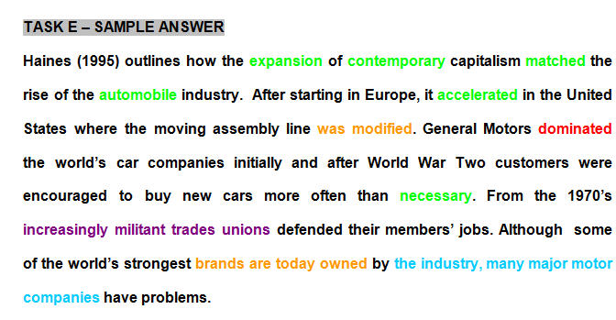

Slide 22
6. Paragraphing – Ensuring cohesion
Discuss with a partner.
What is a topic sentence? What does it tell the reader? How long should it be?
When you are giving supporting evidence, what would you expect to see? Where would you find the supporting evidence?
How can you ensure a main body paragraph is coherent?

Slide 23
High-scoring 1 (Main body)
There have been numerous criticisms of the Expressivist approach. To name a few, firstly, Hyland (2002) states there are not any theoretical principles behind how to evaluate ‘good’ or ‘bad writing’. In fact, what constitutes ‘good’ or ‘bad’ writing can be seen as somewhat subjective (Faigley 1986). This is emphasised in a statement made by Elbow in which he says “I am after real quality: writing that people actually want to read by choice” (1998:Xviii). Secondly, according to Hyland (2002), the theorists are to some extent, naive in believing that all writers have a similar innate intellectual and creative potential and that they simply need the right conditions to express this. Finally, Hyland (2002) believes this approach is under theorised as it does not consider communication in the real-world and it does not consider the cultural differences that exist or the social consequences of writing. From the evidence, it is clear therefore that if this approach is used to teach academic writing, it should be used with caution.

Slide 24
High-scoring 2 (main body)
Historically, the first pension scheme to benefit people over 70 was introduced in Prussia, in 1889. After 19 years, Lloyd George introduced it in England. The life expectancy during these periods was between 45 and 50 years respectively (Wells, 2005). Nowadays, it is clear that we are living much longer, consequently, a large number of elderly people rely on retirement pensions to live. The high demand of pensions payments overload the government expenses, as a result, it could lead to a pension crisis. Moreover, the majority of the pensioners have a medical condition; therefore developed countries are spending a huge amount of money in the health care sector as well. The urgent measure taken by many countries in order to control their expenses was to increase the retirement age. Nevertheless, it proved to be a very slow process. For instance, in the US it will take another 16 years to complete the raising of official retirement age to 67 (Slater, 2008). The slow bureaucratic process in most developed countries could trigger a pension crisis and make this subject unquestionable.

Slide 25
Linking words
Useful website link:
http://library.bcu.ac.uk/learner/writingguides/1.33.htm

Slide 26
Theme & rheme
“Cosmetic surgery is a rapidly growing medical speciality.....”
“Removing the top layers of the dermis promotes regeneration of collagen, elastine and epidermis”.
“Unfortunately, they also remove normal pigment, which may result in bleaching of the skin”.
“Resurfacing methods treat superficial wrinkles and repair skin aged by light”.
Extracts taken from Hoeyberghs, J. L. (1999:514-515)

Slide 27
Theme & rheme (ii)
Time to reflect
Do you ever think about the positioning of words in a sentence?
What type of information do you think is typically placed in theme and rheme position?

Slide 28
Theme & rheme (iii)
Important information about ‘theme’ and ‘rheme’
Typically, ‘given’ information is presented in the theme and ‘new information is presented in the rheme.
And often:
The rheme of one sentence becomes the theme of the next sentence Or
The theme of one sentence is the same as the theme of the next sentence.

Slide 29
Examples
Paragraph 1
Patients requesting cosmetic surgery are usually normal individuals, but with a heightened consciousness about their looks. A proportion of them may seek advice on what, to them, seems an unsatisfactory appearance. They deserve the same professional approach and empathy as patients seeking help for clinical disorders.

Slide 30
Paragraph 2
Sagging eyebrows and forehead creases can be corrected through keyhole incisions in the scalp. This approach has become the standard for many surgeons, and insights into facial movement have enabled more functional surgery to be performed.

Slide 31
7. Expectations of literature reviews / discussion sections
Discuss with a partner.
What is the purpose of a literature review?
What should you include?
Read the high-scoring sections from literature reviews and decide what would appear to be the desirable features.

Slide 32
Functions of a literature review
A review of the literature has the following functions:
to justify your choice of research question, theoretical or conceptual framework, and method
to establish the importance of the topic
to provide background information needed to understand the study
to show readers you are familiar with significant and/or up-to-date research relevant to the topic
to establish your study as one link in a chain of research that is developing knowledge in your field

Slide 33
Academic vocabulary – Literature reviews
The following links show you the most frequent words/phrases and how they are used.
Referring to literature
http://www.phrasebank.manchester.ac.uk/sources.htm
Being critical
http://www.phrasebank.manchester.ac.uk/critical.htm

Slide 34
Language Focus – Literature reviews
argue, assert, claim
propose, speculate, suggest
contend, emphasize, stress
mention, note, remark
caution, warn, urge

Slide 35
7. Improving & revising your work
Exercises on articles
http://learnenglish.britishcouncil.org/en/english-grammar/determiners-and-quantifiers/definite-article

Slide 36
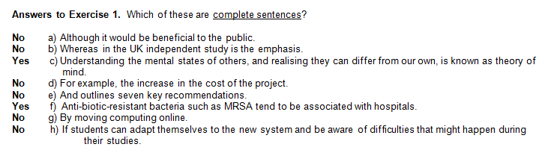
7. Improving & revising work (i)

Slide 37
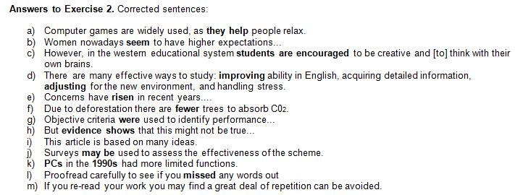
Improving & revising work (ii)

Slide 38
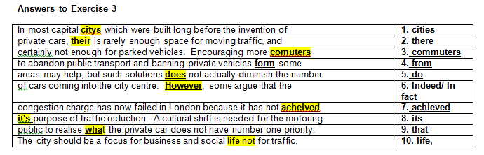
Improving & revising work (iii)

Slide 39
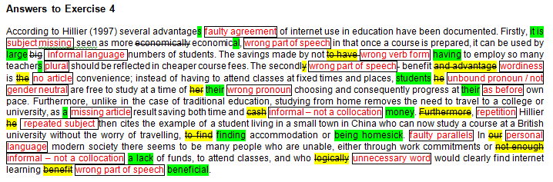
Improving & revising work (iv)

