Slide 1
The brief outline of the history of the Czech Lands in the Middle Ages
Jana Skerlova

Slide 2
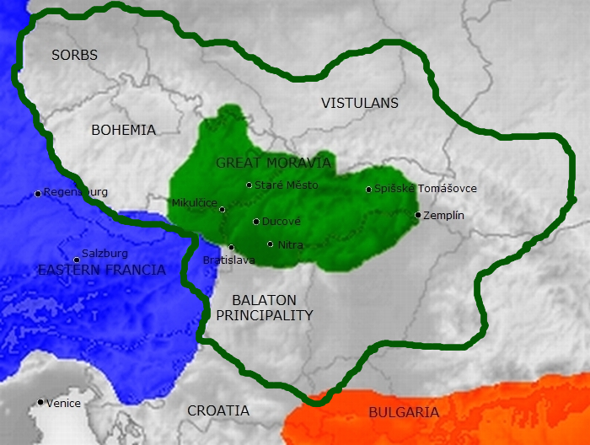
The Great Moravia in the 9th century
http://www.filmcyrilametodej.cz/en/about-film/
The movie (document) about Cyril and Methodius

Slide 3
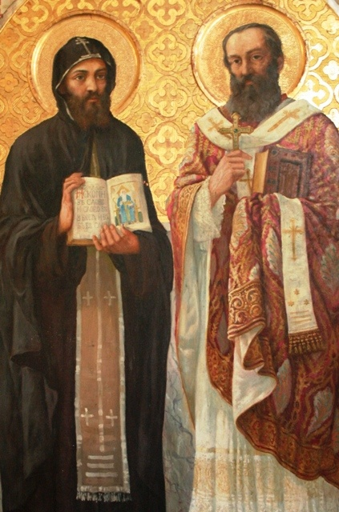
The Great Moravia in the 9th century
6th century – the Slavic tribes came to this area and settled on the left bank of Danube River
the very first Slavic state in the 9th century – situated mostly around the Moravia River – The Great Moravia
cultural development resulted from the mission of Saints Cyril (Constantine) and Methodius – 863
translation of the Bible into the slavic language, preaching in slavic language → the Christianity widespread faster
They created the new slavonic alphabet (Glagolitsa)
885 – Methodius died → their disciples were expeled from G.M. – went to Bulgaria, Croatia, Macedonia etc., invented cyrilic script

Slide 4
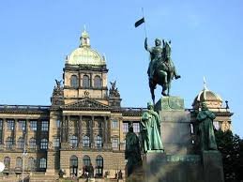
the House of Přemyslids – from 9th century till 1306
Beginning of 10th century – The Great Moravia was destroyed because of internal political struggles and the attack by Hungarian tribes
The territory inhabited by Slovaks became a part of newly created Kingdom of Hungary
the centre of the Bohemian state moved to Bohemia – The duchy of Bohemia was established, dependent on German Empire
Prague became the capital city
10th century – duke Wenceslaus → assassinated by his brother → Saint Wenceslaus – the saint patron of the Czech lands

Slide 5
The Kingdom of bohemia
973 – the Prague Bishopric was established (bishop Adalbert – St. Vojtech - apostolic mission to Poland)
the Kingdom of Bohemia since the end of 12th century
strong and large - emancipation from the German Empire
Ottokar II(1253–1278, Přemysl Otakar II) – The Iron and Golden King , the height of the power of Bohemia
very rich and powerful – his kingdom from the Krkonoše mountains to the Adriatic sea
1278 – killed at the unsuccesfull war against the Habsburgs
Wenceslaus II of Bohemia (1278–1305) – King of Bohemia, King of Poland
Wenceslaus III (1305–1306) – King of Bohemia, Poland and Hungary, assassinated without heirs – the Premyslid dynasty died out in the male tail

Slide 6
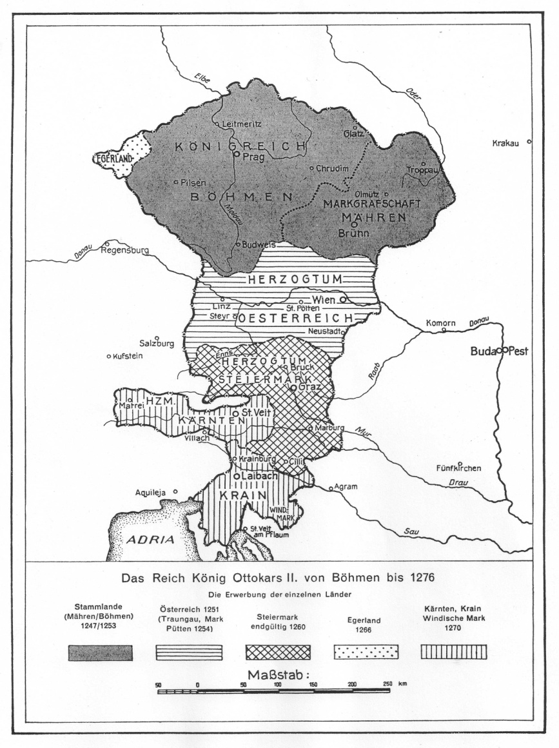
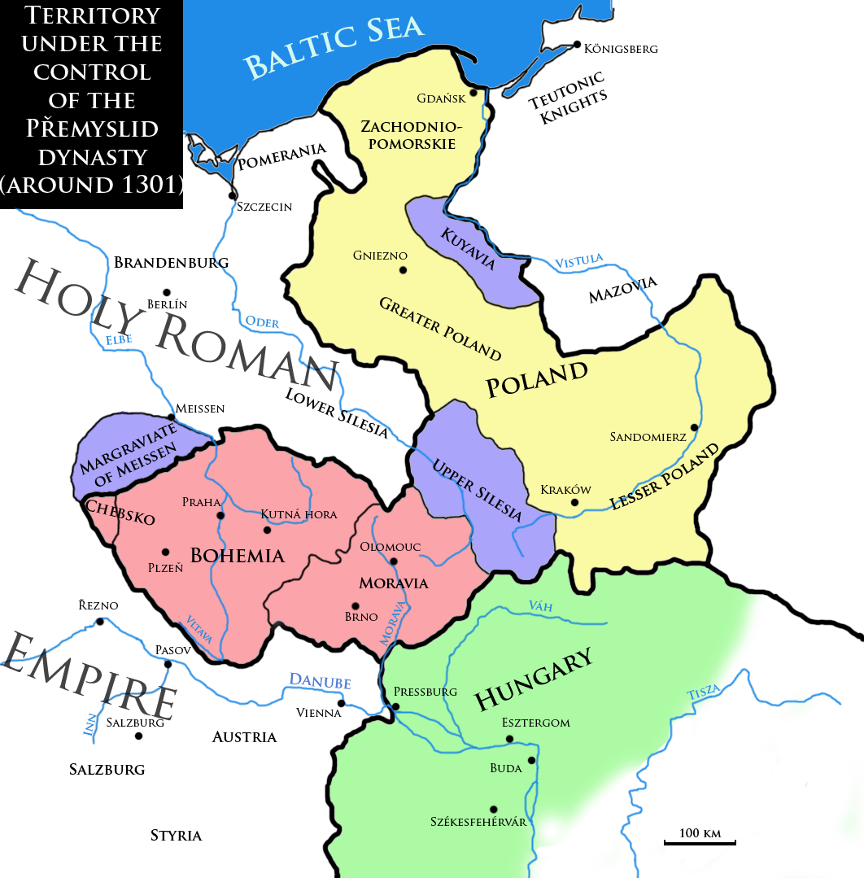
the House of Přemyslids
The kingdom of Ottokar II
Around 1270
The Kingdom of Wenceslaus II around 1301

Slide 7
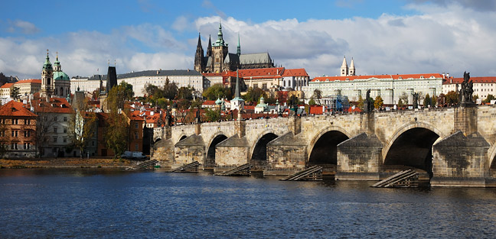
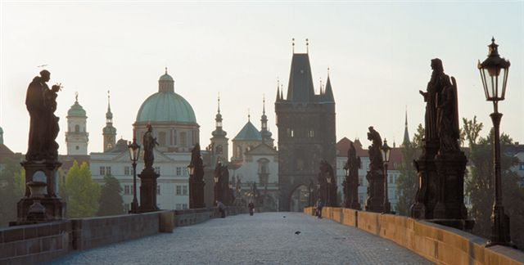

Slide 8
the House of Luxembourgs (1310–1437)
John of Bohemia (1310–1346, John the Blind) married Wenceslaus’s sister Elizabeth (Eliška) → a new dynasty on the Bohemian throne – the Luxembourgs
Charles IV
the king of Bohemia (1346–1378) and Holy Roman Emperor (1355–1378)
The Holy Roman Empire (962–1806) – an empire existing in Europe since 962 till 1806, ruled by Roman Emperor (present –day territories of Germany, Austria, the Czech Republic, Switzerland and Liechenstein, the Netherlands, Belgium, Luxembourg, Slovenia, parts of eastern France, nothern Italy and western Poland)
the most important and the best known Bohemian king – till nowadays regarded as Pater Patriae (Father of the Country), his reign is considered as the golden age of Bohemia
1356 - The Golden Bull – the basic law of the Holy Roman Empire, for a period of more than four hundred years fixed important aspects of the constitutional structure of the Holy Roman Empire

Slide 9
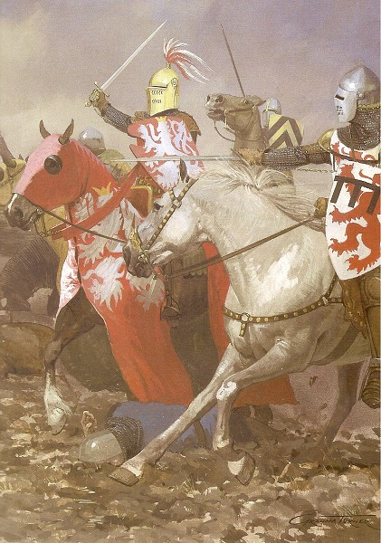
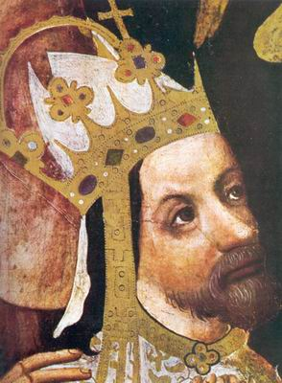
the House of Luxembourgs
John of Luxembourg at the battle of Crecy
Charles IV

Slide 10
Charles IV
Prague became the capital of the Holy Roman Empire, most important city in the Central Europe
Charles IV rebuilt the city on the model of Paris, in Gothic style
established the New Town of Prague (Nové Město), Charles Bridge, Charles Square, St. Vitus Cathedral, rebuilt the Prague Castle …
1348 – he founded the University of Prague, later named after him, the very first university in Central Europe – important for development of education, science and culture in the CE, Prague became intellectual centre of the CE
The Karlstejn Castle – a place for safekeeping the Imperial Regalia and Bohemian Crown Jewels

Slide 11
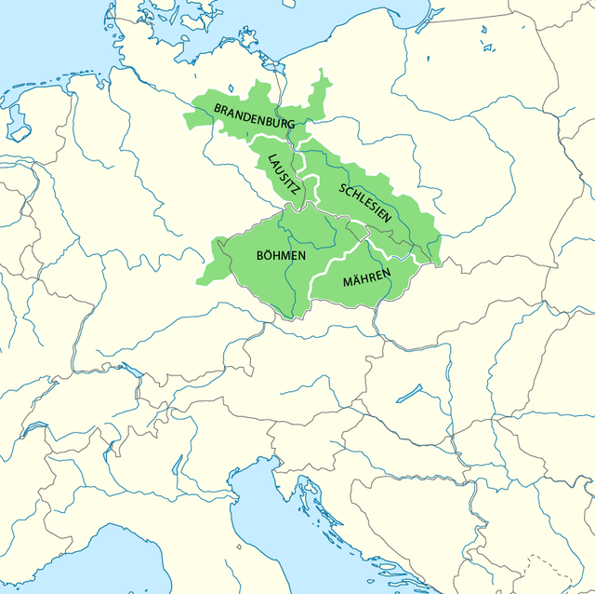
Kingdom of Bohemia during the reign of Charles IV

Slide 12
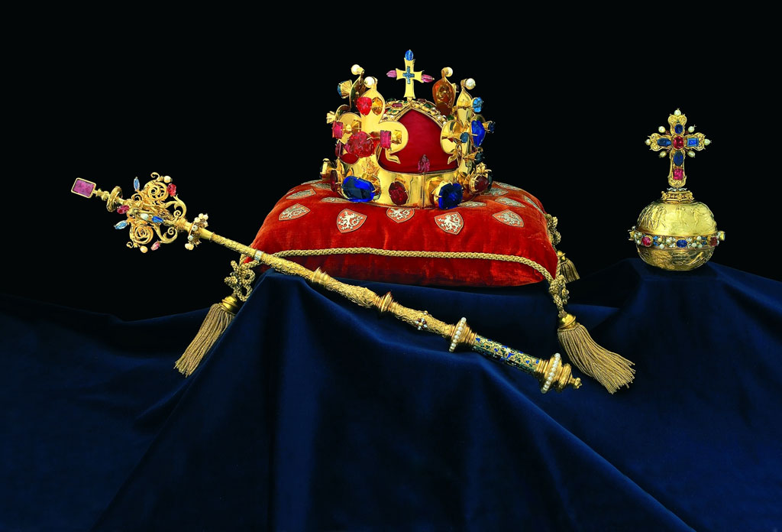
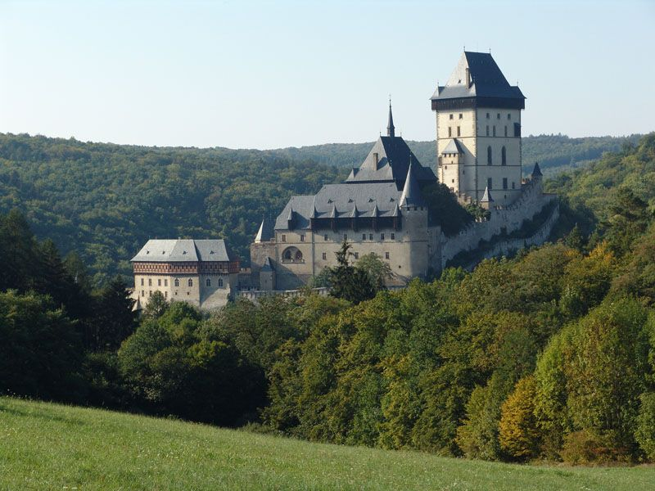
Bohemian Crown Jewels
The Karstejn Castle (near Prague)

Slide 13
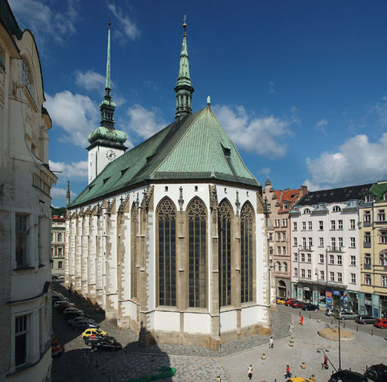
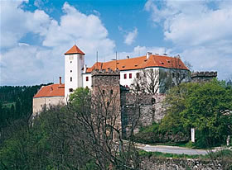
Gothic architecture
Bitov Castle (Southern Moravia)
St. Jakob’s Church (Brno)

Slide 14
The Hussite Revolution (1419 - 1436)
Wenceslaus IV (1378–1419) – weak ruler, King of Bohemia
Sigismund of Luxembourg(1410–1437) – Wenceslaus’ brother, a king of the Holy Roman Empire
religious wars errupted in Bohemian lands
Master Jan Hus – became one of the forerunners of the Protestant Reformation
scholar.clergyman, preacher and Professor of Prague University
wanted to reform certain practices of the Roman Catholic Church
he was protesting against clerical abuses, especially the sale of indulgences (paying for forgivness of the sins during the confession)
he also declared that the clergy should live according to the Bible, in poverty, without property and a secular power
the mortal sins should be prohibited and punished
he also proclaimed that the believers should understand the Holy Writ so it should be proclaimed in the national languages, not in latine

Slide 15
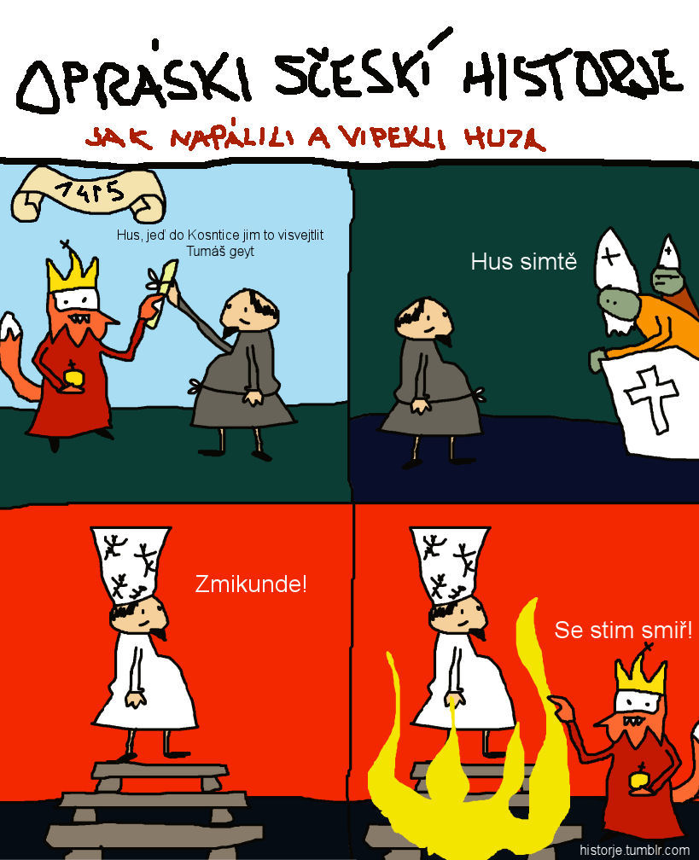
Master Jan Hus
Master Jan Hus was condemned by the Council at Constance as a heretic and was sentenced to death. He was burnt to death in 1415.

Slide 16
The Hussites
the Bohemian people blamed Emperor Sigismund for Hus’ death so they did not want him to become the king of Bohemia after Wenceslaus’
Hus’ followers launched powerful religious movement, they called themselves the Hussites; ( or the Men of the Chalice - the symbol of Hussites movement)
Sigismund organized five crusade campains against Hussites but all the campains were unsuccesfull (due to the outstanding military leader of Hussites – Jan Žižka)
almost 15 years of religious struggles and civil wars – the country was destroyed and plundered
The Hussite movement split into two fractions: the moderate and the radical
the moderate Hussites wanted to finish the warfare so they united with Catholics and destroyed the radical Hussites at the battle of Lipany in May 1434
after that both the religions – the Catholic and the Hussite became legal in Bohemia and two churches were formed
1436 – Sigismund was accepted as the King of Bohemia, but he in 1437

Slide 17
The Hussites
After two weak kings from the house of Habrburgs a Bohemian nobleman and the leader of the Hussites George of Kunštát and Poděbrady (1458–1471) was elected a king
he suggested something what could be considered as a proposal of latter European Union
he tried to prevent isolation of hussite Bohemia in catholic Europe, so he proposed a treaty among all Christian powers, the member states should pledge to settle all differences by exclusively peaceful means and fight altogether against Otoman Turks who were threatening Central Europe
After his death a new dynasty from Poland (originally from Lithuania) came to the Kingdom of Bohemia – Jaggiellonians – Vladislav II (1471–1516) and Louis (1516–1926)
A personal union between Bohemia, Poland and Hungary
Louis II died in 1526 at the battle of Mohács - his troops were defeated by the Ottoman Turks – Sultan Suleyman the Magnificent
The Ottoman victory led to the partition of Hungary for several centuries between the Ottoman Empire, the Habsburg Monarchy, and the Principality of Transylvania.

Slide 18
Readings
Doležalová, Eva – Pánek, Jaroslav (2011): Confession and nation in the era of reformations: Central Europe in comparative Perspective). Prague: Academy of Sciences of the Czech Republic.
Kejř, Jiří (1964). The universal peace organization of king George of Bohemia a fifteenth century plan for world peace 1462/1464 ; Václav Vaněček ; edition of the document Jiří Kejř ; english translation Ivo Dvořák. Prague: Czechoslovak Academy of Sciences.

