Slide 1
international relations in the central europe after WW I
Cetral europe during the interwar period, part I
Jana Skerlova

Slide 2
Woodrow Wilson’s Fourteen Points were first outlined in a speech Wilson gave to the American Congress in January 1918.
Wilson's Fourteen Points became the basis for a peace programme and it was on the back of the Fourteen Points that Germany and her allies agreed to an armistice in November 1918.
1. No more secret agreements ("Open covenants openly arrived at").
2. Free navigation of all seas.
3. An end to all economic barriers between countries.
4. Countries to reduce weapon numbers.
5. All decisions regarding the colonies should be impartial
6. The German Army is to be removed from Russia. Russia should be left to develop
her own political set-up.
7. Belgium should be independent like before the war.
8. France should be fully liberated and allowed to recover Alsace-Lorraine
9. All Italians are to be allowed to live in Italy. Italy's borders are to be "along
clearly recognisable lines of nationality."
10. Self-determination should be allowed for all those living in Austria-Hungary.
11. Self-determination and guarantees of independence should be allowed for
the Balkan states.
12. The Turkish people should be governed by the Turkish government. Non-Turks in
the old Turkish Empire should govern themselves.
13. An independent Poland should be created which should have access to the sea.
14. A League of the Nation should be set up to guarantee the political and territorial
independence of all states.

Slide 3
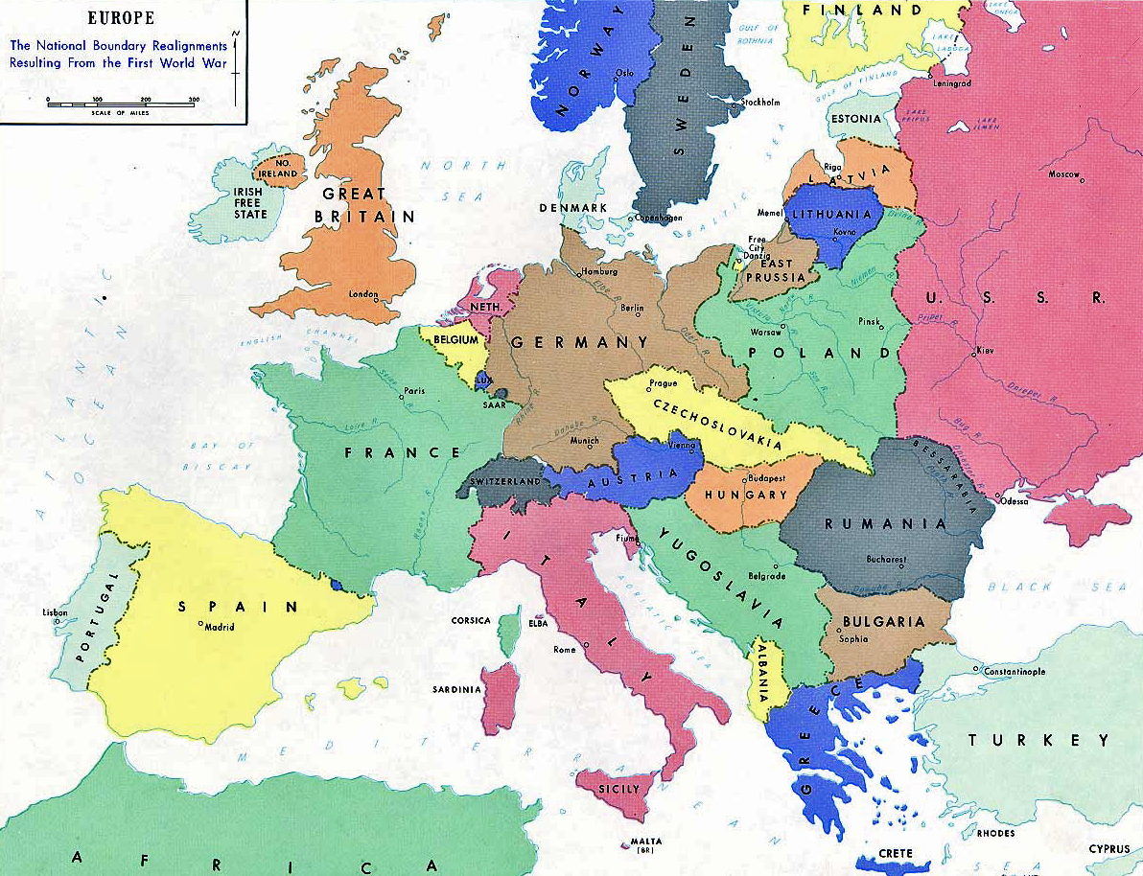
Results of the war
Europe after WW I

Slide 4
Paris Peace Conference
It was the meeting of the Allied victors following the end of World War I – the aim was to set the peace terms for the defeated Central Powers following the armistices of 1918.
It took place in Paris in 1919 and involved diplomats from more than 32 countries and nationalities. They met, discussed various options and developed a series of treaties ("Paris Peace Treaties") for the post-war world.
the winning powers – France, Great Britain, USA, Italy, Japan
other figthing states – Belgium, British dominiums, Poland, Kingdom of Serbs, Croats and Slovenes (Yugoslavia), Czechoslovakia, Romania, Greece, Portugal and other non-european states
defeated states – Germany, Austria, Hungary, Ottoman Empire, Bulgaria
Russia was not invited to the Paris Peace Conference (bolshevik revolution and civil war in Russia)

Slide 5
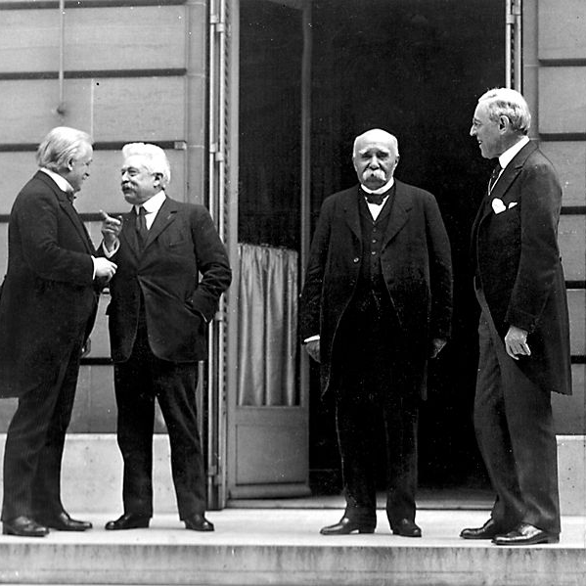
Paris Peace Conference
The Big Four –
David Lloyd Geroge (GB), Vittorio Orlando (It), George Clemencau (Fr), Woodrow Wilson (US) – from left to right

Slide 6
Peace Treaties
The following treaties were prepared at the Paris Peace Conference:
the Treaty of Versailles, 1919, 28 June 1919, (with the German Empire in Weimar Republic form)
the Treaty of Saint-Germain, 10 September 1919, (with Austria)
the Treaty of Neuilly, 27 November 1919, (with Bulgaria)
the Treaty of Trianon, 4 June 1920, (with Hungary)
the Treaty of Sèvres, 10 August 1920; subsequently revised by the Treaty of Lausanne, 24 June 1923, (withTurkey)
http://www.the-map-as-history.com/demos/tome03/index.php

Slide 7
Versailles system
The so-called "Paris Peace Treaties", together with the accords of the Washington Naval Conference of 1921-1922, laid the foundations for the so-called Versailles-Washington system of international relations
the United States never ratified the Treaty of Versailles, never joined the League of Nations, and signed separate peace treaties with the three countries it had declared war against
1920 – the League of the Nations was established
the all over the world organization which goal was to save peace in the World
USA did not join this organization
In fact –useless – did not have any instruments how to enforce its decessions (only resolutions without the real effect)

Slide 8
Central Europe after WWI
Economy
1921–1922 – economic depression as a consequence of the war
1924–1929 – economic boom, liberal economic reforms, technical development, intensification and growth of production
1929, October 24 – the Black Tuesday, New York Stock Market Crash (Wall Street) → The Great Depression – the longest, most widespread, and deepest depression of the 20th century, drop of industrial production, high unemployment, social unrests, crisis of democracy
since 1933 – economic development again, but slow

Slide 9
International relations in the central europe after WWI
unstable peace, effort to avoid conflicts, era of democratism and a pacifism
April – May 1922 – Conference in Genova, Italy
Russia and Germany were invited to this conference as well
The conference should discuss German reparations - Germany was not able to pay it but France insisted on it → no agreement
The result of the conference: meeting of German and Soviet diplomats – they concluded an Agreement in Rapallo –Germany was the first state which recognized the Soviet Union de iure
1924 – the Dawes Plan – the plan of stabilization of German economy and economical recovery (stabilization of German mark, budget, sequential paying of reparations)
The Dawes Plan relied on money given to Germany by the US – high loans

Slide 10
Locarno Conference, Switzerland – October 1925
4 great powers (Great Britain, France, Italy, Germany) – an attempt to overcome the differences between the winners and losers
The principal treaty concluded at Locarno was the "Rhineland Pact" between Germany, France, Belgium, the United Kingdom, and Italy. The first three signatories undertook not to attack each other, with the latter two acting as guarantors
the western borders of Germany were guaranted but the eastern were not – there could come up to some changes – central European countries felt endangered by German imperialism and revanchism
Germany's admission to the League of Nations
the subsequent withdrawal (completed in June 1930) of Allied troops from Germany's western Rhineland

Slide 11
Briand-Kellog Pact - also called the General Treaty for the Renunciation of War or the World Peace Act) was signed on August 27, 1928 57 states
prohibited the use of war as "an instrument of national policy" and as an instrument of settlement of disputes between states
the problem was that there were not defined any sanctions in case of breaching the Pact
no program of disarmement
The Young Plan was a program for settlement of German reparations debts after World War I written in 1929 and formally adopted in 1930
Germany was not able to pay the huge annual payments, so the amount of the reparation payments was reduced again – to 112 billion Gold Marks, Germany should pay them in next 59 years, 2 bilion marks every year

Slide 12
Readings
WWI:
http://www.firstworldwar.com
http://www.the-map-as-history.com/demos/tome03/index.php
14 point of Woodrow Wilson:
http://www.ourdocuments.gov/doc_large_image.php?doc=62
MacMILLAN, Margareth: Peacemakers Six Months That Changed the World: The Paris Peace Conference of 1919 and Its Attempt to End War.
http://www.youtube.com/watch?v=L8uWgbRd8So
Henig, Ruth B. (1995). Versailles and after, 1919-1933. 2nd ed. London: Routledge.
Treaty of Locarno
http://treaties.un.org/Pages/showDetails.aspx?objid=08000002801683d0

Slide 13
Germany
serious problems as the consequences of the war:
economic depression
high reparation payments
restrictions of the area
lost of the colonies,
restrictions of army, navy and air force
lack of food
Many war veterans (lots of them disabled) – problems with their re-integration
1919 – 1933 – Weimar Republic, parliamentary republic, federation of 16 states
the first President – Friedrich Ebert (Social Democratic Party)
1919 – the first elections
general dissatisfaction
1918 – the Communist Party of Germany was founded (headed by Rosa Luxemburg and Karl Liebknecht) – rejected the parliamentary democracy

Slide 14
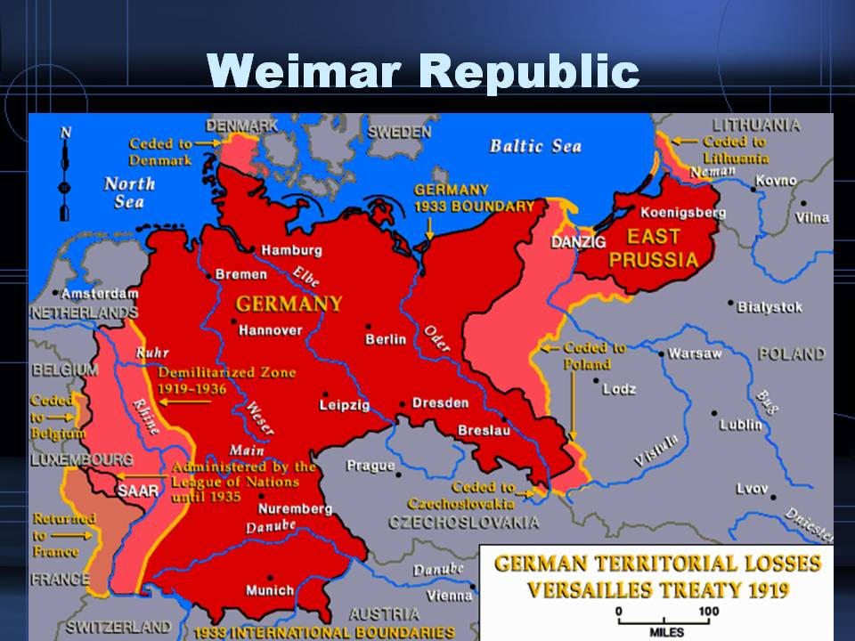

Slide 15
Germany during 1920s
strong revolutionary wave (strikes, rebellions etc.)
in Bavaria – Bavarian Soviet Republic was proclaimed in October, defeated in April 1919
March 1920 – right-wing monarchistic Kapp Putsch – former volunteers (Freikorps)
1923 – suppression of Hitler-Ludendorff Putsch in Munich, Hitler was arrested and wrote his programme book Mein Kampf, his political party NSDAP was banned
1923 - Industrial territory around the River Ruhr was occupied by France (Germany was delayed with paying of reparation payments)
1923 – the new government – Prime Minister (Chancellor) Gustav Stresemann – stabilization of Golden mark, succesful foreign policy
1925 – the second President became Paul von Hindenburg
weak democracy – governments changes very often
since 1929 – Great Depression – in Germany very serious effects (1932 – unemployment was 44,5 %),
the growth of extreme nationalism and revanchism

Slide 16
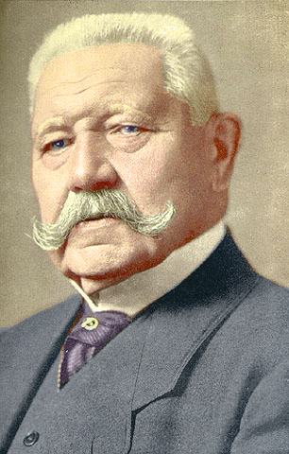
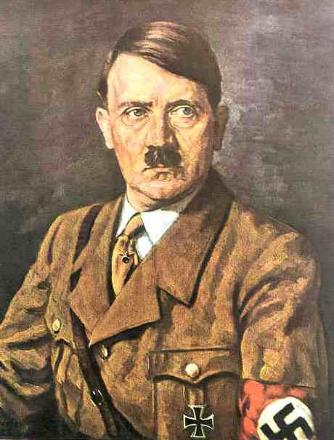
Germany
Paul von Hindenburg
Adolf Hitler

Slide 17
Germany during 1930s
a political crisis: the political parties represented in the Reichstag were unable to build a governing majority in the face of escalating extremism from the far right (the Nazis, NSDAP) and the far left (the Communists, KPD)
1932 – NSDAP won the elections (over 30 %, the communists were third)
1933 – Adolf Hitler was appointed as Chancellor (Prime Minister)
1933 – Germany left the League of Nations
The Nazi regime restored economic prosperity and ended mass unemployment using heavy spending on the military, while suppressing labor unions and strikes → enourmous popularity
Secret police – Gestapo (Heinrich Himmler)
February 1933 – the Reichstag Fire – an arson attack on the building of German parliament (Reichstag) – used by Nazi regime – the communist were accused to burn the Reichstag – the Reichstag trial
persecuting of political oposition – it was destroyed
Concentration camps (1933 – the first c.c. was found in Dachau – for the political prisoners and opponents of the Nazi regime – communists, social democrats, later also for Jews, Gypsies, Slavic peoples etc. )
Propaganda – minister Joseph Goebbles
1934 – Hitler became a Führer – the head of the state (after President’s death)
1934 – The Night of the Long Knives – the top leaders of SA were killed – internal opposition in Nazi party was destroyed

Slide 18
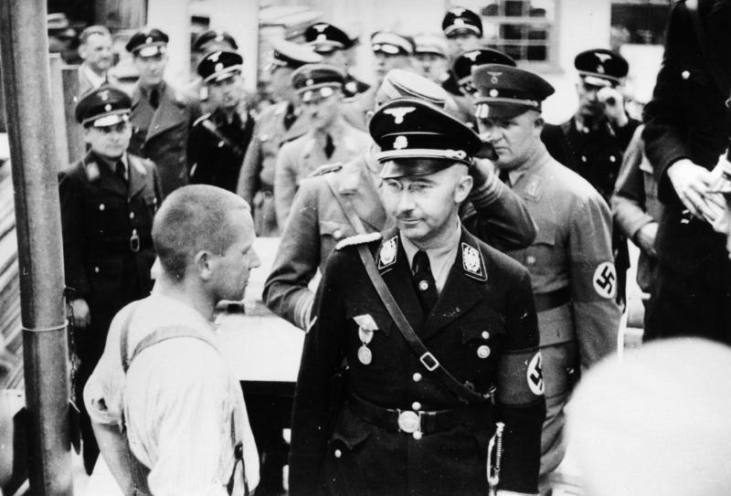
Heinrich Himmler visiting the concentration camp in Dachau (1936).

Slide 19
1935 – Nüremberg laws – anti-Semitism, the Jews excluded from political, economical and public life, had to wear a yellow star
1935 – Germany introduced general military service and began to re-arm
1935 – Germany won the Saar (was under the protection of the League of Nations)
1936 – Germany occupied de-militarized zone in Rheinland
both were breaching of Versailles Peace Treaty and of Rhineland Pact but only formal prostest of great powers succeded
1936 – pact with fascist Italy headed by Benito Mussolini – Berlin-Rome Axis
1936 – Anti-Commintern Pact against the communism (Soviet Union) – with Japan
March 1938 – Anschluss of Austria
September 1938 – the Munich Agreement – the occupation of Sudetenland (borderland of Czechoslovakia)
1938, November 9–10 – Crystal Night – great pogrom against Jews
September 1, 1939 – attack on Poland – WW II started

Slide 20
Germany
Readings:
Kaes, Anton – Jay, Martin – Dimendberg, Edward, (eds.): The Weimar Republic sourcebook. Berkeley: University of California Press, 1994.
http://books.google.cz/books?id=J4A1gt4-VCsC&printsec=frontcover&hl=cs&source=gbs_ViewAPI&redir_esc=y#v=onepage&q&f=false

Slide 21
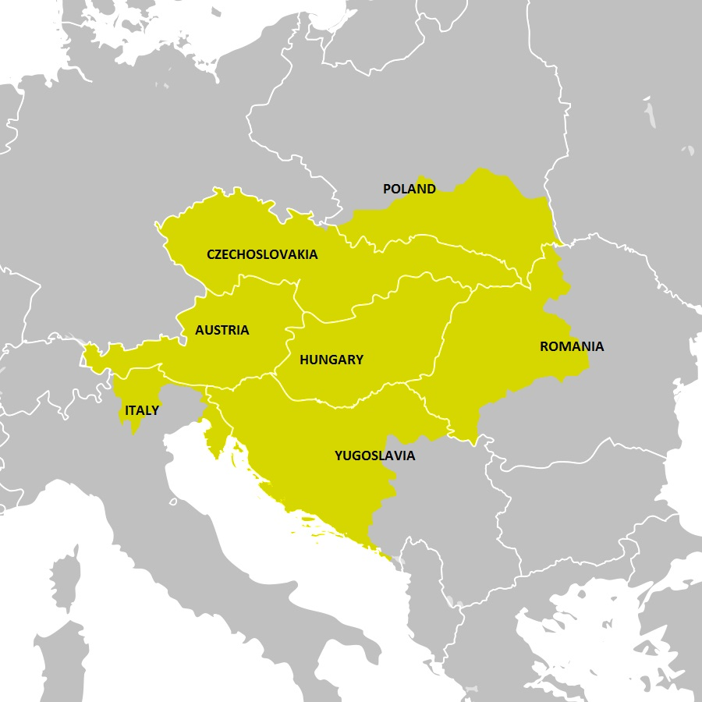
The dissolution of Habsburg Monarchy in 1918.
The newly established states and their territorial gains from Austria-Hungary.

Slide 22
Austria
1919–1934 – the Republic of Austria
Very bad economic situation as a consequence of the war and of the dissolution of Habsburg monarchy (they lost industrial territories in Bohemia) and establishing of the new states and frontiers (new customs taxes, new currynecies in new states etc. That complicated international trade)
The first Chacellor became Ignaz Siepel.
Austria's government was dominated by the Christian Social Party
The second strongest party was Social democratic party
Both the parties had paramilitary forces (Heimwehr – right wing and Schutzbund – left wing) established in 1923
the country was unstable, severe economic consequences of the war (economic depression, lack of food etc.)
In 1927, left-wing supporters engaged in a massive protest over the acquittal of right-wing paramilitaries who were found guilty of killing a man and a child
The huge protest and the clash between right-wing and left-wing paramilitary forces is known as July Revolt of 1927
It was supressed by violence by police – many protestors were killed
1932 – authoritarian regime of Chancellor Engelbert Dollfuss
Strong centralization, dictatorship, one-party state was created since May 1934 – Fatherland Front
Austrofascism – gravitagted to Italy (Austria felt threatened by German demands on Austria – Anschluss), Italy competed with Germany for the political influence in Austria

Slide 23
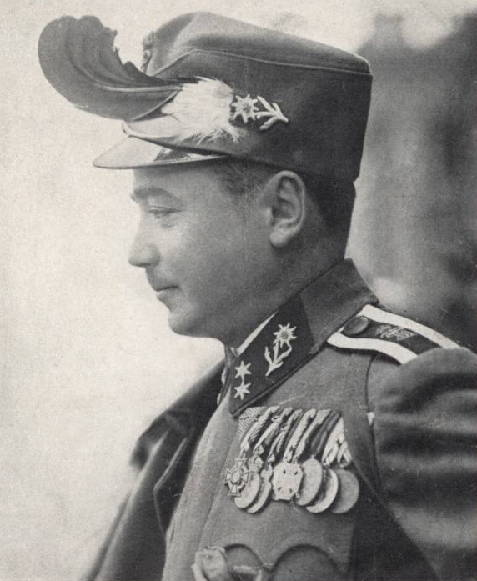
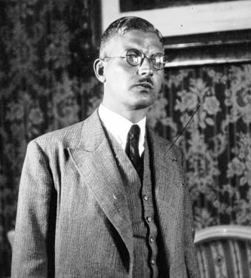
Engelbert Dollfuss
Kurt Schuschnigg

Slide 24
Dollfuss’ government was in competition with growing Nazi party which wanted Austria to join Germany
The state began to crack down on pro-Nazi and pro–German-unification sympathizers
The Austrian Nazis responsed by the revolt
During this revolt Dollfuss was assassinated by Nazi agents who in 1934 – July Putch
The putch was finally supressed (eith the help of Mussolini’s Italy) and the Austrian Nazis were mostly arrested or emigrated
The remaining Austrian Nazis started to make use of terrorist attacks against Austrian governmental institutions, causing a death of more than 800 between 1934 and 1938
A new Chancellor – Kurt Schuschnigg – similar political course as Dollfuss
But still also an effort to keep Austria’s independence – focused on the history of Austria and opposed the absorption of Austria into the Third Reich, according to his philosophy the Austrians were „better Germans“
eventually Schuschnigg gave up his anti-Nazi program and in July 1936 he signed the Austro-German Agreement, which, among other concessions, allowed the release of Nazis imprisoned in Austria and the inclusion of National Socialists in his Cabinet
Strenghtening of pro-German Nazis in Austria
1938 – Anschluss – March 11 – German troops crossed Austrian frontiers and Austria was occupied by Germany
after Anschluss in March 1938 (Fall Otto) Austria became a part of German territory
in April a plebiscite that confirmed annexation of Austria into Nazi Germany took place in Austria
The Austrian Republic was dissolved and became a part of Germany
Schuschnigg was arrested by German Nazis and during the WW 2 was interned in the concentration camp.
The new head of the government became Austrian nazi leader Arthus Seyss Inquart

Slide 25
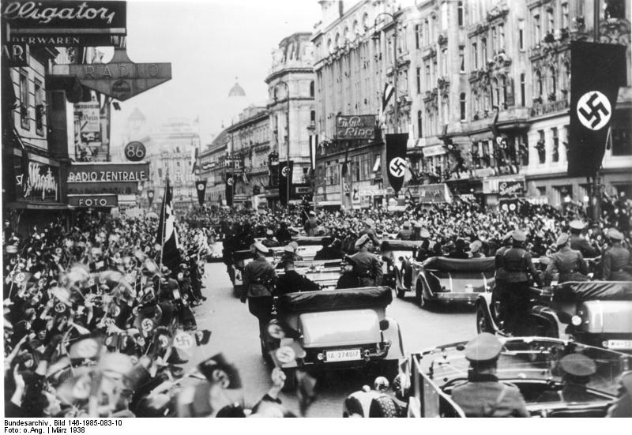
Jubilant crowds greet Hitler's motorcade entering Vienna on 15 March 1938.

Slide 26
hungary
The successfull Aster revolution in Budapest led to proclamation of democratic republic on November 16, 1918
Mihály Károlyi was named as the republic's Prime Minister
the area of Hungary was of only one third of pre-war Hungary – dissatisfaction, attpemts to restore the Great Hungary
the rapid rise of power of Hungarian Communist Party, the Hungarian Soviet Republic was proclaimed on March 21, 1919 – an attpemt to restore the Great Hungary
the head of this republic was Béla Kun
Hungarian communists wanted to connect with Soviet Russia
Czechoslovakia and Rumania felt threatened by Hungarian territorial demands → their armies attacked Hungary and the Romanians took the Hungarian capital city Budapest
the Hungarian Soviet Republic was defeated
the new Government – fascist party of former Austro-Hungarian Admiral Miklós Horthy
1920 – the monarchy was restored in Hungary but no king
Horthy ruled over it as a regent between 1921 and1944
the Prime Minister was István Bethlen (till 1931)

Slide 27
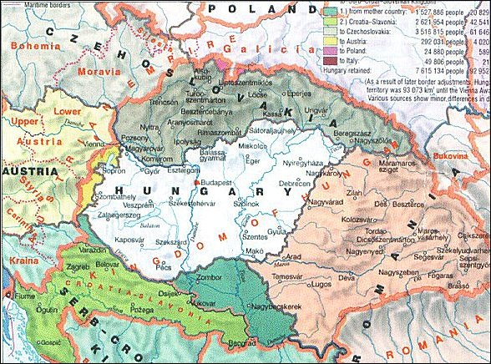
Hungary 1920–1938

Slide 28
Hungary
Hungary’s signing of the Treaty of Trianon on June 4, 1920
ratified the country's dismemberment and establishing of the new borders of Hungary
the loss of territories (71 %) and population (66 %)
limited the size of its armed forces
required reparations payments
3.4 million of ethnic Hungarians lived outside the Hungarian state (minorities in neighboring states)
In Hungary it was seen as a „national disaster“ → revanchism
1920s – „the white terror“ - led to the imprisonment, torture, and execution without a trial of communists, socialists, Jews, leftist intellectuals, sympathizers with the Károlyi and Kun regimes, and others who threatened the traditional Hungarian political order that the officers sought to reestablish
the former Austrian Emperor, Charles I, unsuccessfully attempted to retake Hungary's throne in March and October 1921
No democracy – the suffrage – only 29 % of population, public vote

Slide 29
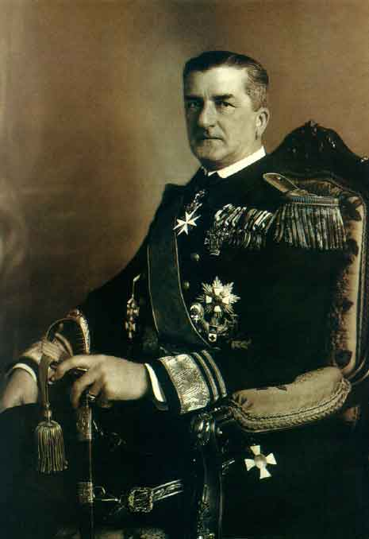
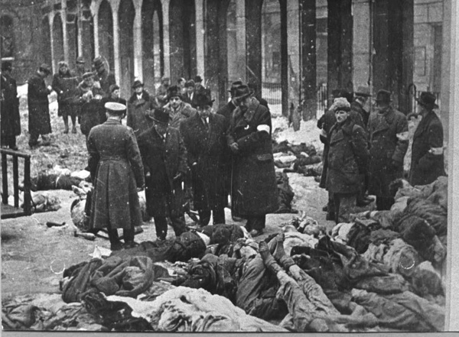
The Jewish victims of Arrow Cross Party men in the Dohányi Street Synagogue in Budapest during WW 2
Miklos Horthy, the Regent of Hungary 1921–1944

Slide 30
The interwar Hungary was semfascist, authoritarian and anti-Semitic (numerus clausu for the Jews at the universities etc.)
1932–1936 – the Prime Minister was Guyla Gömbös –
the radical right’s ascendancy in Hungarian politics
1938 – territorial gains – from Czechoslovakia – so called First Vienna Award
1939 – Hungary occupied Carpathian Ruthenia and parts of eastern Slovakia (earlier those were the parts of Czechoslovakia)
Later also terriotorial gains from Rumania – Second Vienna Award in 1940
1941 – Hungary occupied parts of Yugoslavia
Hungarian nazism
1939 – Arrow Cross Party (Hungarian Equivalent of Nazi Party) won the elections
1940 – Hungary joined the Tripartite Pact (Germany, Italy and Japan)
1941 – Hungary participated on the invasions of Yugoslavia and of the Soviet Union
Hungary lost its territorial gains after the WW 2

Slide 31
