Slide 1
Central europe during the interwar period Part II
Jana Skerlova

Slide 2
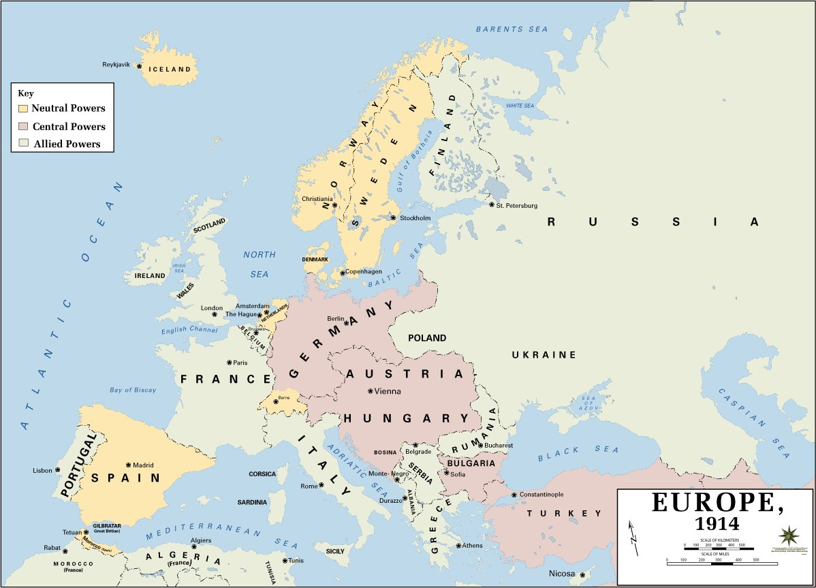
Europe before world war i

Slide 3
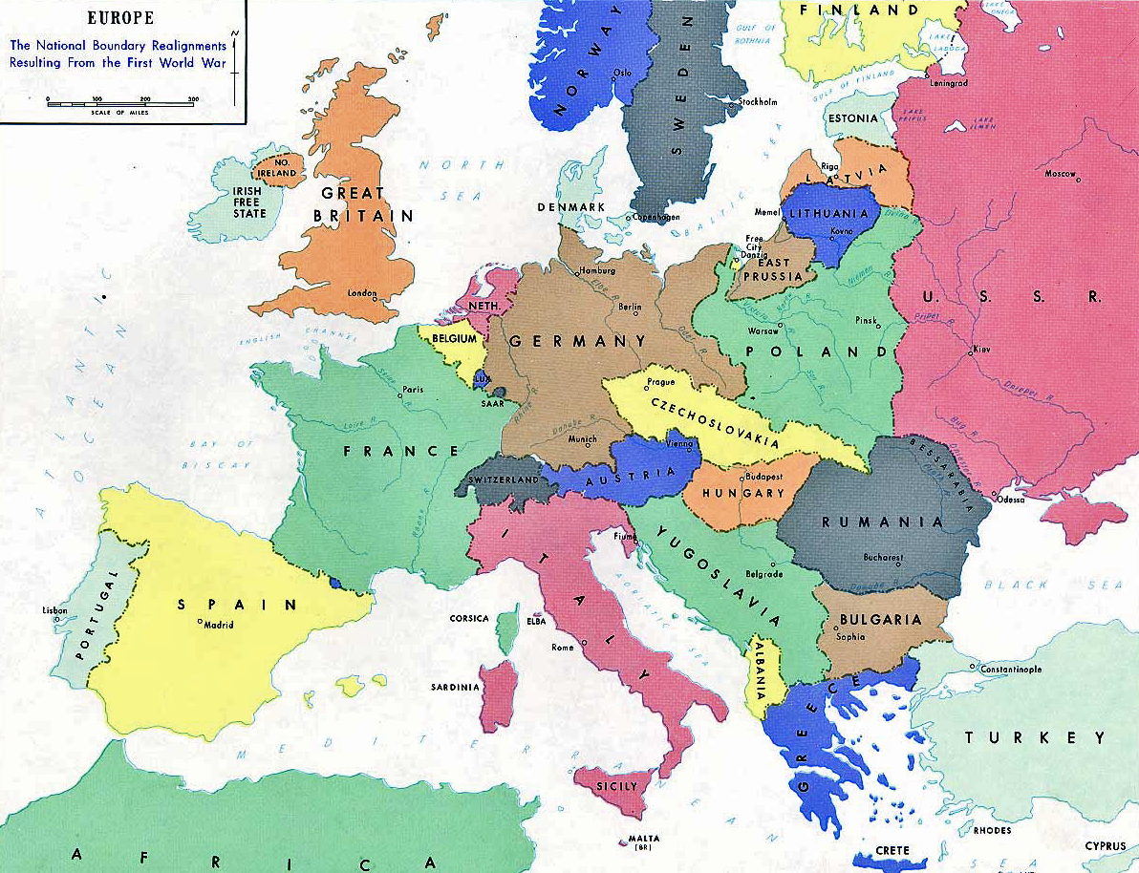
Results of the world war I in europe

Slide 4
poland
During the WW I – exile Polish National Comittee – Roman Dmowski – the spokesman for Polish nationalism in the Allied camp
After german victory on the Eastern front the Russian-ruled territory of Poland was occupied by German troops – The Kingdom of Poland consisting of German, Austrian and Russian part of Poland was established in 1916 – German puppet state – Mitteleuropa scheme
More than 1 000 000 of Poles died during the WW I
December 1918 – The Greater Poland Uprising – against Germany, with the centre in the city of Poznan, succesfull
the Treaty of Versailles granted a reconstituted Poland the area won by the Polish uprising plus some additional territory, most of which had been part of Poland before the partitions (from the end of 18th century)
the Republic of Poland was reestablished in 1918
he independence of Poland was one of the war goals of the Allies (it was mentioned in President Wilson’s Fourteen Points)
The western Polish borders and the borders in Baltic area were ratified by the Treaty of Versailles while the eastern and southern borders were not.

Slide 5
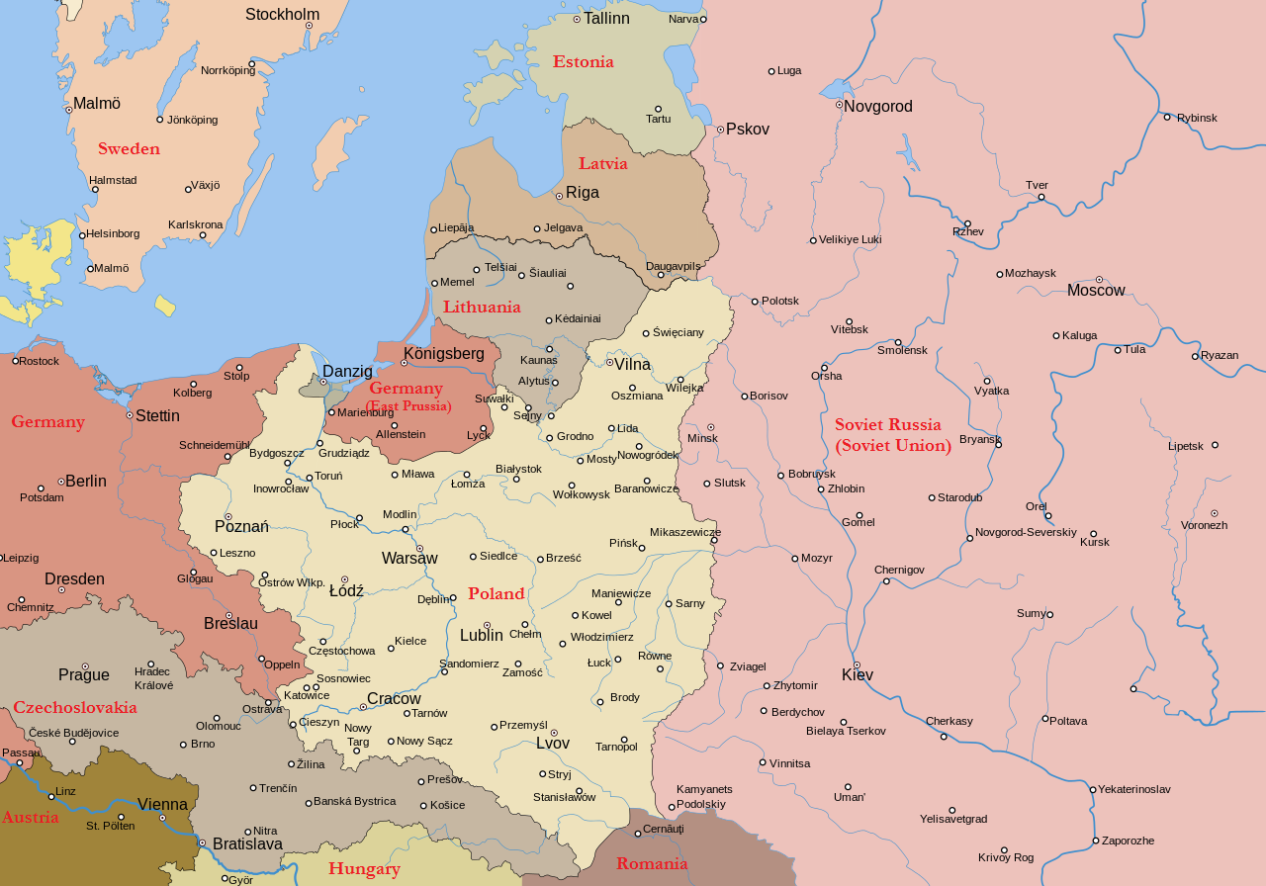
Republic of Poland and its neighboring states after WW 1.

Slide 6
27 milion of inhabitants in 1921 (35 milion in 1939)
Multinational country - one third of its population were national minorities
  Ukrainians – 14 %
  Jews – 10 % (by 1931 Poland had the biggest Jewish population in the world – over 3 milion people)
  Belarusians – 3 %
  Germans – 2 %
  Others (Czechs, Lithuanians, Russians) – 3 %
1919 – the first elections to the Sejm (parliament)
1921 – the March Constitution
The Republic of Poland was a parliamentary democracy form 1919 till 1926
Main political parties – National Democrats, Peasant Parties, Christian Democrats
Several regional conflicts with neigboring states – border disputes:
Polish- Lithuanian War – spring 1919 – November 1920
April 1919 – Poland captured Vilnius
1922 – annexation of Vilnius (Vilno) Region from Lithuania
The dispute over Vilnius remained one of the biggest foreign policy issues in Lithuania and Poland.
Lithuania broke off all diplomatic relations with Poland and refused any actions that would recognize Poland’s control of Vilnius.

Slide 7
1918 – 1919 – Polish – Ukrainian War
A conflict between Polish republic and West Ukrainian People’s Republic for control over Eastern Galicia (ex Austro-Hungarian province with the centre in the town of Lviv).
1st November 1918 - West Ukrainian People’s Republic was proclaimed in former Habsburg provinces of Galicia and Bukovina
The local Poles wanted to rule over this territory – the war conflict broke out
Poland won this war and the territory was annexed by Poland – national conflicts
Approximately 10,000 Poles and 15,000 Ukrainians, mostly soldiers, died during this war.
Seven day war – January 1919
A border conflict with Czechoslovakia for the territory of Těšin (Cieszyn in Silesia), Orava and Spiš (nothern Slovakia)
Czechoslovak units attacked the Polish part of Cieszyn Silesia to prevent the Polish elections in the contested territory
Great strategic importance of the region – coal mining basin and the important railroad connecting the Czech lands with Slovakia
The Czechoslovak attack was halted under the pressure from the Entente
a new demarcation line – the western part of the disputed territory was given to Czechoslovakia while Poland received the eastern part
Czechoslovak-Polish relations were not very good during the whole interwar period

Slide 8
1919 – 1921 – Polish-Soviet War
Soviet Russia wanted to govern the territory of Belarus and the areas of western Ukraine
Poland wanted to use Russian civil war to ensure its eastern borders
Firstly the Polish army was succesfull ( Marshall Jozef Piłsudski)
but later Soviet counteroffensive – they wanted to establish Soviet Republic in Poland and marched into Polish inland
August 1920 – the battle of Warsaw - the Soviet troops were defeated
September 1920 – the battle of Niemen river – the Polish troops won again
March 1921 – the Peace Treaty of Riga – Poland got parts of Belarus and Ukraine (4 millions of Ukrainians and 1 million of Belarussians in Poland)
The rest of Ukraine and Belarus became a part of the Soviet Union
The Peace Treaty of Riga left significant territories populated by Poles within the Soviet Union – almost 1 million of Poles living at the territory of the Soviet Russia (During the 1930s many of them were deported to Siberia)
While the Treaty of Riga led to a two-decade stabilization of the Soviet-Polish conflict, the conflict was renewed during World War II

Slide 9
Many problems in Poland – economy exhausted by the war, problems with unifying of disparate economic regions, which had previously been part of different countries
The chief parties were the left-wing Polish Peasant Party led by Piłsudski and the national Democracy Party led by Roman Dmowski
Weak and inexperienced government had to face many problems.
Since June 1925 – trade war with Germany
October 1925 – Treaty of Locarno – Polish foreign minister Józef Beck said: "Germany was officially asked to attack the east, in return for peace in the west."
The situation resulted in the May Coup d’État in 1926 – it was led by leftist politician and a popular Marshall Jozef Piłsudski
he became most influential politician in Poland and became its de facto dictator till his death in 1935 though he was not a president but only a Minister of defence
So called Sanation Government – its aim was the“moral healing“ of the Polish policy, the coalition rightist, leftist and centrists whose main focus was to eliminate the corruption and reduce the inflation
authoritarian means
1932 – non-agression pact with Soviet Union
October 1938 – the First Vienna Award – annexation of Zaolzie, Górna Orawa, Jaworzyna from Czechoslovakia
March 31, 1939: military guarantees from United Kingdom and France
August 23, 1939: non-aggression pact between Soviet Union and Germany: Ribbentrop-Molotow Pact with a secret military alliance protocol targeting Poland

Slide 10
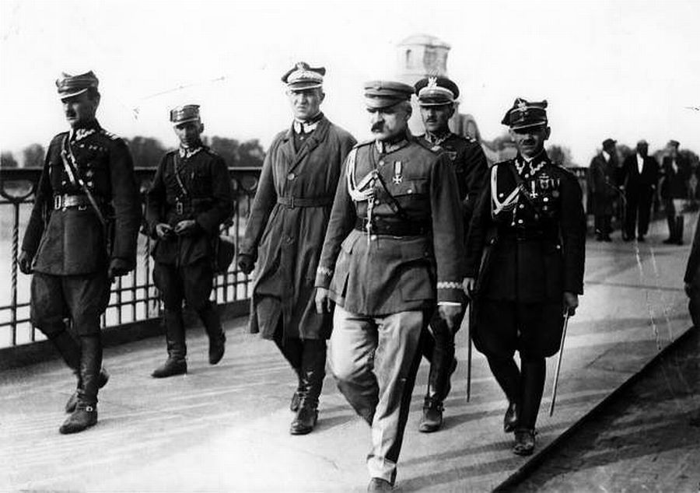
Jozef Piłsudski and other coup leaders

Slide 11
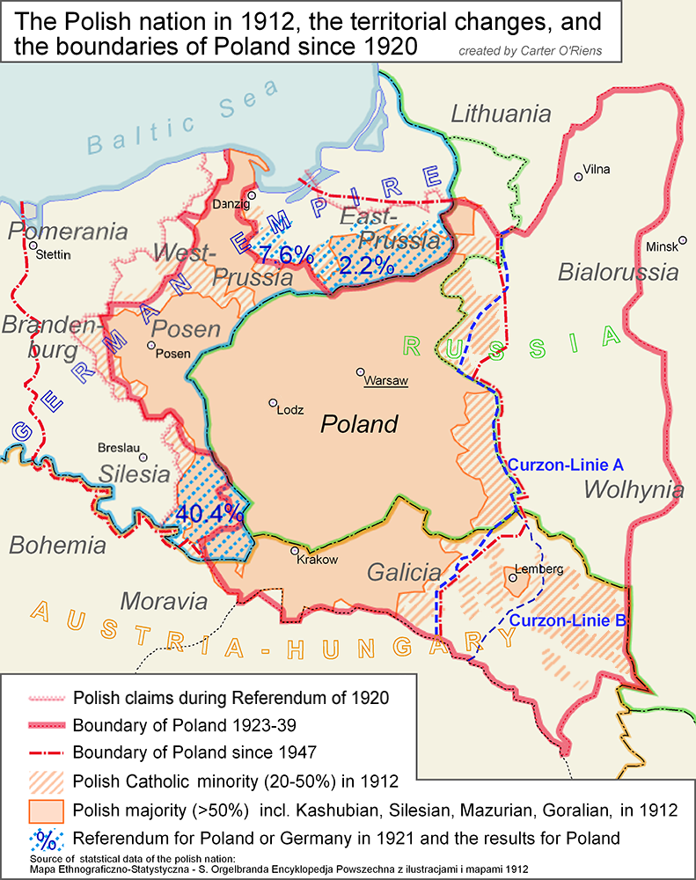
poland

Slide 12
September 1 – October 6, 1939: German Invasion of Poland
Poland attacked by Nazi Germany without declaring war on Poland
17th September – USSR attacked Poland and occupied eastern part of Poland
so called New Partition of Poland – western part under German Reich, central part – General Gouvernement (with the capital city of Krakow) – the head Hans Frank,
eastern part – occupied by USSR
many concentration camps in Poland – Auschwitz, Majdanek, Sobibor, Treblinka ...
segregation of Jews – a big ghetto in Warsaw – from April to May 1943 – Warsaw Ghetto Uprising
of Poland’s prewar Jewish population of 3 million, only about 369,000 survived the war
Polish resistance movement – Polish goverment in exile with Władysław Sikorski as Prime Minister, in Poland the Home Army (Armia Krajowa) and the Peoples Army (Armia Ludowa)

Slide 13
Readings:
Davies, Norman: The God’s Playground. A history of Poland. Volume II (1795 to present). Columbia University Press 1982.
Rothschild, Joseph: Pilsudski's Coup D'État. Columbia University Press 1967.
Rothschild, Joseph: East Central Europe Between the Two World Wars. Columbia University Press 1974.
Frucht, Richard (ed.): Eastern Europe: an introduction to the people, lands and culture. ABC- Clio, Inc. Santa Barbara, USA 2005.

Slide 14
czechoslovakia
The First Czechoslovak republic was proclaimed on October 28, 1918 in Prague (Wenceslas Square).
A new era for two nations (Czechs and Slovaks) which had previously been part of the Austro-Hungarian Empire began.
Czechoslovakia consisted of: Bohemia, Moravia, Silesia, Slovakia and Carpathian Ruthenia
The first Prime Minister – Karel Kramář
1920 – the constitution (liberal) - plural parliament democracy
General suffrage – free, direct and secret ballot, women suffrage since 1918
President was elected by Parliament
in 1920 – Tomáš Garrigue Masaryk (1850–1937) was elected the first President (reelected in 1925 and 1929, served till 1935), he was a philosopher and a politician, very influential personality, his wife was American – Charlotte Garrigue, their son Jan Masaryk served later as Czechoslovak Foreign Minister
most important and most influential political party - Peasant party, they ussually had a Prime Minister – Antonín Švehla in 1920s, Jan Malypetr and Milan Hodža in 1930s
Social Democrats, Peoples Party, Communist Party
German parties – Social Democrats, Peasant Party
Land reform – the great estates of the nobility and the Church were distributed to the peasants
Internal problems – Slovak authonomist movement
After the war – economic problems but not so serious as in neighbouring countries
Czechoslovakia had developed industry
One of the most progresive social-security and pension systems in Europe

Slide 15
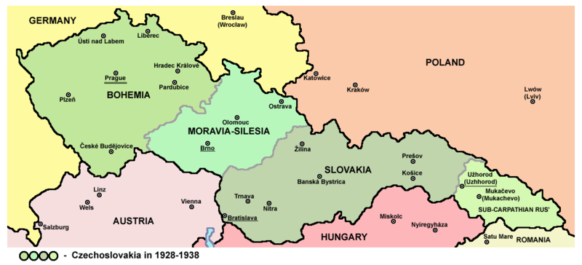
czechoslovakia
The first Czechoslovak republic consisted of: Bohemia, Moravia, Silesia, Slovakia and Carpathian Ruthenia (Sub-Carpathian Rus)

Slide 16
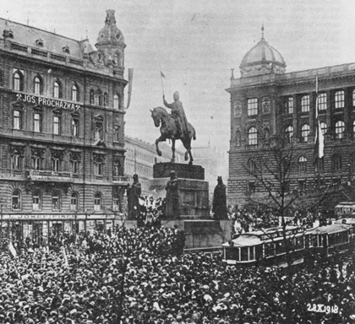
Proclamation of the first Czechoslovak Republic on October, 28 1918 in Prague (Wenceslaus Square).

Slide 17
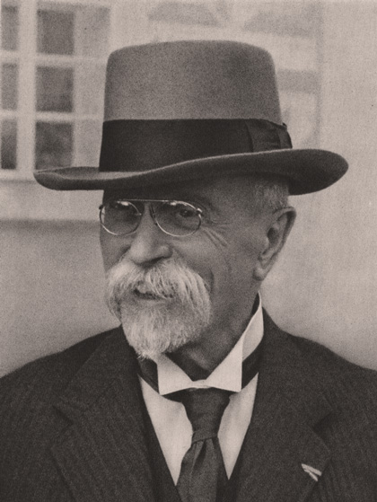
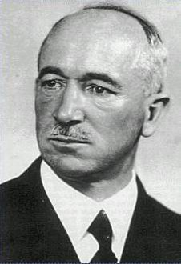
czechoslovakia
Tomaš Garrigue Masaryk
1st President of Czechoslovakia (1920–1935)
Edvard Beneš
2nd President of Czechoslovakia (1935–1938, 1945–1948)

Slide 18
foreign policy – led by Minister Edvard Beneš from 1918 to 1935 – one of the most important European diplomats during the interwar period, in 1936 he was elected second President of Czechoslovakia
Czechoslovakia was faced with Hungarian demands for the return of parts of Slovakia
To protect the borders the Little Entente was formed in 1921
It was an alliance of Czechoslovakia, Kingdom of Serbs, Croats and Slovenes (Yugoslavia) and Romania – against Hungary and its revanchism and against restoration of Habsburgs
Little Entente was supported by France (1924 – Czechoslovak-French Agreement)
the Little Entente was an idea of Czechoslovak Foreign Minister Edvard Beneš
It was also an attmept to establish internationaly important organization with some influence in European politics.
The most important Czechoslovak ally was France
since 1925 – economic growth, cultural development
the great depression since 1930
since 1933 – Czechoslovakia was threatened by Nazi Germany
CZE built border fortification
1935 – mutual security pact with Soviet Union

Slide 19
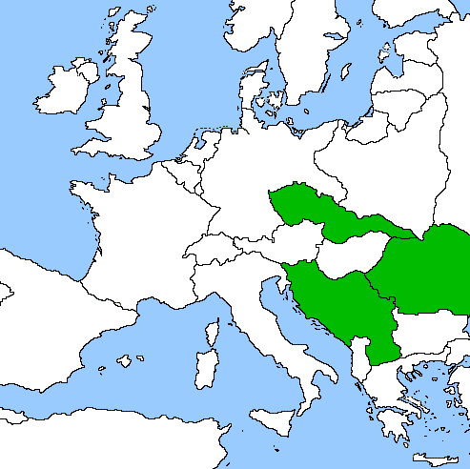
Little entente
Czechoslovakia + Yugoslavia + Rumania

Slide 20
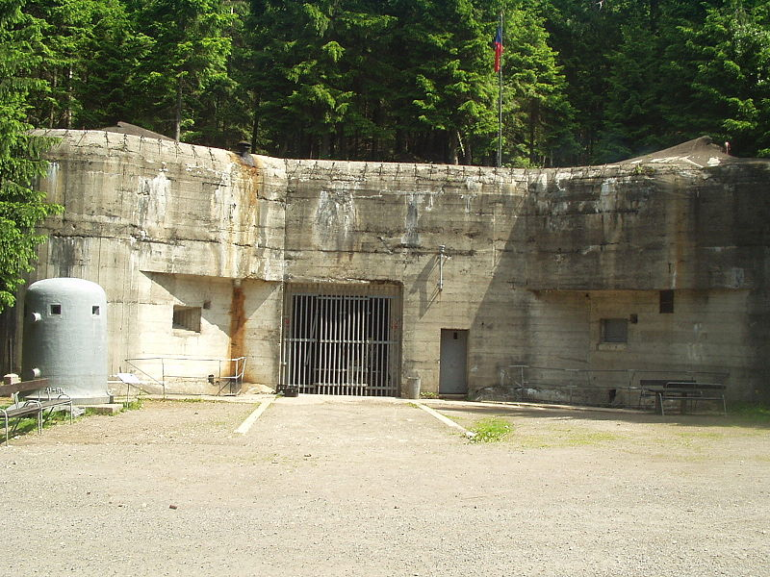
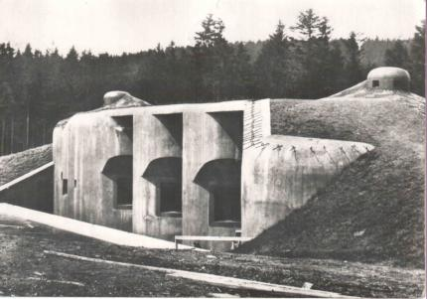
Czechoslovak border fortification
Czechoslovak fortification – Hanička
http://www.hanicka.cz/
Czechoslovak fortification – Bouda
http://www.boudamuseum.com/

Slide 21
National minorities in czechoslovakia
More than 3 million of ethnic Germans were living in Bohemian lands, they were called Sudeten Germans.
The German minority living in Sudetenland demanded autonomy from the Czech government, claiming they were suppressed and repressed by the Czech government.
1938 - Munich Agreement
Other national minorities in Czechoslovakia:
750 000 of Hungarians in southern Slovakia
450 000 of Ruthenians in Karpathian Ruthenia
75 000 of Poles
Jews, Gypsies

Slide 22
There was a numerous German minortity in Czechoslovakia, Sudeten German Party with the leader Konrad Henlein was established in 1935
1935 – Parliamentary elections, the newly founded Sudeten German Party under leadership of Konrad Henlein, financed with Nazi money, won an upset victory, securing over 2/3 of the Sudeten German vote, which worsened the diplomatic relations between the Germans and the Czechs.
https://www.youtube.com/watch?v=cS5GglsNKyo
April 1938 – Karlsbader Decrees demanding the authonomy for Sudeten Germans and the freedom to profess Nazi ideology, Sudeten Germans expected that President Beneš will refuse their exaggerated requirments
Czechoslovak government was forced to coclude an agreement with Henlein but he refused all their suggestions according to Hitler’s instructions
Hitler accused Czechoslovak government of „oppresing“ the Greman minority and demanded ceding of the Sudetenland to Germany
Czechoslovak Govermnent responded that Germany had no legal claims to that region
Great powers – Great Britain, France – were affraid of the new war → politics of appeassement

Slide 23
Appeasement – a diplomatic policy of making political or material concessions to an enemy power in order to avoid conflict
several negotiations on Czechoslovakia between Hitler and British Prime Minister Neville Chamberlain during September 1938
15th September – Berchtesgaden – Great powers were putting pressure on Czechoslovak government to accept Hilter´s requirments – he wanted Sudeten, firstly Czechoslovak government refused British and French pressure but on 21st September was forced to accept Hitler´s requirments
22nd September – Bad Godesberg – new Hitler´s requirments – he wanted to occupy Czechoslovak fortification and some border areas for Poland and Hungary
Hitler announced that he would attack Czechoslovakia on 28th September (according to the Fall Grün prepared already in April 1938)

Slide 24
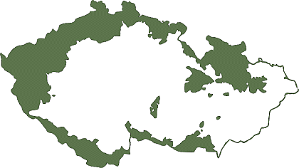
Sudetenland – the areas inhabited by Germans in Bohemia, Moravia and Silesia during the interwar period

Slide 25
change of the government in Czechoslovakia – Prime Minister General Syrový
23rd September – general mobilization in Czechoslovakia
https://www.youtube.com/watch?v=AvQMjamGjI8
29th to 30th September – negotiations of four Great powers in Munich
(Germany – Hitler, Italy – Mussolini, Great Britain – Chamberlain, France – Daladier) – about Czechoslovak frontiers and German requirments but without Czechoslovakia – France and Great Britain were Czechoslovak allies but they signed the agreement with the enemy: the Munich Agreement
Czechoslovakia(Czechoslovak troops) had to evacuate Sudeten and cede it to Germany
the USSR did not reply for the Czechoslovak application for the help
from 1st to 10th October Czechoslovak borderland was occupied by German troops and annexed to Germany, Poland got the area around Těšín and Spiš, Hungary got Carpathian Ruthenia and southern parts of Slovakia
The Munich agreement shatterd Czechoslovakia’s democratic system and created profound disillusionment with the West
The great powers were convinced that they had „saved the peace for our time“ (Neville Chamberlain)
http://www.youtube.com/watch?v=zLR0Vt2sXWQ

Slide 26
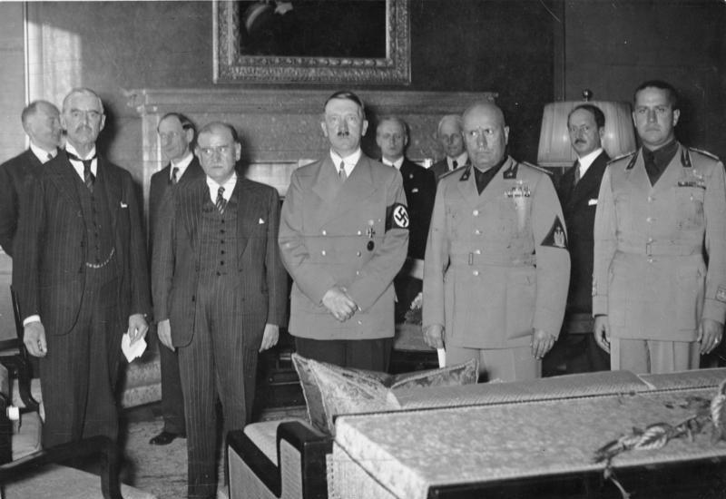
Chamberlain, Daladier, Hitler, Mussolini and Ciano pictured before signing the Munich Agreement (from left to right)

Slide 27
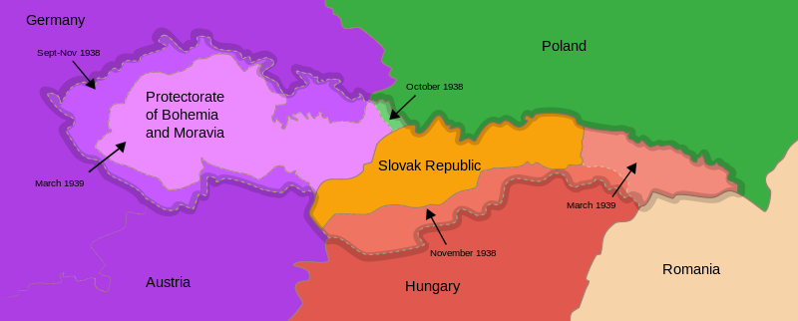
Dissolution of czechoslovakia in 1938
Czechoslovakia lost 1/3 of its area, 1/3 of light industry
in southern Slovakia fertile soil important for agriculture was lost
the First Czechoslovak republic was dissoluted
so called Second Czecho-Slovak Republic was proclaimed - till March 1939 – President Emil Hácha
no parliamentary democracy anymore
7th October – autonomy of Slovakia was proclaimed – Czecho–Slovakia

Slide 28
Protectorate bohemia and moravia, slovak state
13th March 1939 – Slovak Prime Minister Jozef Tiso was invited into Berlin – he was made to enforce the separation of Slovakia
14th March 1939 – Slovak State was separated from Czecho-Slovakia, formally was independent but really the satelite of Nazi Germany
14th March 1939 – President Hácha and Foreign Minister Chvalkovský were invited to Berlin – Hitler threatened with bombing of Prague – they were forced to sign the document asking Germany for protection what was in fact forced capitulations
15th March 1939 – German army occupied Bohemia and Moravia – dissolution of Second Czechoslovak Republic
16th March 1939 – the occupants proclaimed Protectorate of Bohemia and Moravia
it was part of German Reich, formaly autonomous state with so called State President Emil Hácha and Prime Minister Rudolf Beran
but the real power was in hands of Reichsprotektor Konstantin von Neurath and later Reinhard Heydrich
Czech administrations and economy entirely subjected to the German war machine
Many Czech political and cultural leaders were imprisoned or executed

Slide 29
Jews were dismissed from the civil service and placed in an extralegal position
Special concentrations camps for Jews and Romas - Terezín
the Czechs launched secret resistance movement to Nazi occupation
Czechoslovak Government in exile in London (President in exile Edvard Beneš, Prime Minister – Jan Šrámek)
mass demonstrations in October 28, 1939 – an anniversary of establishing of Czechoslovakia – one student Vojtěch Sedláček was shot to death and the second one – Jan Opletal was seriously injured and died later, his funeral on 15th November became a new mass manifestation against nazism
the Nazis started an intervention against students on 17th November 1939 – 9 students were executed, 1200 of them deported into concentration camp in Sachsenhausen
all the Universities in Protectorate were closed (→ November 17 is International Students’ Day)
Terror, omnipresent Gestapo
1942 – Reichsprotector Reinhard Heydrich was mortaly wounded by two members of Czechoslovak Army Abroad who had been trained in Great Britain and then were parachuted into Bohemia
In retaliation the Nazis executed thousands of Czech patriots and razed the town of Lidice to the ground, destroying its entire male pouplation, women were deported into the concentration camps and childern to „re-education“ to German Nazi families
Ausgust 1944 – an armed uprising against Nazis erupted in central Slovakia – supressed

Slide 30
czechoslovakia
Readings:
TUMA, Oldrich – JINDRA, Jiri (eds.): Czechoslovakia and Romania in the Versailles System. Prague 2006.
LUKES, Igor: Czechoslovakia Between Stalin and Hitler: The Diplomacy of Edvard Beneš in the 1930s. New York1996.
LUKES, Igor – GOLSTEIN, Erich (eds.): The Munich Crisis, 1938: Prelude to WWII. London 1999.
Voráček, Emil and others: The Disintegration of Czechoslovakia in the end of 1930s. Policy in Central Europe. Prague 2009.
http://www.holocaustresearchproject.org/toc.html
http://www.radio.cz/en/static/october28/
A movie: Paradisecamp (1986) – a documentary about Terezin concentration camp - written and directed by the Australians Paul Rean and Frank Heimans

