Slide 1
Central europe and the czech lands in the middle ages
Jana Skerlova, Ph.D.
Institute of History
Czech Academy of Sciences

Slide 2
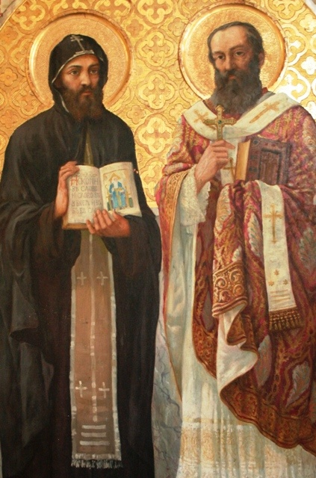
The Great Moravia in the 9th century
5th and 6th century – the Slavic tribes came to this area and settled on the left bank of Danube River and along the Morava River
the very first Slavic state in the 9th century – situated mostly around the Morava River – The Great Moravia
cultural development resulted from the mission of Saints Cyril (Constantine) and Methodius – 863
The missioners were invited by Prince Rastislav
translation of the Bible into the slavic language, preaching in slavic language → the Christianity widespread faster
They created the new Slavonic script (Glagolitsa)
885 – Methodius died → their disciples were expeled from G.M. – went to Bulgaria, Croatia, Macedonia etc., invented cyrilic script

Slide 3
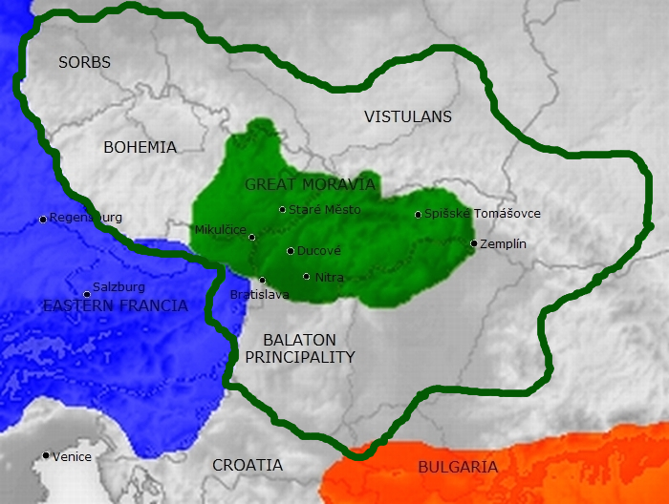
The Great Moravia in the 9th century
http://www.filmcyrilametodej.cz/en/about-film/
The movie (document) about Cyril and Methodius

Slide 4
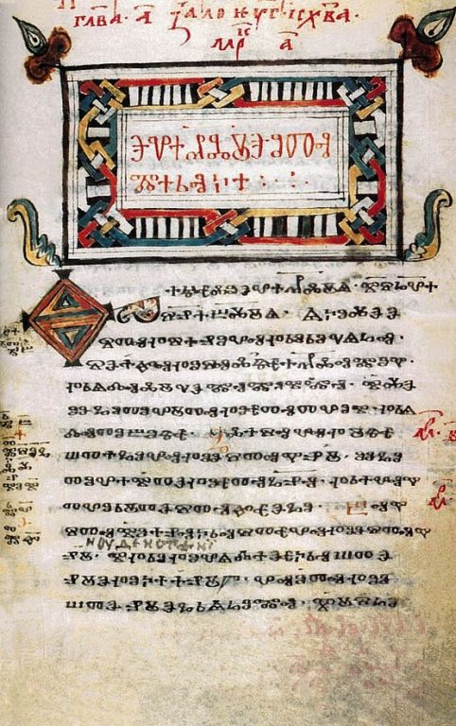
Glagolitsa
the Slavonic script composed by
St. Constantine the Philosopher.
Glagolitsa was an original graphic system consisting of 38 signs and it expressed the whole distinctiveness of the Old Slavic language.
Phonologically it exceeded the Greek and Latin languages.

Slide 5
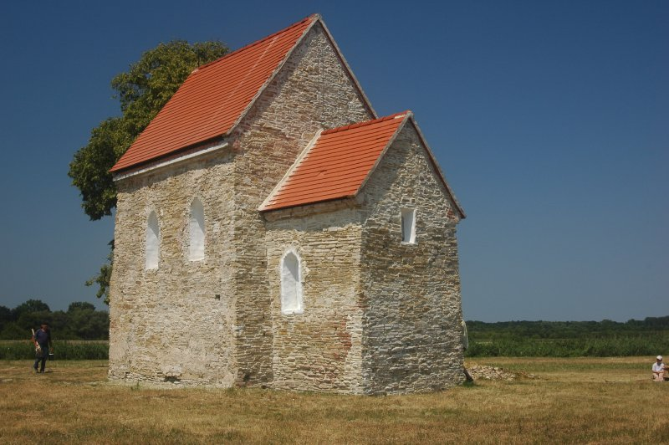
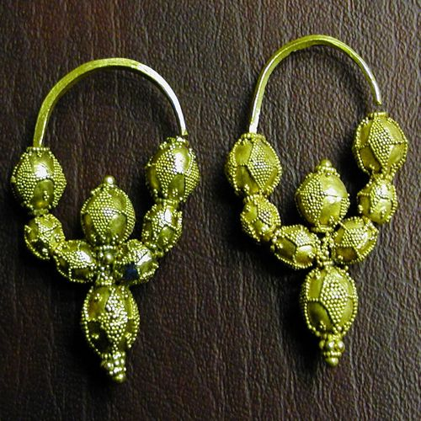
The Church of St. Margareth in Kopčany, Slovakia, is the only remaining Great Moravian building.
Great Moravian jewelery – the golden earrings from 9th century, found in Valy u Mikulčic, South Moravia

Slide 6
Places to visit
Moravian Museum – Zelný trh 8, Brno
http://www.mzm.cz/en/great-moravia/
Great Moravia – this exhibition introduces you to the plentiful treasures documenting the remarkable phenomenon of Great Moravia, the very first Slavonic state. Coming here you shall be astonished by the incredible beauty of Moravian jewellery, pottery, technological skills and handicraft of Moravian craftsmen.
Slavic fortified settlement in Mikulčice, The National Cultural Relic, Mikulčice – Valy, South Moravia
http://www.masaryk.info/english/#mikulcice
The place of historical importance, set in a beautiful countryside, remarkable as a historical site of Great Moravia (8-10th century AD). Two archeological exhibitions with priceless excavations. The original seat of Great Moravia kings and a place of cultural and religious mission of St. Cyril and Methodius.
Modrá u Velehradu – Archeoskanzen
Archeoskanzen Modrá - Fortified settlement in the Central Moravia is located near Uherske Hradiste. It is an important subject showing one of the most important periods of our national history. Skanzen live everyday life, with educational performances, programs, experimental melting of metals, manufacture of ceramics, agricultural production and the constantly carried out archaeological research.

Slide 7
Western europe in 9th and 10th century – frankish empire
Charlemagne (Charles the Great)
764 King of the Franks, 774 King of Italy
800 – crowned by the Pope – Emperor of the Romans - the ceremony formally acknowledged the Frankish Empire as the successor of the (Western) Roman one
after 840 – the empire split into three parts:
West Frankish Kingdom – Charles the Bald – the foundation for the later France under the House of Kapet
Middle Frankia – Lothar I (Lotharingia, Burgundy, nothern Italy – Lombardy)
East Frankish Kingdom – Louis (Ludwig) the German → the area of modern Austria, Switzerland and Germany, later the Holy Roman Empire

Slide 8
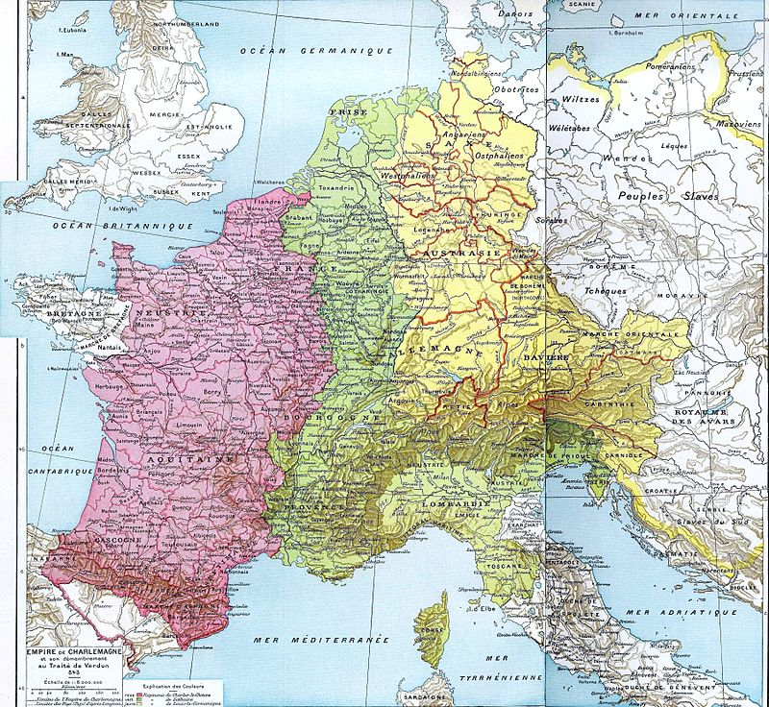
Division of the Frankish
Empire
West Frankia
– pink
Middle Frankia
– green
East Frankia – yellow

Slide 9
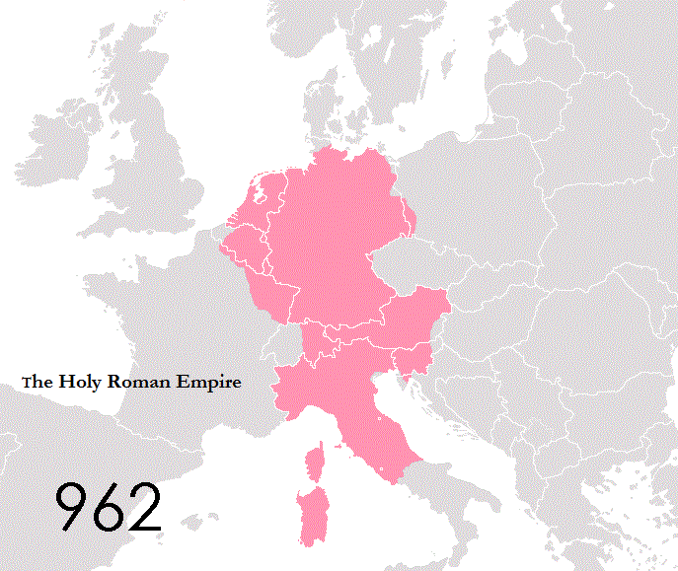
The roman empire in 10th century

Slide 10
The holy roman empire
The Holy Roman Empire – an empire existing in Europe since 962 till 1806
ruled by Roman Emperor
Included present–day territories of Germany, Austria, the Czech Republic, Switzerland and Liechenstein, the Netherlands, Belgium, Luxembourg, Slovenia, parts of eastern France, nothern Italy and western Poland
Otto I the Geat (936–973)
962 crowned the Emperor
955 – defeated the Magyars and ended their invasion to Western Europe – reputation of a savior of Christedom
centralized his control over Germany, also through the investiture of bishops and abbots, making the clergy-class his personal vassals
Cultural development - Ottonian Renaissance
Fridrich I. Barbarossa (1152–1190)
dynasty of Hohenstaufen, 1155 – crowned Emperor
1190 – died during the Third Crusade

Slide 11
Central europe in 10th and 11 th century
Beginning of 10th century – The Great Moravia was destroyed because of internal political struggles and the raids of Hungarian tribes
The territory inhabited by Slovaks became a part of newly created Kingdom of Hungary – the House of Arpád
1000 –Stephen I of Hungary (1000–1038) was crowned a king, christianization – saint patron of Hungary
Ladislaus I of Hungary (107–1095) – expansion – 1091 – King of Croatia
Poland – the Piast dynasty – Duke Mieszko (960–992) – 966 – conversion to christianity → 1000 – Poland recognized by Pope and by the Holy Roman Empire as a state
1025 – Duke Boleslaus I the Brave was crowned a King – strong ruler – expansion – 1002–1003 – Duke of Bohemia (his mother was Přemyslid princess Doubravka)
After his death – the decline of Polish empire – renewed and unified by the King Ladislaus I the Elbow-High (1320–1333)

Slide 12
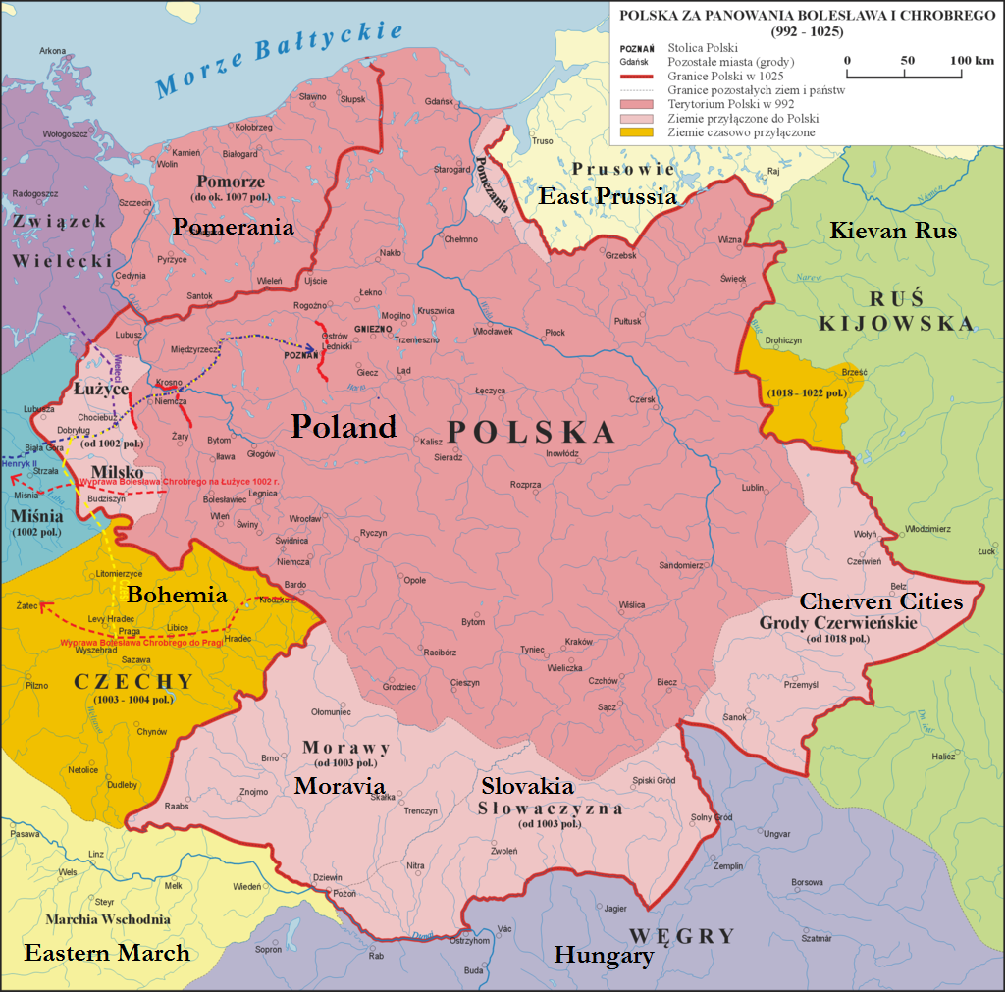
Poland during the reign of Boleslaus the Brave

Slide 13
Bohemia from 9th century till 1306
the centre of the Bohemian state moved to Bohemia – The Duchy of Bohemia was established, dependent on Roman (German) Empire
Prague became the capital city
The Přemyslid dynasty – the mythic founder of the dynasty – Přemysl the Ploughman
883 – Duke Bořivoj and his wife Ludmila were baptised by Methodius – the bishop of Great Moravia
10th century – duke Wenceslaus – vasal of the German Empire
Wenceslaus was assassinated by his brother → Saint Wenceslaus – the saint patron of the Czech lands
973 – the Prague Bishopric was established (2nd bishop Adalbert – St. Vojtech - apostolic mission to Poland)
Přemyslids eliminated other strong noble families who were competing with them (massarcing of two noble clans in 10/11th century )
Duchy of Bohemia was a part of Holy Roman Empire

Slide 14
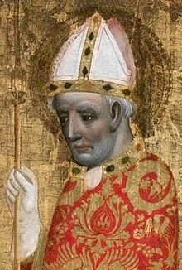
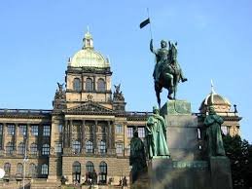
St. Wenceslaus Monument – Wenceslaus Square in Prague
St. Vojtěch (Adalbert) – the Bishop of Prague

Slide 15
The Kingdom of bohemia
strong and large - emancipation from the German Empire
Bohemian kings were members of College of Electors of the German Empire
Ottokar I (1198–1230)
1212 – Golden Bull of Sicily – a decree issued by the Holy Roman Emperor Frederik II in basel that confirmed the royal hereditary title for Ottokar
Wenceslaus I (1230–1253)
Ottokar II (1253–1278, Přemysl Otakar II) – The Iron and Golden King , the rise of the power of Bohemia
very rich and powerful – his kingdom from the Krkonoše mountains to the Adriatic sea
1255 - a crusade to Prussia – founded the city of Königsberg (Kaliningrad today)
1278 – died in a war with his rival, the Roman king Rudolph Habsburg
Wenceslaus II of Bohemia (1278–1305) – King of Bohemia, King of Poland
Wenceslaus III (1305–1306) – King of Bohemia, Poland and Hungary, assassinated without heirs – the Premyslid dynasty died out in the male tail
after four years of struggles for the throne – the new dynasty came to Bohemia and the Polish throne returned to the dynasty of Piasts

Slide 16
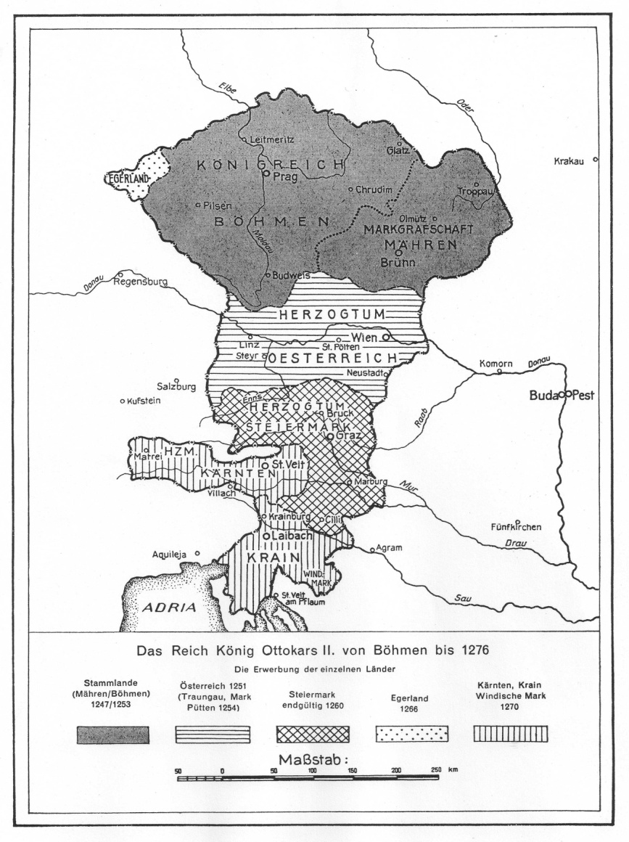
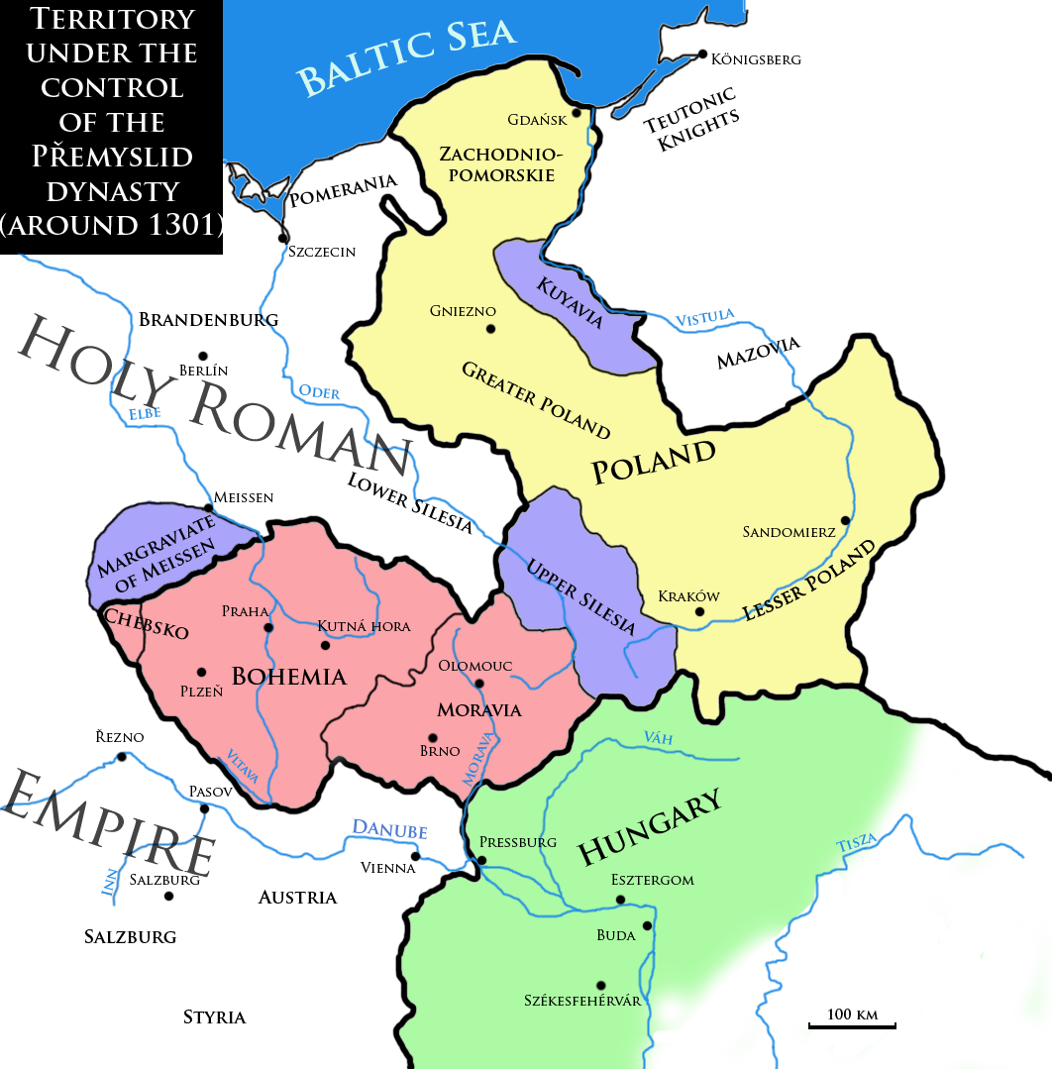
the House of Přemyslids
The kingdom of Ottokar II
around 1270
The kingdom of Wenceslaus II around 1301

Slide 17
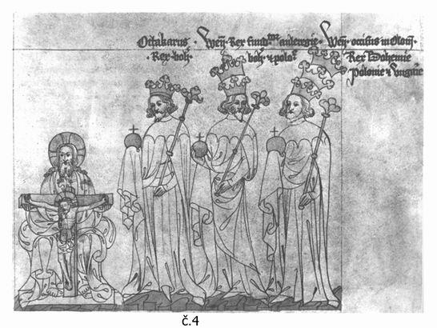
The Bohemian Kings – Otokar II, Wenceslaus II, Wenceslaus III
Chronicle of Zbraslav

Slide 18
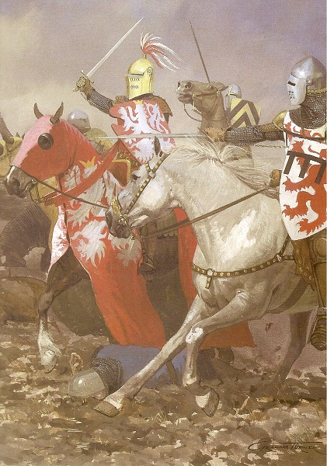
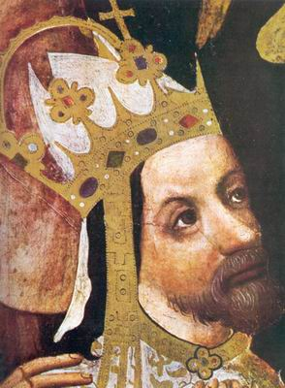
the House of Luxembourgs
John of Luxembourg at the battle of Crecy
Charles IV

Slide 19
the House of Luxembourgs (1310–1437)
John of Bohemia (1310–1346, John the Blind)
married Wenceslaus’s sister Elizabeth (Eliška) → a new dynasty on the Bohemian throne – the House of Luxembourgs
Succesfull European diplomat and warrior, but in Bohemia was unpopular – needed lots of money for his campains, was very often abroad so the country was without a ruler → the power of nobility strenghten
He is well known for having died while fighting in the Battle of Crécy (1346 – during the Hundred Years War between England and France) at age 50, after having been blind for a decade
Charles IV (lived 1316–1378)
Born Wenceslaus – name Charles after French King who was his godfather
the king of Bohemia (1346–1378) and Holy Roman Empire King (1346–1355), Holy Roman Emperor (1355–1378)
had 4 wives and many children but was waiting for male descendant for very long so his oldest son Wencelaus (1361–1419) was very spoiled and was very bad ruler

Slide 20
Charles IV
the most important and the best known Bohemian king – till nowadays regarded as Pater Patriae (Father of the Country), his reign is considered as the golden age of Bohemia
Prague became the capital of the Holy Roman Empire, most important city in the Central Europe
Charles IV rebuilt the city on the model of Paris, in Gothic style
established the New Town of Prague (Nové Město), Charles Bridge, Charles Square, St. Vitus Cathedral, rebuilt the Prague Castle …
1346 – the elevation of the Prague bishopric to an archbishopric
1348 – he founded the University of Prague, later named after him, the very first university in Central Europe – important for development of education, science and culture in the CE
Prague became intellectual centre of the CE
The Karlstejn Castle – a place for safekeeping the Imperial Regalia and Bohemian Crown Jewels

Slide 21
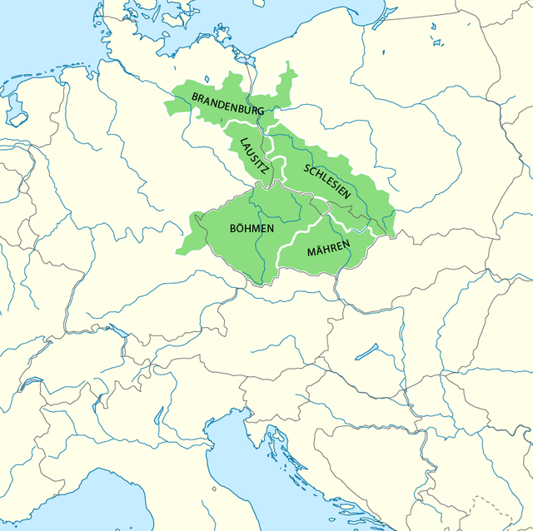
Kingdom of Bohemia during the reign of Charles IV

Slide 22
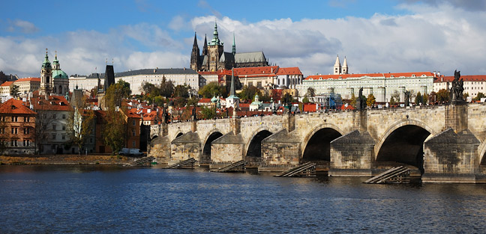
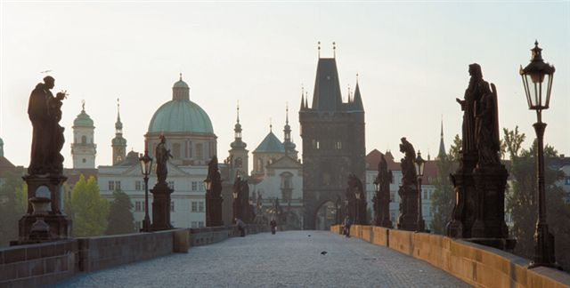

Slide 23
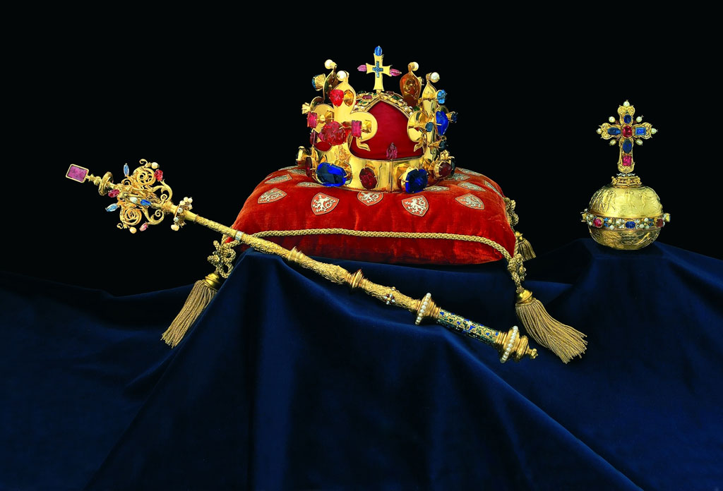
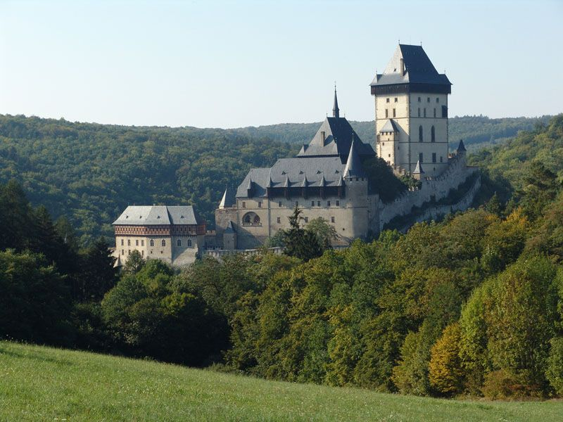
Bohemian Crown Jewels with the so called Crown of St. Wenceslaus
The Karlstejn Castle (near Prague)

Slide 24
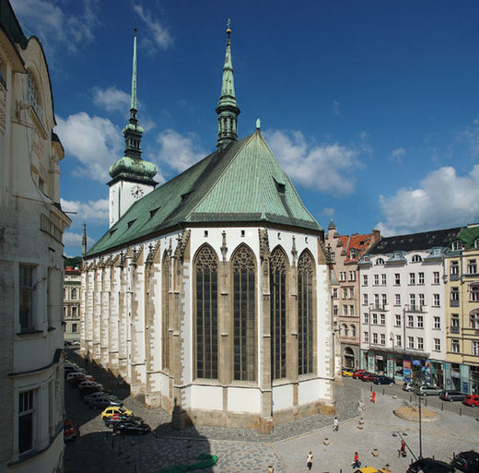
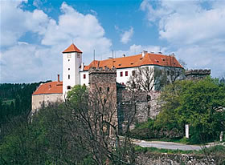
Gothic architecture
Bitov Castle (Southern Moravia)
St. Jakob’s Church (Brno)

Slide 25
The holy roman empire during 14th and 15th century
1273 – Rudolf the Habsburg elected the king of the Roman Empire – unimportant dynasty from Austria, elected because the dukes didn’t want powerful Bohemian king Otakar II on the Roman throne
14th century – the house of Luxembourgs – Henry VII (1308–1311), after his unexpected death the struggle for the throne began – Louis IV of Wittlesbach (1314–1346) from Bavaria won
Charles IV (1346–1378) of Luxembourg
1346 – Holy Roman King, 1355 – crowned the Holy Roman Emperor
1356 - The Golden Bull – the basic law of the Holy Roman Empire, for a period of more than four hundred years fixed important aspects of the constitutional structure of the Holy Roman Empire
Wenceslaus IV (1378–1419) – a son of Charles IV, King of HRE (1378–1411) – weak ruler
Sigismund of Luxembourg (1410–1437) – Wenceslaus’ brother,
1378 – King of Hungary and Croatia (married Mary of Hungary), 1411 – King of HRE, 1419 – King of Bohemia, 1431 - King of Italy, 1433 – Holy Roman Emperor

Slide 26
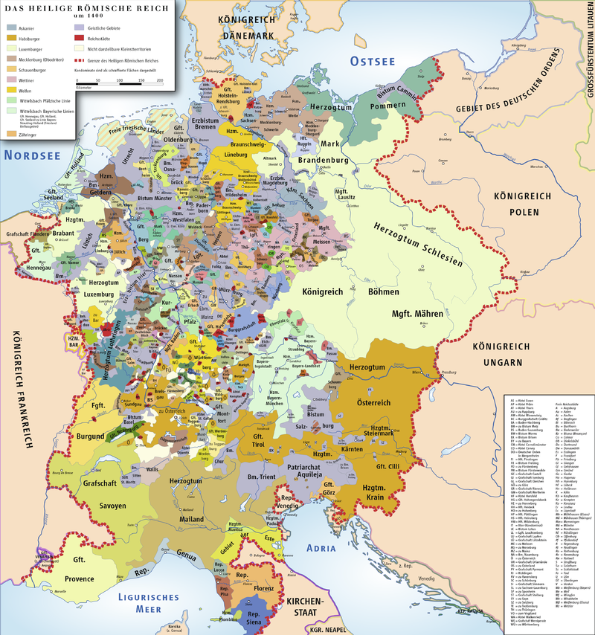
The Holy Roman Empire around 1400

Slide 27
The church in 14th and 15th century
The crisis of Papacy
14th century - Great Papal Schism – two Popes – in Rome (Italy) and in Avignon (France)
1409 – the council of Pisa elected a new pope → three popes
1410 – indulgences were authorized by one of the Popes (John XXIII) who wanted to get money for the crusade against his rival Pope Gregory XII and his protector king Ladislaus of Naples
1414 – the Council of Constance (Germany) was called – the main purpose was to finish the papal schism
1417 – a new pope – Martin V was elected (1417–1437) – he was recognized by the entire Europe - the schism was ended

Slide 28
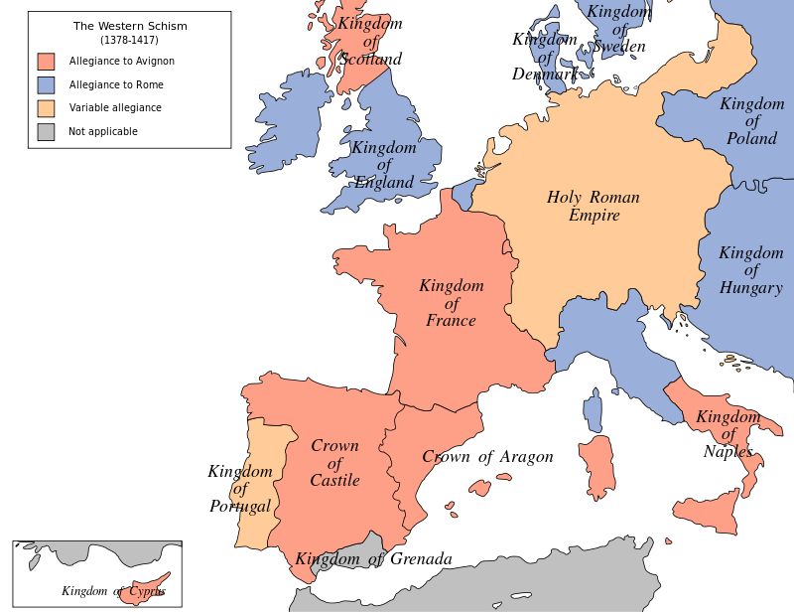
The schism caused aslo diplomatic crisis in Europe – each secular ruler had to choose which Pope he would recognize:

Slide 29
The Hussite Revolution (1419 - 1436)
Master Jan Hus – became one of the forerunners of the Protestant Reformation , was inspired and influenced by British thinker John Wyclif (†1384)
Scholar, clergyman, preacher at the Betlehem Chapel in Prague and Professor of Prague University, 1402 – Rector of Prague University
wanted to reform certain practices of the Roman Catholic Church
he was protesting against clerical abuses, especially the sale of indulgences (paying for forgivness of the sins during the confession)
declared that the clergy should live according to the Bible, in poverty, without property and without a secular power
the mortal sins should be prohibited and punished
proclaimed that the believers should understand the Holy Writ so it should be proclaimed in the national languages, not in latine
1410 – Hus was excomunicated from the church by Pope Alexander V

Slide 30
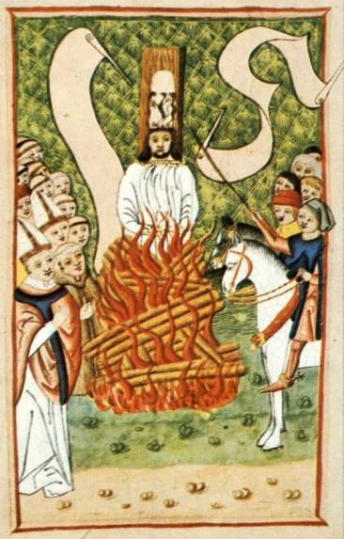
Master Jan Hus
Hus was invited to the Council of Constance to defend himself and explain his theories
The King of Holy Roman Empire Sigismund guaranteed to Hus a safe passage through the HRE but he didn’t have any jurisdiction at the Council of Constance → Hus was imprisoned in Constance for 8 months
Master Jan Hus was condemned by the Council at Constance as a heretic and was sentenced to death.
6th July1415 – he was burnt to death at the stake.
Jan Hus at the stake.
Codex of Jena.
Recommended:
John Hus and the Papal Schism: https://www.youtube.com/watch?v=aF1sqe7Bmto

Slide 31
The Hussites
the Bohemian people blamed Emperor Sigismund for Hus’ death so they did not want him to become the king of Bohemia after Wenceslaus’ death in 1419
Hus’ followers launched powerful religious movement, they called themselves the Hussites; ( or the Men of the Chalice - the symbol of Hussites movement)
Their Programe:
Freedom to preach the Word of God
Celebration of the Lord's Supper in both kinds (bread and wine to priests and laity alike
No secular power for the clergy.
Punishment for the mortal sins.
1420 - after his corronation in 1420 the Hussite uprising in Bohemia → the so called Hussite wars started
Catholics against Hussites
Sigismund organized five crusade campains against Hussites but all the campains were unsuccesfull (due to the outstanding military leader of Hussites – Jan Žižka who became a hero in the Czech tradition)

Slide 32
almost 15 years of religious struggles and civil wars – the country was destroyed and plundered
the ecomonical consequences of the wars – starvation, stagnation of the trade, destroyed buildings (esp. churches and monasteries)
After many years of wars the Hussite movement split into two fractions: the moderate and the radical
the moderate Hussites wanted to finish the warfare so they united with Catholics and destroyed the radical Hussites at the battle of Lipany in May 1434
after that both the confessions – the Catholic and the Hussite became legal in Bohemia and two churches were established
1436 – Sigismund was accepted as the King of Bohemia, but he died in 1437
Sigismund had to fight not only against the Hussites but also against the Osman Turks who spread into Europe from Asia Minor at the end of the 14th century – firstly they attacked the Balkan Peninsula and later – in 15th century – they started to threaten Hungary

Slide 33
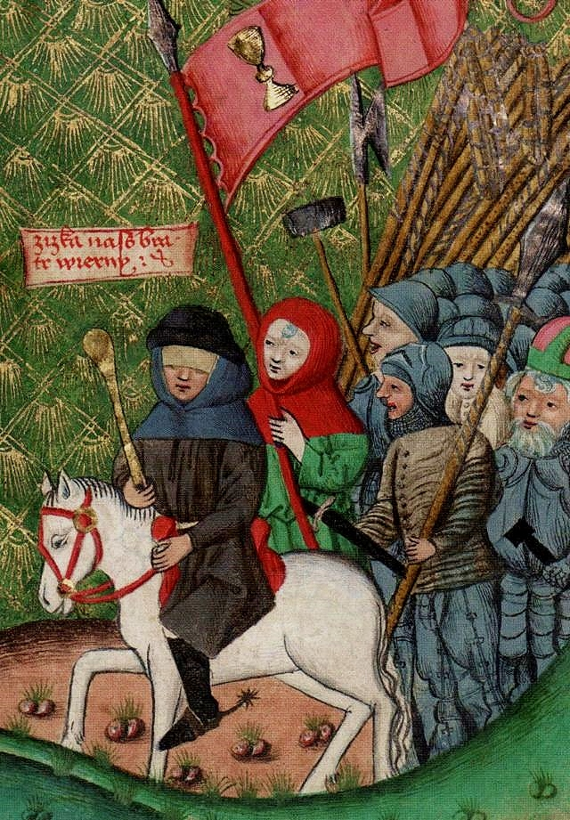
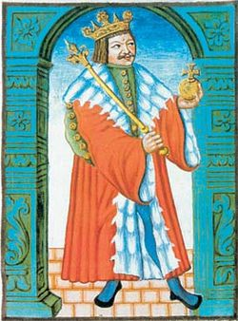
Jan Žižka of Trocnov leading the Hussite army.
The Codex of Jena
King George of Poděbrady

Slide 34
The Hussites
After two weak kings from the house of Habsburgs a Bohemian nobleman and the leader of the Hussites George of Kunštát and Poděbrady (1458–1471) was elected a king
he suggested something what could be considered as a proposal of latter European Union
he tried to prevent isolation of hussite Bohemia in catholic Europe, so he proposed a treaty among all Christian powers, the member states should pledge to settle all differences by exclusively peaceful means and fight altogether against Otoman Turks who were threatening Central Europe
1464 the new Pope Paul II asked George to leave hussite church and join the Catholic Church, but George refused → the Pope proclaimed George a heretic and excomunicated him
He had also enemies among Bohemian catholic noblemen – they allied with Matthias Corvinus of Hungary (1458–1490)
Matthias conquered a large part of Moravia, and in 1469 was crowned King of Bohemia by the papal party in the Moravian ecclesiastical metropolis Olomouc
1470 – an agreement – Mathias was rulling over Moravia and George over Bohemia

Slide 35
The house of Jaggiellonians
After George’s death a new dynasty from Poland (originally from Lithuania) came to the Kingdom of Bohemia – Jaggiellonians
Vladislaus II (1471–1516)
A conflict between Bohemian and Hungarian King succeded – 1471 – the Peace of Olomouc, which allowed both Vladislaus and Matthias Corvinus to use the title "King of Bohemia„
Vladislaus would reign in Bohemia, while Matthias gained Moravia, Silesia, and the two Lusatias
1491 – Mathias died → a personal union between Bohemia, Poland and Hungary – Vladislaus moved his capital to Buda (Hungary)
Vladislaus was weak ruler and didn’ like conflicts
1500 – Czech Council adopted a new municipal constitution that limited royal power and Vladislaus signed it in 1502 (hence it is known as Vladislav municipal constitution)
1515 – his daughter Anna married the future HRE Emperor Ferdinand of Austria from the House of Habsburgs

Slide 36
The house of Jaggiellonians
during their reign Hungary was under consistent border pressure from the Ottoman Empire
Louis (Ludwig) II (1516–1926)
only 10 years old when his Father died
1526 – died at the battle of Mohács - his troops were defeated by the Ottoman Turks – Sultan Suleyman the Magnificent
The Ottoman victory led to the partition of Hungary for several centuries between the Ottoman Empire, the Habsburg Monarchy, and the Principality of Transylvania
because Louis II died without having any children, his succesor became his sister’s husband Ferdinad of Austria

Slide 37
Kingdom of bohemia during the middle ages. a map.
https://www.youtube.com/watch?v=-SK7YmwuVak

Slide 38
Readings
Sedlar, Jean (1994): W. East Central Europe in the Middle Ages, 1000-1500. Seattle: University of Washington Press.
Kalhous, David (2012). Anatomy of a duchy: the political and ecclesiastical structures of early Přemyslid Bohemia. Leiden: Brill.
Doležalová, Eva – Pánek, Jaroslav (2011): Confession and nation in the era of reformations: Central Europe in comparative Perspective). Prague: Academy of Sciences of the Czech Republic.
Kejř, Jiří (1964). The universal peace organization of king George of Bohemia a fifteenth century plan for world peace 1462/1464 ; Václav Vaněček ; edition of the document Jiří Kejř ; english translation Ivo Dvořák. Prague: Czechoslovak Academy of Sciences.
Odložilík, Otakar (1965). The Hussite king: Bohemia in European affairs 1440-1471. New Brunswick: Rutgers University Press.
http://husitstvi.cz/en/

