Slide 1
Central Europe during and after the Napoleonic Wars.
The Rise of National Movements. revolutions 1848/49.
Jana Skerlova, Ph.D.

Slide 2
Central Europe during the Napoleonic Wars
1789 – the French Revolution broke out
1792–1815 – anti-French wars
1792–1802 – the wars against the French Revolution
Several coaliations against France (Austria + Prussia + Great Britain + Russia + several smaller German states against France), several military campaigns
1803–1805 – Napoleon’s Invasion of Great Britain - unsuccesfull
1804 – Napoleon Bonaparte crowned the Emperor of France
March 1805 – Napoleon proclaimed King of Italy
Than he marched via Bavaria towards Austria
The French army occupied Vienna – it was was a big shock for the Austrians

Slide 3
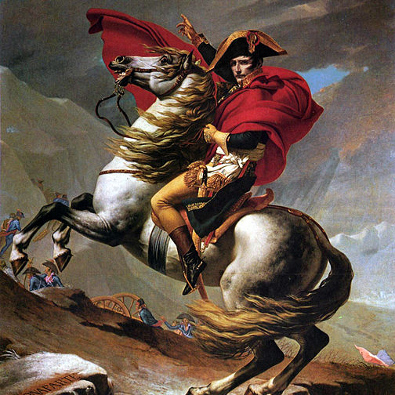
Napoleon by Jacqoues-Louis David

Slide 4
Napoleon continued to South Moravia where the Russian troops supporting the Austrians were situated
Napoleon occupied Brno
December 2, 1805 – the Battle of Three Emperors near the Moravian town of Slavkov (Austerlitz) – a great victory of Napoleon – he defeated Austrian Emperor Francis I and Russian Tzar Alexandr
Napoleon had 73 000 men, austro-russian coalition had 85 000 men
Peace Treaty of Pressburg between Napoleon and Francis II of Austria (Austrian withdrawal from the Third Coalition)
Austria had lost terriotories in Italy, Istria and Dalmacia (Iliric Kingdom was formed) and some German terriories – ceded to Napoleon’s allies (Bavaria)
The effective end of the Holy Roman Empire
1806 – Austrian Empire – Francis I
Rhineland Confederation was formed in German territory
http://www.ceskatelevize.cz/ivysilani/10099029347/
http://www.austerlitz.org/
http://www.youtube.com/watch?v=mdd1a90CFio
http://www.zamek-slavkov.cz/en/

Slide 5
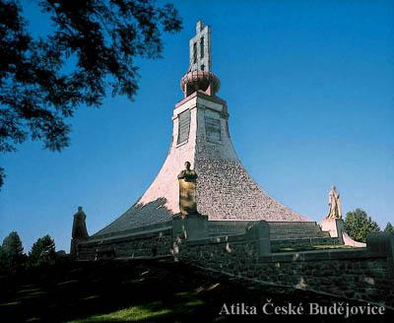
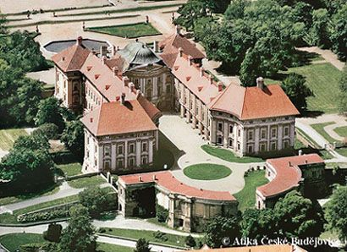
Austerlitz
Cairn of Peace
Chateau Austerlitz

Slide 6
Central Europe during the Napoleonic Wars
Napoleonic wars has brought many changes into the CE
October 14, 1806 – Napoleon defeated Prussia at the battle of Jena and Auerstad
1806 – Berlin was occupied by Napoleon
Napoleon invaded Polish territory – wars with Russians
1807 – the Treaty of Tilsit with Russians –
The Grand Duchy of Warsaw was established in Poland (Duke – Napoleon’s ally – the King of Saxony) – big impact – legal code, abolition of serfdom, modernization
1809 – Austro-British Coalition against France – uncuccesfull
1809 – Napoleon entered Vienna again
1809 – Napoleon married Austrian Archduchess Marie Luisa - with the aim of ensuring a more stable alliance with Austria and of providing the Emperor with an heir
1812 – Napoleon controlled: the French Empire, the Swiss Confederation, the Confederation of the Rhine, the Duchy of Warsaw and the Kingdom of Italy

Slide 7
Territories allied with the French included: Kingdom of Spain (Joseph Bonaparte – N. brother), Kingdom of Westphalia (Jerome Bonaparte – N. brother, Kingdom of Naples (Joachim Murat – N.sister’s Caroline husband), Principality of Lucca (N.sister Elisa and her husband)
1812 – Napoleon launched an invasion of Russia – 650,000 men, but unsuccesful – Russians – the Patriotic War, Scorched Earth tactics, severe winter
September 7, 1812 – Battle of Borodino
Napoleon entered Moscow – mas burnt by Russians before that
November 1812 – Napoleon crossed the Berezina River, but his army weak (380,000 men dead or missing, 100,000 captured during the campain)
Napoleon had left his army and escaped to Paris
1813 – the Battle of Leipzig – the Battle of the Nations – Austria, Prussia, Russia, Sweden against France – Napoleon defeated and forced to abdicate
1814–1815 – the Peace Congres in Vienna
interrupted by Napoleon – June 1815 – the Battle of Waterloo – Napoleon finaly defeated
The Napoleonic wars changed the map of Central Europe

Slide 8
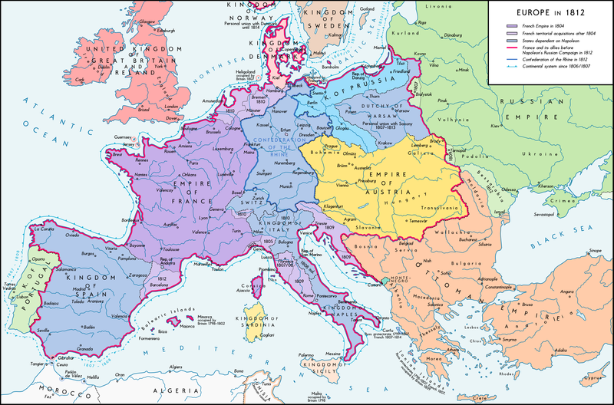
Europe in 1812

Slide 9
Central Europe during the Napoleonic Wars
Readings:
Lefebvre, Georges (1971). The French Revolution: From Its Origins to 1793. Columbia University Press.
Furet, Francois (1995). Revolutionary France, 1770–1880. Blackwell Publishing.
Englund, Steven (2004): Napoleon: A political Life.

Slide 10
Habsburg Monarchy
Francis II (1792 – 1836), since 1804 ruled as the Austrian Emperor Francis I
the era of absolutism
the first minister – Prince Klemens Wenzel von Metternich – convinced conservative monarchist – The Metternich absolutism
1811 – General Civil Code (ABGB)– compromis between old and new ideologies
1811 – devastating collpase of the state finances in February (paper currency was devalued to one fifth of its original value)

Slide 11
What is absolutism?
a political system and theory of government
the King (or Queen) is all-powerful and possesses a monopoly on the use of force and the administration of justice
the ultimate authority to run a state was in the hands of a king who ruled by divine right (i. e. a King/ Queen was given his/her position by some higher power – by God)
The prerequisites for absolutism:
1. The King (or Queen) has an orderly and efficient bureaucracy where all power and directives flow downward from the monarch.
2. The King (or Queen) has a large standing army with which to enforce his (or her) will.
3. The power of any other groups or traditional institutions is suppressed, especially the power of the nobility as a class.
4. Absolute government is costly and usually requires heavy taxation for support.
5. Absolute government depends heavily for its success on strong personality traits in the King (or Queen) as a personal symbol of the state/country.

Slide 12
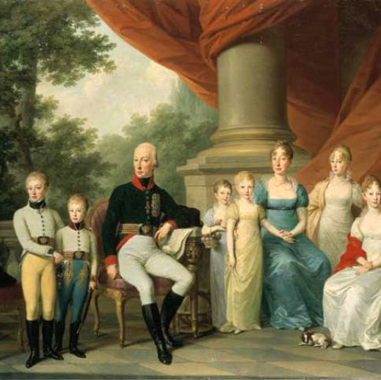
Emperor Francis and his Family, a portrait by Jozef Kreutzinger

Slide 13
Europe After the Congress of Vienna
Congress of Vienna
a conference of ambassadors of European states chaired by Klemens Wenzel von Metternich, and held in Vienna from September, 1814 to June, 1815
the aim – finishing the wars with France and restauration of old principles – the situation before the revolution (no revolutions, no republicanism, lesser civil rights etc.)
4 Great Powers: Russia (Tzar Alexandr I, Foreign Minister Count Carl Robert Nesselrode), Prussia (King Frederick William III, Chancellor Karl August von Hardenberg) , Austria (Emperor Francis I., the Foreign Minister Prince Metternich) and Great Britain (Foreign Secretary Viscount Castelreagh, later Duke of Wellington)
surprisingly important role of defeated France – thanks to Ministre of Foreign Affairs Maurice de Talleyrand – a very good diplomat

Slide 14
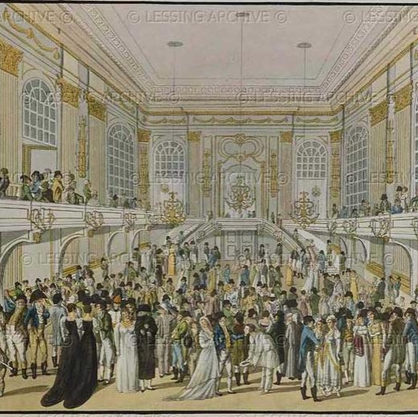
The Congress of Vienna was not only a political congress but also a festive event with concerts, dances, hunting and coursing etc . Due to that it is sometimes called „A Dancing Congress“.

Slide 15
The Final Act – June 1815:
Russia was given most of the Duchy of Warsaw (so called Congress Poland was formed) and was allowed to keep Finland (annexed from Sweden in 1809)
Prussia was given two fifths of Saxony, parts of the Duchy of Warsaw, Danzig, and the Rhineland/Westphalia.
A German Confederation of 38 states was created from the previous 360 of the Holy Roman Empire, under the presidency of the Austrian Emperor
the United Kingdom of the Netherlands was established
The neutrality of Switzerland was guaranteed.
The Bourbon Ferdinand IV, King of Sicily was restored to control of the Kingdom of Naples
The slave trade was condemned

Slide 16
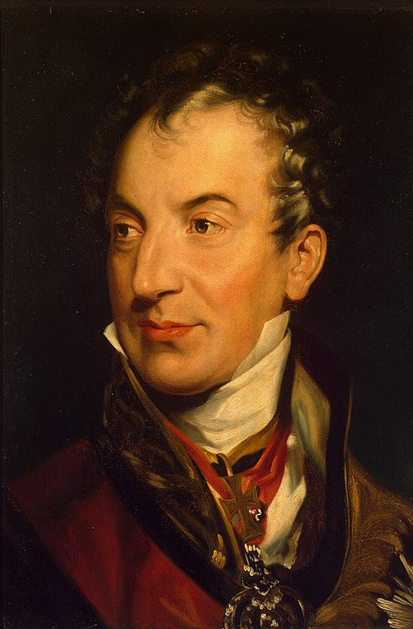
Clement Wenceslas Nepomuk Lothar von Metternich-Winneburg-Beilstein (1773 – 1859)

Slide 17
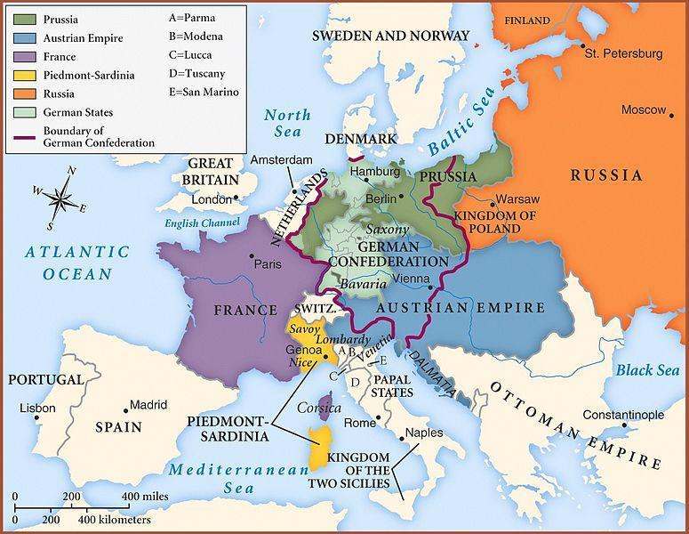
Europe after congress of vienna

Slide 18
The most important results:
so called The Concert of Europe, also known as the Congress System or Vienna System – it was the network of treaties, institutions and practices that should ensure the balance of power that existed in Europe from the end of the Napoleonic Wars (1815) to the outbreak of World War I (1914)
1815 – the Quadruplle Aliance was established – the winners over Napoleon (United Kingdom, Austria, Prussia, Russia)
1815 – the Holy Alliance was signed by Russian Tzar, Austrian Emperor and Prussian King – the aim of this document was to implement the Christian values and principles into the political life, the moral principles were emphasized, the main goal was again the cooperation against revolutionary, liberal and democratic movements
later it was signed by almost all European rulers, except those from Skandinavia, Osman Sultan and the Pope, the Great Britain left the system of the Holy Alliance in 1822
1818 – the occupation of France was finished – France acceded the Quadrupple Alliance → the Quintupple Alliance was established
the meetings of the Great Powers during this period: Aachen (1818), Carlsbad (1819), Verona (1822), London (1832), Berlin (1878)

Slide 19
The Rise of National Movements
Rebirth of national spirits
The first wave of the national movements – 1820s:
German states
Italian states
The second wave of national movements in 1830s:
almost in the whole Europe
started in France (against extremly conservative king Charles X) , then spread to Belgium, to Italy and to other states

Slide 20
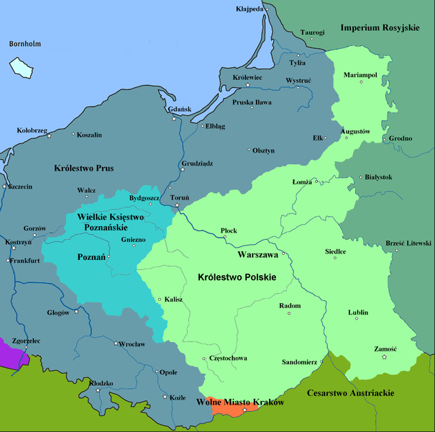
Poland – November Uprising 1830
after Napoleonic wars and the Congress of Vienna there were three states in Poland:
the semi-autonomous so-called Congress Poland controlled by Russia – it was united with Russia through a personal union
the semi-autonomous Grand Duchy of Poznań controlled by Prussia
the semi-autonomous Kingdom of Galicia and Sandomer controlled by Austria

Slide 21
the outbreak of the uprising – November 29, 1830 in Warsaw
On 25 January 1831, the Sejm passed the Act of Dethronization of Tsar Nicolas I and ended the personal union with Russia
on 29 January 1831 Prince Adam Czartoryzski became President of the new Polish National Government
the Russians formed very strong army and defeated Polish army at the Battle of Ostrolenka in May 1831
the Polish Uprising was supressed
cruel persecution succeded, the leaders of the uprising were sentenced to death so they emigrated
the cosequence of the vawe of national movements during the 1830s – the collapse of the Holy Alliance

Slide 22
The third wave of national movements in 1840s
general economic depression spread from England to the rest of Europe in mid-1840s
bad harvest, potato blight and drought in 1846 → famine
strong influence of industrial revolution on politics
bourgeouisie (owners of factories, businessmen) had money but only small political influence
bad living conditions of working classes
the revolution started in January 1848 in Italy (Sicily) – against the Bourbons
February 1848 – revolution in France – ended constitutional monarchy of Louis Phillipe of Orleans

Slide 23
German States
the March Revolution – southern and western parts
it was led by well educated students and intellectuals, but there were also many mass demonstrations
there were 39 states – demand of German national unity
wanted civil rights
two conceptions:
"greater German solution" (including German-speaking areas of Austria)
"smaller German solution"
March 1849 - the new German constitution was proclaimed
they decided to proclaim constitutional monarchy – the crown was offered to Prussian king Frederick William IV – refused to accept the crown from the hands of revolutionary parliament
the new constituion was refused by most of the German rulers
the revolution was unsuccesful

Slide 24
Habsburg Monarchy
Ferdinand I (1836–1848)
weak ruler, mentally challenged, the real ruler of the monarchy was the konservative Chief Minister Klemens Wenzel von Metternich
so called pre-March period - restricted freedom of the press, of the speech, of association
limited many university activities, strong censorship, police control
the empire, ruled from Vienna, included Austrian Germans, Hungarians, Slovenes, Poles, Czechs, Croats, Slovaks, Ukrainians, Romanians, Serbs and Italians,
all of them wanted to either achieve autonomy, independence, or even hegemony over other nationalities
Rebirth of the national spirits among the nationalities of the Habsburg Monarchy

Slide 25
1848 in habsburg monarchy
the first unrests in Prague in March 1848
the conception of austroslavism
June 1848 – the Pan-Slav Congress was held in Prague under the leadership of the historian František Palacký
Discussions whether the Slavs should support federated Austria or work to hasten its dissolution – but no decision
uprising in June – supressed by an Austrian army led by Alfred I, Prince of Windisch-Grätz
March 1848 – revolution in Vienna
Metternich was removed from the office and escaped from Vienna
in September 1848 – the Emperor´s decree – the serfdom was completely cancelled (citizens got civil rights but the suffrage was not general)
October – new uprising in Vienna - supressed
December 1848 – Ferdinad I resigned, lived in Prague till 1875

Slide 26
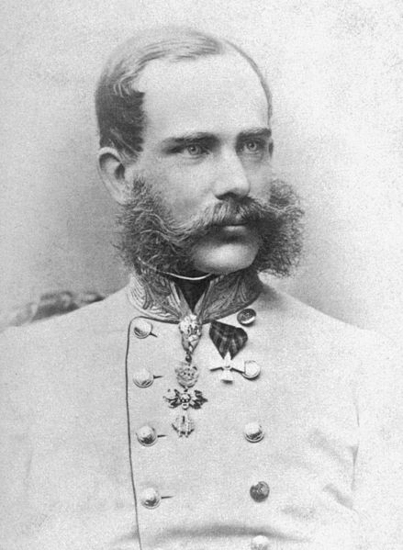
Franz Joseph I of Austria
(1848–1916)
absolutism again
Constituonal experiments and autocratic measures
so called Stadion´s constitution – was not accepted by an assembly

Slide 27
March 1848 – revolution also in Hungary
12 Demands – among others: authonomy, control over its foreign policy, budget and army, general taxes
Hungary was multinational (Slovaks, Croats, Rumanians, Ruthenians, Serbs, Germans etc.)
1848 – Demands of the Slovak Nation – first Slovak political programme demanding national and territorial authonomy within the framework of Hungary
their demands were refused (no politic nor national rights) so they (togenther with other non-Hungarian nations in Hungary) fought against Hungarians
April 1849 –independent Hungarian state was proclaimed
Franz Joseph asked Russian Tzar for a help against Hungarian revolt
13 August 1849 – the Battle of Villágos – Hungarians defeated
Repressions

Slide 28
Habsburg Monarchy in the second half of 19th century
after the defeat of revolution movement in Habsburg monarchy conservative absolutism again
the ruler – Emperor
1851 – the constitution was cancelled – neoabsolutism was introduced
the main personality – the Prime Minister Alexander Bach → Bach’s absolutism
police regime, centralism, control of public life, strict censorship
political rights cancelled
kept – eqality before the law, freedom of religion and cancellation of the serfdom
economic reforms

Slide 29
Foreign policy – unsuccesful
neutrality in Crimean War 1853–1856
Originally a conflict between Ottoman Empire and Russia – the dispute for protection of the rights of Christians in the Holy Land (controlled by Ottoman Empire)
Russia wanted to use the decline of the Ottoman Empire („sick man of Europe“) and take control over the straits Bosporus and Dardanells
November 1953 – Ottoman fleet destroyed by Russians at the Battle of Sinope
Great Britain nad France declared the war against Russia and supported the Ottoman Empire, later also the Kingdom of Sardinia
Austrian Emperor agreed the intervention but did not support it, declared neutrality
1854 – the Russians advanced to the Danubian Principalities Wallachia and Moldavia, after their withdrawl their place in these Principalities was taken by the Austrians
1856 – Paris Peace Treaty – neutrality of the Black Sea and the straits
After the end of the war Austria had to return The danubian Principalities to the Ottoman Empire, practically they became independent
International isolation of Habsburg Monarchy during and after the Crimean War

Slide 30
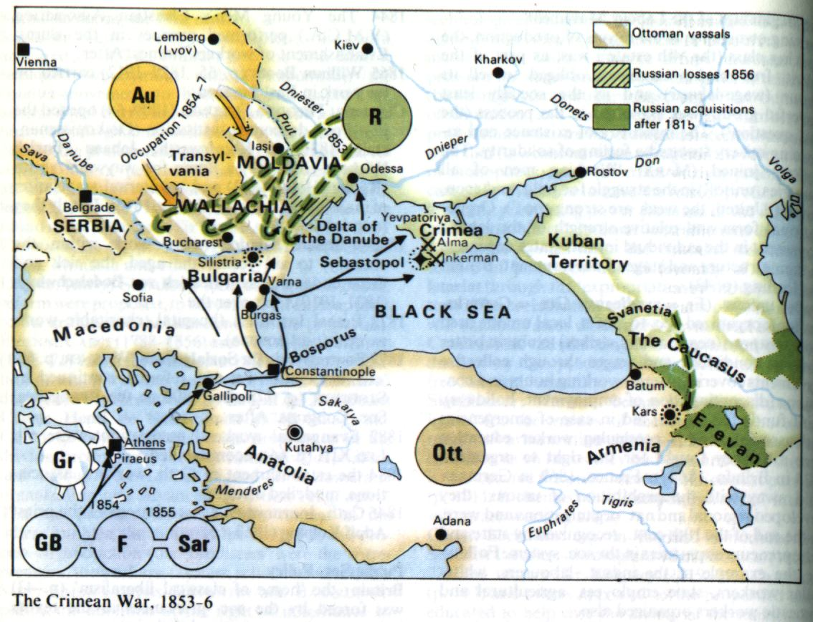

Slide 31
1859 – the war with Italy –
Habsburgs were defeated and lost Lombardy (the territory in Nothern Italy)
this war caused deep financial crisis in Habsburg Monarchy
this crisis and dissatisfaction with absolutist policy led to its end
its main representatives headed by Alexander Bach were withdrawn
1860 – the October Diploma – the new imperial code – was proclaimed
1861 – February – a new the constitution was instroduced, it was the beginning of parliamentary monarchy in the Habsburg Empire

Slide 32
1866 – Austrian-prussian war
Austria was defeated
Austria lost its influence in Italy and in Germany
internal weakness of Habsurg Monarchy was shown
it was used by Hungarians – their representative count Julius Andrássy (1823–1890)
they refused centralism but also federalism which proposed the Czech political representation
so called „Ausgleich“ – a political compromise reached between Germans and Hungarians in Habsburg Monarchy in 1867
the empire was devided into two parts: the border was the river Leithan between Austria and Hungary – the dual monarchy was established
Cisleithania (Austrian lands, Bohemia, Moravia, Galicia and Bukovina, Adriatic lands – Dalmacia, Istria, Terst, Gorica) – domination of German nation
Translaithania (Hungary, Upper Hungary – Slovakia, Transylvania, Croatia, Slavonia, Rijeka) – domination of Hungarian nation

Slide 33
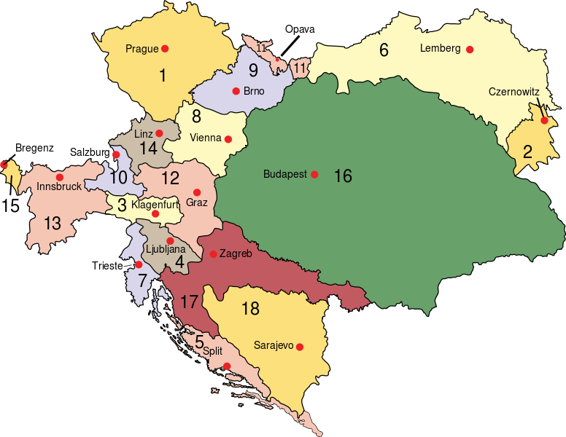
Austria-hungary (1910)
Empire of Austria (Cisleithania):
1.Bohemia,
2. Bukovina,
3. Carinthia,
4. Carniola,
5. Dalmatia,
6. Galicia,
7.Austrian Littoral,
8. Lower Austria,
9. Moravia,
10. Salzburg,
11. Silesia,
12. Styria,
13. Tyrol,
14. Upper Austria,
15. Vorarlberg;
Kingdom of Hungary (Transleithania):
16. Hungary
17. Croatia-Slavonia;
Austrian Condominium:
18. Bosnia and Herzegovina

Slide 34
Austria-hungary
Austria-Hungary became an union of two states with different constitutions and political system
they had common ruler – the Emperor Franz Joseph I., common Ministry of War, Ministry of Finance, Ministry of Foreign Affairs
they were connected also economicaly – common currency, customs union
common legislative organ for common issues
Different political develpment:
Austria – 1867 – liberal constitution, parliament monarchy – the power of the ruler was limited by parliament, the ministrers were responsible to the parliament which was approving the legislation and the taxes
the ruler was not responsible to parliament (the rest of absolutism)
Hungary – no liberalization but centralisation, the only Hungarian nation, the only official language was hungarian, the other nations without any rights, high schools only in Hungarian language etc.

Slide 35
Austria-hungary
the Czech political representation was dissatisfied with the situation – the political rights of Hungarians were accepted but of Czechs were not
Hungary obtained equality with Austria but the Bohemian Lands did not
The Bohemian politicians tried to change this situations many times but their politics were unsuccesful
The Czech hopes for restoration of their political rights received a severe blow
they started so called passive politics – they were boycotting the parliament sitting and the council meetings till 1878
Then they adopted a new constructive political program
the new political leaders – Karel Kramář and Tomáš Garrigue Masaryk

Slide 36
Habsburg monarchy
Readings:
Evans, R. J. W. (ed.) (2000): The Revolutions in Europe 1848–1849. From Reform to Reaction. Oxford.
Okey, Robin (2001): The Habsburg Monarchy c. 1976–1918: From Enlightenment to Eclipse. London: Macmillan Press LTD.

