Slide 1
Central europe before and during wwi
Jana Skerlova, Ph.D.

Slide 2
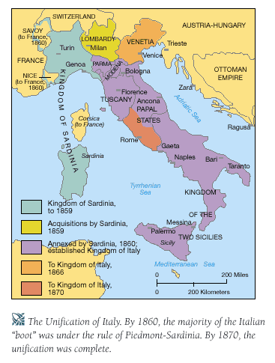
unification of Italy
there were 8 smaller states in Italy - rulers - the Habsburgs, the Bourbons, the Pope
in the north-western part the most economicaly developed Kingdom of Sardinia and Piemont was situated, the home dynasty was ruling there – the House of Savoy – king Victor Emanuel II

Slide 3
1859 - the war with Habsburg Monarchy
at the same time, the revolution in smaller states in central Italy broke out and the local pro-Habsburg rulers were everted
after the plebiscit these states were connected with Victor Emanuel’s state
the uprising led by legendary hero Giuseppe Garibaldi (1807–1882) – he led one thousand of men in red shirts to Palermo (Sicily), occupied it, in September they entered the city of Naples and defeated the army of king Francis (from the house of Bourbons)
then Garibaldi gave his power to Victor Emanuel II and southern parts of Italy were unified with the nothern parts

Slide 4
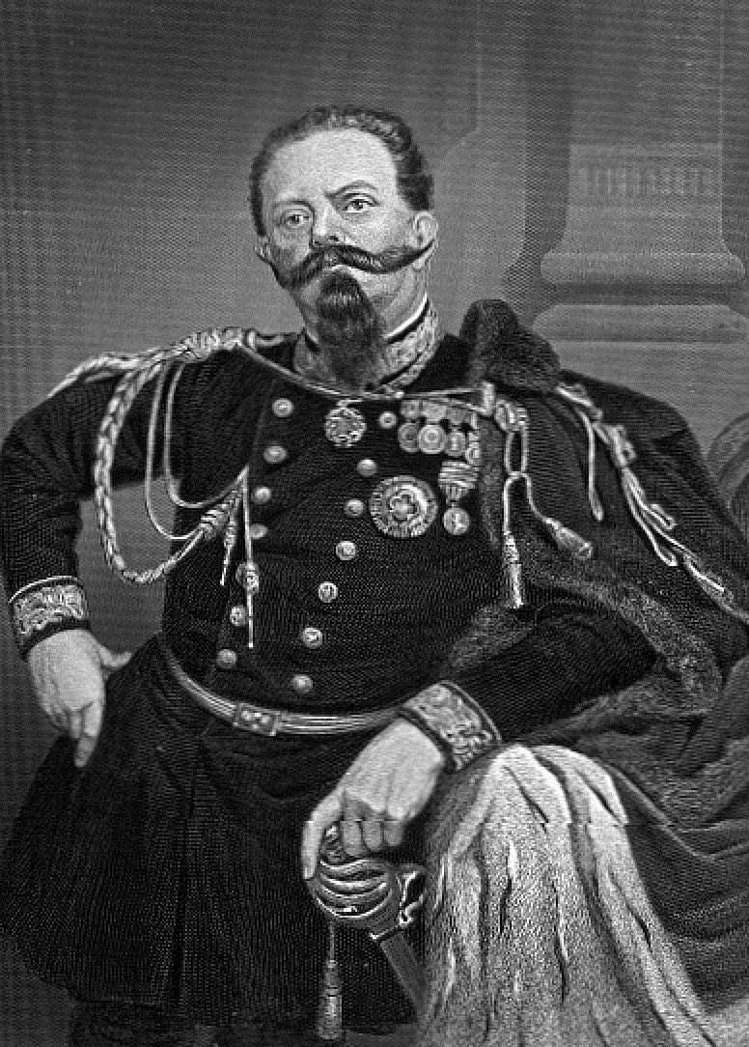
March 1861 – the Kingdom of Italy was proclaimed in Torino
1866 – after Austrian-prussian war Veneto (the territory around the touwn of Venice) was connected with the Kingdom of Italy
1870 – the Papal state with Rome was annexed by the Kingdom of Italy
1871 – Rome became the capital city of Italy
Victor Emanuel II ruled till 1878

Slide 5
unification of Germany
between 1849–1866 – the struggle between Austria and Prussia for domination in German states (German Confederation)
in Prussia the king William I (1861–1888, since 1871 the first German Emperor)
since 1862 – the Prime Minister Otto von Bismarck – his target was to unify Germany „by blood and iron“ that means by army and military power and make Germany the strongest Empire in Europe
1866 – the alliance between Prussia and Italy – againsthabsburg Monarchy
Not all the German states wanted the unification – e. g. Bavaria - allied with Austria against Prussia

Slide 6
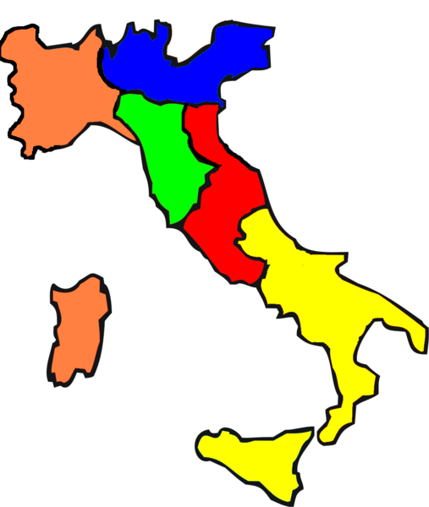
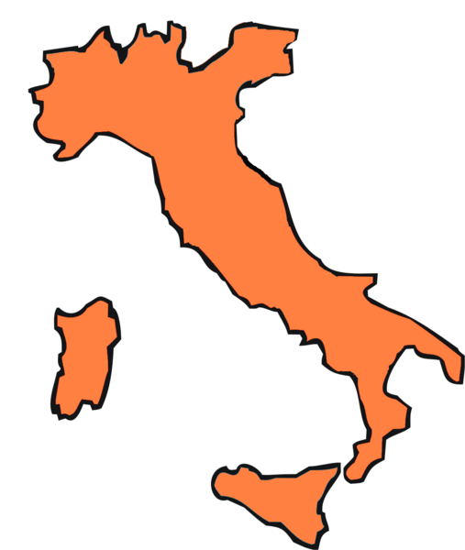
The unification of Italy
Kingdom of Italy in 1859 („the orange area“)
The Kingdom of Italy in 1870.

Slide 7
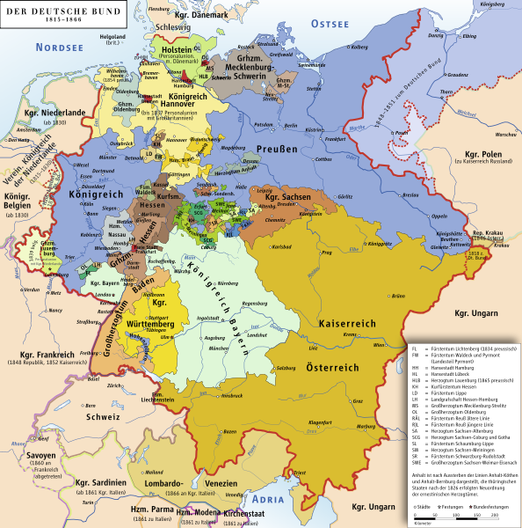

Slide 8
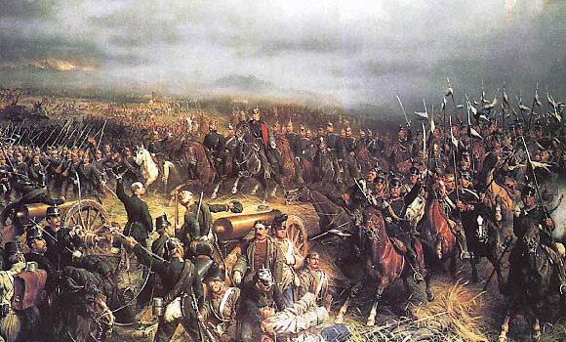
Austro-Prussian war broke out in 1866
July 3rd 1866 the battle of Sadowa near Königgratz (Hradec Králové), 2nd greatest battle in Europe since the Battle of Leipzig in 1813
Austria was defeated and lost some areas in Germany and Veneto in Italy)

Slide 9
the German Confederation existing since 1815 was dissolved
instead of that the North German Commonwealth was constituted – 21 states – customs union, common currency and common foreign policy – the first step to unification
Prussian king became the President of this Commonwealth and the commander-in-chef of the army
Prussia provoked France to declare war on Prussia in 1870
France was defeated at the battle of Sedan in September 1870 – French king Napoleon III was captured what caused the fall of the French Empire and proclamation of the third republic
Paris was besieged since September 1870 till January 1871
in January 1871 – The German Empire was proclaimed

Slide 10
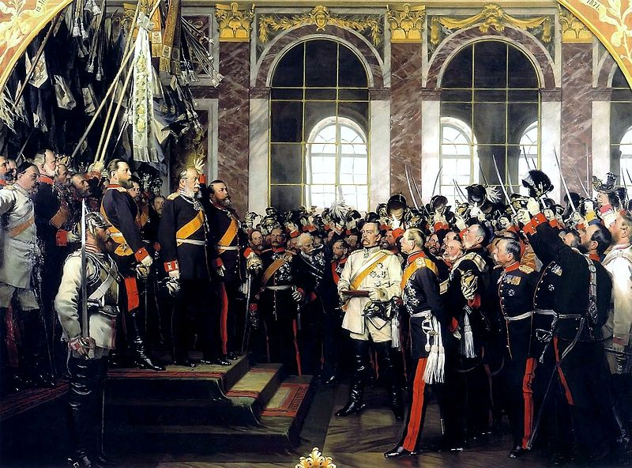
unification of Germany

Slide 11
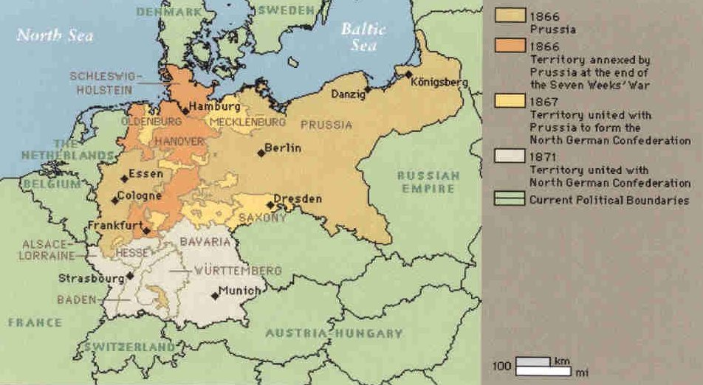
unification of Germany

Slide 12
German empire
Germany annexed Alsace and Loraine what were the richest French provinces
Germany became federation of 25 states (22 states + 3 cities) with its own representatives
each state nominated its represesentative to the Senate (Bundesrat), the memers of the assembly (Bundestag) were voted – the suffrage was universal for all the men since 25 years
Germany became European and world power with strong army and imperial politics
William II (1888–1918) – the last prussian king and German Emperor
Readings:
Breuilly, John (ed.): Nineteenth-Century Germany: Politics, Culture and Society 1780-1918.New York: Oxford University Press, 1997 and 2001.

Slide 13
International Relationships before WW1
Great powers at the end of the 19th century:
USA - the strongest
Germany (2nd world industrial area), the most powerful state in Europe, strong army, developed economy and culture
France – the bank of the world, 2nd strongest European state, succesful colonial politicis – colonies in Africa and in Asia
Great Britain – the greatest colonial power – its domain included the geatest colony – India, also colonies in
in Asia Japan – constitutional monarchy, development of industry, expansive politics
Austria-Hungary –cooperation with Germany, its foreign politics focused on the Balkan Peninsula
Russia – economicaly and politicaly the weakest state among the great powers, military-political system, absolute power of the Tsar, no political rights for citizens, social movement, expansion to Asia – conflicts with Japan and Great Britain

Slide 14
Formation of two enemy blocks in Europe at the end of 19th century
1879 – the secret agreement was concluded between Germany and Austria-Hungary – against France and Russia
1882 – Italy joined this pact → Tripple Alliance (later the Central Powers)
1893 – Russia and France made an agreement – they both were isolated and were affraid of strong and aggresive Germany
1904 – so called Entente Cordial concluded between France and Great Britain (affraid of strong Germany)
1907 – Russia + Britain → Tripple Entente

Slide 15
Balkan Wars
the first conflict in Europe after 40 years
the Balkan nations were fighting against Turkey which was occupiing them
1912–1913 - 1st Balkan War – so called Balkan League (Bulgaria, Serbia, Greece and Montenegro) X Turkey – Turkey was defeated and its European areas were liberated
but then the former allies started to fight with each other because of deviding of the liberated areas, Bulgaria had greatest war casualties and invested the most but the deliberated areas (Macedonia, Thrakia) got especially Greece and Serbia → Bulgaria was dissatisfied and declared war on Greece and Serbia → 2nd Balkan War – 1913
Turkey and Rumania joined Greece and Serbia and they were fighting against Bulgaria which was defeated and lost also the areas which obtained after the 1st Balkan War
but also Serbia was dissatisfied with the results of the wars (Serbia was expecting enlargement of its territory and wanted to raise Adriatic coast but instead of that Albania was formed)
Serbia started to prepair for the new war – wanted tu unify all the southern Slavs – who were living in Austria-Hungary

Slide 16
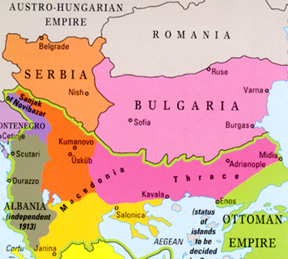
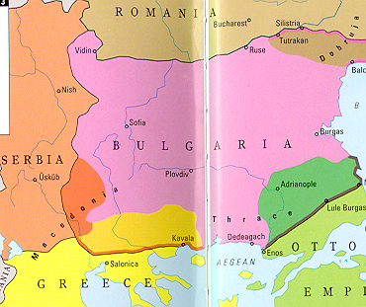
Balkan Wars
1st Balkan War
2nd Balkan War

Slide 17
Central europe before WWI
Since the Crimean War (1853–1856) there was a period without a great war in Europe (only local conflicts)
The tensions persisted on the Balkan Peninsula (1908 – the annexation of Bosnia and Herzegovina by Austria-Hungary, 1912–1913 the Balkan Wars etc.)
Pacifist movement - peace conferences in Hague (1898 and 1907) - unsuccessful
two blocks of powers at the beginning of the war:
Entente (Allied Powers): Great Britain + France + Russia
Central Powers: Germany + Austria-Hungary + (later) Bulgaria + Turkey
Italy – firstly neutral, in May 1915 joined the Entente (the London Treaty in April 1915 promised territorial gains to Italy)
neutral countries: Sweden, Norway, Denmark, Netherlands, Spain, Switzerland, Albania
USA – neutral at the beginning of the war, entered the war in April 1917

Slide 18
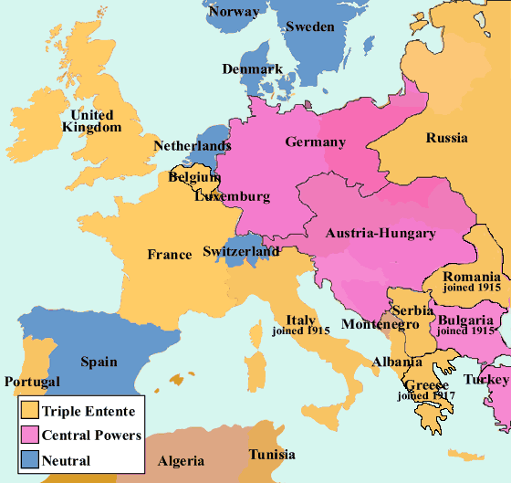
europe during WW i
The blocs of Powers in WWI

Slide 19
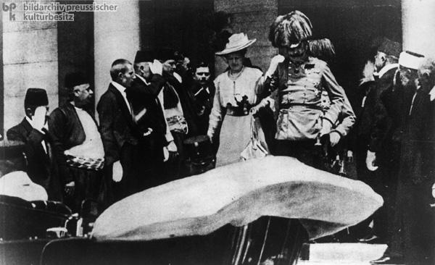
Central Europe and WW I
the pretext for starting the war was the assassination of Archduke Franz Ferdinand of Austria in Sarajevo on June 28, 1914
July 28, 1918 – Austria-Hungary declared the war on Serbia

Slide 20
The targets
Germany – the most agresive, wanted new colonies and wanted to expand to the Middle East (Berlin-Baghdad railroad), also wanted to rule in the Central, Eastern and South-East Europe (with the help of Austria-Hungary), Germany also wanted some areas in France and Belgium
Austria-Hungary – wanted to expand into the Balkan Peninsula and defeat the Kingdom of Serbia, which was independent, Serbia was the enemy for A-H also becauce of Bosnia and Herzegovina
France – wanted to get back Alsace and Loraine from Germany + keep its colonial domains
Russia – wanted Galicia (which was Austro-Hungarian province in those times), Silesia, and some parts of Balkan Peninsula, especially around the straits between Asia and Europe - Bosphorus and Dardanelles
Serbia – wanted to keep its independence and to form the Balkan federation – with Croats, Slovenes and Serbs living in Austria and Hungary
Great Britain – wanted to keep its colonies and exclude Germany from world trade, stop its expansion to the Middle East
USA – wanted to defend democracy in the world and the principle of self-determination of the nations (Woodrow Wilson)

Slide 21
Four phases of the war:
August – December 1914 – offensive operations
1915–1916 – trench warfare
1917–1918 – the era of total exhaustion
March 1918 –November 1918 – supremacy of Allied Powers (USA entered the war in April 1917)

Slide 22
Four main fronts
Balkan front (Balkan Peninsula, firstly in Serbia, then in Greece)
Western front (against France)
Eastern front (against Russia)
Italian front
also naval war (in the Pacific Ocean – Japan + Great Britain against Germany, in the Nothern Sea – Great Britain against Germany)
warfare in the colonies

Slide 23
Balkan Front
Austrian army was not succesful in Serbia
September 1915 – Bulgaria entered the war
during October and November 1915 German-Austrian and Bulgarian troops occupied Serbia
in spring 1915 – the Allied Powers prepared the operation in Gallipoli against Turkey, British troops under the command of Winston Churchill, but the operation was not successful
then in 1916 the Macedonian Front in Greece was opened
the Bulgarians were defeated in September 1918

Slide 24
Western Front
the Germans attacked France according to the so called Schlieffen Plan - designed to attack France quickly through neutral Belgium
Great Britain declared war on Germany because of breaking Belgic neutrality
the German troops were stopped at the First Battle of Marne in September 1914 – the offensive war changed into the trench warfare
March 1915 – the second Battle of Ypres – the Germans used chlorine gas – 15 thousands of men were poisoned
from February till September 1916 – bloody battle of Verdun – 600 thousands of casualties,
from July till November 1916 the great battle of the Somme - totally 1 million casualties during the whole battle, the new British invention was used – the tanks

Slide 25
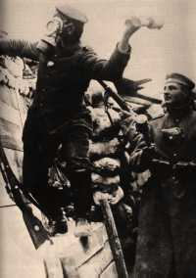
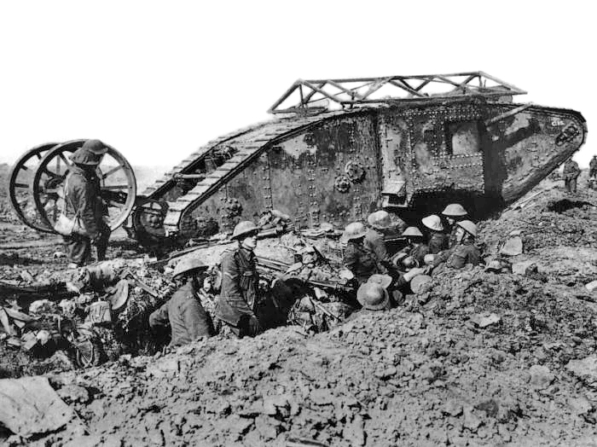
Western Front
The Second Battle of Ypres
The Battle of the Somme

Slide 26
Eastern Front
In the east, Russia attacked East Prussia but was defeated by German army at the series of battles colectively known as the Battle of Tannenberg in August 1914
Already in 1914 – the Czech Company in Russian Army – Legions (originally – the Czechs living in Russia, prisoners of war, volunteers)
summer 1916 – so called Brusilov offensive
1917 – the Czechoslovak Corps in Russia – from 38,000 to 70,000 of men
the Russians were more succesful against Austria-Hungary in Galicia (today – western Ukraine)
Russia occupied parts of Galicia and Bukovina
July 1917 – so called Kerensky offensive – the Battle of Zborov (Galicia) – Czechoslovak Legions won over the Austria-Hungary, the offensive was unsuccesfull for Russians
After the Russian Revolutions the Czechoslovak Legions were fighting against bolsheviks

Slide 27
Italian Front
Italy entered the war in April 1915 – the Allied Powers promised to Italy Istria with Trieste, Dalmacia and Trentino (Austro-Hungarian provinces), so Italy declared war on Austria-Hungary and later also on Germany
but the Italians were not very succesful, their offensives along the Isonzo River were repelled by the Austro-Hungarians
1917 – the Battle of Caporetto – Italian troops were defeated by Austro-Hungarian army and the front line was broken through, usage of poison gas
during 1916 the front stabilized at the Piave River till 1918 – June 1918 – the Battle of the Piave River – participation of Czechoslovak Legions
the Austro-Hungarians were defeated in October – the Battle of Vittorio Veneto – participation of Czechoslovak Legions again

Slide 28
The Final Period of the War
after the Russian revolutions in 1917 Russia concluded separate peace with Germany in Brest Litevski in March 1918
General exhaustion – of sources, armies, people in real (lack of labour power – participation of women)
April 1917 – USA declared war on Germany – originally USA persued the politics of non-interventions, but German submarines several times attacked merchant ships and civil ships with American passengers
The United States were never formally a member of the Allies but became a self-styled "Associated Power"
American troops came to Europe and after the great offensive of Allied Powers in summer 1918 the Central Powers collapsed very quickly
On November 3, 1918 Austria–Hungary sent a flag of truce to ask for an Armistice and the armistice with Austira was signed in Vila Giusti near Padua
on November 11, 1918– an armistice with Germany signed in railroad carriage near Compiègne
at 11 a.m. on November 11, 1918 a ceasefire came into effect

Slide 29
The Results of the War
Casualties:
10 million of soldiers died
7 million of civilians died
The map of Europe has changed:
dissolution of four monarchies (Russia, Austria-Hungary, German Empire and Ottoman Empire)
after dissolution of Austria-Hungary: constitution of 5 new states (Austrian Republic, Czechoslovakia, Hungary, Poland, Kingdom of Serbs, Croats and Slovenes)
Latvia, Lithuania and Estonia was established, independent and unified Poland was renewed
http://www.the-map-as-history.com/demos/tome03/index.php
Economic changes:
Development of industry (iron and steel, textiles, etc.) and technologies(armament industry, automobiles, aircrafts …)
Firstly the in many countries the war prosperity, later economic depresse
Social changes:
Social radicalism – rise of totalitarism, revaschism etc.
Social status of women has changed(sufrage)
Many veterans – problems with reintegration

Slide 30
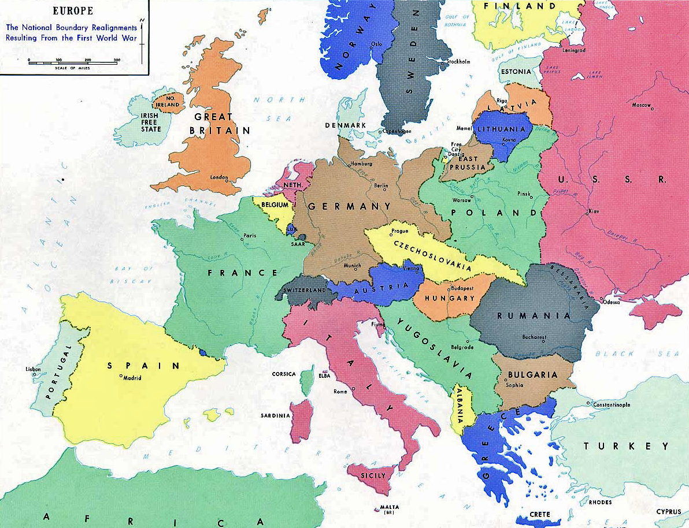
Results of the war

Slide 31
Paris Peace Conference
the meeting of the Allied victors following the end of World War I – the aim was to set the peace terms for the defeated Central Powers following the armistices of 1918
It took place in Paris in 1919 and involved diplomats from more than 32 countries and nationalities. They met, discussed various options and developed a series of treaties ("Paris Peace Treaties") for the post-war world
the winning powers – France, Great Britain, USA, Italy, Japan
other figthing states – Belgium, British dominiums, Poland, Kingdom of Serbs, Croats and Slovenes, Czechoslovakia, Romania, Greece, Portugal and other non-european states
defeated states – Germany, Austria, Hungary, Turkey, Bulgaria
Russia was not invited to the Paris Peace Conference (bolshevik revolution and civil war in Russia)

Slide 32
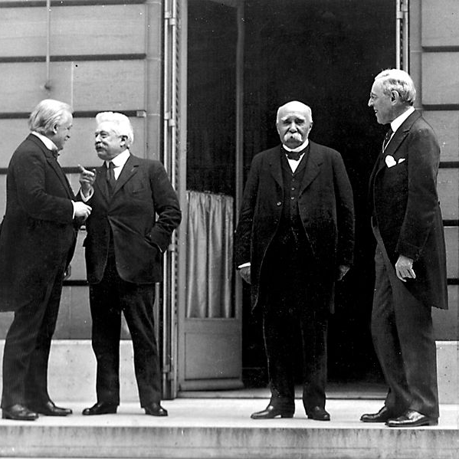
Paris Peace Conference
The Big Four –
David Lloyd Geroge (GB),
Vittorio Orlando (It), George Clemencau (Fr), Woodrow Wilson (US) – from left to right

Slide 33
Peace Treaties
The following treaties were prepared at the Paris Peace Conference:
the Treaty of Versailles, 1919, 28 June 1919, (with the German Empire in Weimar Republic form)
the Treaty of Saint-Germain, 10 September 1919, (with Austria)
the Treaty of Neuilly, 27 November 1919, (with Bulgaria)
the Treaty of Trianon, 4 June 1920, (with Hungary)
the Treaty of Sèvres, 10 August 1920; subsequently revised by the Treaty of Lausanne, 24 June 1923, (withTurkey)

