Slide 1
Central europe Before and during WW II
Jana Hrabcova

Slide 2
Central Europe at the beginning of WW II
Germany
the Third Reich – Adolf Hitler as a Führer (Leader) – all the power centralized in his hands, nazism, Gestapo (secret police – Heinrich Himmler) – persecuting of Jews, liberals, Socialist, and Communist opposition – concentrations camps, propaganda (Minister Joseph Goebbels), economical prosperity again – preparations for the war, in 1935 – Germany began to re-arm, 1936 – remilitarization of Rhineland, axis with Italy and later also with Japan …
attack on Poland in September 1939, attack on France in spring 1940, autumn 1940 – the battle of Britain, June 1942 – operation Barbarossa – attack on USSR – from September 1942 to February 1943 – the battle of Stalingrad – crucial point of the war, the Soviets won and launched great offensive
1944 – crisis of Nazi regime
January 1945 – Germans stopped by French and American troops at western front

Slide 3
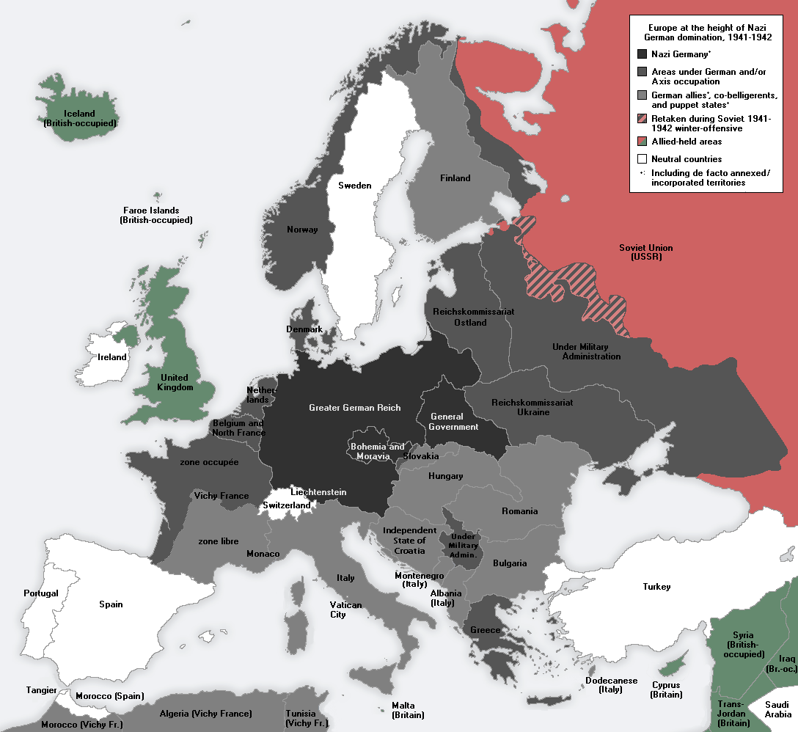
Europe under Nazi domination

Slide 4
Central Europe at the beginning of WW II
Austria
after Anschluss in March 1938 (Fall Otto) Austria became a part of German territory
in April a plebiscite that confirmed annexation of Austria into Nazi Germany

Slide 5
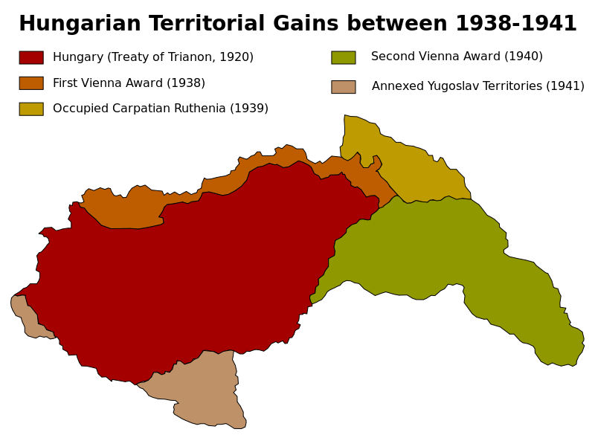
Central Europe at the beginning of WW II
Hungary
territorial gains – from Czechoslovakia, Rumania and Yugoslavia
hungarian nazism
1940 - joined Axis Berlin – Rome – Tokyo
Participated on the invasions of Yugoslavia and of the Soviet Union

Slide 6
Central Europe at the beginning of WW II
Poland
October 1938: annexation of Zaolzie, Górna Orawa, Jaworzyna from Czechoslovakia
March 31, 1939: military guarantees from United Kingdom and France
August 23, 1939: non-aggression pact between Soviet Union and Germany: Ribbentrop-Molotow Pact with a secret military alliance protocol targeting Poland
September 1 – October 6, 1939: Invasion of Poland
Poland attacked by Nazi Germany without declaring war on Poland
17th September – USSR attacked Poland and occupied eastern part of Poland
so called New Partition of Poland – western part under German Reich, central part – General Gouvernement (with the capital city of Krakow) – the head Hans Frank, eastern part – occupied by USSR
many concentration camps in Poland – Auschwitz, Majdanek, Sobibor, Treblinka ...
segregation of Jews – a big ghetto in Warsaw – from April to May 1943 – Warsaw Ghetto Uprising
of Poland's prewar Jewish population of 3 million, only about 369,000 survived the war
Polish resistance movement – Polish goverment in exile with Władysław Sikorski as Prime Minister, in Poland the Home Army (Armia Krajowa) and the Peoples Army (Armia Ludowa)

Slide 7
Central Europe at the beginning of WW II
Czechoslovakia
in Czechoslovakia numerous German minortity, Sudeten German Party with the leader Konrad Henlein
April 1938 – Carlsbad Decrees demanding the authonomy for Sudeten Germans and the freedom to profess Nazi ideology, Sudeten Germans expected that President Beneš will refuse their exaggerated requirments
Czechoslovak government was forced to coclude an agreement with Henlein but he refused all their suggestions according to Hitler´s instructions
several negotiations on Czechoslovakia between Hitler and British Prime Minister Neville Chamberlain during September 1938:

Slide 8
Crisis: A Film of the Nazi Way
A movie:
Crisis: A Film of the Nazi Way
Part 1: http://www.youtube.com/watch?v=try7eIZLN8I&feature=related
Part 2:
http://www.youtube.com/watch?v=fM5Cuf3L8zQ
Part 3:
http://www.youtube.com/watch?v=Vyepon6hE9E&feature=related
Part 4:
http://www.youtube.com/watch?v=msqVf42048s
Part 5:
http://www.youtube.com/watch?v=VIe8yg6YVAs
Part 6:
http://www.youtube.com/watch?v=YfU_C8ShWag
Part 7:
http://www.youtube.com/watch?v=hxWCZx04_xY
Part 8:
http://www.youtube.com/watch?v=cBKgyryPe8Q

Slide 9
Central Europe at the beginning of WW II
15th September – Berchtesgaden – Great powers were putting pressure on Czechoslovak government to accept Hilter´s requirments – he wanted Sudeten, firstly Czechoslovak government refused British and French pressure but on 21st September was forced to accept Hitler´s requirments
22nd September – Bad Godesberg – new Hitler´s requirments – he wanted to occupy Czechoslovak fortification and some border areas for Poland and Hungary
Hitler announced that he will attack Czechoslvoakia on 28th September (according to the Fall Grün prepared already in April 1938)
change of the government in Czechoslovakia – Prime Minister General Syrový
23rd September – general mobilization in Czechoslovakia

Slide 10
Central Europe at the beginning of WW II
29th to 30th September – Negotioations of four Great powers in Munich (Germany – Hitler, Italy – Mussolini, Great Britain – Chamberlain, France – Daladier) – about Czechoslovak frontiers and German requirments but without Czechoslovakia – France and Great Britain were Czechoslovak allies but they signed the agreement with the enemy:
the Munich Agreement, Czechoslovakia(Czechoslovak troops) had to evacuate Sudeten and cede it to Germany,
the USSR did not reply for the Czechoslovak application for the help
from 1st to 10th October Czechoslovak borderland was occupied by German troops and annexed to Germany, Poland got the area around Těšín and Spiš, Hungary got Carpathian Ruthenia and southern parts of Slovakia
Czechoslovakia lost 1/3 of its area, 1/3 of light industry, in southern Slovakia fertile soil important for agriculture was lost
the First Czechoslovak republic was dissoluted, so called Second Czecho-Slovak Republic till March 1939 – President Emil Hácha, no parliamentary democracy anymore
7th October – autonomy of Slovakia was proclaimed – Czecho–Slovakia

Slide 11
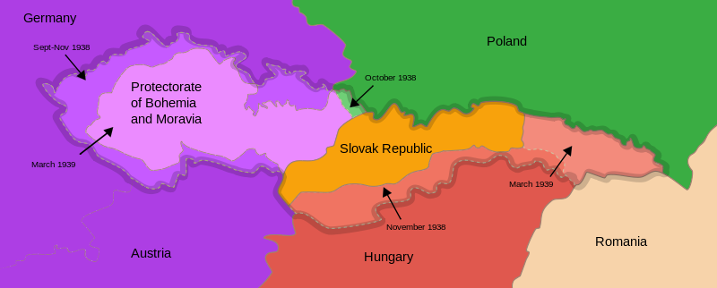
Munich agreement
September 1938 – Munich Agreement – lost of Sudetenland
March 1939 – establishing of Protectorate Bohemia and Moravia
March 1939 – establishing of the Slovak State

Slide 12
Central Europe at the beginning of WW II
13th March 1939 – Slovak Prime Minister Jozef Tiso was invited into Berlin – he was made to enforce the separation of Slovakia
14th March 1939 – Slovak State was proclaimed, dependent on Germany
14th March 1939 – President Hácha and Foreign Minister Chvalkovský invited to Berlin – Hitler threatened with bombing of Prague – they were forced to sign the document asking Germany for protection what was in fact forced capitulations
15th March 1939 – German army occupied Bohemia and Moravia – dissolution of Second Czechoslovak Republic
16th March 1939 – the occupants proclaimed Protectorate of Bohemia and Moravia – it was part of German Reich, formaly autonomous state with so called State President Emil Hácha and Prime Minister Rudolf Beran but the real power was in hands of Reichsprotektor Konstantin von Neurath and later Reinhard Heydrich

Slide 13
Central Europe at the beginning of WW II
Jews were dismissed from the civil service and placed in an extralegal position,
the Czechs launched secret resistance movement to Nazi occupation, Czechoslovak Government in exile in London
mass demonstrations in October 1939 – the anniversary of establishing of Czechoslovakia – one student Vojtěch Sedláček was shot to death and the second one – Jan Opletal was seriously injured and died later, his funeral on 15th November became a new mass manifestation
the Nazis started an intervention against students on 17th November 1939 – 9 students were executed, 1200 of them deported into concentration camp in Sachsenhausen, all the Universities in Protectorate were closed (→ International Students´ Day)

Slide 14
Readings
Seton-Watson, Hugh: Eastern Europe 1918 – 1941. Hamden 1962.
Rotschild, Joseph: East Central Europe between the Wars. Seattle 1974.
Voráček, Emil and others: The Disintegration of Czechoslovakia in the end of 1930s. Policy in Central Europe. Prague 2009.
http://www.holocaustresearchproject.org/toc.html

Slide 15
Liberation of central europe
The Soviet Red Army
since March 1943 to May 1944 – the territories in the Ukraine were liberated
August 1944 – Nazi regime in Romania was overthrown
September 1944 – also Bulgaria became a member of anti-Nazi alliance
Yugoslavia – strong resistance movement – communists (Partisans) under the leadership of Josip Broz Tito, in October 1944 – Belgrade was liberated with the help of Red Army, the rest of Yugoslavia liberated mostly by Partisans
from October 1944 till February 1945 – fights in Hungary, siege of Budapest

Slide 16
Liberation of central europe
in April 1945 German-Hungarian forces finaly pushed from Hungary to Austria
February 1945 Poland (17th February – liberation of Warsaw)
in January 1945 – the Provisional Governement in Poland – with Soviet support
members of anti-German resistance movement that remained loyal to London exile government were arrested by the Soviets, many of them exiled
The conflict in Poland continued – since 1943 – Polish-Ukrainian War

Slide 17
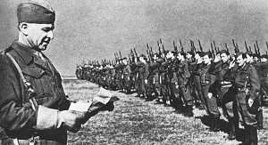
Liberation of central europe
from 29th August 1944 till the end of October 1944 – the Slovak National Uprising – the Partizans and members of so called First Czechoslovak Army against German occupation
September to November 1944 – Red Army crossed border mountains after cruel fights and entered Slovakia (Battle of the Dukla Pass – 22,000 soldiers of Red Army were killed)
then the Red Army advanced throw Slovakia towards Vienna, during this advance Bratislava was liberated (4th April 1945), then Brno (26th April) and Ostrava (30th April)
General Ludvik Svoboda, Commander in Chef of the First Czechoslovak Army

Slide 18
Liberation of central europe
western part of Bohemia was liberated by American troops under the command of general George S. Patton but the Soviets asked Americans to stop in Pilsen and not to continue to Prague
5th May 1945 – the May Uprising of Bohemian People in Prague and then in the whole country
Soviet Generals refused an offer of General Eisehower – he wanted to send American troops to help the uprising but the Soviets wanted to liberate Prague themselves
8th May 1945 – liberation of Prague and the end of the WW II in Europe

Slide 19
Liberation of central europe
30th April – Hitler committed suicide
2nd May – Fall of Berlin
7th May – capitulation of Germany – confirmed again at night from 8th to 9th May
in July 1945 – the Allied leaders met in Potsdam, Germany – this conferrence confirmed earlier agreements about Germany – so called Programme of four D (denazification, demilitarization, democratization and decartelization)
also the resettlement of German minority from Czechoslovakia, Poland, Hungary and Yugoslavia
August 1945 – International Trial in Nüremberg – after almost one year of trial 12 prominent Nazis sentenced to death

Slide 20
Liberation of central europe
Germany divided into four ocuppation zones – French in the southwest, British in the northwest, United States in the south, and Soviet in the east, also Berlin, which was situated in the Soviet zone, was divided into four occupation zones
all the territorries that Germany had occupied (Austria, Czechoslovakia …) were detached
Germany lost some territories for Poland and Russia, new Polish frontiers on the Oder-Niesse line
millions of ethnic Germans expelled from Czechoslovakia, Poland and Hungary returned to Germany

Slide 21
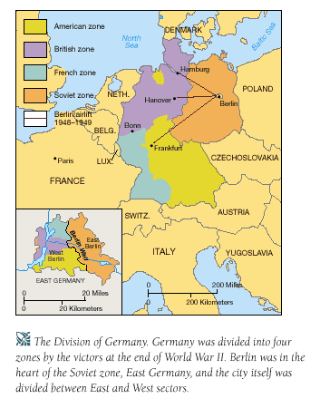
Liberation of central europe
Occupations zones in Germany and Berlin

