Slide 1

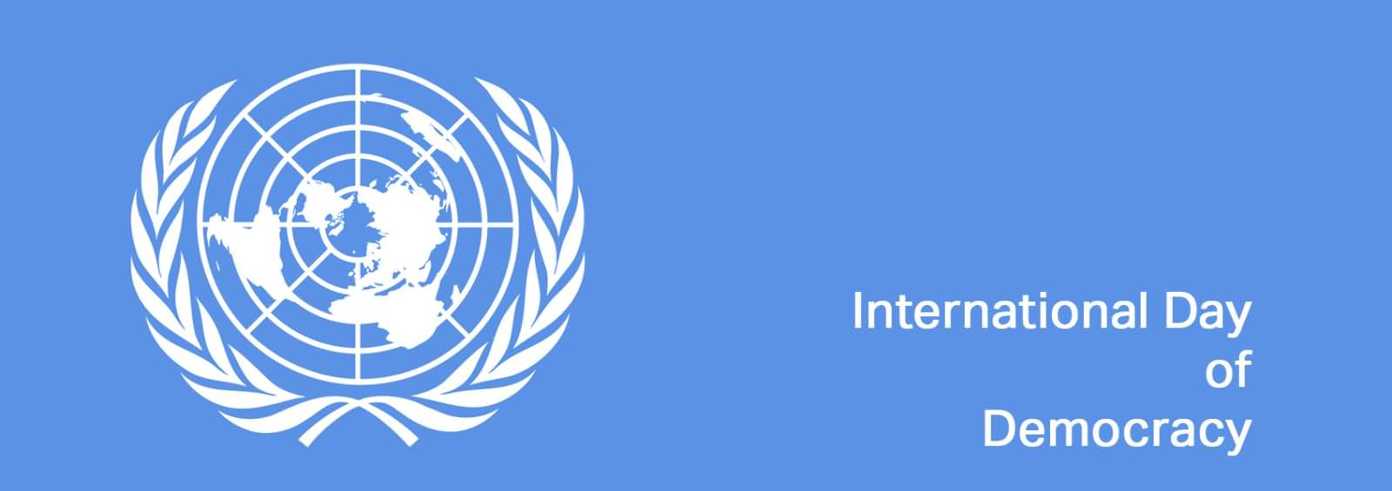
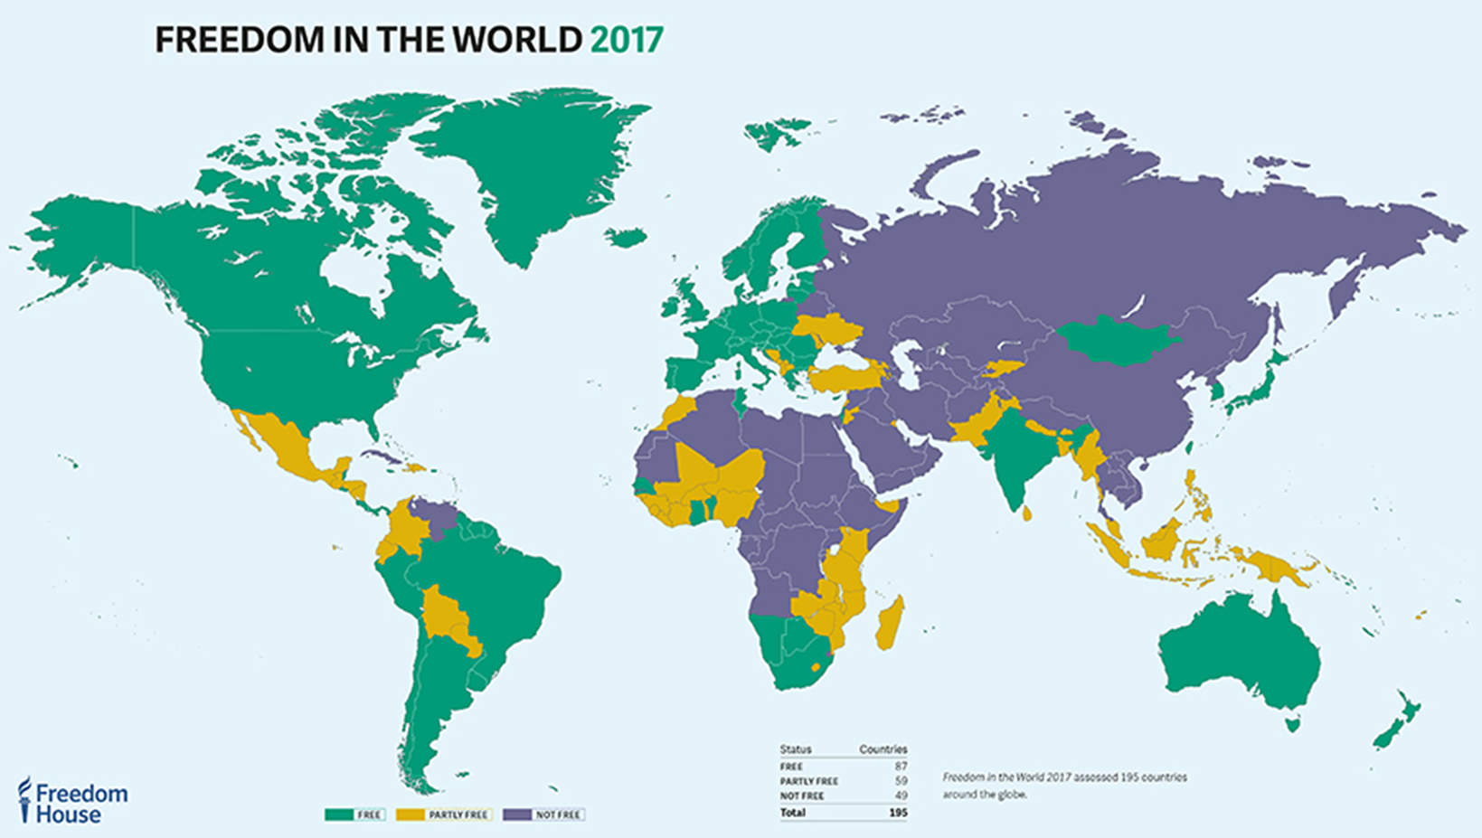
International organizations and their role in democratization
Mgr. Eva Taterova, M.A., Ph.D.
Democratization and Democracy in the East-Central Europe
10/2/2017

Slide 2
CONCEPT OF DEMOCRATIZATION
Democratization is a process of transition to a more democratic political regime
(from the authoritarian regime to full democracy/semi-democracy).
Democratic transition starts with the first signs of collapse of the governing establishment.
The groups in society start to negotiate – a crucial role of the civil society.
Democratization is influenced by various factors such as wealth, social equality, education, culture, ethnicity, previous exprience with democracy, outside intervention.
The necessity to consolidate democracy – only half of transition since 1960s has consolidated.
The proces of democratization is supported by both internal and external factors→
the crucial role of the international community and international organizations!

Slide 3
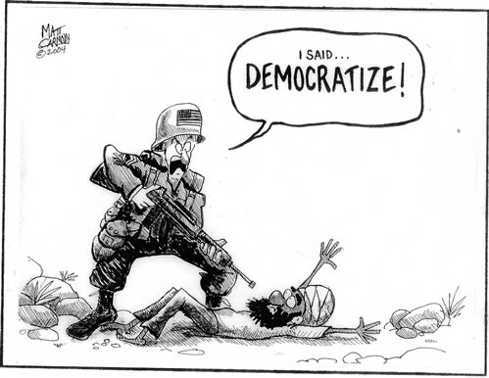

Slide 4
THIRD WAWE OF DEMOCRATIZATION
Concept of the political scientist Samuel P. Huntington.
First wave: 1828 – 1926
Second wave: 1943 – 1964
Third wave:
  Largest democratic wave in the history of mankind
  Started in Portugal in 1974 (by then only 27 regimes were the full democracies).
  The other countries in Central and Eastern Europe, Latin America, Asia, and Africa followed in these trends.

Slide 5
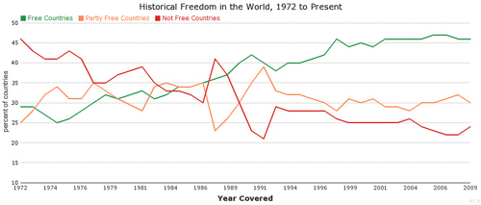

Slide 6
FAILED TRANSITIONS
Ethnic cleaveges in society.
Inability to build up the strong institutions.
Inability to build up checks to the competences of the president – tendency to authoritarian rule.
Consolidated democracies have very good chances to survive but it is difficult to say when the democracy is consolidated.

Slide 7

FREEDOM HOUSE
Established in 1941 by Wendell Wilkie and Eleanor Roosevelt.
U.S. non-governmental organization funded mostly by U.S. government (often criticized).
Since 1972 Freedom House has been publishing the annual reports callled Freedom in the World.
www.freedomhouse.org

Slide 8


Slide 9
FREEDOM HOUSE‘S METODOLOGY
Two broad categories: the political rights and the civil liberties.
Political rights: freedom to vote and to be voted for, be organized in political parties.
Civil liberties: freedom of expression and belief, right to organize, rule of law, personal autonomy without interference of the state.
In both categories states are rated 1-7.
Free, Partly Free and Not Free states.

Slide 10
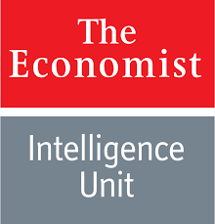
ECONOMIST INTELLIGENCE UNIT
UK-based company, the Democracy index was firstly introduced in 2006.
60 indicators in 5 categories (electoral process and pluralism, civil liberties, functioning of government, political participation, and political culture).
4 types of rEgime: full democracies, flawed democracies, hybrid regimes and authoritarian regimes.

Slide 11
DEMOCRACY INDEX BY REGION

Slide 12
DEMOCRACY INDEX 2017
https://infographics.economist.com/2017/DemocracyIndex/

Slide 13
ORGANIZATION FOR SECURITY
AND COOPERATION IN EUROPE (OSCE)
World's largest security-oriented intergovernmental organization.
Tasks: early warning, conflict prevention, crisis management, and post-conflict rehabilitation.
57 member states.
1973 Conference on Security and Cooperation in Europe – to reduce the tension in Europe, to strenghen the security, to support the human rights in the communist countries → Helsinki Final Act.
After the failure of the Soviet bloc, OSCE expected to have the leading role in the CEE region (democratization of the region, building of the democtratic instituations, good governance, human rights, minority rights).
2016: OSCE Democracy Defender Award.

Slide 14
UN AND DEMOCRATIZATION
Democracy is one of the core principles of UN (UN Chapter does not mention the word „democracy“).
Activities: fostering good governance and monitoring elections, supporting civil society, strengthening democratic institutions and accountability, ensuring self-determination in decolonized countries, assisting the drafting of new constitutions in nations post-conflict.
UN Development Programme, UN Democracy Fund, the Department of Peacekeeping Operations, the Department of Political Affairs, the Office of the High Commissioner for Human Rights,and the United Nations Entity for Gender Equality and the Empowerment of Women.
Intense criticism of UN activities.

Slide 15
EU AND DEMOCRATIZATION
Key role of EU in the democratic transitions in CEE – motivation: most of CEE states desire the EU membership.
Copenhagen criteria (1993):
  A candidate state has the institutions to preserve democratic governance and human rights, has a functioning market economy, and accepts the obligations and intent of the EU.
The European Neigborhood Policy (2004)
  A cooperation with the nearby non-EU countries.
  Tariff-free access to some or all EU markets, financial or technical in exchange for commitments to political, economic, trade, or human rights reform in a country.

Slide 16
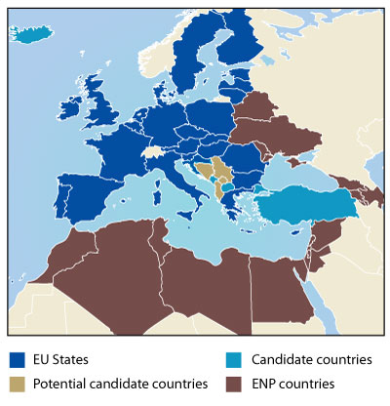

Slide 17
THANK YOU FOR YOUR ATTENTION

