Slide 1
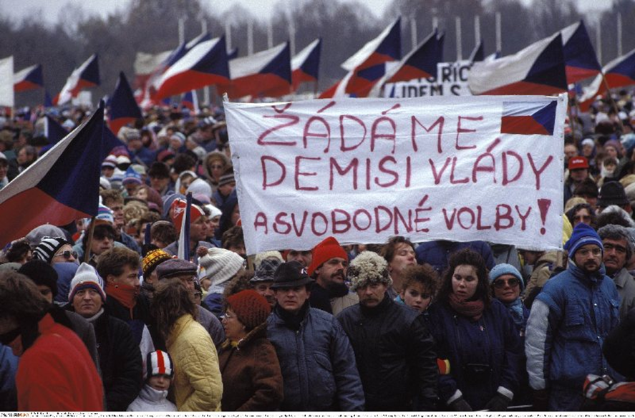
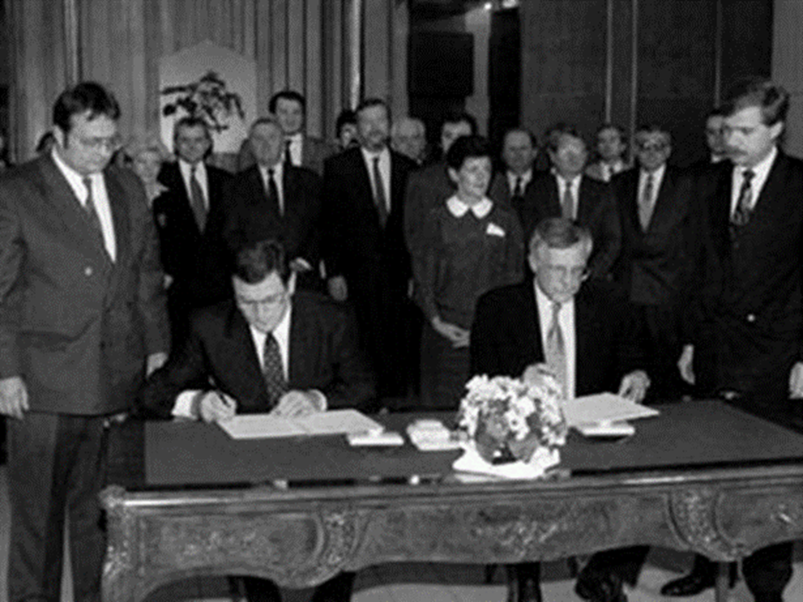
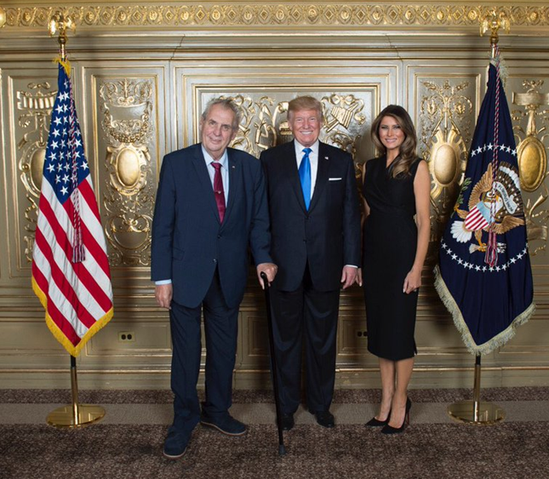
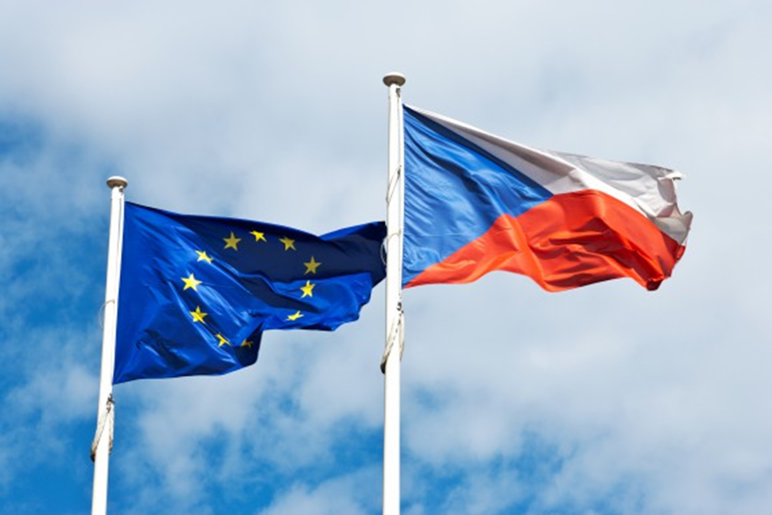
THE CASE OF THE CZECH REPUBLIC
Mgr. Eva Taterova, M.A., Ph.D.
Democratization and Democracy in the East-Central Europe
11/6/2017

Slide 2
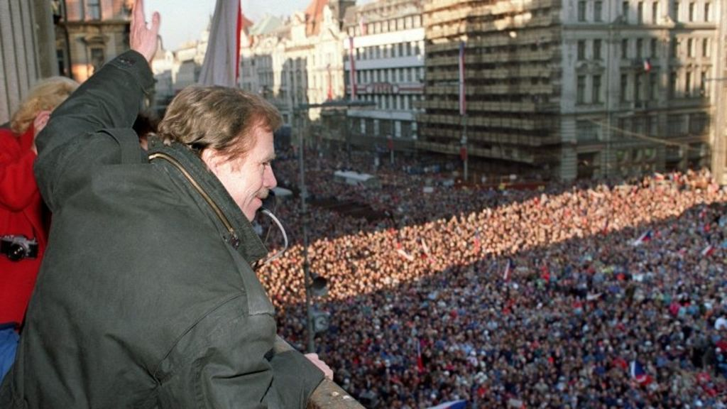
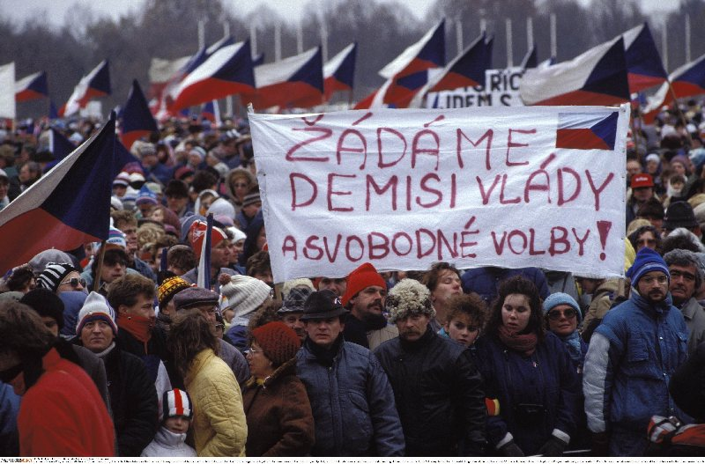
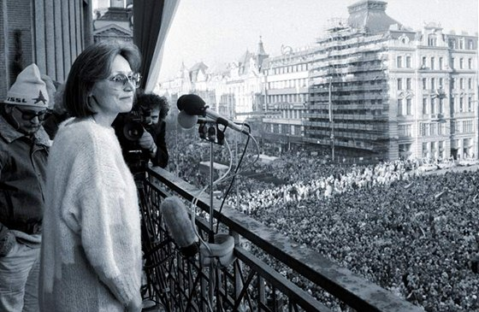
Velvet Revolution: https://www.youtube.com/watch?v=bPyKuGXppsA
Prayer for Marta: https://www.youtube.com/watch?v=TP_CPceCgh0

Slide 3
TRANSITION TO DEMOCRACY
“Return to Europe“ – integration to western political and security institutions.
New leadership – lack of experience, new geopolitical situation in Europe.
The first years of post-communist Czechoslovakia were affected by sometimes exaggerated optimism and enthusiam.
Issues:
Transition to democracy – new political parties (Civic Forum divided into few political subjects – Civil Democratic Party, Social Democratic Party, People‘s Party – The Movement for a Democratic Slovakia).
Transition to capitalist economy – privatization, restitutions.
Slovak independence.
Reconciliation with the past – communist era, Sudeten Germans.

Slide 4
VÁCLAV HAVEL‘S SPEECH, MAY 10, 1990, THE COUNCIL OF EUROPE
“Obviously, the states that had been ruled by a totalitarian system and now are overcoming its consequences and want, so to speak, to return to Europe, can most rapidly and efficiently do so not by competing and contending against one another but by helping one another in solidarity. If these countries want to open up to the new Europe, they must first open to one another. The new democratic government in Czechoslovakia, therefore, wants to do everything in its power to contribute to the coordination of efforts by the Central European countries to enter various European institutions. That is why we so often appeal to different institutions that are theoretically European but in fact are so far only West European, to open more flexibly to those who for long years were segregated and who logically belong in them.“

Slide 5
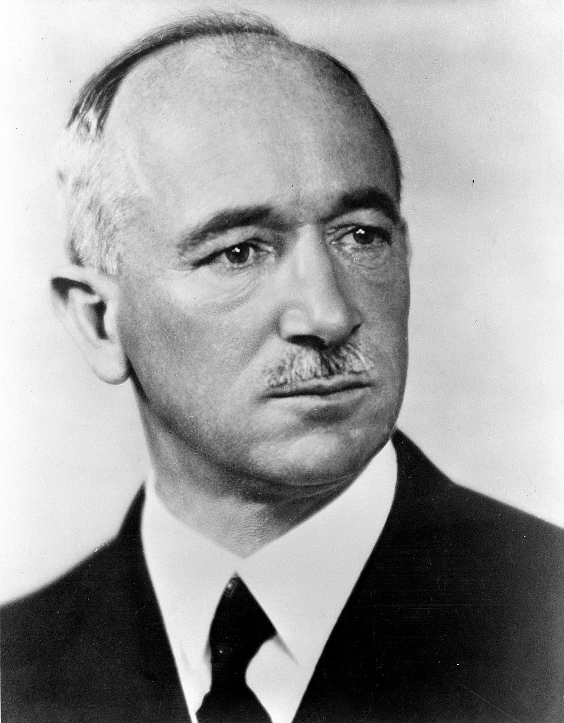
HISTORICAL EXPERIENCE WITH DEMOCRACY
Independent Czechoslovakia was declared in October 28, 1918 (The Treaty of St Germain).
1918-1938: a fully democratic state (parliamentary democracy).
Thomas Garrigue Masaryk
Edvard Beneš

Slide 6
EARLY 1990s
Czechoslovakia declared a desire to integrate into the western world as soon as possible (pro-western orientation has been the official agenda of all goverments since that).
It was important to deal with some issues from the past:
There were still the Soviet soldiers (last of them left the country in June 1991).
The dissolution of Warsaw Pact in February 1991.
The dissolution of The Council for Mutual Economic Assistance in June 1991.

Slide 7
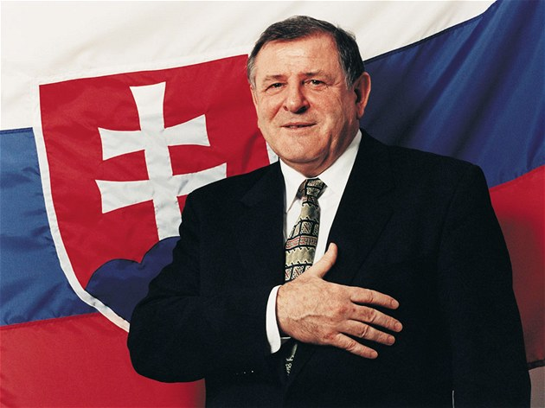
Václav Klaus
Vladimír Mečiar
Miloš Zeman

Slide 8
SEPARATION OF CZECHOSLOVAKIA (VELVET DIVORCE)
The problems existed for decades and culminated in early 1990s.
The elections 1992:
Civil Democratic Party led by Václav Klaus.
People‘s Party – The Movement for a Democratic Slovakia led by Vladimír Mečiar.
The western world was concerned about what was going on in Czechoslovakia (there was a bloody war in Balkan at the very same period of time).
New states – the Czech Republic and Slovakia – were established on January 1, 1993.
Nowadays, the separation of Czechoslovakia is usually presented as one of the best example how a state can be divided.

Slide 9
THE CZECH REPUBLIC AS THE INDEPENDENT STATE
After the failure of the federation, the Czech Republic (lead by prime minister Václav Klaus) got more concerned about the economic transition.
Non-permanent member of the UN Security Council 1994-1995 – a great success of Czech diplomacy.
Nowadays, the orientation on the spread of democracy and human rights in specific post-communist countries (Cuba, Belarus).
Development assistance to specific countries (Angola, Bosnia, Moldavia, Mongolia, Serbia and Montenegro, Vietnam, Zambia, Yemen).

Slide 10
VISEGRAD GROUP (V4)
Established in February 1991 in Visegrad, Hungary.
Cooperation of Hungary, Poland and Czechoslovakia (later the Czech Republic and Slovakia).
Very significant before those countries joint the EU.
Some similar goals concerning the foreign policy: to join EU and NATO, transition to democracy and liberal economy.
Their successful cooperation was seen as a proof that they are able to cooperate and to make compromise → a zone of stability in the Central Europe.
CEFTA (Central European Free Trade Agreement) established in 1992.
Nowadays, the status of V4 is rather decreasing (culture, education – low level policy).

Slide 11
TRANSATLANTIC RELATIONS: CZECH WAY TO NATO
After the failure of USSR and the Warsaw Pact, it was not clear if NATO shall persist or to be dissolved.
The conflict in Yugoslavia demonstrated that Europe is not ready to solve out the serious security problems yet.
“Building a New NATO“ – highly influential article published in Foreign Affairs by R. Asmus, R. Kugler and F. Larrabee in 1993 → explanation why NATO must guarantee the stability in Central Europe.
Program Partnership for Peace (the Czech Republic joins in 1994) – the process of transition and preparation for the membership.
The Czech Republic, Hungary and Poland were invited to NATO in 1997 → ratification process (extremely important especially in USA – 80:19) → they join NATO March 12, 1999.

Slide 12
CZECH REPUBLIC AND EU
Long way to the EU membership (first official application in 1996).
Many legislative and economic changes.
Intense discussion about the advantages and disadvantages of the membership for the Czech Republic.
Membership – May 1, 2004: since that the active member of EU but a significant euroskepticismus in Czech society.
Czech presidency in EU: https://www.youtube.com/watch?v=xi6dKIRjAaw

Slide 13
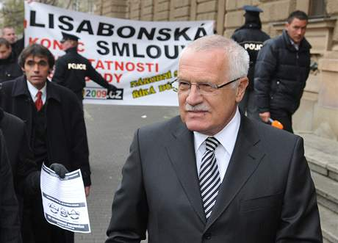
EXAMPLES OF CZECH EUROSCEPTICISM

Slide 14
OSTALGIE: PANE PREZIDENTE (Mr. PRESIDENT) https://www.youtube.com/watch?v=hyc0cZIZ_Z8
Mr. President, constutional representative,
I’m writing you a complaint that my childern have forgotten me.
it’s about my son Karel (Charles) and the younger daughter Eva,
they didn’t write for a year, neither did they come for a visit a year.
You will understand it
you know everything (- that is to say)
you will consult it, you will resolve it
you will save me.
Mr. President,
I just ask for a piece of happiness,
for what else did we tinkle with the keys
in the town square? (This refers to the Velvet Revolution.)
Mr. President, and I’m complaining as well that they marked up (to me) the beer, yoghourt, sausages and even the trolleybus and even the postage stamps, and the notepads, even the veal shoulder, (holiday in) Greece and Germany - simply everything.
You will understand it you know everything (- that is to say) you will consult it, you will resolve it you will save me. Mr. President, I just want a piece of happiness, for what else did we tinkle with the keys in the town square?
Mr. President of my Czech Republic, they fired me at an hour’s notice from my factory, for all the thirty years everything was perfectly all right, and now some young ones have come, and they act like on Klondike.
You will understand it, you sympathize with me, you will consult it, you will resolve it you will save me. Mr. President, I just want a piece of happiness, for what else did we tinkle with the keys in the town square?
Mr. President, my Anežka (Agnes), if she was still alive, would nearly kill me for this letter I’m writing right now, she would say: “Jaromír, you act like a child, do you know how many concern he has with the whole Europe, the Universe and everything?“
You will understand it you know everything (- that is to say) you will consult it, you will resolve it you will save me. Mr. President, I just want a piece of happiness, for what else did we tinkle with the keys in the town square? Mr. President…

Slide 15
CZECH REPUBLIC 2017 ELECTION

Slide 16
CURRENT/FUTURE LEADERS
Andrej Babiš
Miloš Zeman + Donald & Melania Trump
Tomio Okamura: We will stop the illegal immigration and the dictate of EU!

Slide 17
THANK YOU FOR YOUR ATTENTION

