Slide 1
Theories of democratization
Richard Q. Turcsanyi

Slide 2
Democracy: defining features
Rule of majority
Elections and accountable government
Protection of minorities
Rule of law
Division of power
Civic and political liberties
Market economy
Free media
--> Liberal democracy

Slide 3
How to assess/measure democracy?
Freedom in the World Index (https://en.wikipedia.org/wiki/Freedom_in_the_World, https://freedomhouse.org/report/methodology-freedom-world-2017)
  Political rights: Electoral Process, Political Pluralism and Participation, and Functioning of Government
  Civil rights: Freedom of Expression and Belief, Associational and Organizational Rights, Rule of Law, and Personal Autonomy and Individual Rights
Bertelsmann Transformation Index (https://www.bti-project.org/en/index/methodology/, https://www.bti-project.org/en/index/status-index/)
  Political transformation (free elections, civil rights, stateness, rule of law, etc)
  Economic transformation (private property, economic performance, market economy, etc)
Other indices
  https://en.wikipedia.org/wiki/List_of_freedom_indices

Slide 4
Case studies
(https://en.wikipedia.org/wiki/List_of_freedom_indices)
Czech Republic: Free (1-1)
South Korea: Free (2-2)
Hungary: Free (3-2)
Indonesia: Partly Free (2-4)
Thailand: Unfree (6-5)

Slide 5
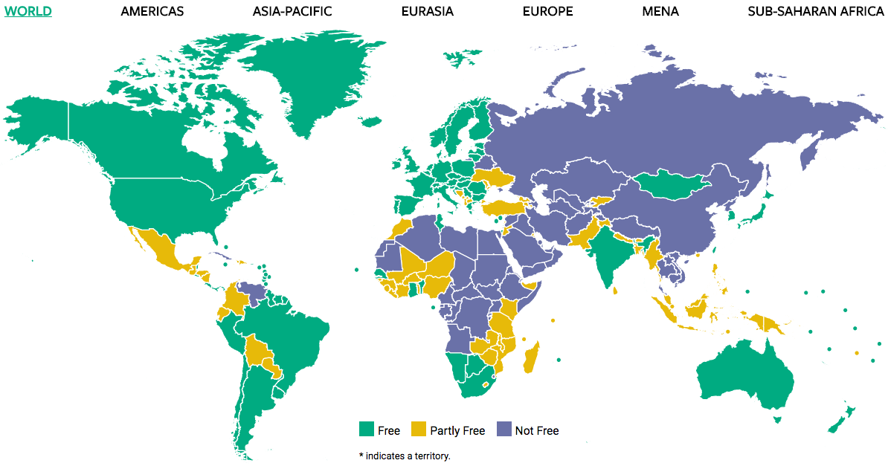

Slide 6
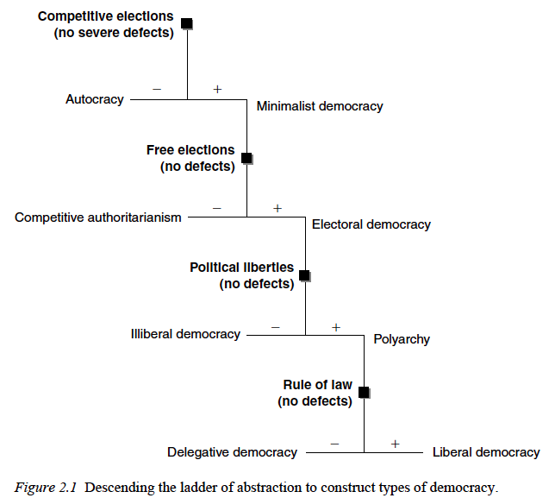
Moller-Skaaning: hierarchical „ladder“ theory
Political liberties: free speech, opinion, right to protest
Rule of law: equal treatment under the law, minority rights and protections

Slide 7
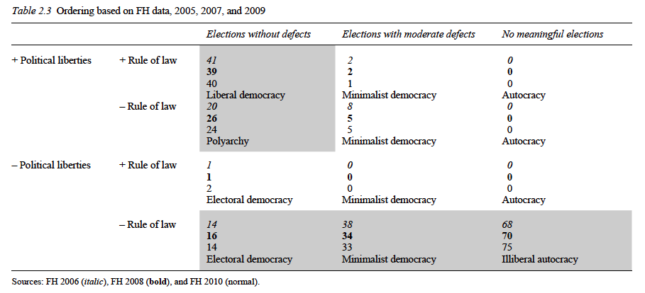

Slide 8
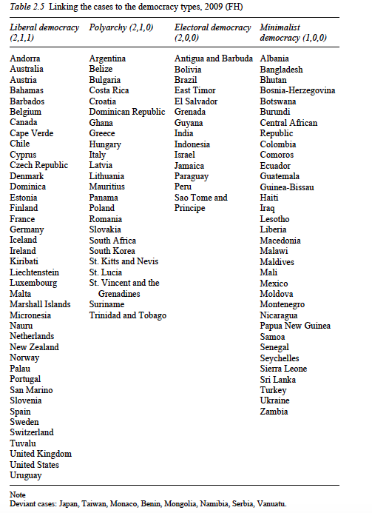

Slide 9
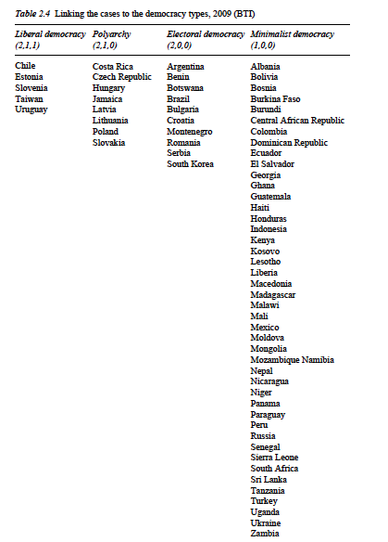

Slide 10
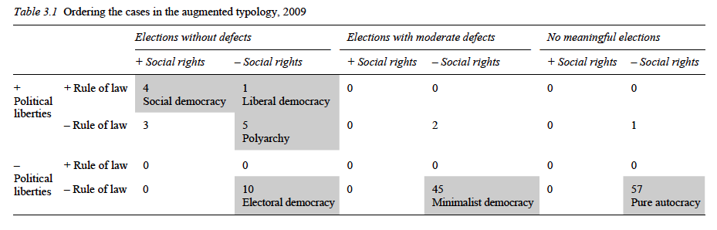
Additional factor: Social rights

Slide 11
Additional factors
Stateness
Wealth
Market economy
Vibrant civil society
Role of religion
Ethnic fragmentation
Natural resources
Others

Slide 12
Sequence of democratization
UK/USA: rule of law → political liberties → election rights → social rights
PL/HU: rule of law → election rights/political liberties → social rights
Taiwan/South Korea: rule of law* → social rights/political liberties → election rights
China: rule of law* → social rights/political liberties? → election rights?

