Slide 1
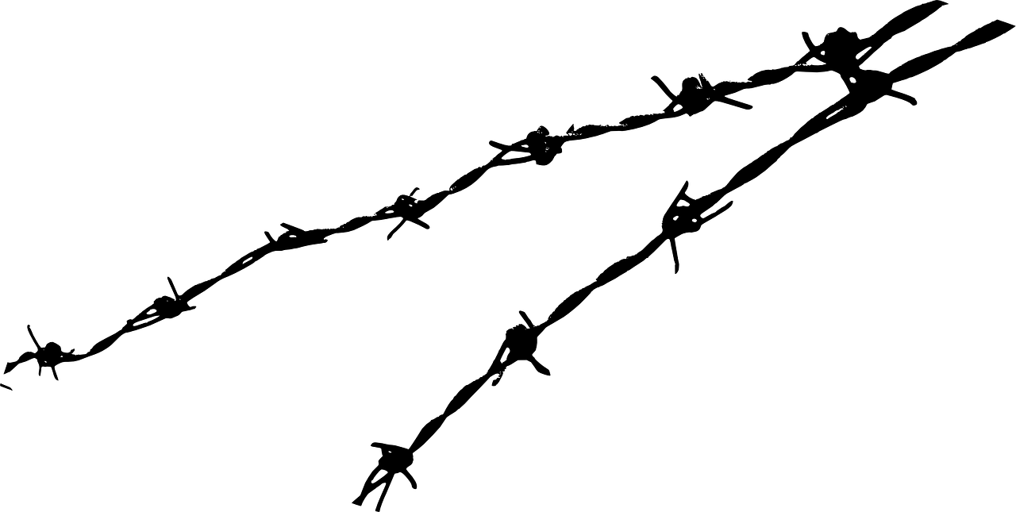
Approach to Migration in Europe and V4 Countries
Session 1
Anna Láníčková

Slide 2
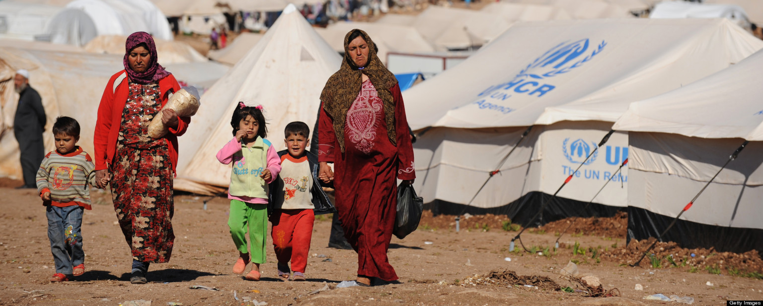
Intro - Videos
Amnesty international: When you don´t exist
  https://www.youtube.com/watch?v=_OUpsWCvE38
Czech Detention Center – worse than a prison?
  https://www.youtube.com/watch?v=JNamlcoWw_I

Slide 3
Introduction
- International Law, EU law, National Law
International protection
legal migration
  Visas, permits, no entitlement (but family reunification, family of EU citizens)
  EU citizenship – free movement of persons (EU citizens and family members)
  European law (but work permits,!seasonal workers, university academics)
illegal migration
  „Words matter“ campaign – illegal, undocumented, irregular
  “Since the word ‘illegal’ has become a stigma in my everyday dealing with people, I started to ask myself whether I was really illegal. Of course, I am not and will never be. I am undocumented.”
  No visa, no permit, no document, overstays, false identity
returns – expulsion, voluntary return (or assisted), forced return
EU agencies: EASO, FRA, Frontex

Slide 4
Terms and definitions
Non-refoulement
  No State shall expel or return (refouler) a refugee in any manner whatsoever to the frontiers of territories where his life or freedom would be threatened on account of his race, religion, nationality, membership of a particular social group or political opinion.
International protection: Asylum, Subsidiary protection
Internally Displaced Person
Stateless person – not considered to be a national by any state
Returnee

Slide 5
Sovereignty of the State
  Right to check the regularity of entry (visa, permits – EU: lists of countries)
  Prohibition to expell its own citizens, obligation to accept its own citizens, not foreigners
  The state can set up the conditions for admitting the foreigners
  BUT international obligations (IP), EU law
  No obligation to let a foreigner to enter – but! Non-refoulement!
    Obligation to let him ask for IP (but Dublin regulation in EU)
    Right to asylum – right to fair proceedings

Slide 6
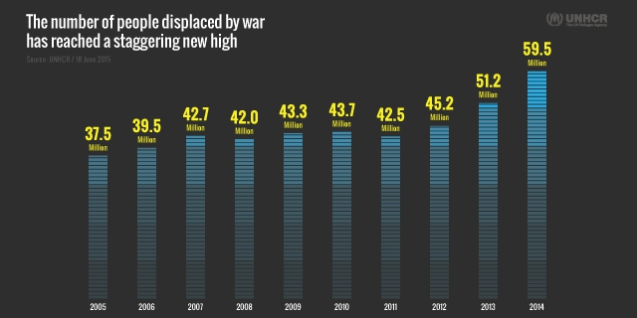

Slide 7
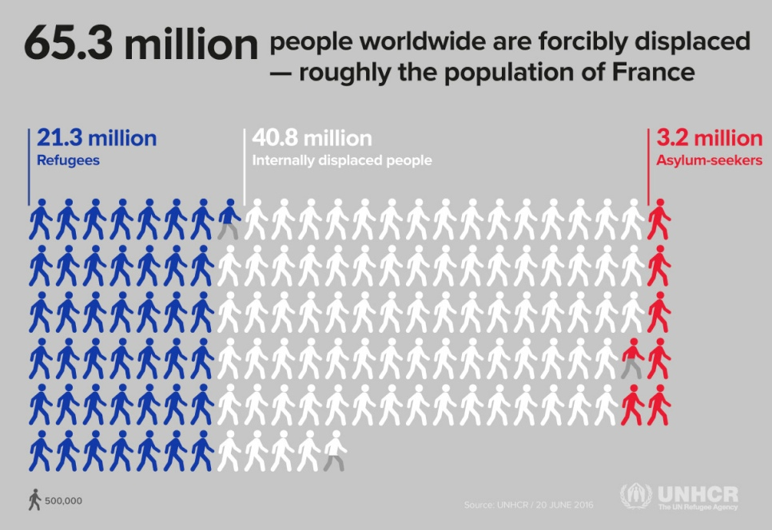

Slide 8
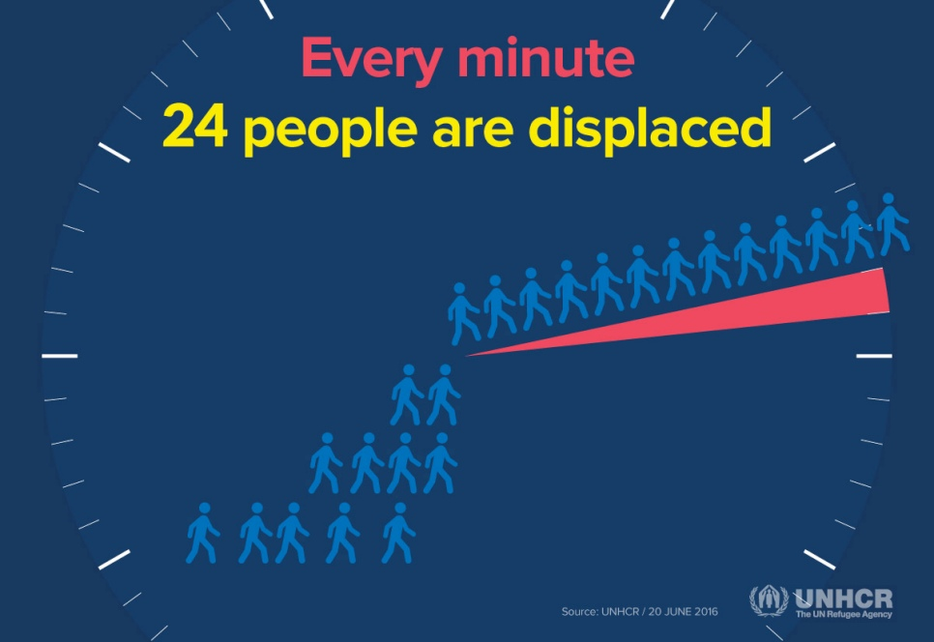
ED

Slide 9
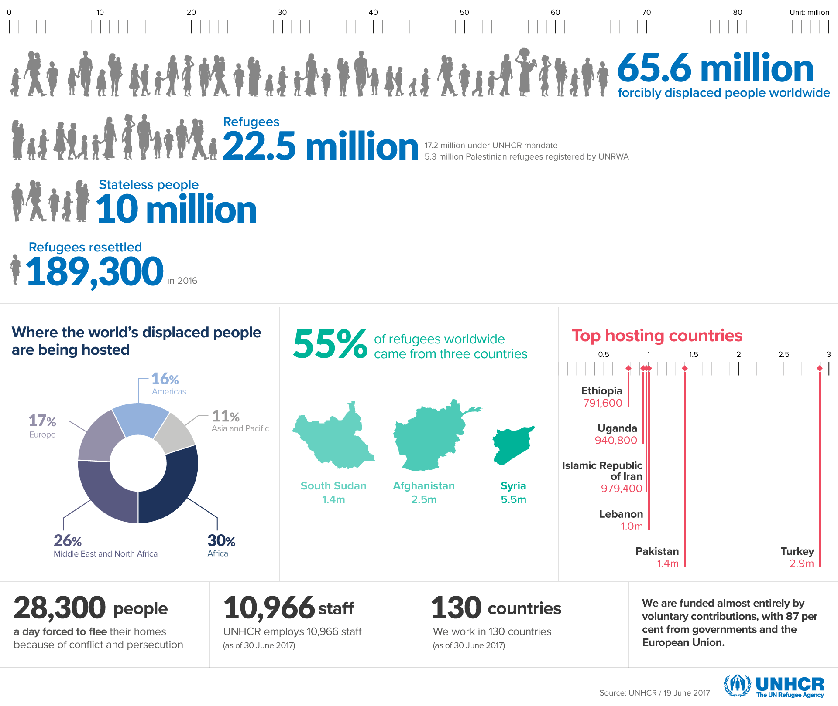

Slide 10
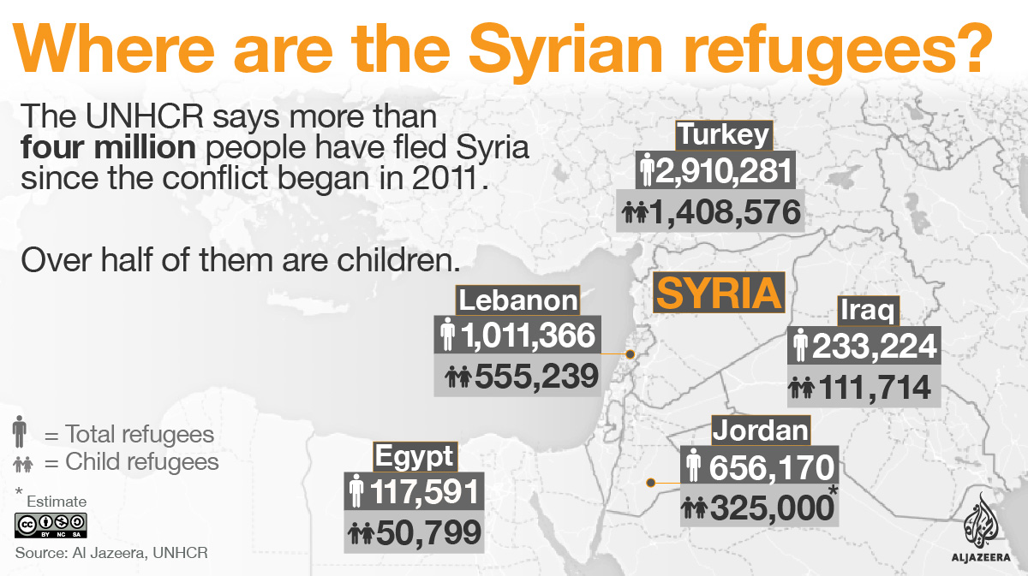

Slide 11
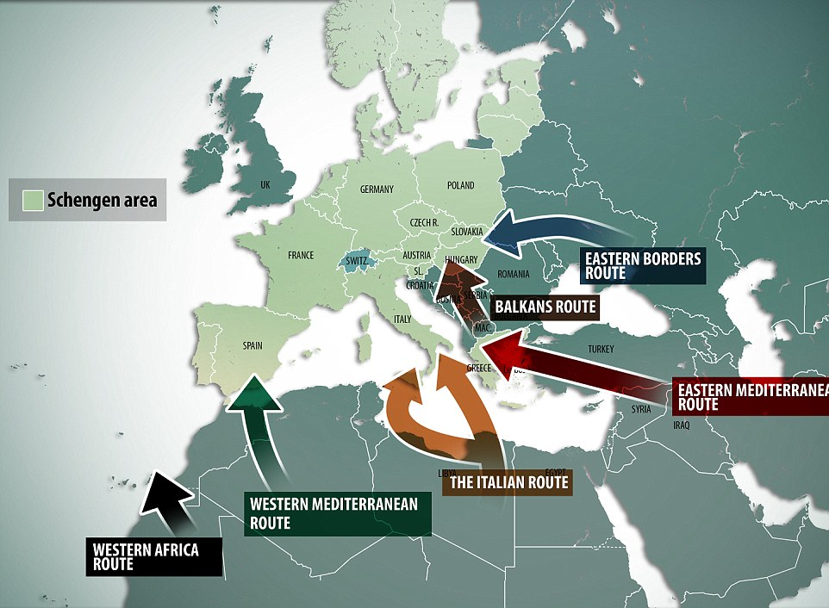

Slide 12
Number of international protection claims in 2016 (EU,Norway and Switzerland)

Slide 13
Year 2016 in numbers – EU+
The biggest number of registered asylum seekers come from Syria (26% of all the claims) Afghanistan, Iraq, Pakistan and Nigerie
Reception countries: Germany, Italy, France, Greece and Austria
Almost one third of asylum seekers is under 18
More than 65 000 are unaccompanied minors (37 % Afghani)

Slide 14
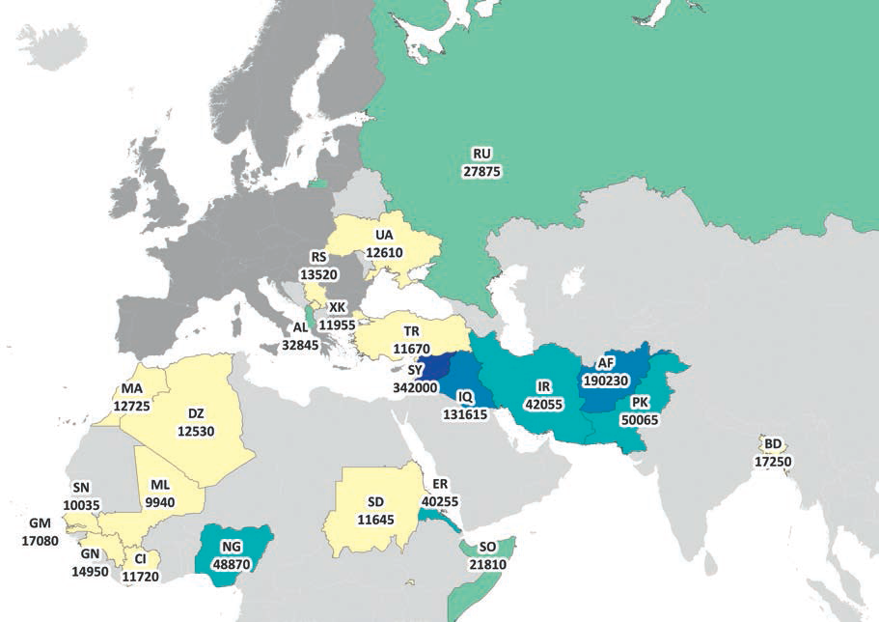
IP claims - COI

Slide 15
International protection claims -2017 in EU (+ Norway, Switzerland, Liechtenstein and Iceland)

Slide 16
International protection in the Czech Republic
- claims

Slide 17
IP claims – nationalities 2016

Slide 18

History:
After the IWW. Almost 1 mil Russians outside of their country, citizenship revoked– Nansen passport (16 coutnries, incl. Czechoslovakia, then 52 countries).1933 broadened – Armenian, Turkish refugees
  S. Rachmaninoff,M. Chagall, V. Nabokov, I. Stravinsky
  Czechoslovkia accepted 25000 of Russian refugees, health care, funding for students, employment, food, housing
Diverse conventions – Germany 1938, Austria 1939, ressetlement to Palestine
Unification - 1951 Refugee Convention (+1967)

Slide 19
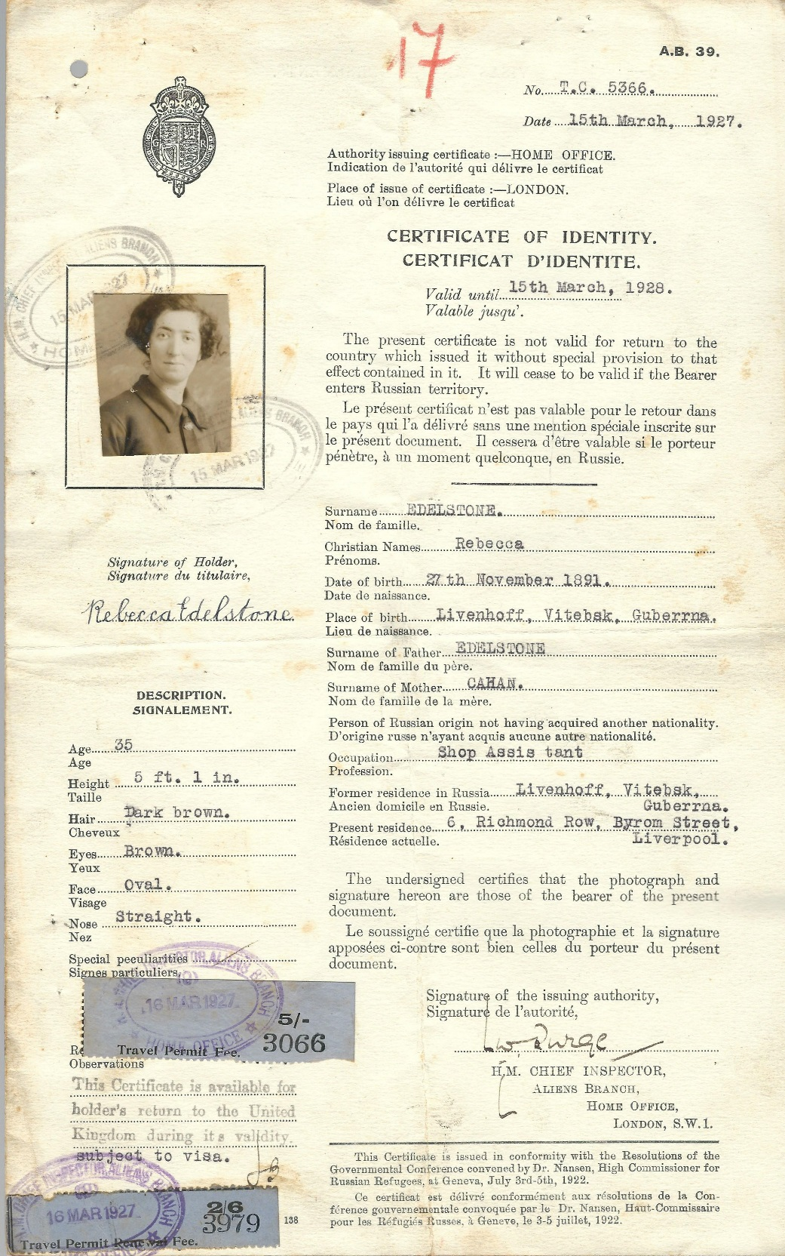
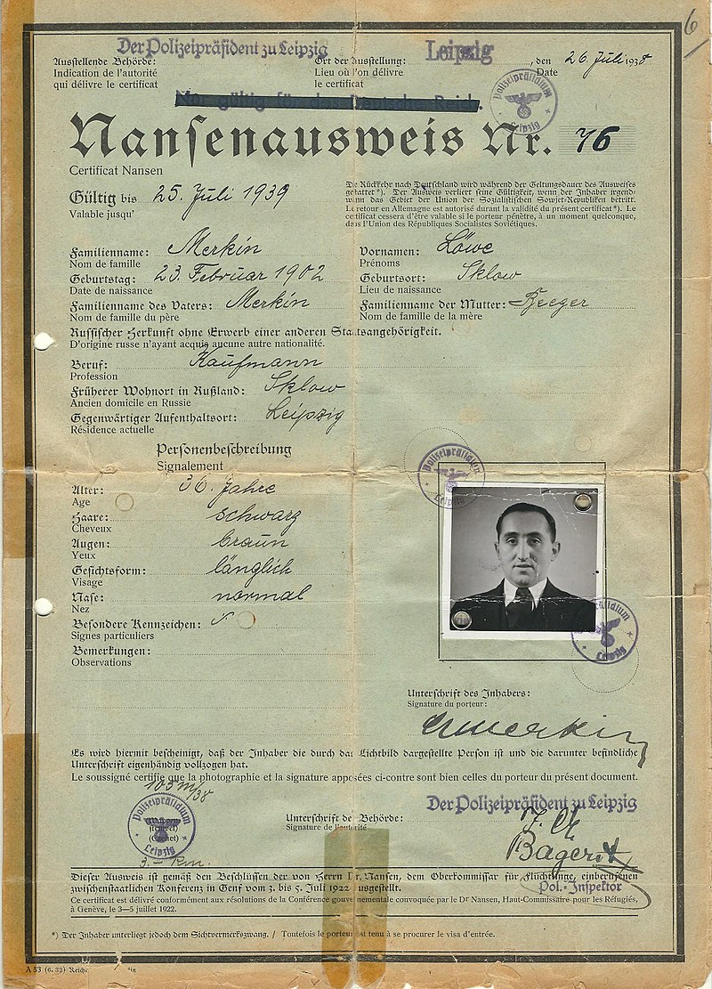

Slide 20
Legal Instruments - International Protection
Interactive map: https://is.muni.cz/do/law/kat/kupp/hrim/index.html
International Law
  Refugee Convention 1951
EU law – Common European Asylum System (+ Returns, Frontex)
  EU Directives →→→ National law
    Asylum Procedures Directive
    Reception Conditions Directive
    Qualification Directive
  EU Regulations
    Dublin Regulation
    EURODAC Regulation
European Court of Human Rights
+
Court of Justice of the European Union

Slide 21
Convention relating to the Status of Refugees (1951)
Originally just for the incidents before 1951 (+ Protocol 1967)
Outside of the country of his nationality
Well-founded fear
Persecution
Race, religion,nationality, membership of a particular social group, political opinion
Unable/unwilling to avail himself the protection (State actors, non-state actors)

Slide 22
Refugees´rights
Non-refoulement
  No State shall expel or return refouler a refugee in any manner whatsoever to the frontiers of territories where his life or freedom would be threatened on account of his race, religion, nationality, membership of a particular social group or political opinion.
Refugee convention deals with the rights – access to employment, housing, public education, social security, freedom of movement, travel documents – usually in regars to the rights of citien – same level, lesser level
Czech law – permanent residency, language course, employment, health care
The proceedings finished? Status granted (asylum, subsidiary protection) or expulsion

Slide 23
No protection to:
The provisions of this Convention shall not apply to any person with respect to whom there are serious reasons for considering that:
(a) He has committed a crime against peace, a war crime, or a crime against humanity, as defined in the international instruments drawn up to make provision in respect of such crimes;
(b) He has committed a serious non-political crime outside the country of refuge prior to his admission to that country as a refugee;
(c) He has been guilty of acts contrary to the purposes and principles of the United Nations.

Slide 24
Subsidiary protection
– protection for those who do not qualify as refugees
third country national or stateless who would face a real risk of suffering serious harm if s/he return to the country of origin.Serious harm is defined as the risk of:
"(a) death penalty or execution; or
(b) torture or inhuman or degrading treatment or punishment of an applicant in the country of origin; or
(c) serious and individual threat to a civilian's life or person by reasons of indiscriminate violence in situations of international or internal armed conflict."

Slide 25
Thank you for your attention!
Anna Láníčková
anna.lanickova@seznam.cz

