Slide 1
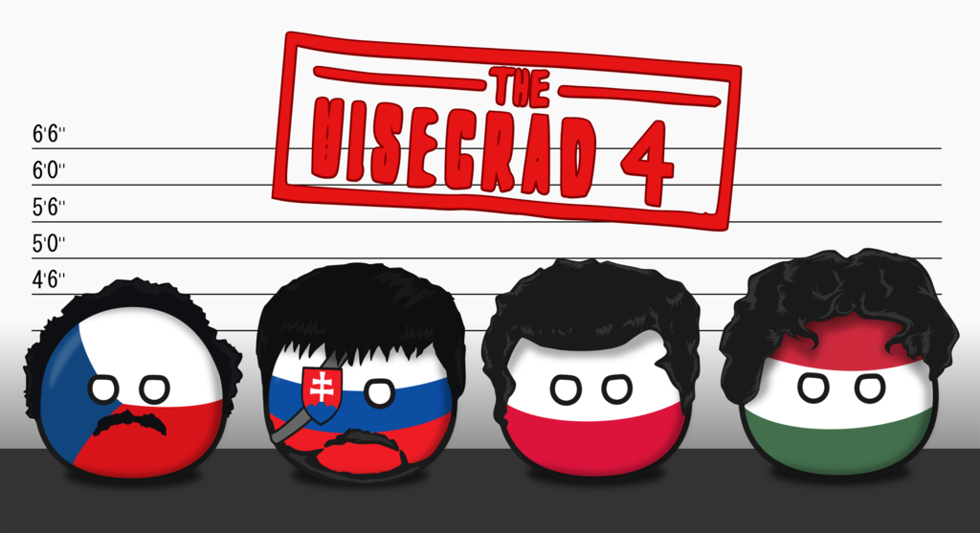
Chinese Greenfield Investment in V4

Slide 2
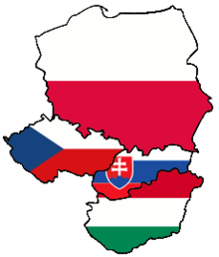
Visegrád 4
Visegrád Group, V4
15 February 1991 (as Visegrad Triangle)
– the Czech Republic, Hungary, Poland and Slovakia
2004 EU
2011 16+1
Czech Republic (USD 36,784 per capita)
Slovakia (USD 35,095 per capita)
Poland (USD 31,430 per capita)
Hungary (USD 31,370 per capita)

Slide 3

Greenfield investment
vs. brownfield investment
Two main types of foreign direct investment (FDI)
Greenfield
creation of a firm from scratch, or the extension of existing production capacity by non-resident investors
it directly generates additional economic activity
Brownfield
captures cross-border mergers or acquisitions of existing domestic firms

Slide 4
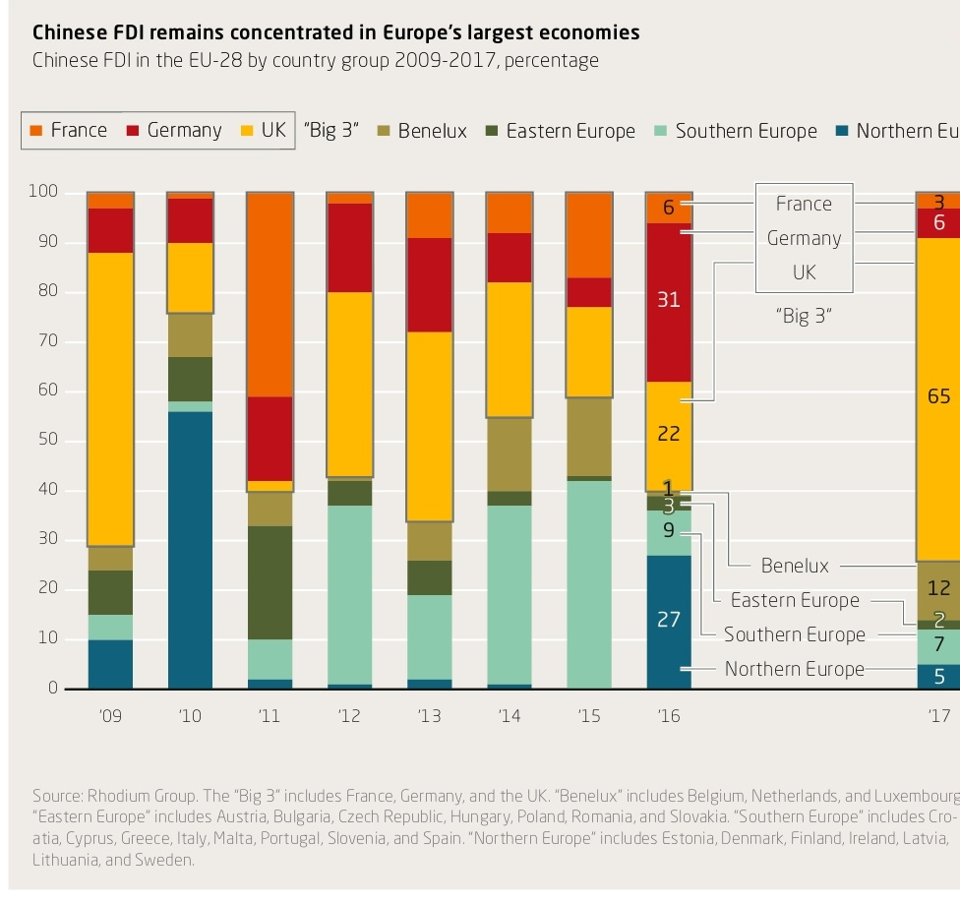
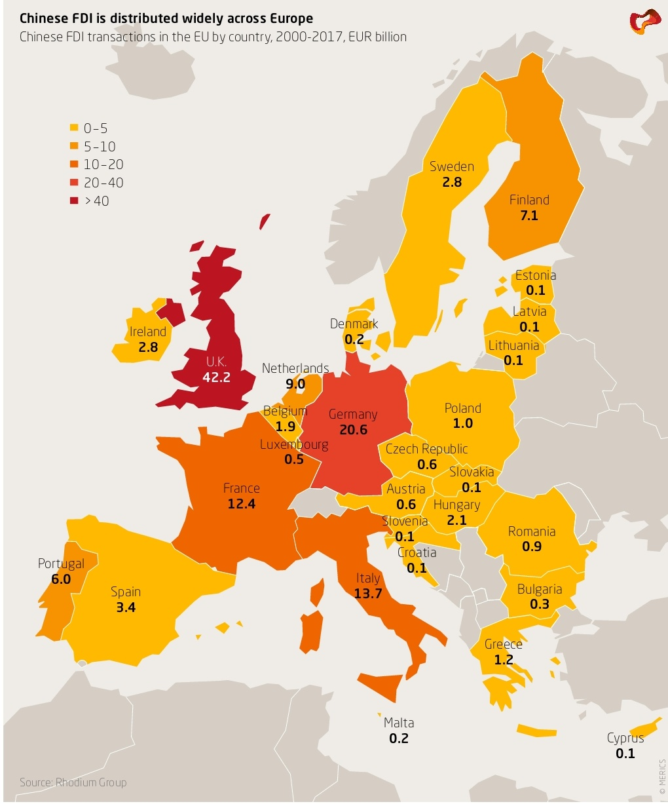
Chinese investments in V4 vs. Europe

Slide 5
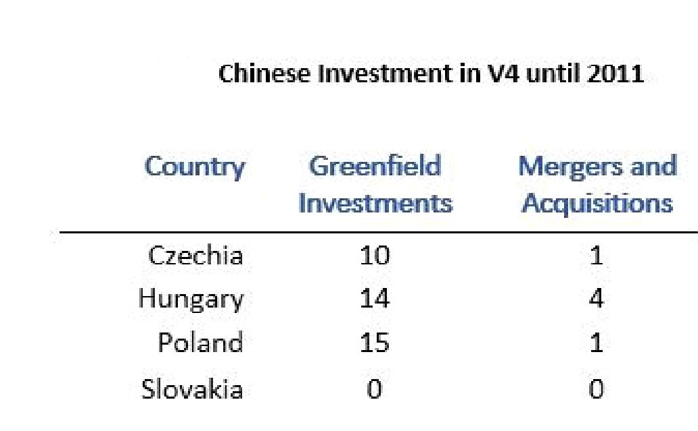
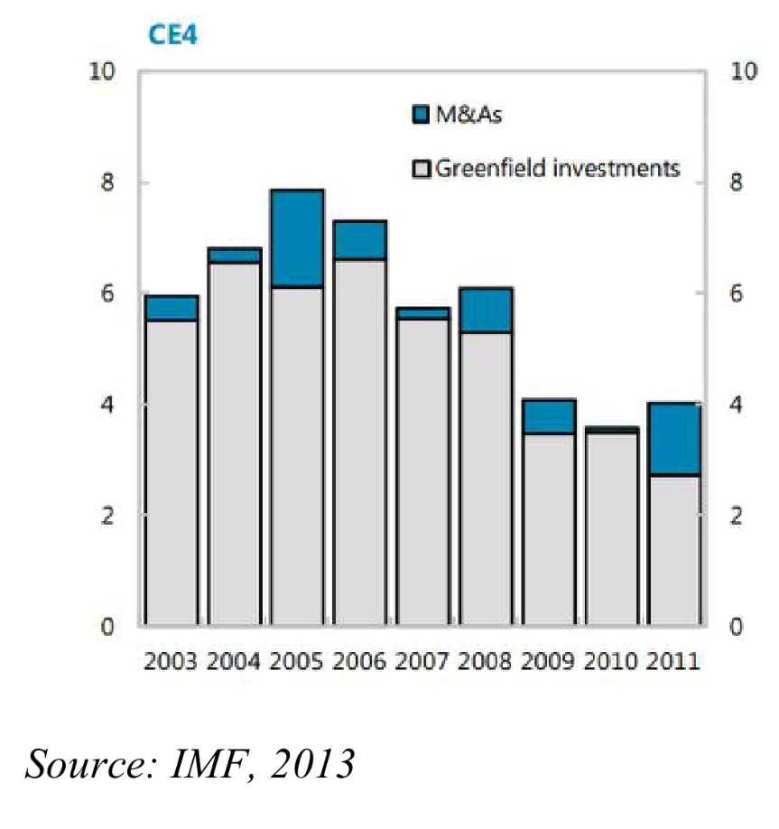
Chinese greenfield investments in V4
Breakdown of FDI into greenfield and M&A
(Percent of GDP)

Slide 6
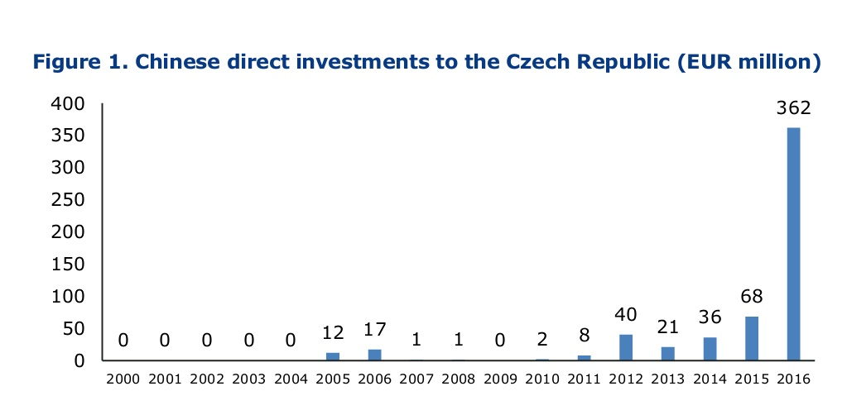
CZECH REPUBLIC
2016 visit of Xi Jinping in Prague - investment memorandum and agreements
CEFC acquisitions
Stable greenfield investment growth in electronics, engineering sectors
Reasons for investments:
strategic location
excellent connectivity
well-skilled labour force (and cheap)

Slide 7

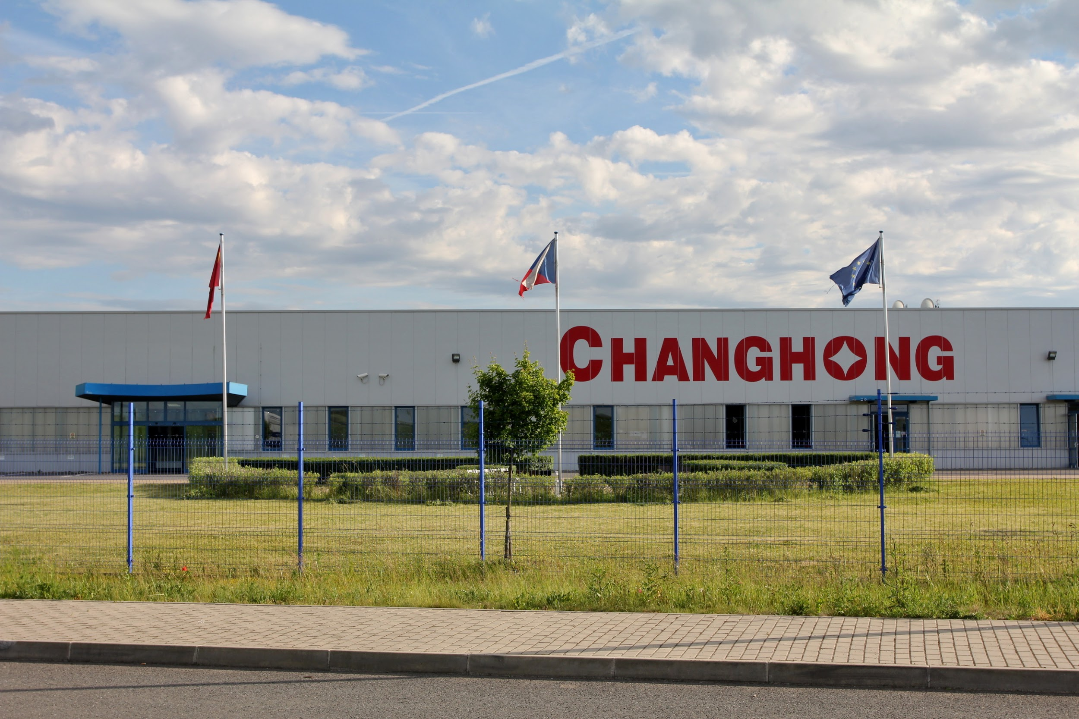
Changhong Europe Electric
LCD and LED TV manufacturer
Nymburk, 2005
Production of 1 million LCD TV´s per year
Employs 400 people

Slide 8
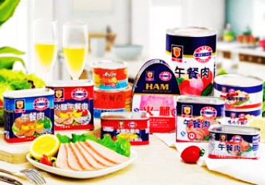
Shanghai Maling Aquarius
Food producer
Teplice, 2008
Should employ 150 people, produce 10 000 tonnes of canned food per year
Reality: only 20 employees, production less than 15% of the planned capacity
Cause of failure: trademark dispute

Slide 9
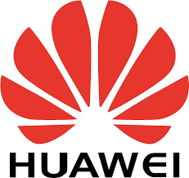

Huawei & ZTE
Cooperate with local mobile phone operators,sale of mobile phones and smartphones
Employ 350 people
Huawei plans to invest over 360 million USD, employ 4000 people within five years

Slide 10
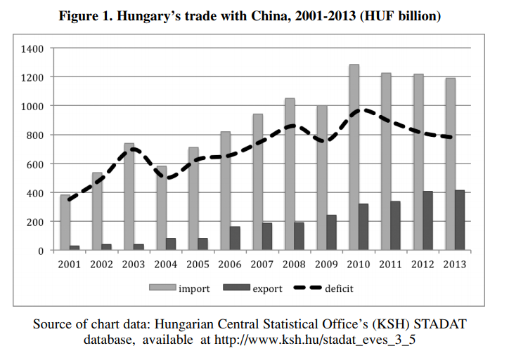
HUNGARY
2010 Eastern Opening
Regarding imports, China is third
most important trading partner
(2016)
Reasons for investment:
excellent geographic location
access to EU markets
favorable political environment

Slide 11
Company | Sector | Year | Total Value (estimate, EUR million) | Result
Yanfeng Automotive Interiors | Automotive | 2004 | 25 | Success
Huawei | ITC | 2005 | 300 | Success
ZTE | ITC | 2005 | 15 | Success
Livan Biodegradable Product | Biotechnology | 2007 | 18 | Failed
Lenovo-Flextronics | ITC | 2009 | NA | Success
Shanghai Construction Group | Cargo Airport | 2009 | NA | Failed
Orient Solar | Solar panels | 2011 | NA | Failed
BYD | Electric buses | 2016 | 20 | Success

Slide 12

BYD - Build Your Dreams
BYD is one of China's largest businesses
Initially specializing in rechargeable battery technology
--- electric-powered public transportation
2017 Komarom, Hungary
production capacity: 400
startup crew: 32 employees (then 300)
Isbrand Ho, Managing Director of BYD Europe:
“Firstly, because of its central location and its long tradition of engineering excellence, but also we are very conscious of the strong heritage of bus making in this immediate area. Now the government is reinforcing that industry and we are proud to be at the forefront of that movement”.

Slide 13
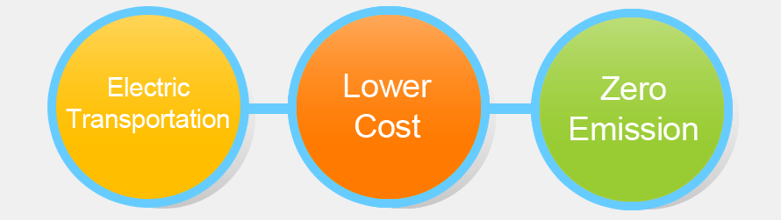
Green City Solution

Slide 14


Slide 15
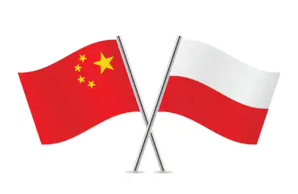
POLAND
2011 visit of Polish president in China Document on establishing a strategic partnership
2016 Xi Jinping visited Poland Comprehensive strategic partnership format
Biggest land area and population in CEE
Close economic and trade ties with China (biggest trade partner among CEE)
Economic and financial stability
Highly educated human capital (and relatively cheap)
Strong position in EU...
Why Poland?

Slide 16
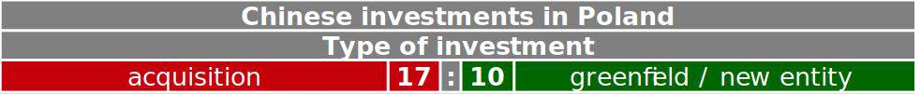
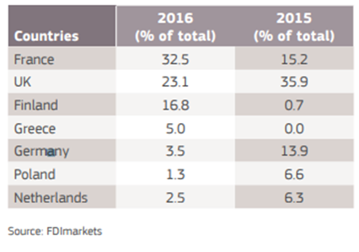
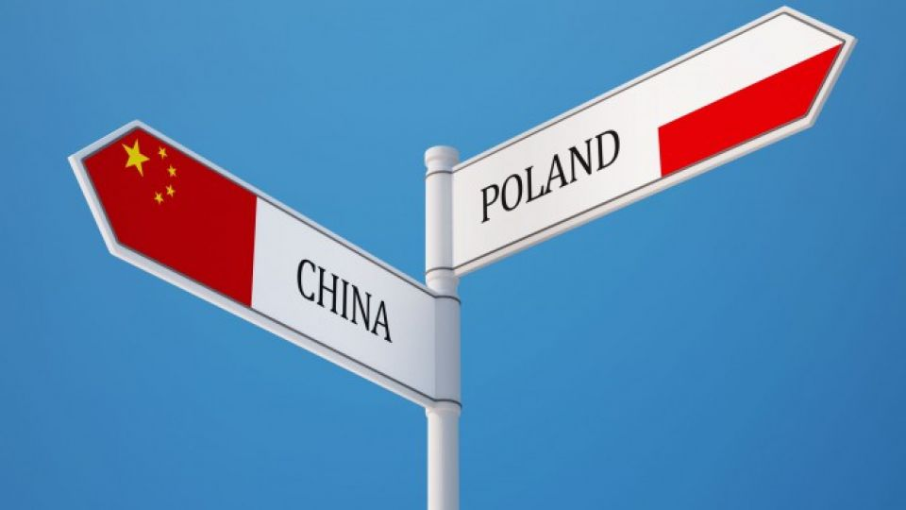
WHAT POLAND WANTS X WHAT CHINA WANTS
Top recipients of Chinese greenfield FDI, by Member State, 2015-2016:

Slide 17



Guotai-Huarong car batteries factory
the only new significant greenfield project this year
investment valued at USD 45 million (EUR 38.6 million)
the plan: build a factory for its flagship product in Godzikowice, in south-west Poland by 2020
initially will employ 60 people, eventually will create about 100 workplaces
Hongbo Clean Energy (Europe) Co., Ltd
the project is located in southwestern Poland
It uses a greenfield investment model with a total investment of 100 million US dollars to build LED lighting equipment.
created approximately 100 workplaces
In August 2017, the first phase of the factory passed the acceptance and production, and supplied it to the IKEA European market
(http://chinaplus.cri.cn/news/business/12/20180820/172809.html 1:57)
Nuctech Warsaw
a global provider of technology services in the fields of security and inspection for customs, airports, ports, railways and major events
office and production plant in Kobyłka covering an area of 6,000 square meters
investment valued at 11 million U.S. dollars

Slide 18
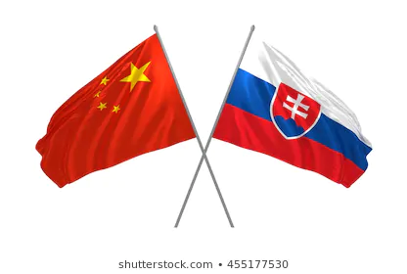
SLOVAKIA
complicated foreign policy towards China
no Chinese investments prior 2007 in general
not a typical developed country with desired technology or brands
not a developing country rich on primary materials
a small country
landlocked geographical position
shortest border with western countries...
Why not?

Slide 19
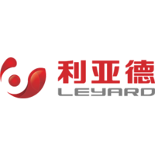
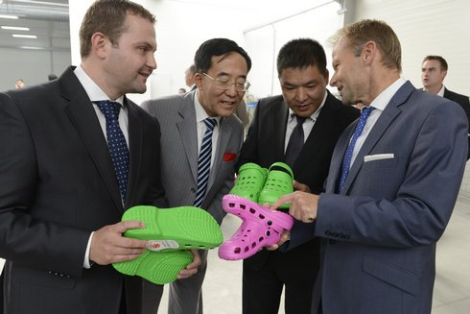

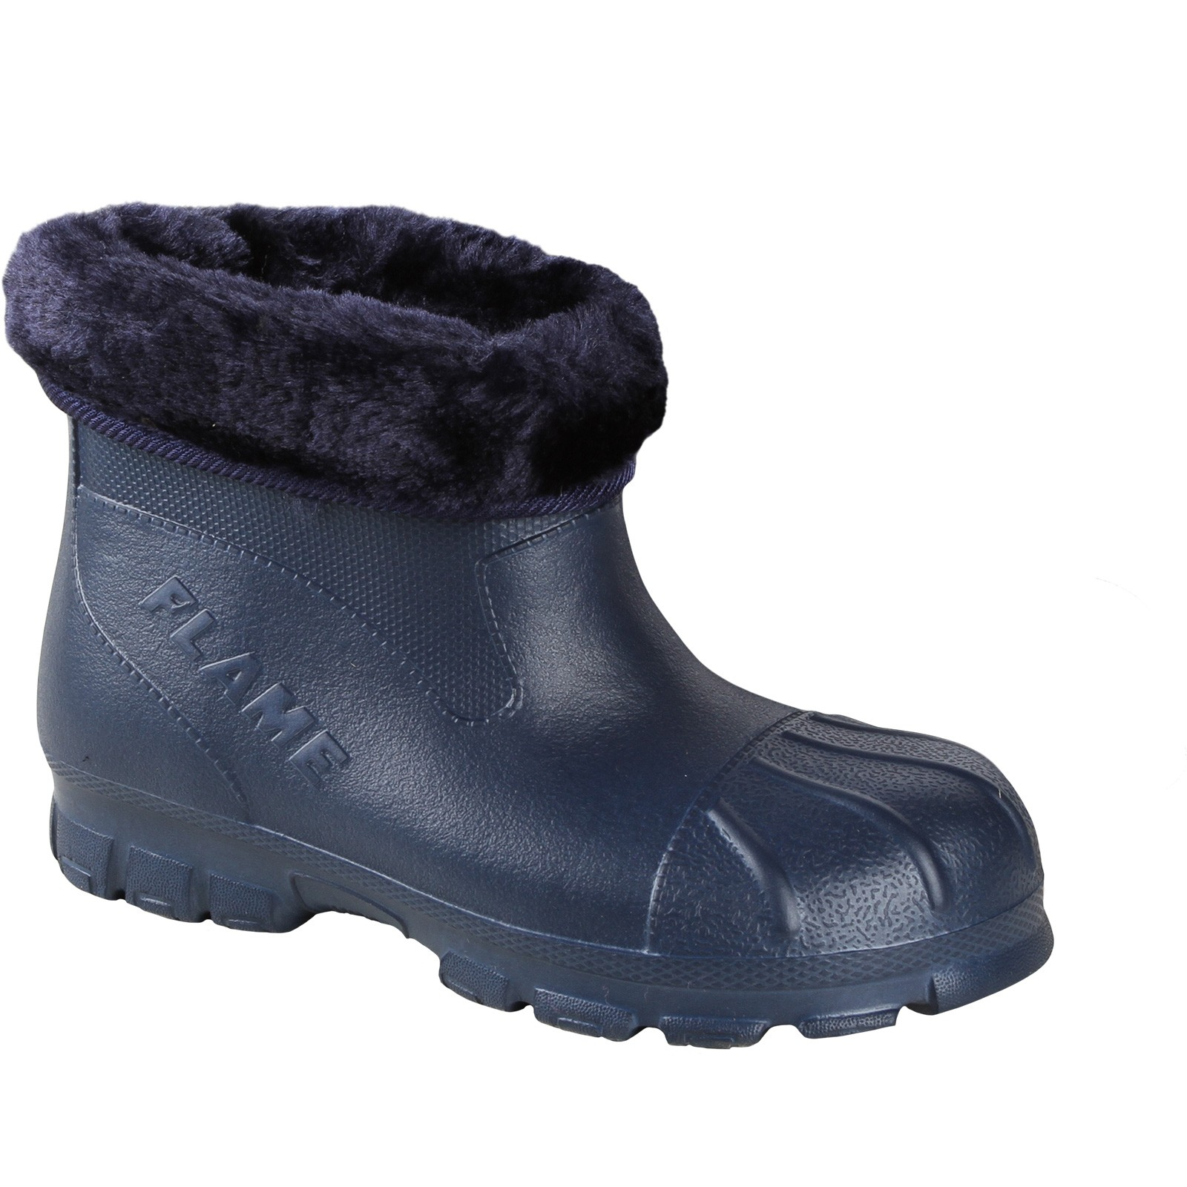
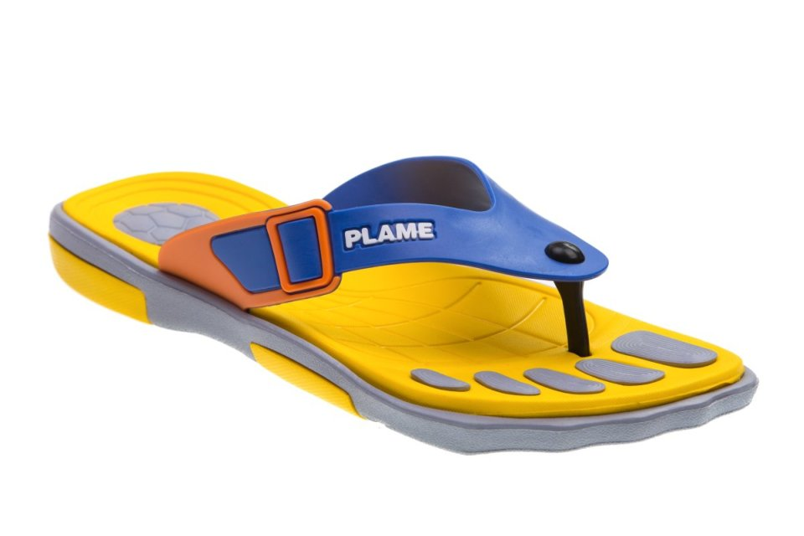
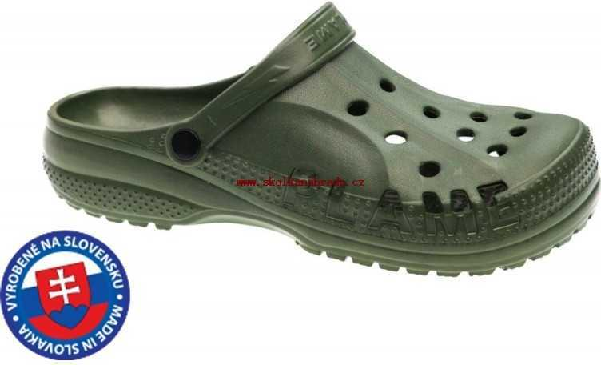
Leyard Shenzhen Opto Electronics
production facility for large-scale display screens
investment valued around 2,6 million USD with a planned further 3,4 million USD investment
created around 200 workplaces
Flameshoes s.r.o.
Chinese investor opened a new plant (2015) focused on a shoe production
investment valued around 16 million USD (Slovakia paid 5 million USD)
created around 200 workplaces

Slide 20



Slide 21
http://ies.cass.cn/english/chinare/cere/201411/t20141105_2464733.shtml
https://sinopsis.cz/en/chinese-fdi-in-poland-still-just-wishful-thinking
https://polandin.com/37446245/chinese-company-to-invest-usd-45-mln-in-poland-to-build-factory
http://westdollar.com/sbdm/finance/a/20181117987250276.html
http://chinaplus.cri.cn/news/business/12/20180820/172809.html
http://en.thholding.com.cn/2017-10/18/c_107229.htm
http://www.chinadaily.com.cn/a/201809/29/WS5baf33d5a310eff3032804bf.html
http://www.xinhuanet.com/english/2017-10/16/c_136681761.htm
http://europe.chinadaily.com.cn/a/201809/29/WS5baf33d5a310eff3032804bf_2.html
http://chinaplus.cri.cn/news/business/12/20180820/172809.html
https://presov.korzar.sme.sk/c/7995693/cinsky-investor-otvoril-v-kruzlove-zavod-na-vyrobu-obuvi.html
https://www.researchgate.net/profile/Rudolf_Fuerst/publication/322068573_The_Czech_Republic_Receiving_the_First_Relevant_Chinese_Investments/links/5a4242fdaca272d29458f0c2/The-Czech-Republic-Receiving-the-First-Relevant-Chinese-Investments.pdf
https://finweb.hnonline.sk/ekonomika/804882-cinsky-gigant-stavia-v-presove-svoju-jedinu-fabriku-v-europe
https://byznys.ihned.cz/c1-65734600-cinsky-huawei-bude-v-cesku-investovat-pres-8-5-miliardy-korun-ma-plan-vytvorit-az-4000-pracovnich-mist
https://teplicky.denik.cz/podnikani/krachujici-hrobcicka-konzervarna-shanghai-maling-ma-noveho-majitele-20170703.html

