Slide 1
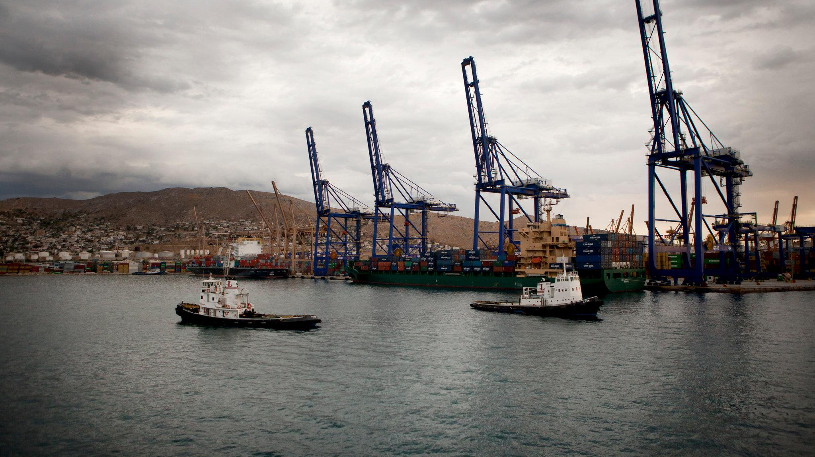
China’s Acquisition of Piraeus Port in Greece
By Eddi Stones and Mason Hayes
Photo from New York Times

Slide 2
Piraeus’ Historical and Contemporary Importance
Traditionally the hub of Greek maritime economic activity
Both military and commercial harbor since circa 400 B.C.E.
It is currently the 8th largest port in Europe
3rd largest port in Mediterranean

Slide 3
Greek Financial Crisis
Required to begin privatization after taking significant bailouts from EU, IMF and European Commission
Greece’s current debt to GDP ratio is 182% (2017)
Piraeus Port Authority was previously owned by the Greek government
An important reason that it was so inefficient and outdated
Lack of competition, overpaid workers, no incentives to innovate
Greek government has no money to invest in the port

Slide 4
COSCO’s Significance
China Ocean Shipping Company
In 2016 COSCO Group and China Shipping Group merged to create China COSCO Shipping
State-owned enterprise with financial support of Chinese state-owned banks
COSCO has been able to operate the port terminals much better than the Greek-owned terminals
COSCO plans to invest nearly $1 billion over the next 10 years
COSCO has had a presence at Piraeus since 2009 when it was leasing rights to use the terminal

Slide 5
Greek View of EU
Europeans acting like ‘medieval leeches’ towards Greece while China keeps bringing money (Douzinas, Greek foreign affairs and defense minister)
In Greece’s view, the EU has treated Greece very badly since the government debt crisis
EU bailouts didn’t help them as much as promised
Immigration crisis has worsened their relationship with EU

Slide 6
Greece’s Relationship with China
Greece and China officially established diplomatic relations in 1972
Chinese investment has significantly influenced the relationship
Many Greeks see China as an economic alternative to EU
China is also seen as a threat that could eliminate even more jobs in Greece
Most importantly, Greece needs money and is not in a position to reject Chinese investments

Slide 7
China’s Goal in Greece and Europe
COSCO’s purchase of Piraeus Port is part of China’s Belt and Road Initiative (BRI)
Greece is China’s maritime entrance to Southern and Eastern Europe
China plans to invest in high-speed railways and other infrastructure in Greece and Central Europe

Slide 8
Greece’s Reaction to Chinese Investment
Domestic reaction to the Chinese takeover was initially hostile, with dock workers going on a 6 week strike at the beginning of the takeover.
COSCO have worked towards showing the Greek people they are there to work with them, currently employing 1200 Greek workers, with wages set at above average levels for Greece.
Initially COSCO only purchased half of the port in 2008, and since have bought up the remaining 2 piers, one of which they built, COSCO notably only hired Greek contracting firms for constructing the 3rd pier and made it a policy to work with as many Greek domestic firms as possible
Domestically the Greek government is still committed to privatising the port entirely, with COSCO seen as the frontrunner, privatising the whole port and bringing the Chinese in as a significant investor in Greece is seen as the leftist Greek government distancing itself from the EU.

Slide 9
Outcome of Piraeus Port Acquisition
Greece’s left-wing government in principle opposes privatization
They have no choice but to privatize
There are 3 terminals in the port
COSCO now operates two of them, terminals II and III
Terminal I is hardly used because it is less efficient and more outdated
This is the one still owned by the government
Piraeus Port Authority generates 1/3 of its revenue from fees that COSCO pays to operate the other terminals
The port is now growing faster than ever

Slide 10
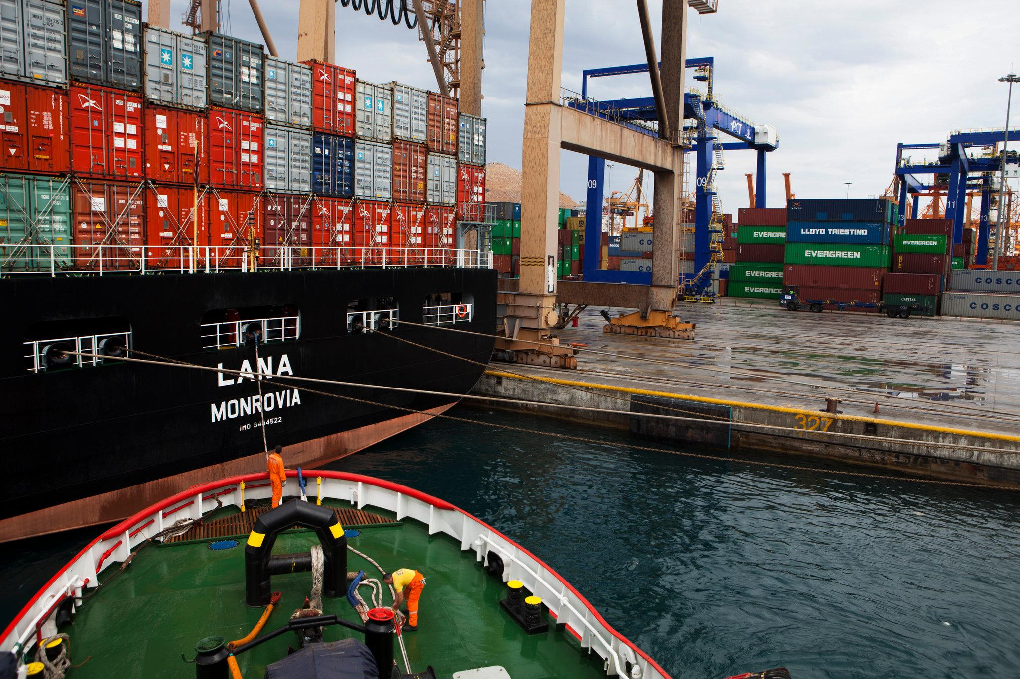
Photo from New York Times

Slide 11
China vs EU: Changing Political Scene
When EU wanted to condemn Chinese aggression in South China Sea, Greece voted no and prevented it
Greece has also prevented condemnation of China’s human rights violations and has voted against restrictions on Chinese investment in Europe
China’s purchase of Piraeus port and its promised future investments are seen as the primary reason for this political support
China’s economic influence has given it political pull in the region

Slide 12
What Will Come Next
Piraeus port is increasing in relevance both politically and economically
As COSCO continues investing money in Piraeus port, it will continue to grow and is projected to be the most important port in the Mediterranean Sea
In next 30 years, project 5.1 billion euros in revenue and 125,000 jobs in Greece from COSCO investment (Foundation for Economic and Industrial Research estimate)
Greece must balance worker protection and privatization

Slide 13
References
Alderman, Liz. "Chinese Company Sets New Rhythm in Port of Piraeus." The New York Times. October 10, 2012. https://www.nytimes.com/2012/10/11/business/global/chinese-company-sets-new-rhythm-in-port-of-piraeus.html?pagewanted=all&login=email.
Europe and China’s New Silk Roads Edited by: Frans-Paul van der Putten John Seaman Mikko Huotari Alice Ekman Miguel Otero-Iglesias ETNC Report December 2016 (https://www.clingendael.org/sites/default/files/pdfs/Europe_and_Chinas_New_Silk_Roads_0.pdf), pg. 30-34.
Fanni, Maráczi, Eszterhai Viktor, Klemensits Péter, and Anton Bendarzsevszkij. "The Geopolitical Significance of Piraeus Port to China." PAGEO Geopolitical Institute. March 19, 2017. http://www.geopolitika.hu/en/2017/03/19/the-geopolitical-significance-of-piraeus-port-to-china/.
"Greek Port Succeeds Under Chinese Leadership." The New York Times. August 23, 2015. https://www.nytimes.com/slideshow/2012/10/10/business/20121011_COSCO/s/20121011_COSCO-slide-M5ND.html.
Horowitz, Jason, and Liz Alderman. "Chastised by E.U., a Resentful Greece Embraces China's Cash and Interests." The New York Times. August 26, 2017. https://www.nytimes.com/2017/08/26/world/europe/greece-china-piraeus-alexis-tsipras.html.
Smoltczyk, Alexander. "One Port, Two Worlds: China Seeks Dominance in Athens Harbor - SPIEGEL ONLINE - International." SPIEGEL ONLINE. April 09, 2015. http://www.spiegel.de/international/business/china-seeks-gateway-to-europe-with-greek-port-a-1027458.html.

