Slide 1
China-CEE relations
Richard Q. Turcsanyi

Slide 2
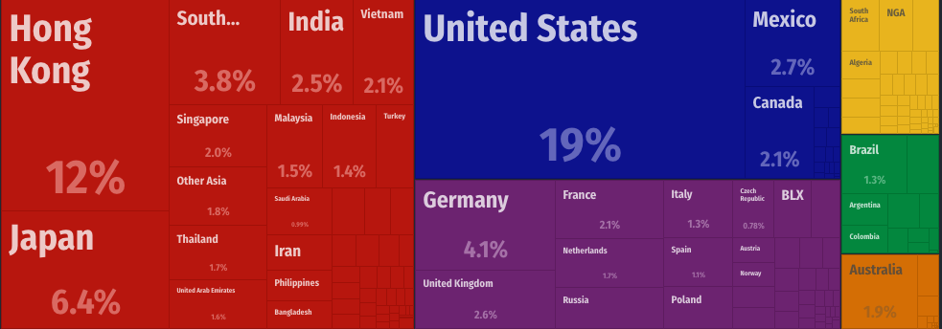
Chinese export partners

Slide 3
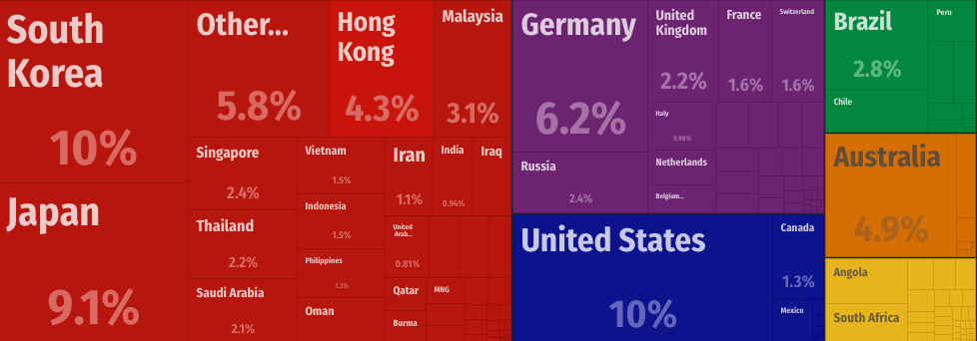
Chinese import partners

Slide 4
Central Europe and East Asia
Relations depended on political system
  1918-1939: first diplomatic contacts with China and Japan
  1945-1989: good relations with communist countries, low level of relations with capitalist countries
  1990 – 2007: vice versa
  2008 - presence: new era
Brief sum up:
  China: late start, today 16+1 platform
  Japan: investments, trade, V4+1 platform
  South Korea: investments, trade, political support
  Taiwan: investments, trade, political support
  North Korea: cold
  Russia: important economic partner, problematic politics

Slide 5
Chinese relations with CE
1990s-2000s: lack of interest on both sides
After 2008 crisis: China started to invest in Europe, CEE felt lack of FDI → development of relations
2011: First 16+1 meeting in Budapest
2012: First 16+1 heads of government summit in Warsaw, Wen Jiaobao → 12 point proposal
2013: First mutually agreed guidelines (Bucharest)
2015: 16+1 formally aligned with Belt and Road

Slide 6
Goals of 16+1: perspectives
CEE
  Economy! →Chinese FDI and CEE exports to China
EU: Economy OK
China
  Economic goals by political means?
  Political goals by economic means?
→ China-CEE “Pragmatic” cooperation

Slide 7
16+1 platform
Kapitola 1
2011: Budapest
2012: Varšava
2013: Bukurest
2014: Belehrad
2015: Suzhou
2016: Riga
2017: Budapest
2018: Sofia

Slide 8
16+1 vs. BRI
16+1
  Older (2011/2012)
  Mechanism for cooperation
  Aligned formally with BRI in Suzhou 2015
  Most of the CEE part of the developed world
BRI
  Initiative for long term goals
  Connectivity
  Most of the BRI part of the developing world
For BRI to succeed, it must adapt to differences → specially tailored approach to CEE (the only developed part of the BRI)

Slide 9
Goals of 16+1
Establishment of the secretariat at the Chinese Ministry of Foreign Affairs cooperating the relations with the CEEC,
Opening of a 10 billion USD special credit line to CEE countries for projects aimed especially at the development of infrastructure, high-tech industry and green economy,
Setting up a joint investment fund with the goal of raising 500 million USD in the first stage,
Sending trade and investment promotion missions to CEEC and reach 100 billion USD in common trade by 2015,
Establishing one economic and technological zone in each country in the next five years,
Exploring financial cooperation such as currency swap, local currency settlement for cross-border trade, and establishment of bank branches in each other’s countries,
Establishing an expert advisory committee on the construction of transportation network to explore the building of regional highway or railway demonstration networks through joint venture, joint contracting and other means,
Holding a forum on cultural cooperation and hold regular high-level and expert meetings on culture, cultural festivals and theme activities,
Providing 5 thousand scholarships to the CEEC students and host an education policy dialogue with central and eastern European countries next year,
Establish a tourism promotion alliance, explore the possibility of opening more direct flights between China and the CEEC, co-organize a tourism products promotion during the China International Tourism Mart in Shanghai 2012,
Establish a research fund on relations between China and CEEC to which China will contribute 2 million RMB every year,
Hosting the first young political leaders forum of China-CEEC in 2013,

Slide 10
16+1 results: Hot Politics, Cold Economics
Improved and stabilized diplomatic relations
Improved people-to-people relations
Trade has grown, but not CEE exports to China and not too much (less than in the case of Western Europe and less than in the comparable period before the 16+1 was established)
Chinese investments in the CEE have largely not kicked-off (very few Greenfield FDI, few acquisitions, infrastructural projects successful only in non-EU members)

Slide 11
Implementation of the Measures of the Belgrade Guidelines for Cooperation between China and Central and Eastern European Countries
1. In January 2015, the customs clearance facilitation cooperation mechanism for the China-Europe Land-Sea Express Line among the Chinese, Hungarian, Serbian, Macedonian and Greek Customs was officially established.
2. From February to October 2015, the Chinese Art Festival was held in Lithuania, Estonia and Latvia.
3. In March 2015, the launch ceremony of the Year of Promotion of China-CEEC Tourism Cooperation was held in Budapest, Hungary.
4. In March 2015, the 1st working group meeting under the Framework Agreement on Cooperation in Facilitating Customs Clearance Among the Chinese, Hungarian, Serbian and Macedonian Customs was held in Shanghai, China.
5. In April 2015, the Chinese Ministry of Foreign Affairs appointed the Special Representative for China-CEEC Cooperation.
6. In April 2015, the 1st meeting of the China-CEEC Business Council was held in Katowice, Poland.
7. In April 2015, the Riga High Level Conference on Transport and Logistics and the 3rd ASEM Transport Ministers' Meeting was held in Riga, Latvia.
8. In May 2015, the 1st Customs Control Techniques Workshop for the China-Europe Land-Sea Express Line among the Chinese, Hungarian, Serbian and Macedonian Customs was held in Shanghai, China.
9. In May 2015, the 33rd Meeting of the Central Bank Governors' Club of the Central Asia, Black Sea Region and Balkan Countries was held in Shanghai, China.
10. In May 2015, the 1st Meeting of China-CEEC Association of Provincial Governors was held in Hebei Province, China.
11. In May 2015, the Beijing-Budapest regular flight was launched.
12. In May 2015, heads of customs of China, Hungary, Serbia and Macedonia met in Xi'an, China, and signed the Cooperation Action Plan for 2015-2016.
13. In May 2015, China and Hungary signed an MoU on nuclear energy cooperation.
14. From May to June 2015, the Chinese Ministry of Culture organized Chinese performing arts organizations to purchase programs from Hungary, Serbia and Romania.
15. In June 2015, a delegation of CEEC journalists visited Zhejiang Province, Henan Province and Beijing, China.
16. In June 2015, the 1st China-CEEC Investment and Trade Expo was held in Ningbo, China.
17. In June 2015, the launch ceremony of the China-CEEC Association on Promoting Agricultural Cooperation and the 1st Meeting of Ministers of Agriculture was held in Sofia, Bulgaria.
18. In June 2015, the 1st China-CEEC Health Ministers' Forum was held in Prague, the Czech Republic.
19. In June 2015, the 1st TCM center in the Czech Republic was established.
20. In June 2015, the cartoon series Panda and the Little Mole co-produced by China and the Czech Republic was premiered in the Czech Republic.
21. In July 2015, the 5th China-CEEC National Coordinators' Meeting was held in Beijing, China.
22. In July 2015, a delegation of senior CEEC officials visited Sichuan Province, Yunnan Province and Beijing, China.
23. From July to August 2015, the 1st China-CEEC Summer Dance Camp was organized in Shaanxi Province, China.
24. In August 2015, Bank of China Prague Branch was opened.
25. From August to September 2015, the 2nd China-CEEC High-Level Conference on Tourism Cooperation was held in Bled, Slovenia.
26. In September 2015, the 10th China-CEEC Agrotrade and Economic Cooperation Forum was held in Budapest, Hungary.
27. In September 2015,the 3rd China-CEEC Education Policy Dialogue and the 2nd working consultation of the China-CEEC Higher Education Institutes Consortium were held in Warsaw, Poland.
28. In September 2015, the Beijing-Prague direct flight was launched.
29. In September 2015, the 2nd China-CEEC Seminar on Innovation, Technology Cooperation and International Technology Transfer was held in Bratislava, Slovakia.
30. In October 2015, an exhibition area dedicated to CEECs was created at the 11th China International Small and Medium Enterprises Fair in Guangzhou, China.
31. In October 2015, the Workshop on Customs Clearance Procedures of Transit Goods and Risk Management among the Chinese, Hungarian, Serbian and Macedonian Customs was held in Skopje, Macedonia.
32. In October 2015, a delegation of artistic directors of CEEC jazz festivals visited China.
33. In October 2015, the Seminar on Radio and Television Program Production for Central and Eastern European Countries was held in Shanghai and Hunan Province, China.
34. In October 2015, the 6th China-CEEC National Coordinators' Meeting was held in Warsaw, Poland.
35. In October 2015, the 2nd China-CEEC Young Political Leaders' Forum was held in China.
36. In November 2015, the 2nd China-CEEC Cultural Cooperation Forum was held in Sofia, Bulgaria.
37. In November 2015, the China Investment Forum was held in Prague, the Czech Republic.
38. In November 2015, China and Slovenia signed an MoU on the establishment of the China-CEEC coordination mechanism for forestry cooperation.
39. The 3rd China-CEEC High-Level Symposium of Think Tanks will be held in Beijing, China, in December 2015.
40. China and Romania will sign a new agreement on avoidance of double taxation as appropriate; China signed cooperation agreements on education with the Czech Republic, Estonia, Lithuania and Romania respectively; China signed cooperation agreements on quality inspection with Lithuania, Macedonia, Poland, Romania, Serbia and Slovenia respectively; China signed documents on cultural exchanges and cooperation with Bulgaria, Croatia, Latvia and Poland respectively; China signed with Romania an MoU regarding the relevant nuclear power project.

Slide 15
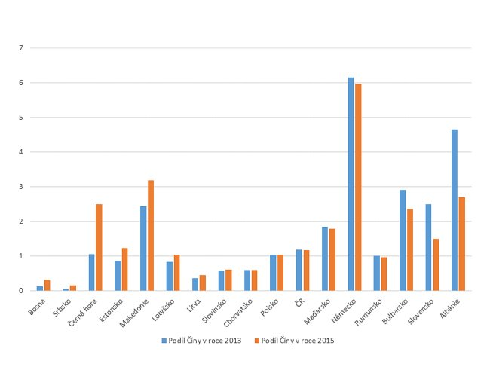
China’s shares in EU countries exports (Semerak)

Slide 16
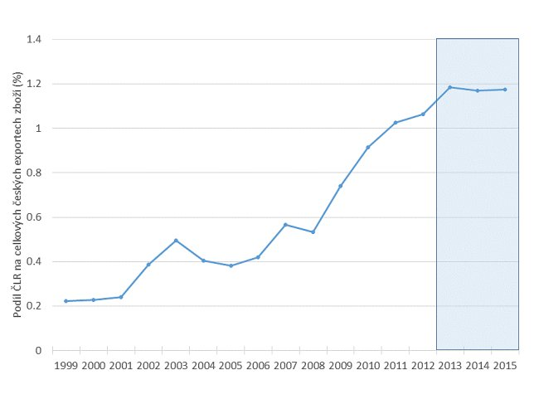
Share of China in Czech exports (%) (Semerak)

Slide 17
Chinese total FDI stock in CEE16 (MOFCOM)

Slide 18
Chinese OFDI: comparison (MOFCOM)

Slide 19
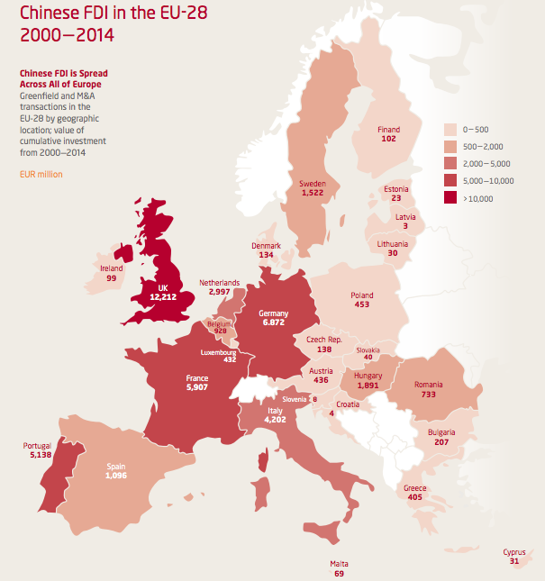

Slide 20
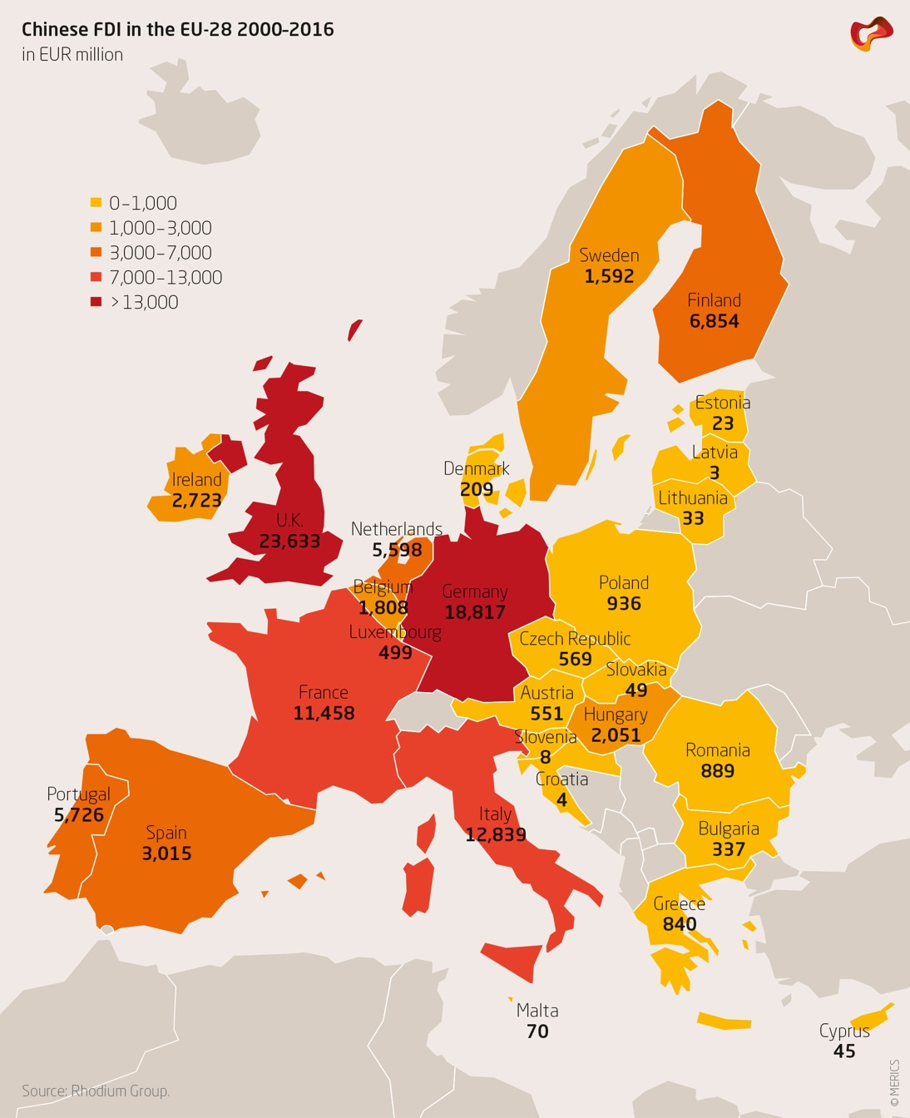

Slide 21
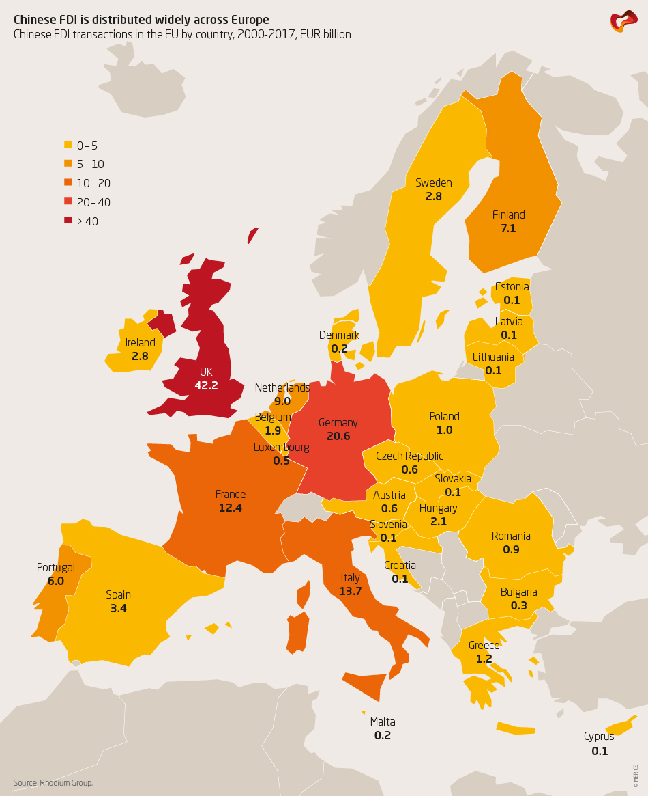
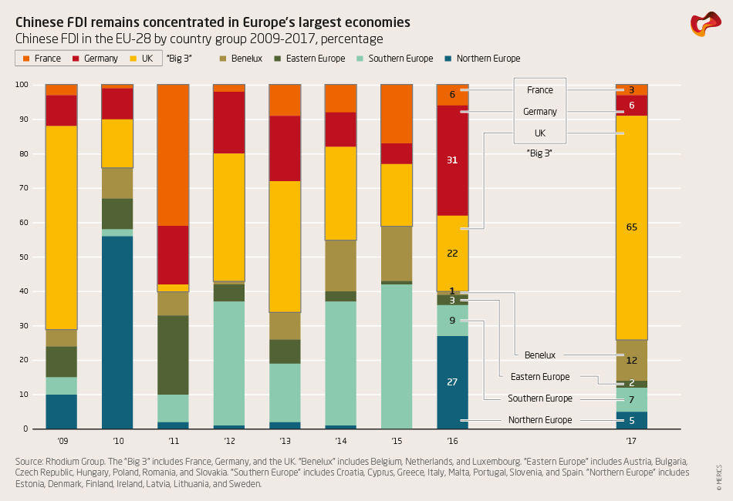

Slide 22
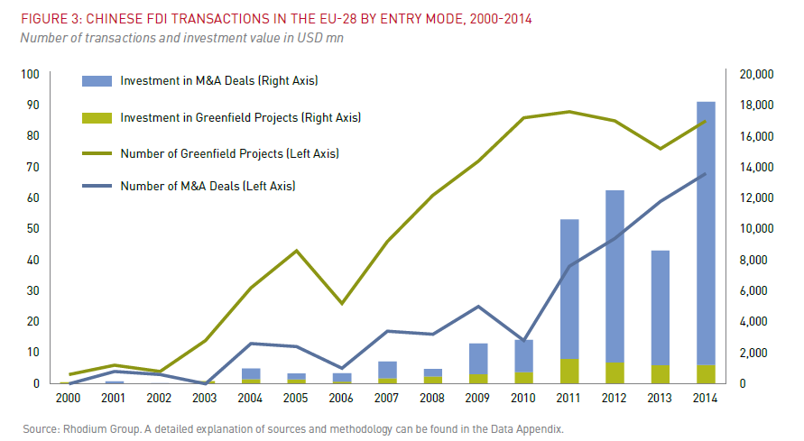

Slide 23
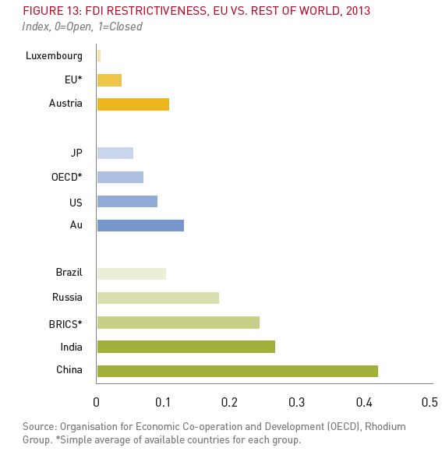

Slide 25
Chinese FDI in CEE (AEI/Heritage Foundation)
Bosnia | 2510
Bulgaria | 330
Croatia | 130
Czech Republic | 1320
Hungary | 6100
Latvia | 110
Macedonia | 400
Montenegro | 1120
Poland | 1920
Romania | 2350
Serbia | 3700

Slide 26
Examples of Chinese FDI in V4
CZ: J&T, Lobkowicz, Slávia, Travel Service
SR: U.S.Steel?
HU: BorsodChem, železnica Bud-Beo?
PL: prekladisko,

Slide 27
Hot politics and cold economics: possible explanations
CEE is not an interesting and stable investment environment
CEE does not have competitive products for Chinese market
China’s economy is slowing down and it does not have enough opportunities
Chinese market is protected against exports from CEE
China has been always interested in politics first of all – not interested in having CEE imports and FDI in CEE
There is a structural gap between Chinese offer/capabilities and CEE interest/needs

Slide 28
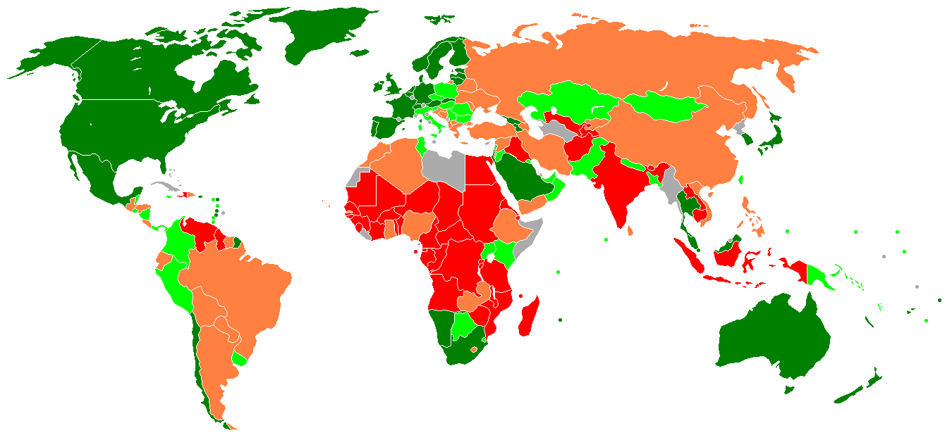
Ease of doing business

Slide 29
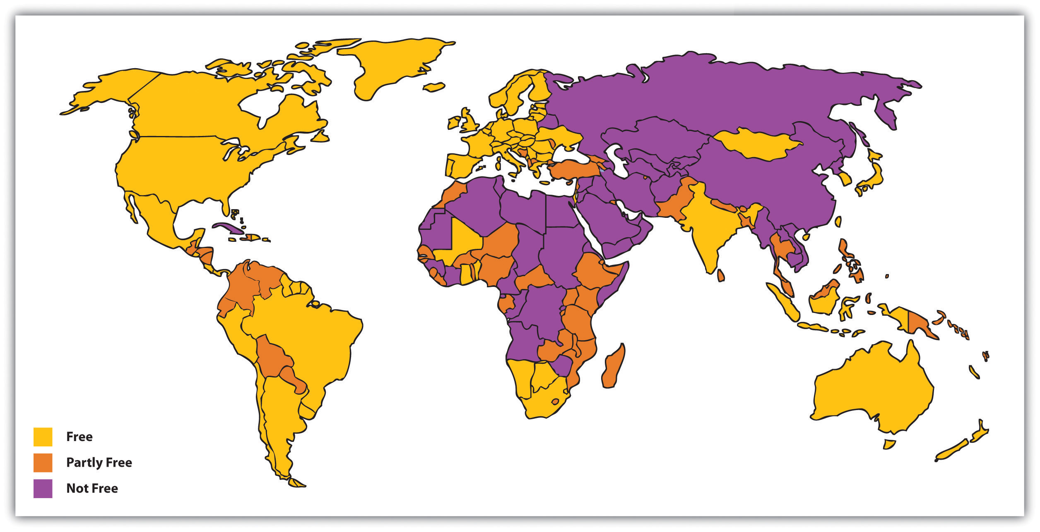

Slide 30
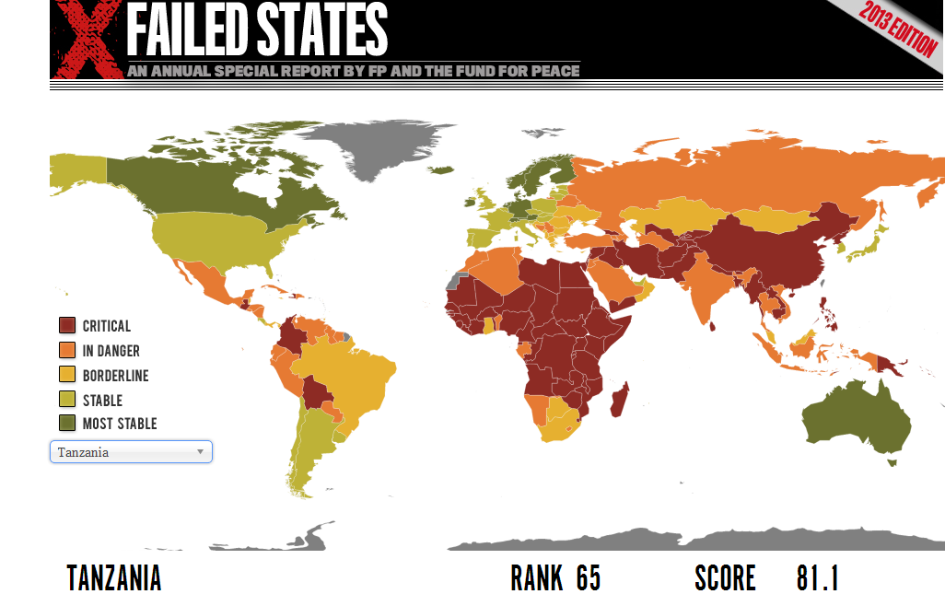

Slide 31
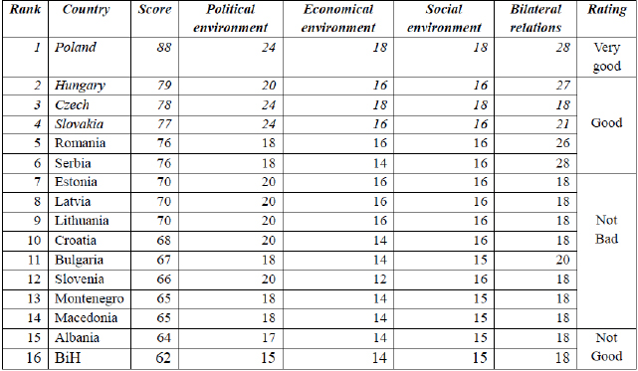
Attractiveness of CEE investment environment (Liu Zuokui)

Slide 32
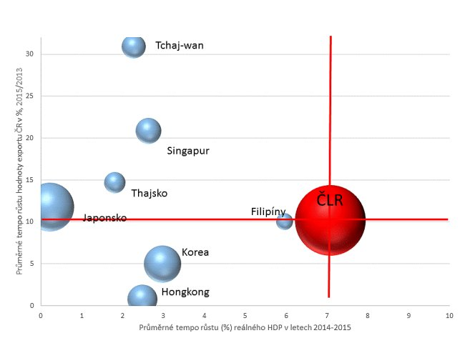
Czech exports to East Asian economies (Semerak)

Slide 33
Chinese foreign policy goals
Chinese foreign policy under Xi Jinping is oriented predominantly towards political goals (vs. economic)
Chinese external national interests are closely linked with the Chinese domestic politics (international success = domestic stability)
China is interested in soft power with “Chinese characteristics” (what Chinese people think others think of them)

Slide 34
Explanations: conclusion
Trade (= CEE exports to China)
  Regulation, administrative measures, protection → potential problems in future
  Questionable capability (and motivation) of the CEE companies
FDI
  Structural gap (what is supplied is not demanded – infrastructure/natural resources and acquisitions, what is demanded is not supplied – hi-tech greenfield)
  Complex environment vs. lack of experience and knowledge

Slide 35
China-CEE hot politics, cold economics: explanations
In line with the theory of Chinese foreign policy:
  Focus on politics
  Winning of international allies
  Rhetoric vs. substance
  Host diplomacy
  Economy as a means
  Soft power with Chinese characteristic
  Pro-active approach
Additional factors:
  Structural gap between Chinese offer/capabilities and CEE interest/needs
  Lack of mutual understanding
→ China’s CEE 16+1 diplomacy: Politics by (the promise of) economic means

Slide 36
Politics by economic means: additional evidence
No prospects for major change (trade and investments) – “structural gap“
16+1 diplomatically more active than the platforms in Latin America and Africa
Recent anecdote: Liu Yunshan leading Chinese delegation in Prague for 2017 China Investment Forum

Slide 37
Theoretical take-aways for the study of Chinese foreign policy
China’s CEE 16+1 diplomacy suggests, in line, with the literature that:
  Chinese foreign policy under Xi Jinping is becoming more active and is oriented predominantly towards political goals (vs. economic)
  Chinese external national interests are closely linked with the Chinese domestic politics (international success = legitimacy at home = domestic stability)
  China is interested in soft power with “Chinese characteristics” (what Chinese people think others think of them)
  May show how to understand Belt and Road Initiative as well

Slide 38
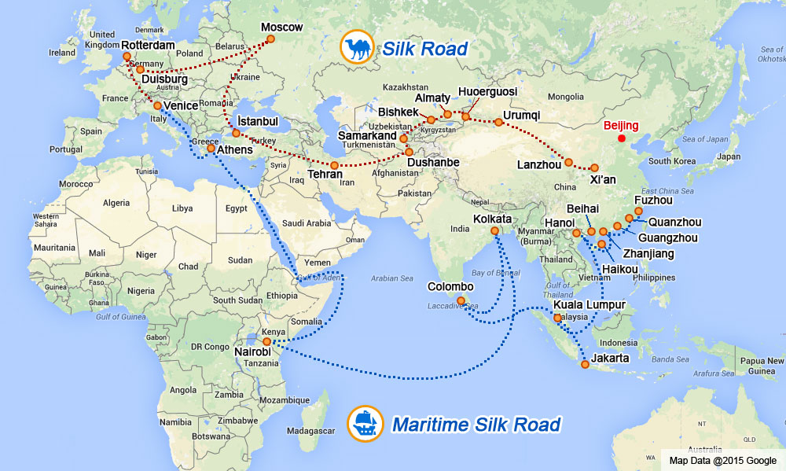

Slide 39
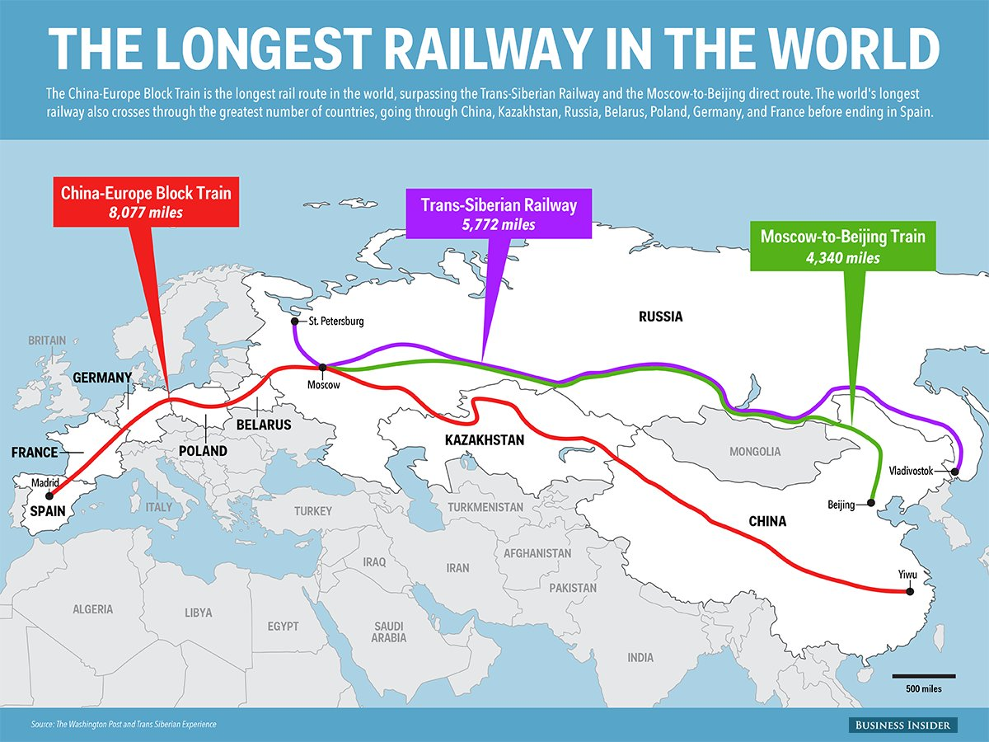

Slide 40
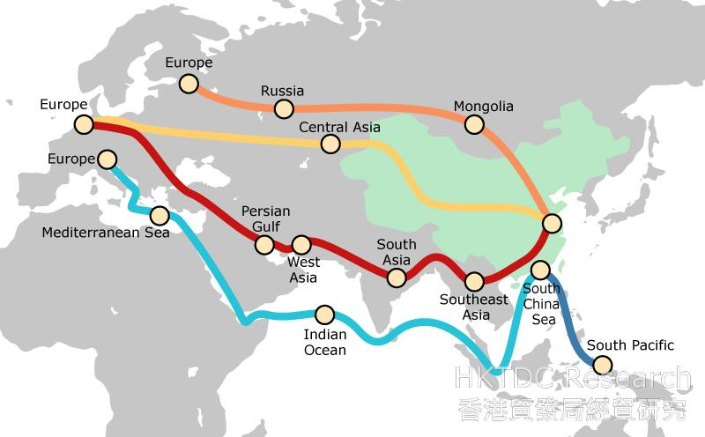

Slide 41
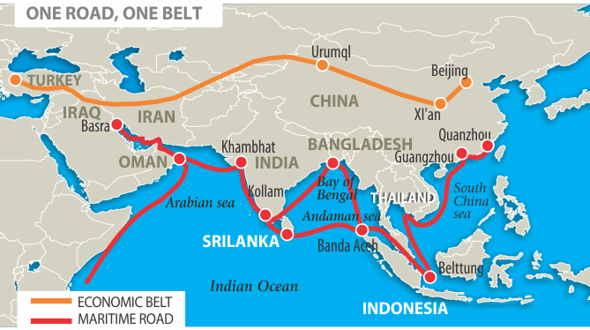

Slide 42
