Slide 1
Chinese foreign policy drivers
Richard Q. Turcsanyi

Slide 2
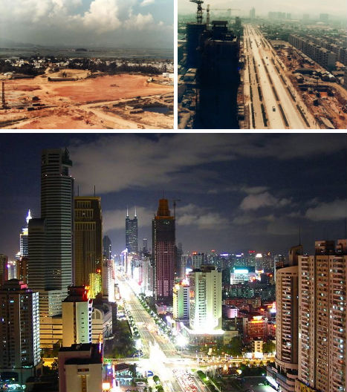

Slide 3
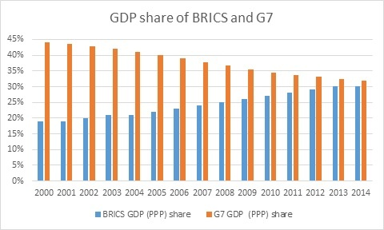
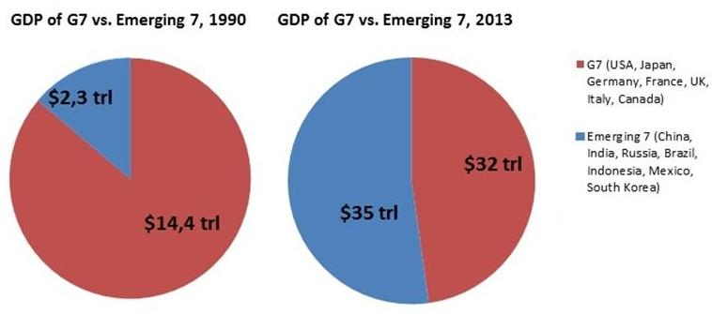
G7 vs. Emerging countries

Slide 5
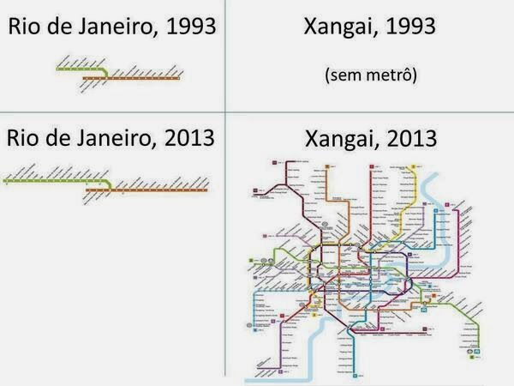
Rio and Shanghai metro maps

Slide 6
HDP
 | 0 | 1000 | 1820 | 2000
Western Europe | 11,1 | 10,2 | 163,7 | 6 961
Western Offshoots | 0,5 | 0,8 | 13,5 | 8 456
Japan | 1,2 | 3,2 | 20,7 | 2 582
Group A | 12,8 | 14,1 | 198,0 | 17 998
Latin America | 2,2 | 4,6 | 14,1 | 2 942
SSSR and Eastern Europe | 3,5 | 5,4 | 60,9 | 1 793
Asia (ex. Japan) | 77,0 | 78,9 | 390,5 | 9 953
Africa | 7,0 | 13,7 | 31,0 | 1 039
Goup B | 89,7 | 102,7 | 496,5 | 15 727
World | 102,5 | 116,8 | 694,4 | 33 726
Bill. USD 1990

Slide 7
HDP per capita
 | 0 | 1000 | 1820 | 2000
Western Europe | 450 | 400 | 1 232 | 17 921
Western Offshoots | 400 | 400 | 1 201 | 26 146
Japan | 400 | 425 | 669 | 20 413
Group A | 443 | 405 | 1 130 | 21 470
Latin America | 400 | 400 | 665 | 5 795
SSSR and Eastern Europe | 400 | 400 | 667 | 4 354
Asia (ex. Japan) | 450 | 450 | 575 | 2 936
Africa | 425 | 416 | 418 | 1 368
Goup B | 444 | 440 | 573 | 3 102
World | 444 | 435 | 667 | 5 709
Income per capita USD 1990

Slide 8
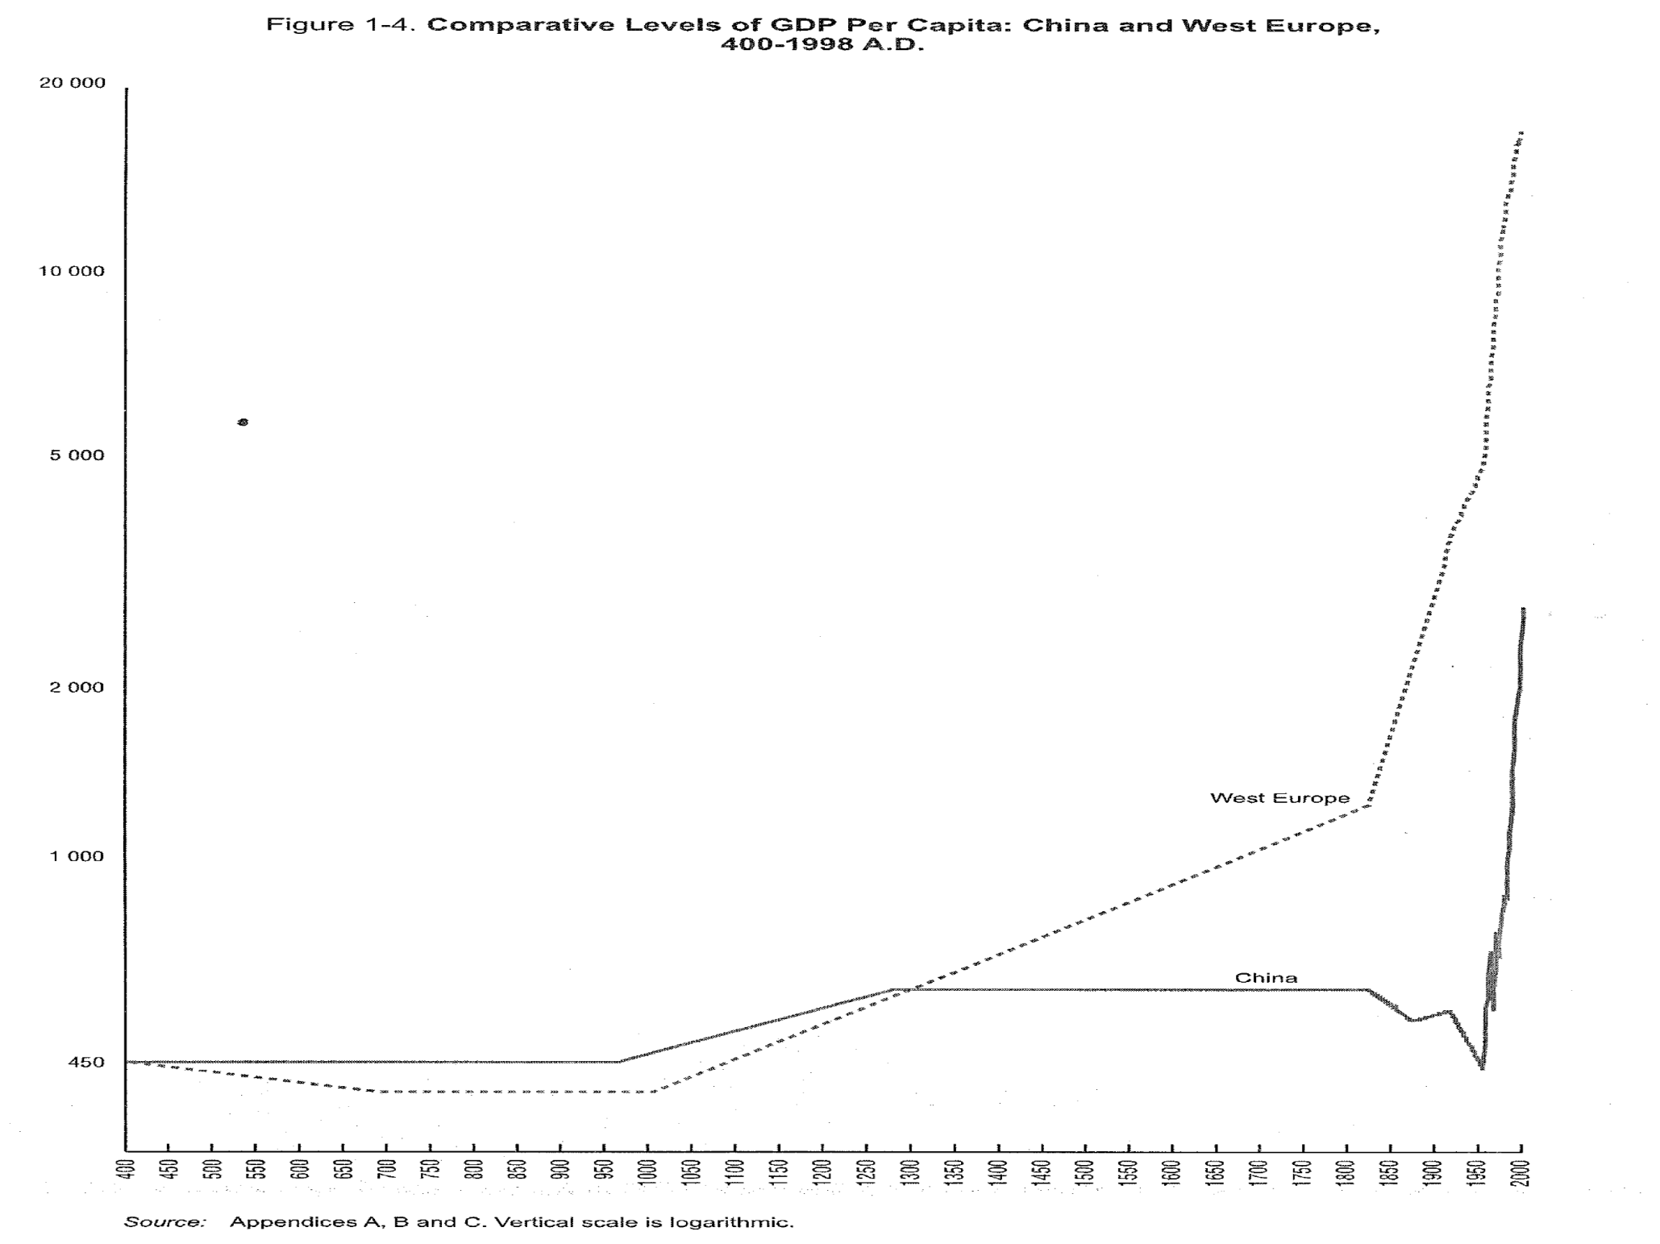

Slide 9
GDP (nominal)

Slide 10
GDP (PPP)

Slide 17
Foreign policy analysis
1. What China has been doing in the foreign policy?
  History (1950s, 1960s, 1970s, 1989)
  Bilateral relations (Rapprochement with the US, Korean War, Vietnamese War, Third Taiwan crisis, relations with Japan)
  Concepts and directions (War and revolution, Peace and development, Taoguang Yanghui=Low profile FP, Peaceful rise/development, Chinese dream, Assertive FP)
  China-CEE (late start, golden age in 1950s, sino-soviet split, improvement in 1980s, post-1989 divergance, post 2008 crisis improvements)
2. Why China has been doing this?

Slide 18
FP levels of analysis
Systematic level
  Character of the international system, power distribution
State level
  Strategic culture (ideas, identity - „irrational“ factors)
  Bureaucratic structure (material - „rational“ - factors)
  Media and public opinion
Individual level
  Personality of leader

Slide 19
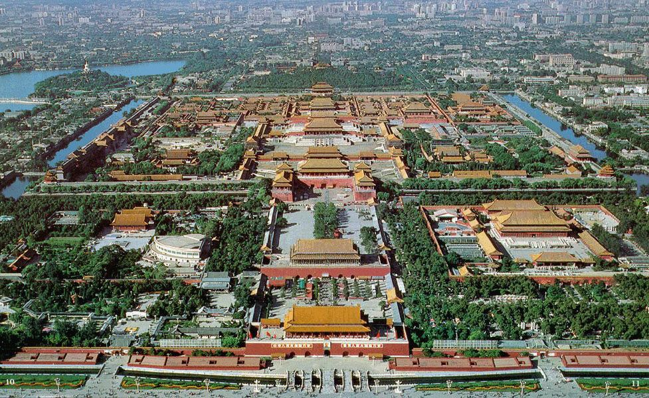

Slide 20
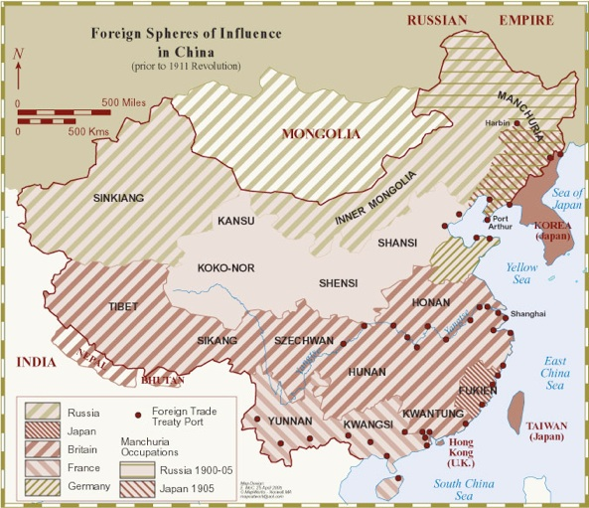

Slide 21
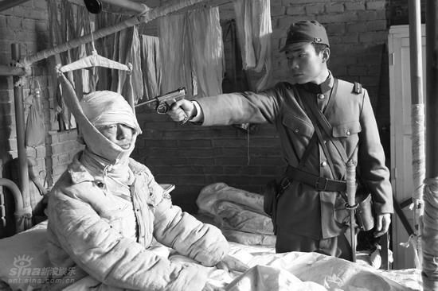
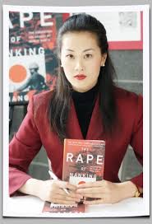
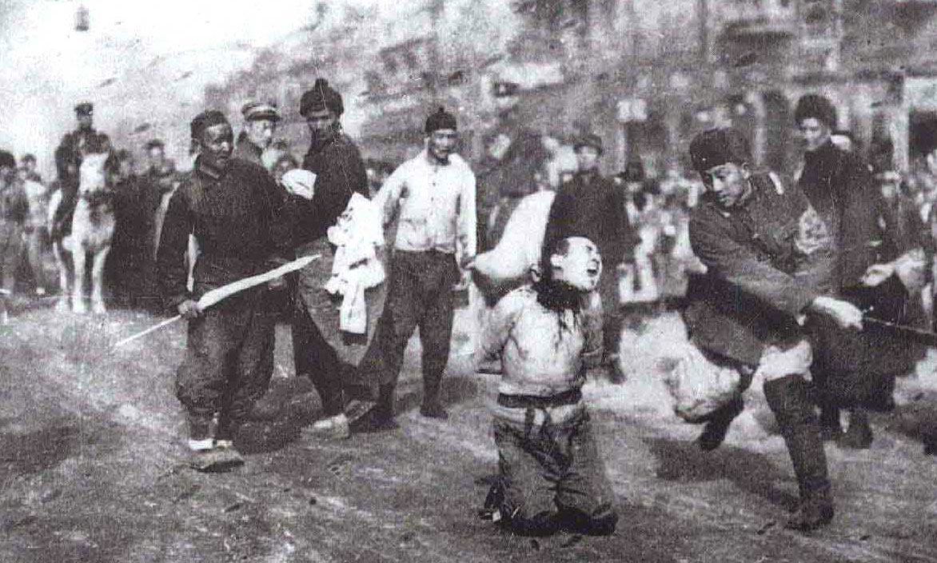

Slide 22
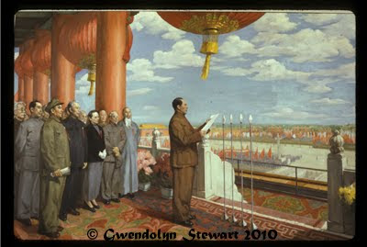
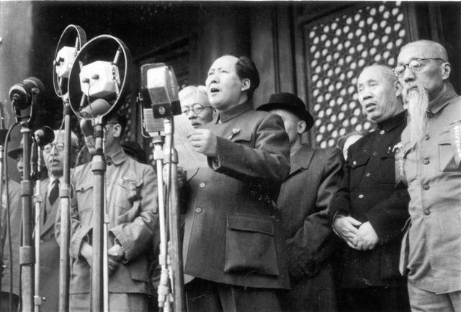

Slide 23
Chinese foreign policy since 1948
1950s: “Leaning to one side”
1960s: “Fighting with two fists”
1970s: “United front”
1980s: Opening up and reform - Peace and development
1990s: “Taoguang yanghui” (Biding time, keeping low profile – hiding brightness, cherishing obscurity)
2000s: Peaceful rise/development
2010s: Assertiveness, Winning political allies vs achieving economic interests, Soft power

Slide 24
Future outlook
“Europe’s past will be Asia’s future”
  J. Mearsheimer, A. Friedberg
“Asia’s past will be Asia’s future“
  D. Kang

Slide 25
Chinese strategic culture
Confucian
  Traditional philosophy, morality, benevolence, justice, harmony, order
Realpolitik
  A. Johnston
  Historical preference of aggressive solutions
Dualistic
  Peaceful self-perception vs. pro-active/aggressive behavior
  Cult of defense

Slide 26
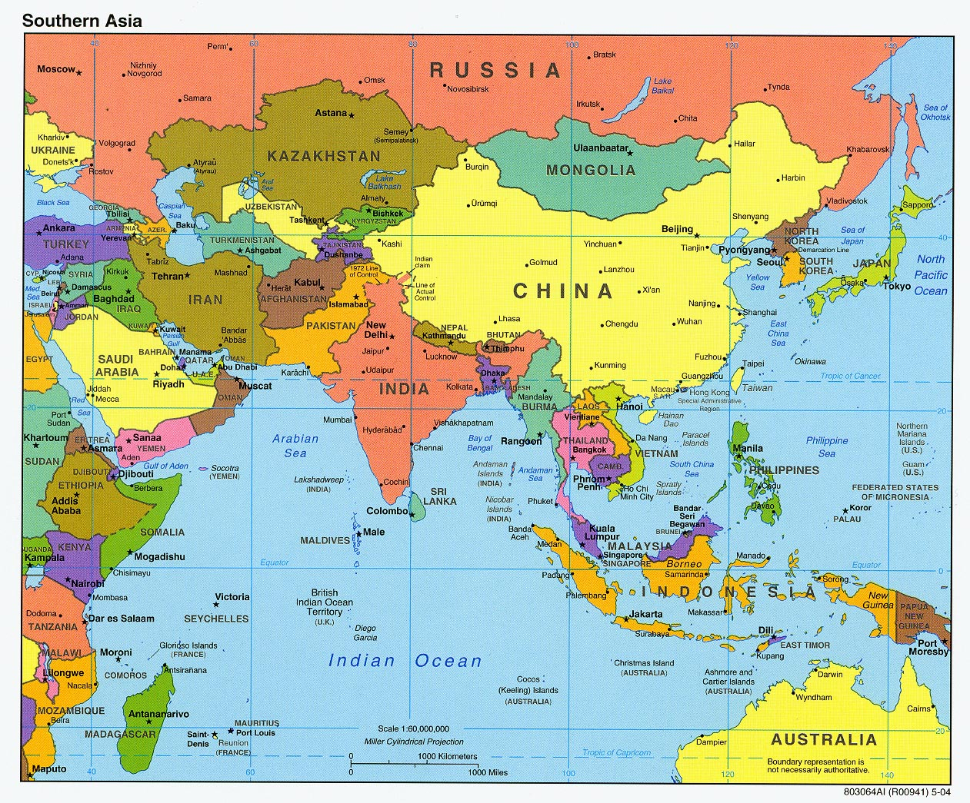

Slide 27
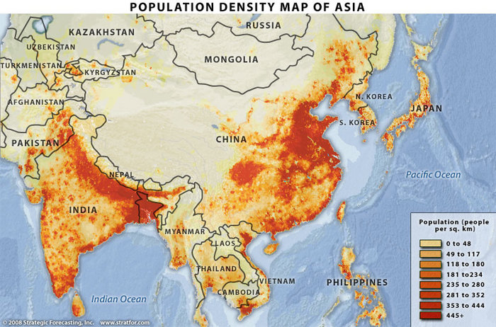

Slide 28
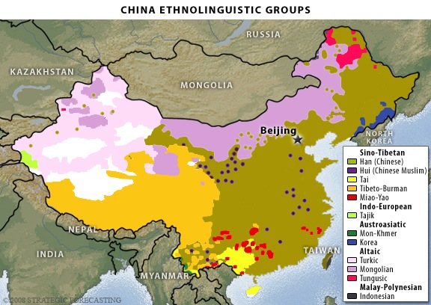

Slide 29
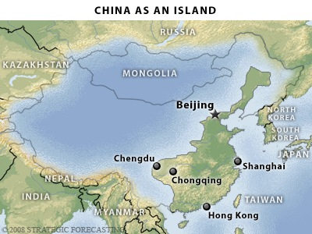

Slide 30
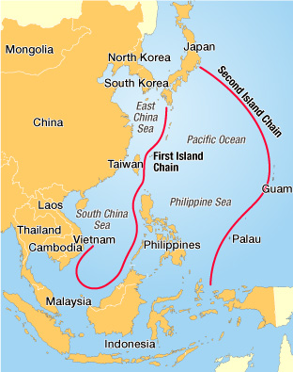

Slide 31
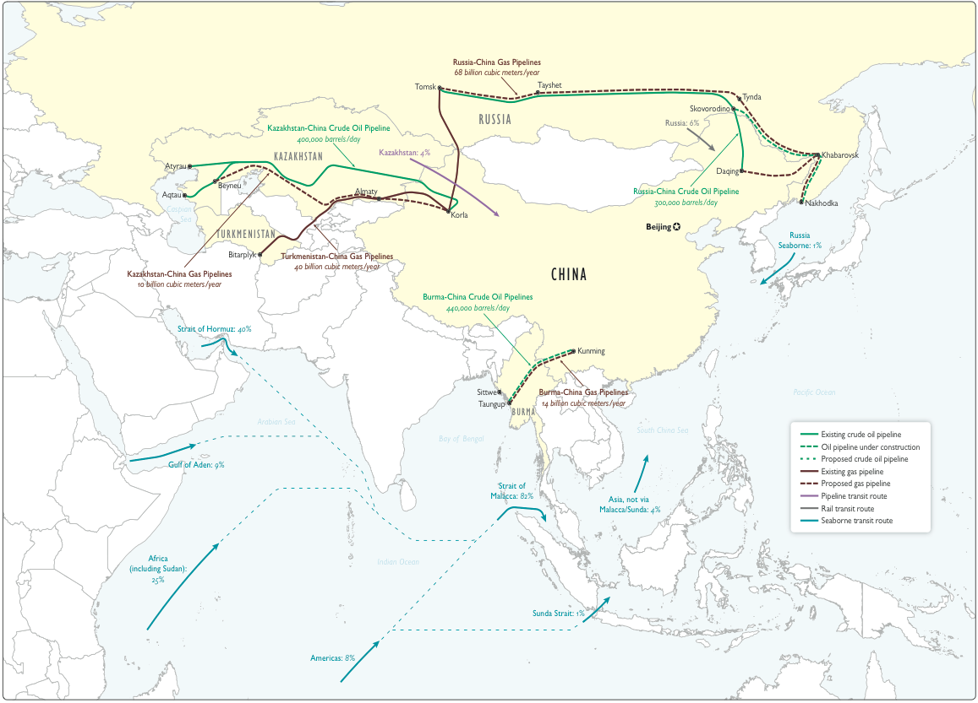
Energy supplies

Slide 32
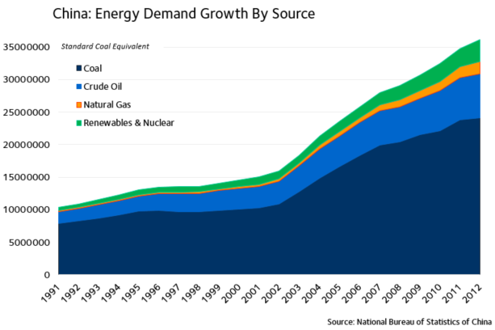

Slide 33
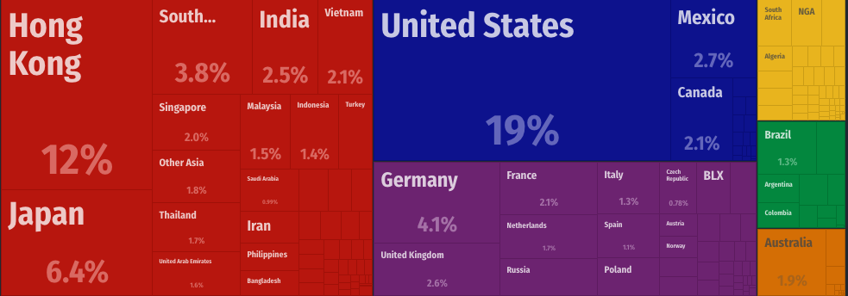
Chinese export partners

Slide 34
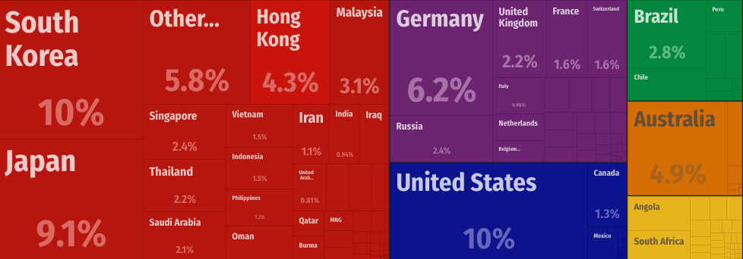
Chinese import partners

Slide 36
http://transitoriented.design/chinese-metro-evolution/

Slide 37
Actors of Chinese FP
Party (Politbyro SC)
State Council (Vice Premier for FP/State Councilor, Ministry of Foreign Affairs)
Military
→ Coordination: small leading groups
New actors
  Public
  Media
  Researchers, universities, think tanks
  Provinces
  Economic corporations

Slide 38
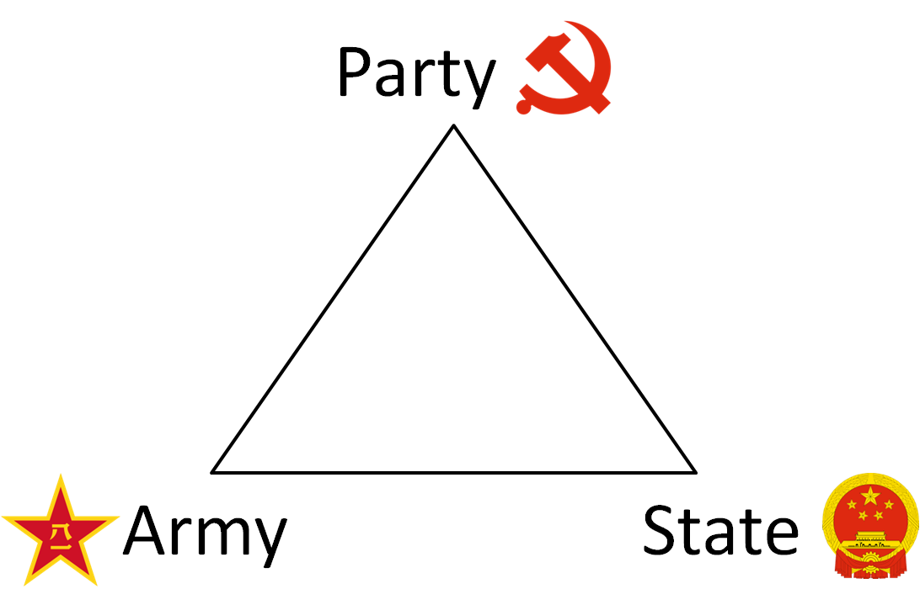

Slide 39
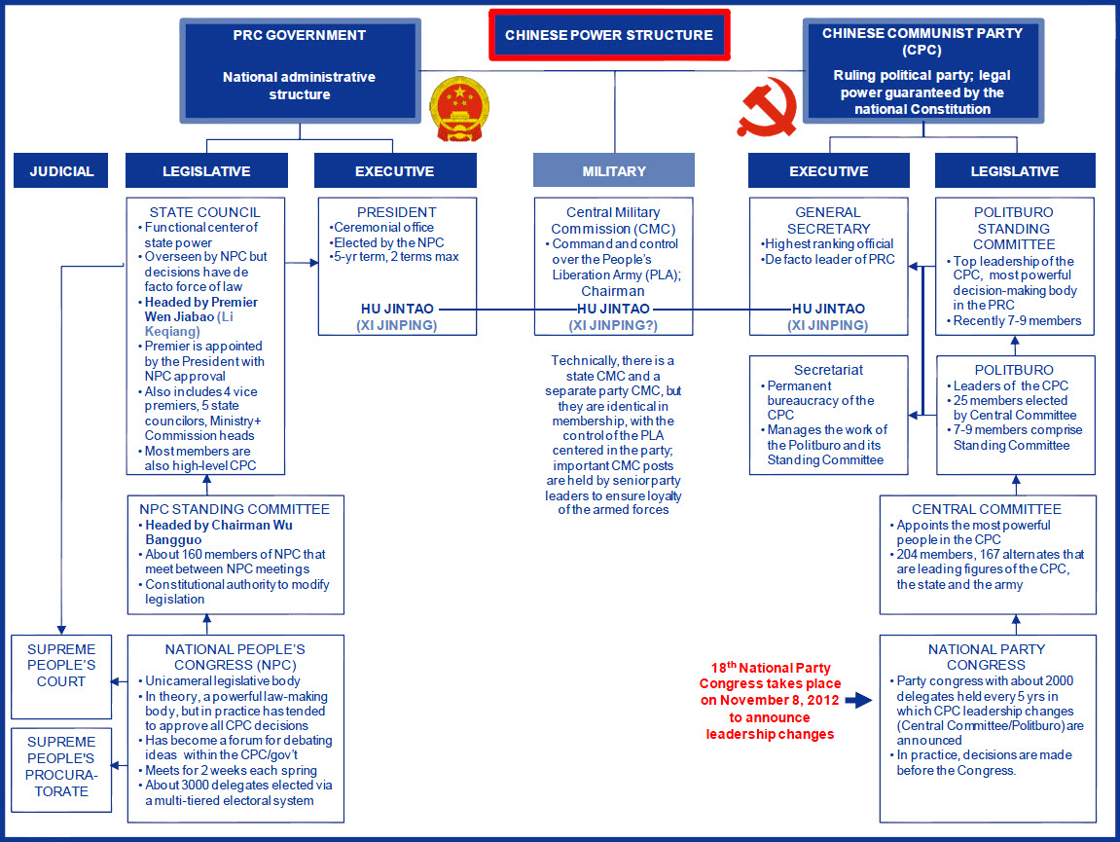

Slide 40
Informal institutions
Consensual decision making
Generation ‘core’ and retirement
Informal personal relations
Interest groups
Tendency to preserve status quo and keep the unity
Risk aversion
„Collective leadership, democratic centralism, individual preparation, decisions made at meetings.“

Slide 41
Changes in Chinese decision making process
Professionalization and institutionalization
  Rise of technical capabilities of personal
  Development of relations with the rest of the world
Pluralization and decentralization
  Broadening and deepening of decision making structure
Changes of the role of a leader
Globalization

Slide 42
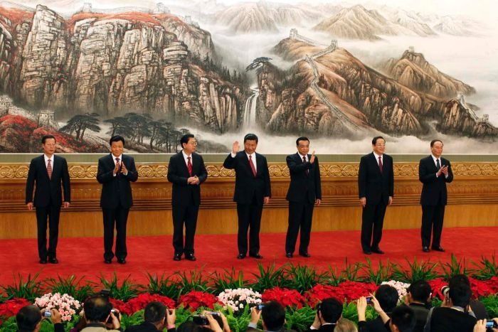
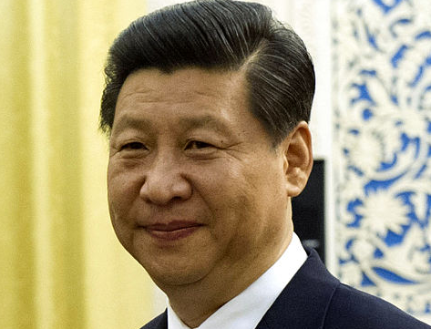

Slide 43
Xi Jinping (1953)
Origin/experience: Shaanxi, Henan, Hebei, Fujian, Zhejiang, Shanghai
Sent to countryside during Cultural Revolution
His father Xi Zhongxun: revolutionary, vice-premier, purged and imprisoned during Cultural Revolution, then governor of Guangdong
Technical and legal education (Tsinghua), study trip in the US (Iowa)
Interest in FP, experience with army

Slide 44
Who is Xi?
Calm, comfortable in the position of the leader
Man of the people, hard worker
Reformer, but not democratic
He likes literature , quotes Chinese classics (and Mao)
His wife Peng Liyuan, his daughter studies at Harvard
New trinity: Confucian-Daoist, Marxist-Maoist, Dengist-capitalist,
  plus moralism vs. legalism
Three historical comparisons: emperor Qin Shi Huang, Li Shimin (Tang dynasty), Mao Zedong
Chinese dream, national rejuvenation, Belt and Road initiative

Slide 45
Public opinion in China
Main goal of Chinese government?
Regime security -> legitimacy
  Economic development
  Ideology (communism v. nationalism)
-> Preventing a rival interest group from emerging
FP: relatively open political space for public
Government supporting of nationalism?

Slide 46
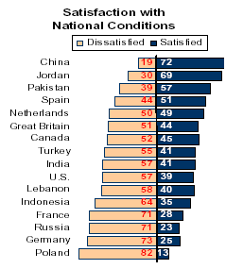

Slide 47
Satisfaction rates with government

Slide 48
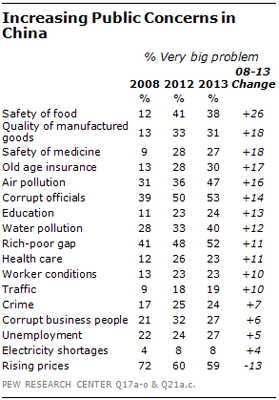

Slide 49
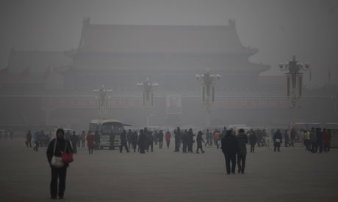

Slide 50
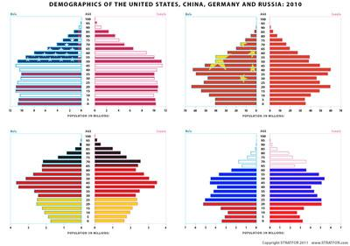

Slide 51
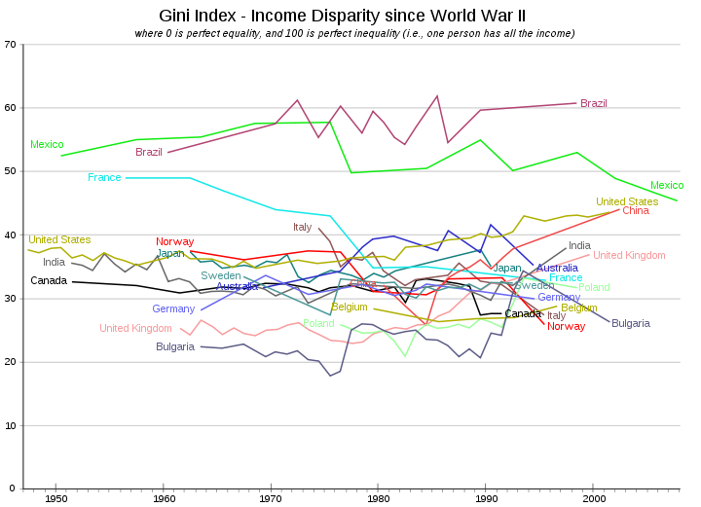

Slide 52
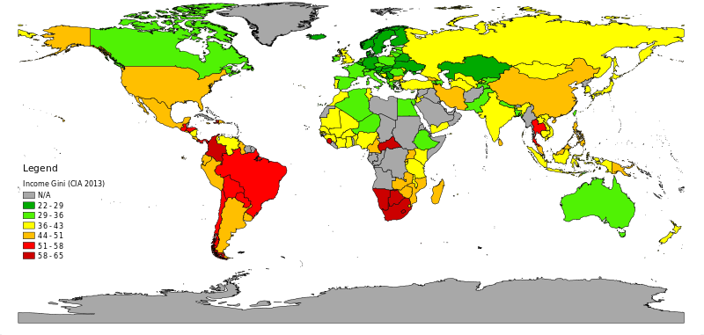
GINI (2013)

Slide 53
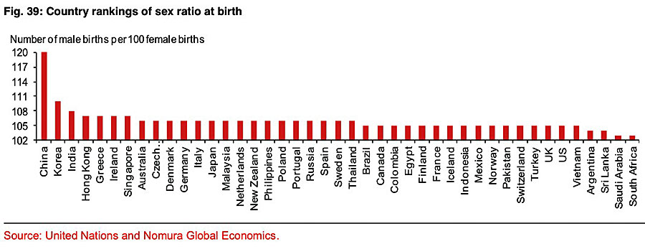

Slide 54
Chinese foreign policy goals in 2010s
Chinese foreign policy under Xi Jinping is oriented predominantly towards political goals (vs. economic)
Chinese external national interests are closely linked with the Chinese domestic politics (international success = domestic stability)
China is interested in soft power with “Chinese characteristics” (what Chinese people think others think of them)

