Slide 1
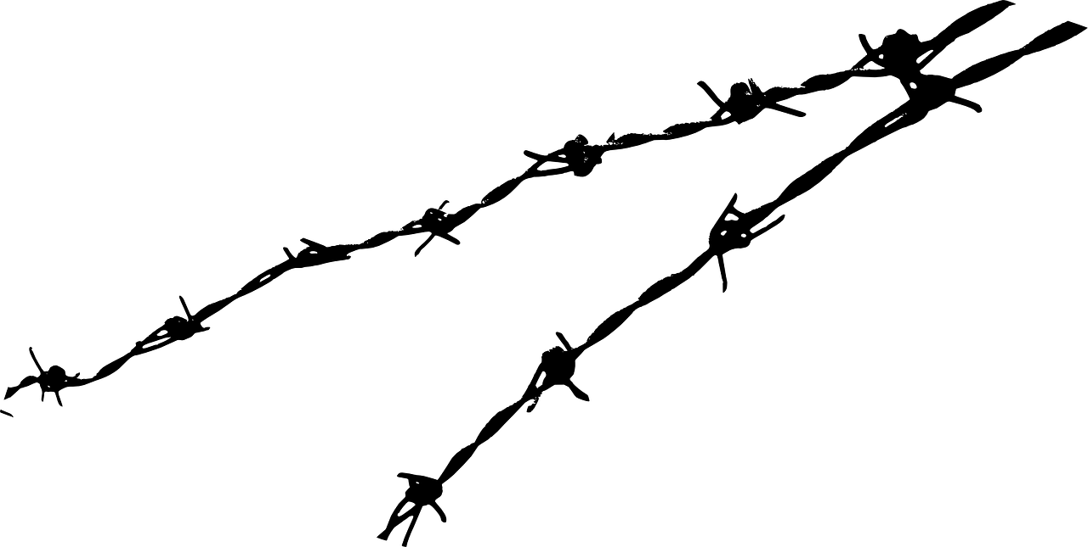
Approach to Migration in Europe and V4 Countries
Session 1
25. 9. 2019
Anna Láníčková

Slide 2
Introduction
Key terms
Figures
History
Legal instruments

Slide 3
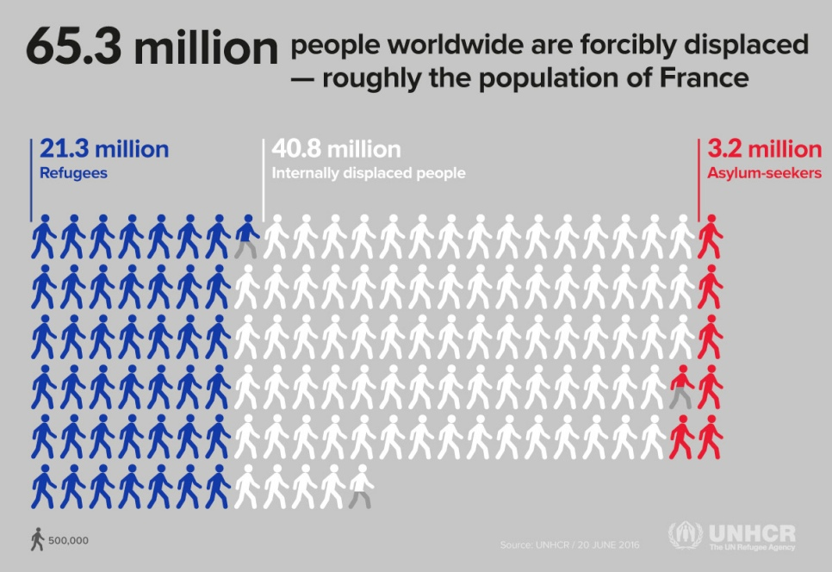

Slide 4
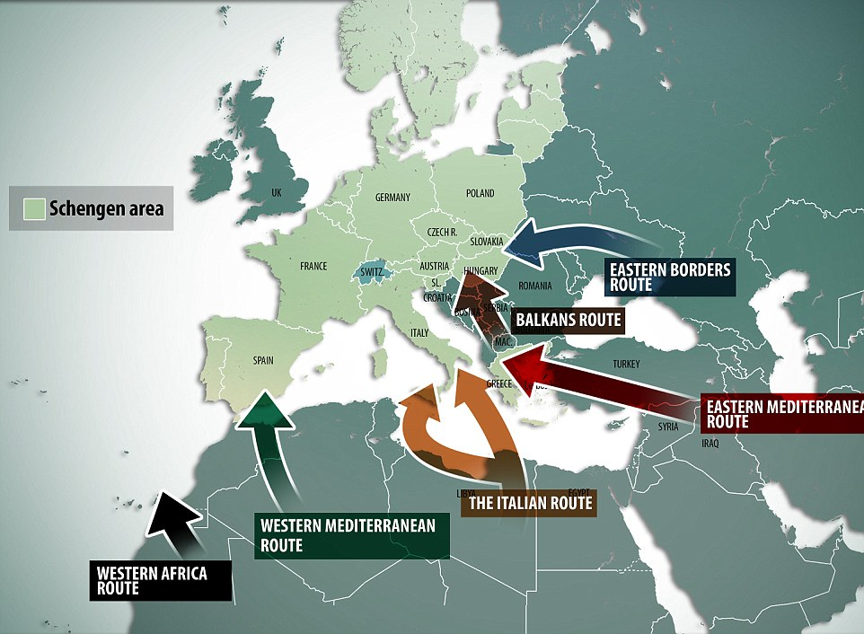

Slide 5
Introduction – KEY TERMS
International protection: ASYLUM, SUBSIDIARY PROTECTION
legal migration
  Visas, permits
  EU citizenship – free movement of persons (EU citizens and family members)

Slide 6
Key terms - cont.
illegal migration
  „Words matter“ campaign – illegal, undocumented, irregular
  “Since the word ‘illegal’ has become a stigma in my everyday dealing with people, I started to ask myself whether I was really illegal. Of course, I am not and will never be. I am undocumented.”
  No visa, no permit, no document, overstays, false identity
returns – expulsion, voluntary return (or assisted), forced return
EU agencies: EASO, FRA, Frontex

Slide 7
Key terms – cont.
Non-refoulement
  No State shall expel or return (refouler) a refugee in any manner whatsoever to the frontiers of territories where his life or freedom would be threatened on account of his race, religion, nationality, membership of a particular social group or political opinion.
Internally Displaced Person
Stateless person – not considered to be a national by any state

Slide 8
Sovereignty of the State
  Right to check the regularity of entry (visa, permits)
  Prohibition to expell its own citizens, obligation to accept its own citizens, not foreigners
  BUT international obligations (IP), EU law
  No obligation to let a foreigner to enter – but! Non-refoulement!
    Obligation to let him ask for IP (but Dublin regulation in EU)
    Right to asylum – right to fair proceedings

Slide 9
International protection in the Czech Republic
- claims (1990-2018)
2017
1450
2018
1702

Slide 10
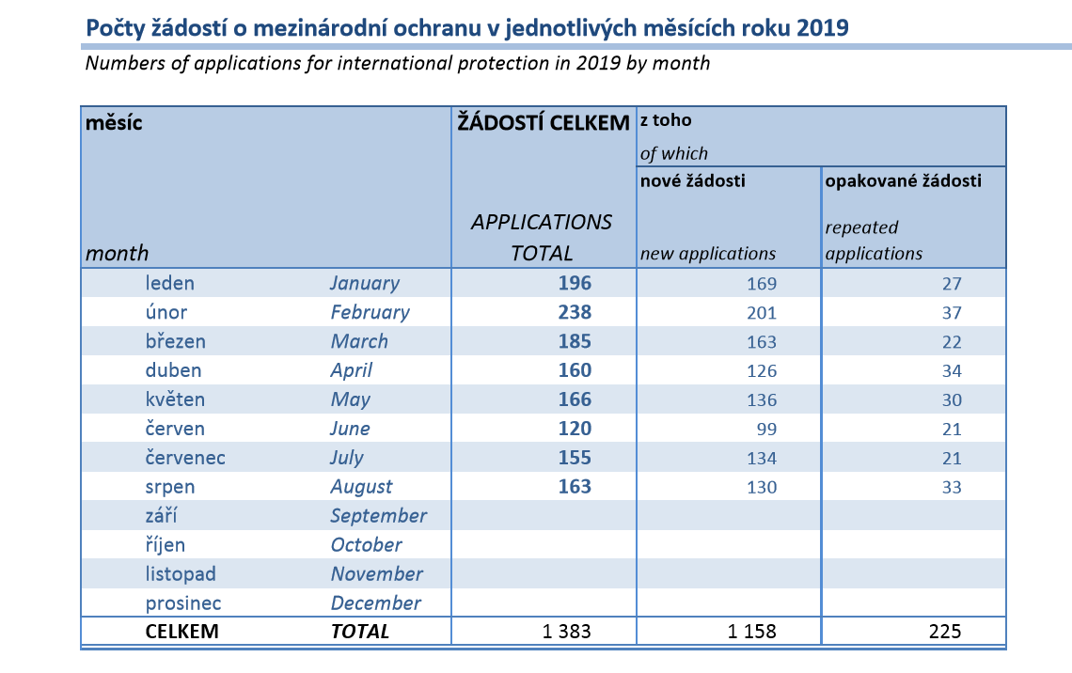

Slide 11
IP claims – nationalities 2016!
https://www.mvcr.cz/mezinarodni-ochrana.aspx

Slide 12
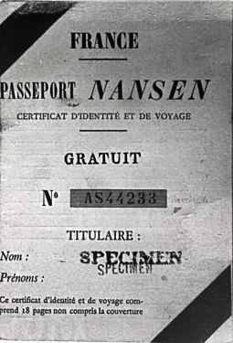
A bit of history :
After the IWW. Almost 1 mil Russians outside of their country, citizenship revoked.
Nansen passport=stateless people passport. (16 coutnries, incl. Czechoslovakia, then 52 countries)
  Famous holders: S. Rachmaninoff,M. Chagall, V. Nabokov, I. Stravinsky
  Czechoslovkia accepted 25000 of Russian refugees, health care, funding for students, employment, food, housing
1933 broadened – Armenian, Turkish refugees. 1933 Convention relating to the international status of refugees.

Slide 13
History – cont.
Diverse conventions
  Convnention concerning the status of refugees coming from Germany 1938,
  Convnention concerning the status of refugees coming from Austria 1939,
Unification - 1951 Refugee Convention (+1967)
  Originally just for the incidents before 1951 and in Europe. After 1967 this limitations were removed.

Slide 14
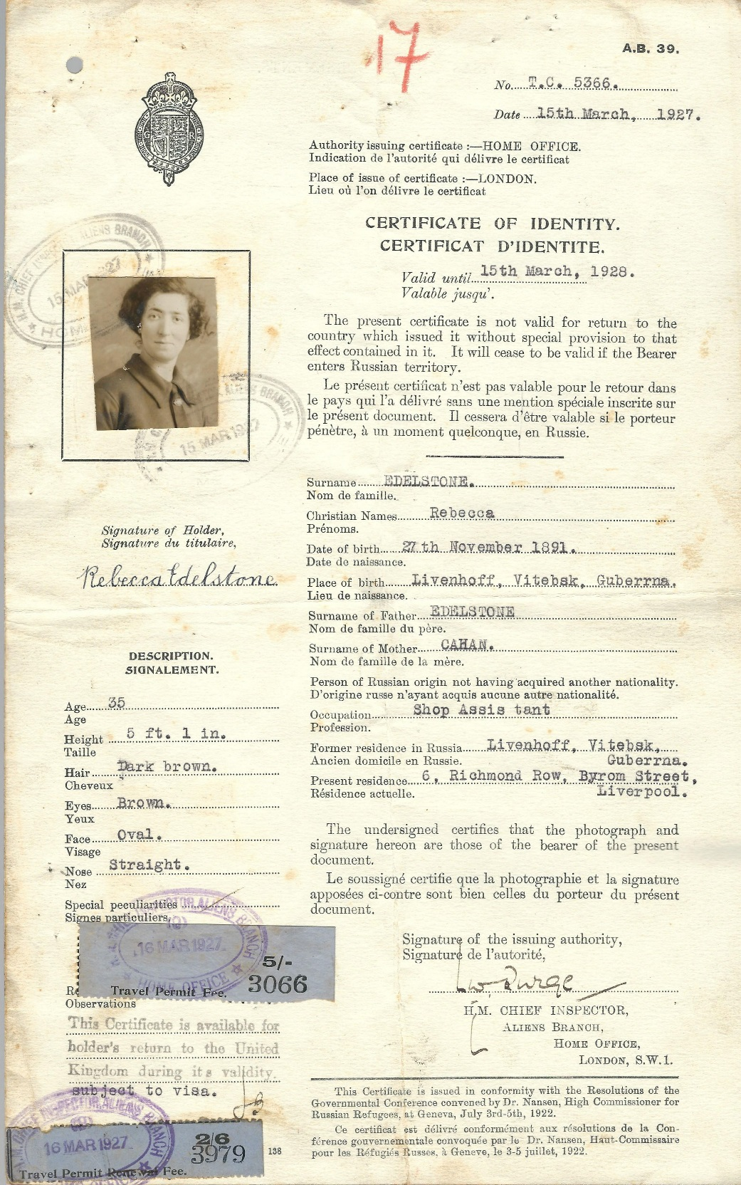
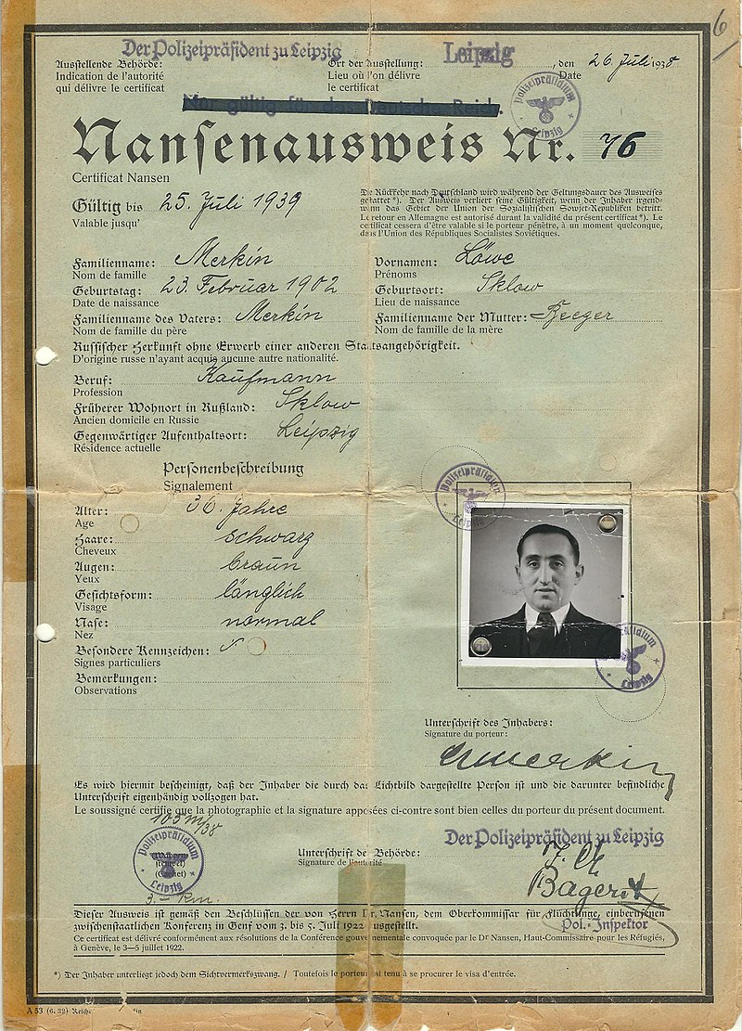

Slide 15
History – contin.
Czech citizenship revoqued by the regime (ex. Milan Kundera)
Migration in the 90s from Balcan states
Accession to EU
Czech republic = transit country
Czech Detention Center – worse than a prison?
  https://www.youtube.com/watch?v=JNamlcoWw_I

Slide 16
Legal Instruments - International Protection
Interactive map: https://is.muni.cz/do/law/kat/kupp/hrim/index.html
International Law
  Refugee Convention 1951
EU law – Common European Asylum System
(+ Returns, Frontex)
European Court of Human Rights
+
Court of Justice of the European Union

Slide 17
EU law
  EU Directives →→→ needs to be implemented into National law of member states!
            Asylum Procedures Directive
      Reception Conditions Directive
      Qualification Directive
  EU Regulations --- these apply like a „set of code“, no further implementation needed.
          Dublin Regulation
          EURODAC Regulation

Slide 18
Convention relating to the Status of Refugees (1951)
Outside of the country of his nationality
Well-founded fear
Persecution
Race, religion,nationality, membership of a particular social group, political opinion
Unable/unwilling to avail himself the protection (State actors, non-state actors)

Slide 19
No protection to:
The provisions of this Convention shall not apply to any person with respect to whom there are serious reasons for considering that:
(a) He has committed a crime against peace, a war crime, or a crime against humanity, as defined in the international instruments drawn up to make provision in respect of such crimes;
(b) He has committed a serious non-political crime outside the country of refuge prior to his admission to that country as a refugee;
(c) He has been guilty of acts contrary to the purposes and principles of the United Nations.

Slide 20
Refugees´rights
Non-refoulement
Refugee convention deals with the rights – access to employment, housing, public education, social security, freedom of movement, travel documents – usually in regards to the rights of citien – same level, lesser level
Czech law – permanent residency, language course, employment, health care
The proceedings finished? Status granted (asylum, subsidiary protection) or expulsion

Slide 21
Subsidiary protection
– protection for those who do not qualify as refugees
third country national or stateless who would face a real risk of suffering serious harm if s/he return to the country of origin.Serious harm is defined as the risk of:
"(a) death penalty or execution; or
(b) torture or inhuman or degrading treatment or punishment of an applicant in the country of origin; or
(c) serious and individual threat to a civilian's life or person by reasons of indiscriminate violence in situations of international or internal armed conflict."

Slide 22
Thank you for your attention!
Anna Láníčková
anna.lanickova@seznam.cz
Pop culture reference:
https://www.youtube.com/watch?v=oJEjrNB2iTA
Asylum claim in Handmaid´s Tale (TV series, 3.season) – no pushback!
Interesting literary works:
Martin Pollack – The Emperor of America
Patrick Kingsley – The New Odyssey

