Slide 1
Czech New Wave
CZS36
Dr. Šárka Gmiterková
Fall 2022
15. 11. 2022

Slide 2
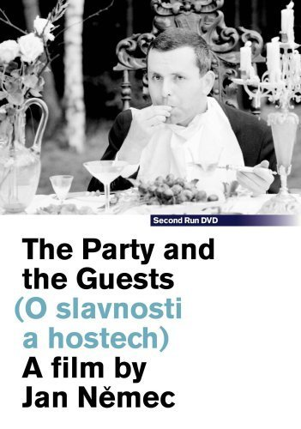
The Party and the Guests
1965, dir. Jan Němec
After the existential war drama Diamonds of the Night, on which Němec collaborated with the writer Arnošt Lustig, this is a movie co-authored with Ester Krumbachová. She participated not only on the visual aspects of the film, but on the story as well.
A group of people gets ready for a birthday party in the middle of the woods. The idyllic day is spoiled by various mishaps, escalated by the disappearance of one of the guests. This leads to the start of a brutal chase…

Slide 3
The Party and the Guests
„ In Diamonds of the Night the man is imprisoned due to the external pressure called the war. In The Party people are not free, because they are willing to participate on any kind of collaboration.“ (Jan Němec in the interview with AJ Liehm)
Although these characters lack names, many of them personalize common human flaws and deformations. Focusing on the central seven characters, try to give them nicknames based on their main character traits, roles and behaviour.
Visually, this film is frequently characterized as „manyristically ornamental“. Note down at least three aspects, which support such label.
Němec and Krumbachová cast this film with their friends, collaborators and other known personalities from period culture and arts. Try to compare their performance with the ones you already know from Forman‘s films and Intimate lighting. Is it the same principle or not? Do these famous colleagues of the duo function on the same basis as the regular civilian types you have seen throughout this course?

Slide 4
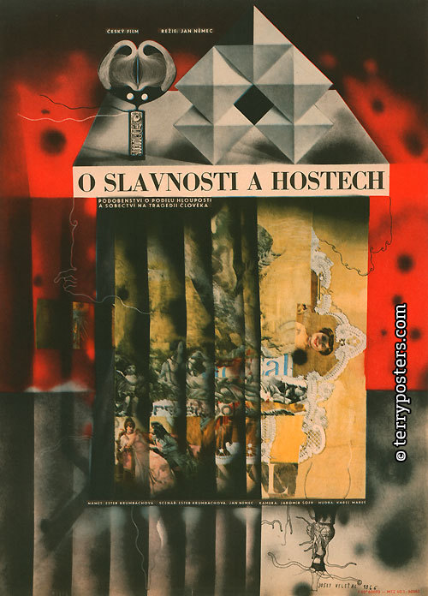
The Party and the Guests
Alegorical morality >> similarly as other problematic films such as Daisies or Firemen‘s Ball
In contrast to the Diamonds of the Night much more static film with carefully composed image
Fragments of dialog and non-professional actors
Problems appear once the film is in post-production >> the screenplay does not foreshadow possible problems
January 1966 – prezident Antonín Novotný is strongly against the film and orders Jan Němec to be released from Barrandov studios
The film is strategically eliminated from the public view, incl.the ban for festival screenings and sales abroad
Standard cinema distribution two years after the film is finalized – spring 1968.

Slide 5
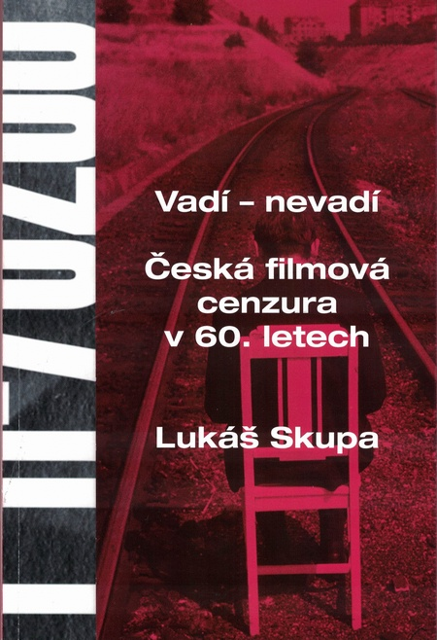
L9_Reading
SKUPA, Lukáš. Perfectly Unpredictable: Early Work of Věra Chytilová in the Light of Censorship and Production Reports. Studies in Eastern European Cinema 9, 2018, No. 3, pp. 233–249.

Slide 6
About the oral exam:
Date: 15. 12. 2022, 14:00, office C.317
Duration: 120 minutes
Prepare: an anotation and an interpretation of 10 films which we have watched together and some of them you have uploaded in the IS system. PLUS a resumé of one article/chapter you have been provided.
Length of the indivudal annotations plus one reading resumé: 200 words maximum
Due date – no later than one day before the exam (that is 14.12.) send me the file through email.
Films we have watched or are to be watched:
  Pearls of the deep, Black and White Sylva plus The Celing (count as one since they are mid-length features), Intimate Lighting, Daisies, The Murder of Mr. Devil, Loves of a Blonde, The Prime of Life, Diamonds of the Night, The Party and the Guests, Closely Watched Trains, The Joke, The Case for a Rookie Hangman

Slide 7
Censorship…
as a form of communication? As a tactical game? As a form of PR?
Censorship as the invisible and other side of the golden sixties
Prevailing negative perception of censorship X a form of communication, a tactical game and/or negotiation
Censorship as a hidden process >> only fragments of written records and a few oral testimonies survived
Does not pertain only to the totalitarian regimes
The concept of “dispersed censorship“ (including self-censorship) + the existence of „structural gaps“
Not only censorship limits and erases layers of meaning, but sometimes is the co-creator
„Censohip intervention“ X “administrative intervention“, carried out by „authorized organs“ and „organisation personel“, sometimes „official reviewers“, who merely „recommend“ individual measures

Slide 8
Cinema censorship institutions
(on the side of film production)
The censorship communication is carried out by:
  ČSF director: Alois Poledňák (1959–1969)
  FSB (Barrandov studios) director: based on the proposals coming from the CG he greenlighted screenplays, preparations and field works, budgets and key creative personnel. He had the right to watch the dailies, greenlight the first copy of the film; in fact, he could decide any matter connected to the agenda of the studios. In the years 1963–1969 this man was Vlastimil Harnach.
  Central (main) dramaturg: he follows the dramaturgical activities of all CGs as they start working on a topic or story early on. In cooperation with CGs he prepares dramaturgical and production plans, he reviews them from the idelogical and artistic perspectives, he greenlights the screenplays of films in preproduction; he can request review of any story in any stage of the creative proces; he can attend meetings, screenings of the dailies and suggest revisions. In the years 1960–1968 this man was Břetislav Kunc.
  Censorship was carried out by individual dramaturgs or CG leaders once they declined to work on potentially risky topics and stories.

Slide 9
Crucial factor: decentralized dramaturgy
1959–1962: one central institution oversees the development phase of film projects (Ideology and Artistic Council) >> its reviews are strict and rigid + filmmakers test its limits with topics and stories with various amount of social and moral criticism = the strategy of caution results in dramaturgical crisis; Czechoslovak films lack originality, modern expression and progressive ideas
February 1962: ČSF becomes independent economic institution, which fall under communist party supervision only in matters of ideological nature
March 1962: the central Ideology and Artistic Council is cancelled
April1962: individual Ideology and Artistic Councils are created and are attached to individual CGs (consisting of 7–8 internal and external employees) >> their power increases
Outside of film production censorship was carried out by Central Press Supervision Office (CPSO), on the higher level Ideological Department of the Central Committee of the Communist Party of Czechoslovakia

Slide 10
1962–1965: the years of carefull liberalization
Revised cultural politics: previously banned artists were returning to the public sphere, new generation of young artists; first testimonies of self-censorship appear in media
FSB starts to strategically orient itself on recruiting young autheurs >> in 1963 nine directors made their feature debut – Miloš Forman, Věra Chytilová, Jaromil Jireš, Pavel Hobl, Zdenek Sirový or Čestmír Mlíkovský >> cheap films with international visibility (even success), sometimes commercial success on top of all things
FSB and artists are becoming more confident – they test limits of censorship processes, for example they did not present materials for approval before production was started/finished
This changed in 1965: 22 censorship interventions, the numbers show a tension between CPSO, Communist Party and FSB (CGs)

Slide 11
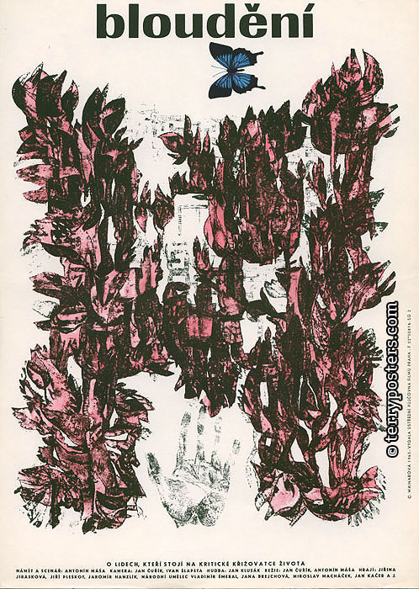
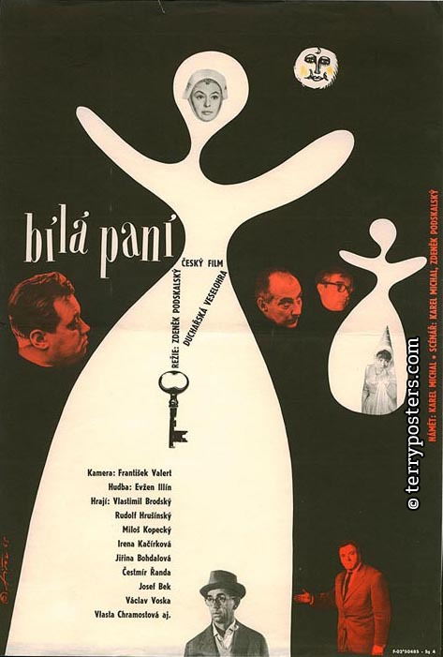
1965: the year of problematic films
This is the end of searching of and identifying structural gaps
Economic priorities – films should suceed at the box office (form of censorship?)
CPSO considers year 1965 as a problematic one, a string of films causing troubles during the approval process, most notably: Courage for Everyday (1964, dir. Evald Schorm), Thirty-three Silver Quails (1964, dir. Antonín Kachlík), The Hero is Afraid (1965, dir. František Filip) or Searching (1965, dir. Jan Čuřík, Antonín Máša)
In reaction to this development, FSB stops at least three work-in-progress projects as a form of preventive regulation

