Slide 1
Czech New Wave
CZS36
Dr. Šárka Gmiterková
Fall 2022
22. 11. 2022

Slide 2
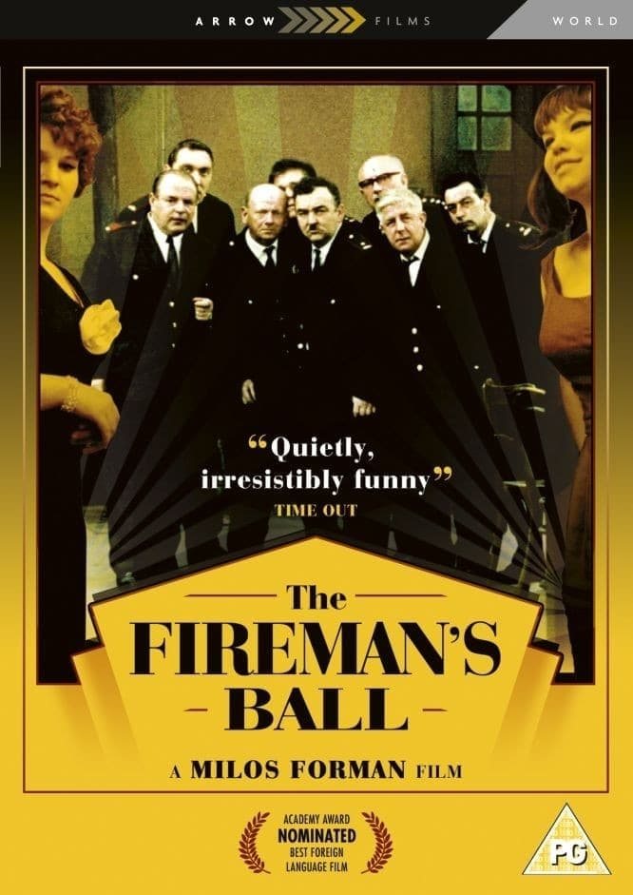
The Firemen‘s Ball
(1967, dir. Miloš Forman)
“Film comedy, where drinking, dancing and theft takes place“
Last Czechoslovak and most ambitious film of the trio and their collaborators
CG Šebor-Bor, Screenwriters and story development: Forman + Papoušek + Passer, Cinematography: Miroslav Ondříček, Editing: Miroslav Hájek

Slide 3
The Firemen‘s Ball – Questions
1. Period Czechoslovak reviews and even contemporary analytical essays have a tendency to view this film as a distorted mirror image of the national character (mainly negative views). Do you agree? Which topics and parts of the story have the potential to speak internationally – that is, to you?
2. Although we recognize some familiar faces not only behind the camera, but also in front of it, this film introduces new aspects in Forman‘s work. Can you name at least two aspects, which you feel are different from Black Peter and Loves of a Blonde?
  „The schtick with the non-professional actors, we‘ve seen that so many times! No more original. Still the same. For the first time it was something new. Not anymore.“ (anonymous viewer, quoted in: SOELDNER, Ivan. Světová gala premiéra ve Vrchlabí. Filmové a televizní noviny, 1967.)

Slide 4

The Firemen‘s Ball
(1967, dir. Miloš Forman)
Forman‘s most ambitious and most expensive Czechoslovak film
His image as the most successful director, who stays out of trouble, is shattered

Slide 5
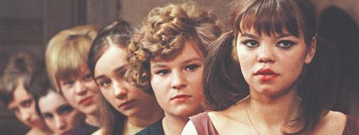
Firemen‘s Ball smoothly passed through the pre-production and production phases (story development, screenplay, casting, location scouting, shooting), no negative feedback X strong opposition from the Czechoslovak Union of Fire Protection (ČSPO – Československý svaz požární ochrany)
Coproduction with the Italian company Sostar film – Carlo Ponti – he supports the project with 110 000 USD (color stock, plans for global distribution), in the end the coproducer backed out of the contract
Opening night: 15. 12. 1967 + previous series of unoficial screenings
„This film is not against the firefighters nor for them. It is not about the uniform. It is about every single one of us, about our character, about the relationships between various people in our society.“ – an opening title inserted in March 1968.

Slide 6
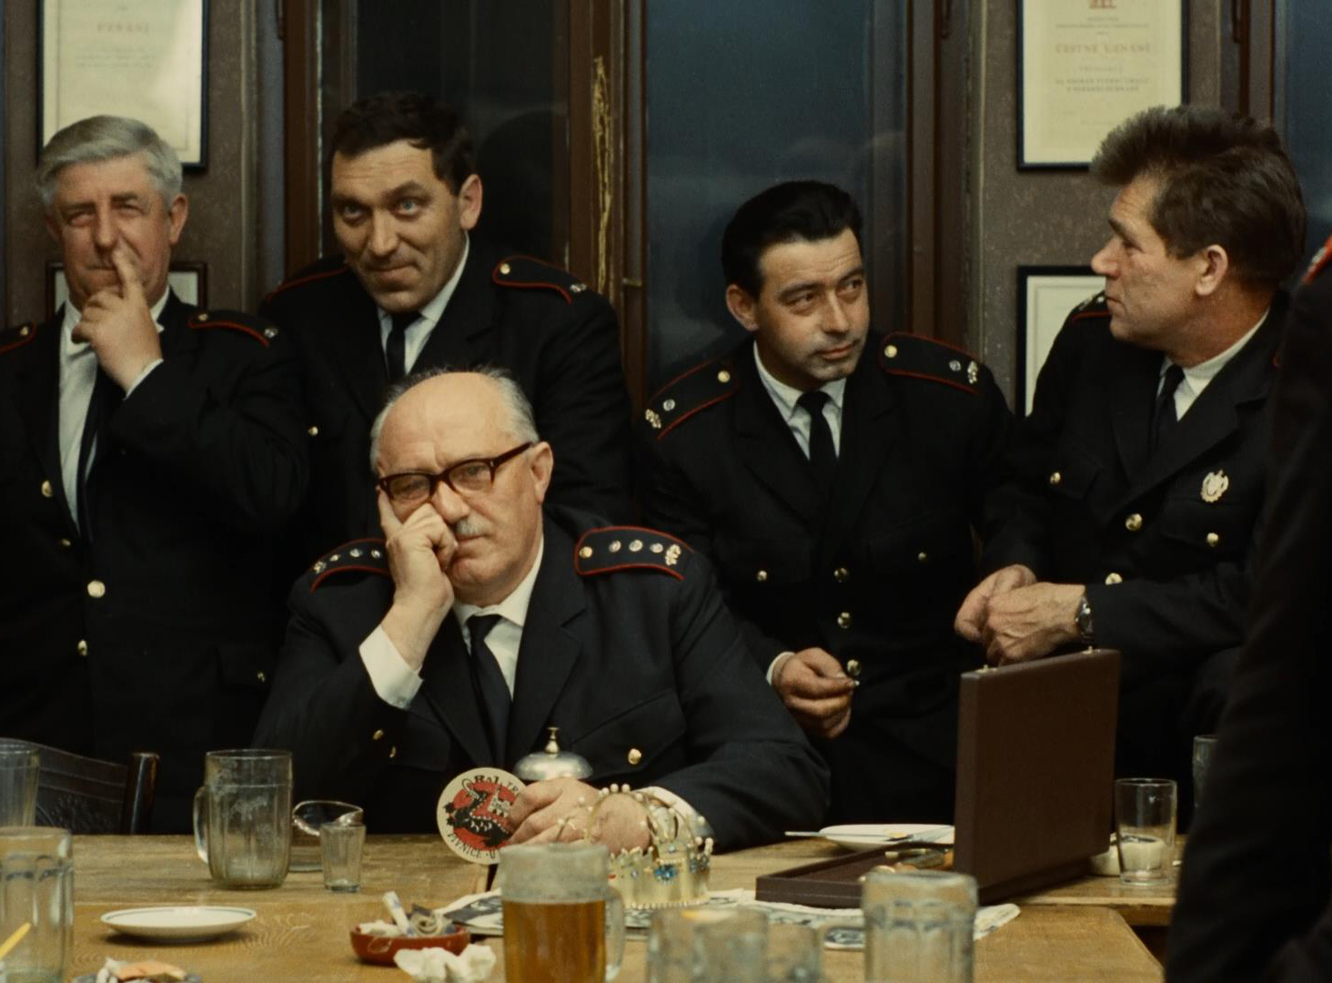
Disagreements with ČSPO
ČSPO has hopes for a movie promoting voluntary firefighting, as a form of education and because its membership decreases
In October 1967 Czechoslovak film calms ČSPO down, claiming that this film is intended solely for international distribution and not for domestic screenings
Firefigters, or a certain type of people, are portrayed very negatively in this film. Forman‘s youngsters frequently embarassed themselves and behaved inappropriately, but gained our sympathies because of their age and hypeprbolic portraiture X Firemen‘s Ball has no singular hero, just allegorical collective; ruthless ridicule instead of partial empathy
The scandal points to a wider issue of social satire in art cinema – are artists entitled to it or not? => a signal about persisting ideas about subordinate role art has to play in socialist society.

Slide 7
!Change alert!
Due to conflicting schedule I have to move our oral exam session to a different (much better!) date! Everybody will be available ☺
Tuesday 13. 12. from 10:00 till 12:00 (instead of our final lecture)
Please send me your lists with preparations (10 film summarys plus one item of reading resumé) no later than midnight, Sunday 11. 12.
The additional films with subtitles:
Audition (Konkurs) on YouTube, The Cremator (on Netflix)
Slovak films with subtitles
  The Sun in Net: https://www.youtube.com/watch?v=YkSls3-fL8I&t=1807s
  Birds, Orphans and Fools: https://www.youtube.com/watch?v=6W78QYUueDo&t=2s
  Boxer and Death: https://www.youtube.com/watch?v=E0xSZEaBc2g

Slide 8
Censorship 1965–1967
„Control or censorship, financial or political, is in its consequences more or less the same. It breaks characters and talents. Financial control is slightly more consistent, because everything can be count to the last penny.“ (Ivan Passer)
There is no universal model of art (X socialist realism), no unified audience >> filmmakers should take into consideration audience needs and the economic state of cinema
November 1965: Czechoslovak film and television union (FITES) was established => allows the community to articulate unified stances vis-a-vis the development of audiovisual industry and reactions towards criticism; publishes its own influential newspaper Filmové a televizní noviny (a biweekly)
Since january 1967: HSTD can intervene only when there is a risk of publishing state, economic and/or service secrets + censorship is legalized (before there was no legal framework)

Slide 9
Changes in censorship communication
1966–1967: both filmmakers and film critics prefer aesthetically demanding projects, realist impulses are used up X calls for realism in art production
The box office results and cinema attendance of domestic films are alarmingly low >> the importance of economic criteria is accented and genre films are strongly called for
New Wave projects are still important for export
Censorship interventions in the years 1966 and 1967 are coming from the ČSF/FSB leadership. Also, the relationships between cinema management and party leadership are weakened and have a turn for the worse (CGs, their independence and lack of top-down control are the main target of ideologically motivated critique).
Sharp reservations against individual projects; preproduction phases are suspended in case of The Case for a Rookie Hangman (dir. Pavel Juráček), The Joke (dir. Jaromil Jireš) or The End of a Priest (dir. Evald Schorm)

Slide 10
Consequences both symbolic and real
Two pioneer films of the antirealist branch of the Czech New Wave: Daisies (caution in the preproduction phase) and The Party and the Guests
May 1967: „Please, what kind of films are you making?“ >> famous interpelation of the deputy Jaroslav Pružinec in the parliament, where he criticized Daisies, The Party and the Guests, Martyrs of Love and Hotel for Stragers
  His speech became a symbol of censorhip oppression in the 1960s
FSB reacted: less debuts and first feature films directors employed at Barrandov studios – comparing 1963 (9) and 1965 (8) we see a fall to cca 3 projects of this kind a year. Young filmmakers are evaluated as ideologically unreliable and have a tendency for obscure experiments.

