Slide 1
Czech New Wave
CZS36
Dr. Šárka Gmiterková
Fall 2022
27. 9. 2022

Slide 2
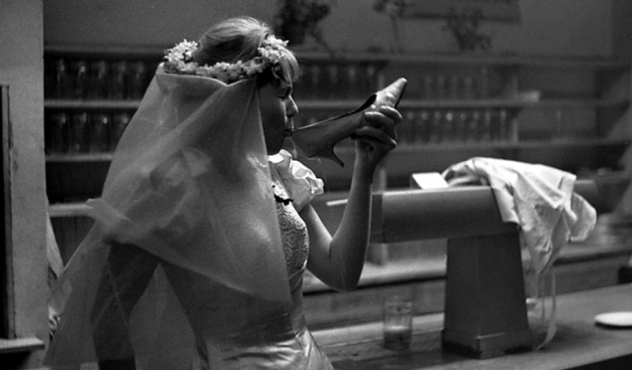
Pearls of the deep
1965 dir. Jiří Menzel, Jan Němec, Evald Schorm, Věra Chytilová, Jaromil Jireš
Adapted from a collection of short stories by Bohumil Hrabal
Screenplay: Bohumil Hrabal, Jiří Menzel, Jan Němec, Evald Schorm, Věra Chytilová, Jaromil Jireš
Cinematographer: Jaroslav Kučera
Music: Jan Klusák a Jiří Šust
Staring: Ferdinand Krůta, Pavla Maršálková, Miloš Čtrnáctý, František Havel, Václav Žák, Ivan Vyskočil, Vladimír Boudník, Alžběta Laštovková, Ivan Vyskočil, Dana Valtová a další…

Slide 3
Pearls of the deep: Background and questions
According to Czech critic and film historian Jan Lukeš, Pearls of the deep can be considered as an „unintended manifesto“ of Czech New Wave. The reason behind this charactersitics lies in the fact that the impulse for making the movie came from Barrandov studios (creative group Šmída-Fikar) and not from the auteurs themselves.
  Pearls of the deep clearly demontrate,that Czech New Wave cannot be reduced to one single aesthetics/worldview/storytelling. However – is there a single element, that unites these five vastly different stories?
Bohumil Hrabal is a celebrated Czech author, who invented the word „pábitel“ (noun), “pábit“ (verb). This word applies to those individuals who have a specific take on life; they look for beauty in ordinary, everyday things and they like to talk about their life, experiences and encounters. They bend the reality according to their worldview.
  2. In the context of 1960s Czechoslovakia – is this a political or apolitical stance?

Slide 4
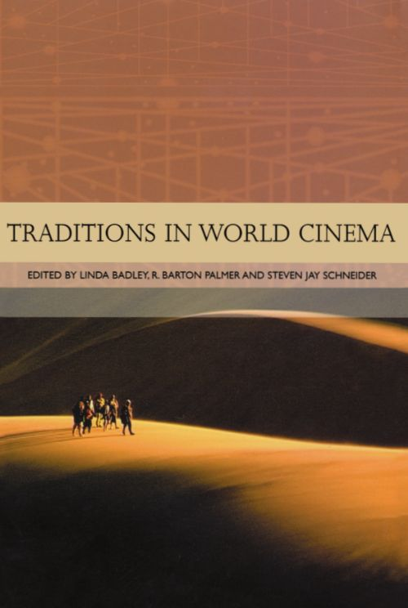
Reading L2
HAMES, Peter
The Czechoslovak New Wave. A revolution denied.
In: Linda Bradley, Barton Palmer and Steven Jay Schneider (eds.). Traditions in World Cinema. New Brunswick, New Jersey: Rutgers University Press, 2006, pp. 67–94.

Slide 5
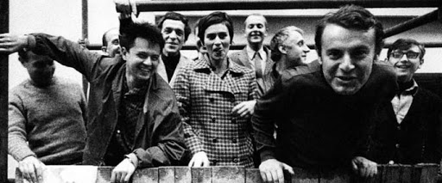
„Czechoslovak Film Miracle“ X „Some new wave films should be screened only as a form of punishment.“
„Golden Sixties“ X „New Wave as a myth?“
„The absolute quality of Czech Cinema“ X „A marketing triumph?“

Slide 6
New Wave as both a break and a continuity in Czechoslovak cinema
Czech (Czechoslovak) cinema was up to the 1960s a local cinema and international success belonged only to a handfull of individual titles (Extase, 1932; Siréna, 1946) X Czech New Wave as a national film school, clearly absorbing international influences as well as emanating from and evolving domestic cultural and cinematic traiditons.
It is not possible to reduce it on one single trait or perspective >> it‘s heterogenity and plurality is crucial, resulting in non-schematic films and a truly auteur cinema
Two innovations
  Aesthetic – different films than those in previous periods (cinematography, lighting, casting, editing, production values)
  Cultural – signaling the changing status of cinema in society and culture (not as an entertainment, but as an art form)

Slide 7
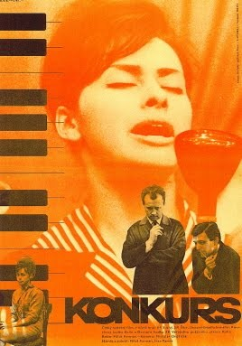
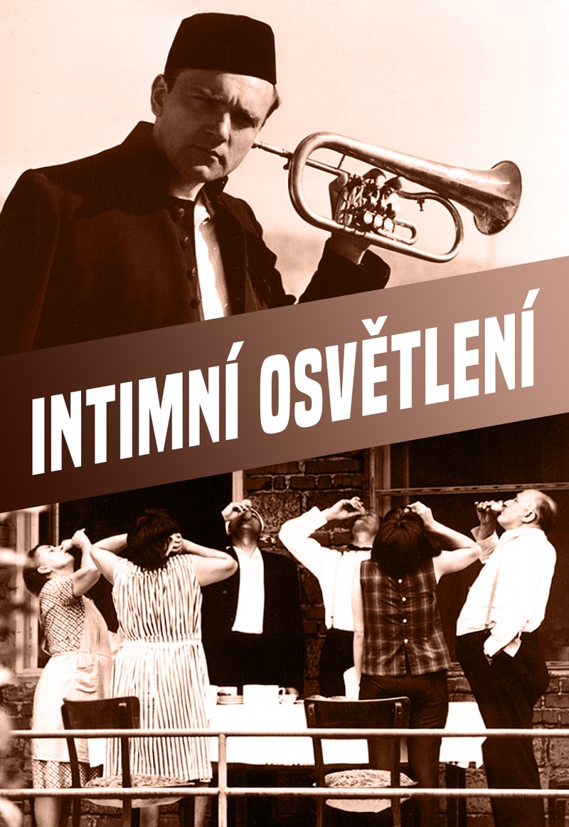
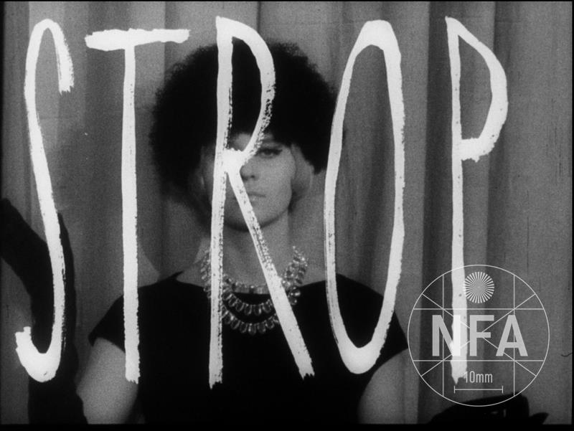
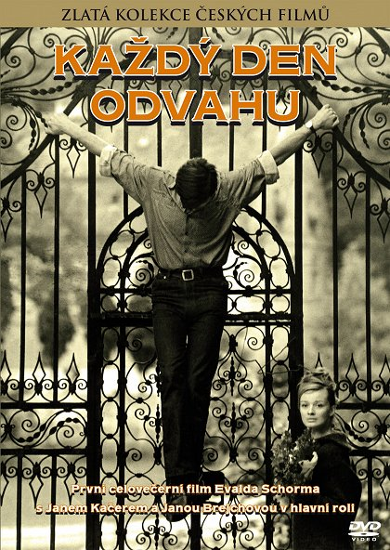

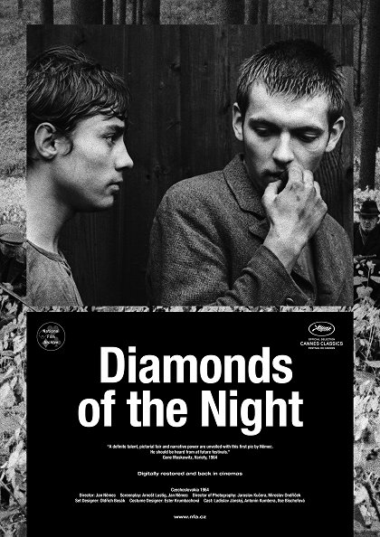
… and the two main tendencies
Objective and critical, inspired by cinema-verité
  Miloš Forman, Ivan Passer, Jaroslav Papoušek; up to the year 1966 also Věra Chytilová
Philosophical alegories with varying degrees of stylization
  Jan Němec, Evald Schorm, Věra Chytilová

Slide 8
New Wave as seen by period film criticism
Early in the 1960s we can see a lot of discussions around the issue of a modern Czechoslovak film >> it encourages new generation of filmmakers, as they seeked inspiration internationally
Modern VS Fashionable cinema
  Czechoslovak modern film can be inspired by european and world cinema, but not copying them mechanically >> it should encourage local artists to seek their own expression
  On the other hand, fashionable film just blindly follows trends in french, italian or swedish cinema, but without their own ideas, unique perspective or creative solutions
  >> truly modern Czechoslovak film thus should have it both ways: be progressive on the level of film form and also include its own perspective or idea embeded in the story/film, preferably truly Czech or even a communist one

Slide 9
„Emotional“ or „Authentic“ Films
This is how period film journalists labeled those local films, which aspired to truly modern works of film art.
Around 1962: Ceiling (1961, dir. Věra Chytilová), Slnko v sieti (1962, dir. Štefan Uher), A Convoy Leaving Paradise (1962, dir. Zbyněk Brynych), The Cry (1963, dir. Jaromil Jireš)
>> adopting the perspective of its main protagonists, representing their state of mind through voiceovers, monologues and improvised dialogues; also hidden camera or other stylistic devices, which communicated the characters‘ emotions
In order to keep the continuity with traditions of local cinema, these films were not only compared to contemporary european titles, but also domestic ones (namely with 1950s films of Vojtěch Jasný or František Vláčil).

Slide 10
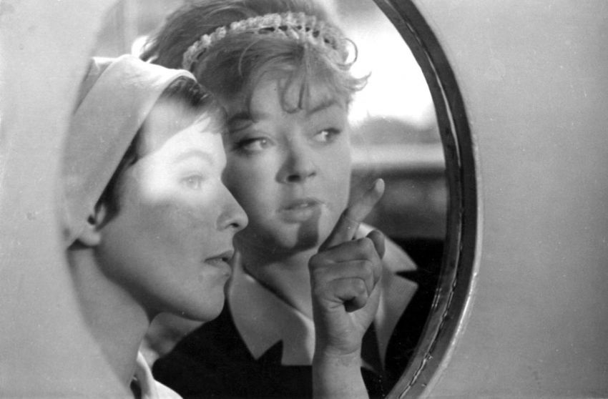
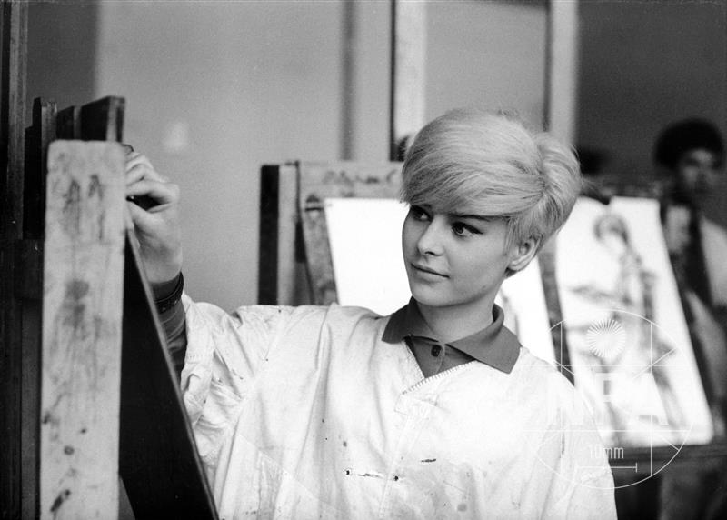
„Emotional“ or „Authentic“ Films
Some of these ambitious films met with rather harsh criticism. Their directors either gave up on filmmaking or they did not make another movie in Czechoslovakia.
Tak blízko u nebe (1963, dir. Vladimír Brebera)
Letos v září (1963, dir. František Daniel)
Pražské blues (1963, dir. Georgis Sklenakis)
Bubny (1964, dir. Ivo Novák)
Třiatřicet stříbrných křepelek (1964, dir. Antonín Kachlík)
částečně Okurkový hrdina (1963, dir. Čestmír Mlíkovský).

Slide 11
„Film – truth“
Czech equivalent of „cinema verité“, but it does not have a strong tradition in Czechoslovak cinema
It was used as a tool for a better definition of those aesthetic strategies, which Věra Chytilová used in her early films (A Bag of Fleas, Another Way of Life) or Miloš Forman (Talent Competition/Konkurs)
It announces the term „new wave“, emerging around the mid1960s – at first it was necessary to tone down its associations with tensions between generations (as in French New Wave) and aesthetic radicalism

Slide 12
„Czech (Czechoslovak) New Wave“
According to film critics, authenticity became the key concept to be associated with Czech New Wave, mostly achieved through:
Casting of non-professional and untrained actors
Hidden camera and/or its simulation
Introspection >> preference for those films, which go against classical storytelling and instead focus on the inner landscapes of the main protagonist(s) (emotions, state of minds, stream of consciousness, monologues)
The circle of Czech New Wave gradually gets smaller – at first some 40 names fell under this category, later, in 1966, the group consisted of the core we associate with the label today

