Slide 1
Czech New Wave
CZS36
Dr. Šárka Gmiterková
Fall 2022
25. 10. 2022

Slide 2
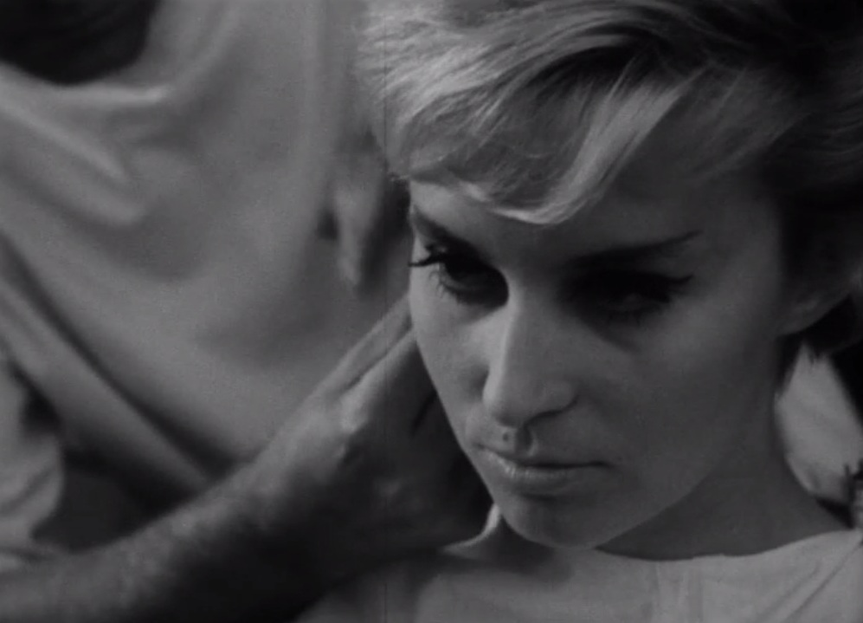
The Ceiling
(1961, dir. Věra Chytilová)
https://vimeo.com/260569888
Story: Pavel Juráček, Věra Chytilová, Screenplay: Věra Chytilová, Cinematographer: Jaromír Šofr, Music: Jan Klusák, Staring: Marta Kaňovská, Julián Chytil, Jaroslav Satoranský, Josef Abrhám, Ladislav Mrkvička, Jiří Menzel
With this medium-length feature film, Chytilová finished her studies at FAMU at the department of directing. In the story of a young fashion model Marta, she reflects both on her own experiences in the fashion industry, as well as on real-life Marta‘s story. This compilation of two uniquely female experiences foreshadows Chytilová‘s crucial topic – that of freedom and emancipation.

Slide 3
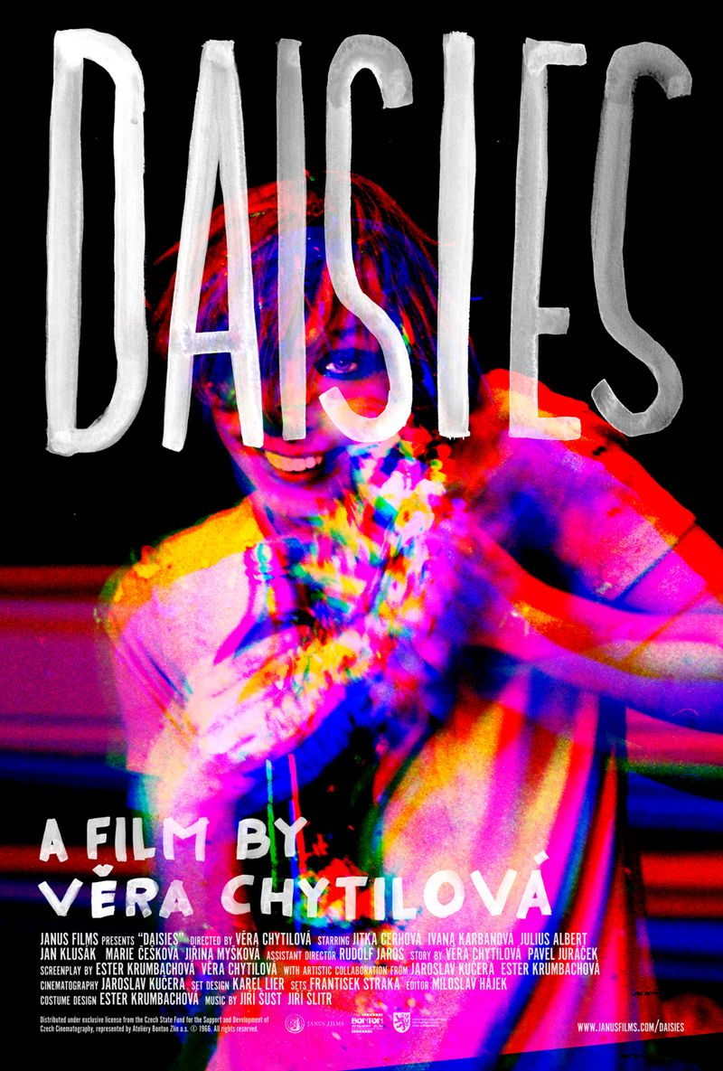
Daisies
1966 dir. Věra Chytilová
Story: Věra Chytilová, Pavel Juráček, Screenplay: Ester Krumbachová, Věra Chytilová, Cinematography: Jaroslav Kučera, Music: Jiří Šust a Jiří Šlitr, Staring: Jitka Cerhová (Marie I.), Ivana Karbanová (Marie II.), Julius Albert, Jan Klusák, Marie Češková, Marcela Březinová
The most well known film by Chytilová both locally and globaly
American premiere in 1966, Chytilová was offered a contract with Warner Brothers studio
Controversial film at home – Juráček hated the result; the communist deputy Jaroslav Pružinec spoke critically about the film in parliament >> hence the title dedicating the film to all those people, who are outraged only by the destructed salads

Slide 4
The Ceiling and Daisies : Question
Think about Marta, the main character. What do we know about her? What is her story? And how Chytilová tells her story?
The Ceiling used to be interpreted as a story of a young person, who sets the limit for himself/herself as way too low and strips himself/herself of the possibility to live a better, fuller life. Do you agree with such take on the film? If not, why?
_____________________________________________________________________
1. How would you describe the main characters, Marie and Marie – what about their age, behaviour, speech, looks and ways they treat others (older men)? Try to compare them with Marta or other female characters in New Wave films you have seen so far.
„Something has aesthetic qualities, it looks beautiful, but it is an image of a destruction, in fact“ (Věra Chytilová)
2. The topic of destruction seems to be a crucial one. On how many levels you can identify these destructive tendencies? And is the destruction perceived purely on negative terms?

Slide 5
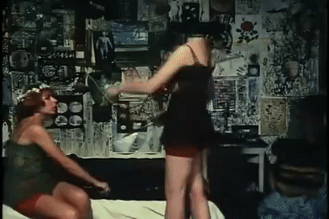
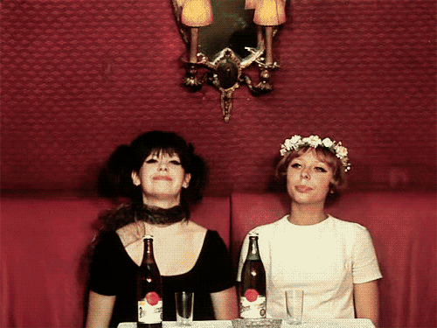
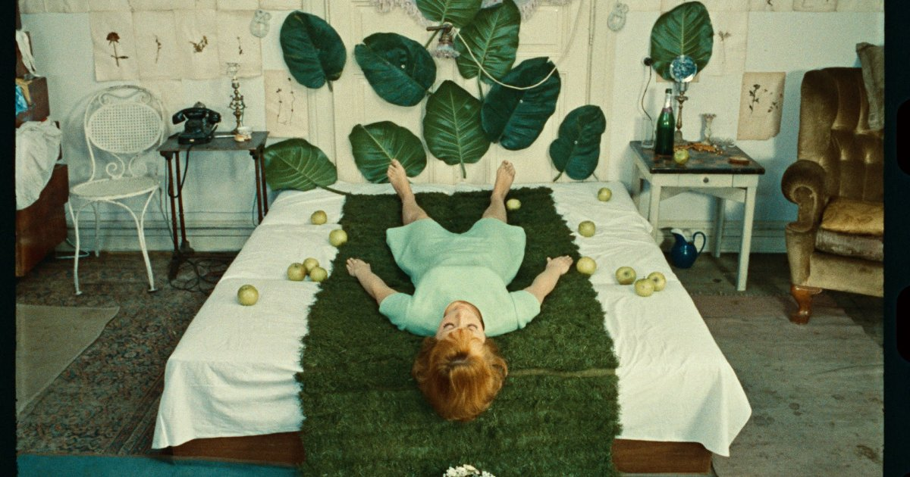

Slide 6
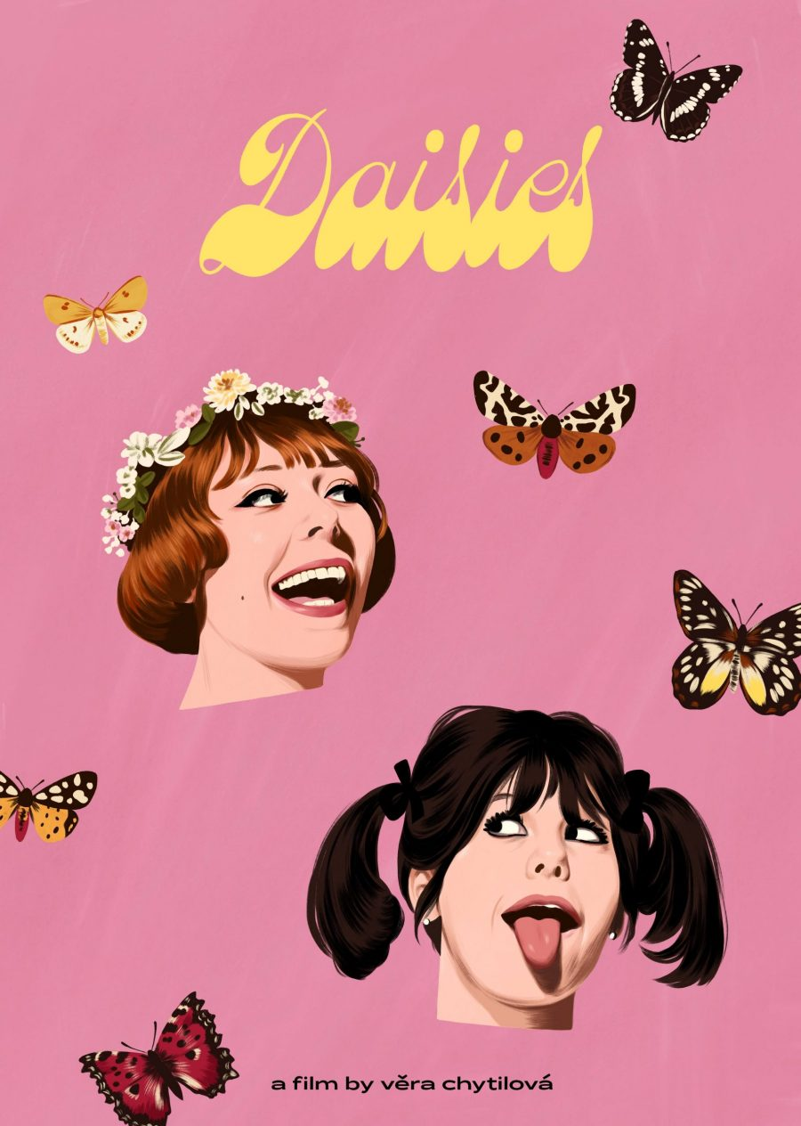
Reading_L6
A trio of contemporary articles reflecting on the film‘s legacy
https://www.filmovyprehled.cz/en/revue/detail/trampled-on-the-original-critical-reception-of-daisies-in-the-us-and-uk
https://www.nytimes.com/2022/08/17/movies/daisies-vera-chytilova.html
https://collider.com/vera-chytilova-daisies-movie-why-its-good/

Slide 7
State Socialist Mode of Production: 1948 – 1989
„ […] liberating cinema from the dictate of the market means puting it directly under state control. […] Weakening of the state control allowed cinema to také advantage of the nationalized production.“ (A.J. Liehm, NYC 1973)
______________________________________________________
State ownership >> state and its direct representatives as leaders of the Czechoslovak state film „company“
Political and ideological supervision, together with strategical management of the film industry >> both aspects did not change drastically during SSMP
Dramaturgy
(strong position of the director during all stages of the creative and production proces = projects had one creative supervision from the development up to the postproduction)

Slide 8
System of Creative Groups (CG)
CGs allow for both personal and working style continuities with previous modes of production; they might be the reason why not only in Czechoslovakia, but in the whole Eastern European region we are witnessing a space for artistic innovations and the rise of modernist cinema tendencies + the decline of this system post 1989 as one of the reasons for the crisis in the film industry
1954 – first batch of the CGs >> state control slowly decreases and allows for liberalization in the second half of the 1950s
Personal changes at the end of the decade:
  From 1959 Alois Poledňák is the head of the Czechoslovak State Film
  1960 – Vlastimil Harnach becomes the head of the Film Studio Barrandov
  1960 – Břetislav Kunc is the head of dramaturgy

Slide 9
CGs 1954–1970
1954-1970: relative stability of the system = conditions for profiling individual CGs (topics, style, genres)
„networking“ – we might think of CGs as „stables“ with core screenwriters, dramaturgs („script doctors“) and directors >> every CG has its own group identity (in period language „a face“)
Especially between the years1963–69 the CGs were stabilized >> crucial platforms for intiitation and development of projects / as an artistic and economical supervision / as a space for grooming promising talents
There is 5 main CGs:
  Bohumil Šmída – Ladislav Fikar
  Karel Feix – Miloš Brož
  Erich Švabík – Jan Procházka
  Jiří Šebor – Vladimír Bor
  Ladislav Novotný – Bedřich Kubala.
Apart from the CG Feix – Brož we see the New Wave films spread across remainig four CGs

Slide 10
Individual CGs: Creative profile
Producer Karel Feix and dramaturg Miloš Brož
Producer Ladislav Novotný and dramaturg Bedřich Kubala
Crowdpullers: genre films, stars and experienced directors, for example comedies and musicals
Lemonade Joe (a western parody from 1964), The Hop Pickers (youth musical) Lady of the Lines (musical for middle generation)
As a former „capitalist“ producer Feix regularly emphasized, that his group makes only 12 to 15% of Barrandov and Koliba studios overal production, but these films attract large audiences and have potential for export
Originally under Army film studios (up to 1956)
In the 1960s it stoped making films thematizing the army and opened itself to making existential dramas
Evald Schorm and Antonín Máša as key auteurs

Slide 11
Individual CGs: Creative profile
Jiří Šebor – Vladimír Bor
Producer Bohumil Šmída – dramaturg Ladislav Fikar
Contrasting with CG Feix–Brož and a direct competitor with CG Šmída–Fikar
They discovered and cultivated Miloš Forman, Ivan Passer and Jaroslav Papoušek. They had the courage to produce feature debuts of other newcomers; they cooperated with prominent writers such as Jan Procházka, Josef Škvorecký, Zdeněk Páral, Ladislav Fuks and others.
Other discoveries: directors Zdeněk Podskalský, Jiří Hanibal, Štěpán Skalský, Ivo Novák, Jindřich Polák, Zdeněk Sirový
Paradoxically, Šmída doesn‘t remember 1960s as his most successful period – but his CG made films of Pavel Juráček, Jiří Menzel and Věra Chytilová
Pavel Juráček as one of the dramaturgs since 1959
Networking in charge of Fikar – poet and a translator, influential intellectual and a sense for modernist aesthetic

