Slide 1
Czech New Wave
CZS36
Dr. Šárka Gmiterková
Fall 2022
25. 10. 2022

Slide 2
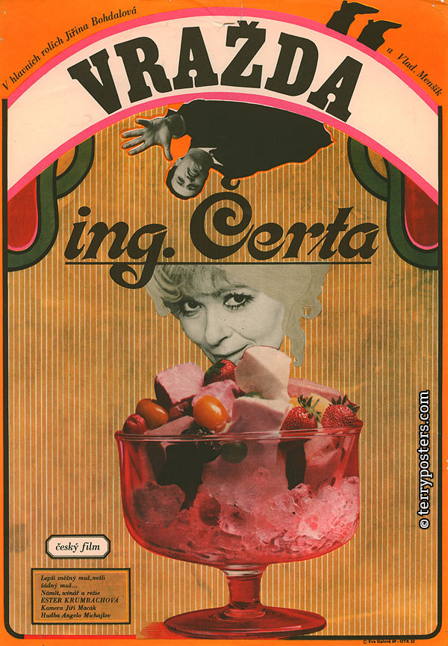
The Murder of Mr. Devil
1970, dir. Ester Krumbachová
The only film directed by the „muse of the Czechoslovak New Wave“ – Ester Krumbachová.
- writer, screenwriter, dramaturg, art production designer, painter, costume designer, director
She frequently collaborated with Věra Chytilová and Jaroslav Kučera (Daisies, Fruit of Paradise), also with her second husband Jan Němec (Diamonds of the Night, The Party and the Guests, Martyrs of Love).

Slide 3
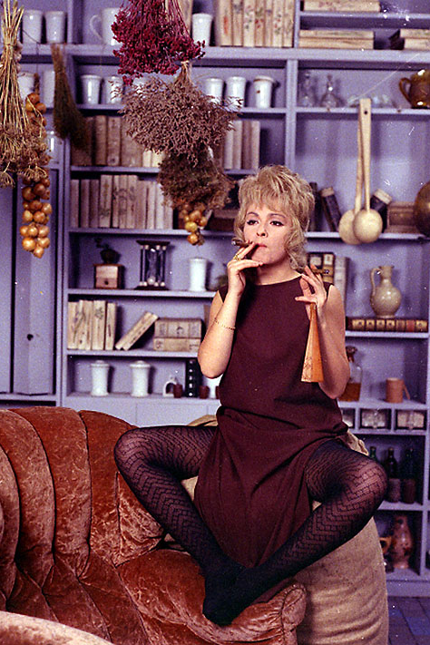
The Murder Mr. Devil
Questions
1.What does this film tell us about the dynamics between men and women?
2.Think about the look of the film. How does it support its central topic?
3.The main protagonists are characterized mainly through their looks and actions. How about their language?

Slide 4
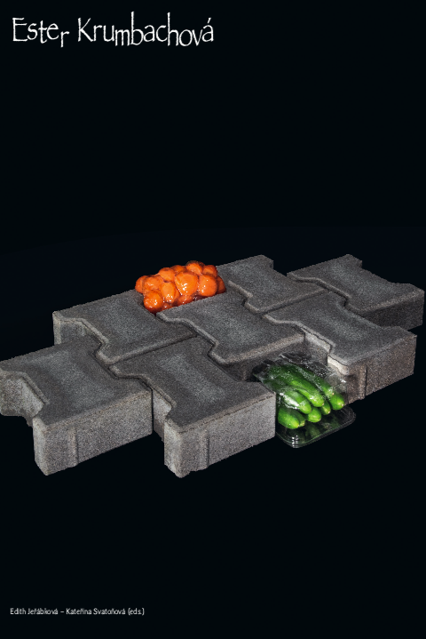
L8_Reading
SWIETOCHOWSKA, Galina. Ester Krumbachová: The Lady and Her Wunderkammer, pp. 78–89.
SKUPA, Lukáš. The Architect of Film Images: Ester Krumbachová a Production Designer and Her Imprint on the Czech Film Industry, pp. 36–51.
Both In: JEŘÁBKOVÁ, Edith – SVATOŇOVÁ, Kateřina (eds.). Ester Krumbachová. Praha: Umprum and ARE, 2021.

Slide 5
Women‘s liberation
The priority of the socialist regime
Female employment was a frequently highlighted priority of the socialist régime >> it is in tune with communist ideology, but it was also an economic necessity
So-called double (triple) burden
Women were delegated to the spheres of education and healthcare, where salaries tend to go down rather then up; they were paid less than their male colleagues and not many of them were to be found in the leadership
In cinema industry: despite the official proclamations the film production did not become more feminized >> creative positions are not the domain of women, other branches of Czechoslovak film are more open to female employment (cinemas, distribution)
Continuity assistants („script girls“), grips, editing assistants, wardrobe personnel; only rarely assisting directors and production assistants, editors and make-up designers
  „Feminized professions“, characterized by the essencialist rhetoric as requiring traditionally female character traits – attention to detail, multitasking, sensitivity, empathy, consistency

Slide 6
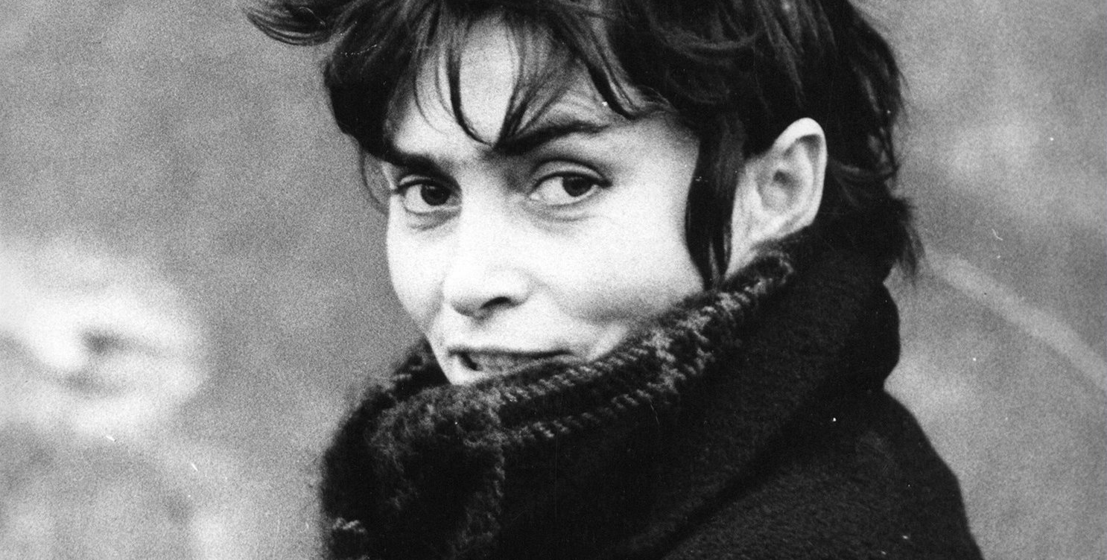
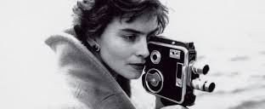
Věra Chytilová (1929–2014)
„A person should have the strength to do what satisfies him (or her).“
Key topics – ethics, morals and freedom
Emancipation: in the context of Chytilová‘s work one should not see emancipation tied only with the equality of genders and sexes, but in a wider sense, as a liberation from any kind of oppresion
Feminist interpretations are welcomed, but are to be found mostly in the reflections of her work outside of Czechoslovakia.

Slide 7
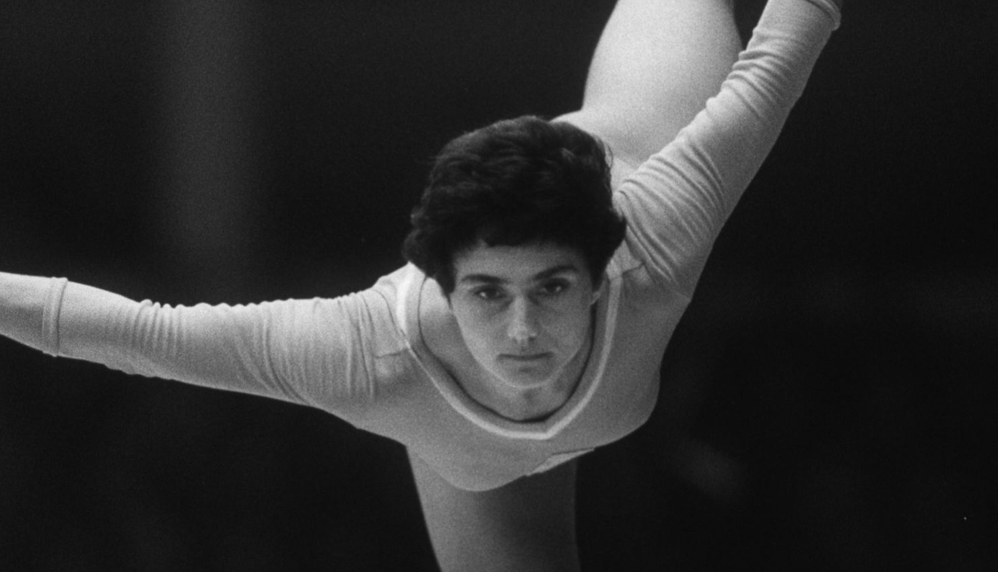
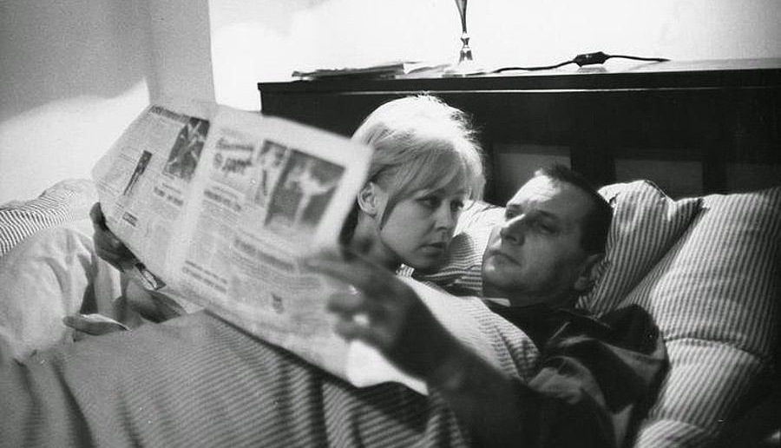
Something Different (1963)
„Film about Eva Bosáková? No, about something different.“
Chytilová‘s feature debut, CG Šmída-Fikar, originally a story by writer František Kožík about a top gymnast Eva Bosáková.
  The author doesn‘t just higlight Bosáková‘s successes and treats the gymnast as merely positive youth idol, but also questions the prize of victory in such a demanding sport.
  She also included the second heroine, a housewife called Věra, so she could treat the topic of socialist women and their lifestyle with complexity the topic deserves.
  None of her protagoinists is happy – neither top athlete, who dedicated her life to the profession, nor the housewife.
On the style level, this is another take on the cinema-verité method and „look“ – untrained actors, improvisation, everyday reality.
https://www.youtube.com/watch?v=OkW3zQwut1k

Slide 8
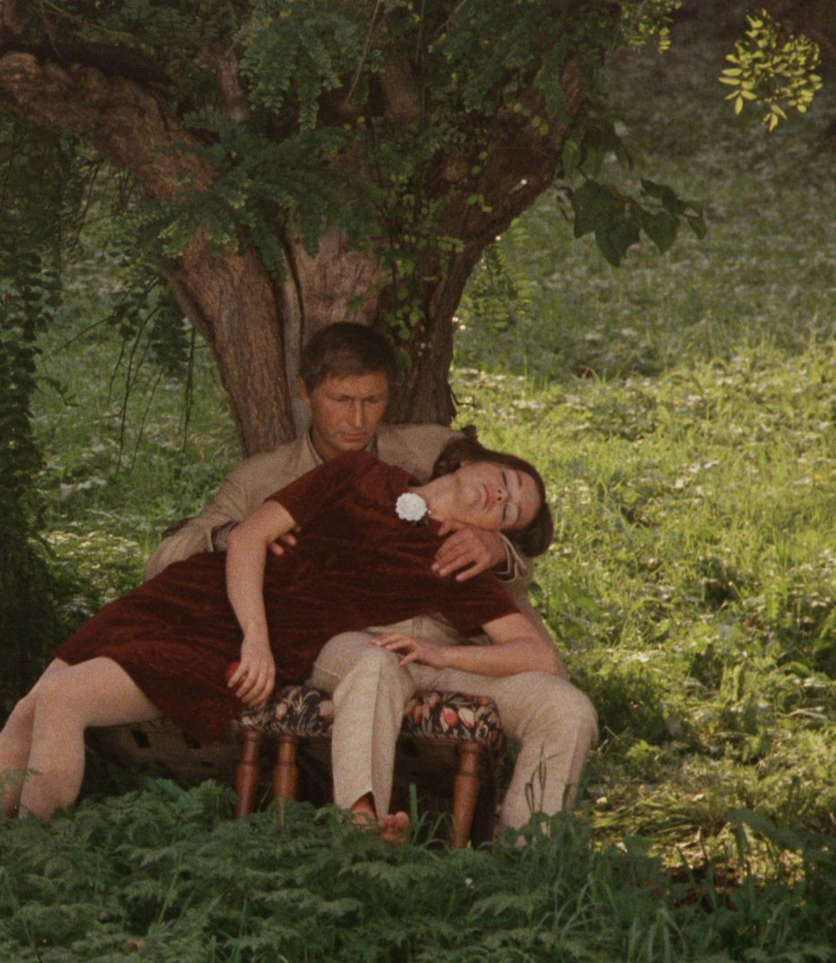
Forbidden Fruit of Paradise
(1969)
Another film by the trio Chytilová – Krumbachová – Kučera
Coproduction with a Belgian company Elizabeth film
Parables, very loosely tied to a biblical story of Adam, Eve and the snake charmer; detective story, a comedy of morals or horror; the effort to speak about the normalization of Czechoslovakia as a consequence of Soviet occupation starting from August 1968
Main parts embodied by the actors from studio Ypsilon (Jitka Nováková, Karel Novák, Jan Schmid), very stylized performance, radical departure from previously cast untrained and/or non-professional actors + almost operatic performance and style
The topic of taboo female sexuality?

Slide 9
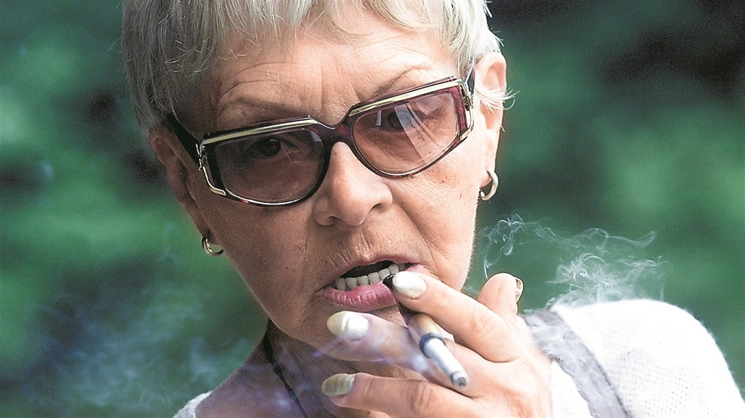
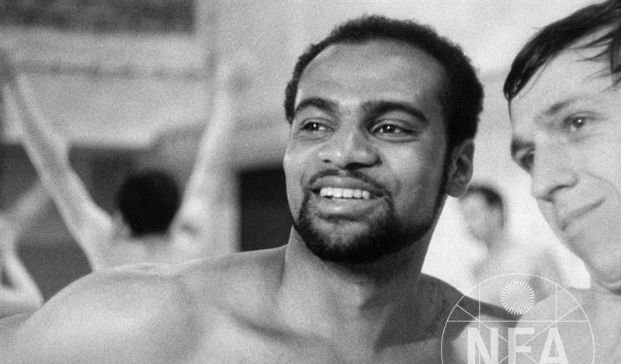
Drahomíra Vihanová (1930–2017)
Student film called The Black Keys Fugue (1964) >> she continually reflects the topic of racism and ethnicity
She worked as an assistant director at Otakar Vávra‘s films Romance for the Bugle (1966) and The Thirteenth Chamber (1968)
Studied film directing and editing at FAMU, her feature debut is called A Squandered Sunday (1969) >> addresses inner closure, resulting in depression and suicide
Three feature films and a string of short documentaries

Slide 10
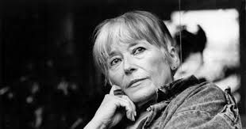
Ester Krumbachová (1923–1996)
„the grey eminence“, „the muse of the Czechoslovak New Wave“
She participed on multiple new wave projects on various postions >> the principle of collective authorship?
Directed a single film: The Murder of Mr. Devil (1970)
https://www.youtube.com/watch?v=pqrX9s0zVyA
Never studied film, just painting and graphics on secondary school in Brno, started as an art production designer in theatre >> she enjoys cinema as a form gesamtkunstwerk, allowing her to melt painting, words and movement together with color composition

Slide 11
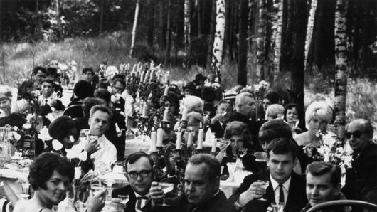
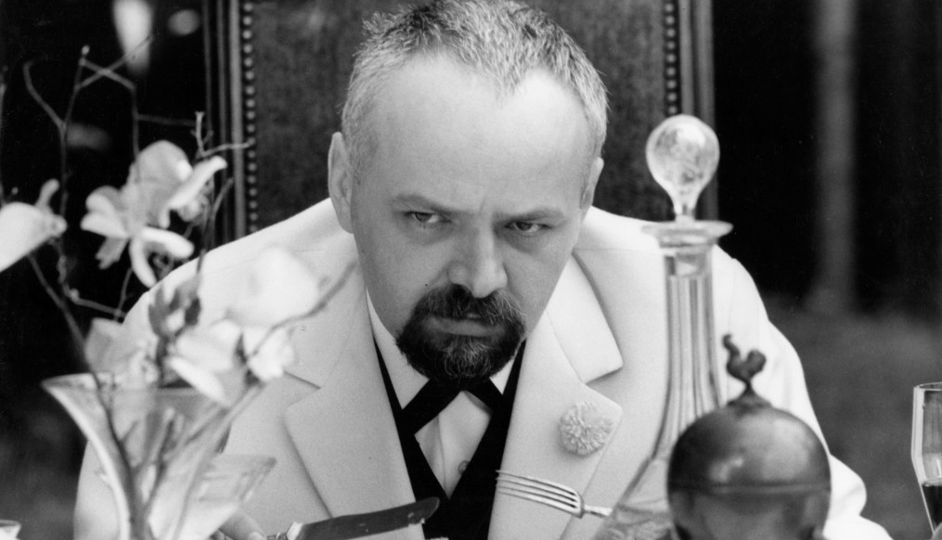
Ester Krumbachová
There is a tendency to include her solely in the New Wave context, however she collaborated with celebrated domestic auhors (Martin Frič, Otakar Vávra), with first generation of FAMU trained directos (Karel Kachyňa, Zbyněk Brynych, Vojtěch Jasný), with directors focusing on genre production (Zdeněk Podskalský) and those creators, whom she liked personally and where she worked on multiple positions (especially Jan Němec and Věra Chytilová).
Frequently worked as a costume designer or art production designer >> exclusive and unique position without specific definition, „tailored“ for individual projects and interactions with directos or screenwriters

Slide 12
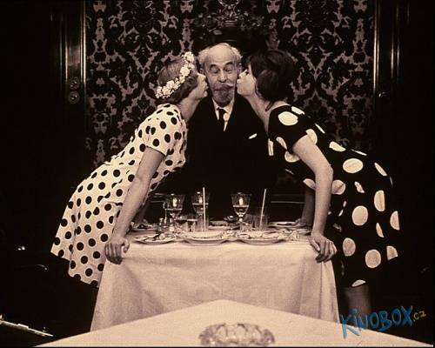
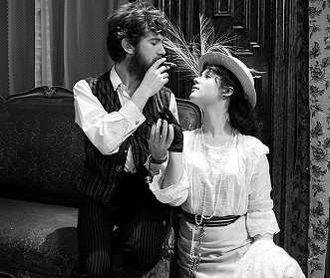
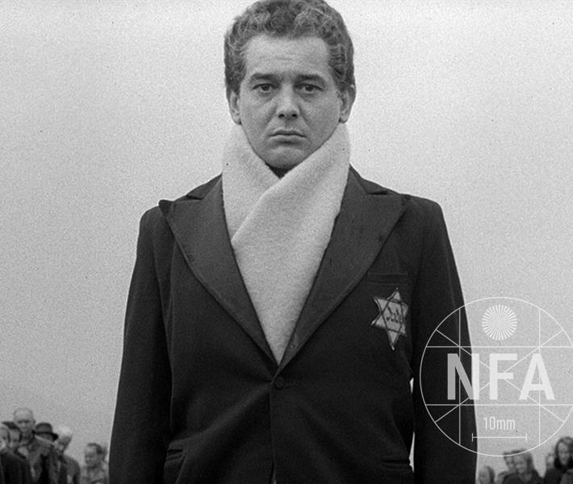
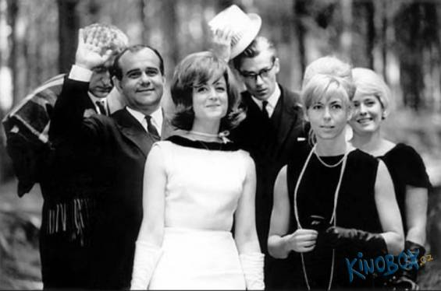
„Costume as a concentrated visual clue of a film character”

Slide 13
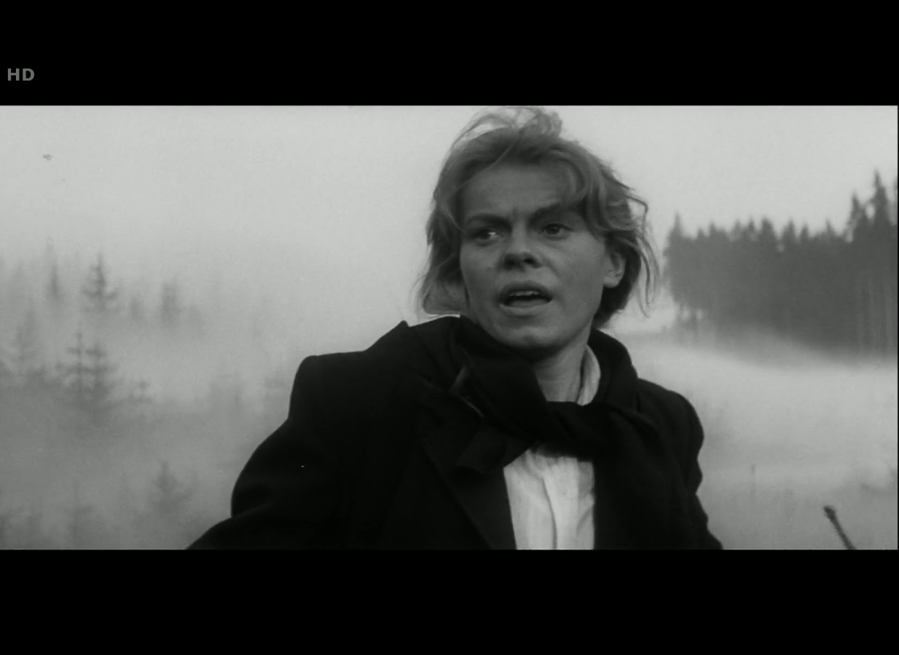
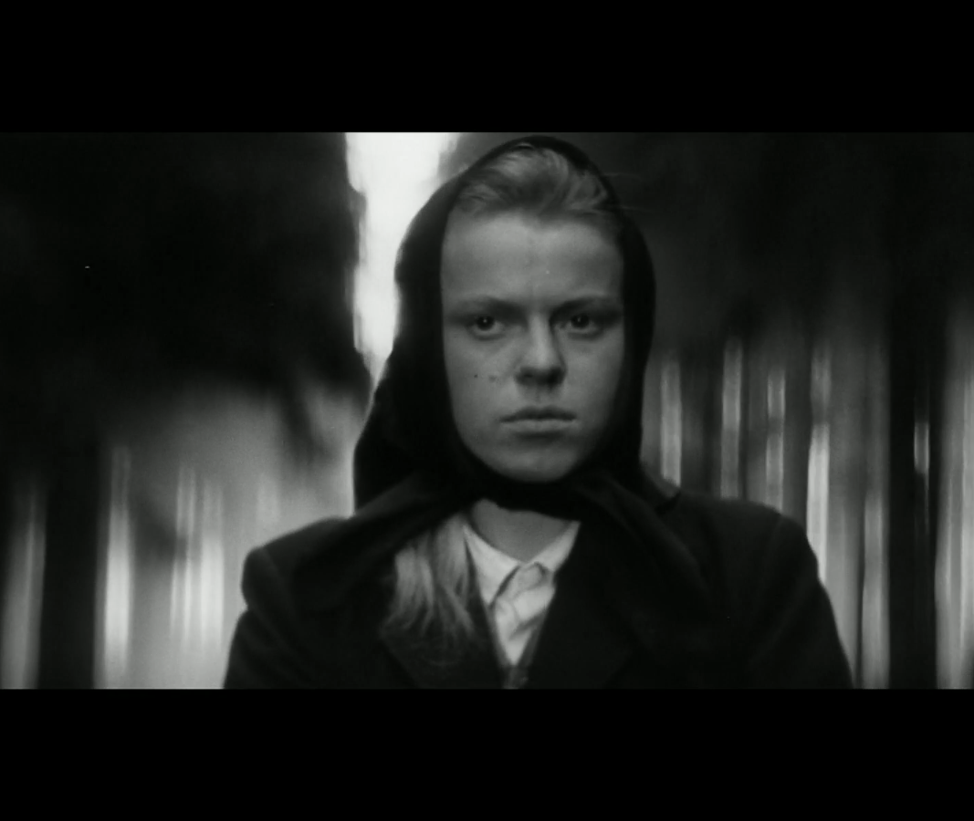
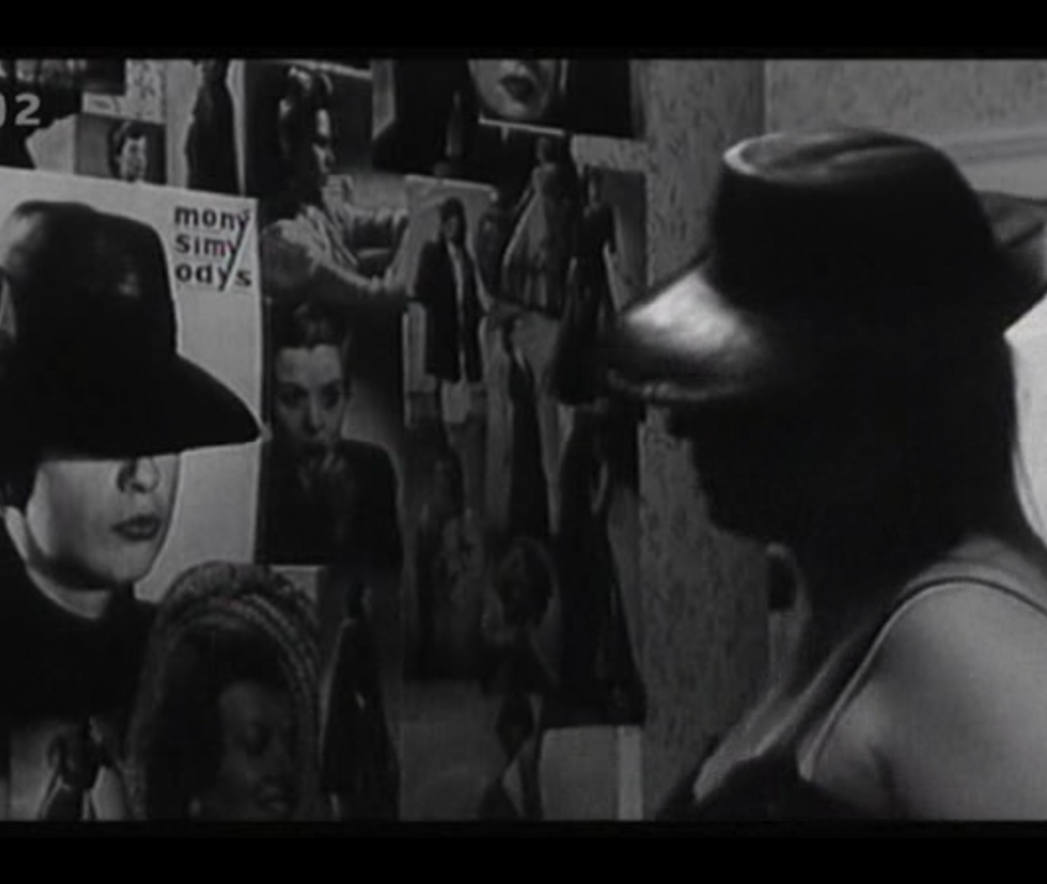
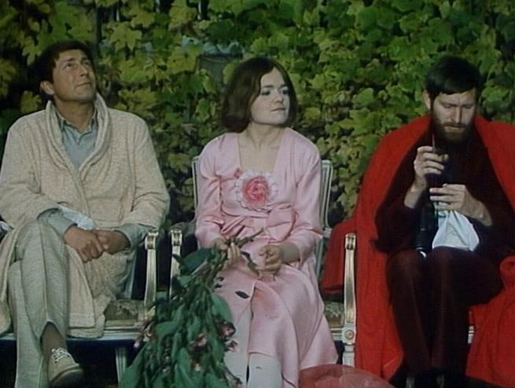
Accessories, Colors, Silhouettes

