Slide 1
Czech New Wave
CZS36 + CMA018
Dr. Šárka Jelínek Gmiterková
Fall 2023
2. 11. 2023
Please note, that L6 films are not uploaded in the IS, but can be accesed on famufilms.cz and dafilms.cz

Slide 2
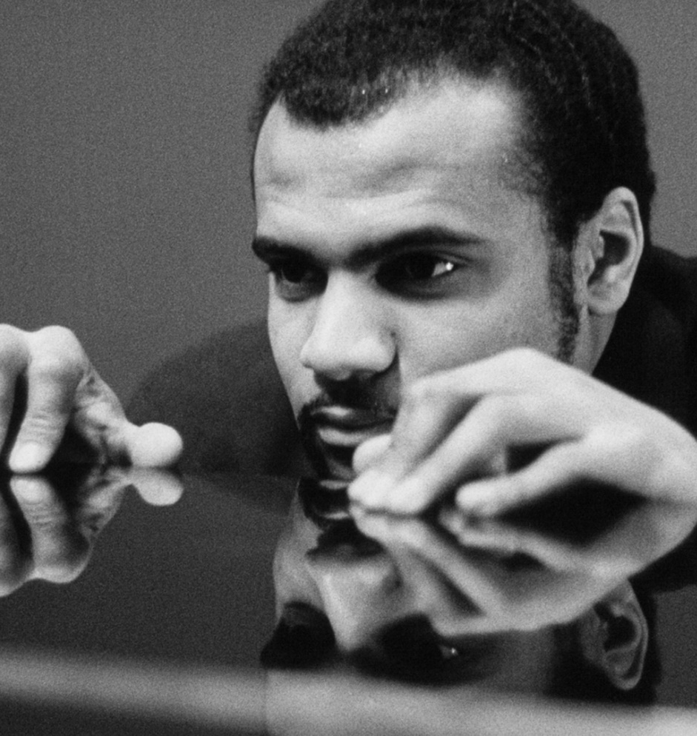
The Black Keys Fugue (1964)
A student film directed by Drahomíra Vihanová tells a story about Faty Farari, who comes from Africa and studies music in Prague. Before his graduate concert he finds out, that his whole family tragically deceased.
This is a very personal film for Vihanová, since she always wanted to study music. In contrast to her peers she knew that creative writing was not her forte. On the other hand, her sense of rhytm and her visual style were remarkable; she also edited her own films.

Slide 3
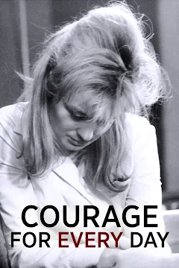
Courage for Every Day (1964)
Directed by: Evald Schorm, Screenplay: Antonín Máša, Cinematography: Jan Čuřík, Music: Jan Klusák, Starring: Jana Brejchová, Jan Kačer, Josef Abrhám, Vlastimil Brodský, Jiřina Jirásková, Václav Trégl, Olga Scheinpflugová...
The screenwriter Antonín Máša started to develop this psychological drama as a comissioned work by the CG Novotný–Kubala, wishing to make a film about a small-town youth. While researching the topic, Máša met in one of the factories a former youth functionary- His story was the basis for a film exploring connections between the purpose of work and the meaning of life; and subtly examining a sense of stagnation.

Slide 4
Questions
The Black Keys Fugue and Courage for Every Day
1. In which aspects The Black Keys Fugue feels like a typical new wave film and which characteristics go against?
2. Note the scenes, where you feel Vihanová‘s sense of rhytm and her tendency for visual storytelling the strongest.
3. Think about three characteristics, which adequately describe the movie and why.
1. How would you describe the main character, Jarda Lukáš?
2. Schorm‘s style is not ostentatious and very visible, similarly to the films by the trio Passer, Papoušek and Forman. Yet these films are definitely not without interesting stylistical choices. Try to think about those instances, when Schorm transforms and elevates reality for the needs and purposes of his storytelling.
3. „This is how the Sartrian concept of nothingness becomes the expression of modern experience of human existence: lonely man, freed from his past, forced to choose and to look out for his own self, endangered by the freedom of others, constantly has to face the lack of sublime values, and this lack is incorporated by the concept of nothingness.“ (KOVÁCS, András Bálint. Screening modernism. European Art Cinema, 1950–1980. Chicago and London: The University of Chicago Press, 2007, s. 93)
Is this characteristics suitable for describing Courage for Every Day? Why?

Slide 5


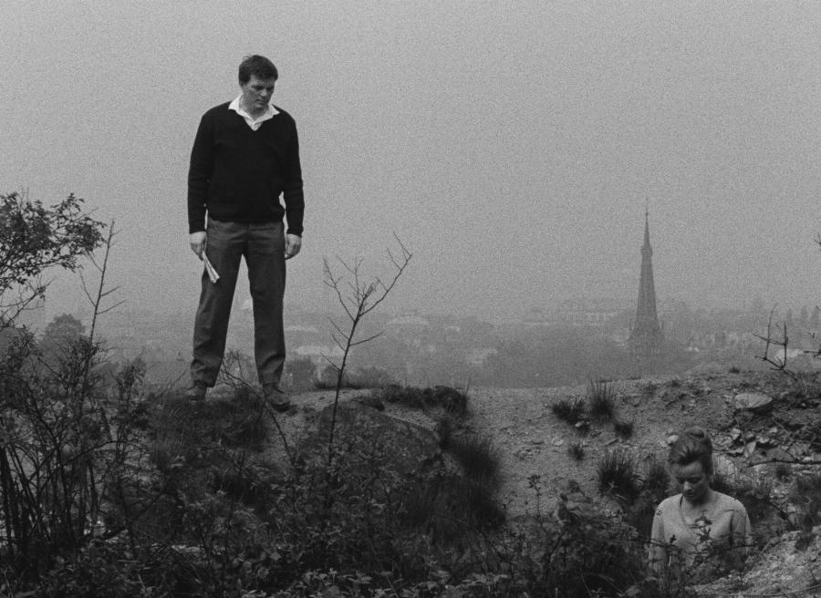
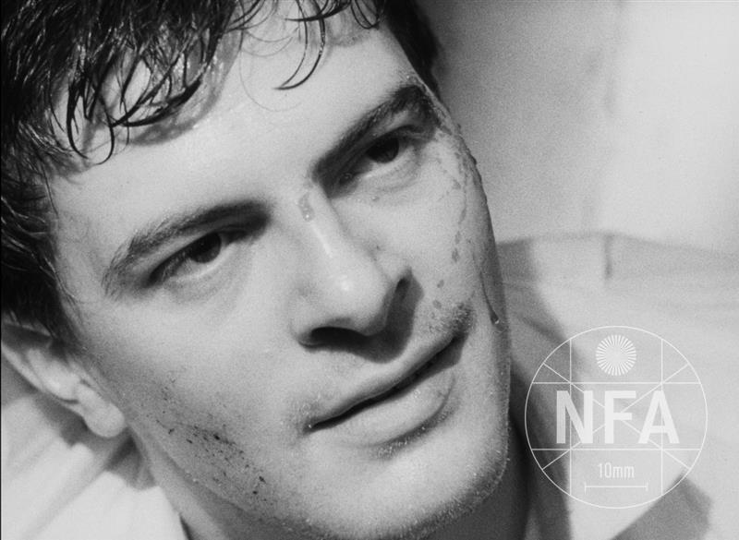

Slide 6
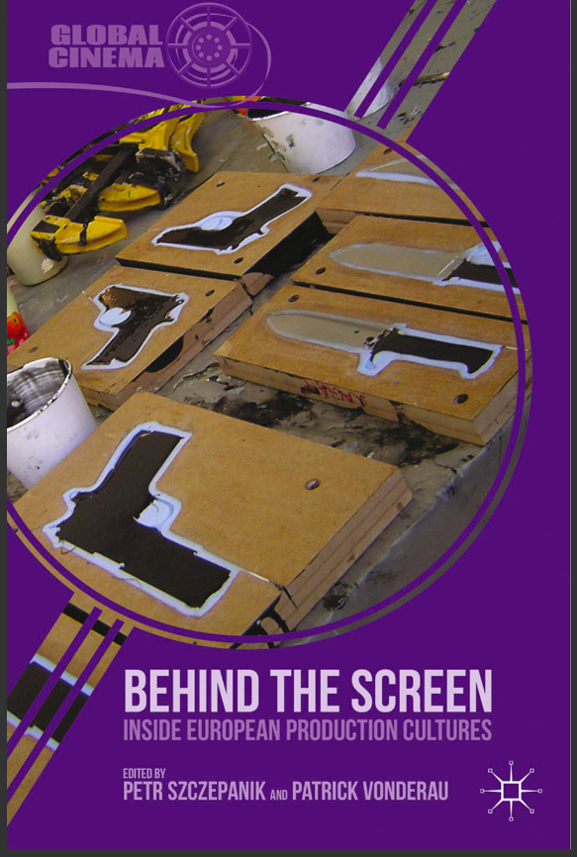
Reading L6
SZCZEPANIK, Petr. The State-socialist Mode of Production and the Political History of Production Culture. In: Petr Szczepanik and Patrick Vonderau (eds.). Behind the Screen. Inside European Production Cultures. New York: Palgrave Macmillan, 2013, pp. 113–133.

Slide 7
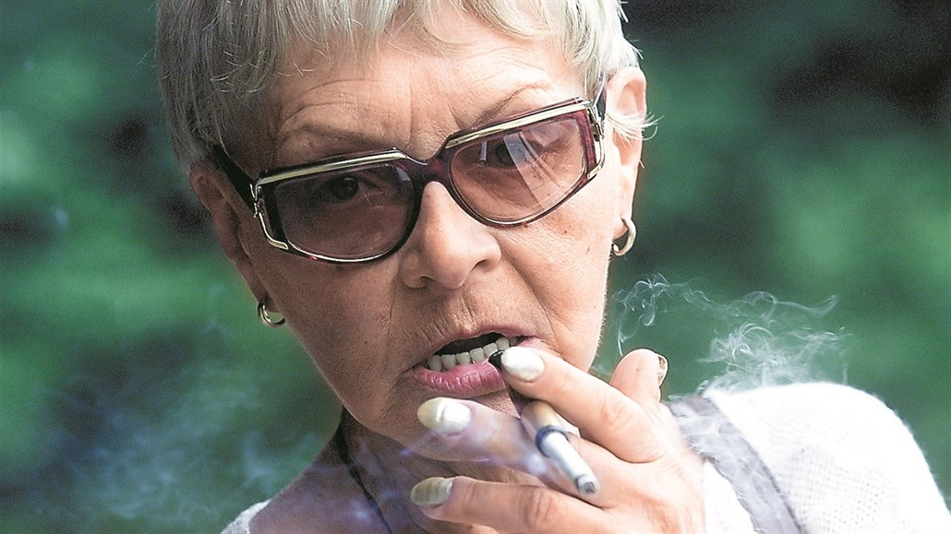
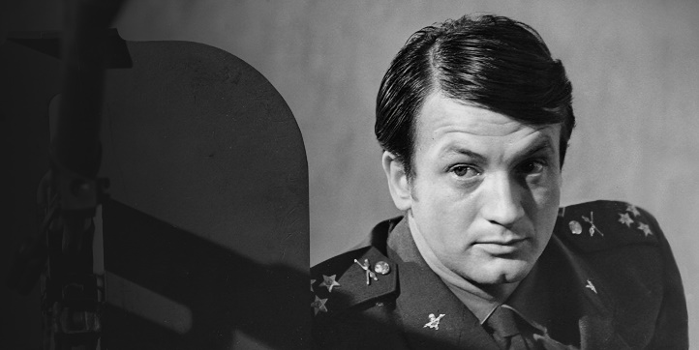
Drahomíra Vihanová (1930–2017)
Student film called The Black Keys Fugue (1964) >> she continually reflects the topic of racism and ethnicity
She worked as an assistant director at Otakar Vávra‘s films Romance for the Bugle (1966) and The Thirteenth Chamber (1968)
Studied film directing and editing at FAMU, her feature debut is called A Squandered Sunday (1969) >> addresses inner closure, resulting in depression and suicide
Three feature films and a string of short documentaries

Slide 8
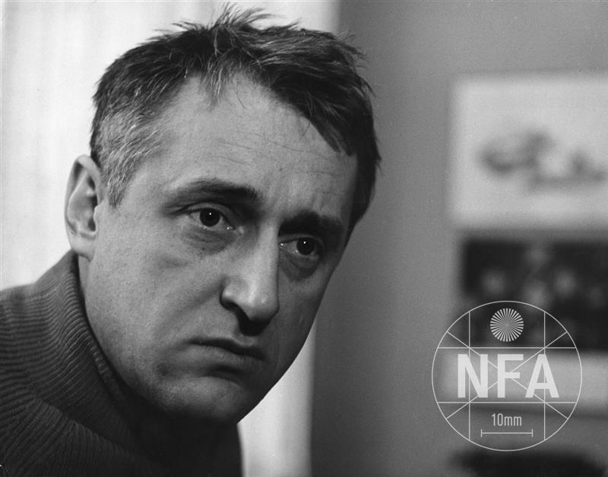
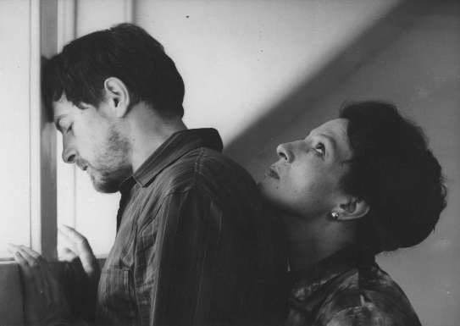
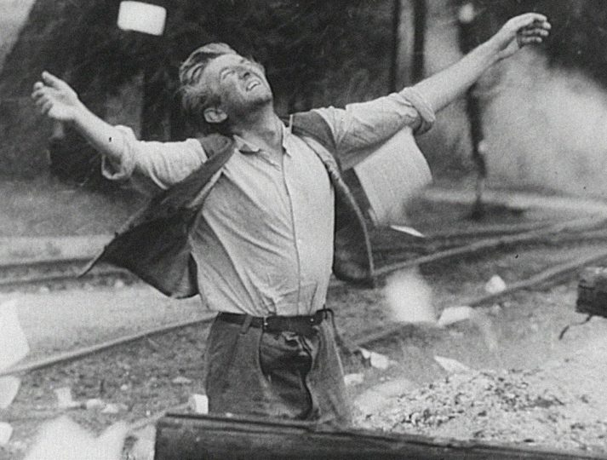
Evald Schorm (1931–1988)
„ Creativity and arts should be like a dessert after a great diner. But I am like a bone that is stuck inside your throat.“ >> the author of worrying and existential films.
He made many documentaries, which demonstrate his interest in people not in tune with the regime, and in the topics nobody wanted to talk about (biblical references)
Lacking consistent style – his films are tied together on the topical level and articulating similar values
His films are cast with professionally trained actors, even stars (Vlastimil Bordský, Dana Medřická, Jana Brejchová, Jan Kačer)
Feature debut Courage for Every Day (1964), followed by The Return of the Prodigal Son (1966), Left with Five Girls (1967), The End of a Priest (1968), concluding 1960s with The Seventh Day, the Eigth Night (1969)

Slide 9
State Socialist Mode of Production: 1948 – 1989
„ […] liberating cinema from the dictate of the market means puting it directly under state control. […] Weakening of the state control allowed cinema to take advantage of the nationalized production.“ (A.J. Liehm, NYC 1973)
______________________________________________________
State ownership >> state and its direct representatives as leaders of the Czechoslovak state film „company“
Political and ideological supervision, together with strategical management of the film industry >> both aspects did not change drastically during SSMP
Dramaturgy („script-doctoring“)
(strong position of the director during all stages of the creative and production proces = projects had one creative supervision from the development up to the postproduction)

Slide 10
System of Creative Groups (CG)
CGs allow for both personal and working style continuities with previous modes of production; they might be the reason why not only in Czechoslovakia, but in the whole Eastern European region we are witnessing a space for artistic innovations and the rise of modernist cinema tendencies + the decline of this system post 1989 as one of the reasons for the crisis in the film industry
1954 – first batch of the CGs >> state control slowly decreases and allows for liberalization in the second half of the 1950s
Personal changes at the end of the decade:
  From 1959 Alois Poledňák is the head of the Czechoslovak State Film
  1960 – Vlastimil Harnach becomes the head of the Film Studio Barrandov
  1960 – Břetislav Kunc is the head of dramaturgy

Slide 11
CGs 1954–1970
1954-1970: relative stability of the system = conditions for profiling individual CGs (topics, style, genres)
„networking“ – we might think of the CGs as „stables“ with core screenwriters, dramaturgs („script doctors“) and directors >> every CG has its own group identity (in period language „a face“)
Especially between the years1963–69 the CGs were stabilized >> crucial platforms for inititation and development of projects / as an artistic and economical supervision / as a space for grooming promising talents
There is 5 main CGs:
  Bohumil Šmída – Ladislav Fikar
  Karel Feix – Miloš Brož
  Erich Švabík – Jan Procházka
  Jiří Šebor – Vladimír Bor
  Ladislav Novotný – Bedřich Kubala.
Apart from the CG Feix – Brož we see the New Wave films spread across remainig four CGs

Slide 12
Individual CGs: Creative profile
Producer Karel Feix and dramaturg Miloš Brož
Producer Ladislav Novotný and dramaturg Bedřich Kubala
Crowdpullers: genre films, stars and experienced directors, for example comedies and musicals
Lemonade Joe (a western parody from 1964), The Hop Pickers (youth musical) Lady of the Lines (musical for middle generation)
As a former „capitalist“ producer Feix regularly emphasized, that his group makes only 12 to 15% of Barrandov and Koliba studios overal production, but these films attract large audiences and have potential for export
Originally under Army film studios (up to 1956)
In the 1960s it stoped making films thematizing the army and opened itself to making existential dramas
Evald Schorm and Antonín Máša as key auteurs

Slide 13
Individual CGs: Creative profile
Jiří Šebor – Vladimír Bor
Producer Bohumil Šmída – dramaturg Ladislav Fikar
Contrasting with CG Feix–Brož and a direct competitor with CG Šmída–Fikar
They discovered and cultivated Miloš Forman, Ivan Passer and Jaroslav Papoušek. They had the courage to produce feature debuts of other newcomers; they cooperated with prominent writers such as Jan Procházka, Josef Škvorecký, Zdeněk Páral, Ladislav Fuks and others.
Other discoveries: directors Zdeněk Podskalský, Jiří Hanibal, Štěpán Skalský, Ivo Novák, Jindřich Polák, Zdeněk Sirový
Paradoxically, Šmída doesn‘t remember 1960s as his most successful period – but his CG made films of Pavel Juráček, Jiří Menzel and Věra Chytilová
Pavel Juráček as one of the dramaturgs since 1959
Networking in charge of Fikar – poet and a translator, influential intellectual with a sense for modernist aesthetic

