Slide 1
Czech New Wave
CZS36 / CMA18
Dr. Šárka Jelínek Gmiterková
Fall 2023
21. 9. 2023

Slide 2

Black Peter
Czechoslovakia 1963 (Černý Petr)
dir. Miloš Forman
What do you make of the film‘s title?
How would you describe the main protagonists – Petr, Pavla, Čenda,
father and mother? What doest the film tell us about generational gap?
Why do you think this film was praised
by state and party authorities as a great example of socialist cinema?

Slide 3
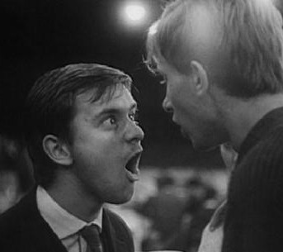
Petr x Čenda
Two portraits of period young masculinity
Petr not a rebel, just a regular guy (clumsy, quiet, yet doesn‘t bend to the ideas of the older generation)
Čenda – efficient and dedicated labourer, the film pokes a fun at him?
— dynamic, loud, not smart

Slide 4

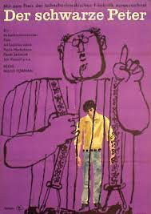
“A great example of socialist film art“ WHY?
Comedy
Observation: almost no experiments with narration, style and/or ideological background X absorbing international influences and abrupt ending
International success and visibility –
various prizes at Venice, Locarno and Lisbon IFF

Slide 5
Czech New Wave Course: Organization
Study materials will be provided every week – that is reading (chapters and articles), presentations and films (files or links)
Each session will consist of a screening, followed by a discussion and a lecture on a film/topic/artist
Two stages of evaluation:
          A written essay on the film Cozy dens (Pelíšky, 1999, dir. Jan Hřebejk). The paper should be three to five pages long and will have to highlight similarities and/or differences with selected New Wave films in terms of narration / settings / character construction / values / meanings. Deadline: Sunday November 19th.
          Oral exam – students have to provide a list of 10 films, with short abstract of 250 words, summarizing the story and highlighting any element they feel are worth discussing + summary of two chapters/articles provided by the teacher in the Readings file
— The dates of the exam TBA

Slide 6




Recommended reading
Databases, (S)VOD platforms and reading:
KVIFF.TV and Netflix
English friendly programmes in Prague cinemas such as Aero and Edison
https://www.filmovyprehled.cz/en
https://dafilms.com/

Slide 7
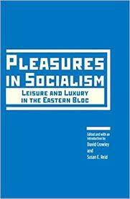

Reading: Week 1
CROWLEY, David and REID,
Susan E. (eds.): Introduction: Pleasures in Socialism? In: Pleasures in Socialism.
Leisure and Luxury in Eastern Bloc. Evanston IL, Northwestern University Press, 2012, pp. 3–51.
HAMES, Peter. Czech and Slovak Cinema. Theme and Tradition. Edinburgh: Edinburgh University Press, 2009, pp. 1 – 14, 55 – 74 (Realism).

Slide 8
Postwar Czechoslovak Cultural and Social History: A Brief Overview
1945–1948: Third republic
BREAKS
  Nationalization of many industries, incl. cultural and media industries
  Cinema fell under the direct supervision of the state 11th August 1945
  Theatres could not be owned by a private entrepenur since June 8th 1945
  Strong inclination towards communist ideology and Soviet Union
CONTINUITIES
  Culture and citizens used to a certain degree of discplination and control since the war years (Protectorate of Bohemia and Moravia)
  Leftist tendencies already present in the socalled First Republic era (1918–1938), although they were a minority
  Strong preferences for the working class

Slide 9
1948–1953: Forming the system and the first crisis
1948, February 17th–25th – the Communist putsch
  Starting the era of a very tight and rigid ideological control in agreement with a larger society
  Important formative years of the system
  Top-down implementation of Soviet politics
  Numerous clashes between party leadership and state government
  working class is the new domineering social class
  Radical youth and female employment
The „Sharp Course“ politics
  socialist realism is the norm
  revision of Czech cultural heritage
  cutting ties with western influences and democratic tradition
since 1951 stagnation and militarization of society: preparation for global conflict, “fight for peace”
1953 – death of Stalin and president Klement Gottwald
The politics of New Course >> return of entertainment and commercial genres (operetta, satire)

Slide 10


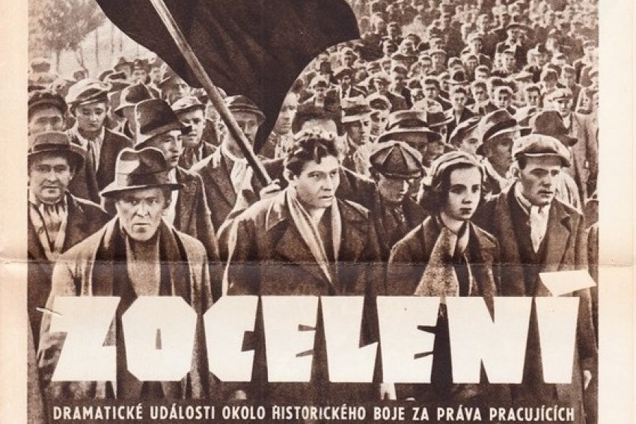

Slide 11
1954–1956: Changing priorities
1957–1960: Schizofrenia of the regime
the foundation of modern socialist society
Changing priorities >> securing a more comfortable life standard for Czechoslovak citizens
socialist realism is not considered as a strict norm
the country opens towards western influences
In the second half of the decade a lot of opposing tendencies
  the effort to finalize the cultural and ideological revolution and getting closer to communist utopia resulted in the tendency to weaken critical voices and renewed preference for ideological purity
  X the regime was much weaker than at the beginning of the decade, bottom-up reaction on societal changes and trends
  Faith in technological progress / the return to world fashion in 1957 / Czechoslovak success at Expo Brusel 1958
  the ideal of a regular citizen >> no more a worker, but a middle class, cultured person

Slide 12



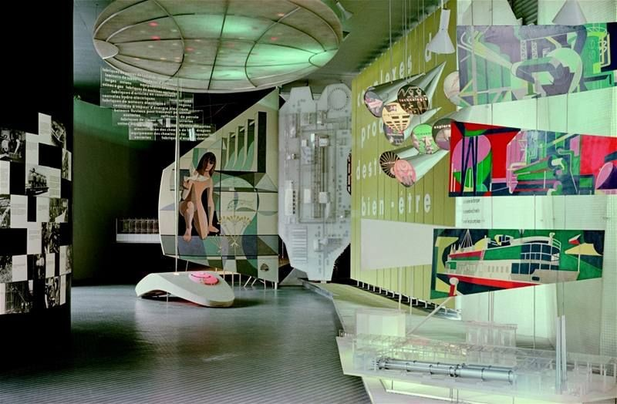

Slide 13
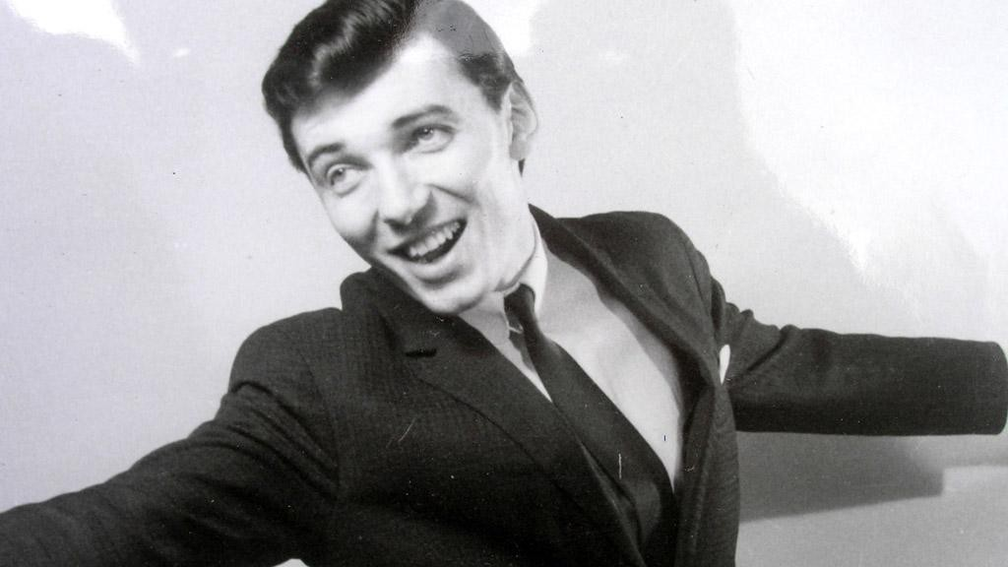
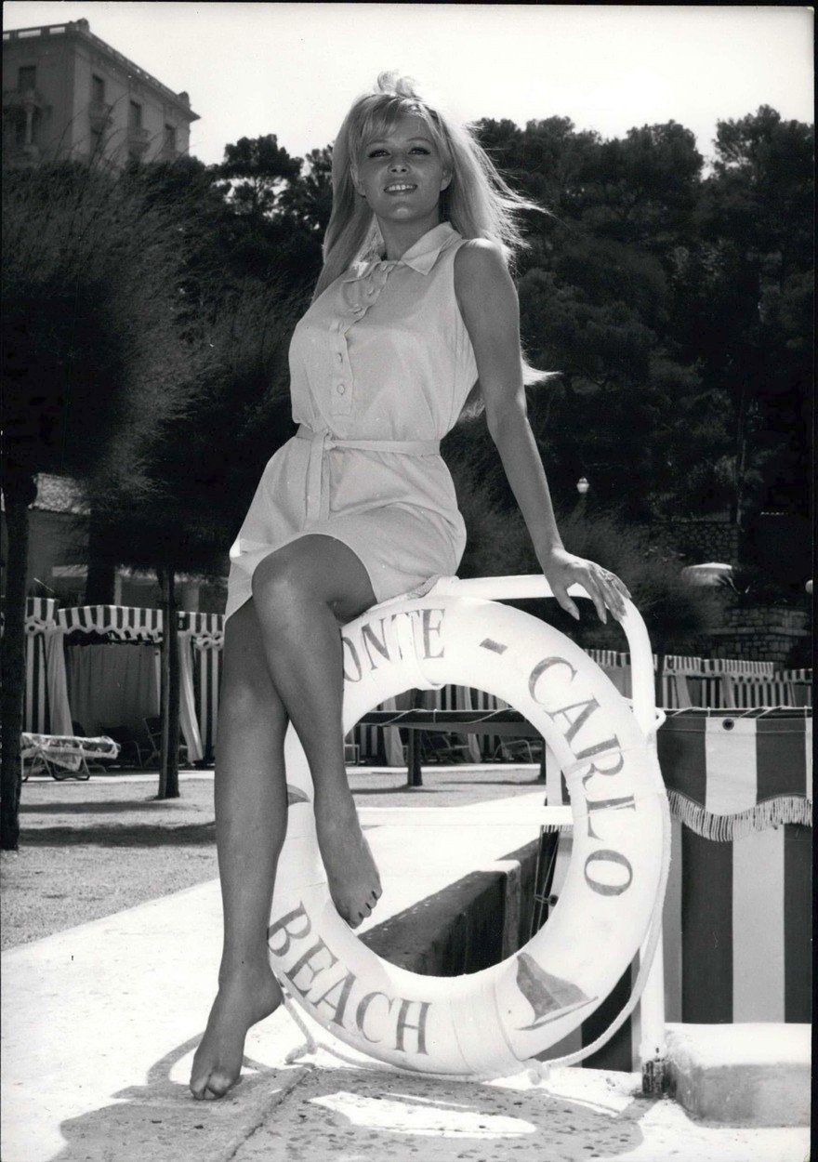
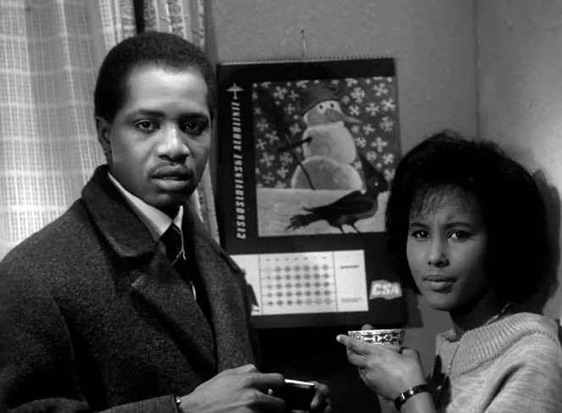
1961–1963: Economical problems
1964–1968: Consumer socialism
In the first half of the decade economical issues + global politics crisis
new generation of top level politicians (generational shift reflected in cinema as well)
the country is open to international influences (tourism, international students)
In the second half of the decade the economic situation stabilized
— Tolerance for western films, music, fashion, although not general (men with long hair, drug using)

Slide 14
Key elements of cultural politics and socialist lifestyle 1948–1968
Democratization of culture
any citizen can participate on socialist culture, either as a consumer or as a producer
Downsides – culture was differentiated from ideological perspectives
- Luxury based on the difficulty of access: cars, electronics, fashion, food items
Ateistic propaganda and rationalization of life
Departure from religious traditions
New socialist citizen should be a fully formed person, acting in accordance with his or her rationality >> easier for planning standardization and distribution
Against petite bourgeoisie (lower middle class)
Wide, yet flexible category

