Slide 1
Czech New Wave
CZS36 + CMA018
Dr. Šárka Gmiterková
Fall 2023
6. 12. 2023

Slide 2
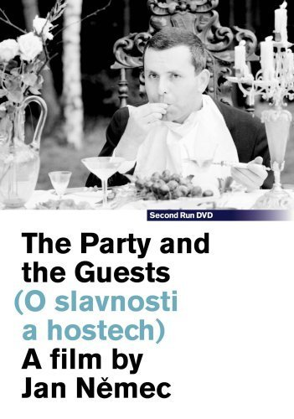
The Party and the Guests
1965, dir. Jan Němec
After the existential war drama Diamonds of the Night, on which Němec collaborated with the writer Arnošt Lustig, this is a movie co-authored with Ester Krumbachová. She participated not only on the visual aspects of the film, but on the story as well.
A group of people gets ready for a birthday party in the middle of the woods. The idyllic day is spoiled by various mishaps, escalated by the disappearance of one of the guests. This leads to the start of a brutal chase…

Slide 3
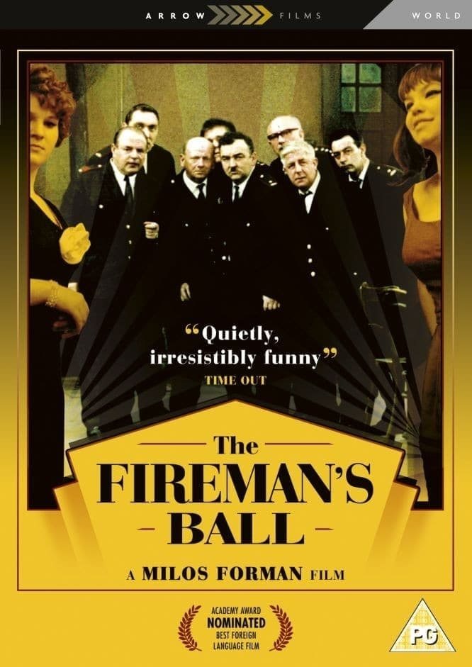
The Firemen‘s Ball
(1967, dir. Miloš Forman)
“Film comedy, where drinking, dancing and theft takes place“
Last Czechoslovak and most ambitious film of the trio and their collaborators
CG Šebor-Bor, Screenwriters and story development: Forman + Papoušek + Passer, Cinematography: Miroslav Ondříček, Editing: Miroslav Hájek

Slide 4
The Party and the Guests – Questions
„ In Diamonds of the Night the man is imprisoned due to the external pressure called the war. In The Party people are not free, because they are willing to participate on any kind of collaboration.“ (Jan Němec in the interview with AJ Liehm)
Although these characters lack names, many of them personalize common human flaws and deformations. Focusing on the central seven characters, try to give them nicknames based on their main character traits, roles and behaviour.
Visually, this film is frequently characterized as „manyristically ornamental“. Note down at least three aspects, which support such label.
Němec and Krumbachová cast this film with their friends, collaborators and other known personalities from period culture and arts. Try to compare their performance with the ones you already know from Forman‘s films and Intimate lighting. Is it the same principle or not? Do these famous colleagues of the duo function on the same basis as the regular civilian types you have seen throughout this course?

Slide 5
The Firemen‘s Ball – Questions
1. Period Czechoslovak reviews and even contemporary analytical essays have a tendency to view this film as a distorted mirror image of the national character (mainly negative views). Do you agree? Which topics and parts of the story have the potential to speak internationally – that is, to you?
2. Although we recognize some familiar faces not only behind the camera, but also in front of it, this film introduces new aspects in Forman‘s work. Can you name at least two aspects, which you feel are different from Black Peter and Loves of a Blonde?
  „The schtick with the non-professional actors, we‘ve seen that so many times! No more original. Still the same. For the first time it was something new. Not anymore.“ (anonymous viewer, quoted in: SOELDNER, Ivan. Světová gala premiéra ve Vrchlabí. Filmové a televizní noviny, 1967.)

Slide 6

L9_Reading
SKUPA, Lukáš. Perfectly Unpredictable: Early Work of Věra Chytilová in the Light of Censorship and Production Reports. Studies in Eastern European Cinema 9, 2018, No. 3, pp. 233–249.

Slide 7
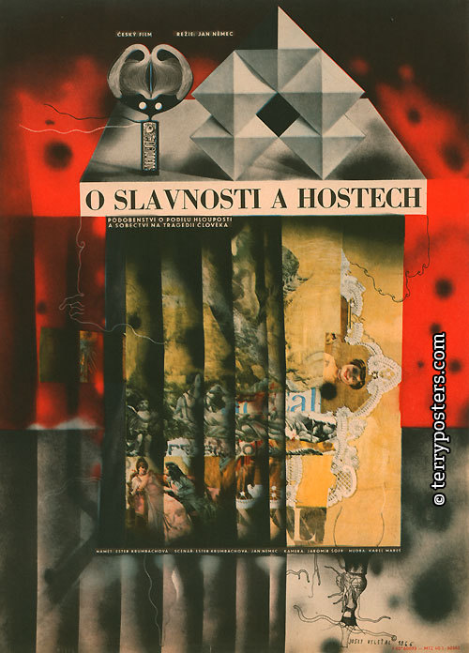
The Party and the Guests
Alegorical morality >> similarly as other problematic films such as Daisies or Firemen‘s Ball
In contrast to the Diamonds of the Night much more static film with carefully composed image
Fragments of dialog and non-professional actors
Problems appear once the film is in post-production >> the screenplay does not foreshadow possible problems
January 1966 – prezident Antonín Novotný is strongly against the film and orders Jan Němec to be released from Barrandov studios
The film is strategically eliminated from the public view, incl.the ban for festival screenings and sales abroad
Standard cinema distribution two years after the film is finalized – spring 1968.

Slide 8

The Firemen‘s Ball
(1967, dir. Miloš Forman)
Forman‘s most ambitious and most expensive Czechoslovak film
His image as the most successful director, who stays out of trouble, is shattered

Slide 9
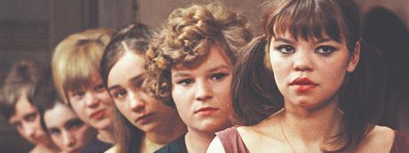
Firemen‘s Ball smoothly passed through the pre-production and production phases (story development, screenplay, casting, location scouting, shooting), no negative feedback X strong opposition from the Czechoslovak Union of Fire Protection (ČSPO – Československý svaz požární ochrany)
Coproduction with the Italian company Sostar film – Carlo Ponti – he supports the project with 110 000 USD (color stock, plans for global distribution), in the end the coproducer backed out of the contract
Opening night: 15. 12. 1967 + previous series of unoficial screenings
„This film is not against the firefighters nor for them. It is not about the uniform. It is about every single one of us, about our character, about the relationships between various people in our society.“ – an opening title inserted in March 1968.

Slide 10
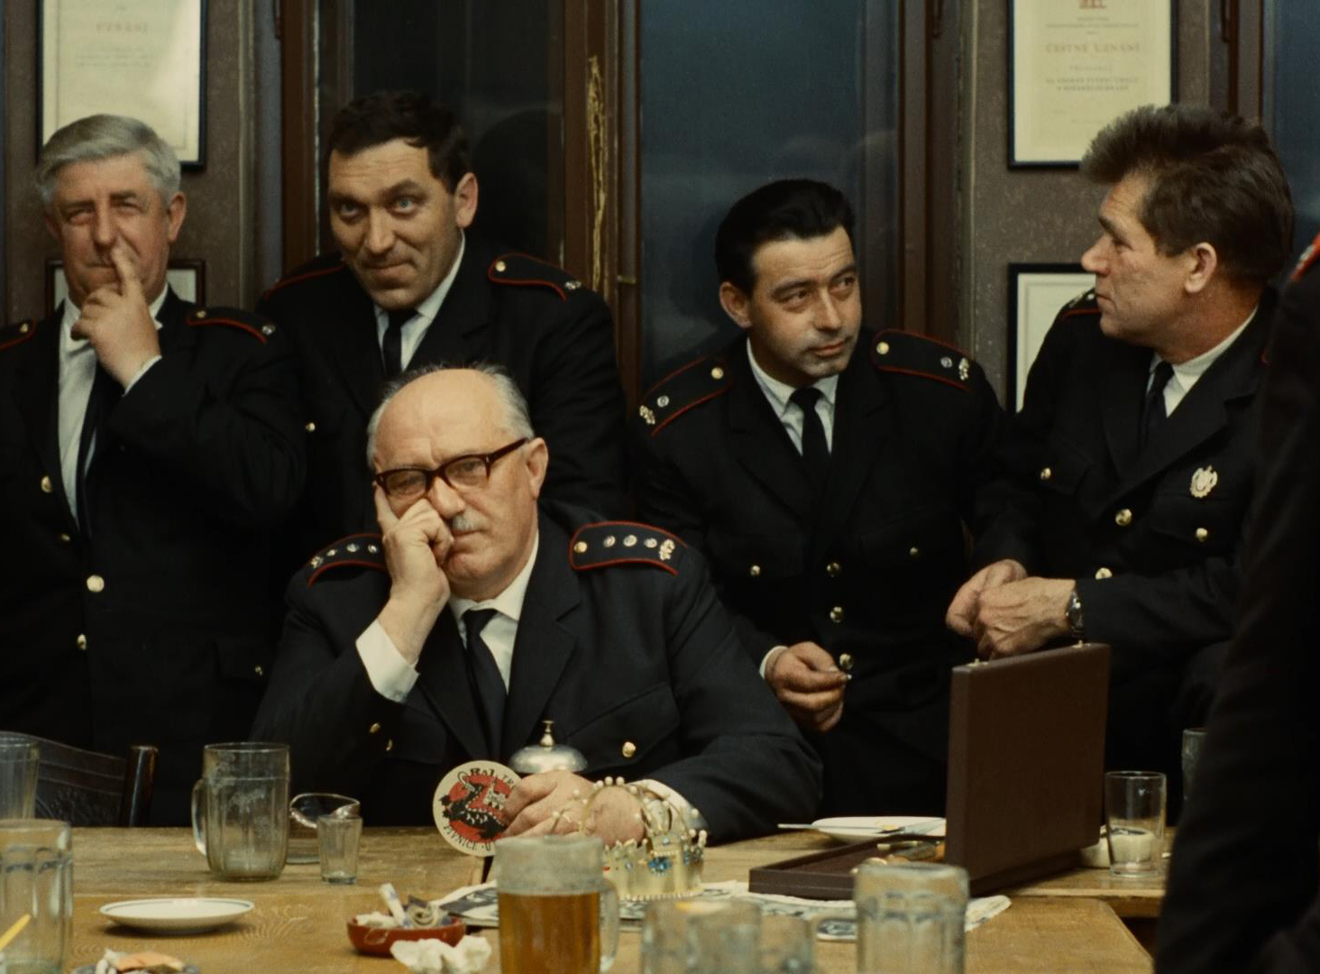
Disagreements with ČSPO
ČSPO has hopes for a movie promoting voluntary firefighting, as a form of education and because its membership decreases
In October 1967 Czechoslovak film calms ČSPO down, claiming that this film is intended solely for international distribution and not for domestic screenings
Firefigters, or a certain type of people, are portrayed very negatively in this film. Forman‘s youngsters frequently embarassed themselves and behaved inappropriately, but gained our sympathies because of their age and hypeprbolic portraiture X Firemen‘s Ball has no singular hero, just allegorical collective; ruthless ridicule instead of partial empathy
The scandal points to a wider issue of social satire in art cinema – are artists entitled to it or not? => a signal about persisting ideas about subordinate role art has to play in socialist society.

Slide 11
Censorship 1965–1967
„Control or censorship, financial or political, is in its consequences more or less the same. It breaks characters and talents. Financial control is slightly more consistent, because everything can be count to the last penny.“ (Ivan Passer)
There is no universal model of art (X socialist realism), no unified audience >> filmmakers should take into consideration audience needs and the economic state of cinema
November 1965: Czechoslovak film and television union (FITES) was established => allows the community to articulate unified stances vis-a-vis the development of audiovisual industry and reactions towards criticism; publishes its own influential newspaper Filmové a televizní noviny (a biweekly)
Since january 1967: HSTD can intervene only when there is a risk of publishing state, economic and/or service secrets + censorship is legalized (before there was no legal framework)

Slide 12
Changes in censorship communication
1966–1967: both filmmakers and film critics prefer aesthetically demanding projects, realist impulses are used up X calls for realism in art production
The box office results and cinema attendance of domestic films are alarmingly low >> the importance of economic criteria is accented and genre films are strongly called for
New Wave projects are still important for export
Censorship interventions in the years 1966 and 1967 are coming from the ČSF/FSB leadership. Also, the relationships between cinema management and party leadership are weakened and have a turn for the worse (CGs, their independence and lack of top-down control are the main target of ideologically motivated critique).
Sharp reservations against individual projects; preproduction phases are suspended in case of The Case for a Rookie Hangman (dir. Pavel Juráček), The Joke (dir. Jaromil Jireš) or The End of a Priest (dir. Evald Schorm)

Slide 13
Consequences both symbolic and real
Two pioneer films of the antirealist branch of the Czech New Wave: Daisies (caution in the preproduction phase) and The Party and the Guests
May 1967: „Please, what kind of films are you making?“ >> famous interpelation of the deputy Jaroslav Pružinec in the parliament, where he criticized Daisies, The Party and the Guests, Martyrs of Love and Hotel for Stragers
  His speech became a symbol of censorhip oppression in the 1960s
FSB reacted: less debuts and first feature films directors employed at Barrandov studios – comparing 1963 (9) and 1965 (8) we see a fall to cca 3 projects of this kind a year. Young filmmakers are evaluated as ideologically unreliable and have a tendency for obscure experiments.

