Slide 1
Czech New Wave
CZS36
Dr. Šárka Jelínek Gmiterková
Fall 2023
19. 10. 2023

Slide 2

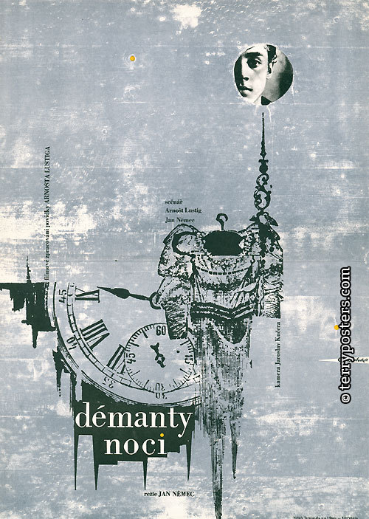
Joseph Kilian (1963) + Diamonds of the night (1964)
Double Feature

Slide 3
Diamonds of the night / Joseph Kilian dir. Jan Němec dir. Pavel Juráček, Jan Schmidt
Ester Krumbachová – costume design and dramaturgy (not credited)
„Diamonds of the night are easy as a slap. It‘s a principle of a target: if you want to say something important, it is better not to go for a center. If you are a good shooter, then aim for the periphery; and shoot there many times. The shots create holes, forming a target on their own.“
Cinematography – Jaroslav Kučera and Miroslav Ondříček
Starring: Antonín Kumbera (of Romani origin) and Ladislav Janský
Paralel English title „The Character in Need of Support“ (meaning a statue carrying sg heavy on its back)
As a former student of scriptwriting and without director credits, Juráček could not have directed the film himself
According to Juráček, the film is „a representation of absurd sitations, in a Kafkian manner, stemming from the period of the personality cult, when we were not aware of the regime‘s absurdity“
Cinematography: Jan Čuřík
Starring: Karel Vašíček, Jiří Stivín, Pavel Bártl

Slide 4
Joseph Kilian // Diamonds of the Night
Pavel Juráček himself characterised the film as „Kafkian“ and this seems to be main motive associated with the movie.
Which parallels with the works of Franz Kafka you see in Joseph Kilian?
Try to focus on the aspects of film style – sound, lighting, camera, editing, framing – and think about the ways they support the topic of the film. Think about the similarities with films you have already seen.
Jan Němec was called enfant terrible of the Czech New Wave – a label, which he fulfilled already during his studies at FAMU (various clashes with multiple pedagogues, frankness and provocation through attitudes, opinions and his creative output)
Diamonds of the night, as well as his previous short film Mouthful, adapts a short story by Arnošt Lustig – a truly modern Czech author (such as Bohumil Hrabal), who reflected his experiences during World War II in a very naturalistic way. Diamonds are his own story – he escaped the transport of death, together with a friend, who later died.
  1. Can you name reasons why this film can be considered as a modernist (surrealist) work of art (narration, historical background, characters, formal elements?)
  2. How the film treats Jewishness / Holocaust topic? Can you think of films which treat this sensitive issue in a similar way?

Slide 5
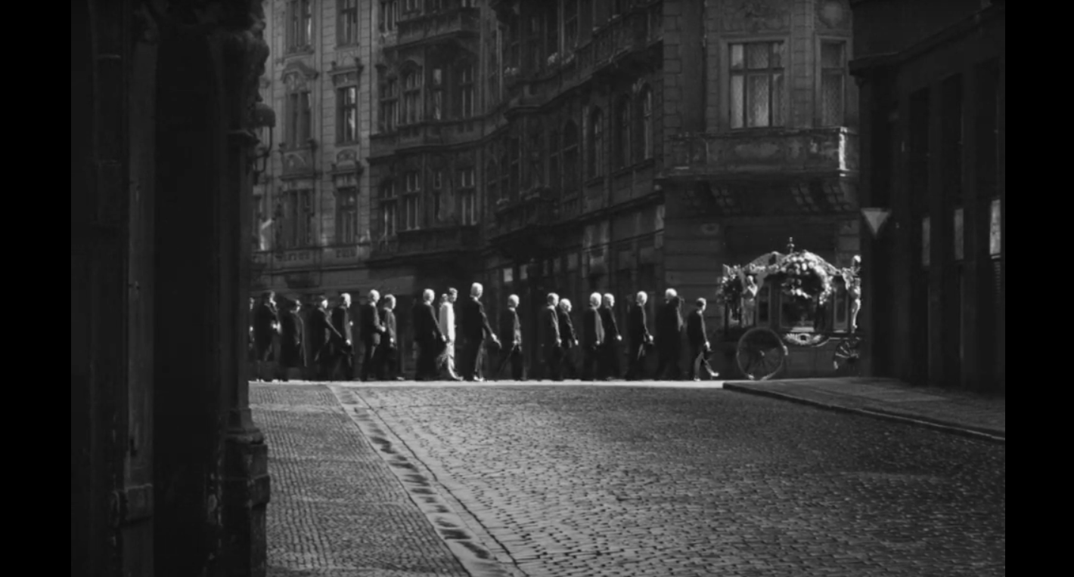
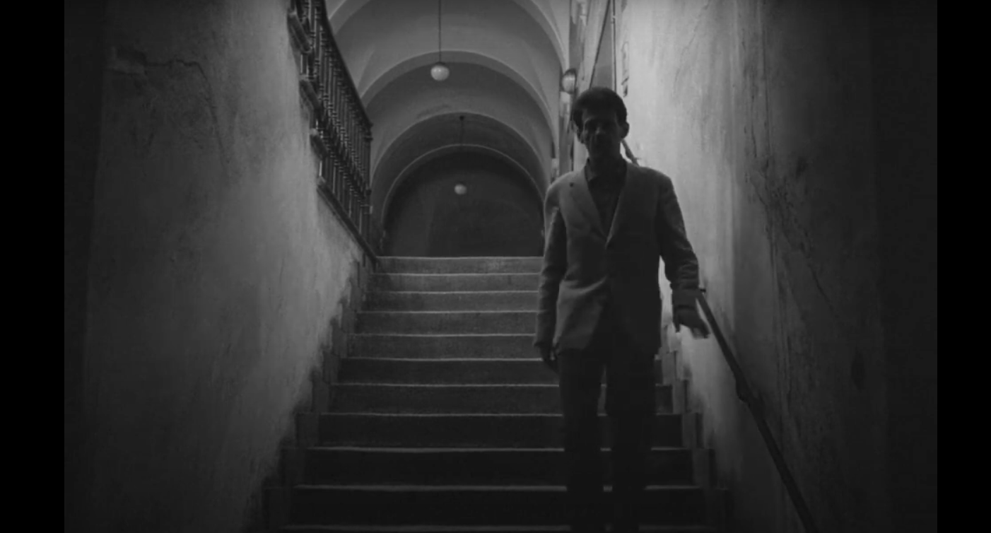
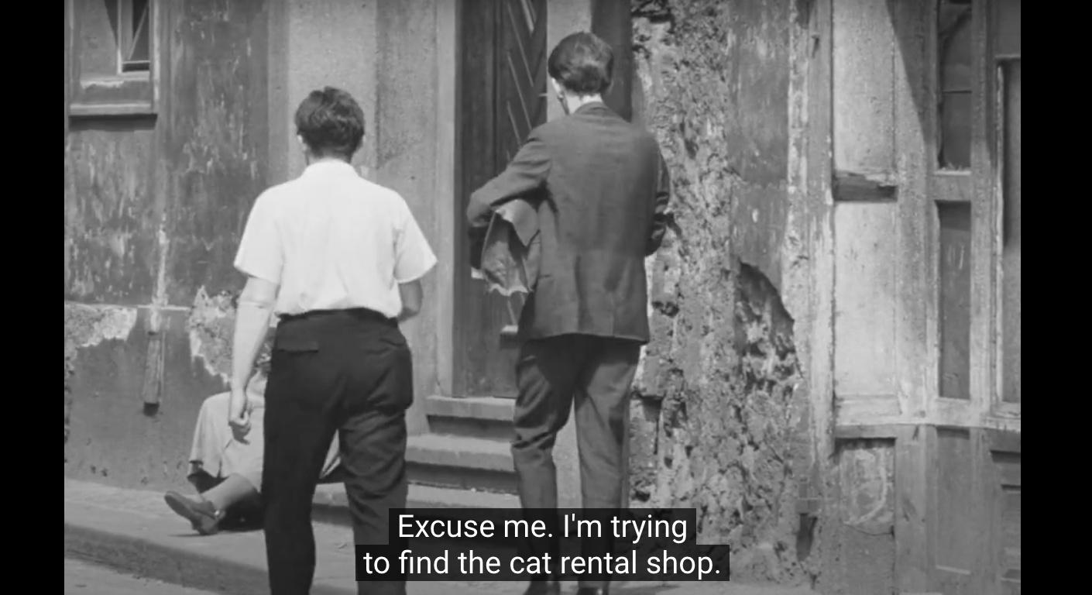
https://www.youtube.com/watch?v=QRfpa8c28y0

Slide 6
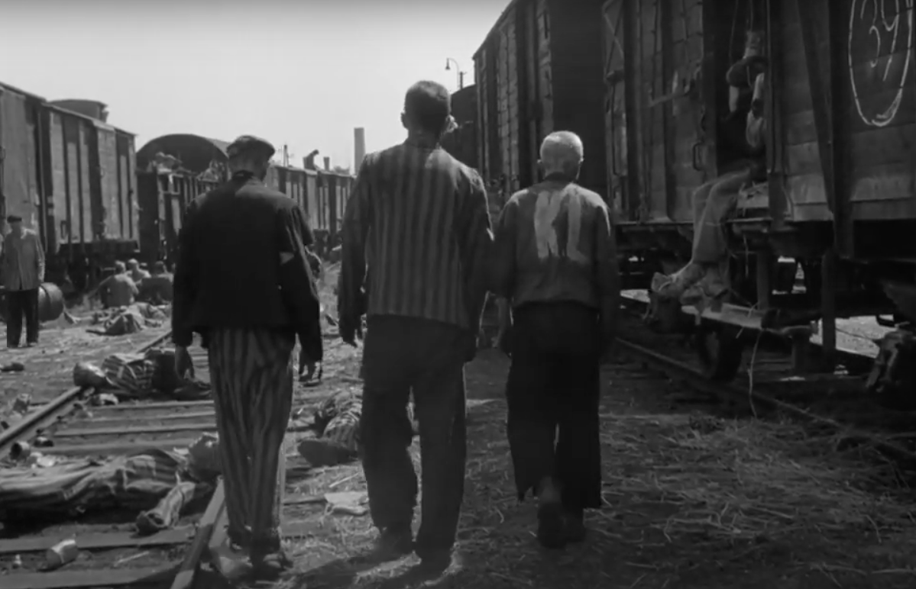
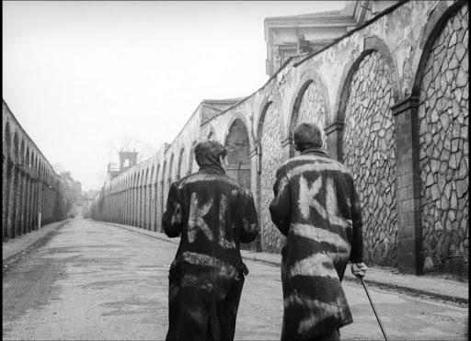
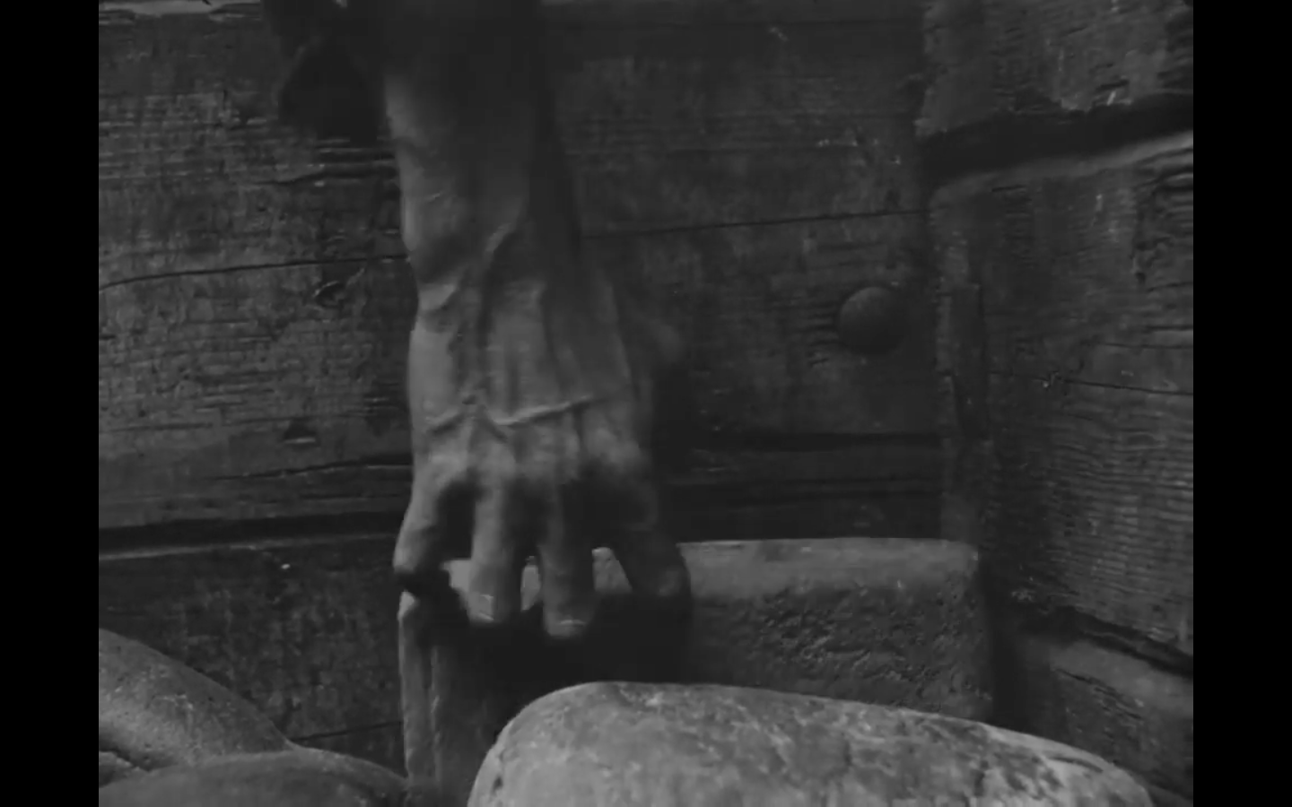
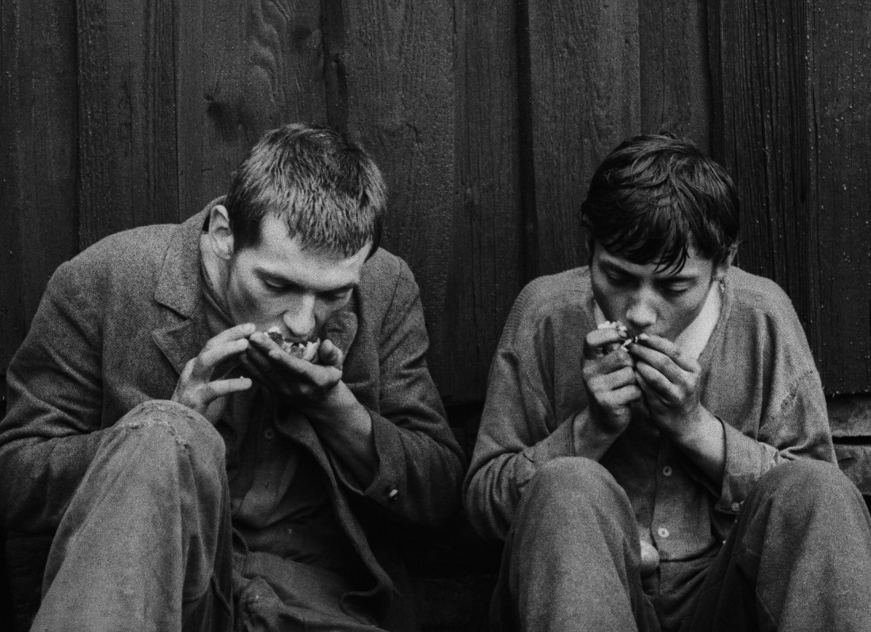

Slide 7
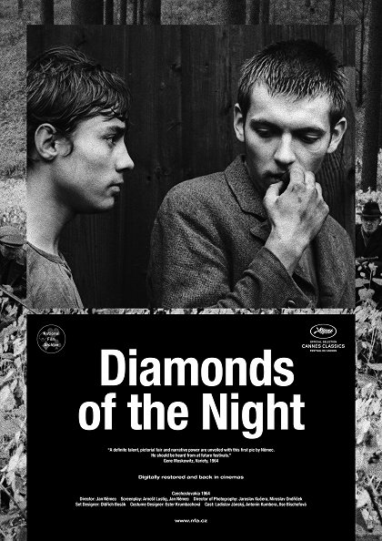
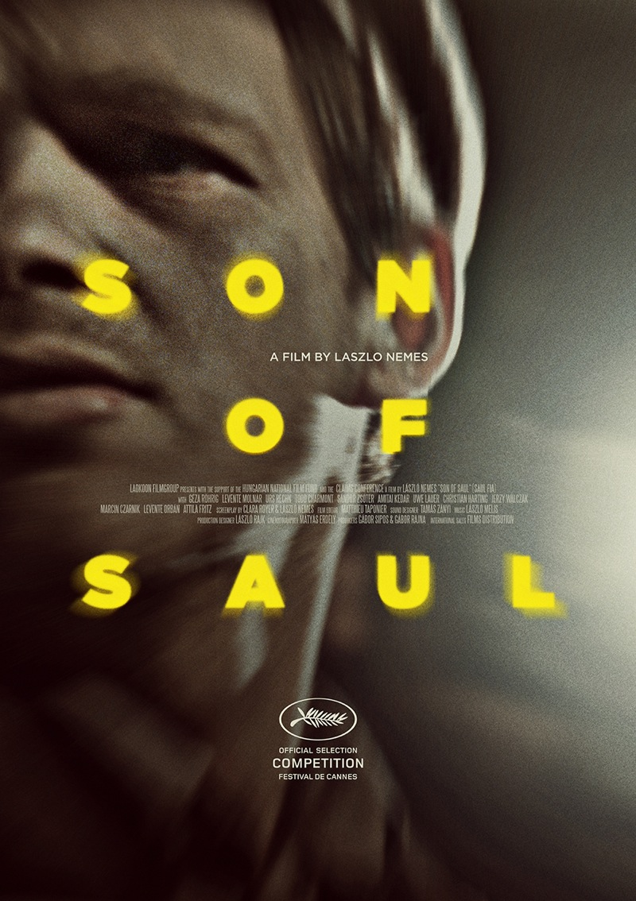

Slide 8
Diamonds of the Night in cinemas and its afterlife
Very low cinema attendance – 70 000 viewers
  >> so-called second distribution circuit, just four copies circulating in cinemas in larger city centres and art cinemas, not in smaller cities
Export potential was highlighted >> this film speaks the universally comprehensible cinematic language
Praised by film critics – this movies ascends above strict and concrete historical time
In 2018 the restored copy of the films was screened in the Cannes Classics section of the famous film festival, in August 2018 the film returned to regular distribution („Back to Cinemas“ project of the National Film Archive)

Slide 9
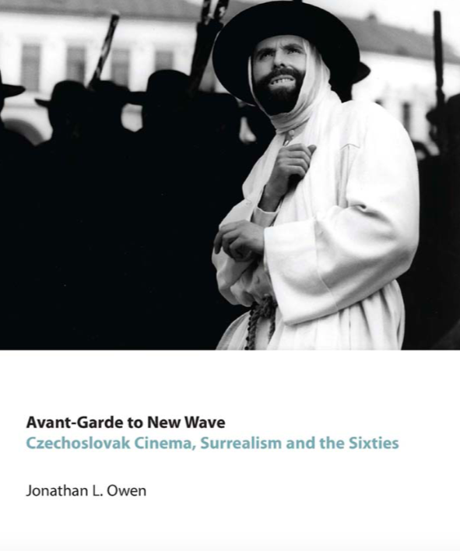
Reading
L4
OWEN, Jonathan L. Avant-Garde to
New Wave. Czechoslovak Cinema,
Surrealism and the Sixties. New York
and Oxford: Berghaghn books, 2011,
pp. 25–45.

Slide 10
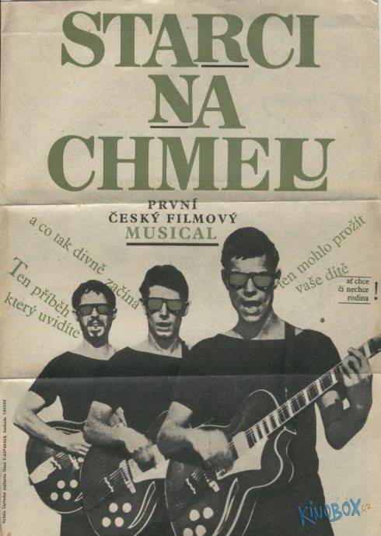
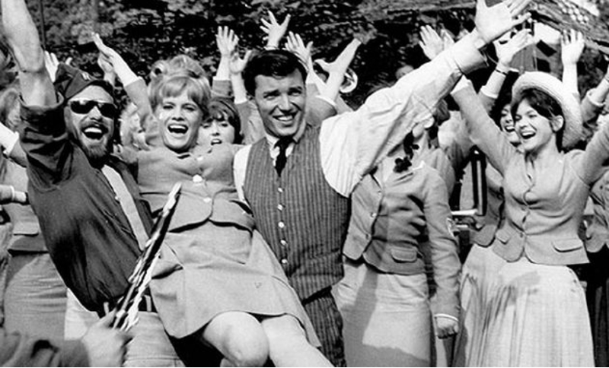
„Juvenilization“ of cinema
In the second half of the 1950s the number of cinemagoing audiences rises up to uprecedent levels; however it drops down rapidly throughout the 1960s
Television is a crucial factor in such development >> at the turn of the 1950s and 1960s it is a preferred leisure activity for the middle generation
Young audiences (up to 25 years of age) prefer cinemagoing (+ outdoor cinemas)
They enjoy genre films and movies growing out of contemporary music and theatre scene (The Hop-Pickers, Loves of a blonde, If a Thousand Clarinets)

Slide 11

The Hop-Pickers: Bossa Nova (1964)

Slide 12
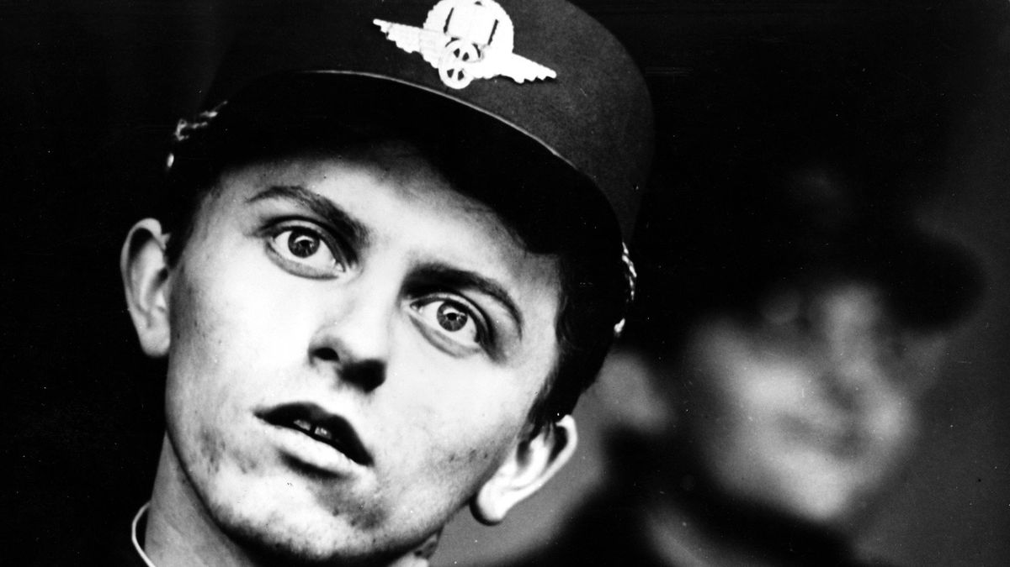
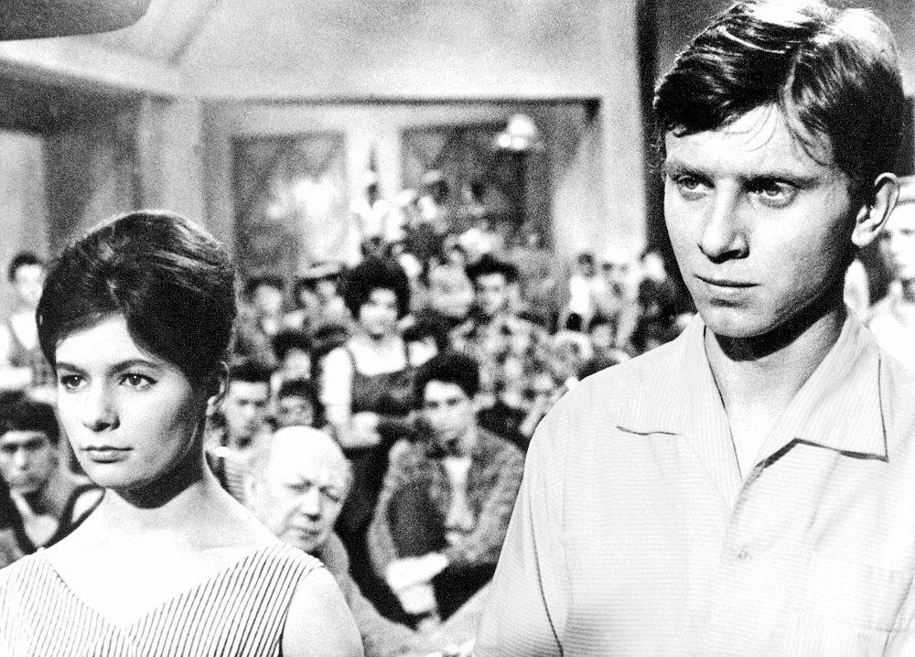
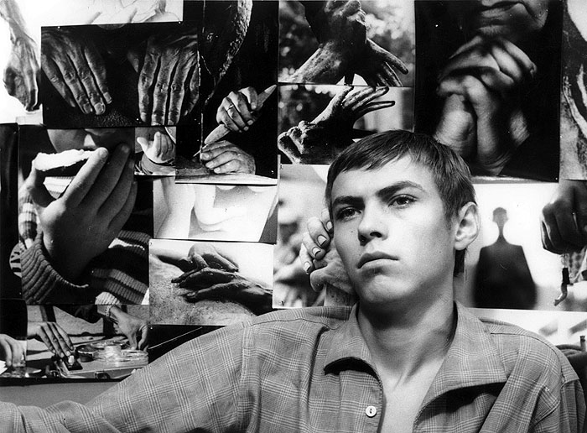
Generations of film characters in New Wave Films
In the first half of the 1960s films of the New Wave have contemporary setting, they are apolitical (with the exception of Evald Schorm‘s films?), with „middle class“ ordinary characters
Young generation is creatively portrayed through new faces – not glamorous, but unexceptional and commonplace
Comedies with grotesque overtones rather than tragic portrayals
Boys and young men are clumsy, awkward and childish, not rebelious (Forman‘s male heroes); emotional and lyrical protagonists (characters portrayed by Vladimír Pucholt)

Slide 13
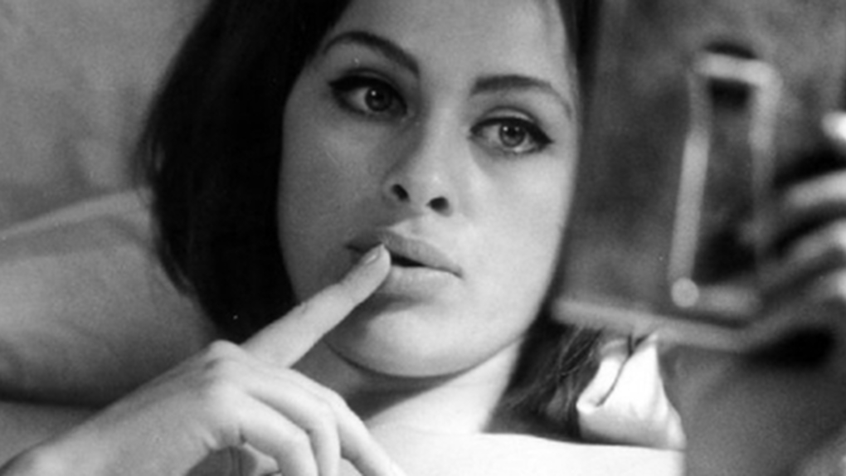
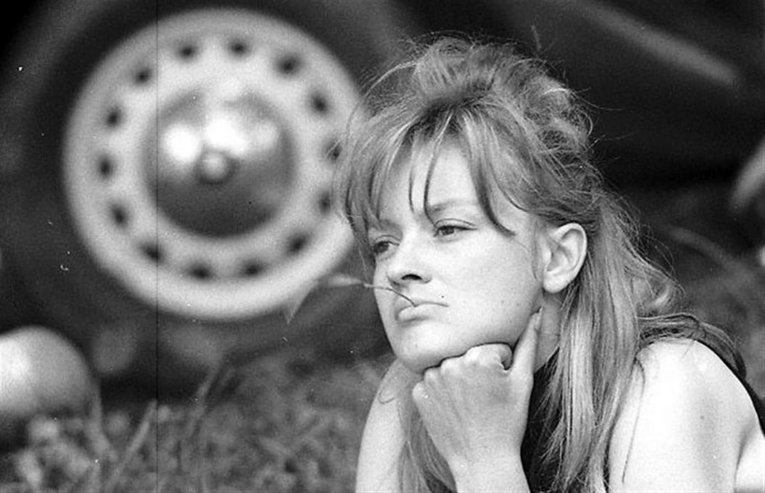
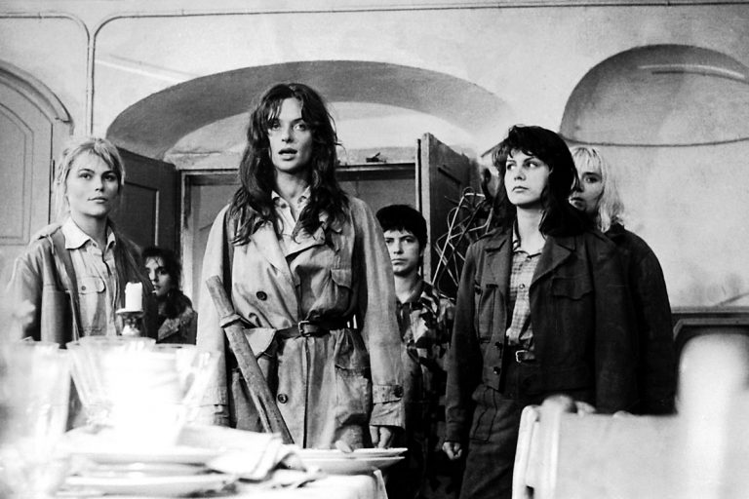
Generations of film characters in New Wave Films
Female characters lack such focused attention as their male counterparts; their presence is closely tied to the existence of distinctive professional actresses
Věra Chytilová‘s films are the exception (The Ceiling, Something Different, Fruit of Paradise) >> emancipation, female self-exploration, but also comedic overtones, f.e. Daisies as the portrayal of young, dynamic, self-indulgent and destructive femininity
The naive blonde type (Loves of a Blonde) and flirtatious brunettes (Black Peter, characters of Věra Křesadlová, Táňa Fischerová in Hotel for Strangers)
Jana Brejchová is starring in the films of Evald Schorm (Courage for Everyday, The Return of the Prodigal Son, The End of a Priest)
Female intelectuals are negatively portrayed (such as Jiřina Jirásková in Courage for Everyday)

Slide 14
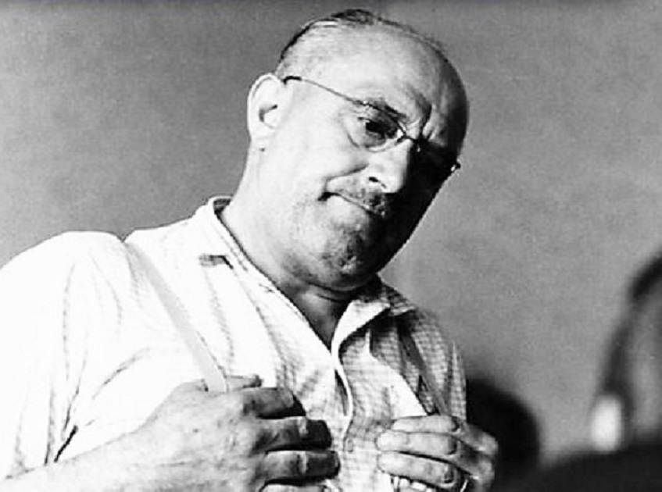
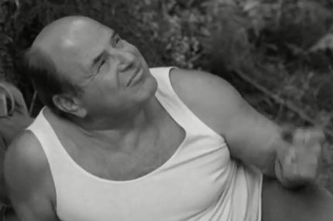
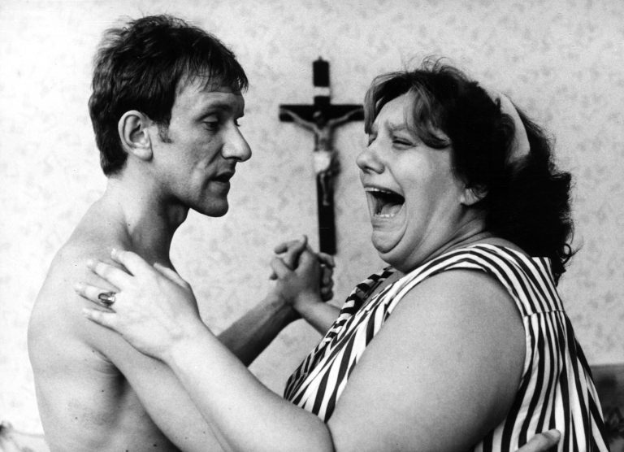
Middle-aged and older generation of characters
Ordinary parents rather than extraordinary heroes
Struggles between generations portrayed extensively in Miloš Forman‘s, Ivan Passer‘s and Jaroslav Papoušek films, but only Intimate Lighting brings a positive take on the coexistence of generations under one roof
Fathers are symbols of totalitarian patriarchy, but they can also be considered as the continuity of domestic film and literaty tradition (the figure of father Kondelík)
On the contrary, the motherly archetype, so strongly rooted in Czech culture, disappers

Slide 15
Film and TV Faculty of Performing Arts: FAMU
Crucial formative background of the Czech New Wave
1946 – Faculty of Performing Arts is established
First departments – Department of directing, cinematography, scriptwriting and dramaturgy, in 1950 the departmentd of production was added
Very liberal atmosphere despite the regime >> screenings of foreign films, which were not distributed in cinemas (films from the 1930s and 1940s, foreign contemporary movies), inspirative creative personalities as teachers (Milan Kundera, František Daniel, Italian and other western and eastern european directors)
Since 1957 Otakar Vávra (an influential director) was the head of the department of directing and teacher of the future New Wave core auteurs (Věra Chytilová, Evald Schorm, Jan Schmidt, Jiří Menzel, who studied in the years 1957–1962).

