Slide 1
Czech New Wave
CZS36 + CMA018
Dr. Šárka Jelínek Gmiterková
Fall 2023
26. 10. 2023

Slide 2
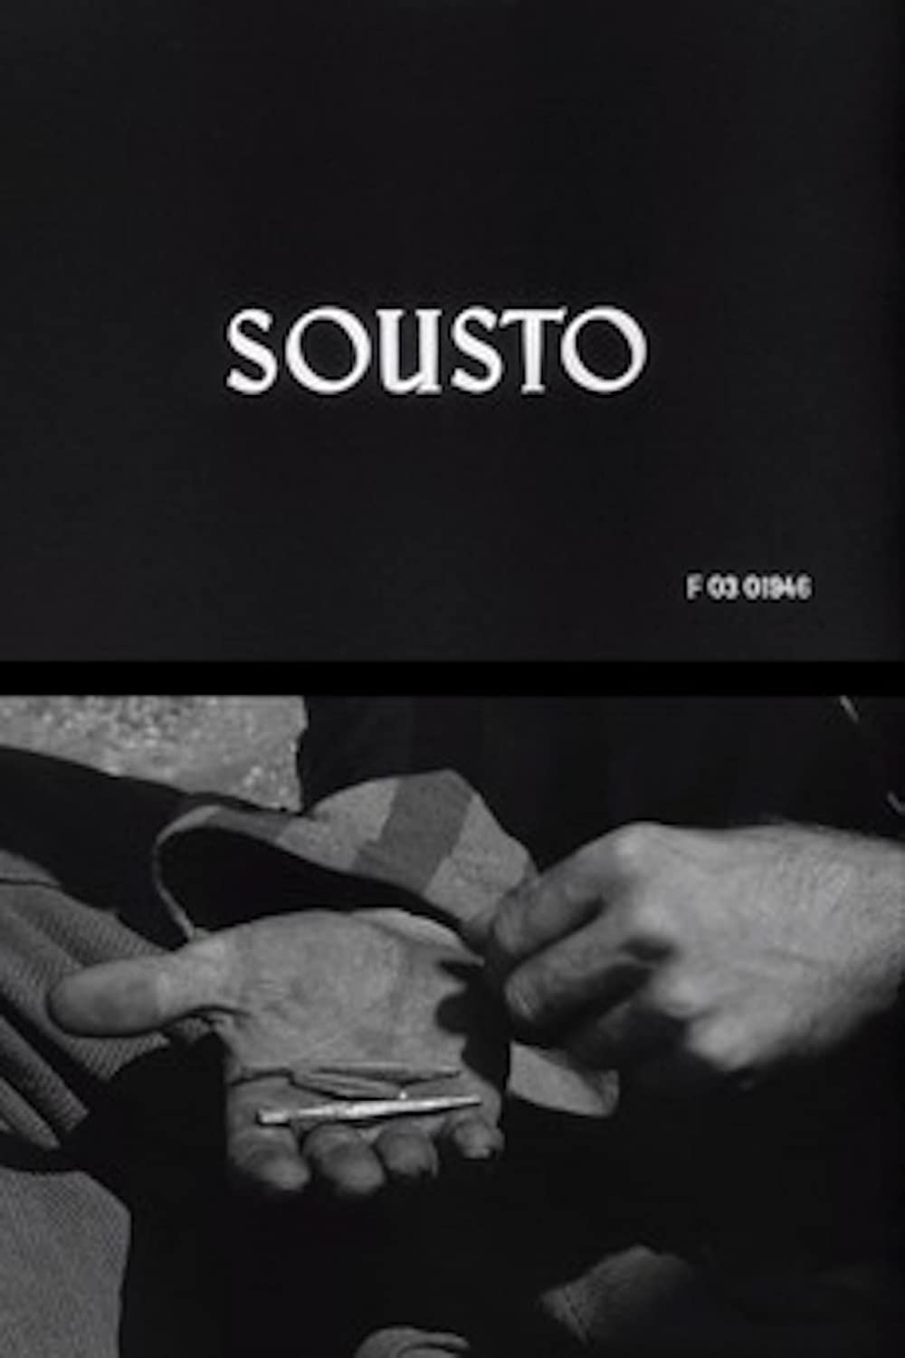
Mouthful
A short graduate film, made in 1960 by Jan Němec
The film is based on the short story „Round two“ by Arnošt Lustig
Attracted international attention and can be perceived as a prequel to Diamonds of the night

Slide 3
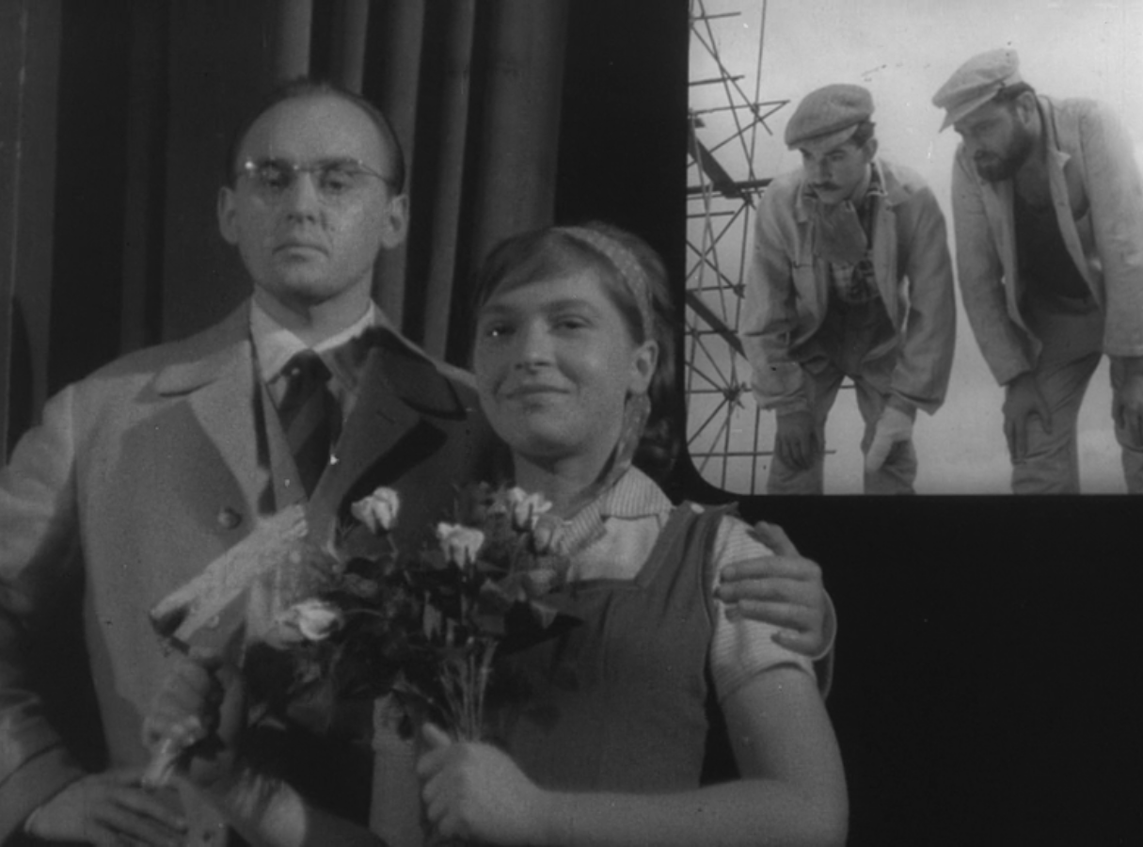
Black-and-white Sylva
1961, dir. Jan Schmidt
This is a graduate film directed by Jan Schmidt, written by Pavel Juráček, who studied scriptwriting and dramaturgy and later became a celebrated auteur. For Schmidt, Juráček previously wrote a voiceover narration for a documentary film made during their studies on FAMU, called Cars without home (thematizing car parking issues in Prague).
They collaborated also on Schmidt‘s mid-length feature film debut called A Character in Need of Support (1963); Juráček also developed a story for Schmid‘s feature debut called The End of August at the Ozone Hotel (1967).
Despite their tight and frequent collaboration, Juráček did not portray Schmidt positively in his later published diaries.

Slide 4
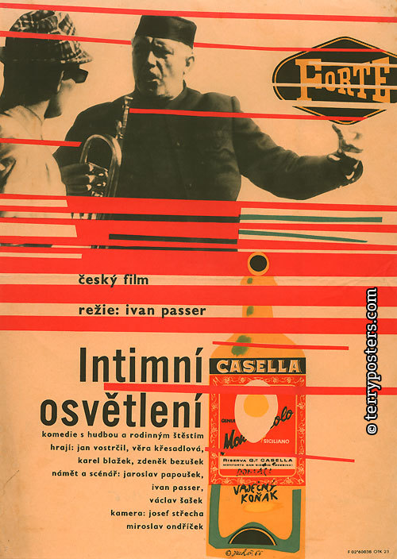
Intimate lighting
1965, dir. Ivan Passer
One of the most beloved films of the Czech New Wave.
Ivan Passer was the frequent collaborator of Miloš Forman, together with Jaroslav Papoušek.
Forman did not collaborate on Passer‘s feature film debut, Papoušek helped to develop the story and write the screenplay.

Slide 5
Questions
Compare Black and White Sylva with Mouthful. What are their strong assets and can you identify their (possible) weaknesses?
Do these early films already foreshadow the tendencies in later works of both of all the directors?
______________________________________________________
Intimate lighting is always characterized as “the cream of Forman films.“ Can you think about reasoning behind such label?
“Have you noticed, how in our movies the protagonists never change? They go through one microcrisis after another. It is a permanent, chronical condition, which perfectly sums up our current existence. Permanent microcrisis. There is nothing really going on, just a string of tiny troubles. One mess is not the issue, but their volume is.“ (Ivan Passer in an interview with journalist A. J. Liehm) >> where do you see this state of permanent microcrisis in the film (the ending)?
Intimate lighting is frequently characterized as the most „musical“ (as a feeling for the music, not in terms of genre) film of the new wave. Think about the ways this movie employs music (in terms of rhytm, character construction, genres etc.)

Slide 6
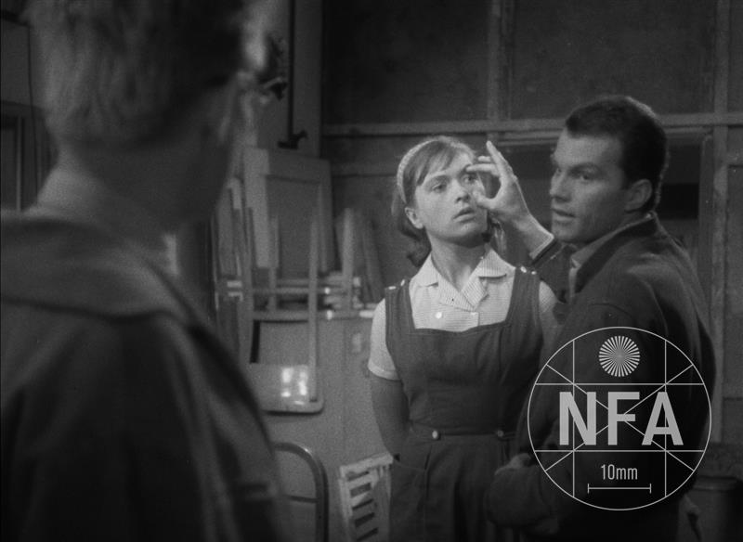
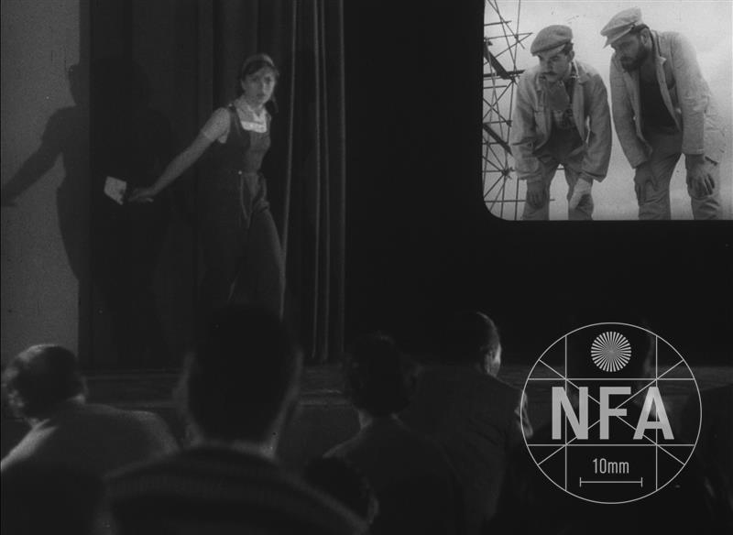
„We were in our eighth semester, Věra finished The Ceiling, Evald The Tourist and Honza Black and White Sylva. When I saw all these films one after the other, I was astonished, as if I turned blind due to the sudden exposure to a very strong light. […] Because when the lights in the screening room went on, I knew that Ceiling and Tourist are films inseparable from Věra and Evald, while Black and White Sylva will enter history books as a film made by students of FAMU.“ (Pavel Juráček, 1969)

Slide 7
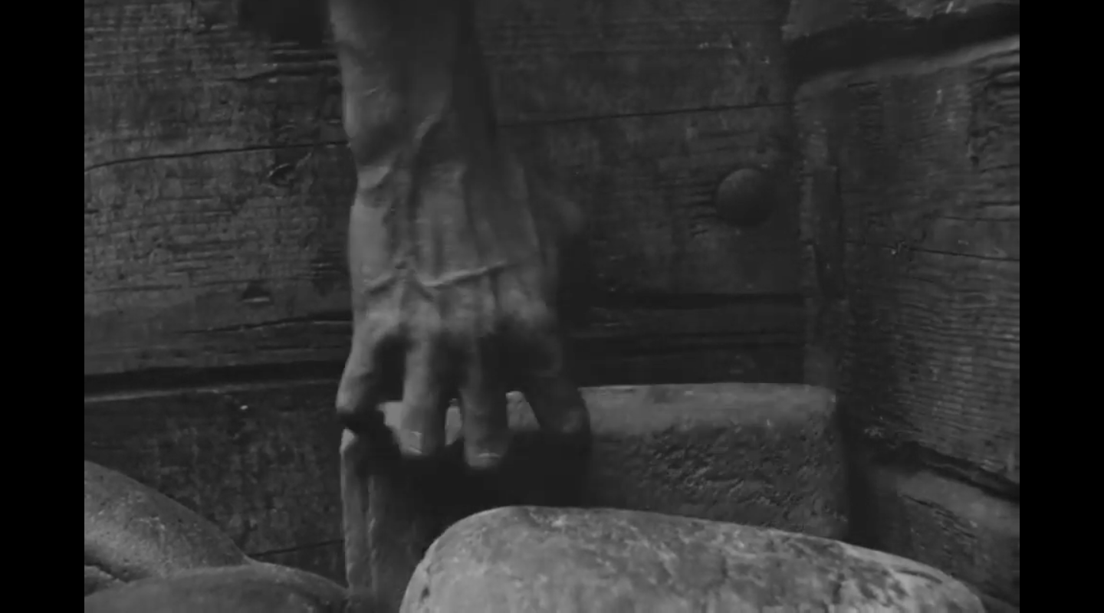
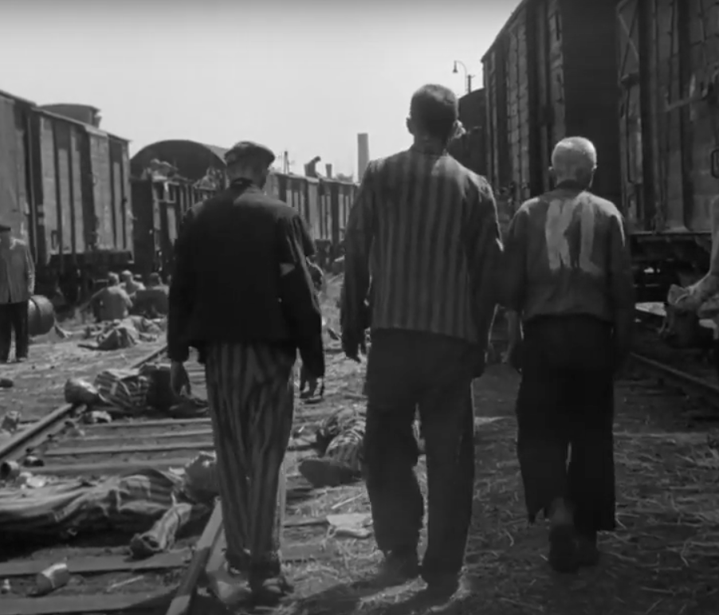
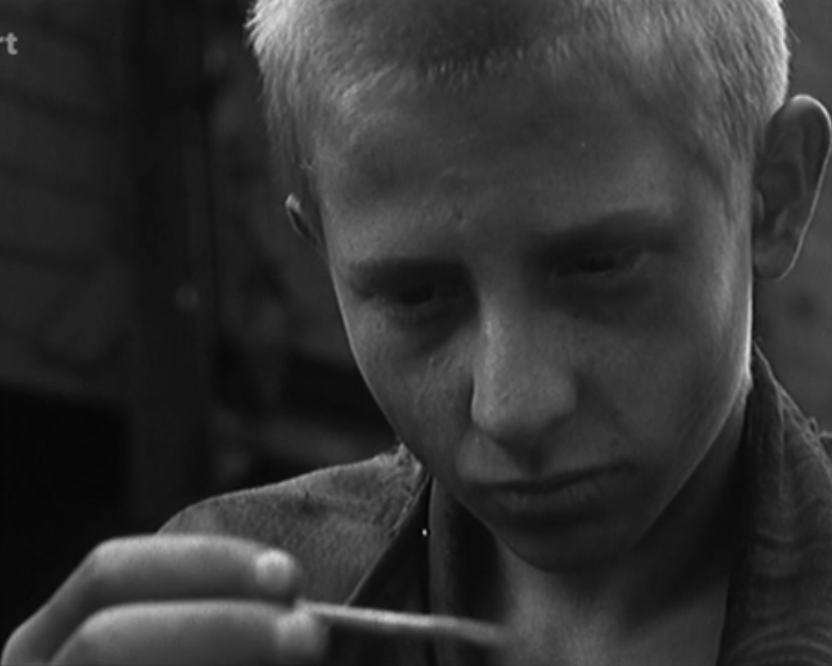

Slide 8

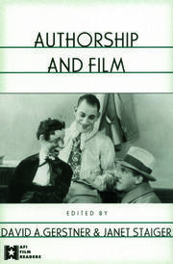
Reading L5
MAZIERSKA, Ewa. Masculinities in Polish, Czech and Slovak Cinema. Black Peters and Men of Marble. New York and Oxford: Berghahn Books, 2010, pp. 83–130.
STAIGER, Janet. Authorship approaches. In: David A. Gerstner and Janet Staiger (eds.). Authorship and Film. New York and London: Routledge, 2003, pp. 27–57.

Slide 9
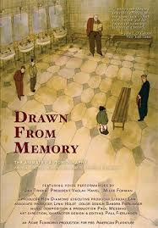
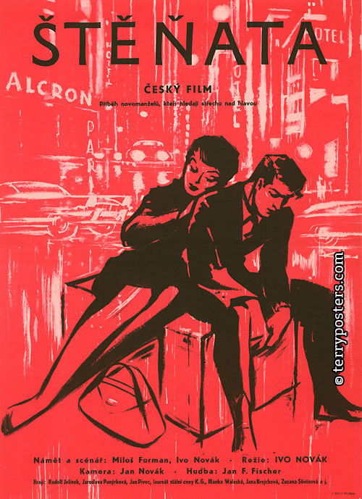
Miloš Forman
(1932–2018)
„I don‘t care about middle-aged people. […] I care about powerless youth and old age. These two groups are usually manipulated by social order in the worst way.“
>> generational tension is typical for his early films.
Works with non-professional and/or untrained actors
His protagonists are usually outsiders, not exemplary leaders, heroes or rebels
As a war orphan he was accepted on the College of Jiří z Poděbrad, a prestigious and elite school; however he was expeled in 1951 for mocking the communist party
Failed entrance exams for dramatic faculty at the academy of performing and musical arts; later was accepted on FAMU (dept.of scriptwriting and dramaturgy)

Slide 10
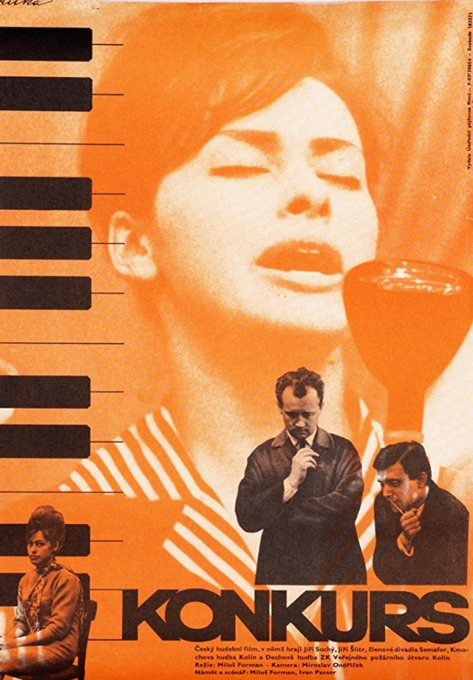
Audition /
If Only They Ain‘t Had Them Bands
(1963)
Forman’s feature film (CG Šebor-Bor)
Cinematography: Miroslav Ondříček, Editing: Miloslav Hájek
Two parts – in the first one, we see Josef Vostrčil in a semi-documentary record of the practice of the orchestra in Kolín, the second one follows the audition for a singer in the then very popular Semafor theatre, with two prominent stories (Markéta, a pedicurist, who loses her job because of her attendance and Věra Křesadlová as a talented singer, who fails the audition
Crucial moment in the film: a sequence of the period hit song “Oliver Twist”, performed by various singers and edited together.

Slide 11
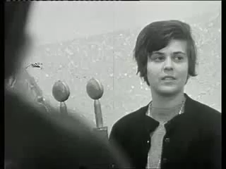
Audition (1963) – „Oliver Twist“ sequence

Slide 12
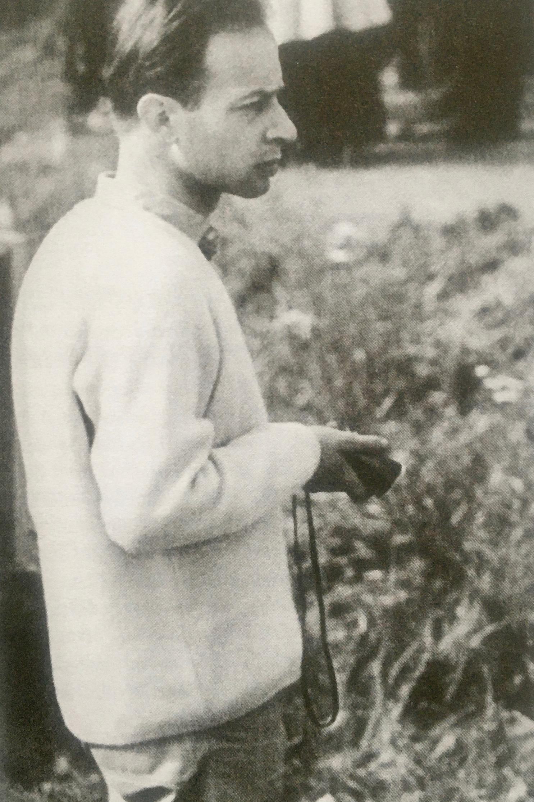
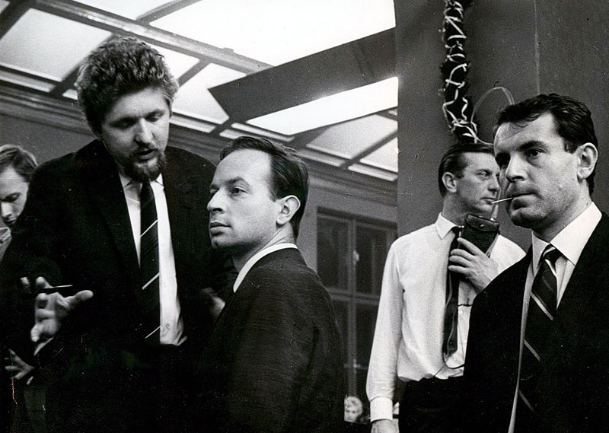
Ivan Passer
(1933–2020)
Together with Forman and Václav Havel he studied on the College of Jiří z Poděbrad
He was expeled from FAMU because of his unsuitable class origin
„Raise your hand if you have been expeled from school, from work, pushed out from cinematic structures as much as Passer. The curse of his unsatisfactory origin burdened him much more than Chytilová or Schorm, both in Stalinist and post-Stalinist times.“ (AJ Liehm)
In the 1960s he worked on screenplays for films such as Audition, Loves of a blonde, Firemen‘s ball
Directed a short film A Boring Afternoon (1964), Intimate lighting (1965) and worked as an assistant director on Forman‘s film Black Peter

Slide 13
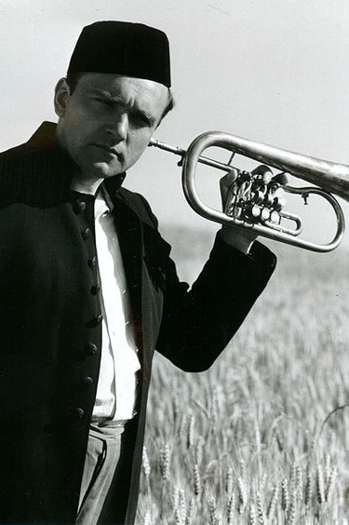
Intimate lighting
(1965)
Not a satirical take on his topic, nor a sociological analysis as in the films of Miloš Forman; rather a lyrical perspective and psychological introspection, however his films still have an everyday feel about them
Never a cinephile >> he genuinely cared for people and he spoke about cinema as a chance to meet different human characters
Both his 1960s films have a light touch and a sense of ease about them, however there was a tremendous dramaturgical preparation behind them; although he worked with non-professional actors, he could improvise only to a certain level

Slide 14
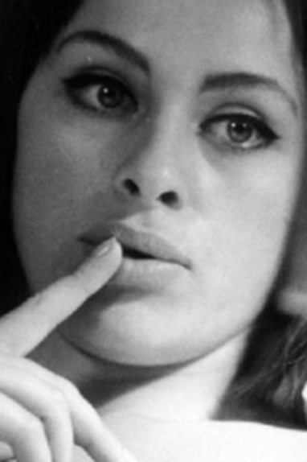
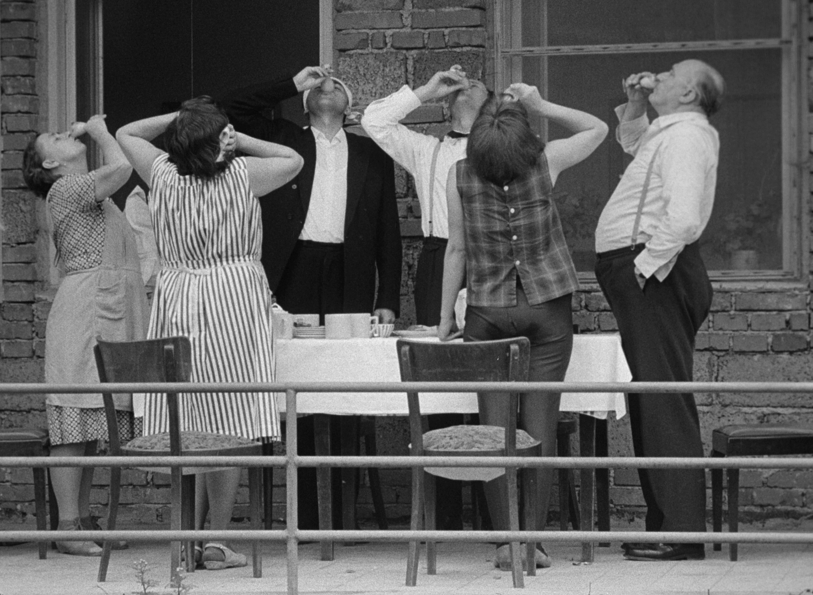
Intimate lighting
(1965)
An image of a peacefull, homely peripehery at the beginning of summer, when two classmates meet years after their graduation
Newcomers‘ project – Passer + cinematographer Miroslav Ondříček (Josef Střecha)
Vlastimil Harnach (the head of Barrandov studios): One of the most boring films I have ever seen X critical success, both domesticaly and internationally
Audiences: Intimate lighting 345 129 / Pearls of the deep 117 687 / Every Young Man (Pavel Juráček‘s feature debut) 282 387 X Loves of a blonde as an absolute hit – 2 255 858
1970 – banned from distribution

Slide 15
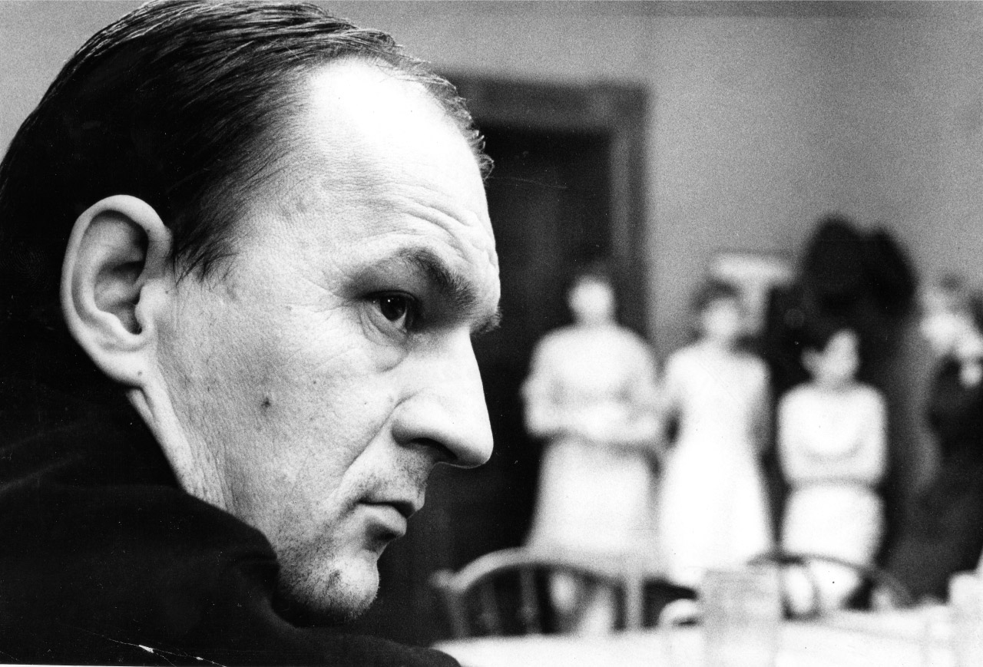
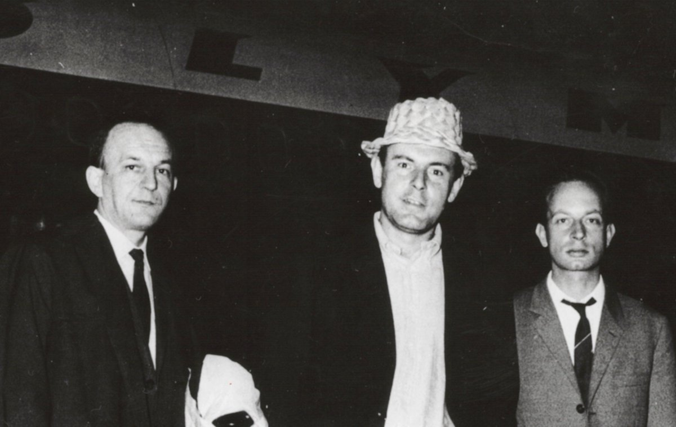
Jaroslav Papoušek
(1929–1955)
„Well, I am here just for the silly stuff“ >> in contrast to Forman in his solo work he was not able to elevate his humour from banality to a critical statement
„I enjoyed when everybody asked Miloš or Ivan about stuff and I could be silent and do some work“ >> he is not as visible and as celebrated as the rest of the trio. Also, he is the most hardworking out of the three and we believe that the sharp satirical edge of Forman‘s films was to his credit
As a screenwriter he collaborated on: Black Peter, Intimate lighting, Loves of a Blonde, Firemen‘s ball
As a director: feature debut The Most Beautiful Age, fllowed by a sharp satirical comedy Ecce Homo Homolka

Slide 16
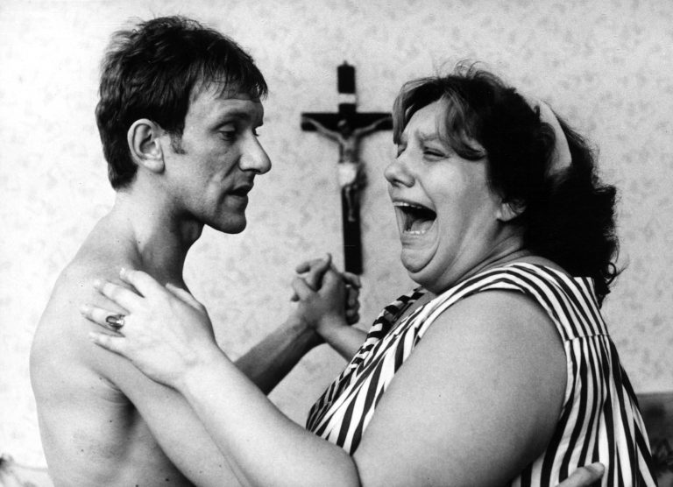
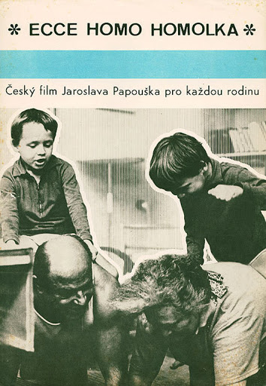
Jaroslav Papoušek
Director, screenwriter, writer, painter and sculptor, caricaturist >>very versatile talent
Spatial imagination together with a sense for image composition + razor sharp sense of humor
Forman was intrested in youth, Passer favored middle generation, Papoušek is interested in old age
Ecce Homo Homolka (1969): a very distanced look on family, marriage, religion and multiple generations living together in small spaces
Film full of contrasts - between generations, nature and household, musical styles etc.

