Slide 1
Czech New Wave
CZS36 + CMA018
Dr. Šárka Jelínek Gmiterková
Fall 2023
09. 11. 2023

Slide 2
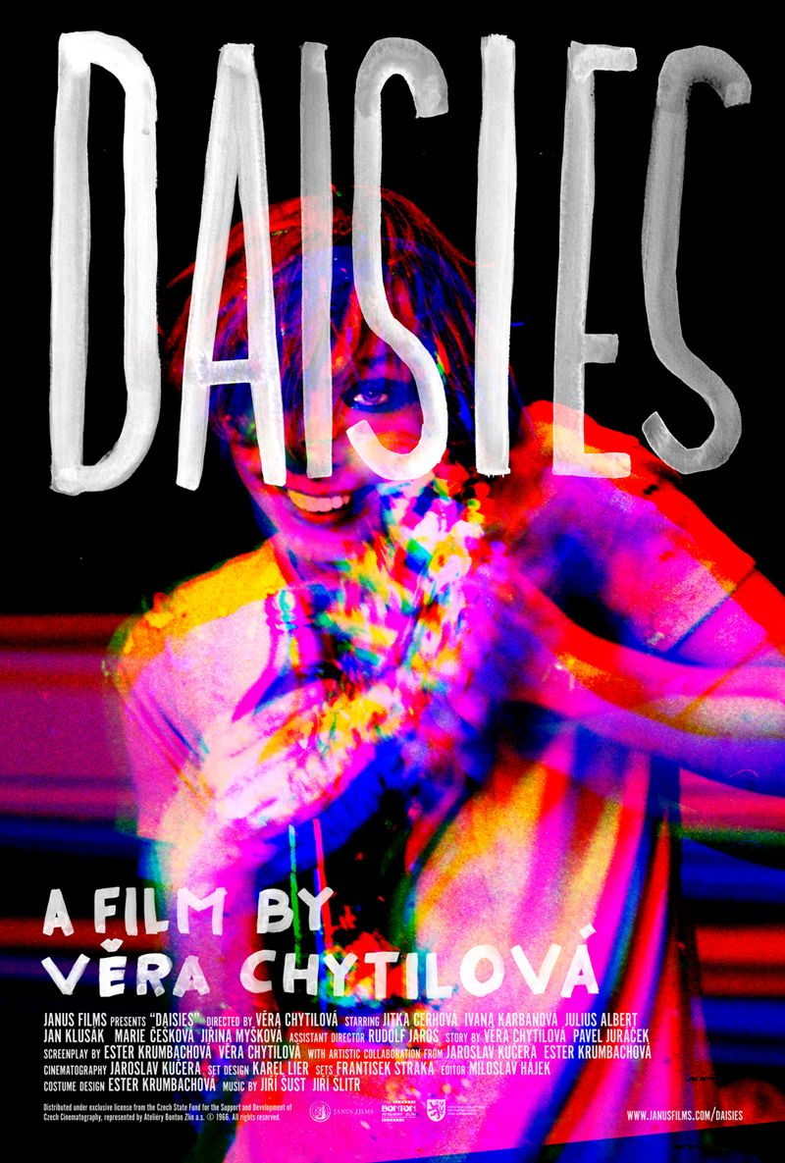
Daisies
1966 dir. Věra Chytilová
Story: Věra Chytilová, Pavel Juráček, Screenplay: Ester Krumbachová, Věra Chytilová, Cinematography: Jaroslav Kučera, Music: Jiří Šust a Jiří Šlitr, Staring: Jitka Cerhová (Marie I.), Ivana Karbanová (Marie II.), Julius Albert, Jan Klusák, Marie Češková, Marcela Březinová
The most well known film by Chytilová both locally and globaly
American premiere in 1966, Chytilová was offered a contract with Warner Brothers studio
Controversial film at home – Juráček hated the result; the communist deputy Jaroslav Pružinec spoke critically about the film in parliament >> hence the title dedicating the film to all those people, who are outraged only by the destructed salads

Slide 3
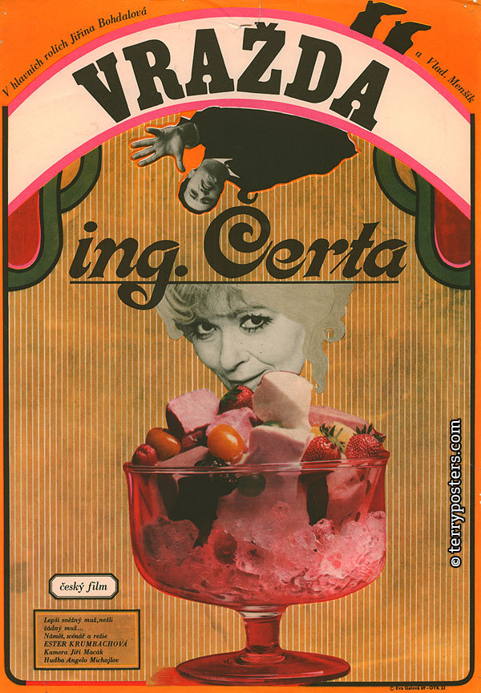
The Murder of Mr. Devil
1970, dir. Ester Krumbachová
The only film directed by the „muse of the Czechoslovak New Wave“ – Ester Krumbachová.
- writer, screenwriter, dramaturg, art production designer, painter, costume designer, director
She frequently collaborated with Věra Chytilová and Jaroslav Kučera (Daisies, Fruit of Paradise), also with her second husband Jan Němec (Diamonds of the Night, The Party and the Guests, Martyrs of Love).

Slide 4
Daisies and The Murder of Mr. Devil : Questions
1. What does this film tell us about the dynamics between men and women? How does the look of the film support this topic?
2.The main protagonists are characterized mainly through their looks and actions. How about their language?
_____________________________________________________________________
1. How would you describe the main characters, Marie and Marie – what about their age, behaviour, speech, looks and ways they treat others (older men)? Try to compare them with Marta or other female characters in New Wave films you have seen so far.
„Something has aesthetic qualities, it looks beautiful, but it is an image of a destruction, in fact“ (Věra Chytilová)
2. The topic of destruction seems to be a crucial one. On how many levels you can identify these destructive tendencies? And is the destruction perceived purely on negative terms?

Slide 5
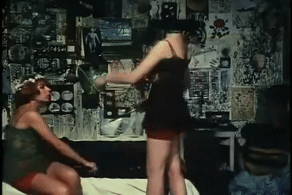
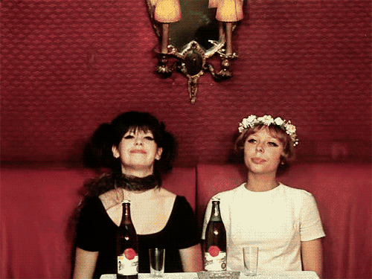
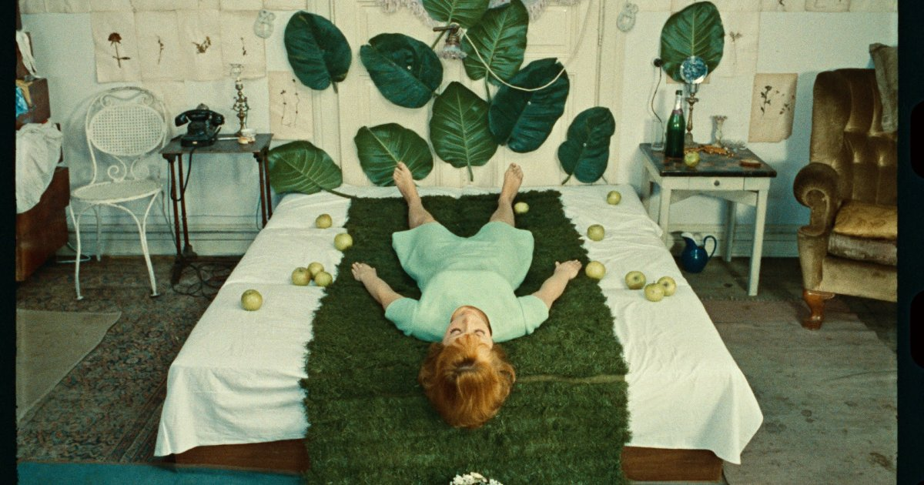

Slide 6
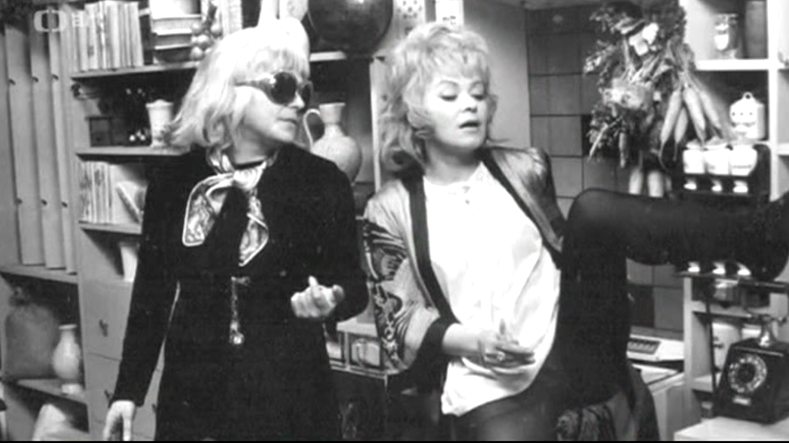
Ester Krumbachová and Jiřina Bohdalová on the set of The Murder of Mr. Devil

Slide 7
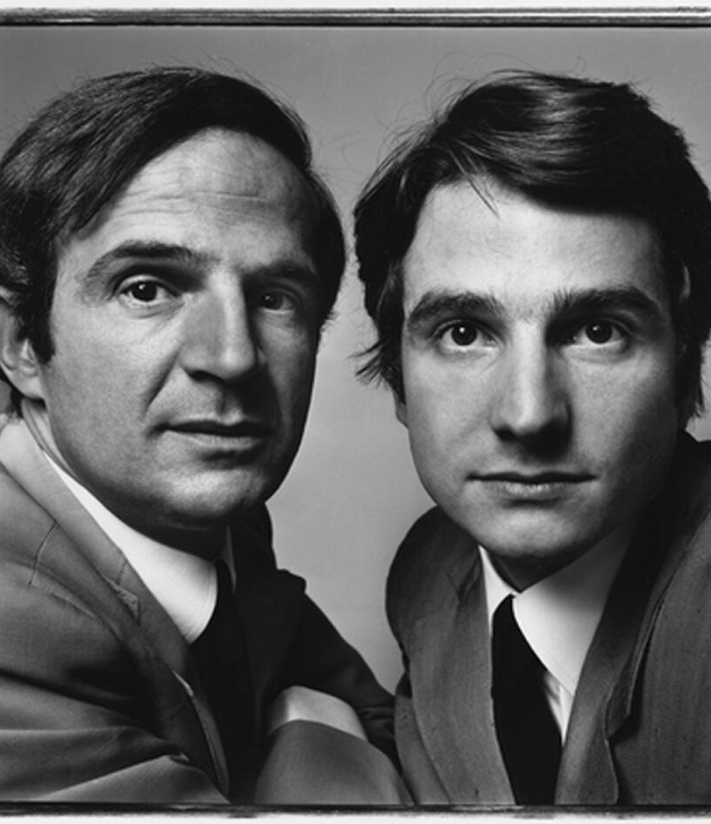
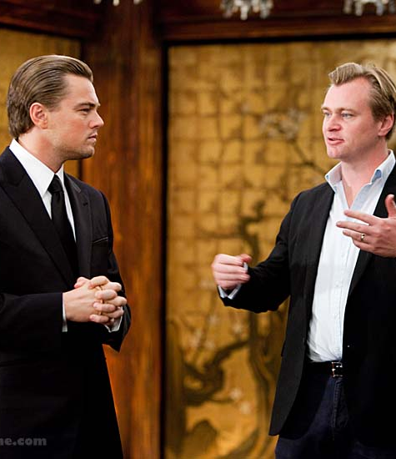
Film directors and their alter egos

Slide 8
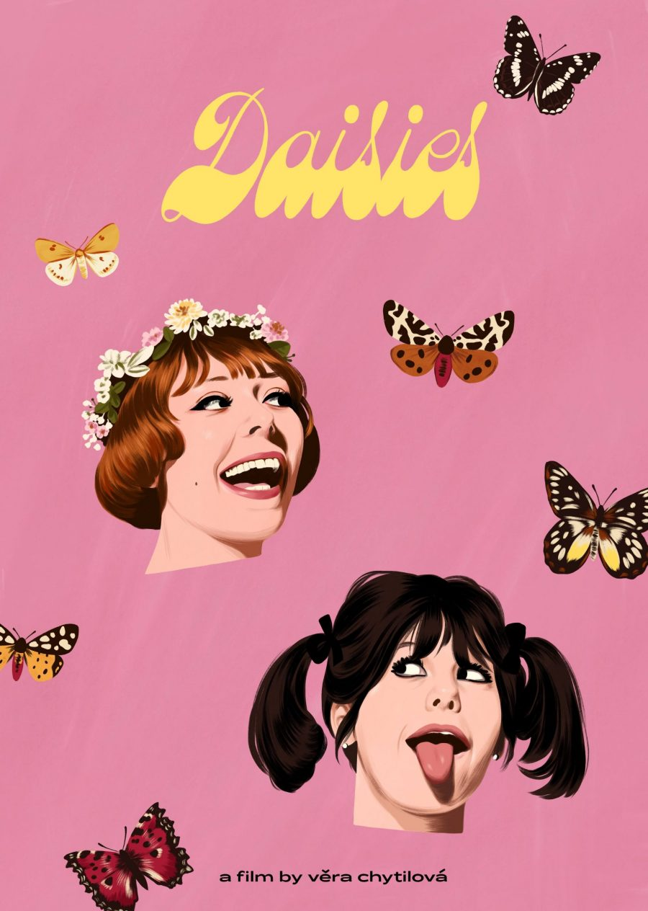
L7_Reading
A trio of contemporary articles reflecting on the film‘s legacy
https://www.filmovyprehled.cz/en/revue/detail/trampled-on-the-original-critical-reception-of-daisies-in-the-us-and-uk
https://www.nytimes.com/2022/08/17/movies/daisies-vera-chytilova.html
https://collider.com/vera-chytilova-daisies-movie-why-its-good/

Slide 9
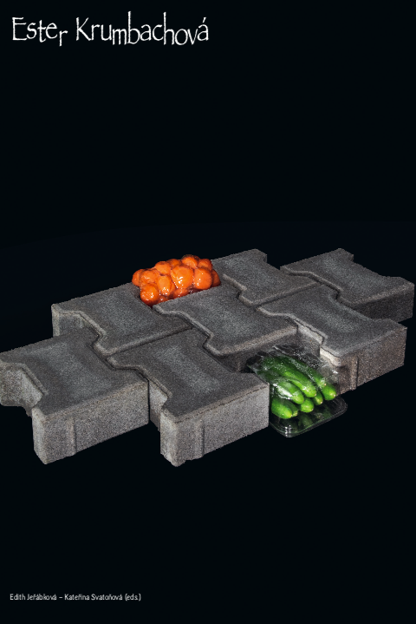
L7_Reading
JEŘÁBKOVÁ, Edith – SVATOŇOVÁ, Kateřina (eds.). Ester Krumbachová. Praha: Umprum and ARE, 2021.

Slide 10
Women‘s liberation
The priority of the socialist regime
Female employment was a frequently highlighted priority of the socialist régime >> it is in tune with communist ideology, but it was also an economic necessity
So-called double (triple) burden
Women were delegated to the spheres of education and healthcare, where salaries tend to go down rather then up; they were paid less than their male colleagues and not many of them were to be found in the leadership
In cinema industry: despite the official proclamations the film production did not become more feminized >> creative positions are not the domain of women, other branches of Czechoslovak film are more open to female employment (cinemas, distribution)
Continuity assistants („script girls“), grips, editing assistants, wardrobe personnel; only rarely assisting directors and production assistants, editors and make-up designers
  „Feminized professions“, characterized by the essencialist rhetoric as requiring traditionally female character traits – attention to detail, multitasking, sensitivity, empathy, consistency

Slide 11
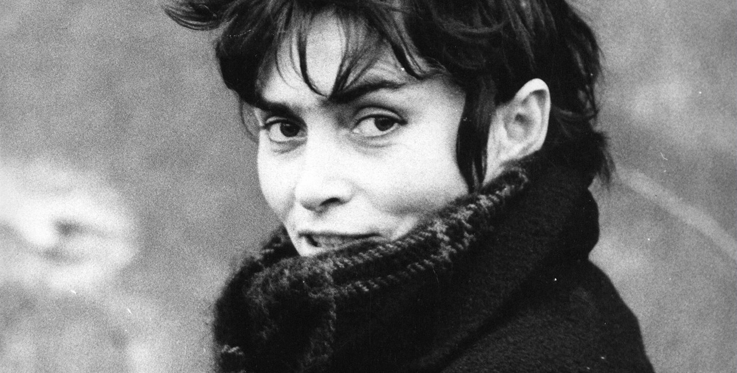
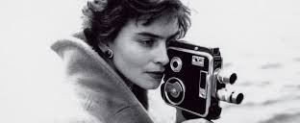
Věra Chytilová (1929–2014)
„A person should have the strength to do what satisfies him (or her).“
Key topics – ethics, morals and freedom
Emancipation: in the context of Chytilová‘s work one should not see emancipation tied only with the equality of genders and sexes, but in a wider sense, as a liberation from any kind of oppresion
Feminist interpretations are welcomed, but are to be found mostly in the reflections of her work outside of Czechoslovakia.

Slide 12
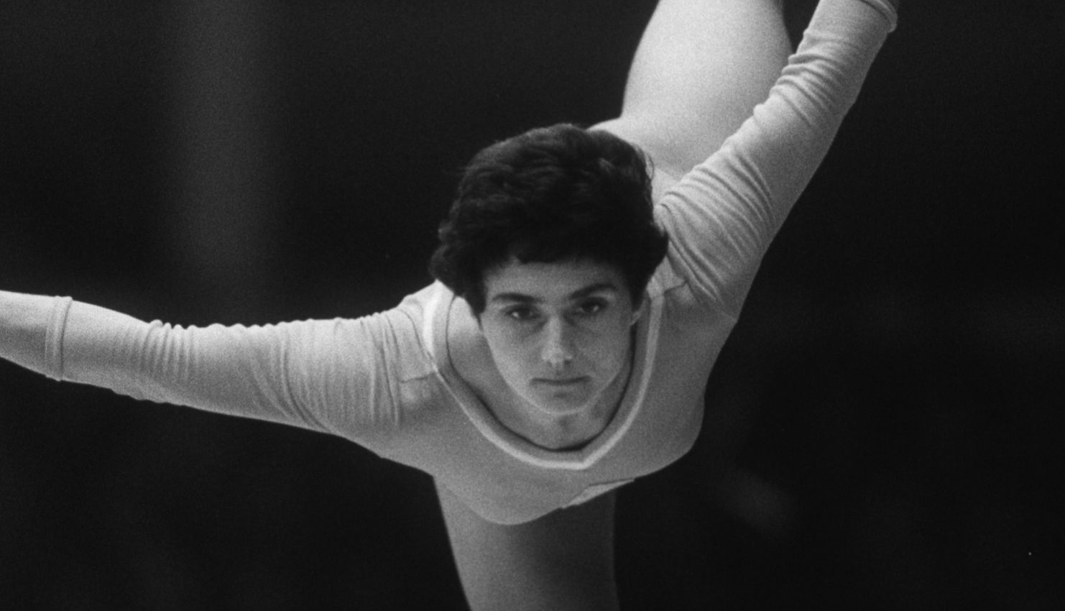
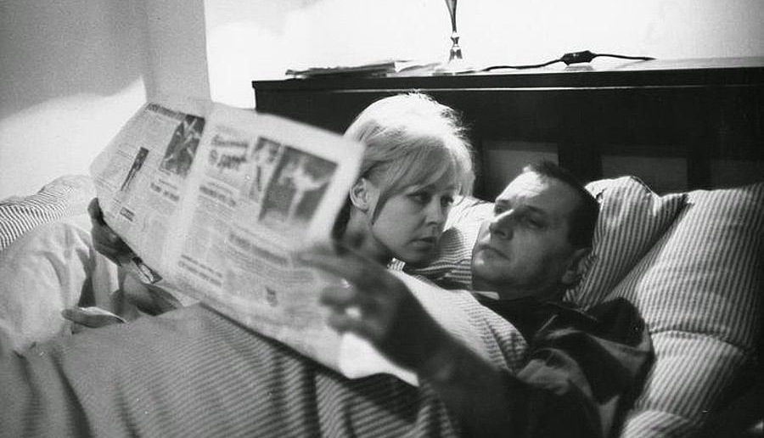
Something Different (1963)
„Film about Eva Bosáková? No, about something different.“
Chytilová‘s feature debut, CG Šmída-Fikar, originally a story by writer František Kožík about a top gymnast Eva Bosáková.
  The author doesn‘t just higlight Bosáková‘s successes and treats the gymnast as merely positive youth idol, but also questions the prize of victory in such a demanding sport.
  She also included the second heroine, a housewife called Věra, so she could treat the topic of socialist women and their lifestyle with complexity the topic deserves.
  None of her protagoinists is happy – neither top athlete, who dedicated her life to the profession, nor the housewife.
On the style level, this is another take on the cinema-verité method and „look“ – untrained actors, improvisation, everyday reality.

Slide 13
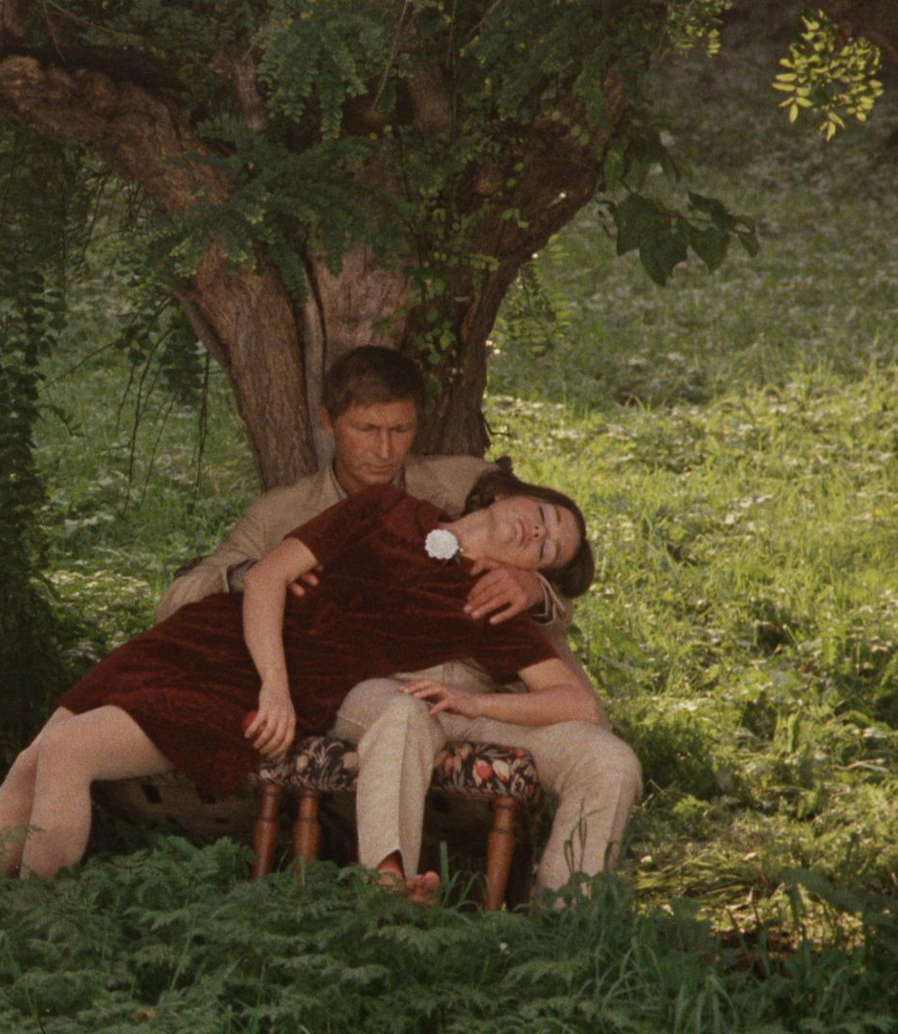
Forbidden Fruit of Paradise
(1969)
Another film by the trio Chytilová – Krumbachová – Kučera
Coproduction with a Belgian company Elizabeth film
Parables, very loosely tied to a biblical story of Adam, Eve and the snake charmer; detective story, a comedy of morals or horror; the effort to speak about the normalization of Czechoslovakia as a consequence of Soviet occupation starting from August 1968
Main parts embodied by the actors from studio Ypsilon (Jitka Nováková, Karel Novák, Jan Schmid), very stylized performance, radical departure from previously cast untrained and/or non-professional actors + almost operatic performance and style
The topic of taboo female sexuality?

Slide 14
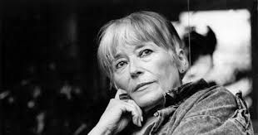
Ester Krumbachová (1923–1996)
„the grey eminence“, „the muse of the Czechoslovak New Wave“
She participed on multiple new wave projects on various postions >> the principle of collective authorship?
Directed a single film: The Murder of Mr. Devil (1970)
https://www.youtube.com/watch?v=pqrX9s0zVyA
Never studied film, just painting and graphics on secondary school in Brno, started as an art production designer in theatre >> she enjoys cinema as a form gesamtkunstwerk, allowing her to melt painting, words and movement together with color composition

Slide 15
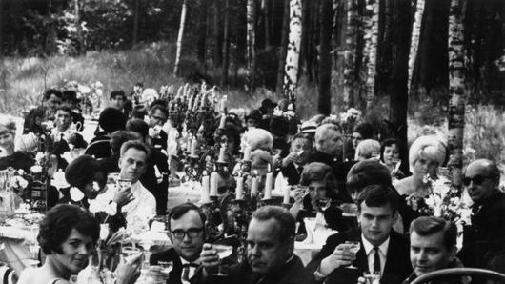
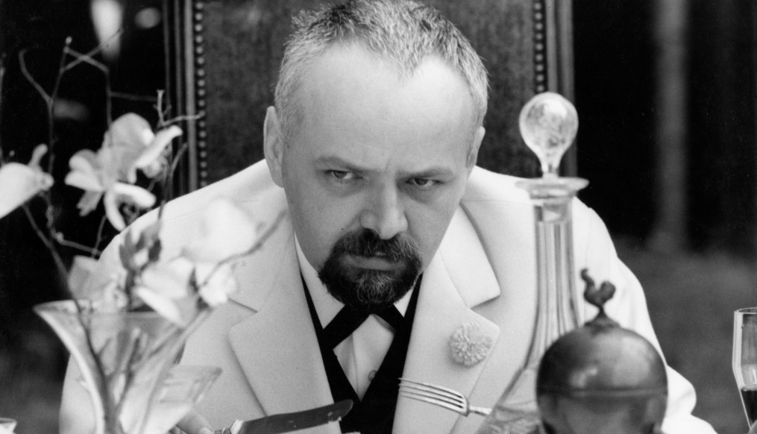
Ester Krumbachová
There is a tendency to include her solely in the New Wave context, however she collaborated with celebrated domestic auhors (Martin Frič, Otakar Vávra), with first generation of FAMU trained directos (Karel Kachyňa, Zbyněk Brynych, Vojtěch Jasný), with directors focusing on genre production (Zdeněk Podskalský) and those creators, whom she liked personally and where she worked on multiple positions (especially Jan Němec and Věra Chytilová).
Frequently worked as a costume designer or art production designer >> exclusive and unique position without specific definition, „tailored“ for individual projects and interactions with directos or screenwriters

Slide 16
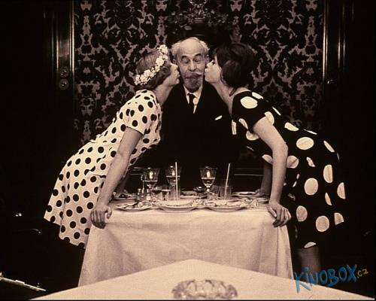
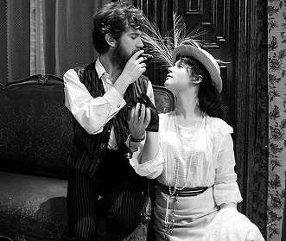
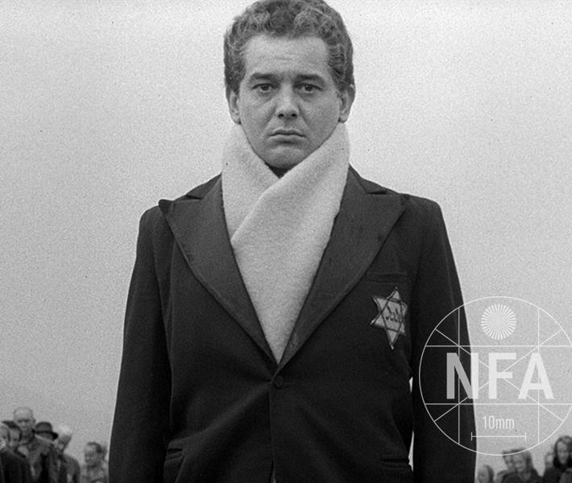
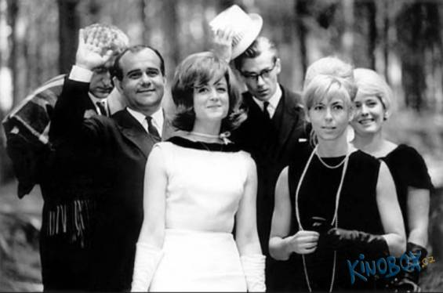
„Costume as a concentrated visual clue of a film character”

Slide 17
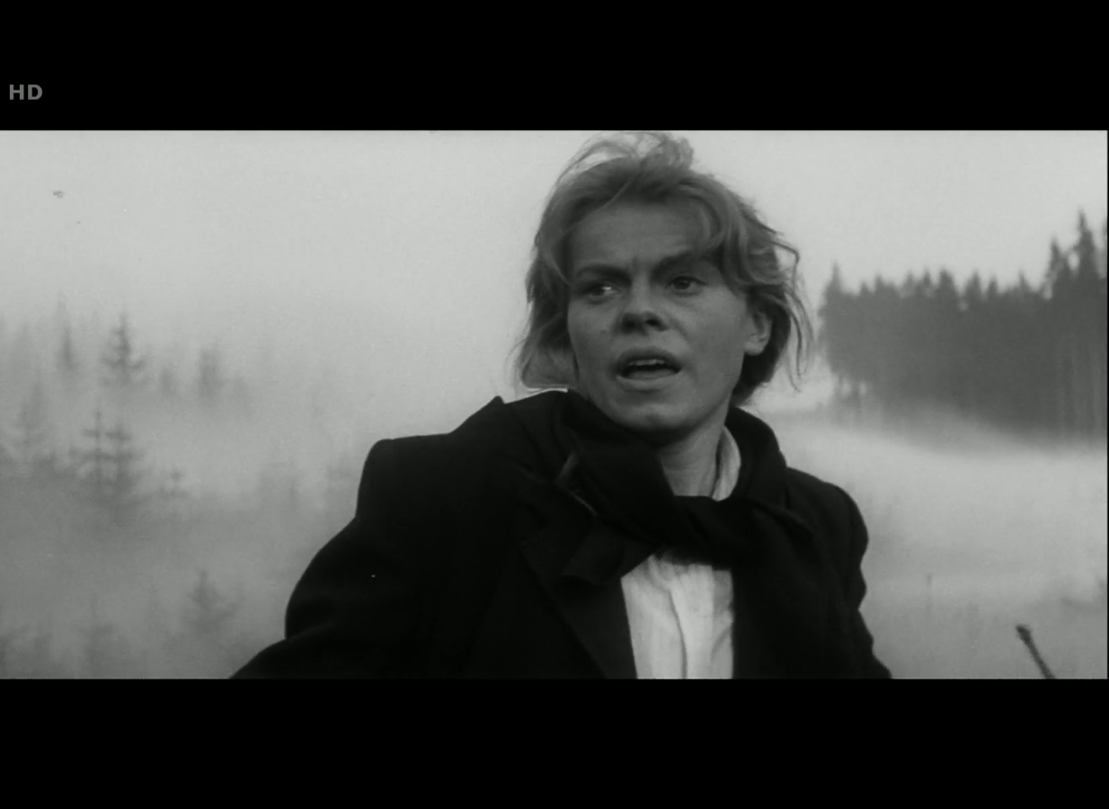
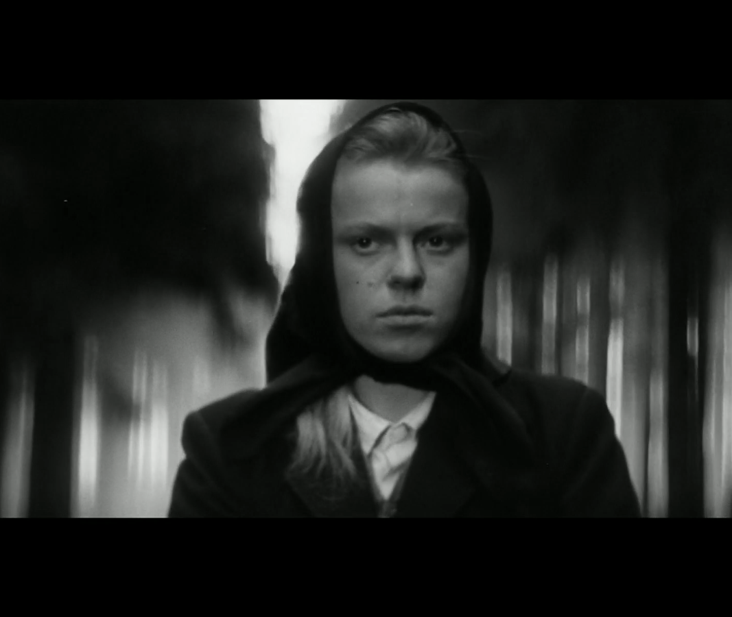
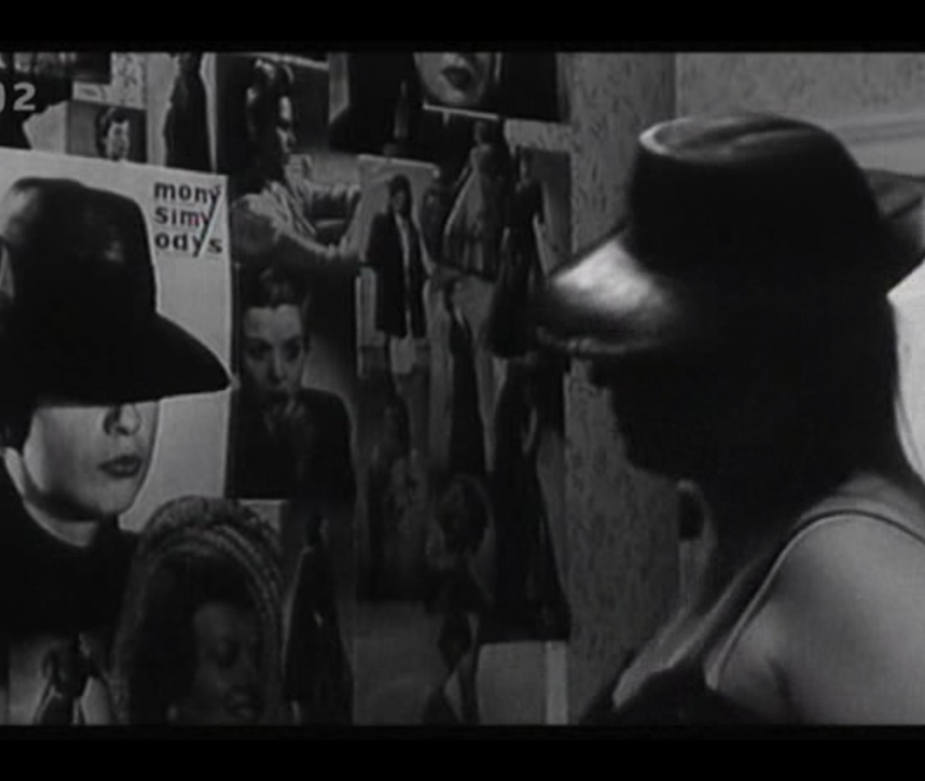
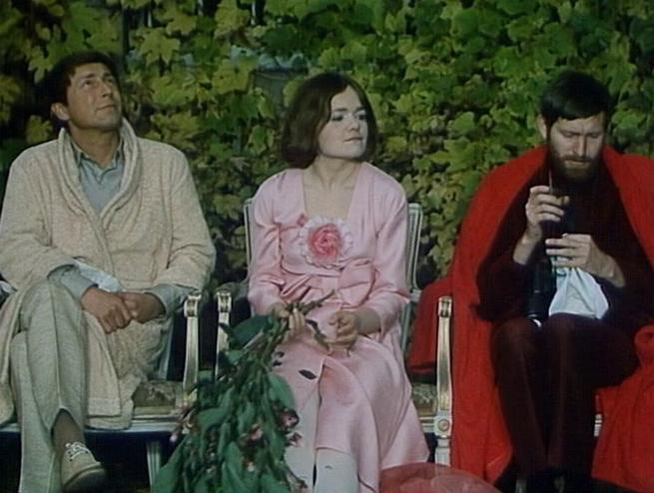
Accessories, Colors, Silhouettes

Slide 18
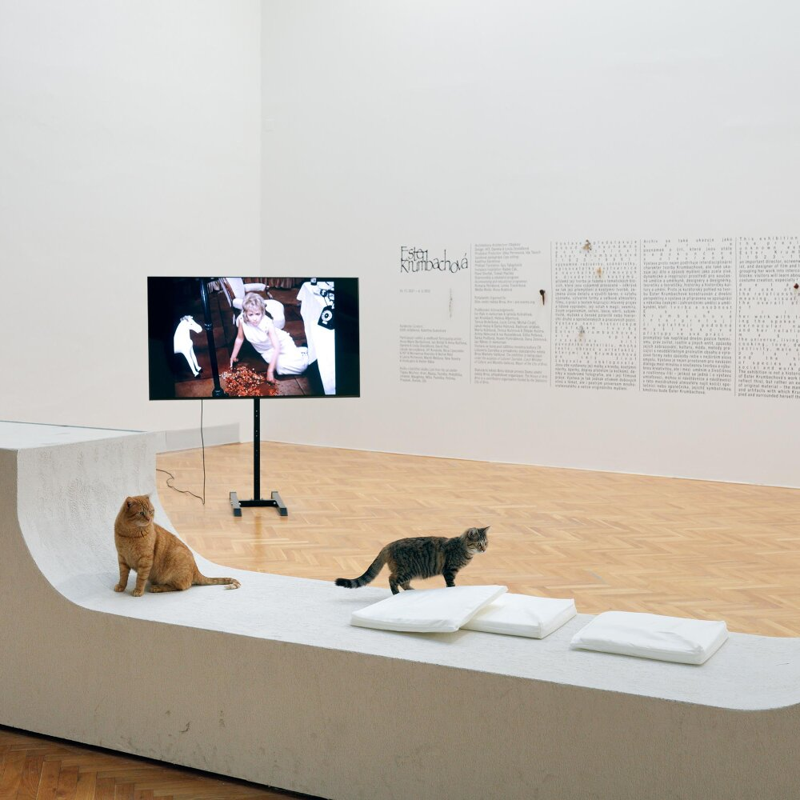
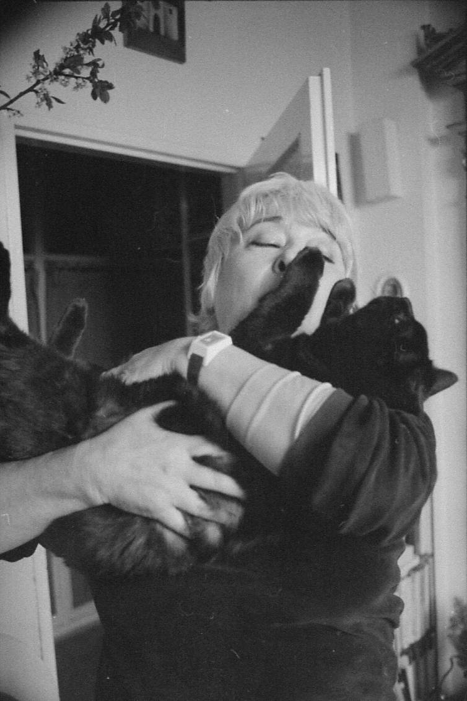
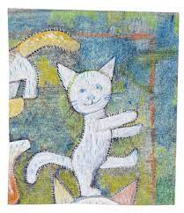
Live cats at the exhibition dedicated to EK‘s legacy
Ester Krumbachová with one of her cats
EK‘s drawing of a cat

